Slide 1
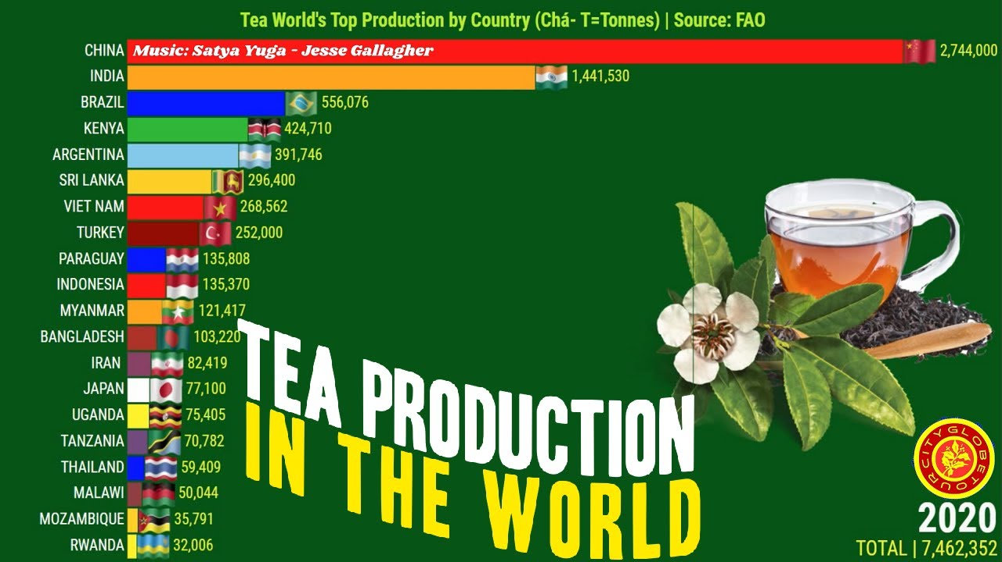
January is Hot Tea Month!
What is going on in this data visualization VIDEO?
Why does it matter?
4.MD.B
Notes:
Week of January 3, 2023
Check out the video!
https://www.youtube.com/watch?v=Mv4ufje2TSk

Slide 2
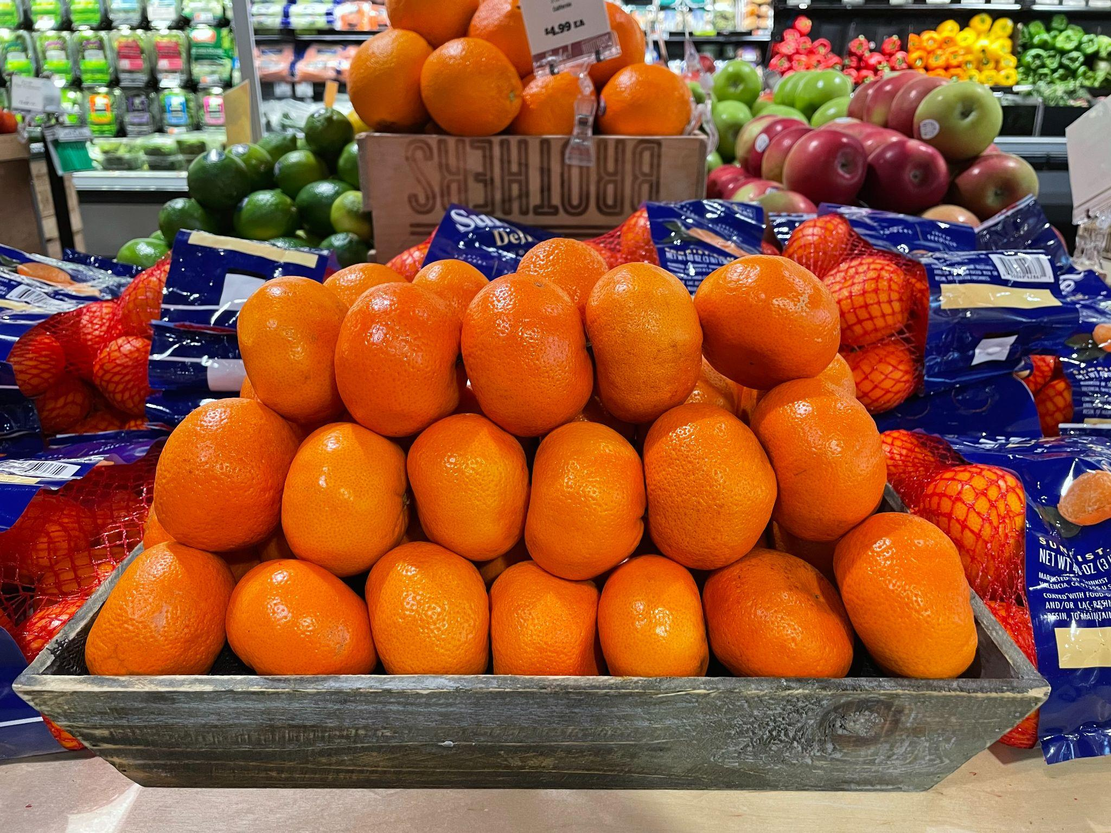
What do you notice?
What do you wonder?
How many oranges might be in this crate?
How can we use math to figure it out?
4.OA.C

Slide 3
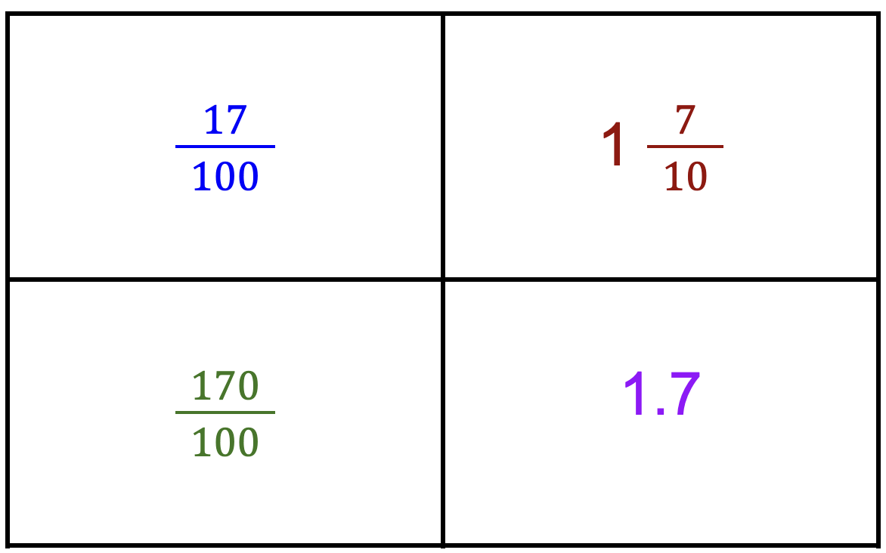
Which one does not belong?
4.NF.C6
Notes:
WHAT DO THEY ALL HAVE IN COMMON?
Top left: not 17 tenths
Top right: only mixed number
Bottom left: only fraction greater than 1
Bottom right: not a fraction (decimal)

Slide 4
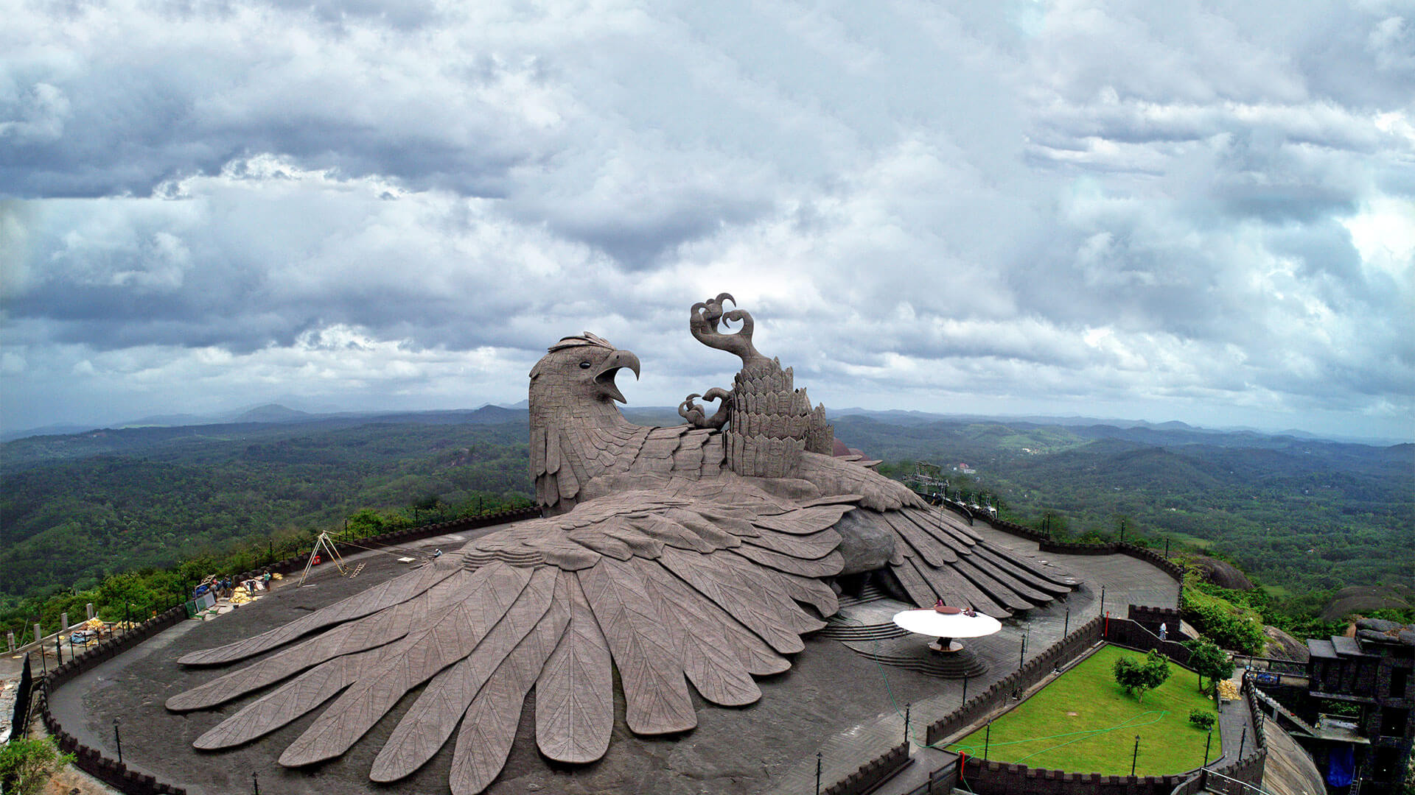
The World’s Largest Bird Sculpture Sits Atop a Rolling Hillside in Kollam, India in the Jetayu Nature Park.
This giant bird is 200 feet long, 150 feet wide, and 70 feet high!
How long is that? How many times longer, or higher is it than you?
4.NBT.B

Slide 5
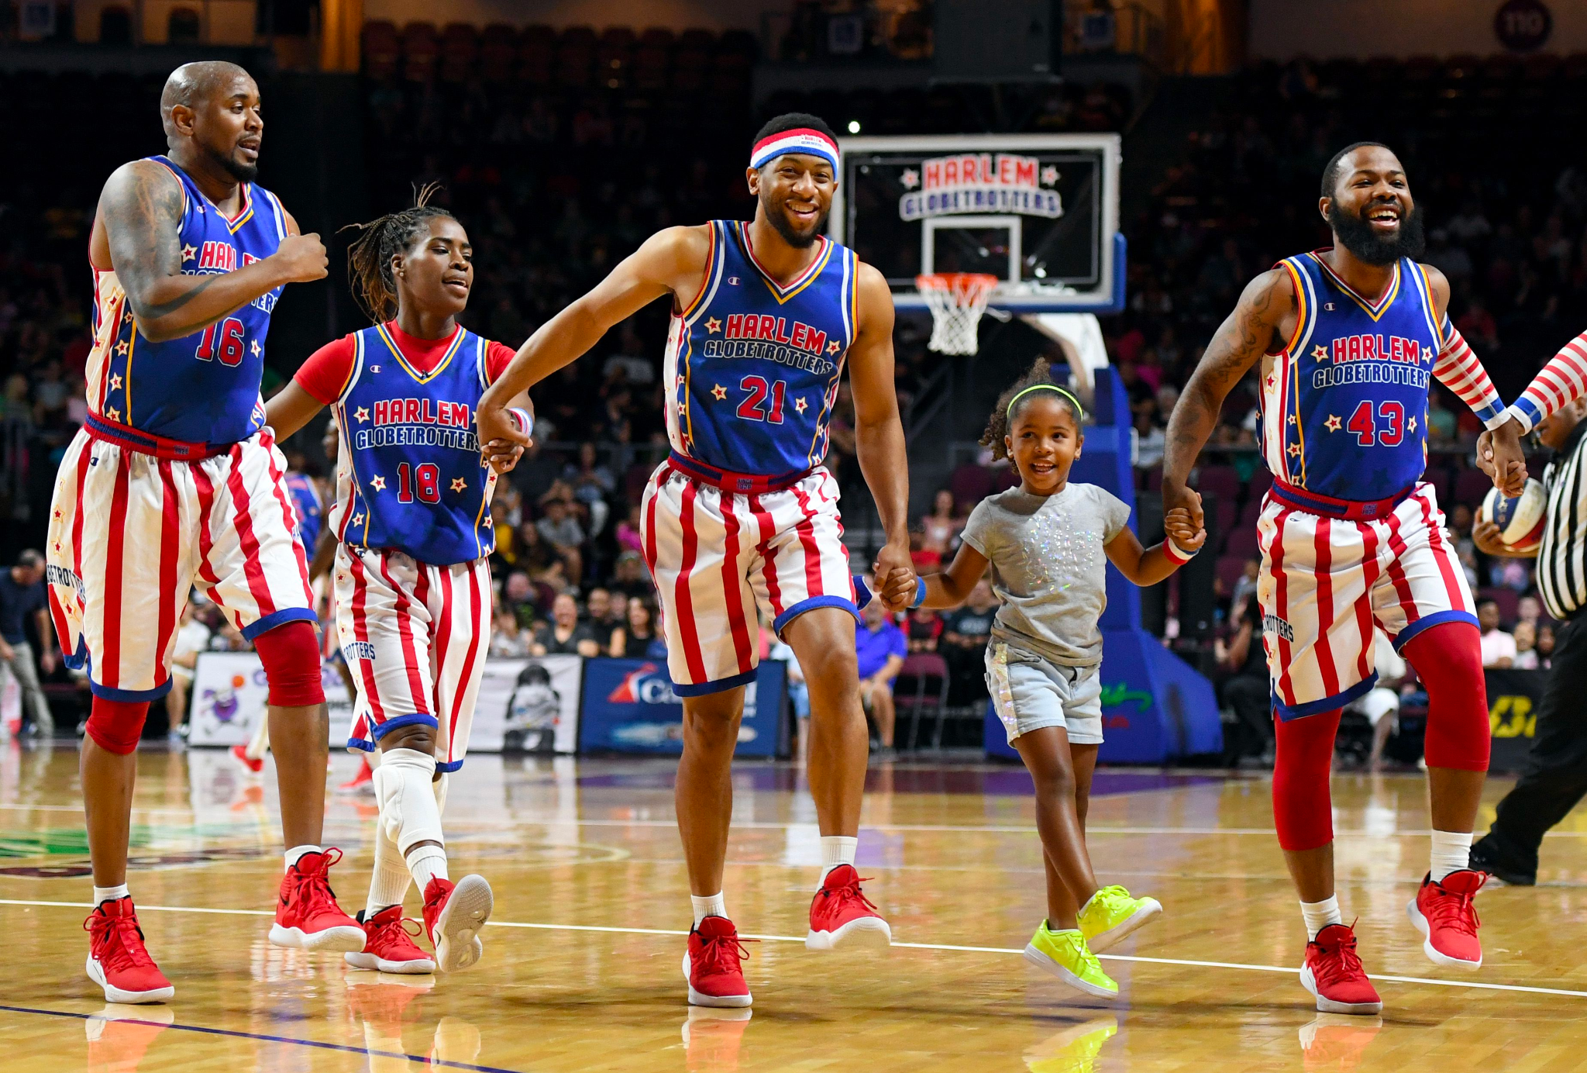
It’s Harlem Globetrotter’s Day!
The Globetrotters played their first road game in Hinckley, Illinois, on January 7, 1927.
How long ago was that?
4.NBT.B4
Notes:
Week of January 9, 2023

Slide 6
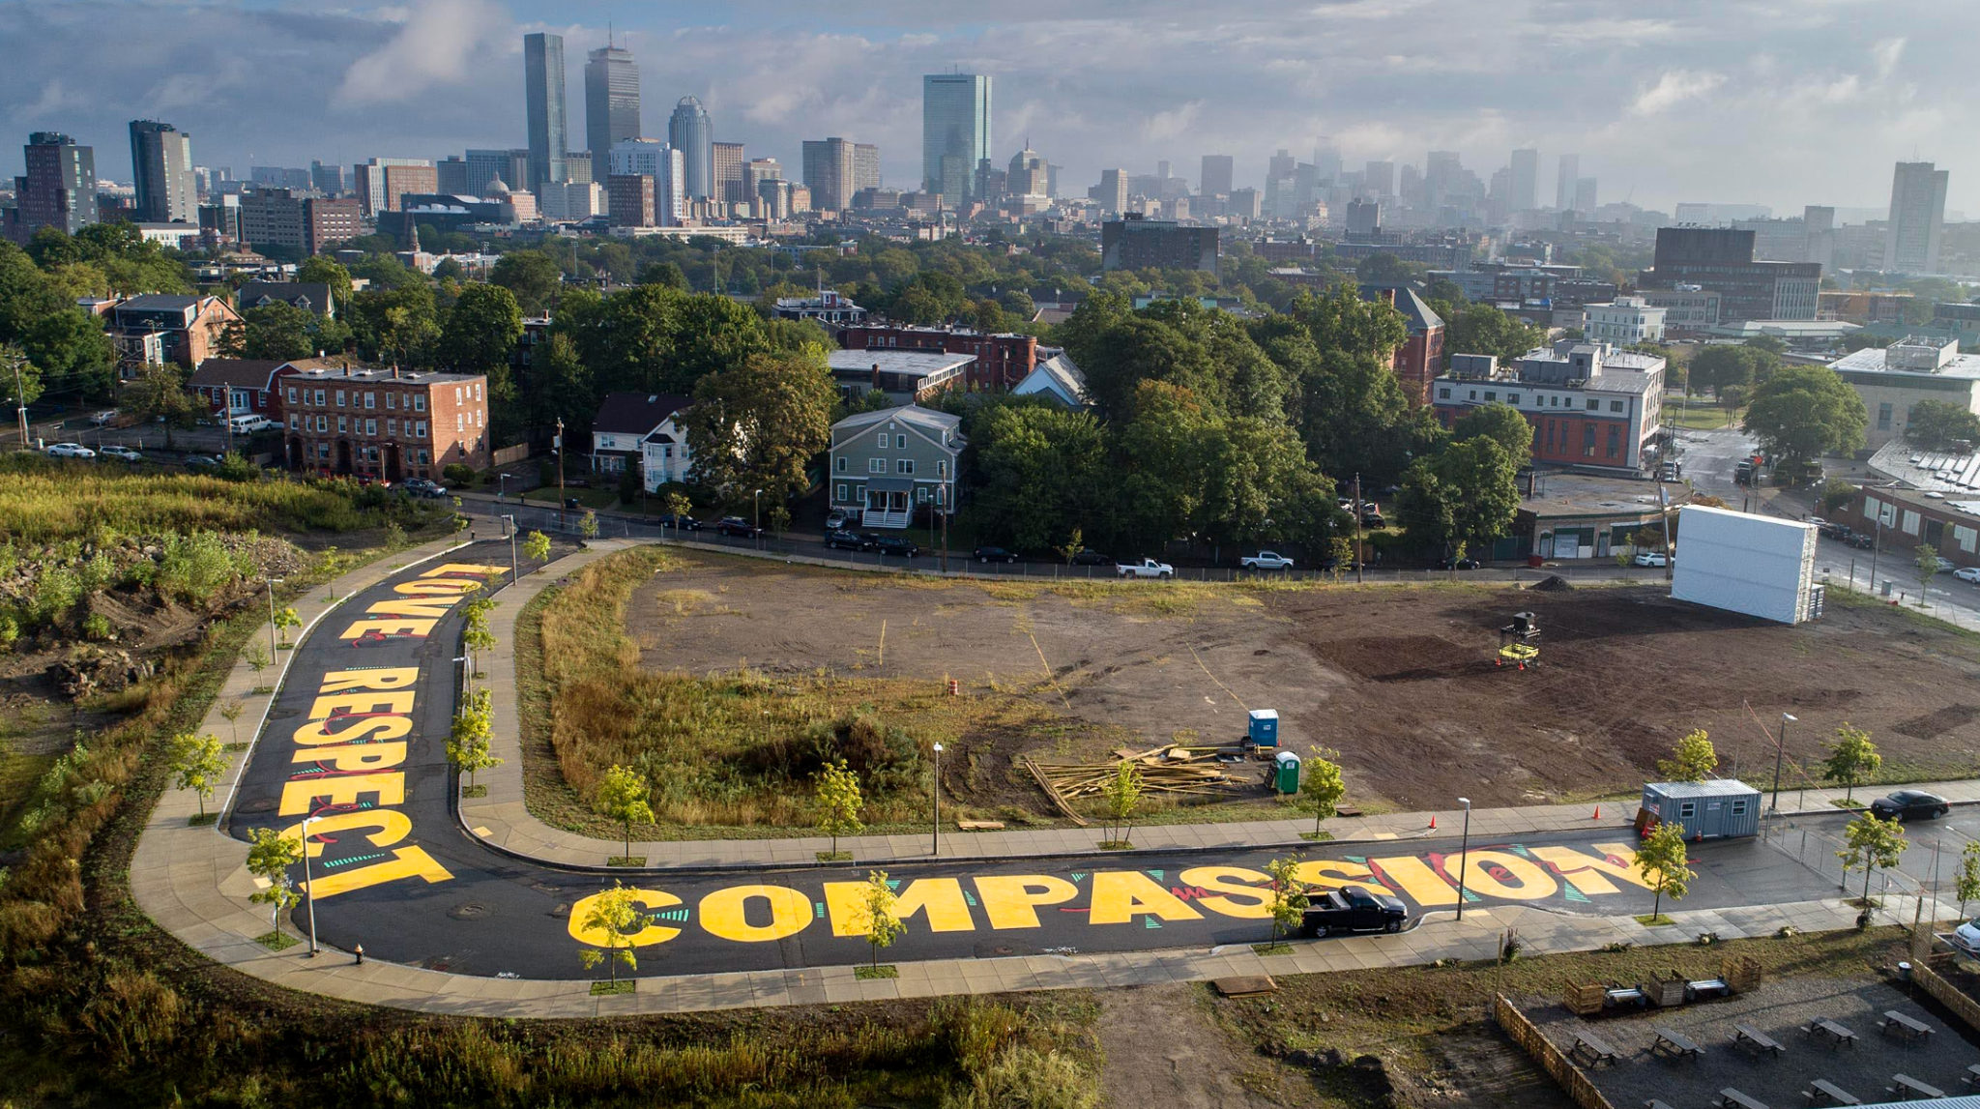
Artist Ricardo Gomez painted this mural on Bartlett Station Drive in Roxbury. Estimate the size of the letters in this mural.
4.MD.A2

Slide 7
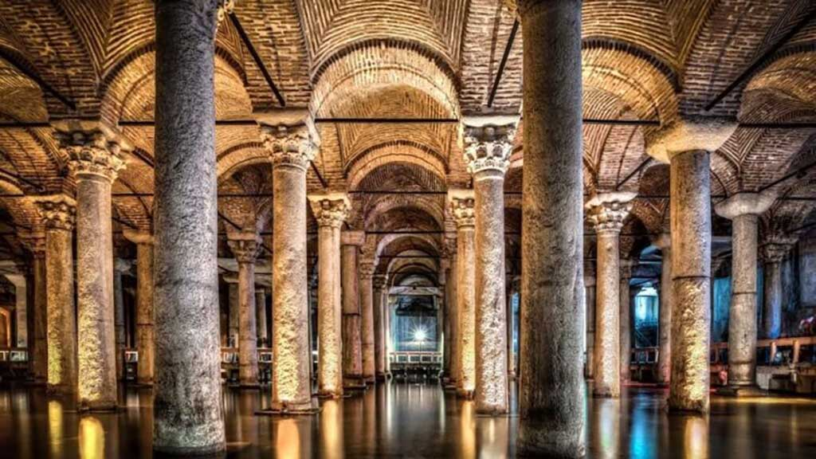
The Basilica Cistern in Istanbul!
With more than 300 marble columns, each 9 meters high and arranged in 12 rows of 28 columns, it is one of Turkey’s most beautiful landmarks.
Where is the math here?
4.OA.A3

Slide 8
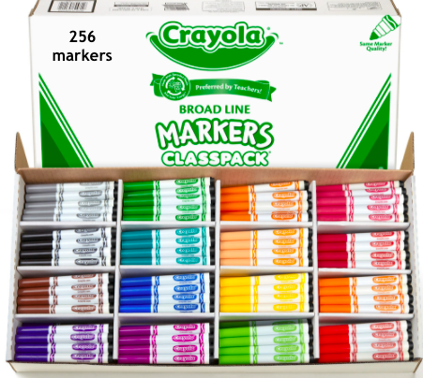
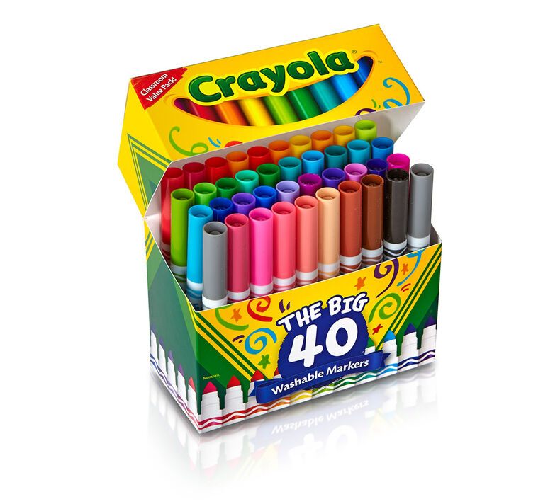
Would you rather have
7 small boxes of markers OR 1 big box?
4.OA.A2

Slide 9
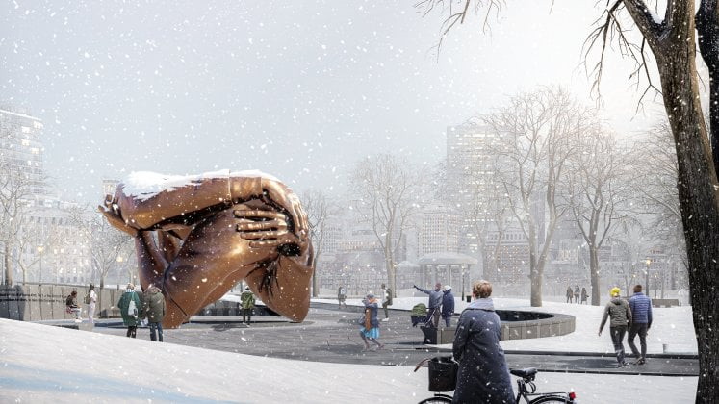
“Embrace” is the new monument in the Boston Common, a tribute to Dr. Martin Luther King and Coretta Scott King.
Embrace stands 20 feet tall and 40 feet wide.
How many times taller is it than you?
What FRACTION are YOU of this monument?
4.NF.A
Notes:
Week of January 17, 2023

Slide 10
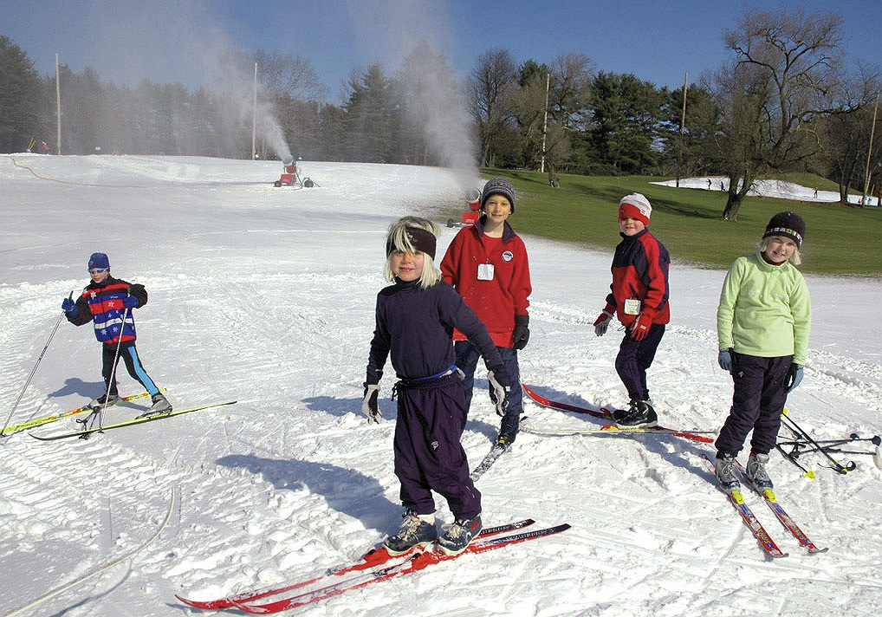
Cross Country Skiing in Weston!
The ski track in Weston is 2.5 km.
How long is that?
How many meters?
Centimeters?
What do you notice?
4.MD.A1

Slide 11
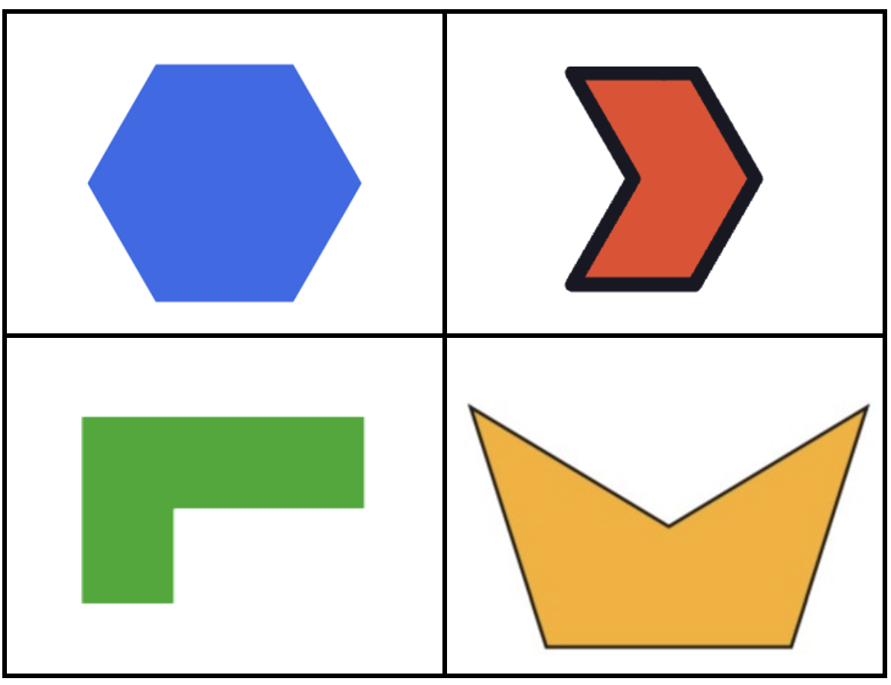
Which one does not belong?
4.G.A2
Notes:
Top leftt: most lines of symmetry, only regular polygon
Top right: only polygon with outline
Bottom left: no symmetry
Bottom right: not hexagon

Slide 12
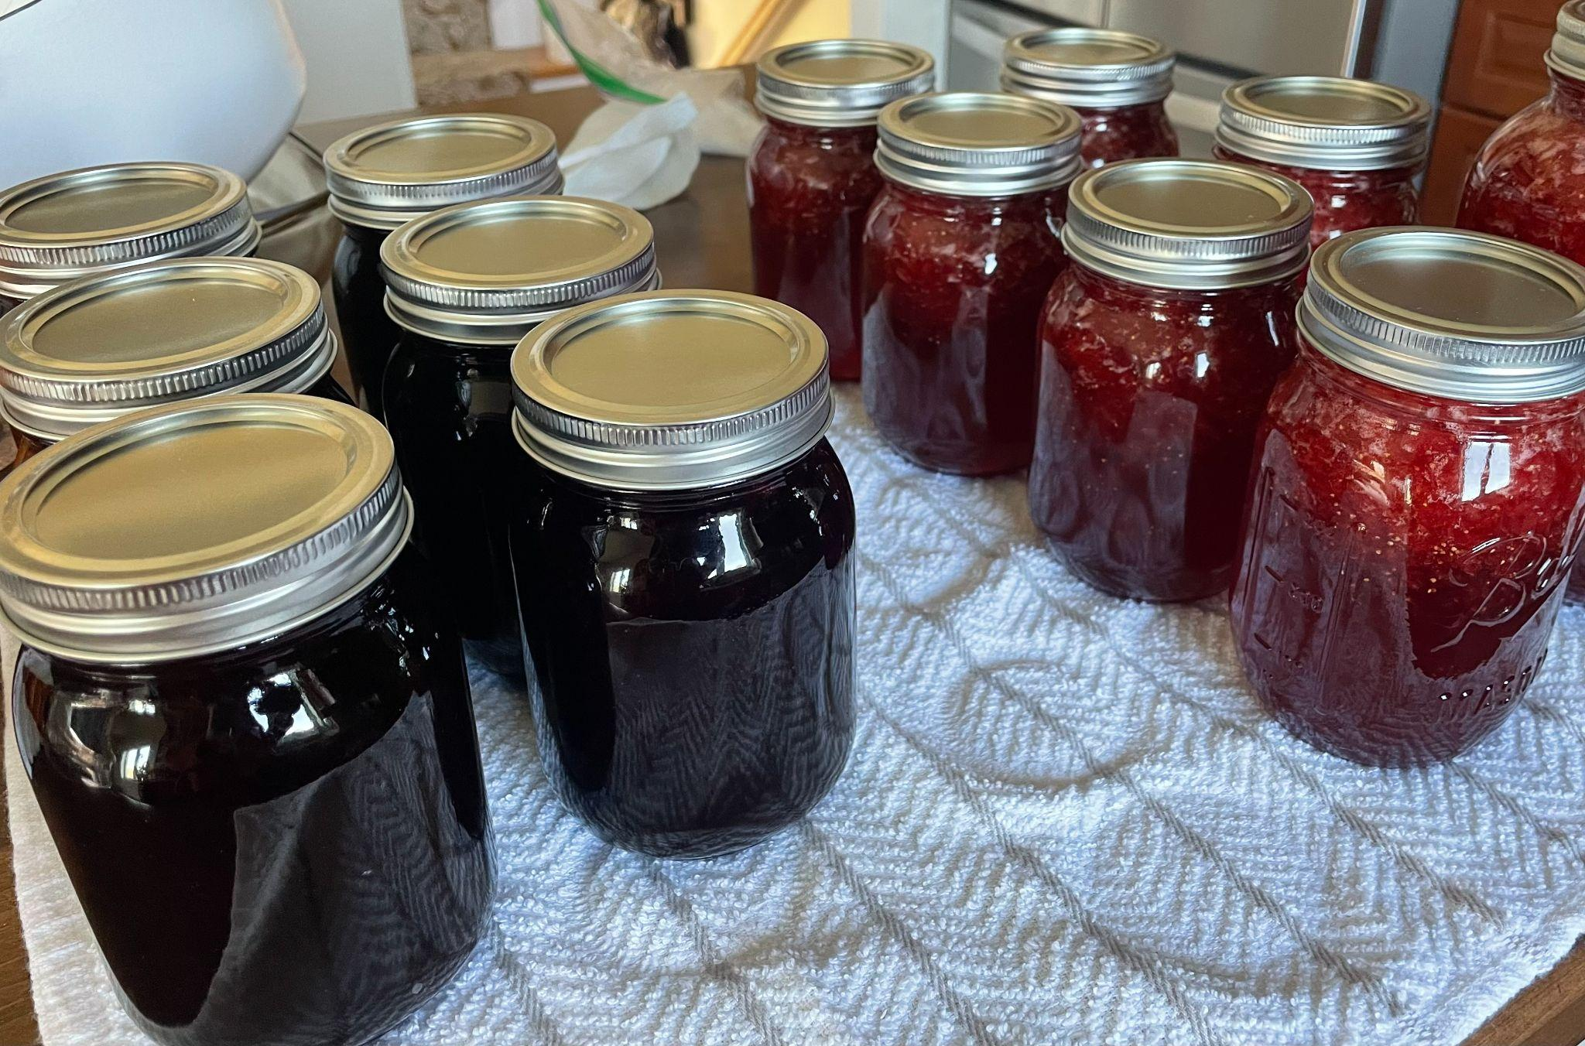
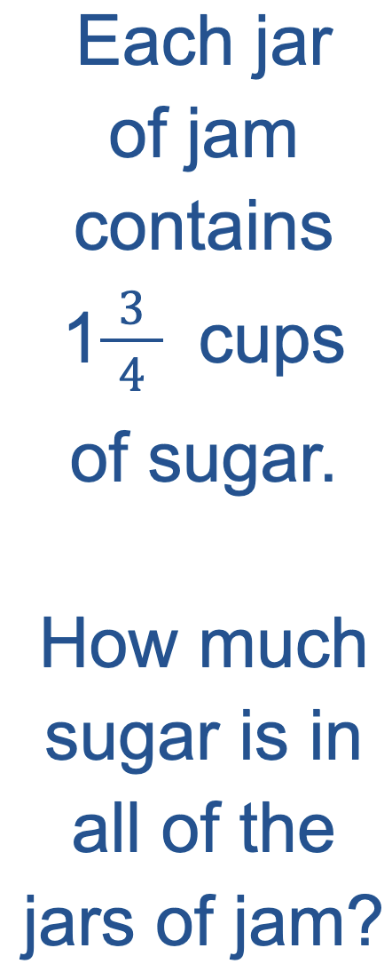
Homemade Jam!
Yum!
4.NF.B4

Slide 13
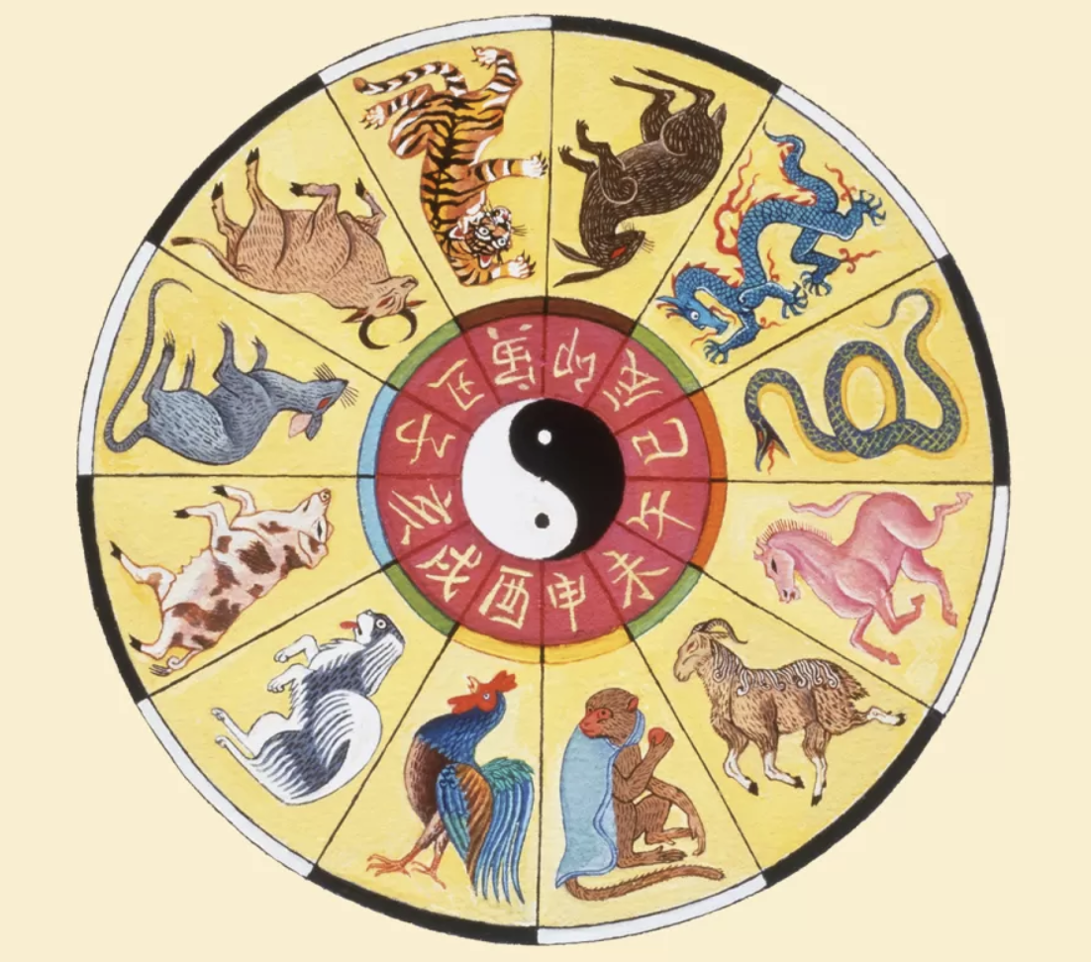
Happy Lunar New Year!
恭喜发财
It’s the Year of the Rabbit!
The Chinese Zodiac is a 12 year cycle.
When is the next Year of the Rabbit?
The next, and the next? What patterns do we see in the years?
4.OA.C5
Notes:
Week of January 23, 2023
Lunar New Year

Slide 14
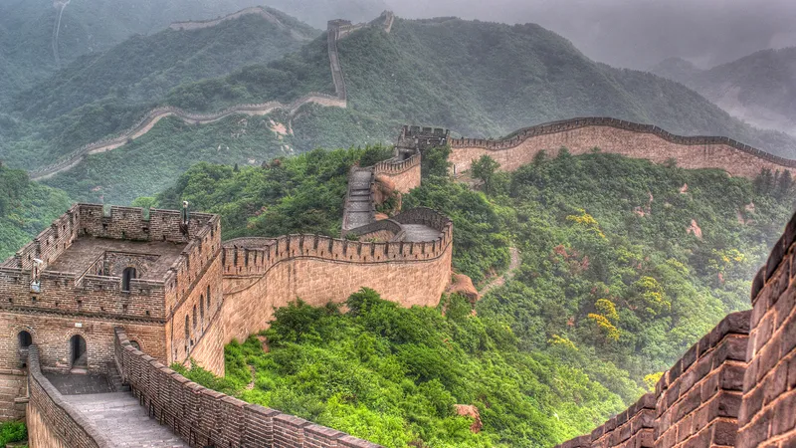
The Great Wall of China is 21,196 kilometers!
How long is that?
How many meters?
How long would it take you to walk that far?
4.MD.A2

Slide 15
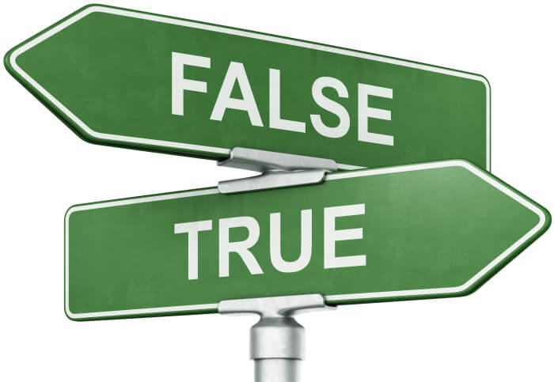
15 x 21 > 16 x 20
300 ÷ 60 = 30 ÷ 6
4 x 15 = 15 x 2 x 2
4.OA.A1

Slide 16
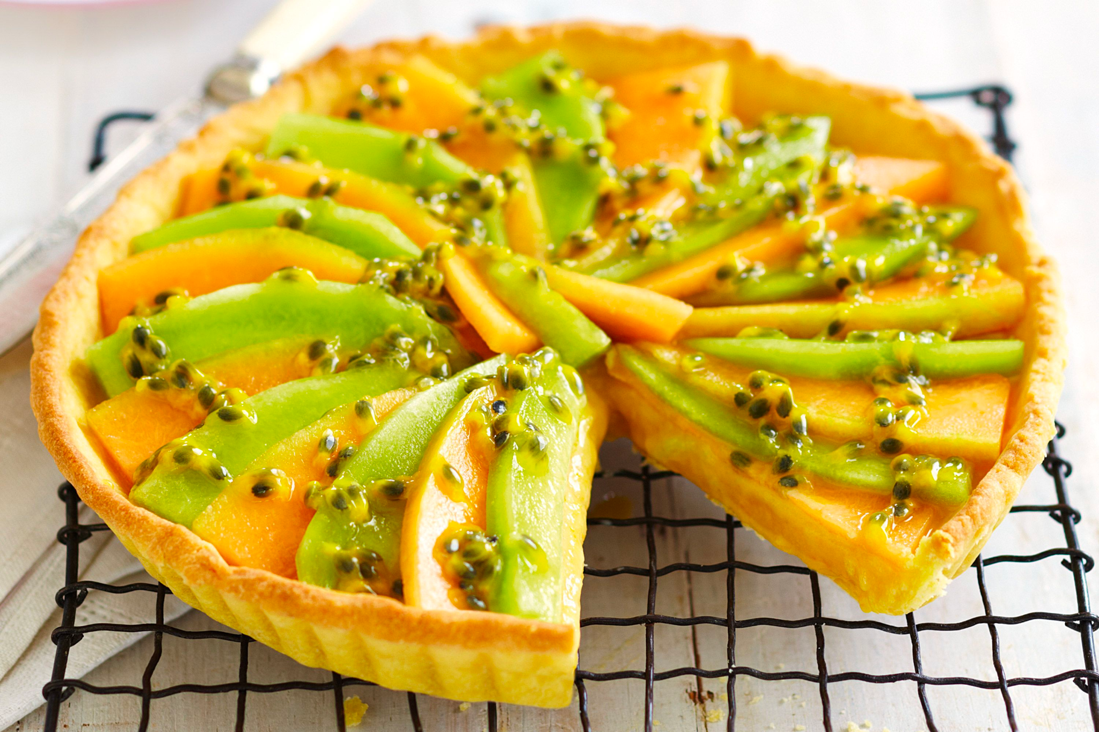
Celebrate India Republic Day!
What fraction of this melon tart has been eaten?
What fraction remains?
4.NF.B3

Slide 17
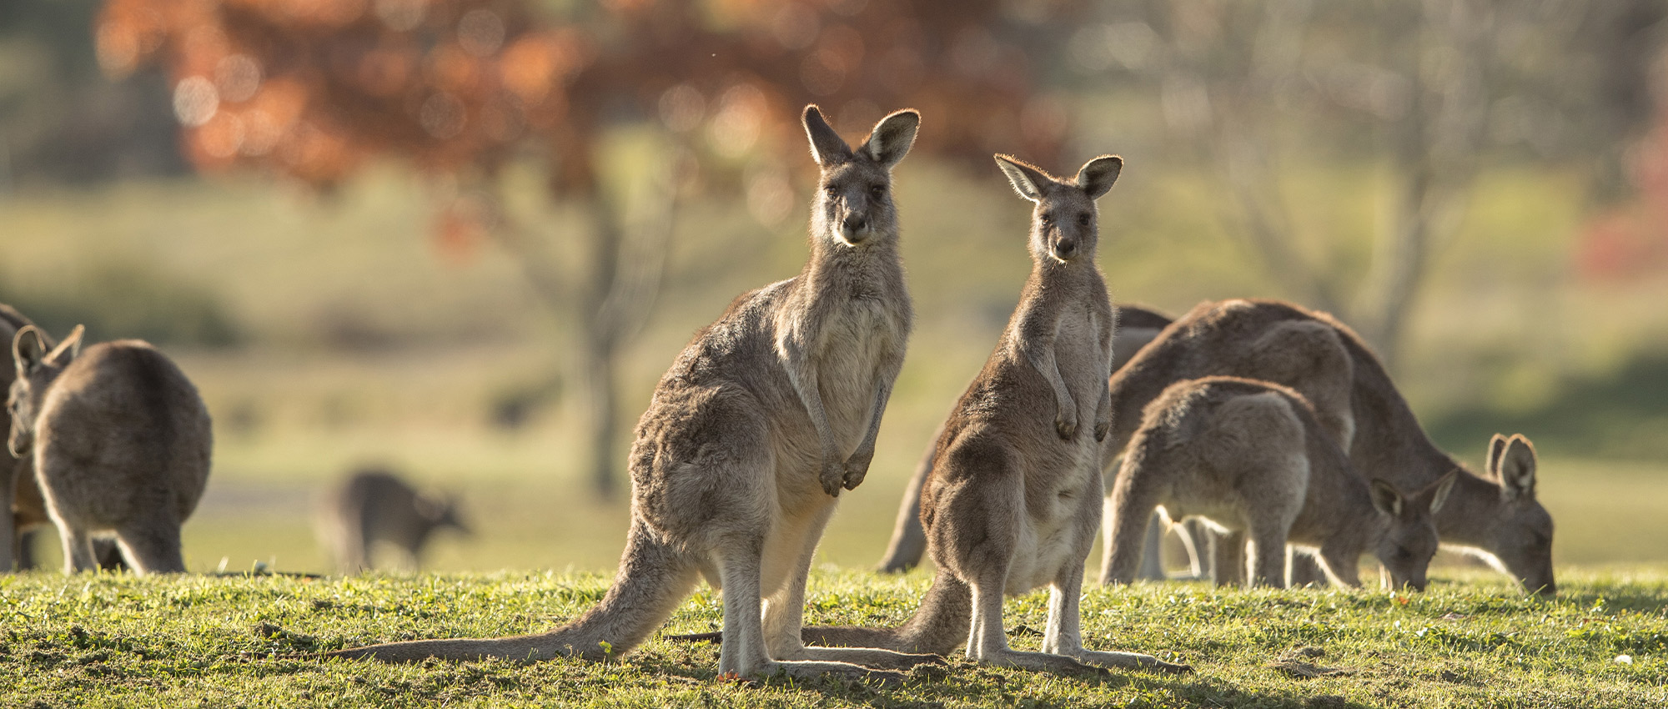
4.MD.A2
Happy Australia Day!
Did you know that an average adult kangaroo weighs between 35 - 90 kg?
Males can weigh up to twice as much as females!
If these female kangaroos weigh between 35 and 50 kg, how much might the males weigh?
Notes:
Australia Day

