Slide 1
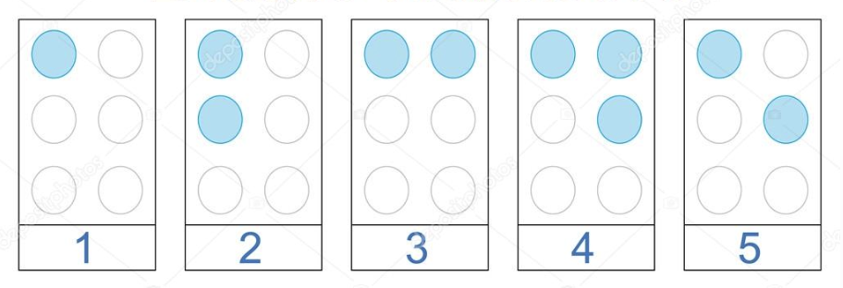
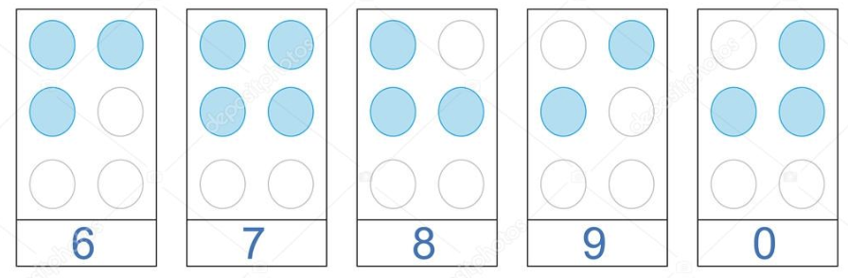
January is National Braille Literacy Month
What do we notice about the numbers 1-5?
What do we think the numbers 6-10 will look like?
Are we surprised?
2.SMP.3
Notes:
Week of January 3, 2023
National Braille Literacy Month

Slide 2
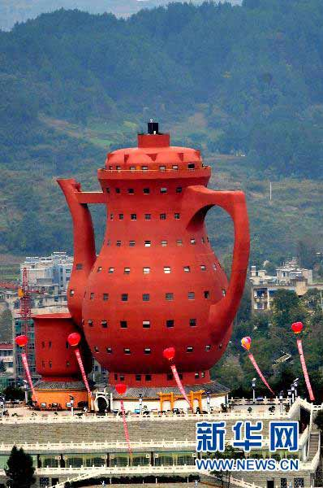
January is International Hot Tea Month!
The largest teapot in the world is in Meitan, China!
Estimate the height of the teapot!
74 meters!!!
2.MD.B5

Slide 3
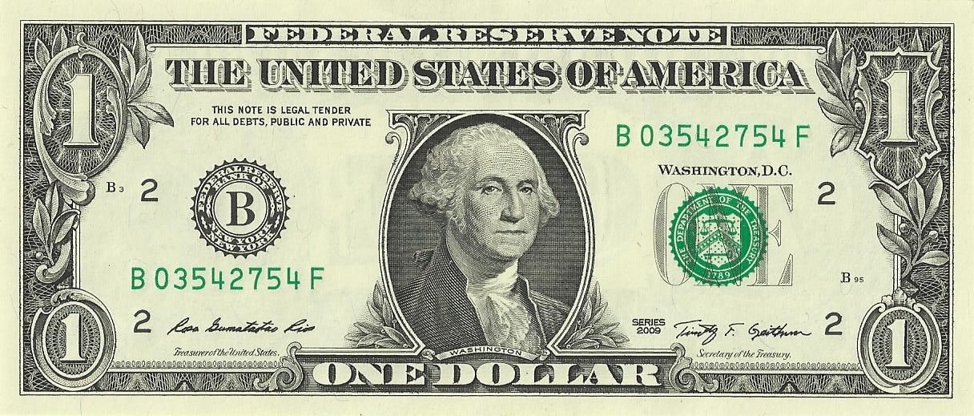
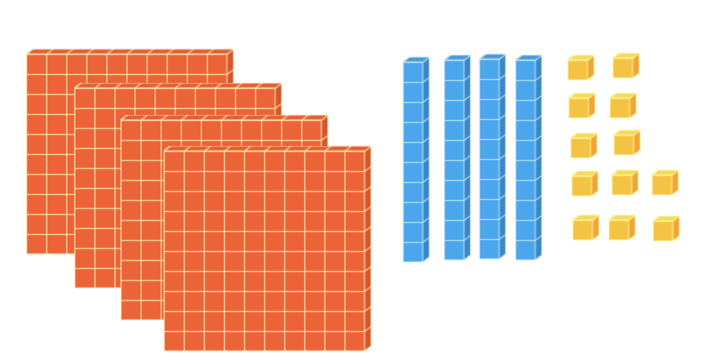
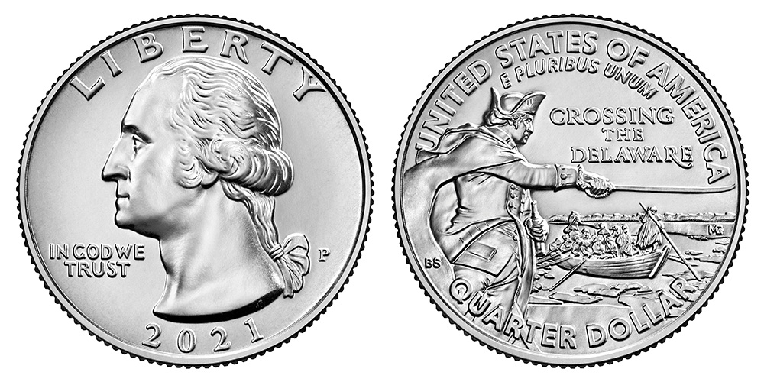
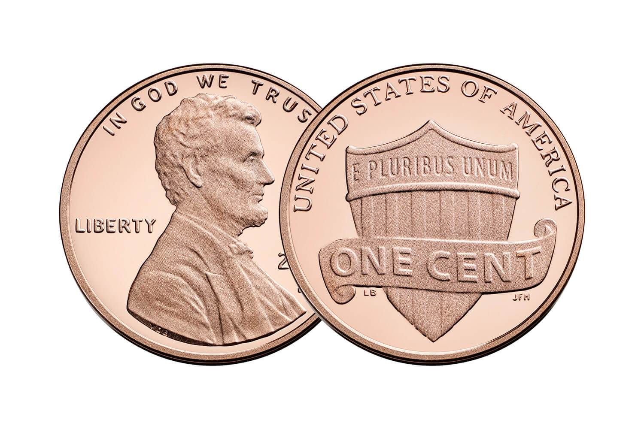
What is the same?
What is different?
2.MD.C8

Slide 4
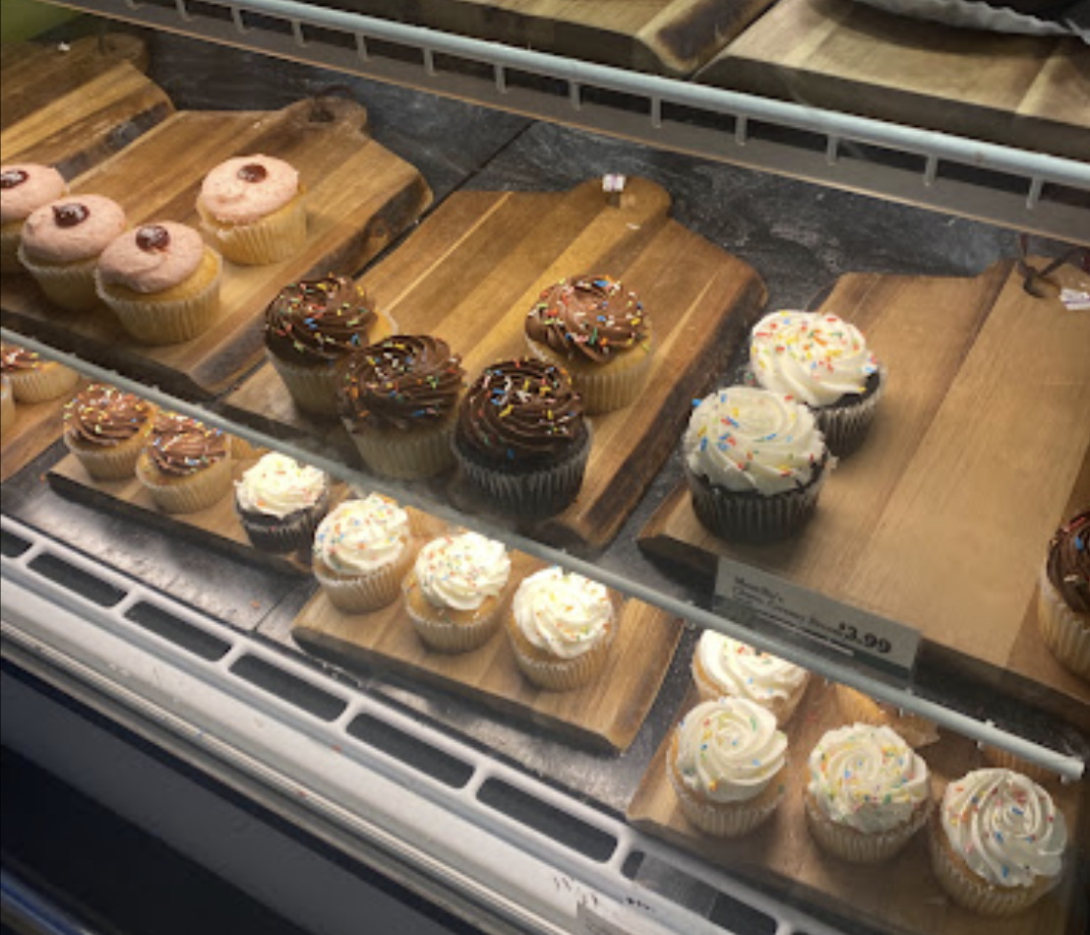
What do we notice at the Bakery in Brother’s Market?
What do we wonder?
Where do we see “groups of?”
How many cupcakes would be here if the case was full?
2.NBT.B6

Slide 5
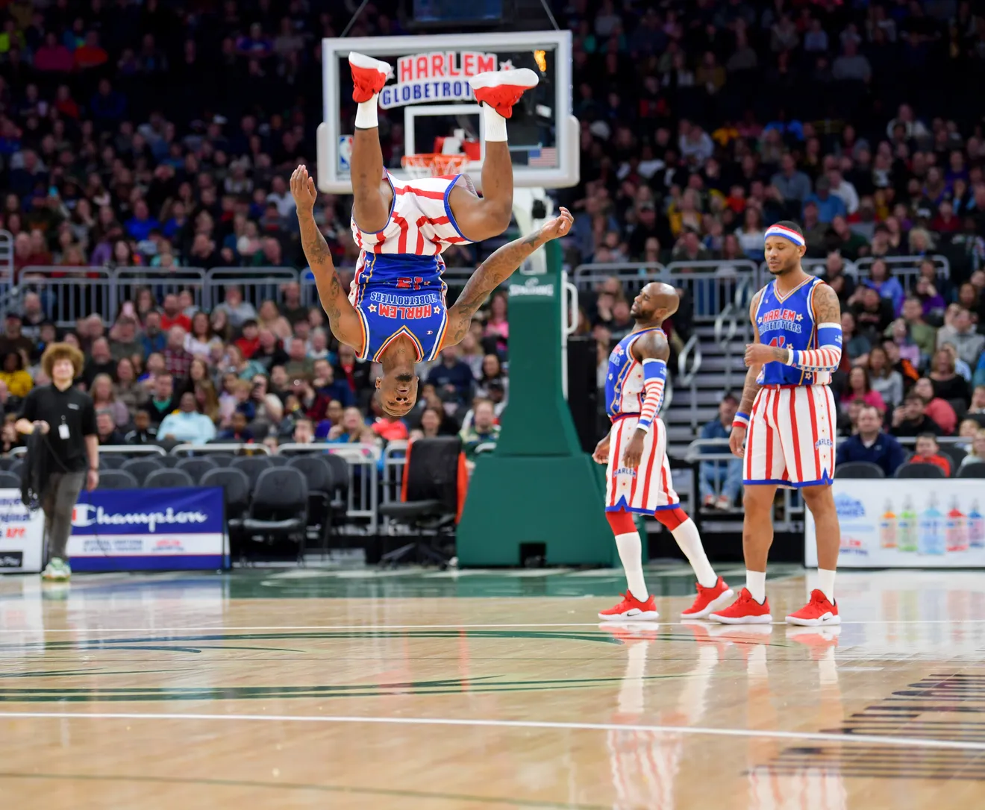
It’s Harlem Globetrotter’s Day!
The Harlem Globetrotters were inducted into the Hall of Fame in 2002.
How long ago was that?
How can we solve this using mental math?
2.NBT.B7
Notes:
Week of January 9, 2023

Slide 6

400 + 120 + 15 > 500
700 < 600 + 50 + 19
200 + 200 > 300 + 90 + 11
2.NBT.A4

Slide 7
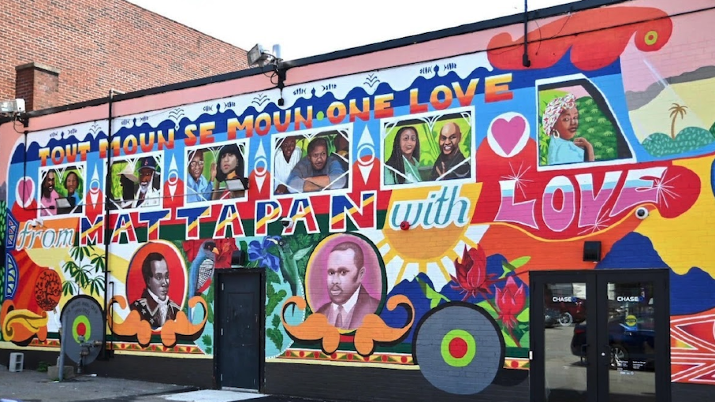
What can we say about the shapes in this Mattapan mural?
Sketch one of the the shapes you see. Change the shape in ONE way!
2.G.A1

Slide 8
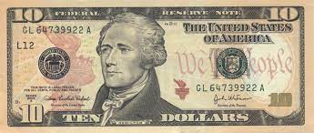
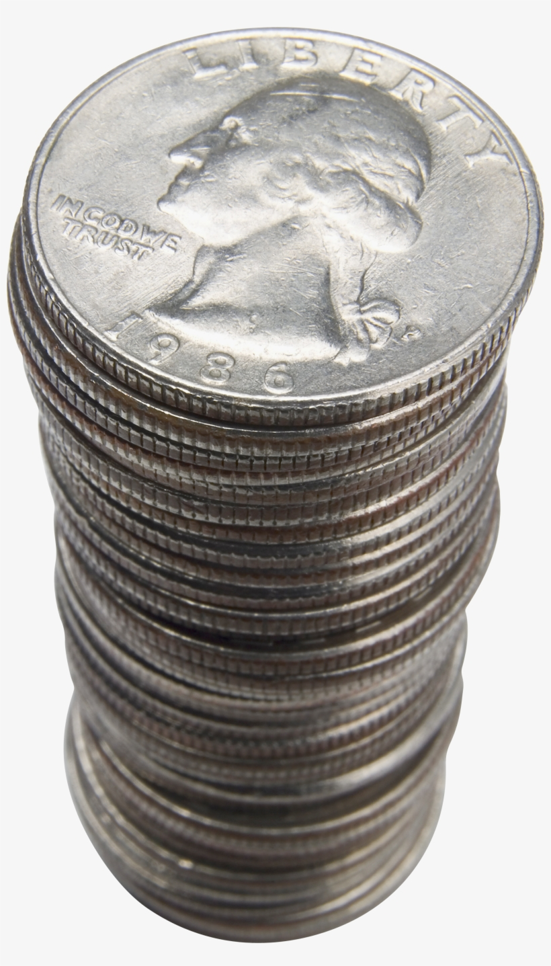
Would you rather have
a ten dollar bill,
or that stack of quarters?
2.MD.C8

Slide 9
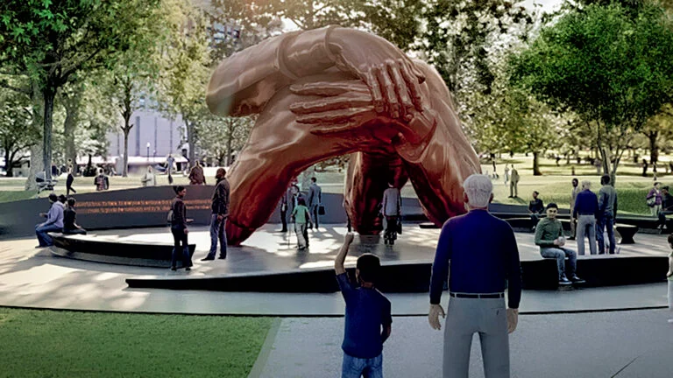
2.MD.A3
Estimate the height of “Embrace,” the new Dr. Martin Luther King, Jr. tribute in the Boston Common. Use math in your estimation.
Notes:
Week of January 17, 2023
Martin Luther King Day

Slide 10
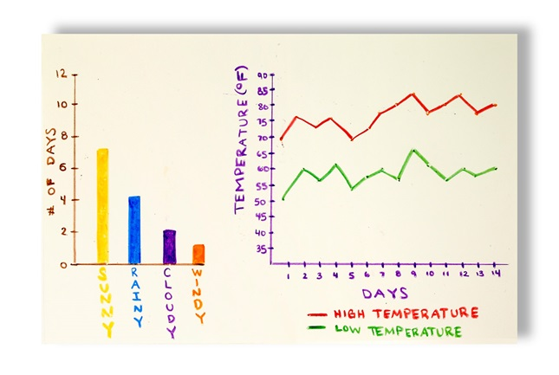
What’s going on in this data visualization?
Why does it matter?
2.MD.D10

Slide 11
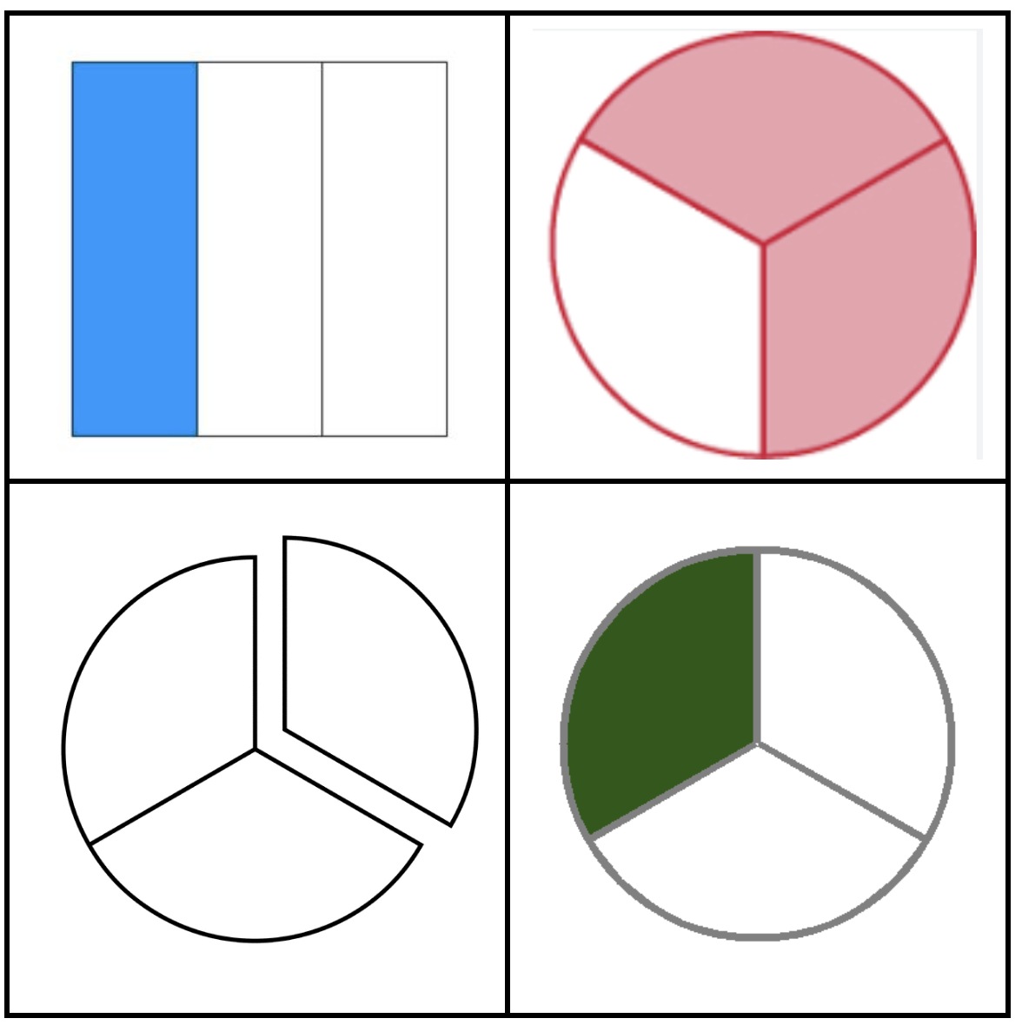
Which one does not belong?
2.G.A3
Notes:
Top left: not a circle
Top right: one-third removed
Bottom left: two-thirds + one-third
BR: two-thirds removed, one-third shaded

Slide 12
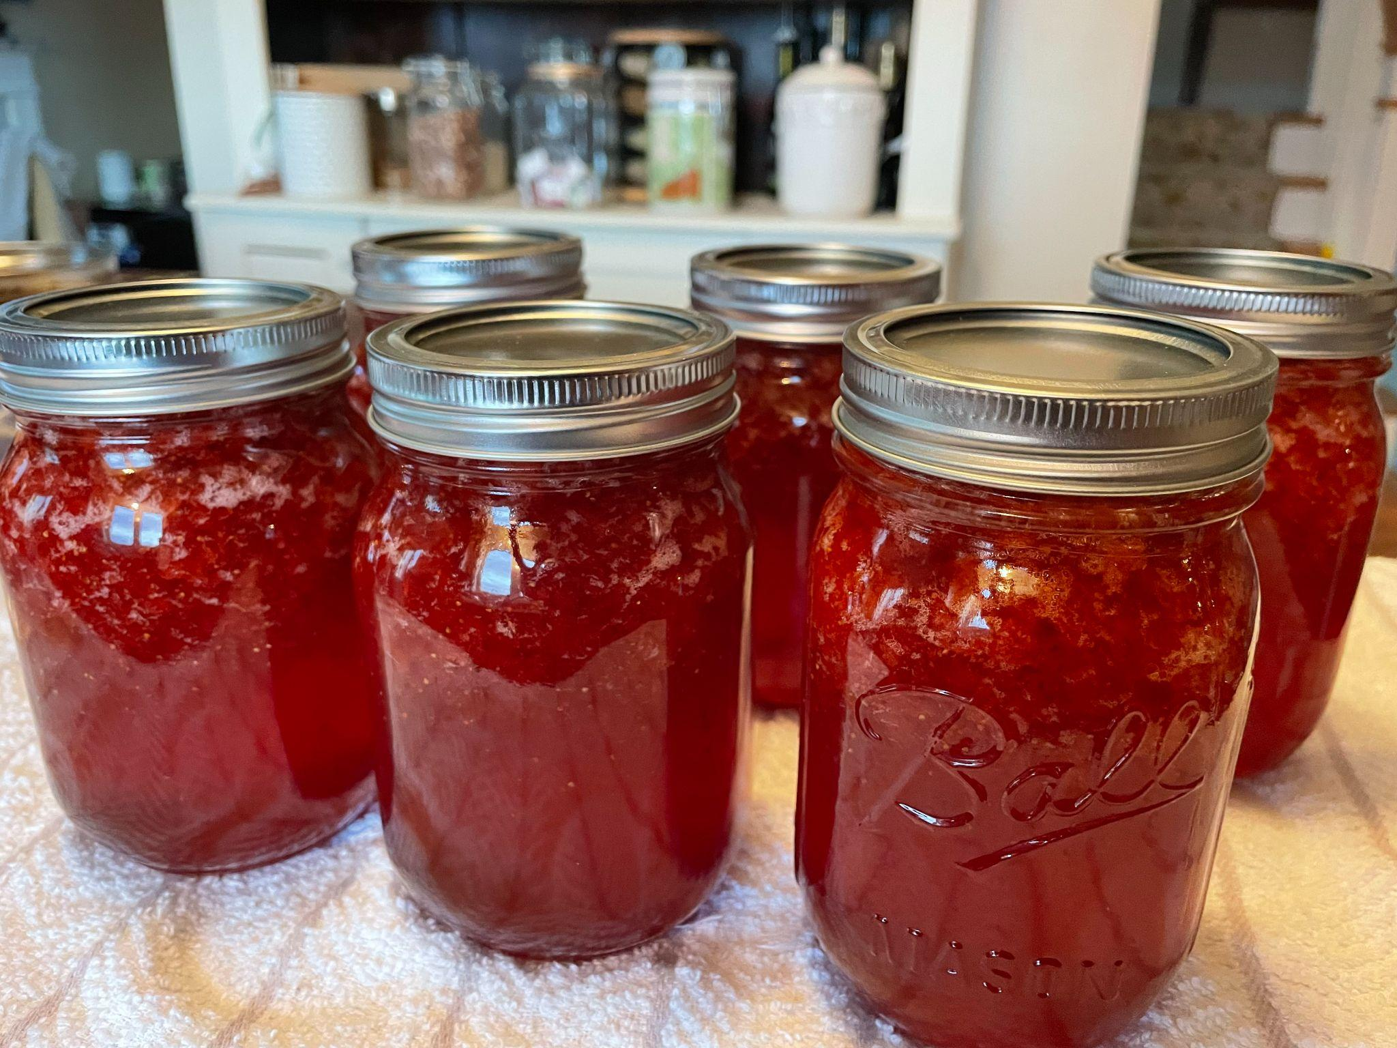
Homemade Strawberry Jam!
It take about 25 berries to make one jar of jam.
How many berries did we need to make all of this jam?
Share your strategy!
2.OA.C3

Slide 13
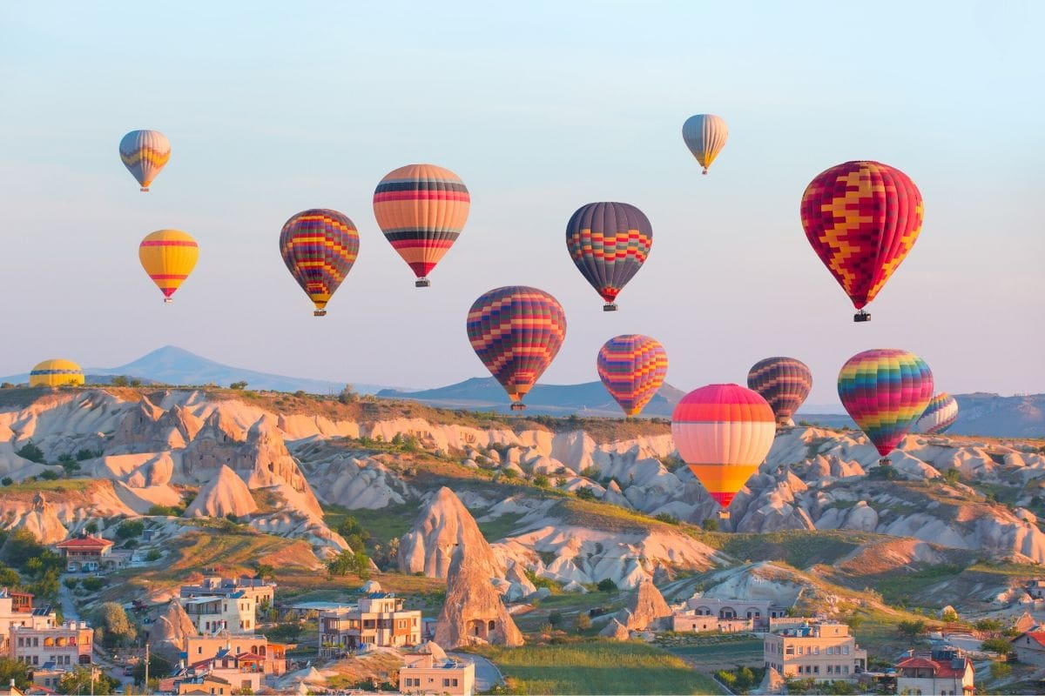
How high do you think these Hot Air Balloons are flying In Cappadocia, Turkey?
The balloons fly at an altitude of 2,500 feet!
What can we say about the number 2,500?
2.OA.A3
Notes:
Week of January 23, 2023

Slide 14
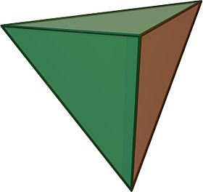
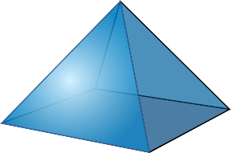
What is the same? What is different?
2.G.A1

Slide 15
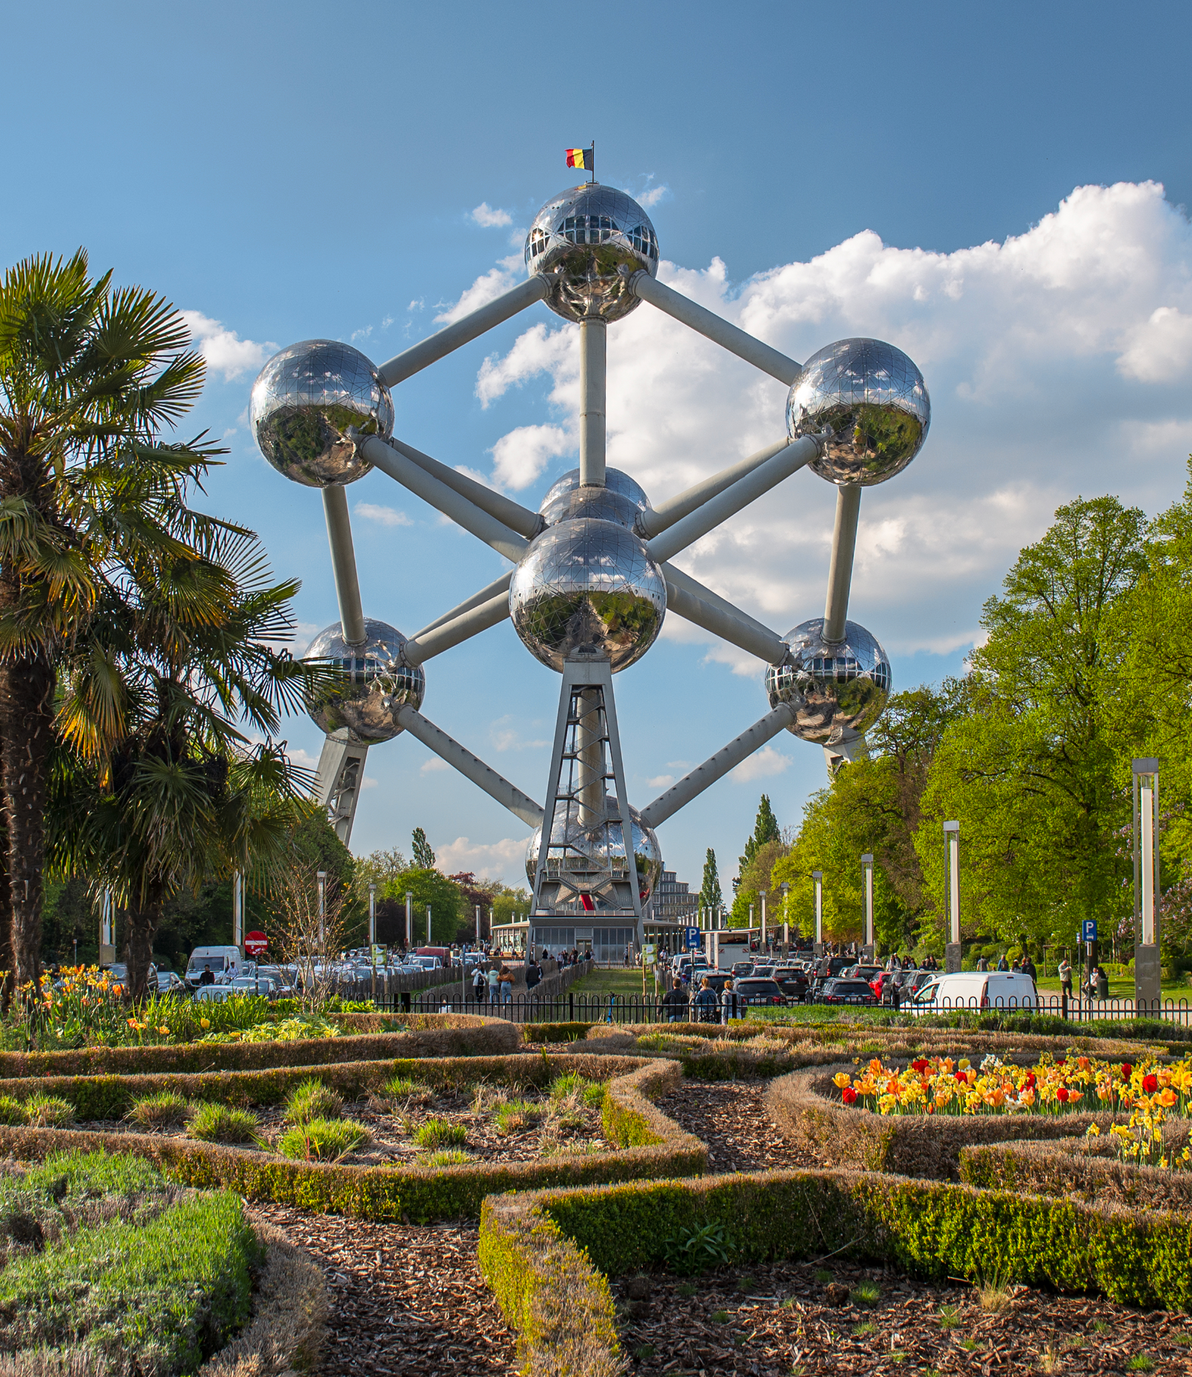
The Atomium in Belgium stands 102 meters tall.
How tall is that?
Create a fun story problem with an equation that equals 102 meters!
2.MD.B5

Slide 16
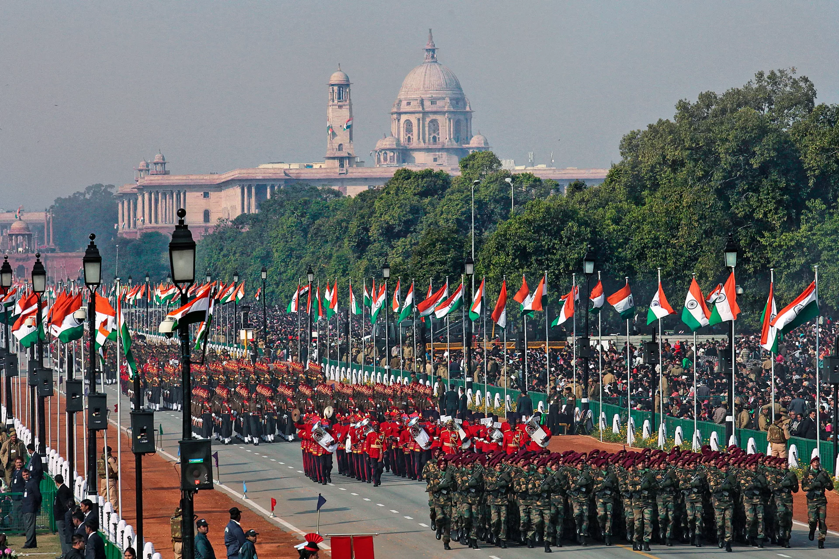
Today is India Republic Day!
On this day in 1950 the Constitution in India was formed.
How long ago was 1950?
Can we use mental math to figure it out?
2.NBT.B7
Notes:
January 26, 2023
India Republic Day

Slide 17
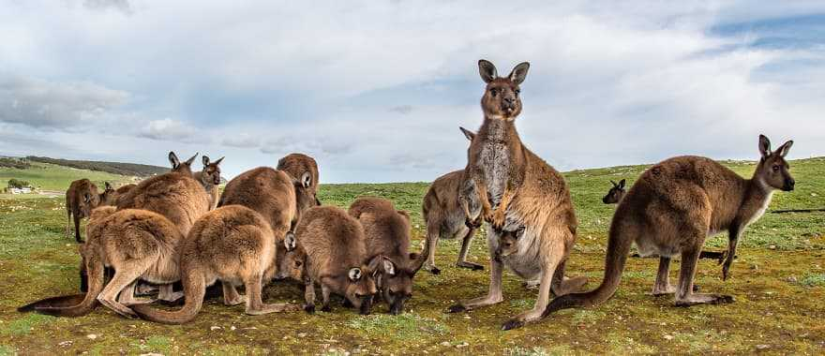
Happy Australia Day!
The kangaroo is the national animal of Australia!
Estimate how many kangaroos are here. How many kangaroo ears would that be?
How many kangaroo legs?
2.OA.C3

