Slide 1
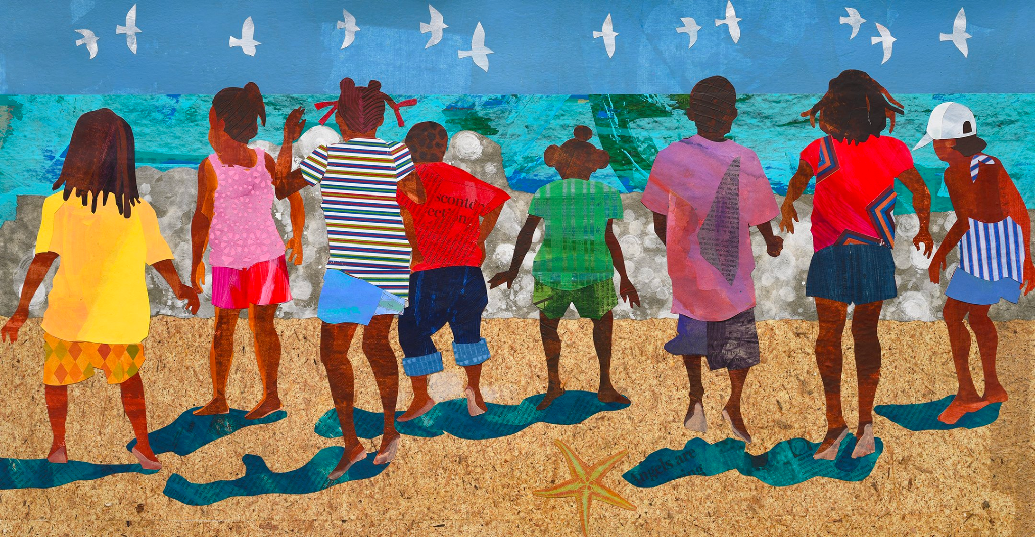
K.CC.B5
What can we count in this mural by Ekua Holmes?
Notes:
Week of January 30, 2023

Slide 2

It is Independence Day in Nauru!
What shapes do we see in the flag of Nauru? What can we count?
K.G.B4

Slide 3
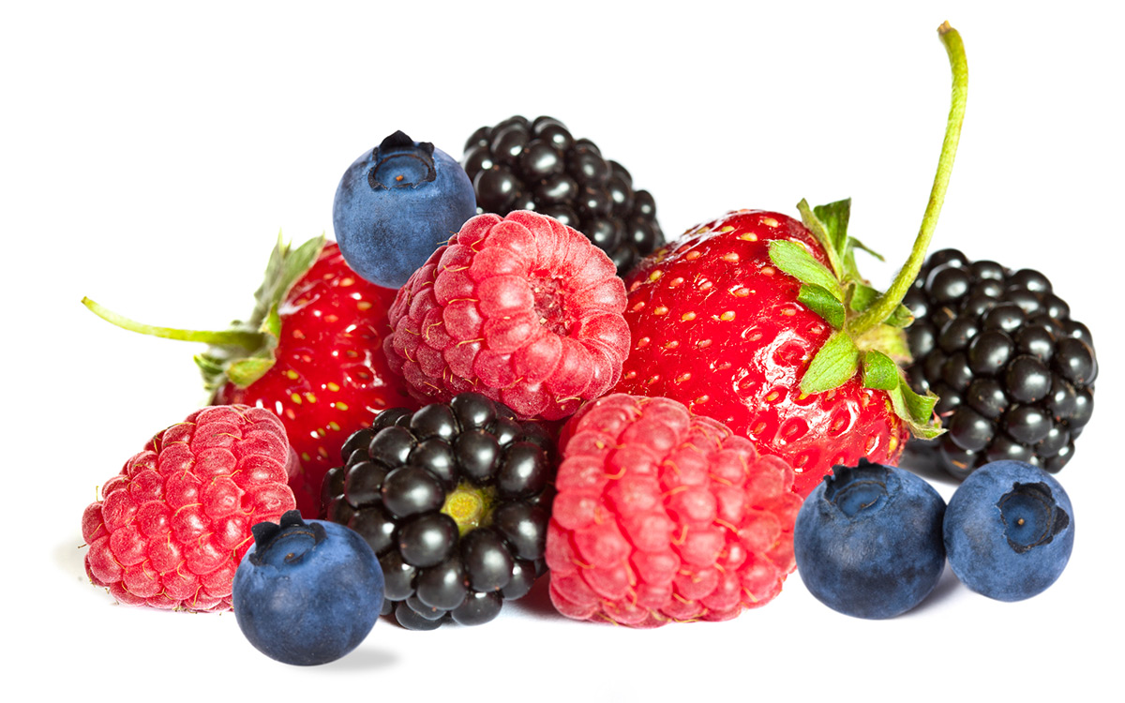
February is National Berries Month!
How many berries are here? How can we sort them?
K.MD.B3
Notes:
February 2023!

Slide 4
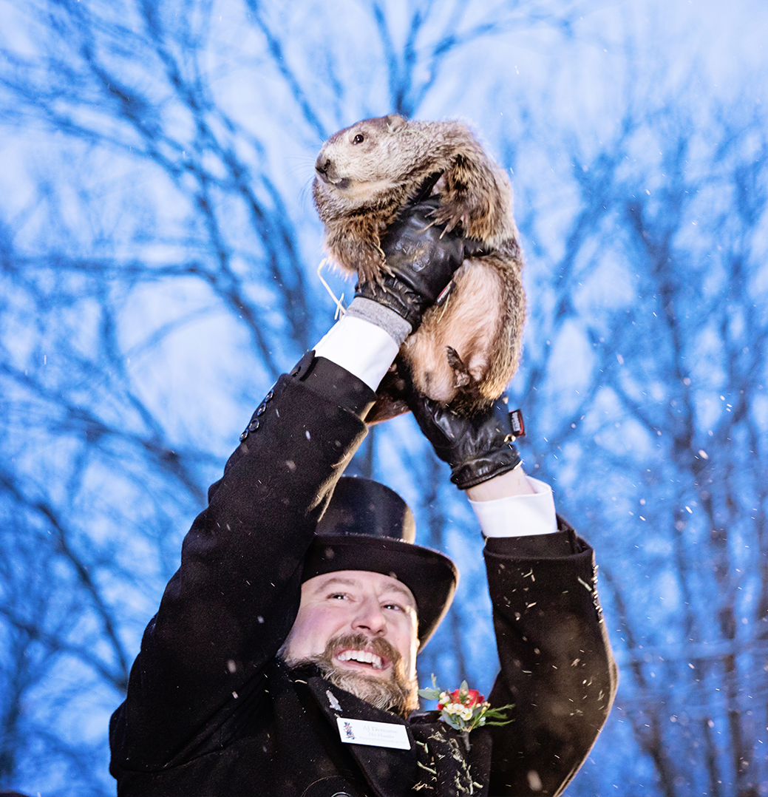
It’s Groundhog Day!
Will Punxsutawney Phil
See his shadow?
How big is a groundhog?
Can we name some animals that are larger than a groundhog?
Can we name some animals that are smaller than a groundhog?
K.MD.A2

Slide 5
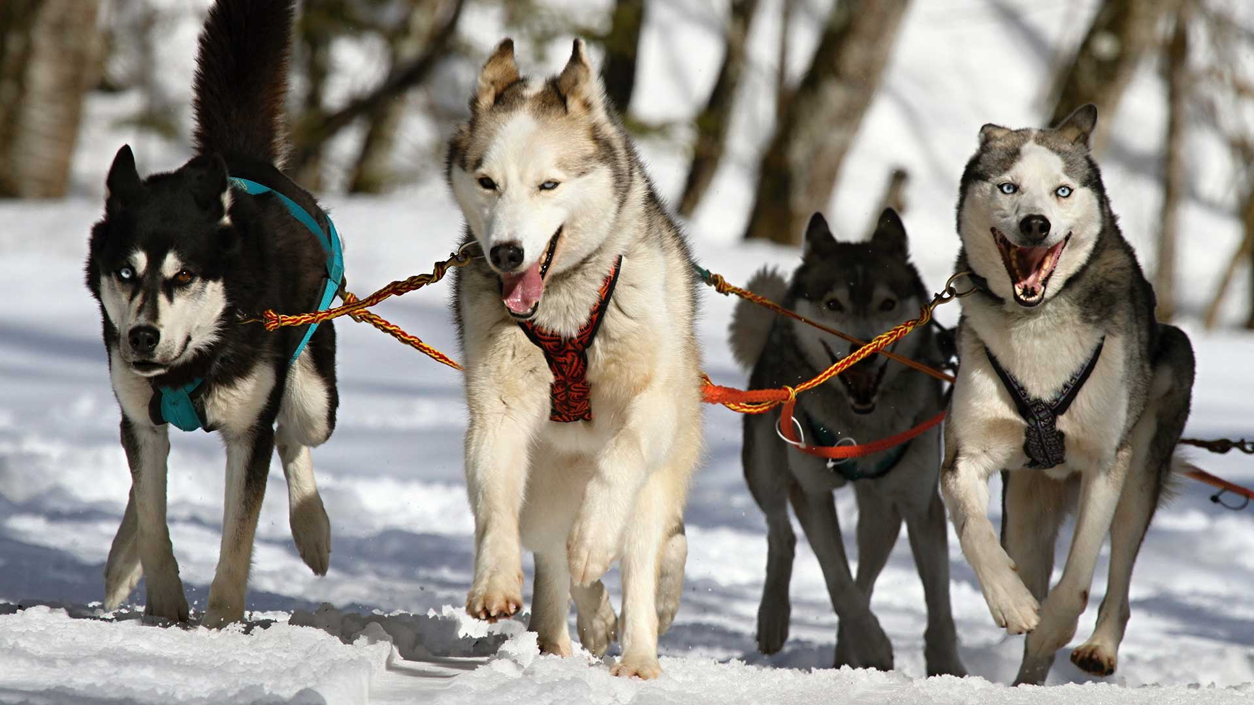
Today is Sled Dog Day! How many sled dogs are here? How many eyes? How many legs?
K.CC.B

Slide 6
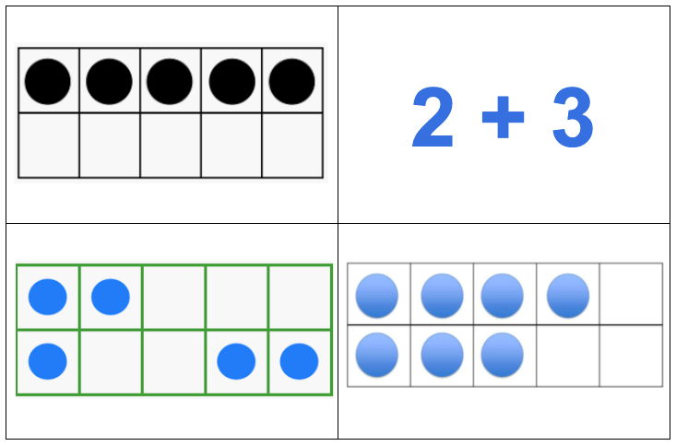
Which one does not belong?
K.OA.A1
Notes:
Week of February 6, 2023

Slide 7
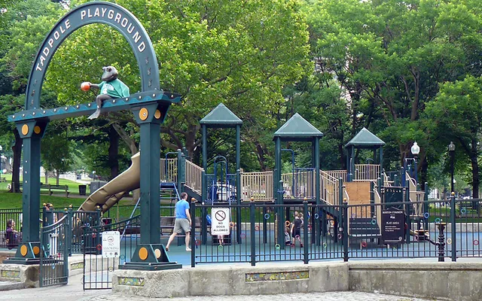
Let’s talk about the shapes we see in the Tadpole Playground!
K.G.A2

Slide 8
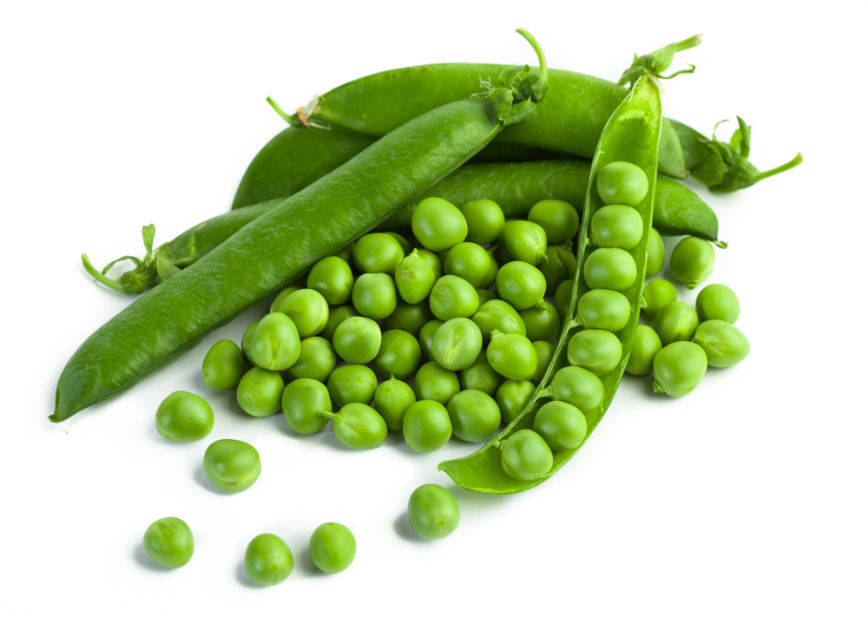
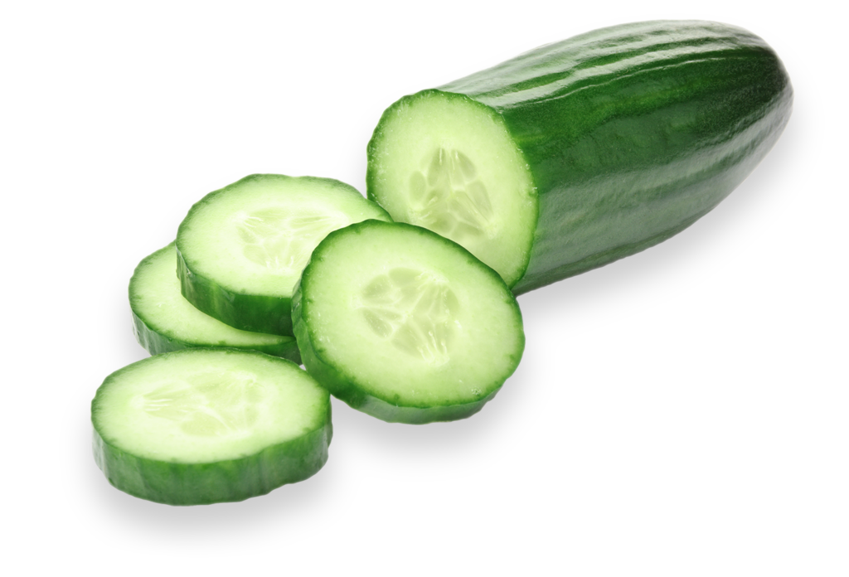
How can we compare these two vegetables?
K.MD.A1

Slide 9

Happy 100 Day!
Would you rather . . .
Count to 100 by ONES or by TENS?
K.CC.A1
Notes:
Thursday, February 9, 2023
100 DAY!!!!

Slide 10
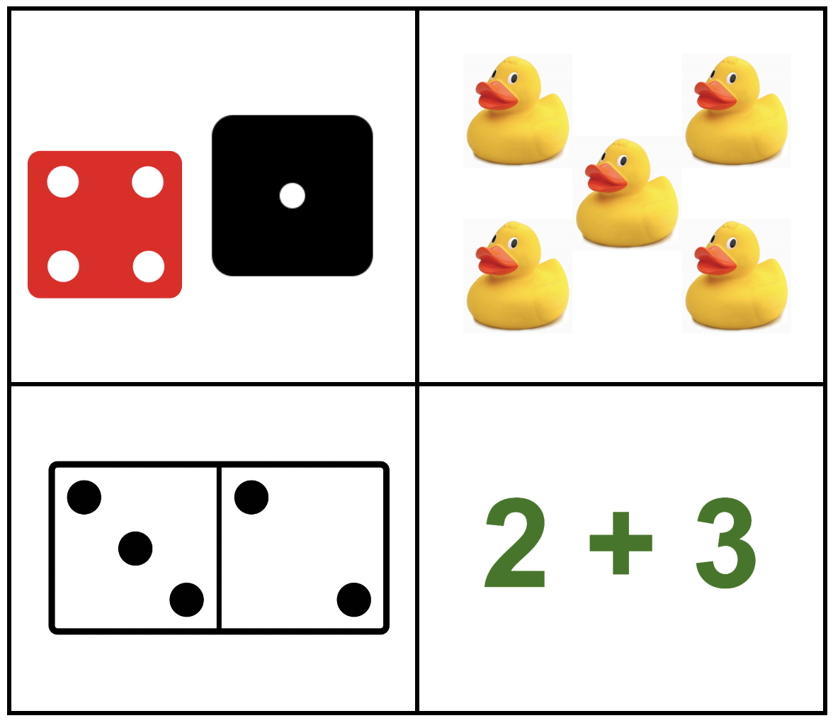
Which one does not belong?
What do they all have in common?
K.OA.A5

Slide 11
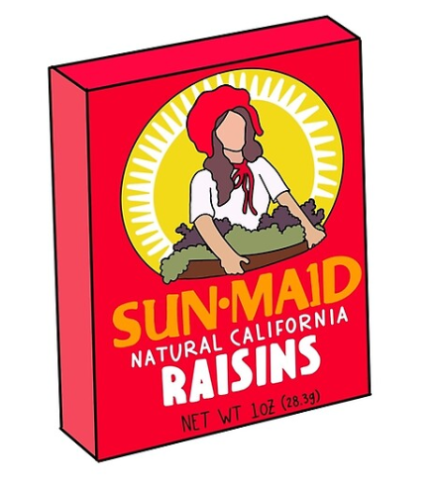
What is the same?
What is different?
K.G.A3
Notes:
Week of February 13, 2023

Slide 12
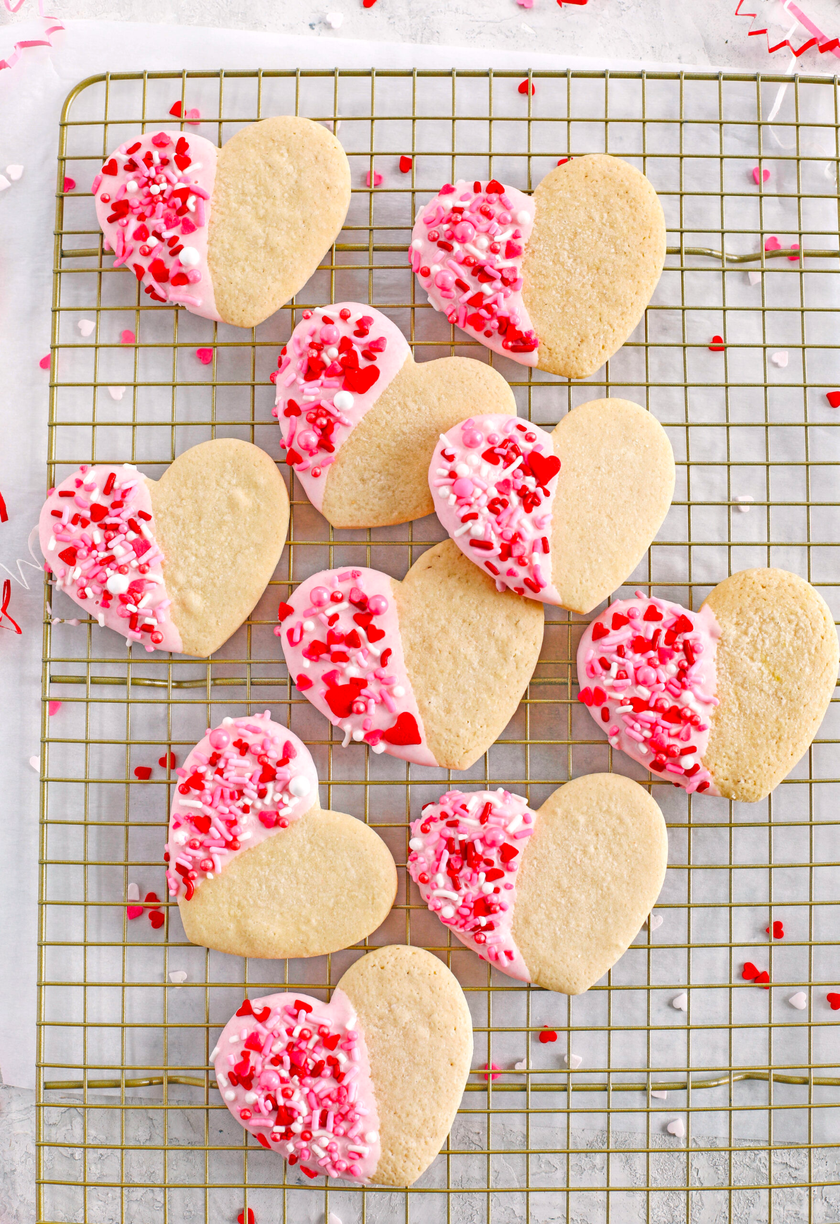
What do we notice about these cookies?
How can we count them?
K.CC.B4

Slide 13
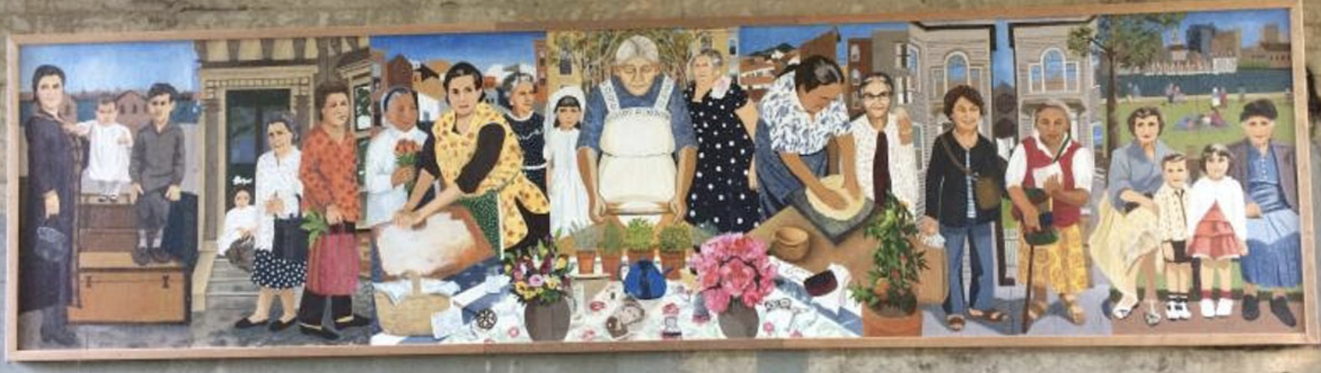
This mural “Our immigrant Abuelitas” is in East Boston!
Let’s describe what we see here using words like above, below, in front of, behind and next to.
K.G.B4

Slide 14
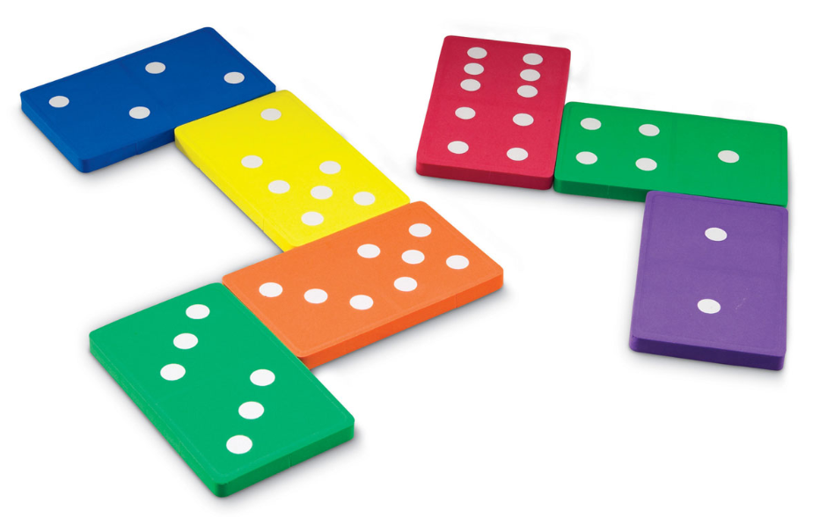
What do we notice?
What do we wonder?
K.OA.A1

Slide 15
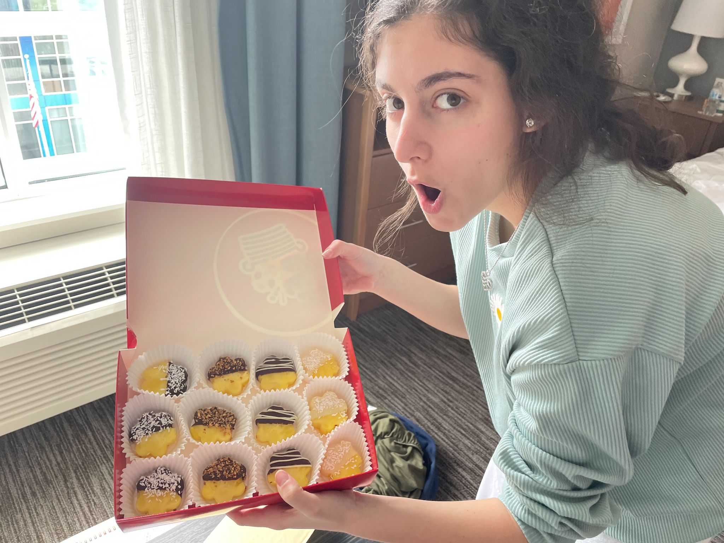
Yum!
Chocolate covered pineapple flowers!
Can you write a number sentence to match this photo?
K.OA.A2

