Slide 1
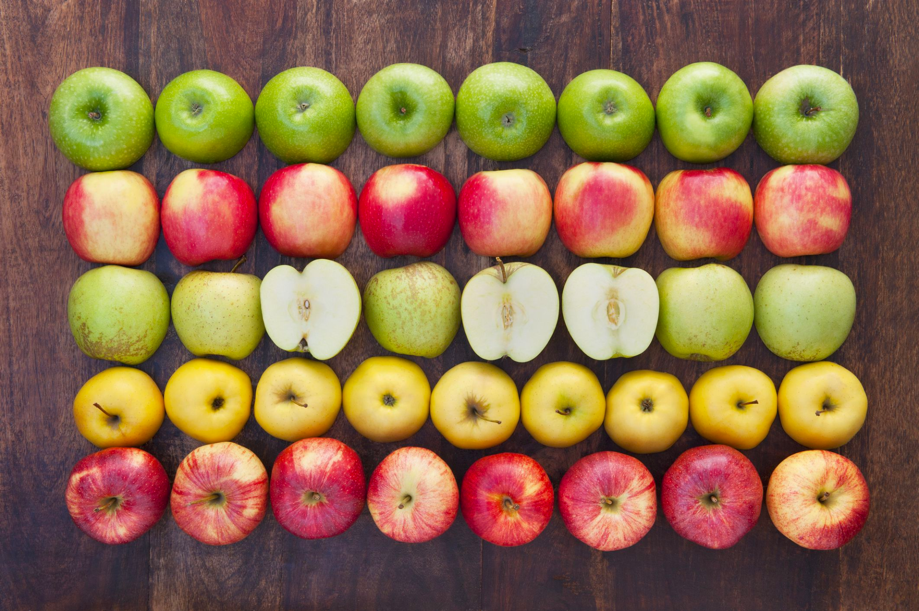
What can we say about this fruit array?
Create an equation to match this photo.
3.OA.A3
Notes:
Week of January 30, 2023

Slide 2
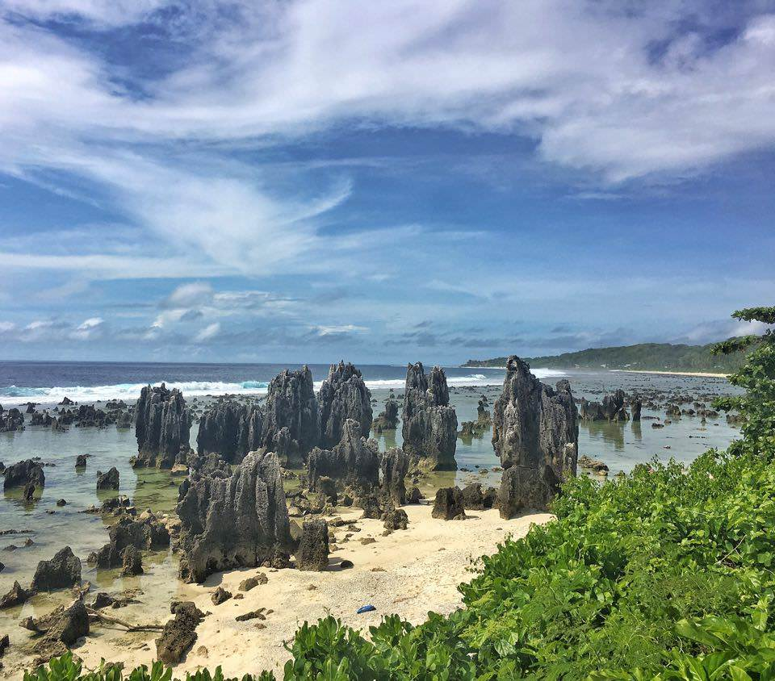
It’s Independence Day in Nauru!
Nauru is a very small, and a very young country! It declared independence in 1968!
How long ago was that?
3.NBT.A2

Slide 3
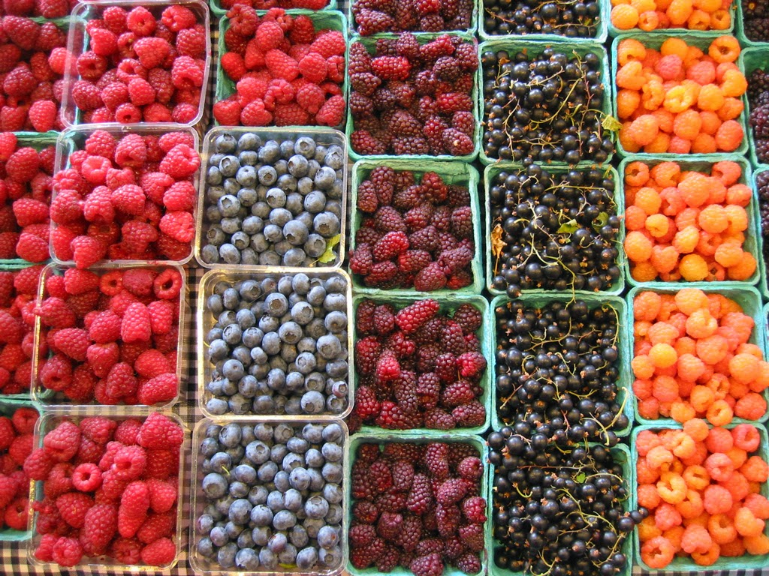
February is Berries Month!
What math do we notice?
Where do we see fractions?
3.NF.A1

Slide 4
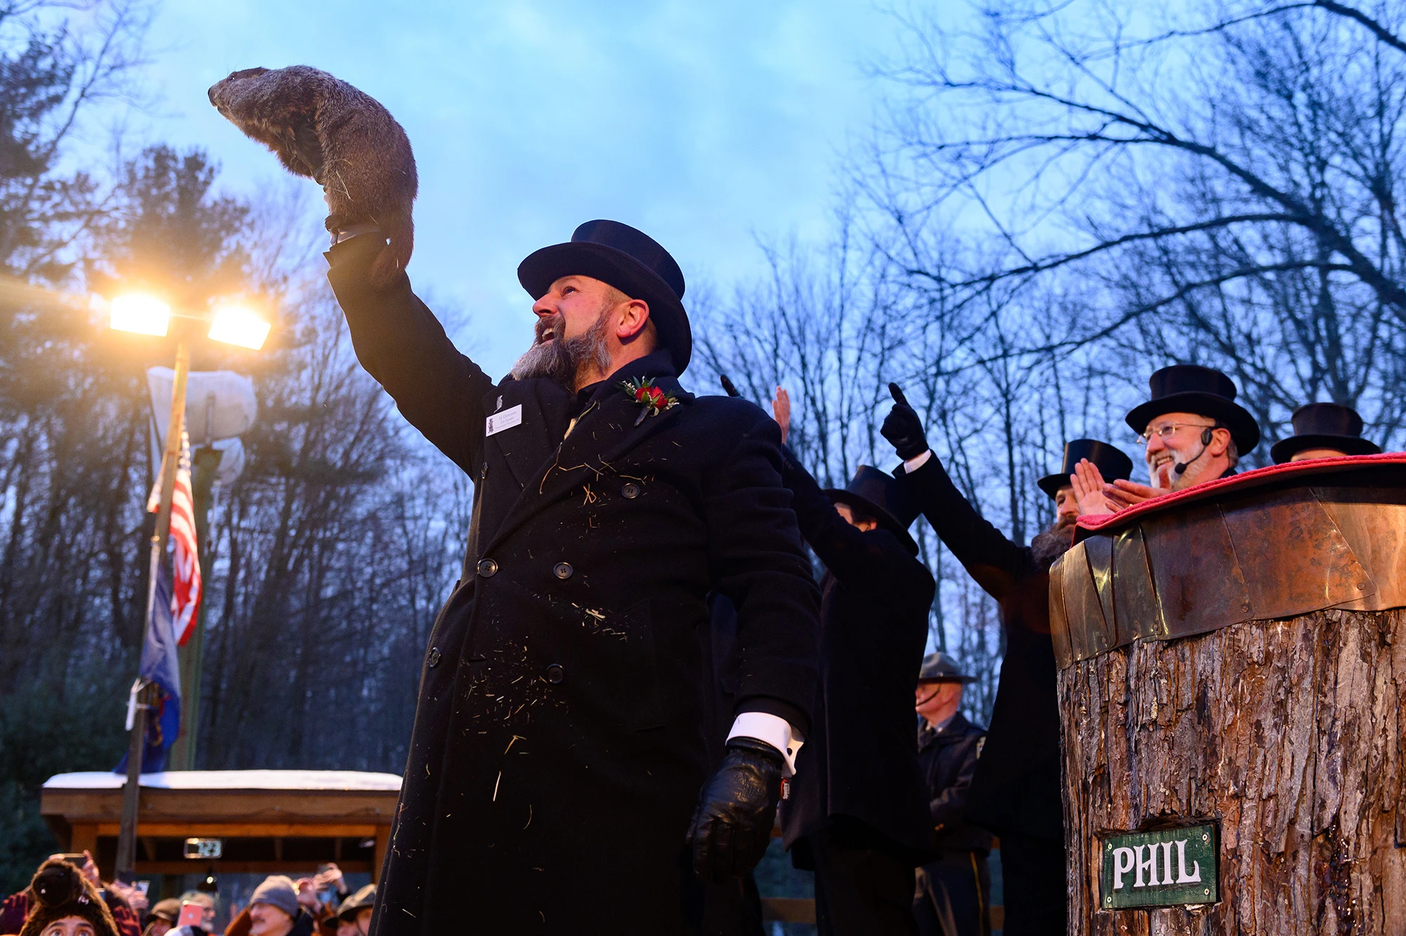
It’s Groundhog Day!
The Punxsutawney Groundhog Club hosts their Groundhog Day celebration - and the announcement of Phil’s prediction - at Gobbler’s Knob in Punxsutawney, PA.
The reveal is made around 7:20 a.m. each year.
How many minutes ago was 7:20 a.m.?
3.MD.A1

Slide 5
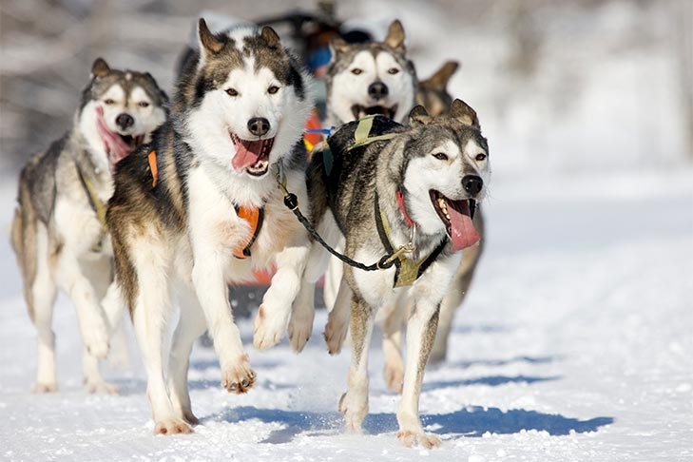
It’s Sled Dog Day!
The first formal sled-dog race was held in 1850, from Winnipeg, Manitoba, to St. Paul, Minnesota.
How long ago was that?
How can we use mental math to figure it out?
3.NBT.A2

Slide 6
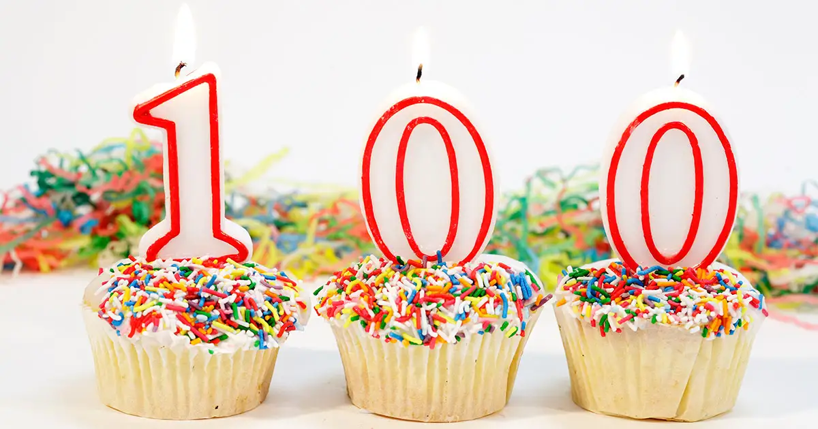
Happy 100 Day of School!
What are some FACTORS of 100?
How do we know we have them all?
3.OA.C7
Notes:
Week of February 6, 2023
100 Day!

Slide 7
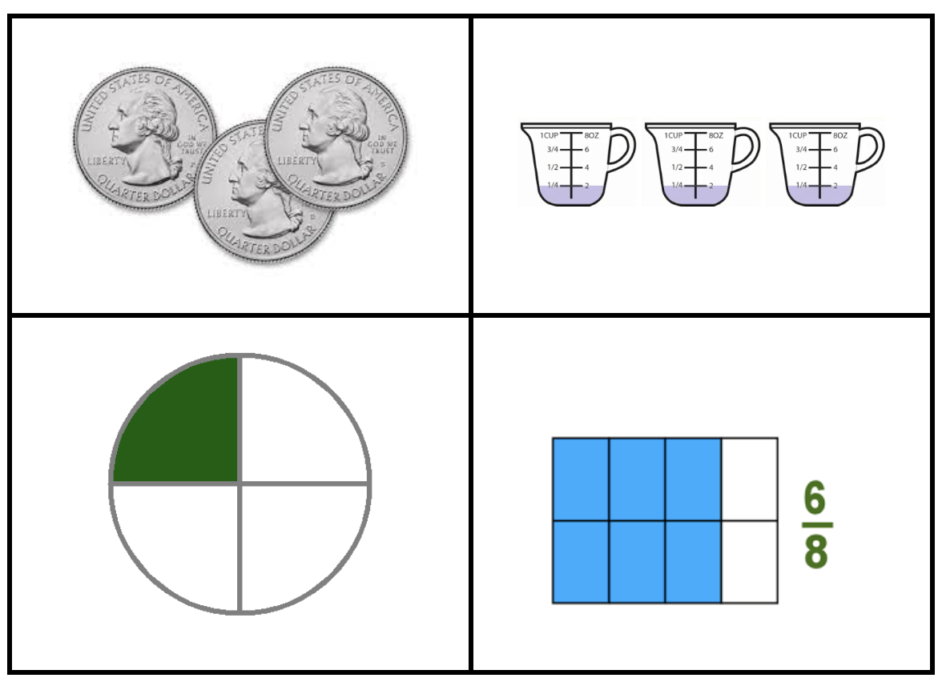
Which one does not belong?
What do they all have in common?
3.NF.A3
Notes:
Top left: only coins
Top right: only addends
Bottom left: one-fourth, three-fourths missing
Bottom right: only equivalent fraction

Slide 8
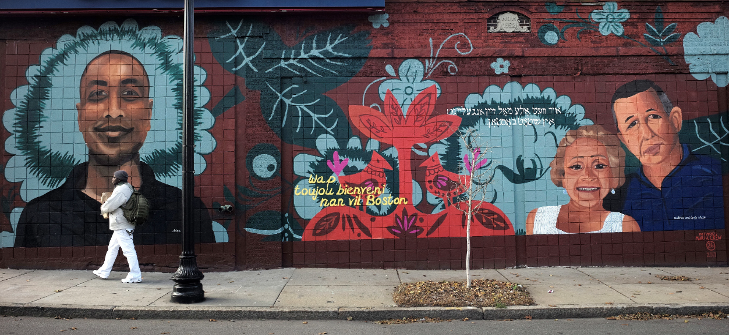
Estimate the height of this Roslindale mural.
How do we know our estimate is reasonable?
3.MD.A2

Slide 9

3 x 5 x 2 = 6 x 5
8 x (5 + 2) = 40 + 16
2 x 3 x 10 = 10 x 5
3.OA.B5

Slide 10
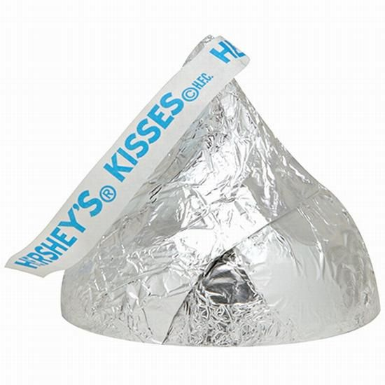
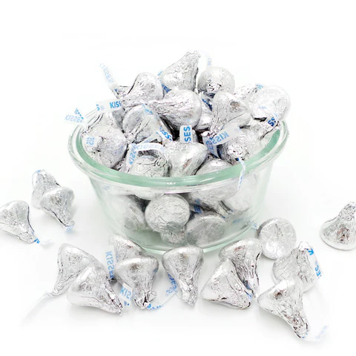
Would you rather have an overflowing bowl of Hershey’s Kisses or One giant Hershey’s Kiss?
3.SMP.3

Slide 11
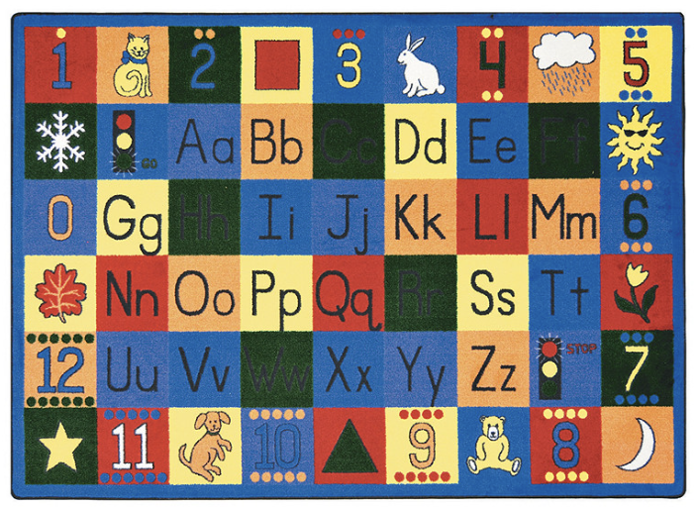
What a nice classroom rug!
This rug has a perimeter of 28 square feet.
What is possible?
Think about area!
3.MD.D8
Notes:
Week of February 13, 2023

Slide 12
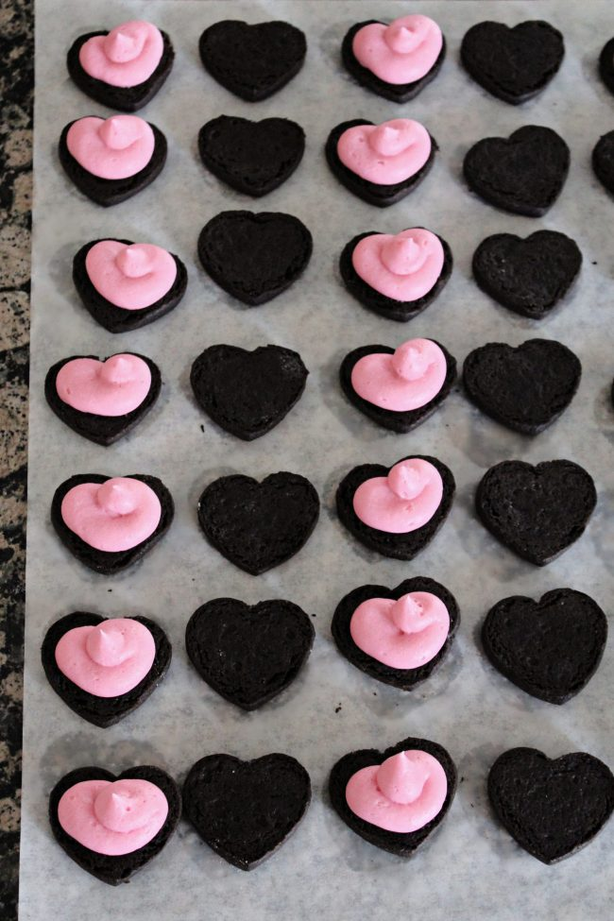
What do we notice?
What do we wonder?
What can we say about this array of cookies?
How many are here?
Can we write an equation to match our thinking?
3.OA.A3

Slide 13
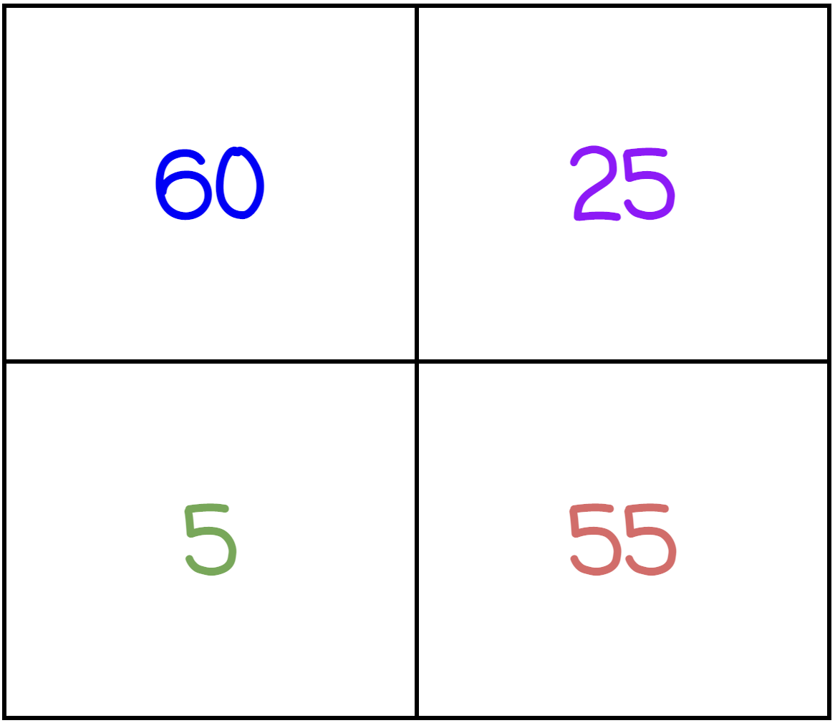
Which one does not belong?
What do they all have in common?
3.OA.D9
Notes:
Top left: only even, multiple of ten
Top right: only square number
Bottom left: only single-digit
Bottom right: only palindrome

Slide 14
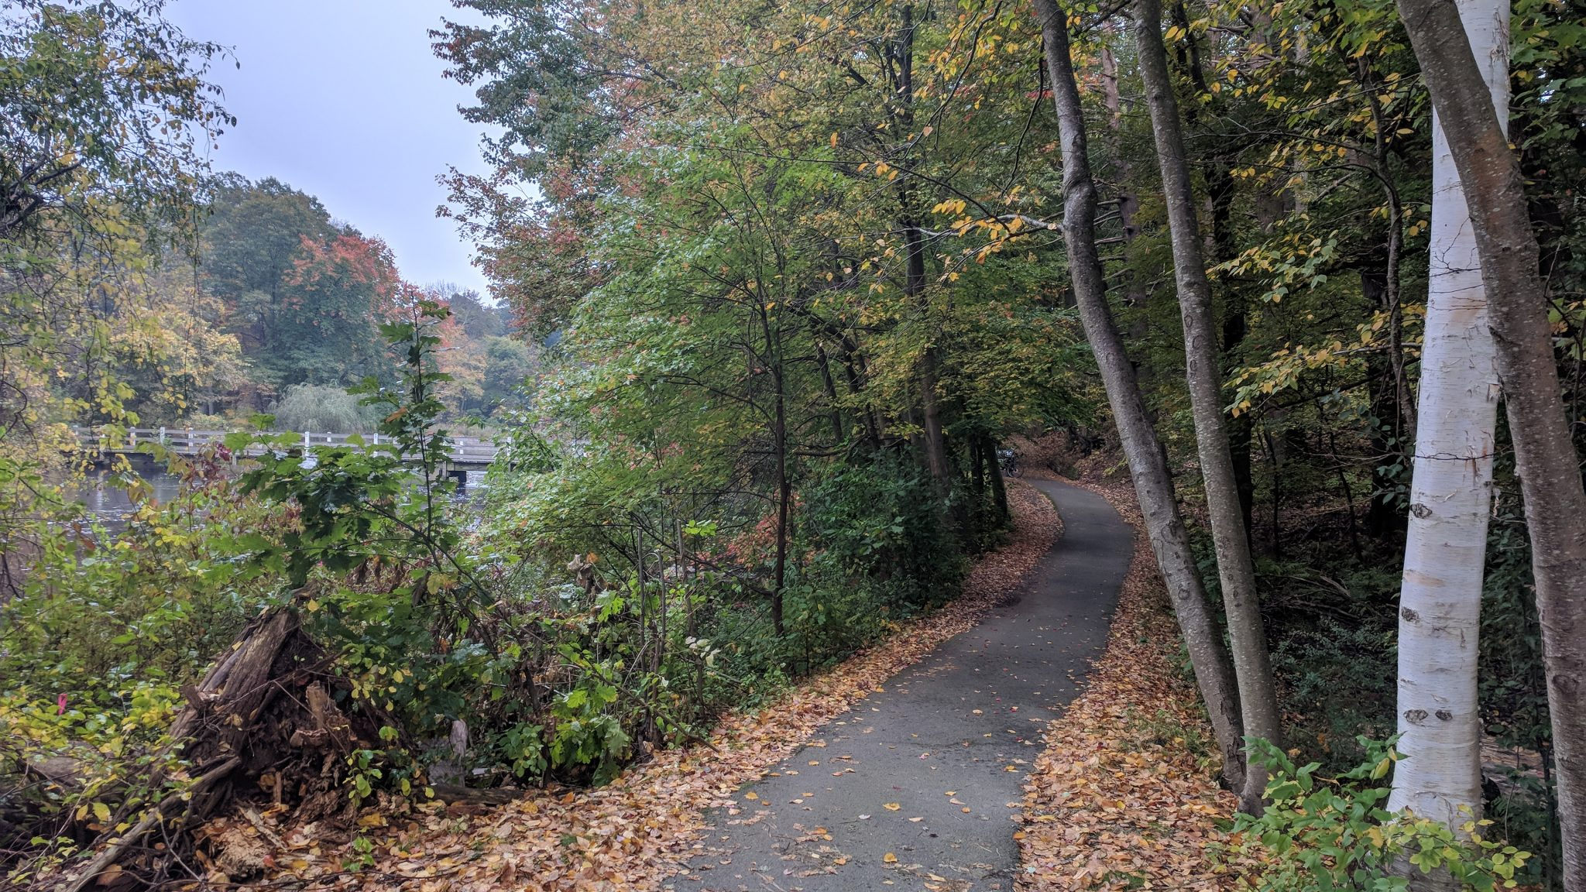
There are over 90 miles of trails in Weston.
What can we say about the number 90?
How many different expressions can we create that have a value of 90?
2.NBT.B5

Slide 15
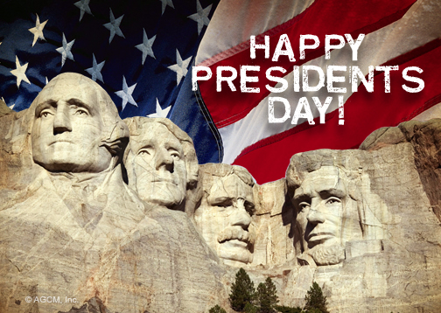
In 1879, President Rutherford B. Hayes signed Washington’s Birthday into law.
How long ago was that?
How do you know?

