Slide 1
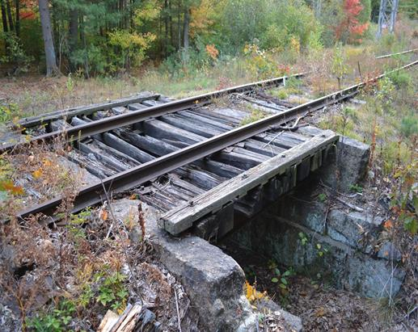
Mass. Central Rail Trail
This old railway in North Weston will be part of the 25 mile Rail Trail from Berlin to Waltham.
How many different ways can we get to 25 using tens and ones?
1.NBT.B2
Notes:
Week of January 30, 2023

Slide 2

It is Independence Day in Nauru! What do we notice about the flag of Nauru? How many points does the star have? How many points on 2 stars? How do you know?
1.OA.A1
Notes:
January 31, 2023
Nauru Independence Day

Slide 3
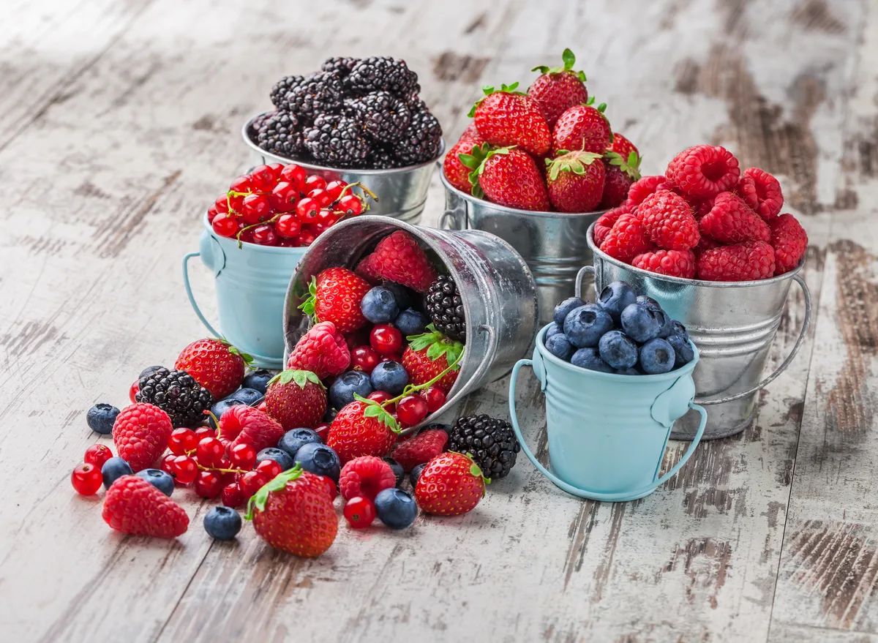
February is Berries Month!
How can we estimate how many berries are in each can?
How do we know our estimates are reasonable?
1.NBT.A1
Notes:
February 2023

Slide 4
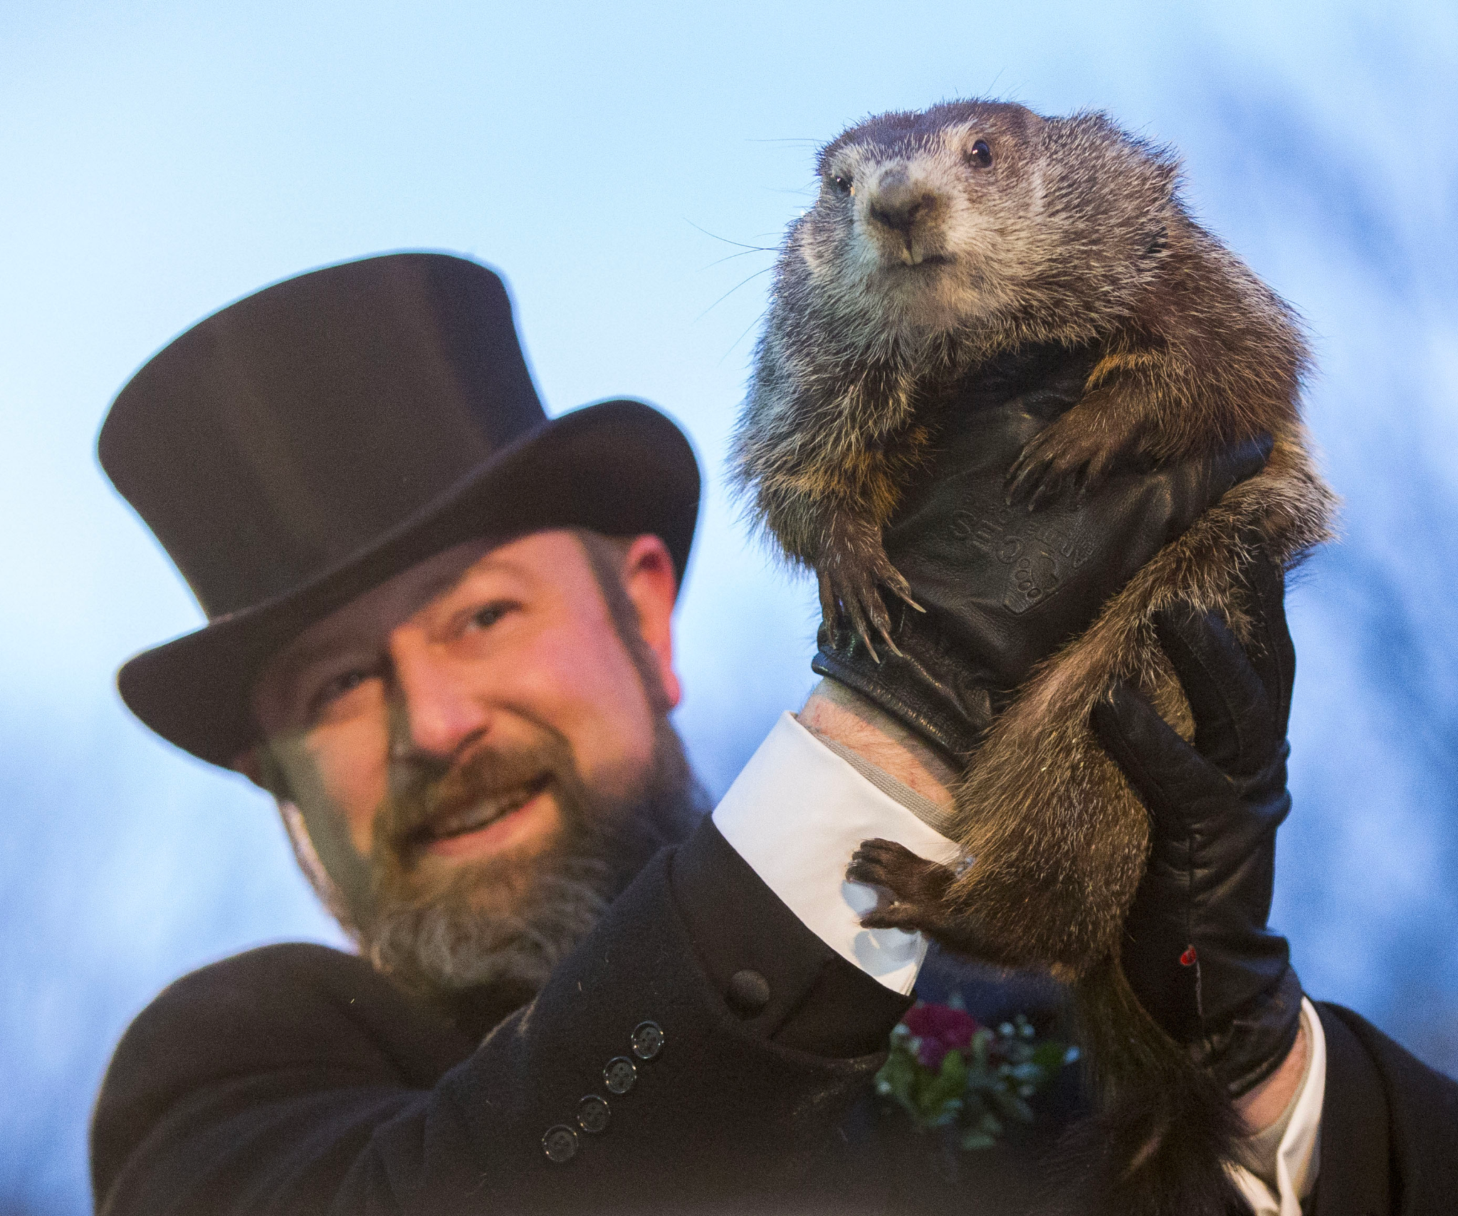
Happy Groundhog Day!
An adult groundhog is 20 inches long!
How many different expressions can we write with a value of 20?
Do we see any patterns in our expressions?
1.OA.C6
Notes:
February 2, 2023
Sled Dog Day

Slide 5
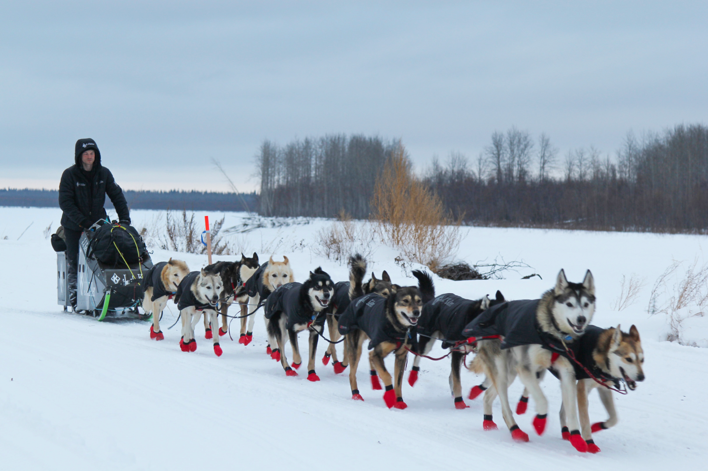
It’s Sled Dog Day!
How many sled dogs are in this team?
How many eyes?
How many legs?
How do we know?
1.NBT.C5
Notes:
February 2, 2023
Sled Dog Day

Slide 6

What can we say about the number 100?
How many different ways can we count to 100?
1.NBT.A1
Notes:
Week of February 6, 2023
100 DAY!

Slide 7
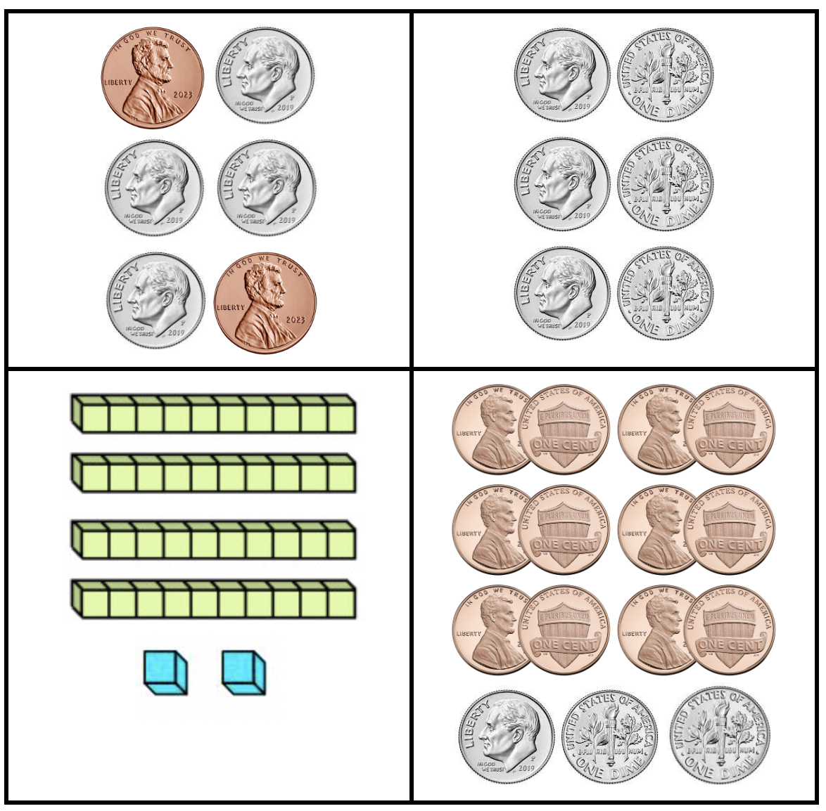
Which one does not belong?
1.MD.D5
Notes:
Top left: dimes and pennies are mixed up, only “heads”
Top right: not 42
Bottom left: not coins
Bottom right: not 6 objects

Slide 8
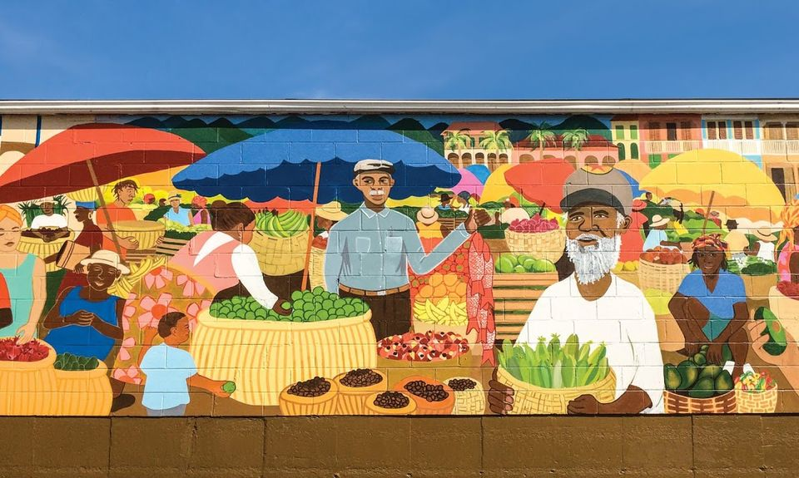
What do we notice about the shapes we see in this Boston mural?
Can you find two shapes that are similar?
Can you find two that are different?
1.G.A1

Slide 9
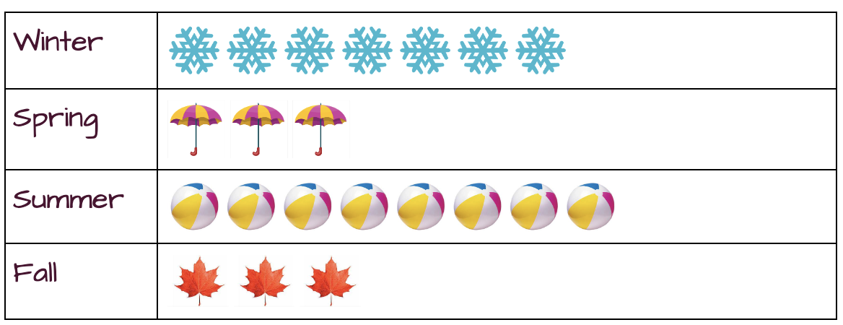
If this chart could talk, what would it say?
What would you name this graph?
1.MD.C4

Slide 10

7 = 12 - 5
13 + 5 = 6 + 12
14 + 3 = 4 + 13
20 - 2 = 21 - 1
1.OA.D7

Slide 11
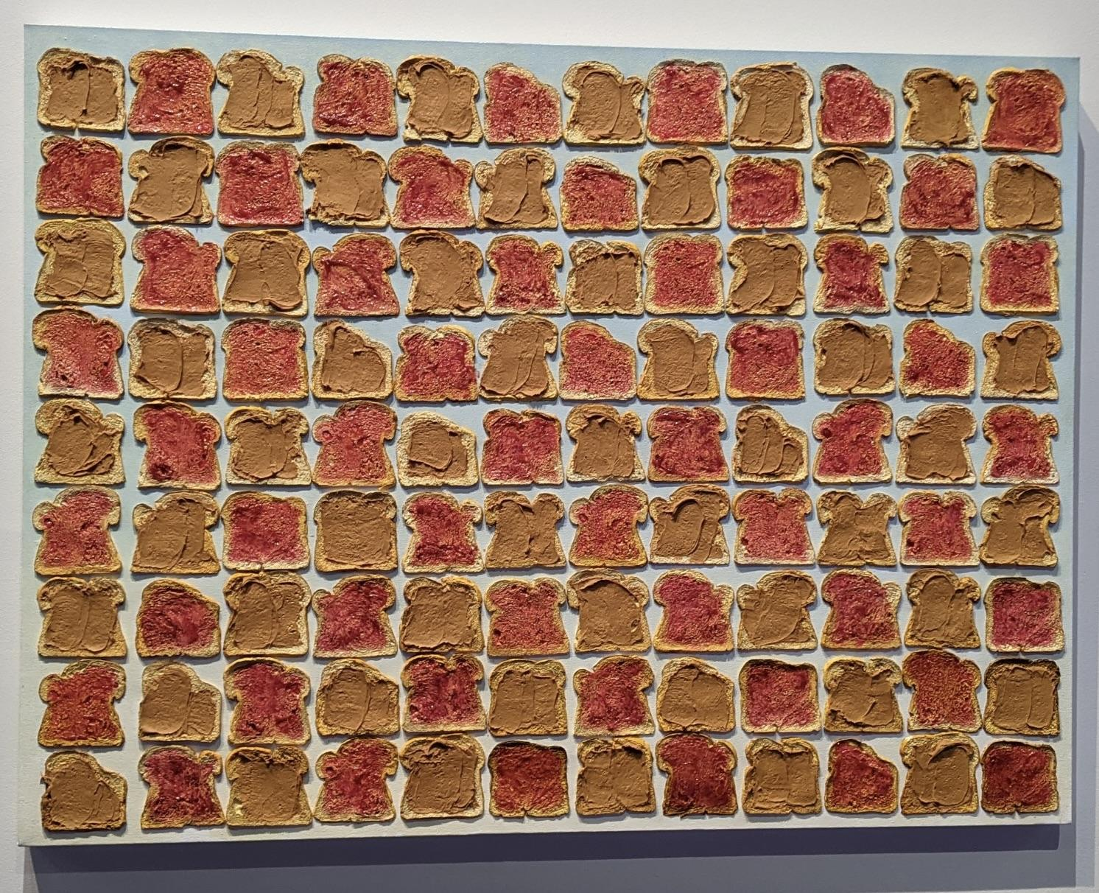
Estimate how many peanut butter and jelly sandwiches are here in this painting.
How can we come close?
How many peanut butter?
How many jelly?
M. Zimmerman
1.NBT.A1
Notes:
Week of February 13, 2023

Slide 12
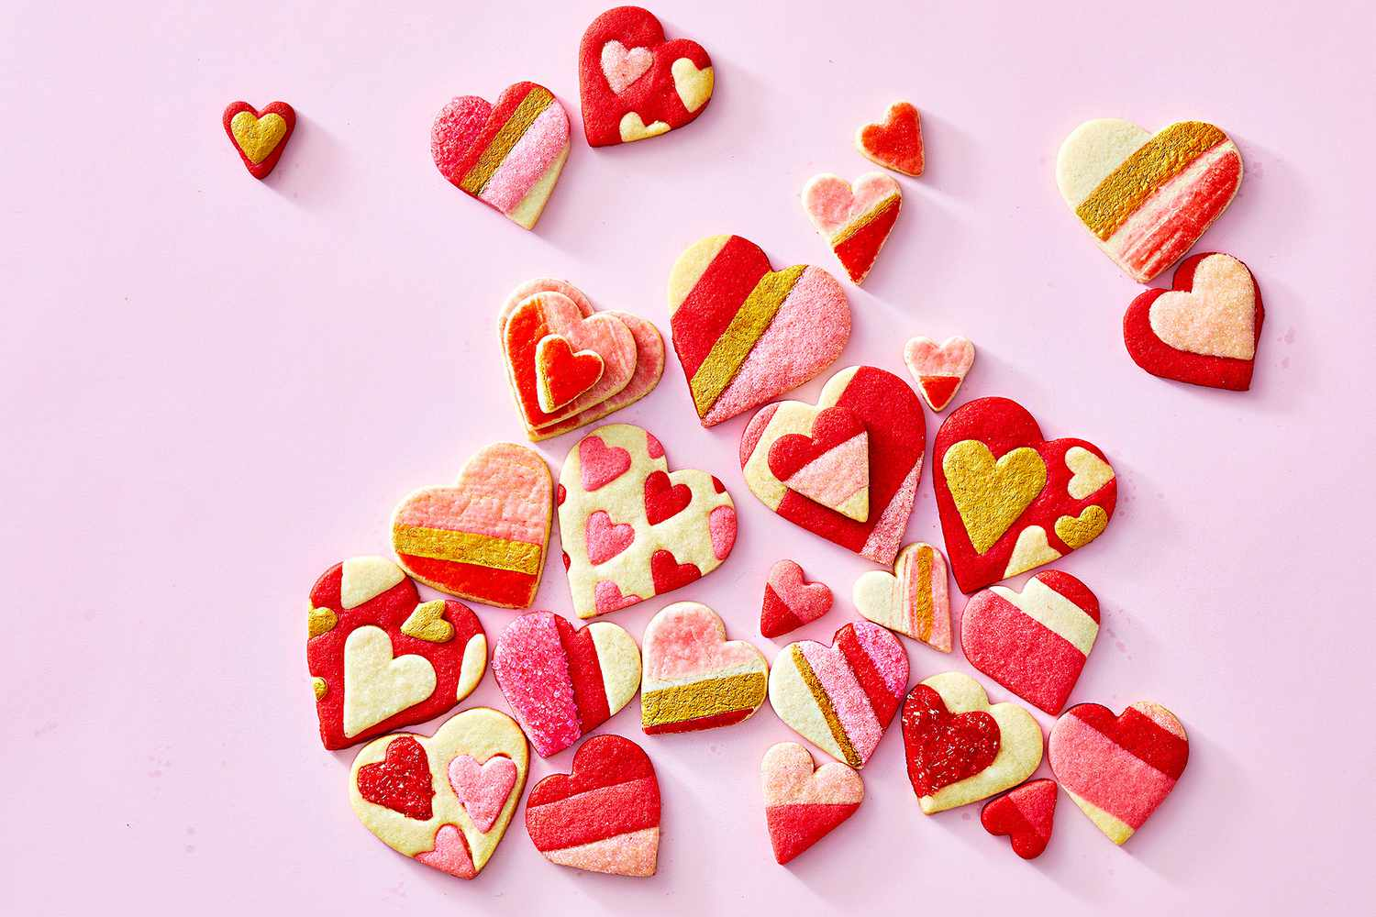
What do we notice?
What do we wonder?
How many cookies are here?
How would you sort them?
1.MD.C4

Slide 13
Sketch this shape!
What is it?
Now let’s sketch a shape this is the same in ONE way, and different in ONE way.
What shape do you have?
1.G.A2

Slide 14
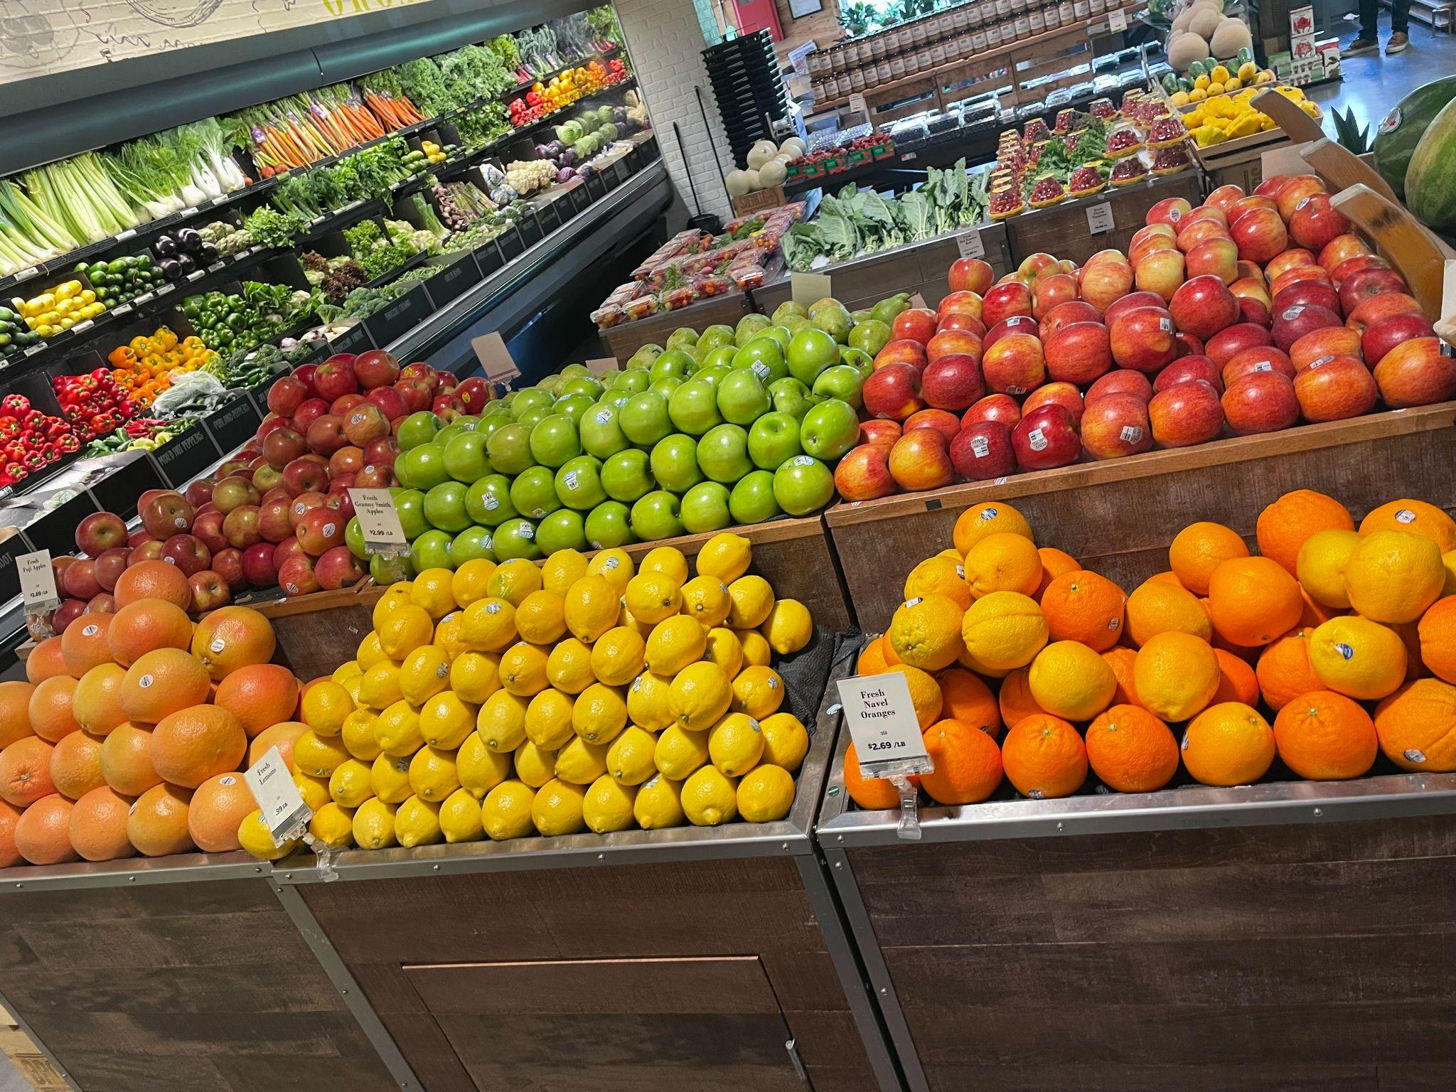
Look at all this fruit at Brother’s Market!
What can we count in this photo?
What can we estimate?
1.NBT.A1

Slide 15
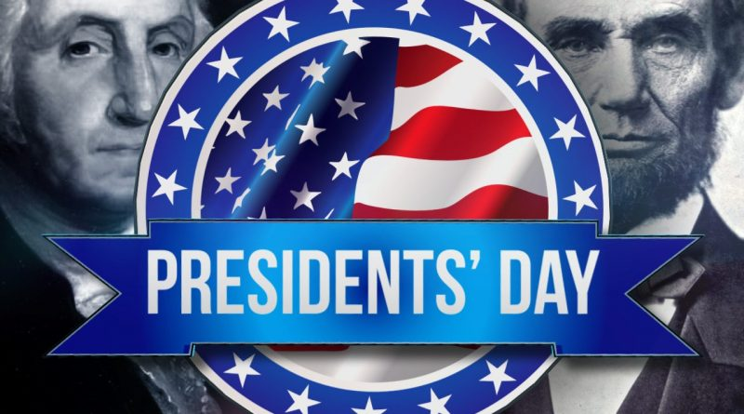
Celebrate President’s Day!
There have been 46 US presidents!
How many expressions can we create that have a value of 46?
1.NBT.C4

