Slide 1

It’s Cyber Monday!
American consumers spent $10,700,000,000 on Cyber Monday in 2021.
What is that number?
Can we show that number with an exponent?
A decimal?
Do you think Americans will spend more or less in 2022?
Why?
4.NBT.A2
5.NBT.A2
Notes:
Week of November 28, 2022

Slide 2
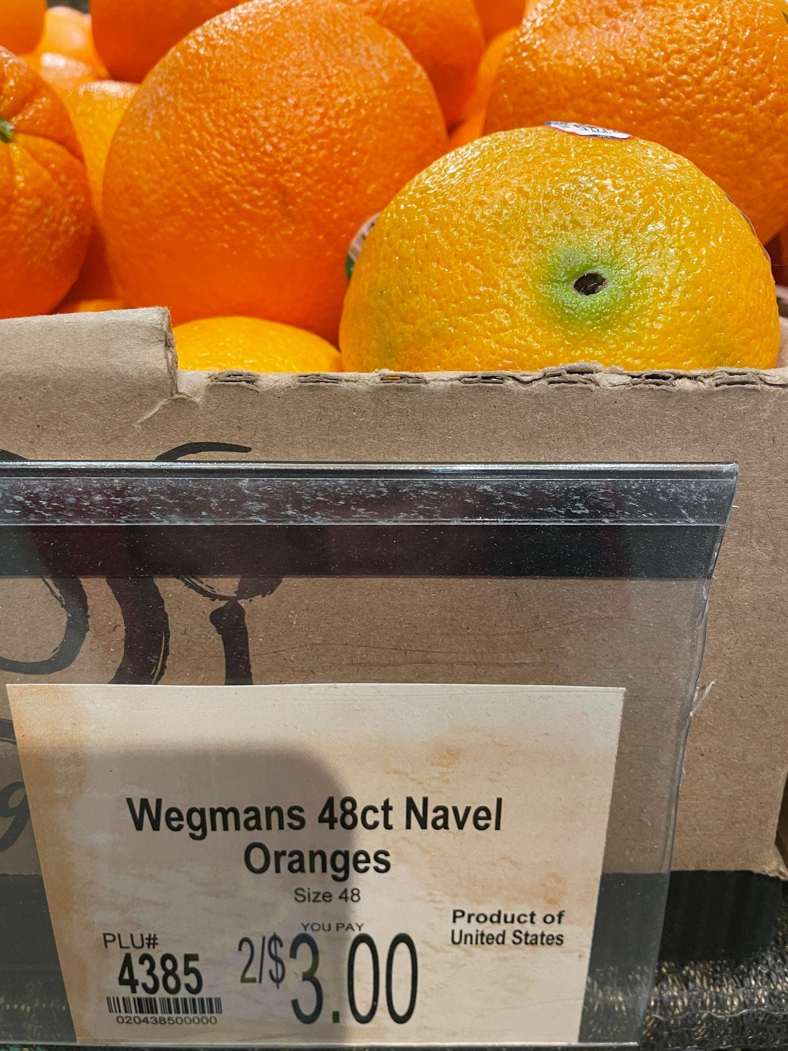
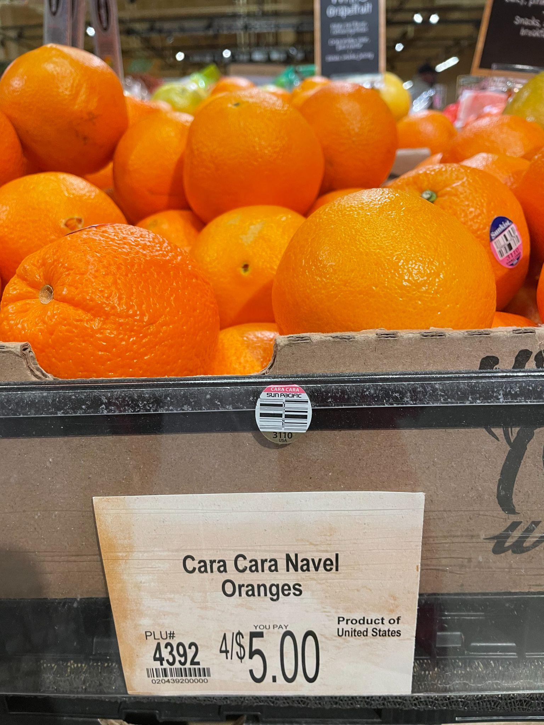
Would you rather …
5.NBT.B7

Slide 3
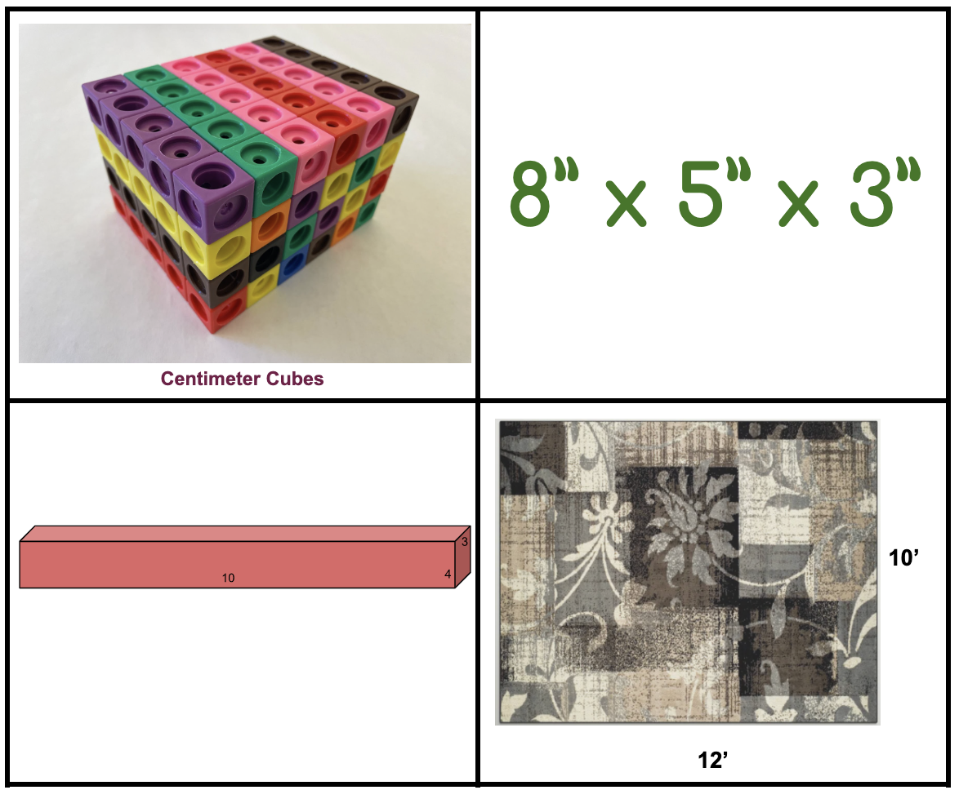
Which one doesn’t belong?
What do they have in common?
5.MD.C5
Notes:
Top left: no numerals
Top right: no model
Bottom left: no units (measurement)
Bottom right: not volume, or 3-dimensional

Slide 4

It’s Independence Day in Portugal!
On this day in 1668 Portugal gained independence from Spain.
Approximately what fraction of the flag of Portugal is red?
How do you know?
4.NBT.B4
5.NF.A1
Notes:
December 1, 2022
Independence Day Portugal

Slide 5
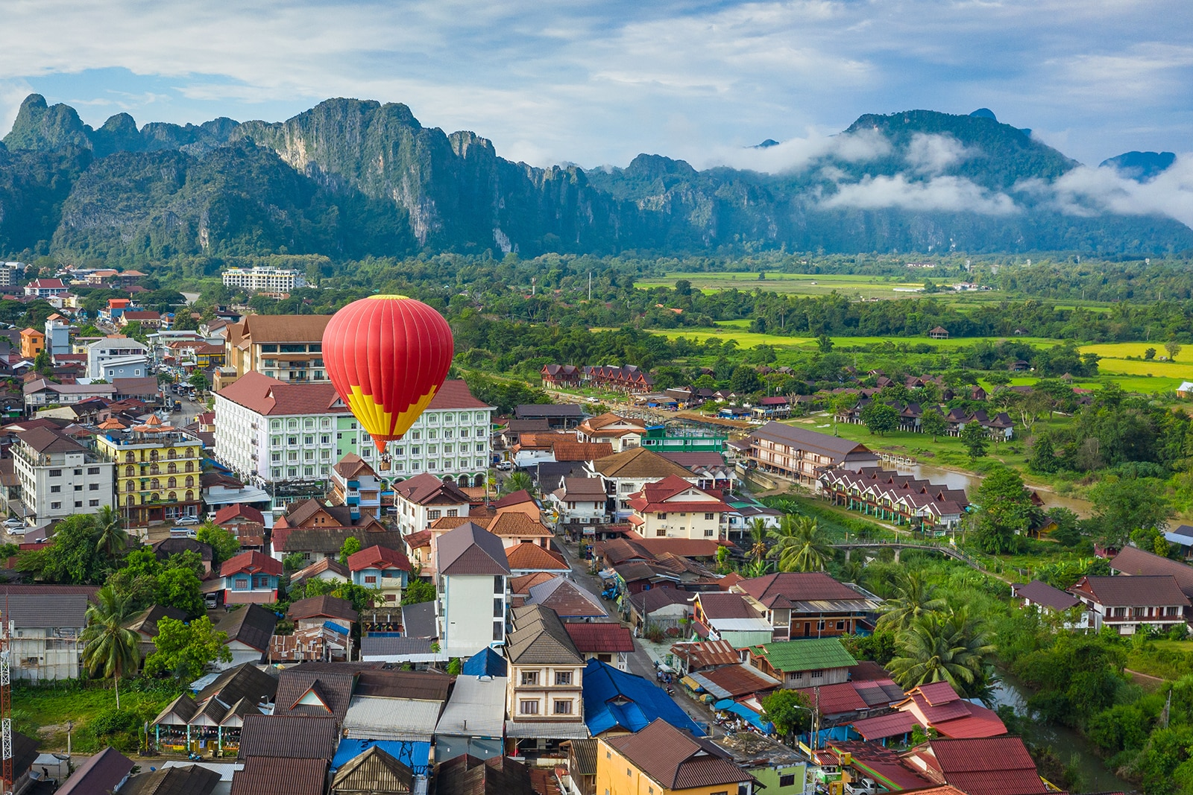
It’s National Day in Laos!
Laos is a beautiful country in Southeast Asia.
The current population of Laos is 7,529,884.
What are some FACTORS of 7,529,884?
How do you know?
5.NBT.B6

Slide 6
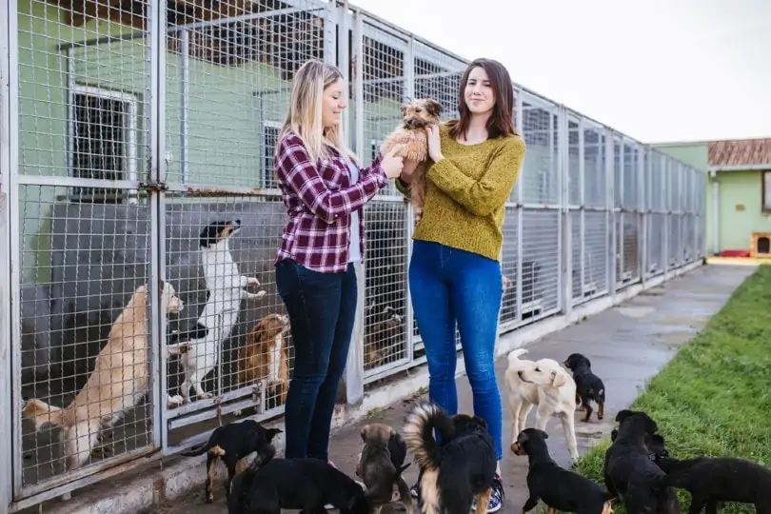
Today is Shelter Pets Day!
In 2021
1,987,325 dogs and 2,516,750 cats were adopted into wonderful families.
How many pets is that altogether?
How many more cats than dogs were adopted?
5.NBT.B7
Notes:
Week of December 5, 2022
Shelter Pets Day

Slide 7
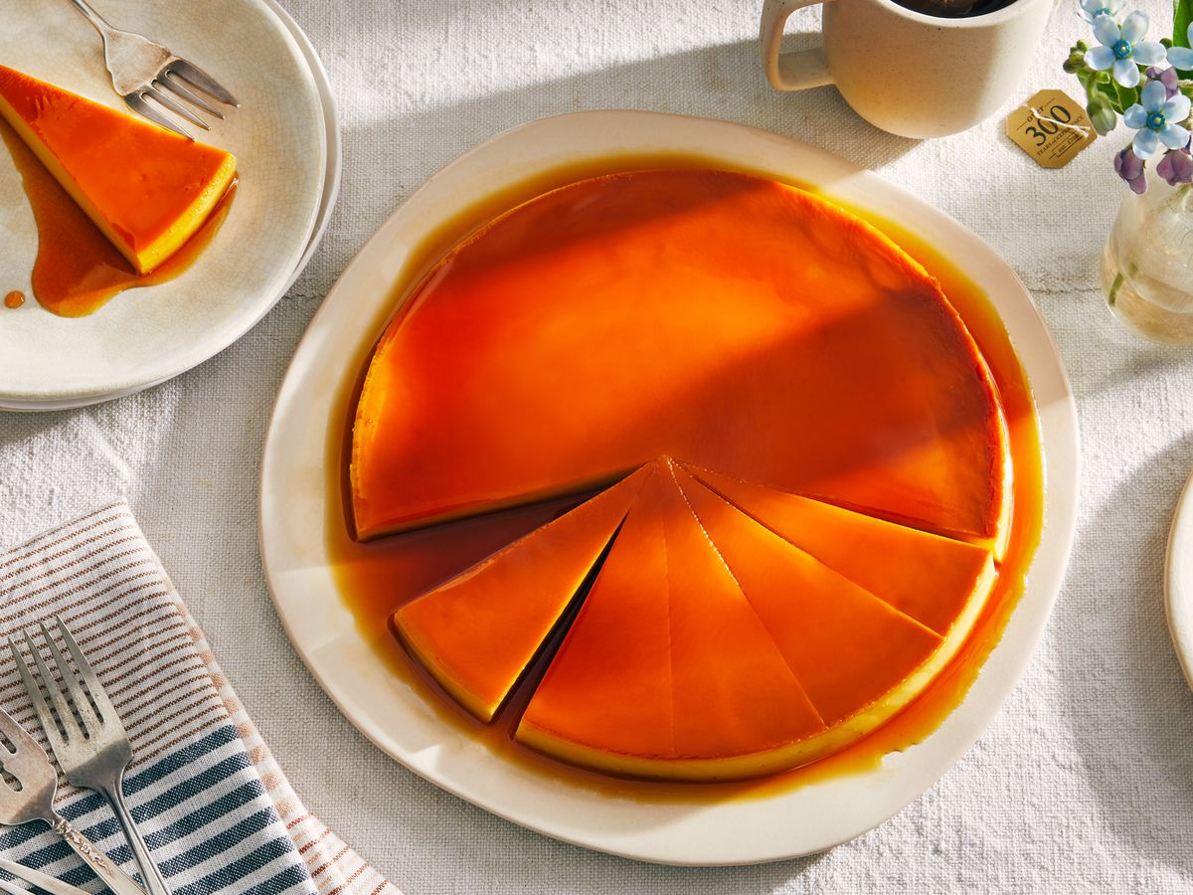
It is Constitution Day in Spain!
Flan is one of Spain’s most delicious desserts.
About what fraction of the flan is cut out?
What fraction remains?
5.NF.A1
Notes:
December 6, 2022
Constitution Day ~ Spain

Slide 8

Triple the sum of 8 and 7 = 3 x 8 + 7
4 x (18,233 + 17,212) > 5 x (257 + 999)
60 x 0.5 = 30 x 10
5.OA.A2

Slide 9
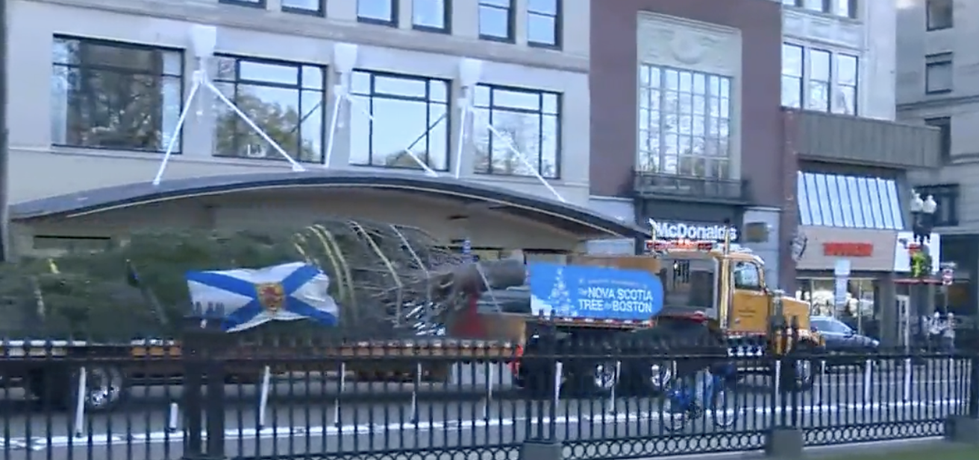
The tree on Boston Common, an annual gift from Nova Scotia, weighs approximately 900 pounds.
What are the factor pairs of 900?
Watch the video!
5.NBT.B6

Slide 10
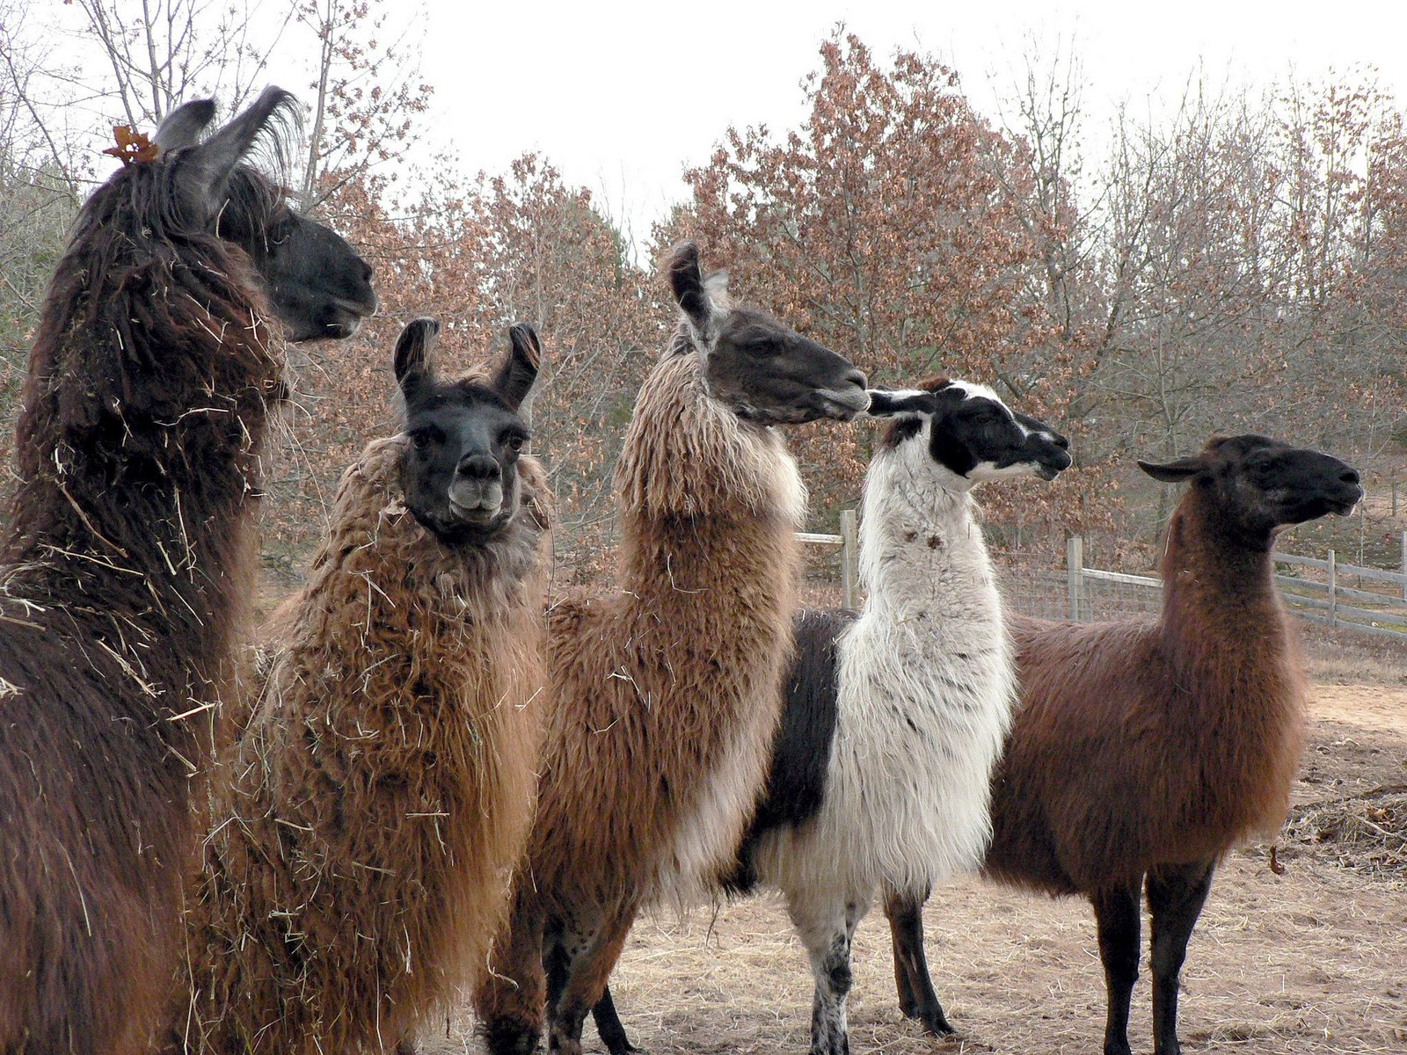
It’s International Llama Day!
A llama can weigh between 290 and 440 pounds.
Together these five llamas weigh 1790 pounds.
What is possible?
5.NBT.B7
Notes:
December 9, 2022
International Llama Day

Slide 11
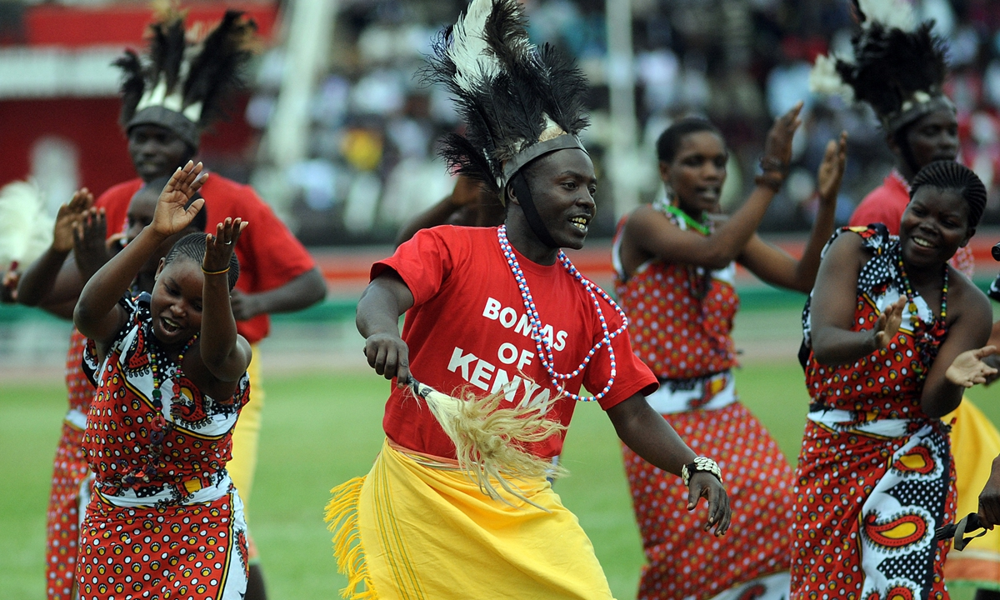
It’s Independence (Jamhuri) Day in Kenya!
On this day in 1964 Kenya became a republic!
How long ago was that?
How many months has Kenya been a republic?
How many days?
Is that surprising to you?
5.MD.A1
Notes:
Week of December 12, 2022
Jamhuri Day (Kenya)

Slide 12
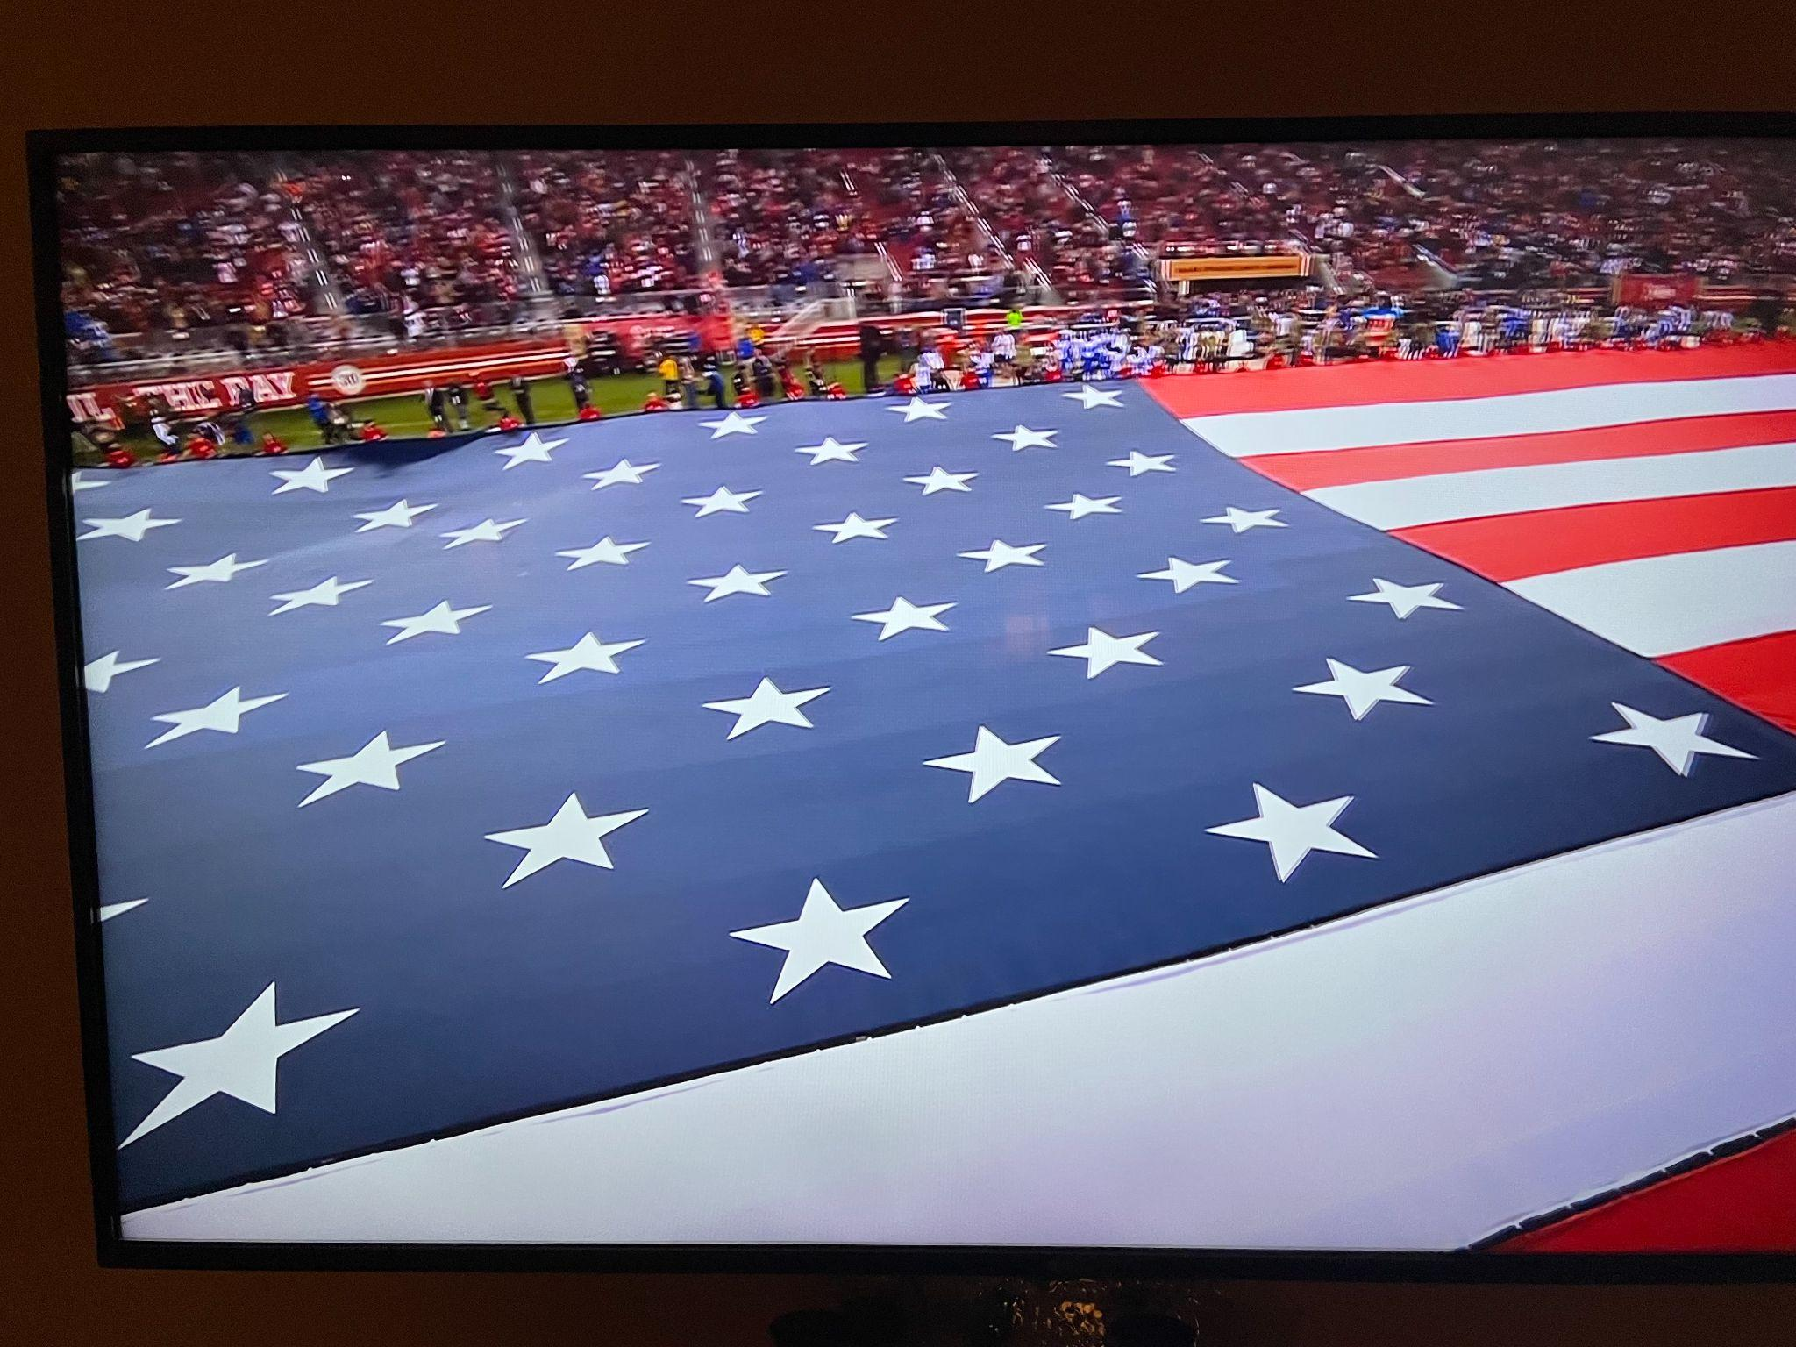
Wow! Look at this NFL American flag!
What do you notice?
What do you wonder?
What might the dimensions be?
What is the area?
5.NBT.B5

Slide 13
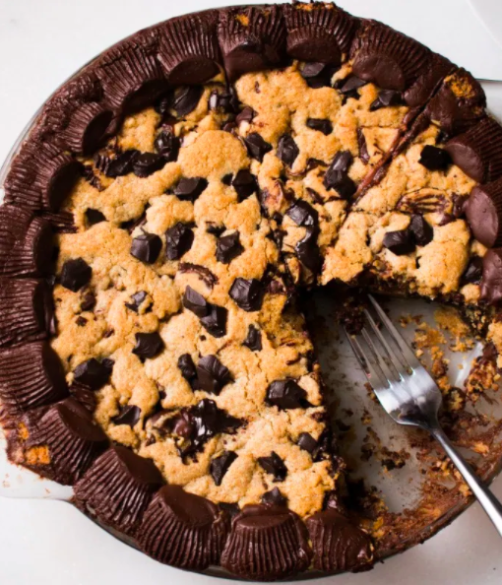
ABOUT how much Reese's Chocolate Chip Pie is left?
What fraction OF THE WHOLE PILE would be one half of what is left?
5.NF.B7

Slide 14
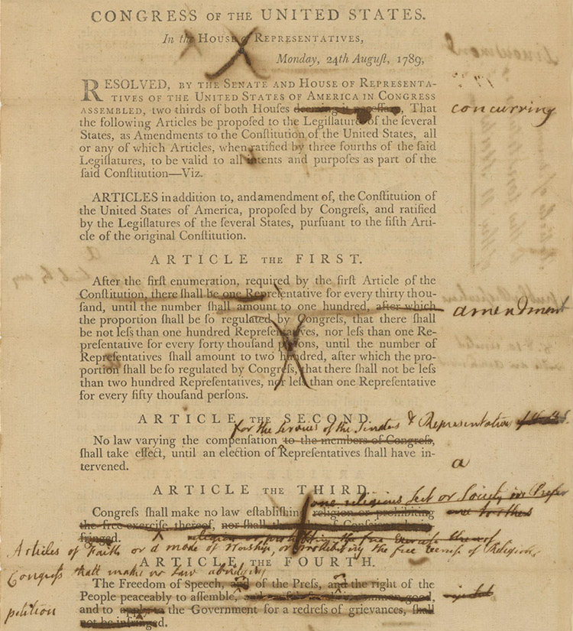
Today is Bill of Rights Day
The first amendments to the Constitution were written on September 9, 1789 and ratified on December 15, 1791.
How long did that take? How many months? How many days?
The 10 amendments protect the most basic rights of Americans, known as the Bill of Rights. It consists of notions like freedom of speech, freedom of religion, freedom of the press, the right to protest, and equal protection under the law.
How long ago was 1791?
5.MD.A1
Notes:
December 15, 2022
Bill of Rights Day

Slide 15
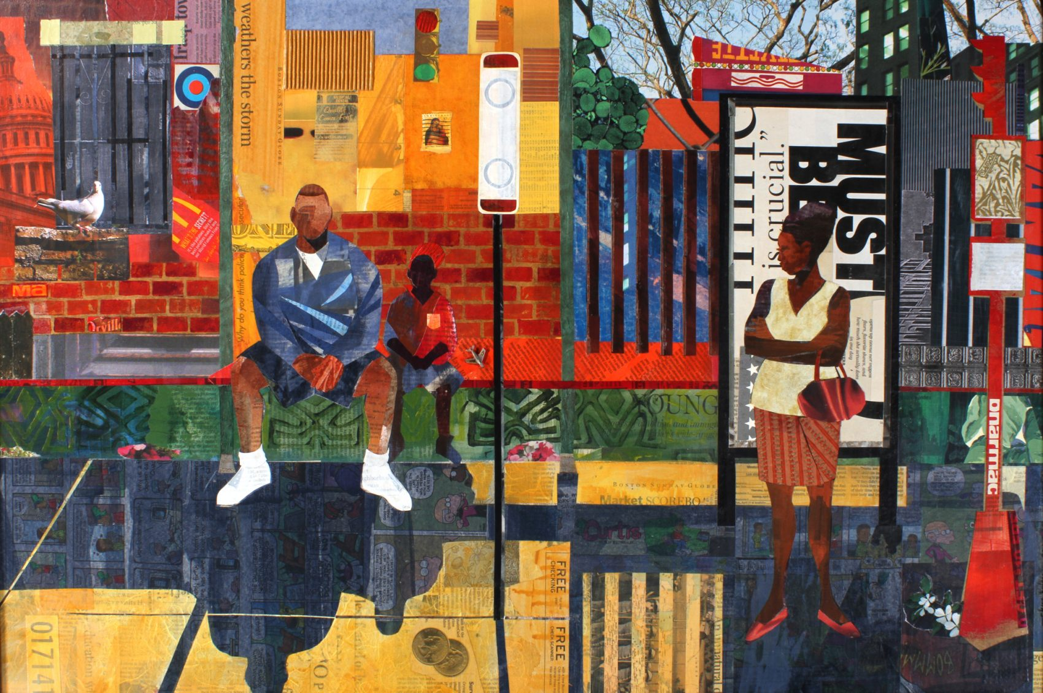
“Bus Stop” by Roxbury artist Ekua Holmes is
76.2 cm
by
50.8 cm.
What is the area of this piece?
5.NBT.B7

Slide 16
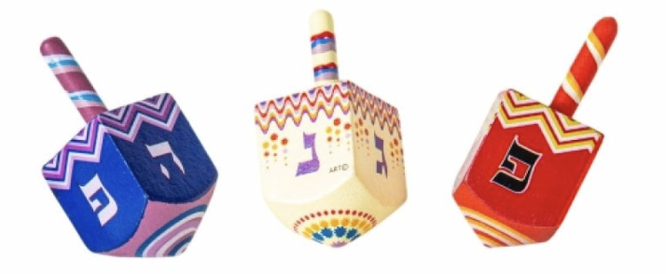
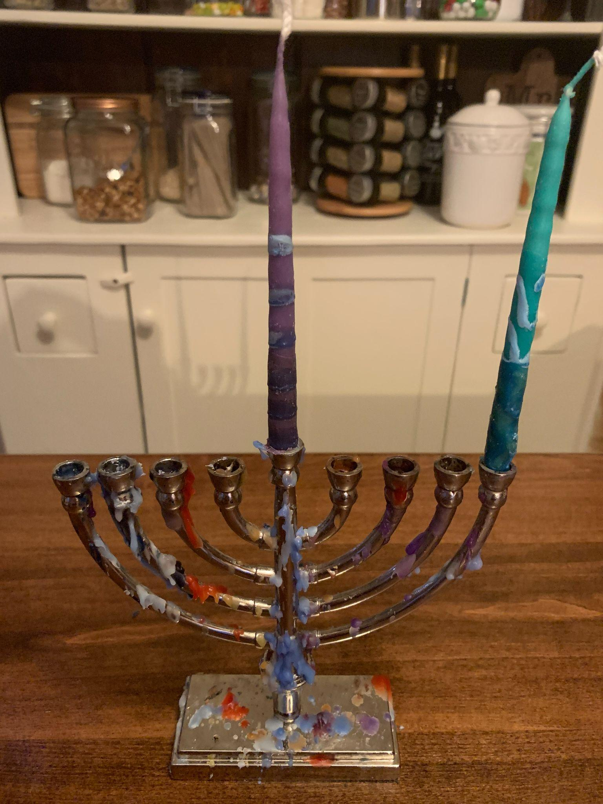
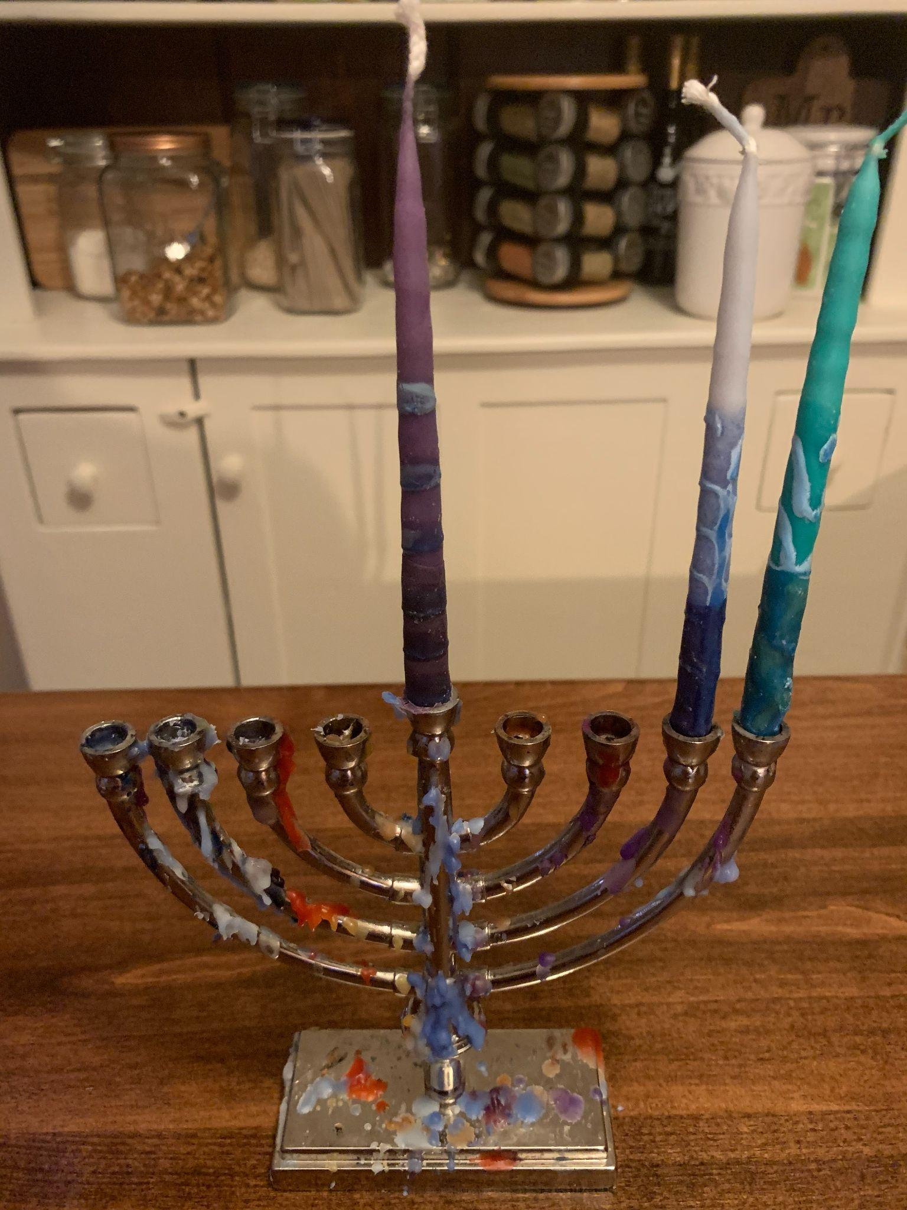
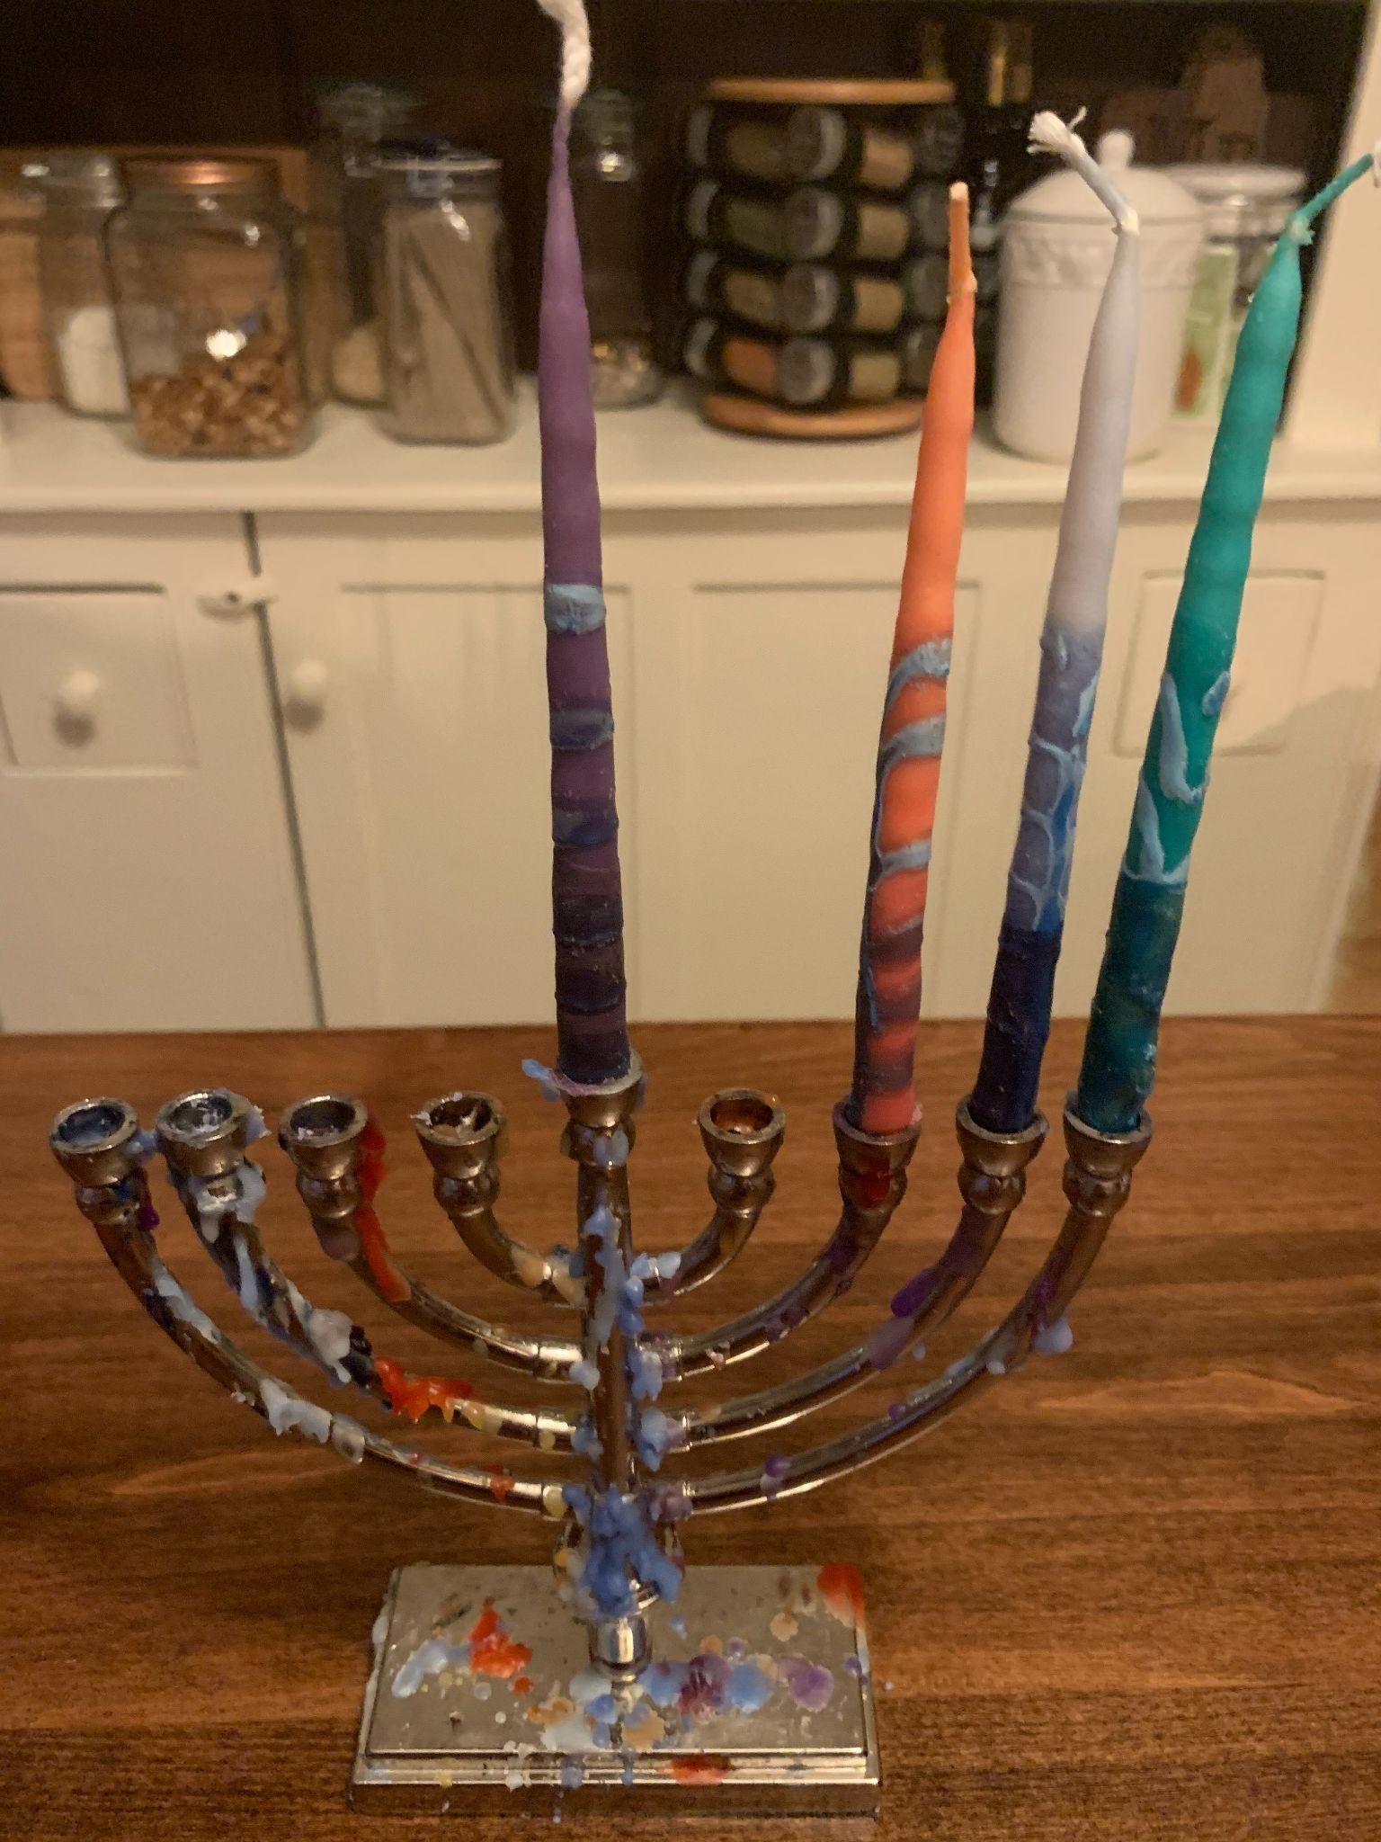
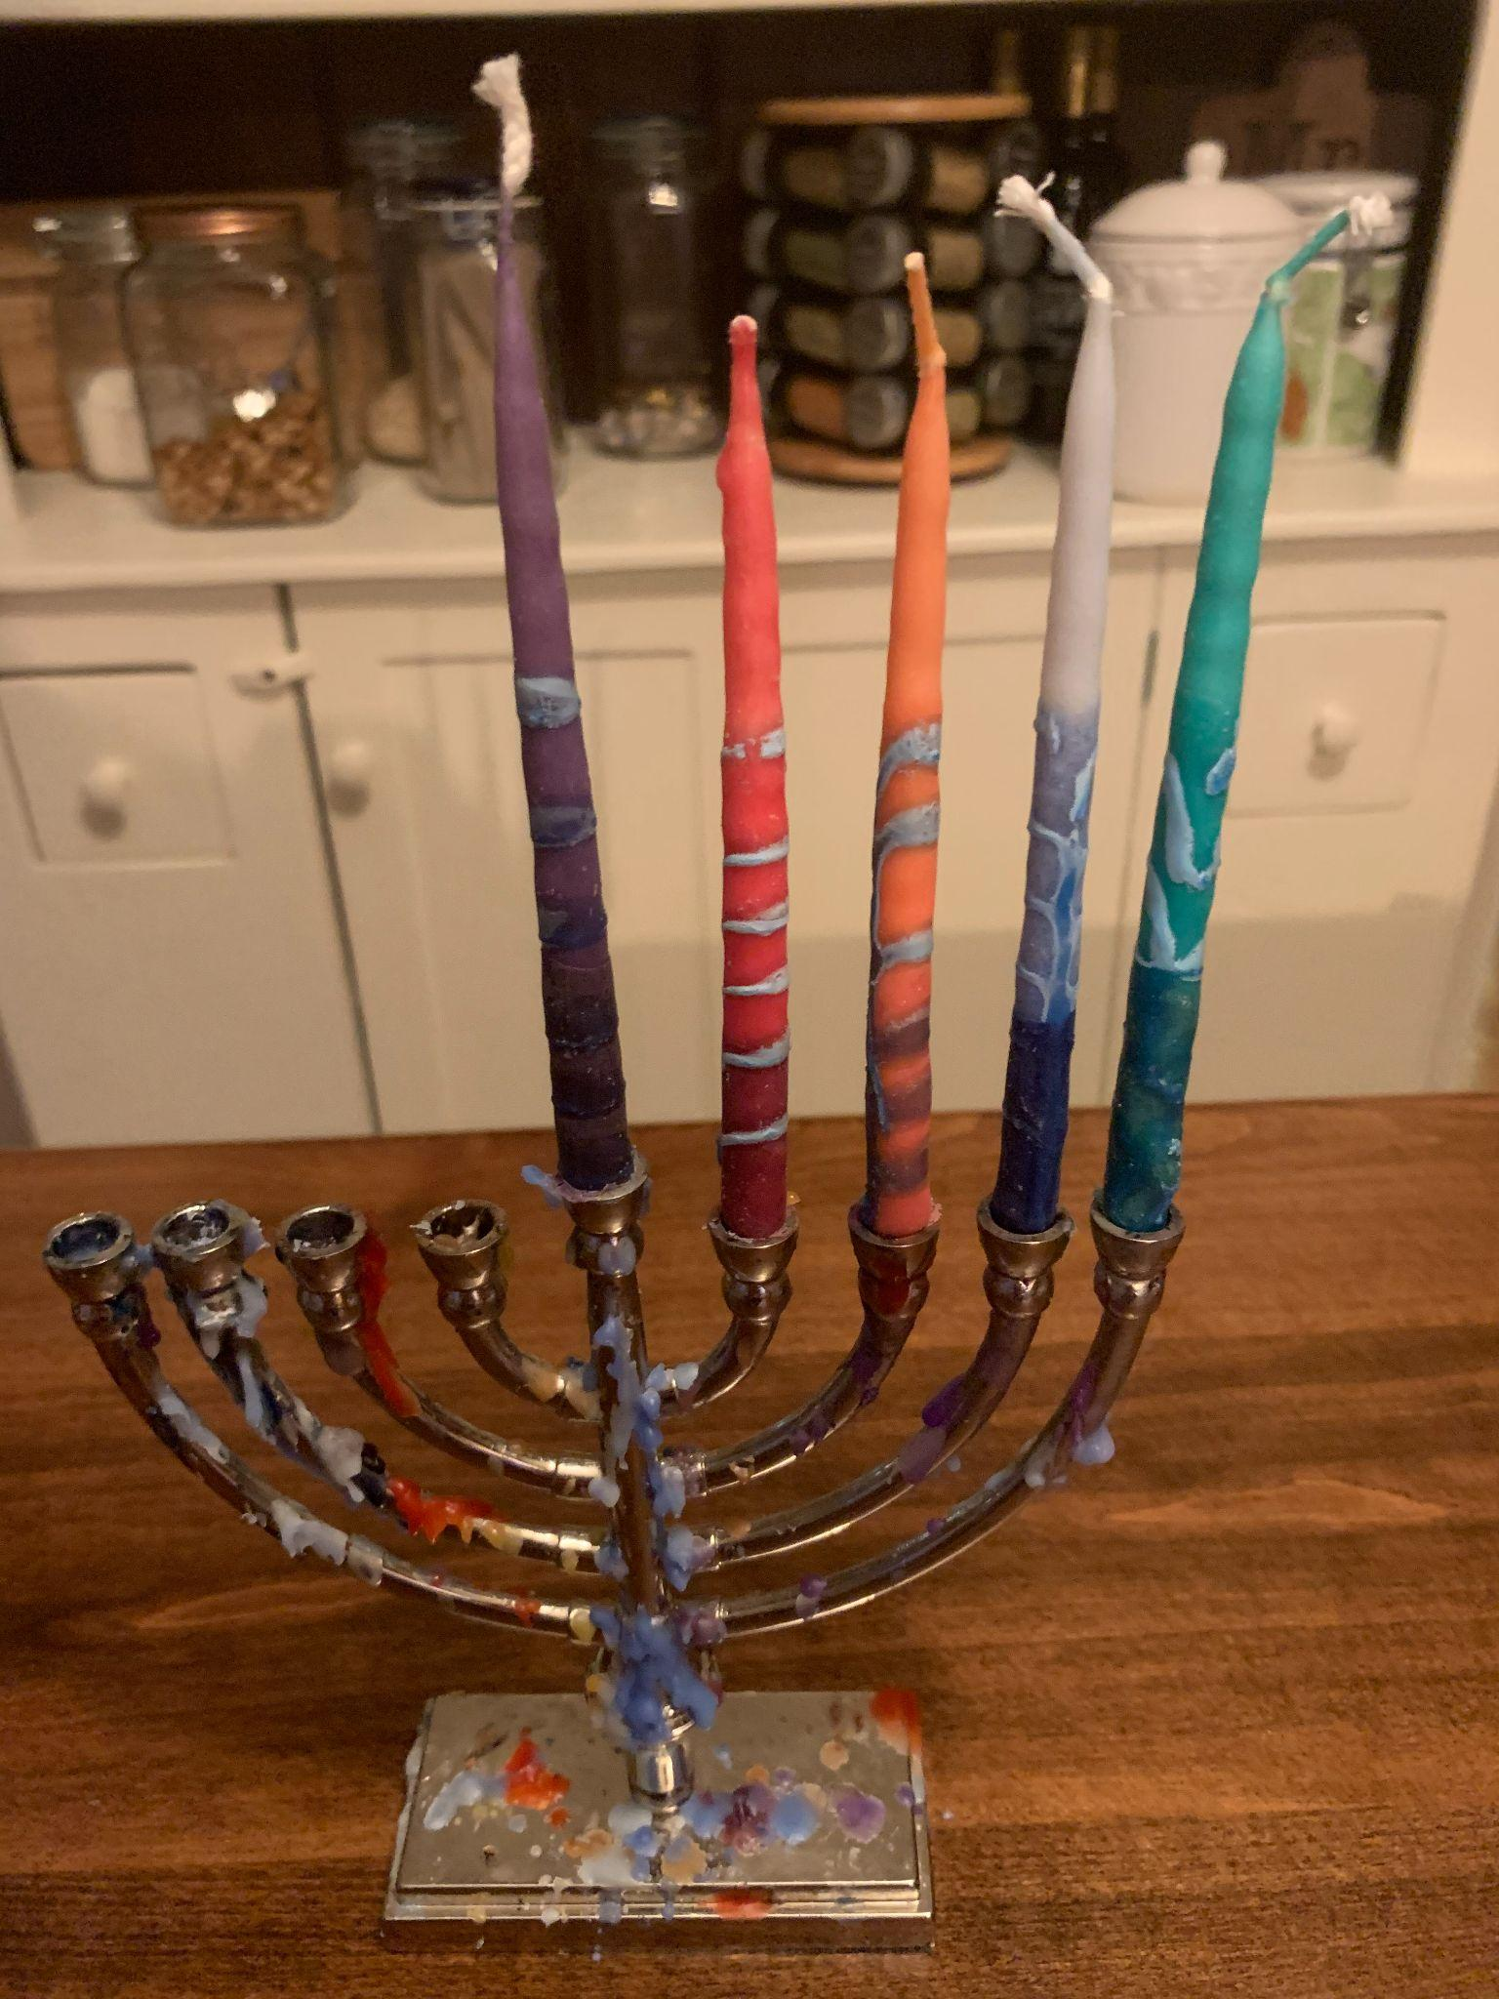
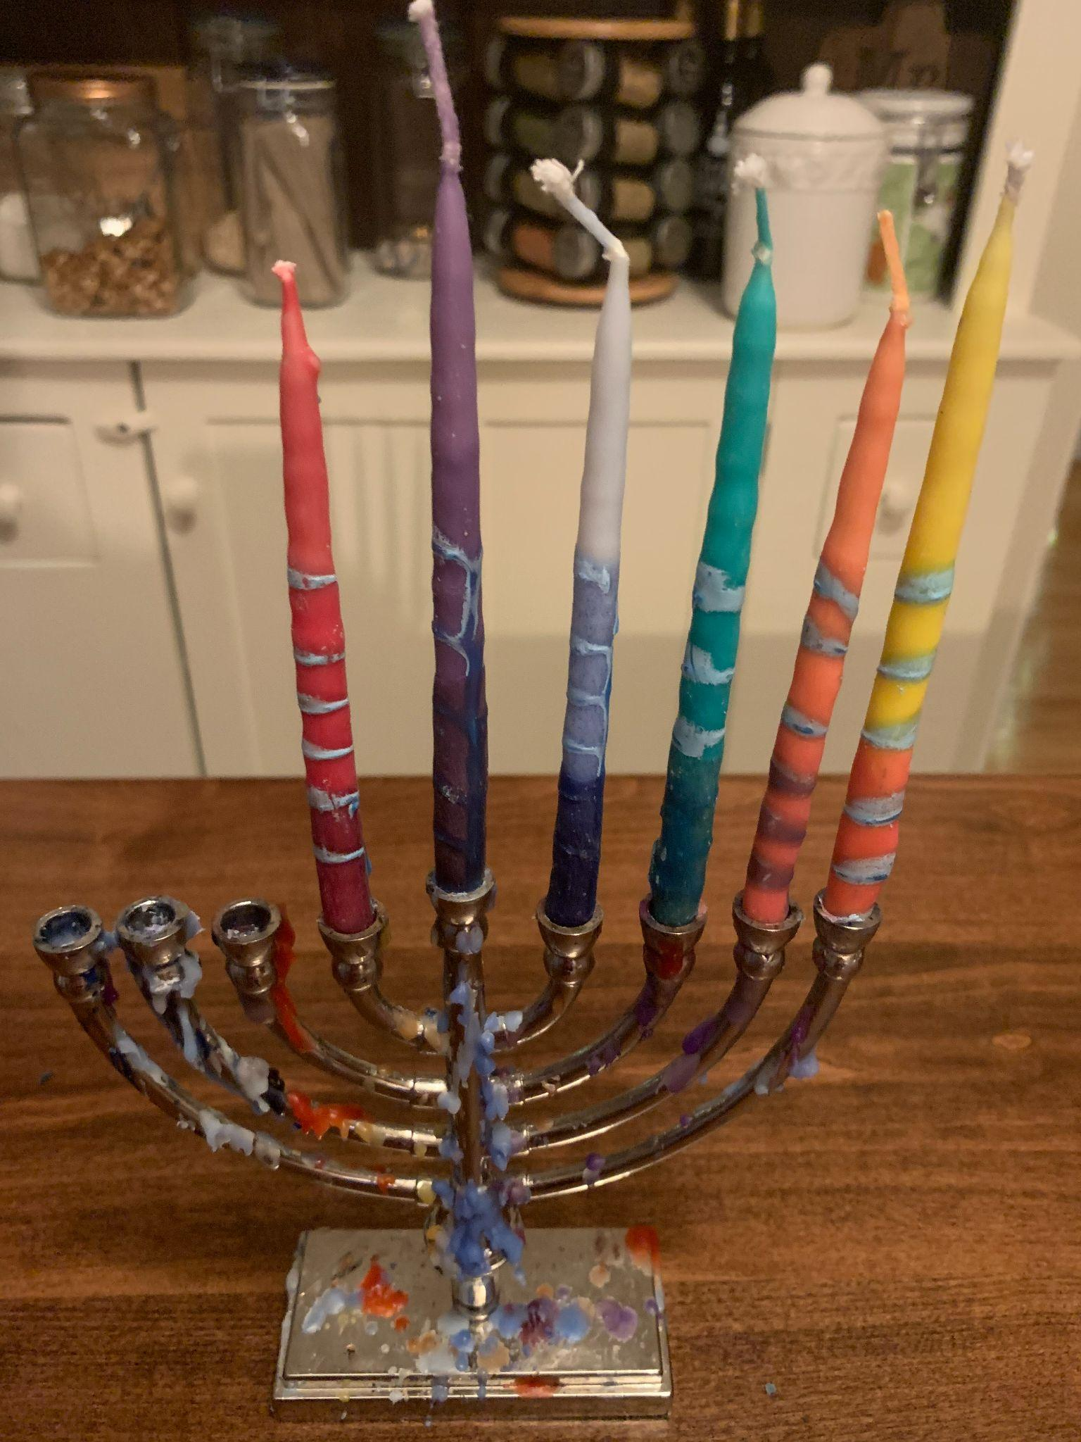
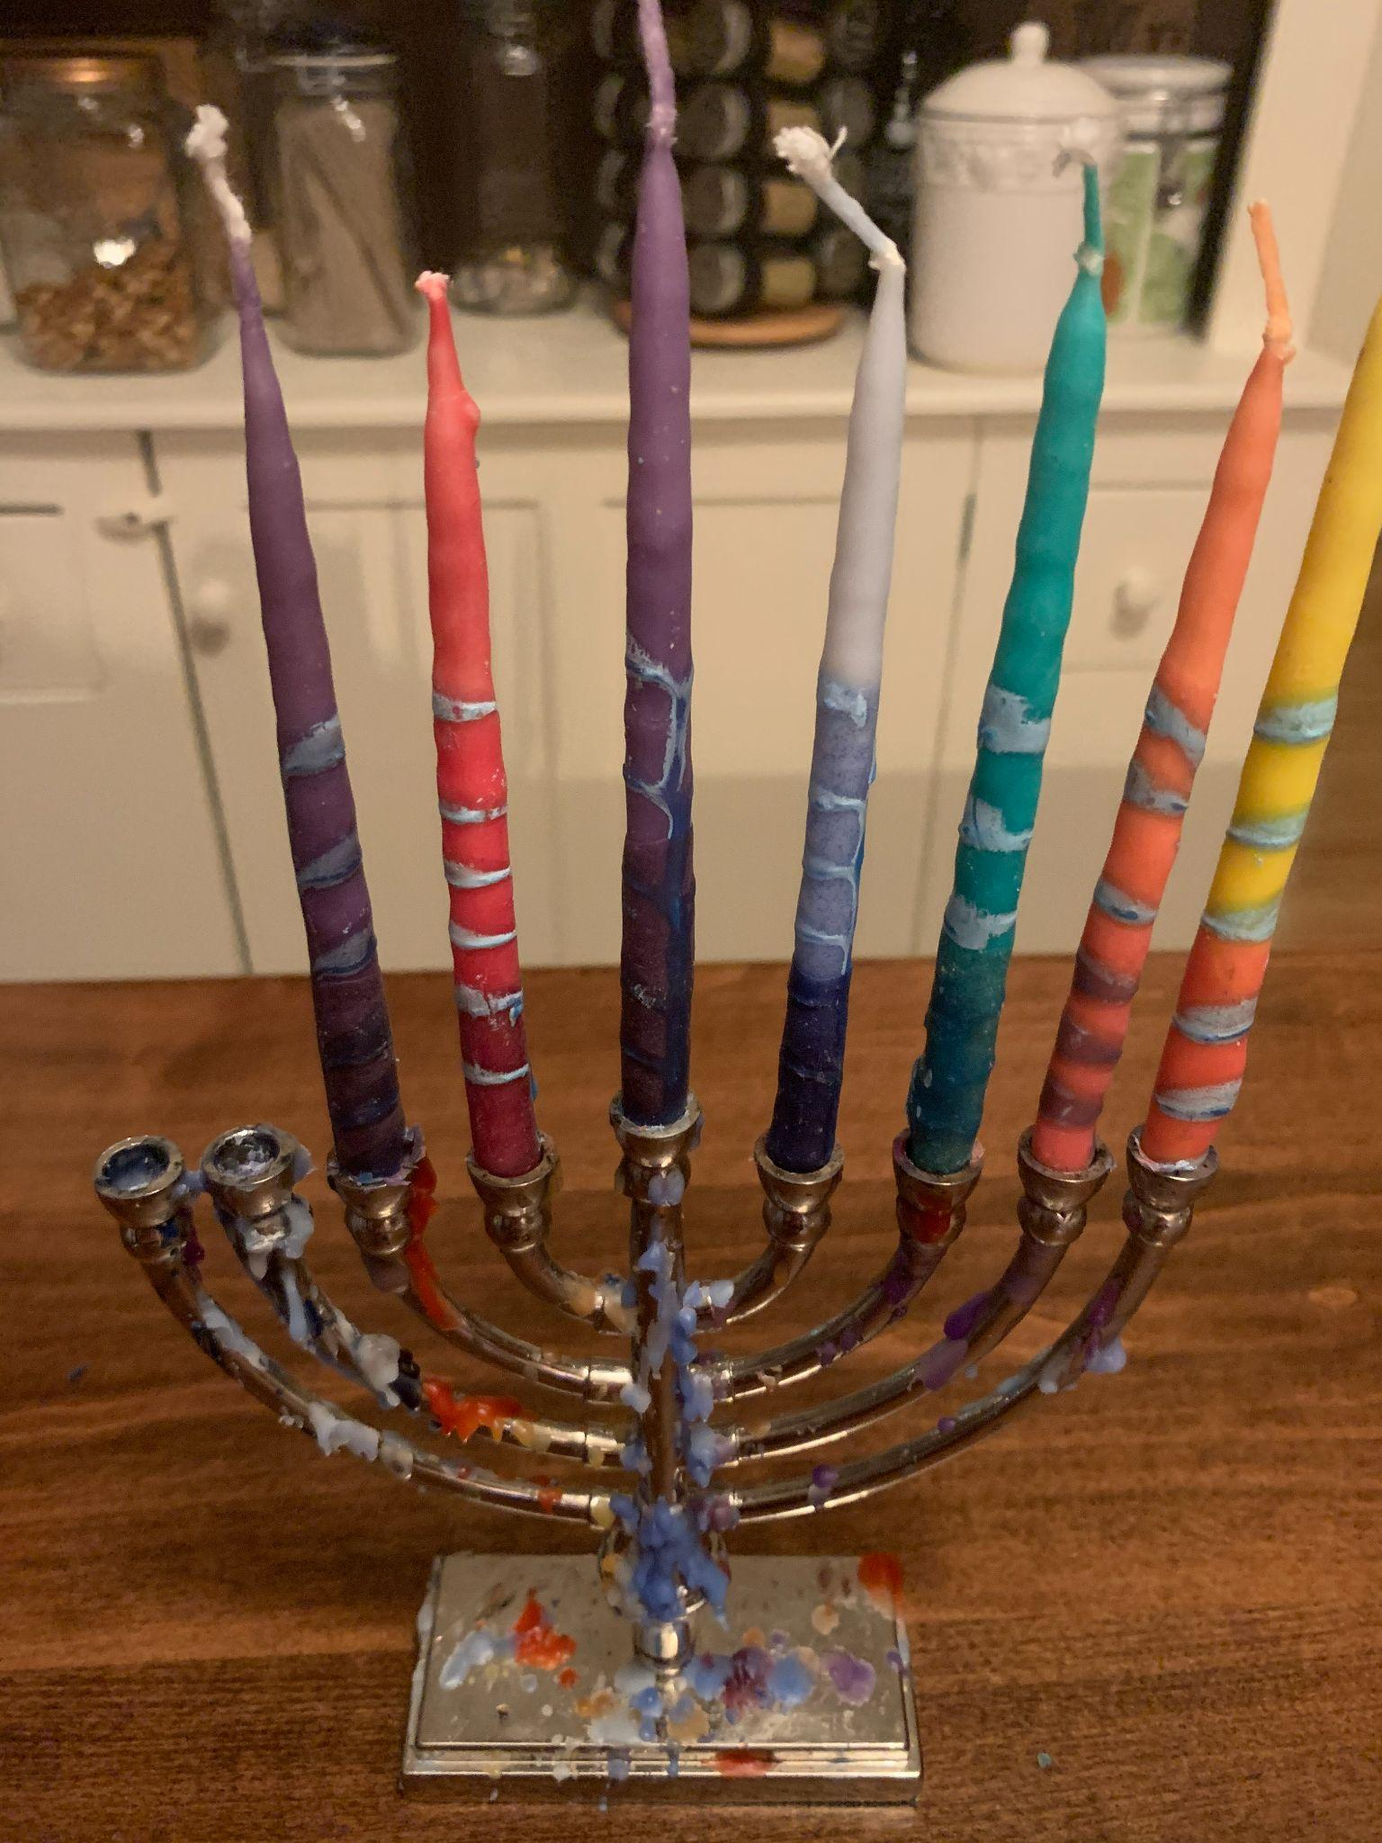
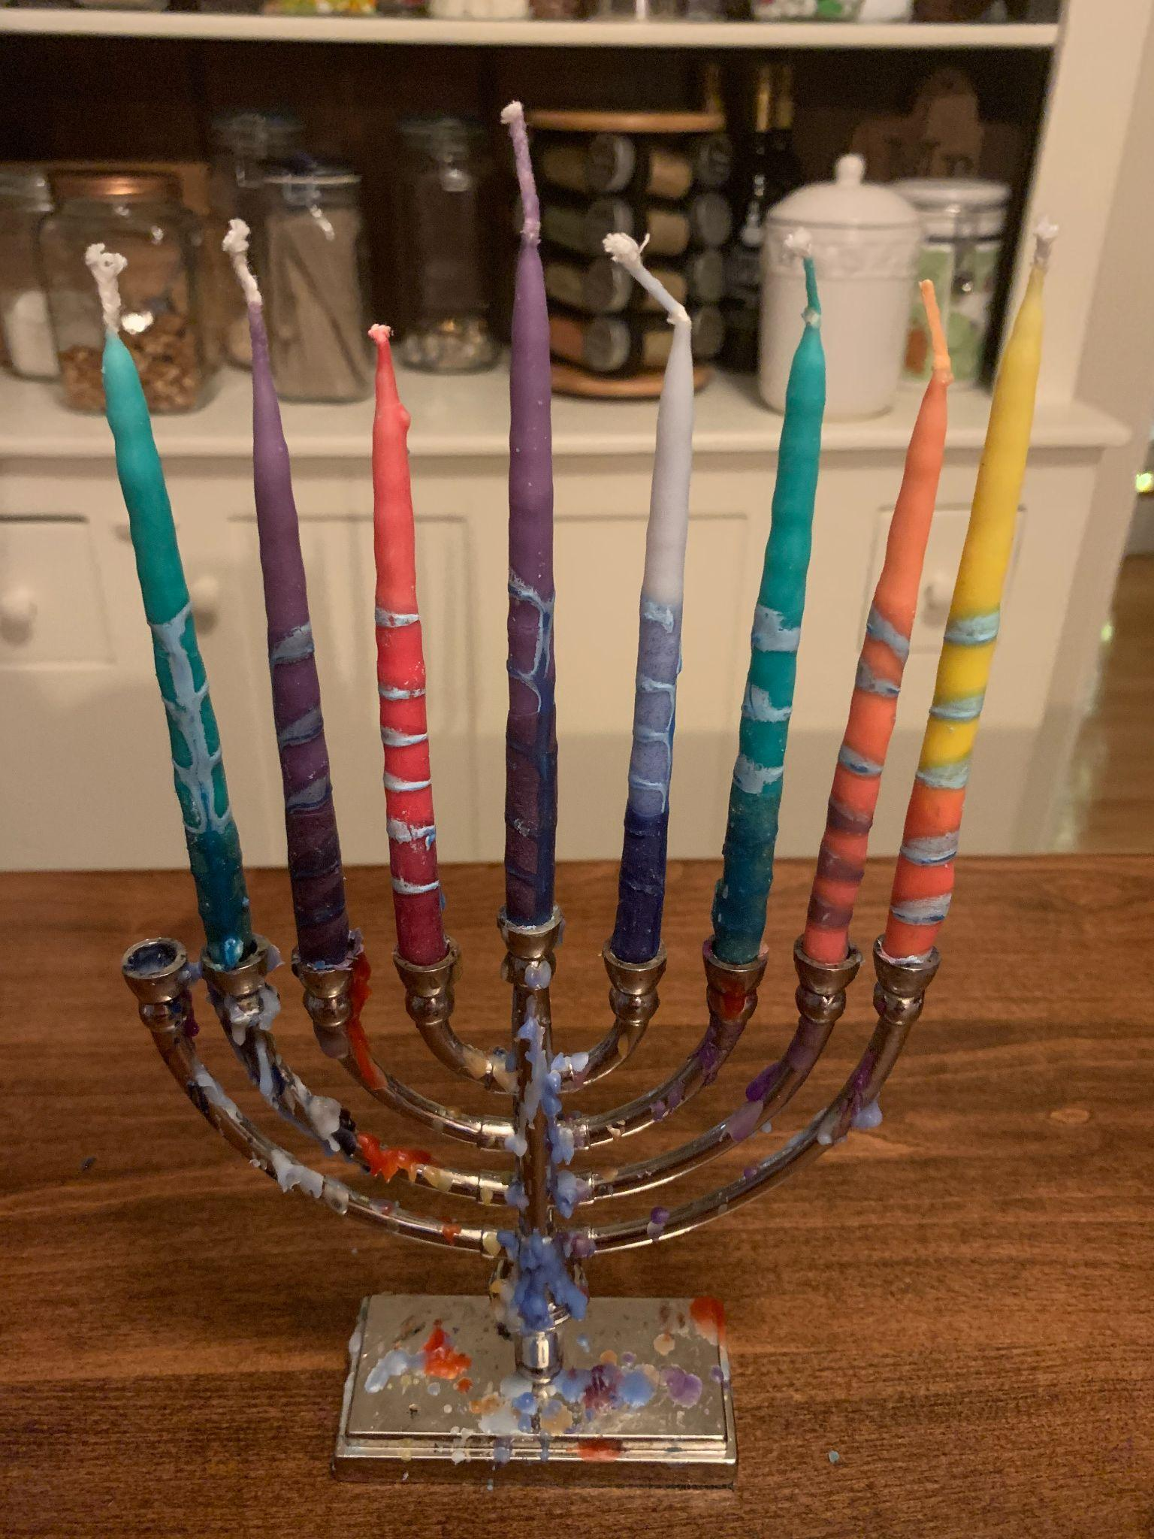
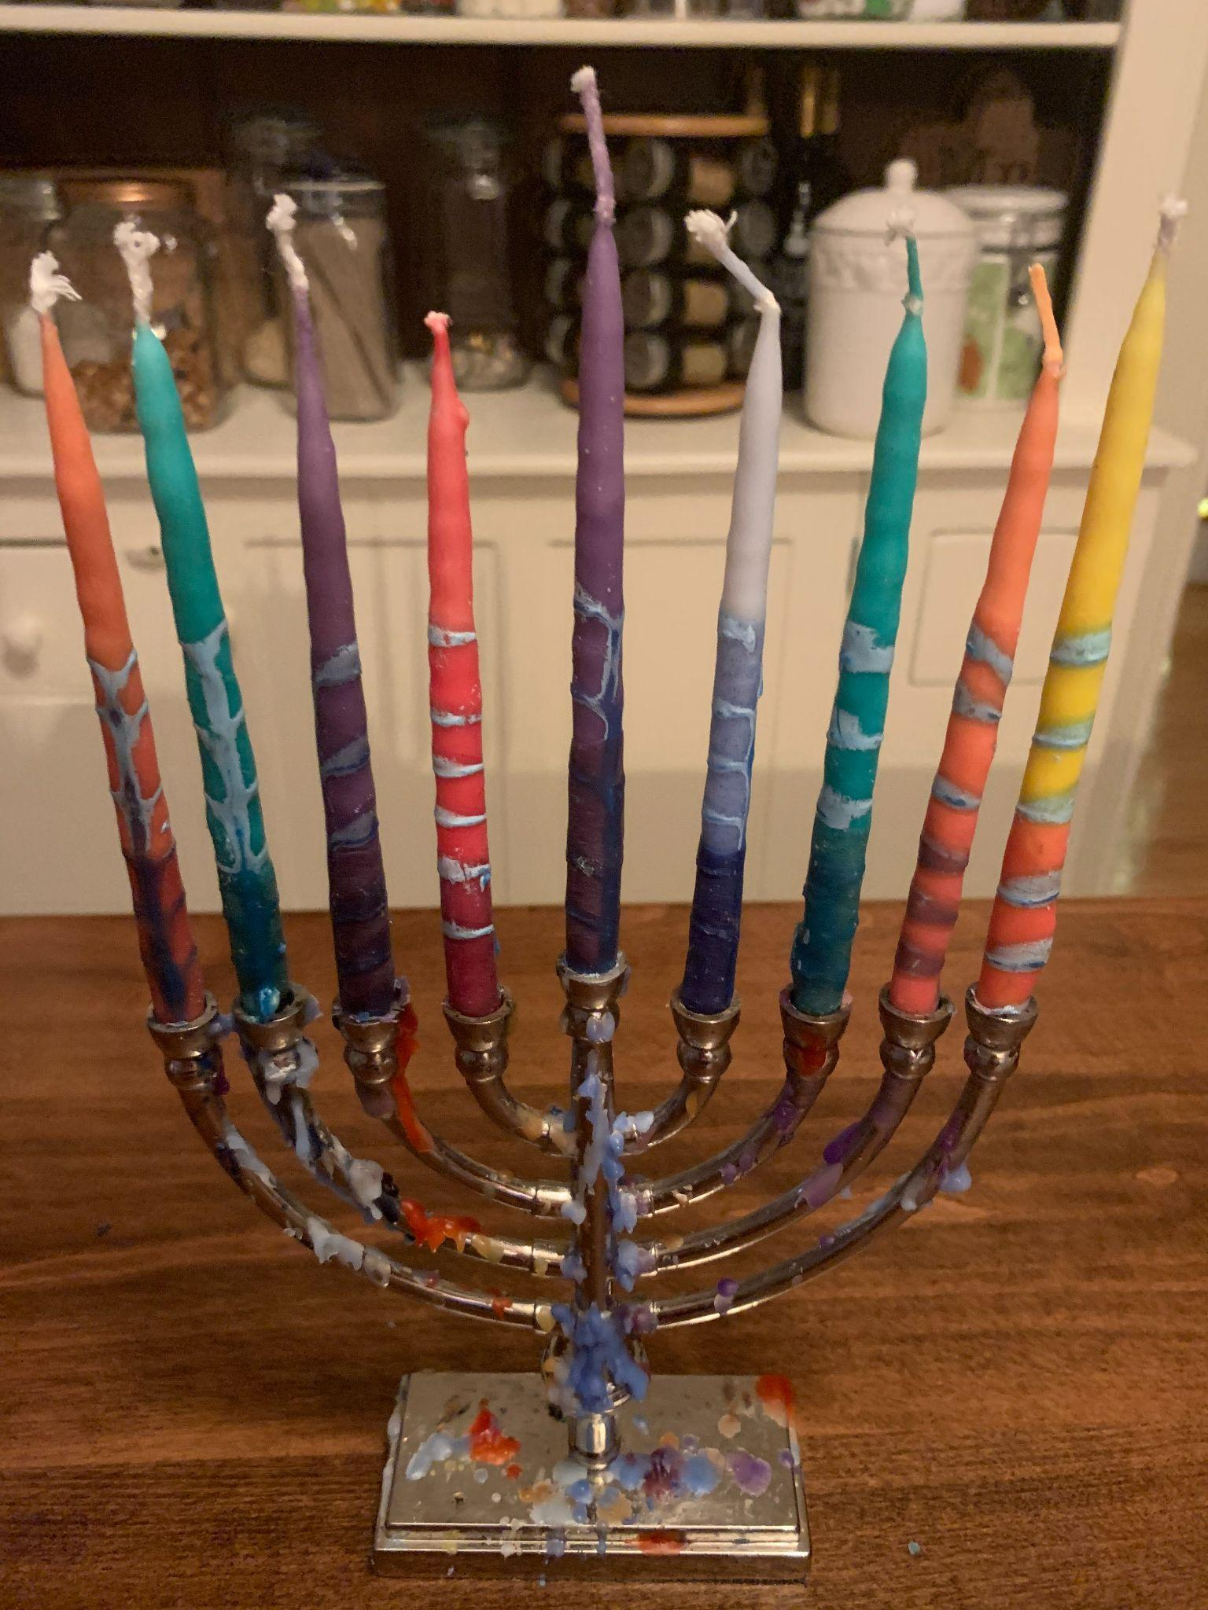
Happy Hanukkah!
Day 1
Day 2
Day 3
Day 4
Hanukkah is celebrated for 8 nights.
Each night when we light the Menorah we add one more candle.
On the first night we light 2 candles, the Shamash and the 1st candle. The second night we light 3, and so on.
How many candles do we need for all 8 nights?
Day 5
Day 6
Day 7
Day 8
5.OA.B3
Notes:
Week of December 19, 2022
Hanukkah

Slide 17
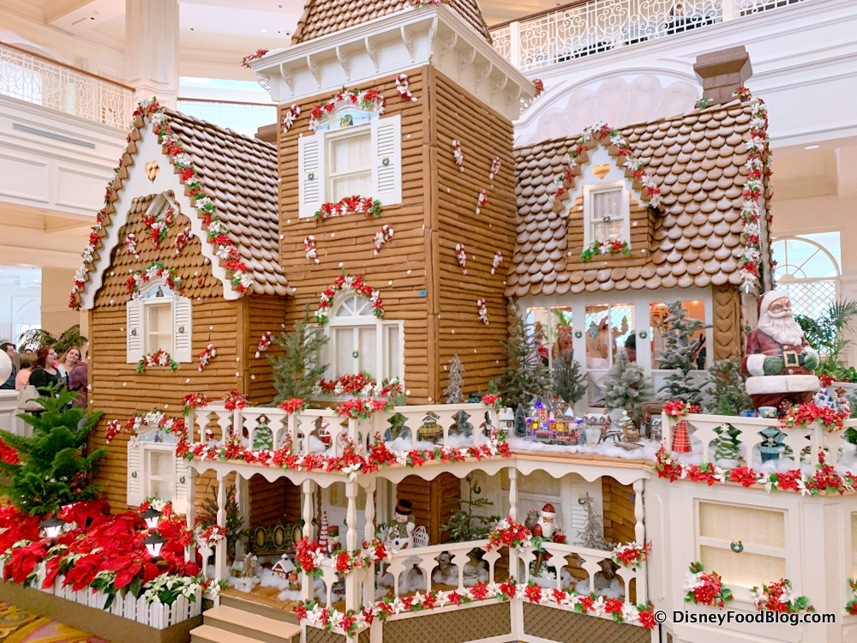
What do you think the DIMENSIONS of this giant gingerbread house are at The Floridian Resort in Disney?
Estimate the VOLUME!
Estimate how many bakers it took to create it!
5.MD.C5

Slide 18
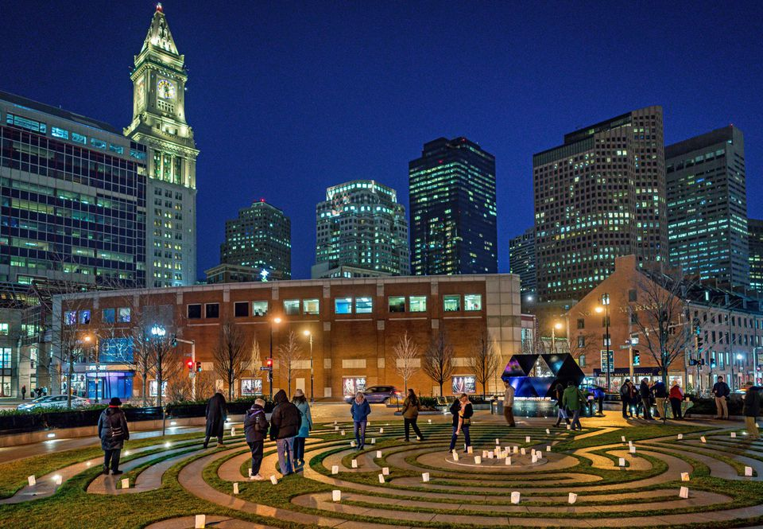
Today is the winter solstice!
It is the shortest day and the longest night of the year!
Today the sun rises at 7:10 AM and sets at 4:14 PM.
How many minutes of nighttime will we have tonight?
5.MD.A1
Notes:
December 21, 2022
Winter Solstice

Slide 19
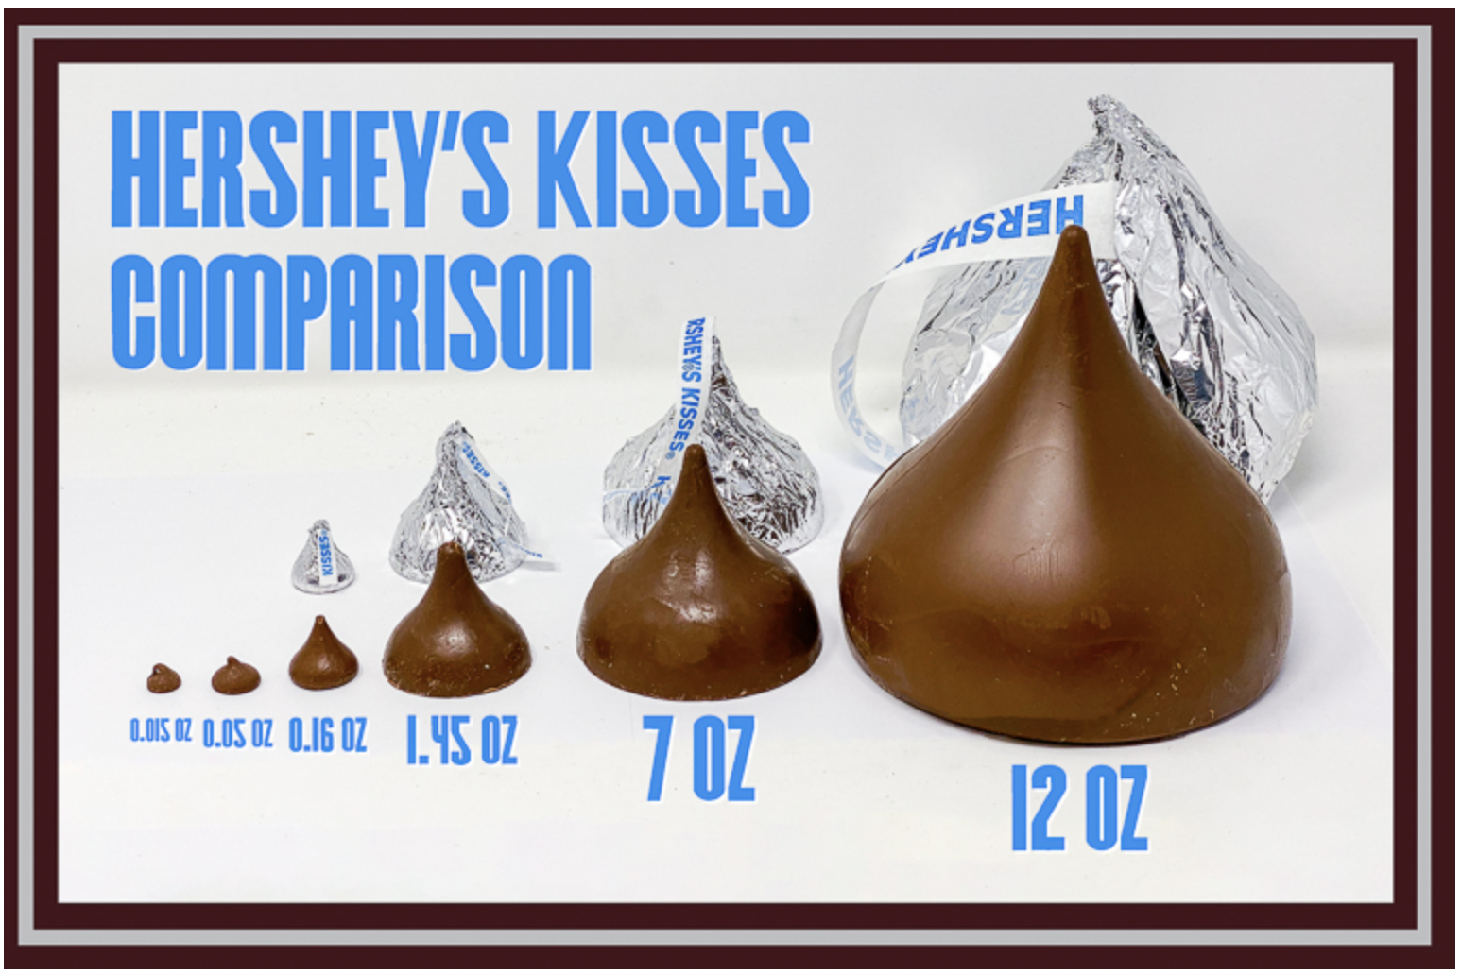
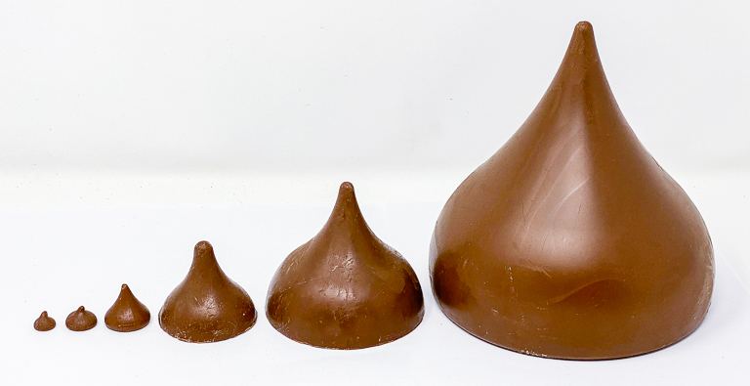
If the medium-sized kiss weighs 1.45 oz, estimate the weights of the other kisses!
1.45 oz.
5.NBT.B7

Slide 20

Happy Kwanzaa!
We light the Kinara for 7 nights.
On the first night we light 1 candle.
On the second night we light 2, and so on.
How many candles will we need for all 7 nights?
5.OA.B3

