Slide 1

It’s Cyber Monday!
American consumers spent $10,700,000,000 on Cyber Monday in 2021.
What is that number?
Do you think Americans will spend more or less in 2022?
Why?
4.NBT.A2
Notes:
Week of November 28, 2022

Slide 2
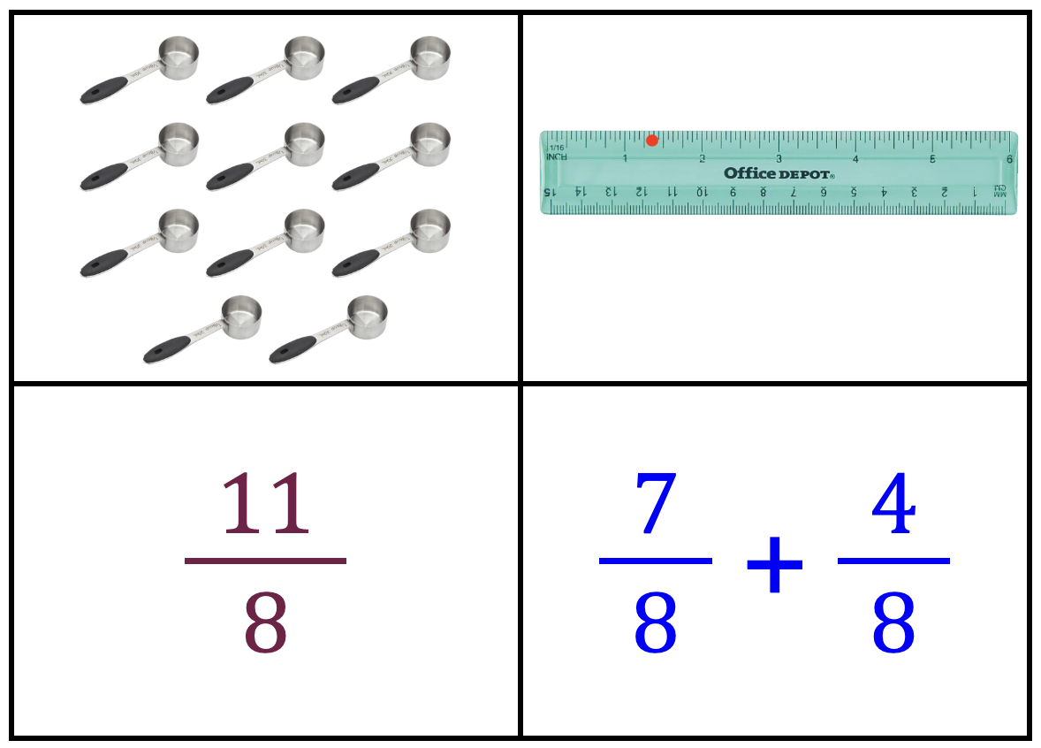
Which one does not belong?
4.NF.B3
Notes:
Top left: only model of 11 x one-eighth
Top right: only number line
Bottom left: only fraction
Bottom right: only expression

Slide 3
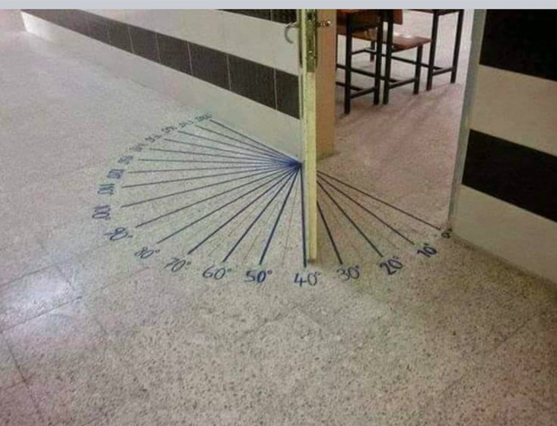
What can you say about this door?
What measurement would you typically use to enter the room?
What if the door opened INTO the classroom?
4.MD.C5

Slide 4
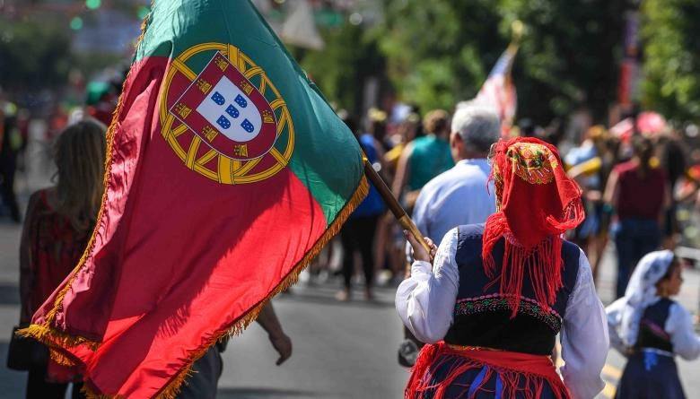
It’s Independence Day in Portugal!
On this day in 1668 Portugal gained independence from Spain.
How long ago was that?
How can we use mental math to figure it out?
4.NBT.B4

Slide 5
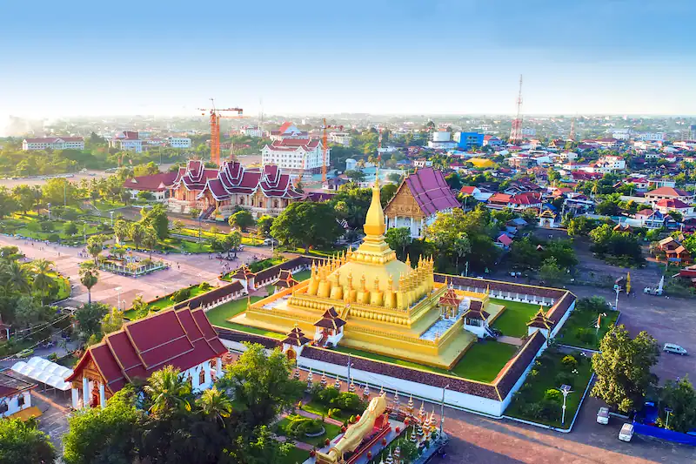
It’s National Day in Laos!
Laos is a beautiful country in Southeast Asia.
The current population of Laos is 7,529,884.
What do we notice about this number?
How many thousands are in this number?
4.NBT.A2

Slide 6
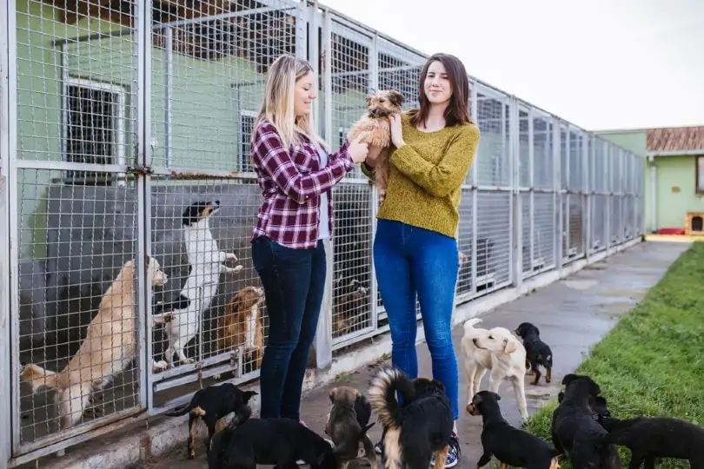
Today is Shelter Pets Day!
In 2021
1,987,325 dogs and 2,516,750 cats were adopted into wonderful families.
How many pets is that altogether?
How many more cats than dogs were adopted?
4.NBT.B4
Notes:
Week of December 5, 2022
Shelter Pets Day

Slide 7
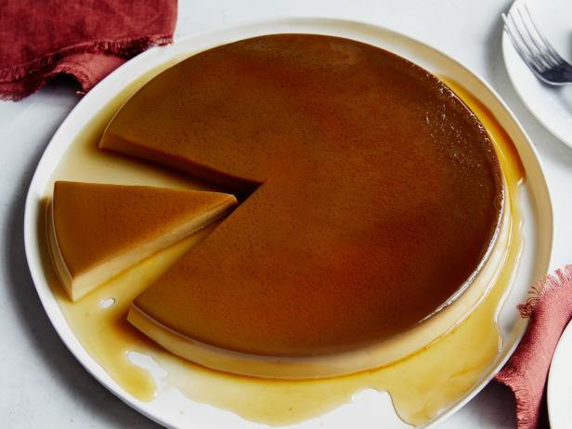
It is Constitution Day in Spain!
Flan is one of Spain’s most delicious desserts.
About what fraction of the flan is cut out?
What fraction remains?
4.NF.A1
Notes:
December 6, 2022
Constitution Day ~ Spain

Slide 8
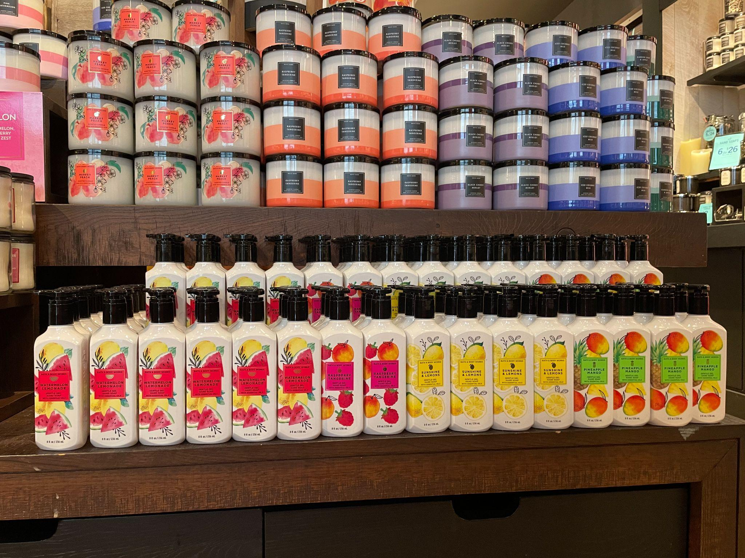
How can we use arrays to figure out how many candles are here?
How many bottles of lotion are on display?
4.NBT.B5

Slide 9
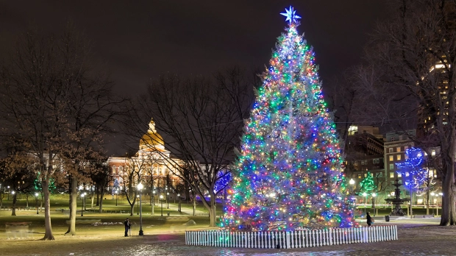
The tree on Boston Common, an annual gift from Nova Scotia, weighs approximately 900 pounds.
What are some factor pairs of 900?
4.OA.B4

Slide 10
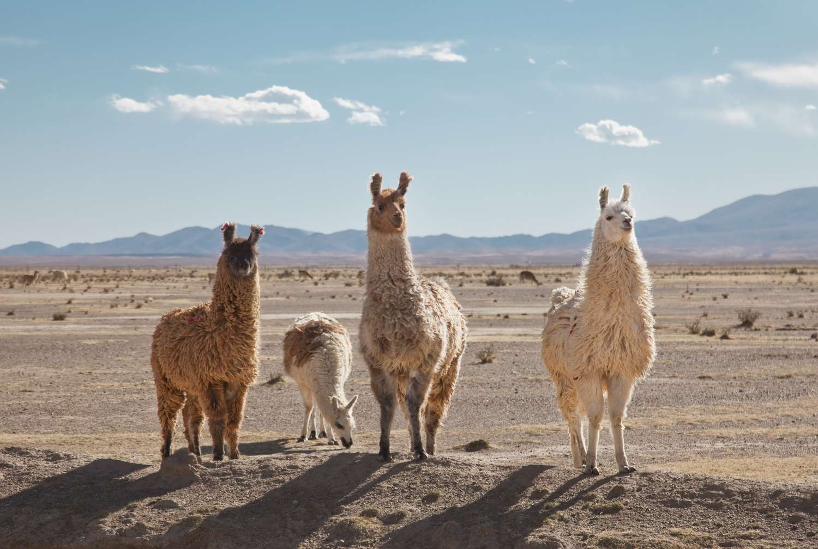
It’s International Llama Day!
A llama can weigh between 290 and 440 pounds.
Together these four llamas weigh 1495 pounds.
What is possible?
4.OA.B3
Notes:
December 9, 2022
International Llama Day

Slide 11
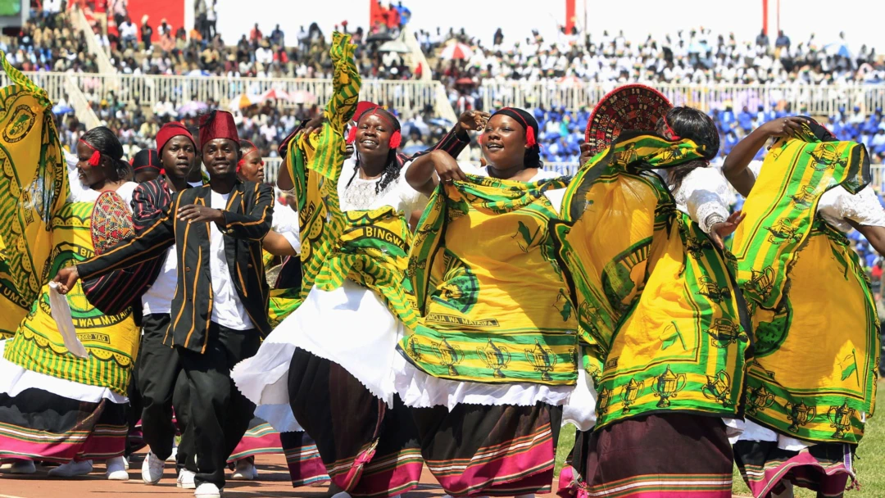
It’s Independence (Jamhuri) Day in Kenya!
On this day in 1964 Kenya became a republic!
How long ago was that?
Is that surprising to you?
4.NBT.B4
Notes:
Week of December 12, 2022
Jamhuri Day (Kenya)

Slide 12
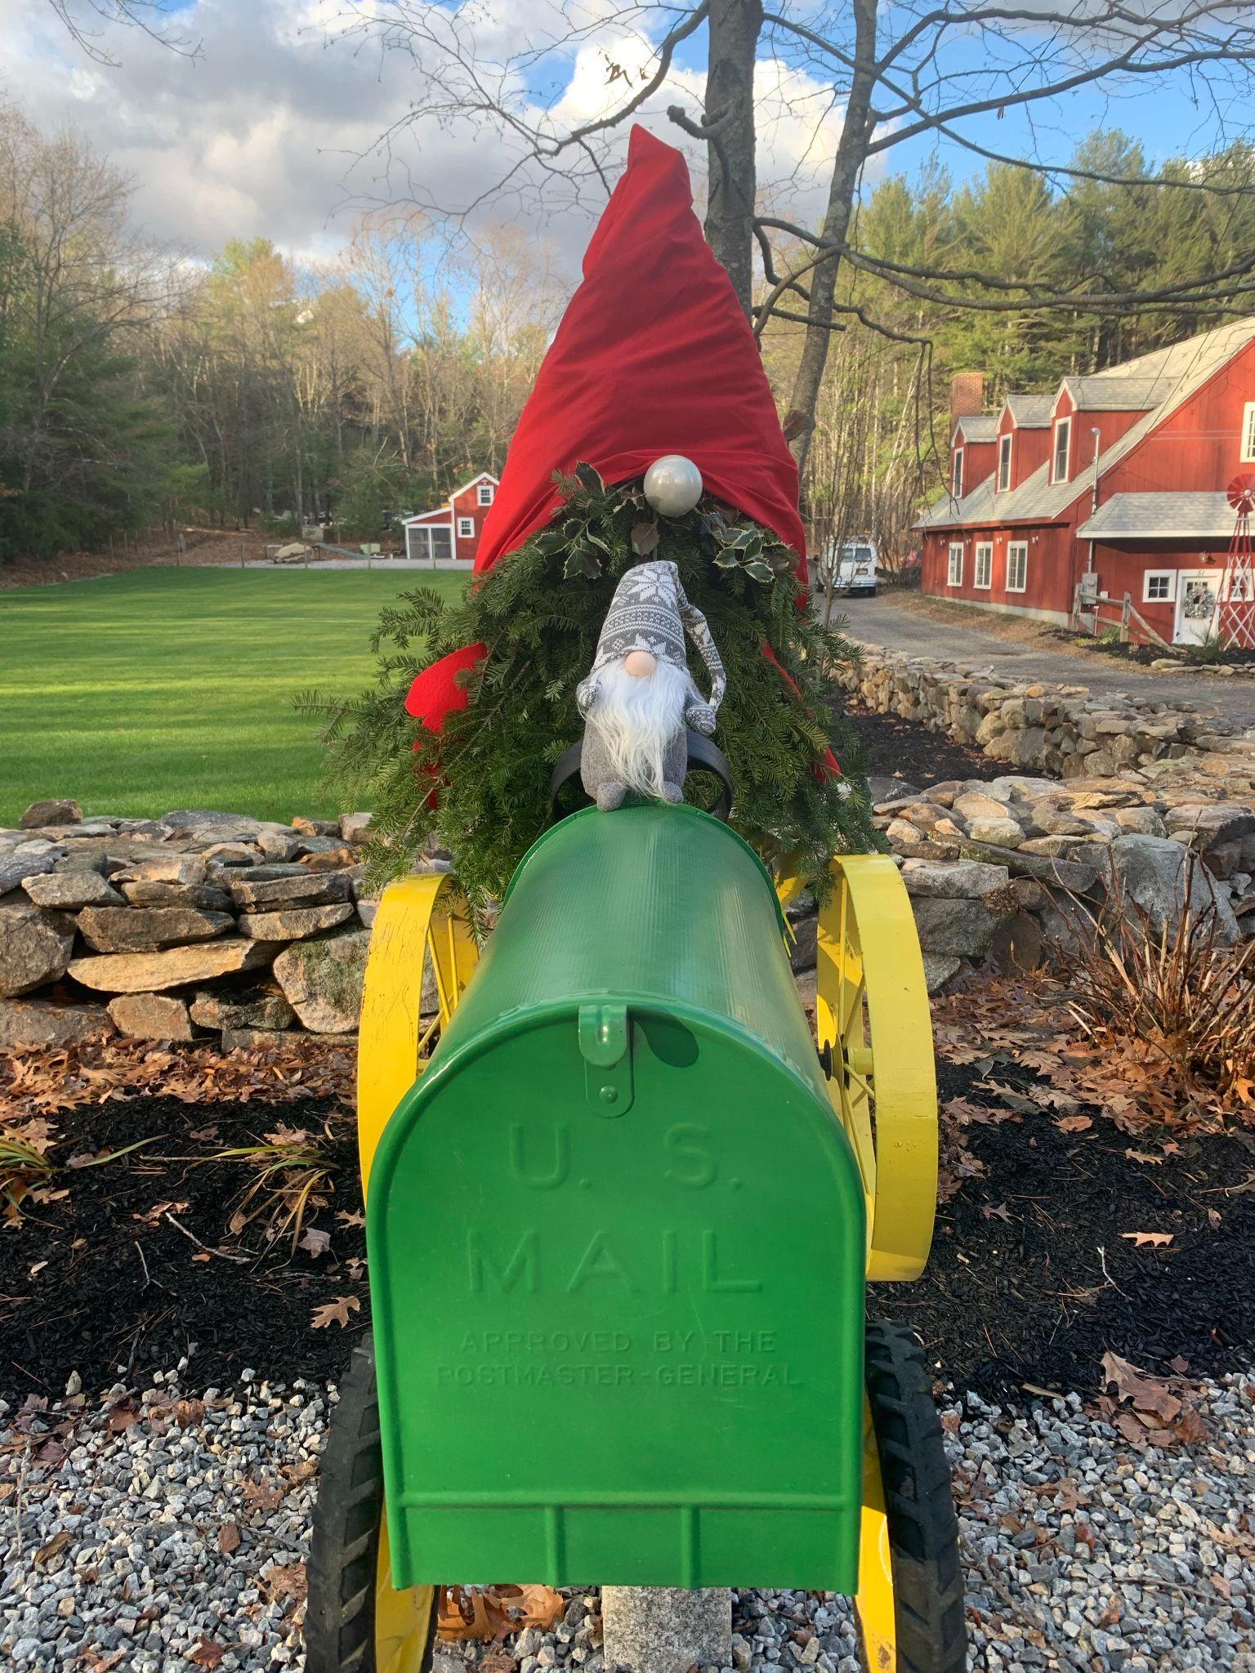
It’s gnome season again!
About what fraction of the larger gnome (with the red hat) is Al (the small gray gnome).
If Al is 25 cm, how tall might the other gnome be?
4.NF.A2

Slide 13
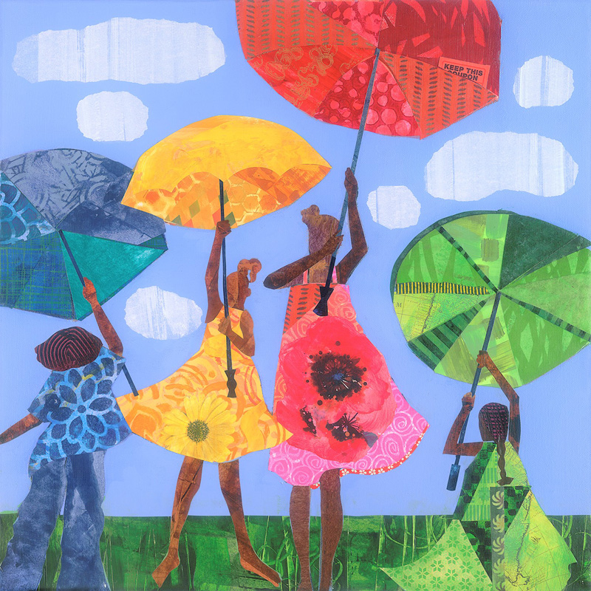
Where do we see fractions in “Flowers” by local artist Ekua Holmes?
What can we say about the partitions?
4.NF.A1

Slide 14
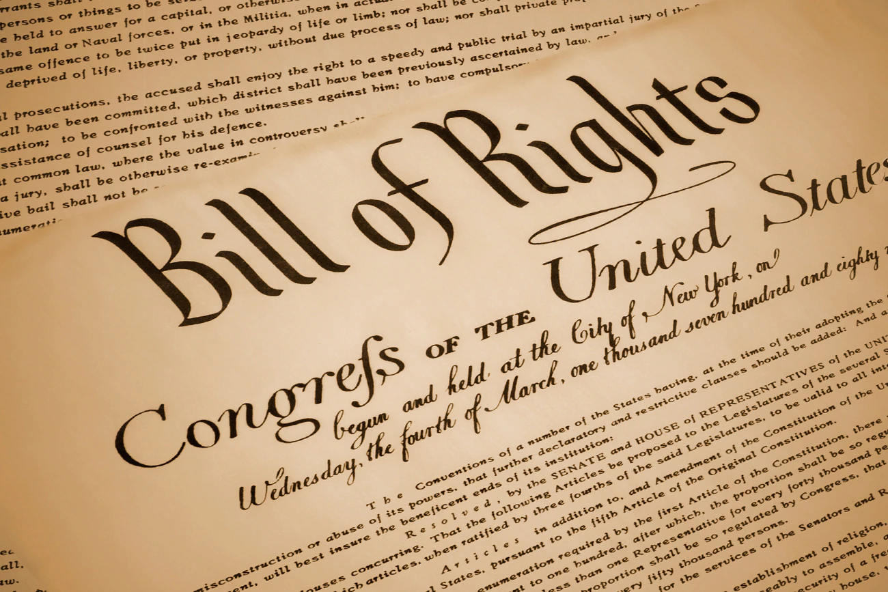
Today is Bill of Rights Day
The first amendments to the Constitution were ratified on December 15, 1791.
The 10 amendments protect the most basic rights of Americans, known as the Bill of Rights. It consists of notions like freedom of speech, freedom of religion, freedom of the press, the right to protest, and equal protection under the law.
How long ago was 1791?
4.NBT.B4
Notes:
December 15, 2022
Bill of Rights Day

Slide 15
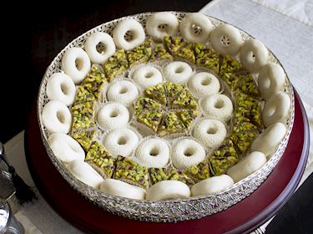
Where do we see elements of geometry in these pastries from Morocco?
Look closely at the center of this dish.
What do we notice?
Do we see fractions?
4.G.A3

Slide 16
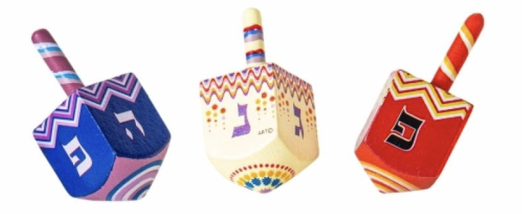
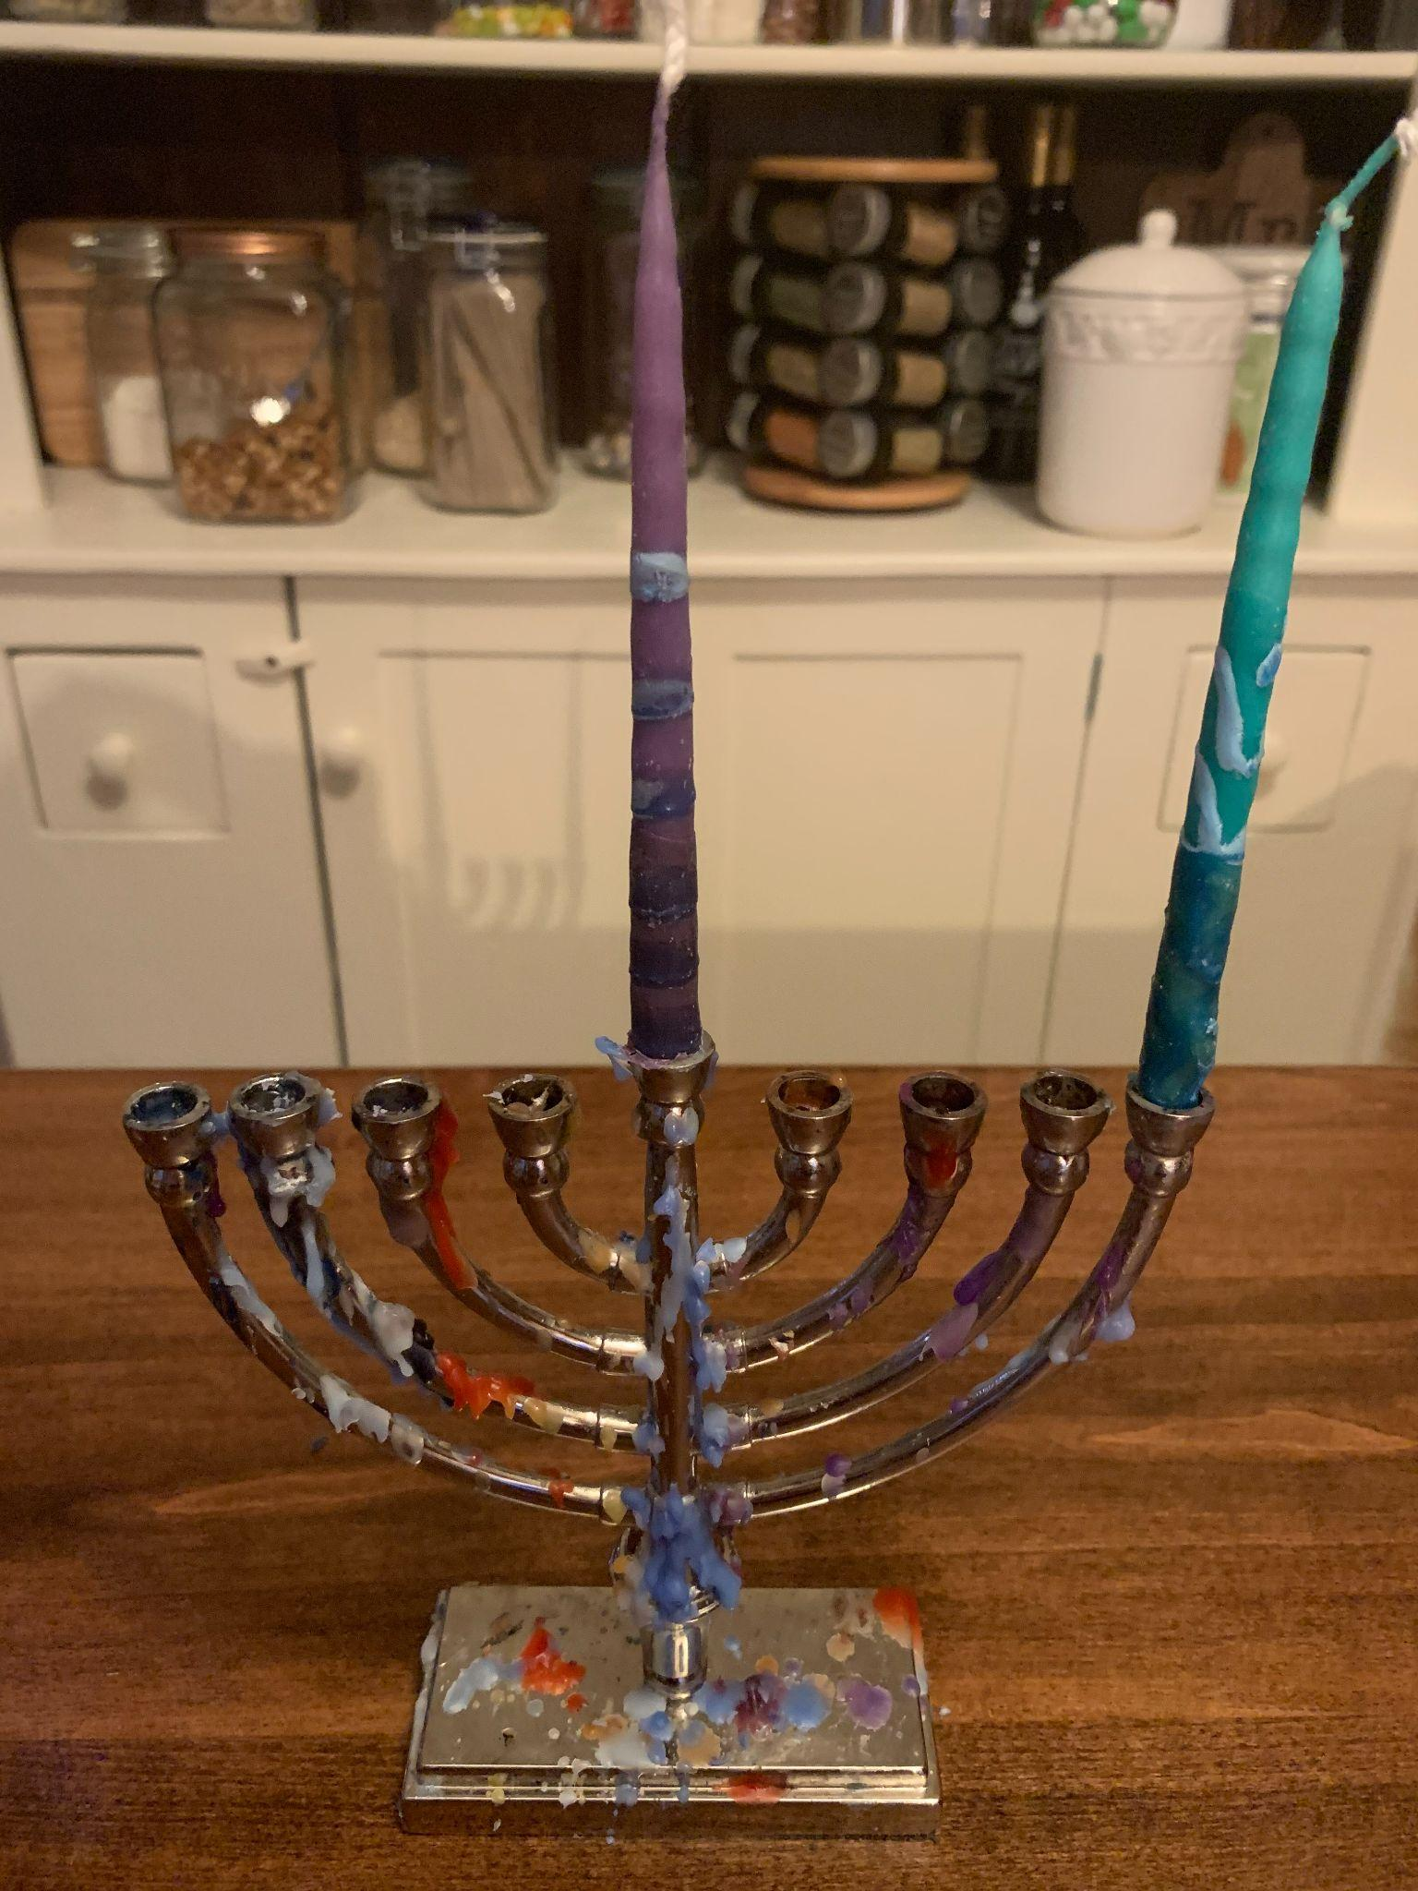
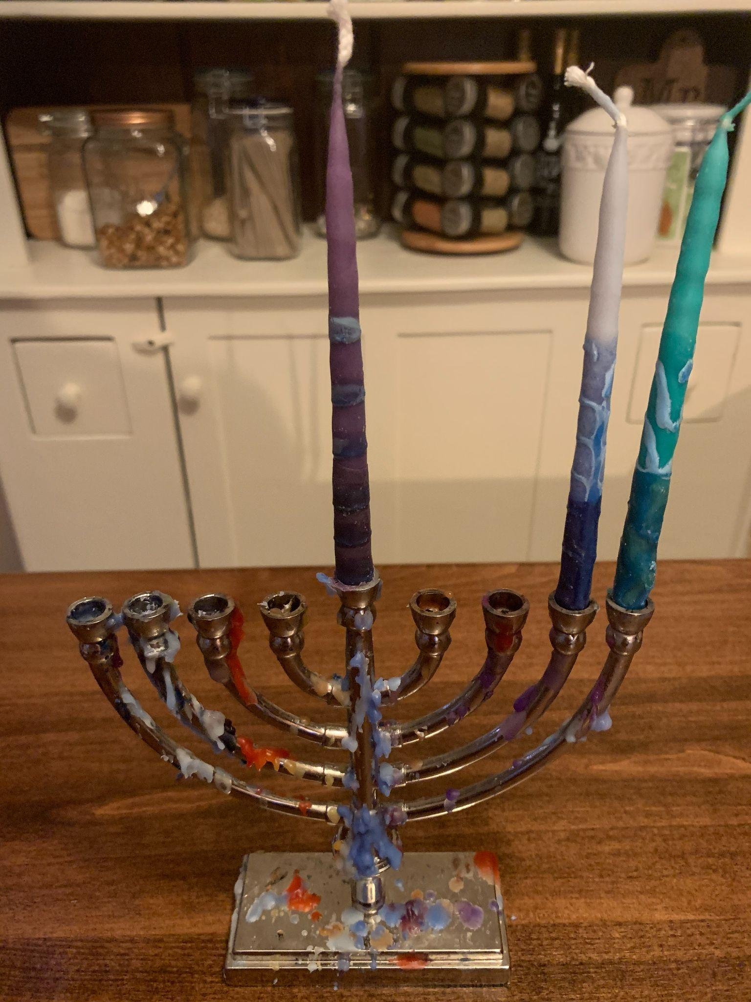
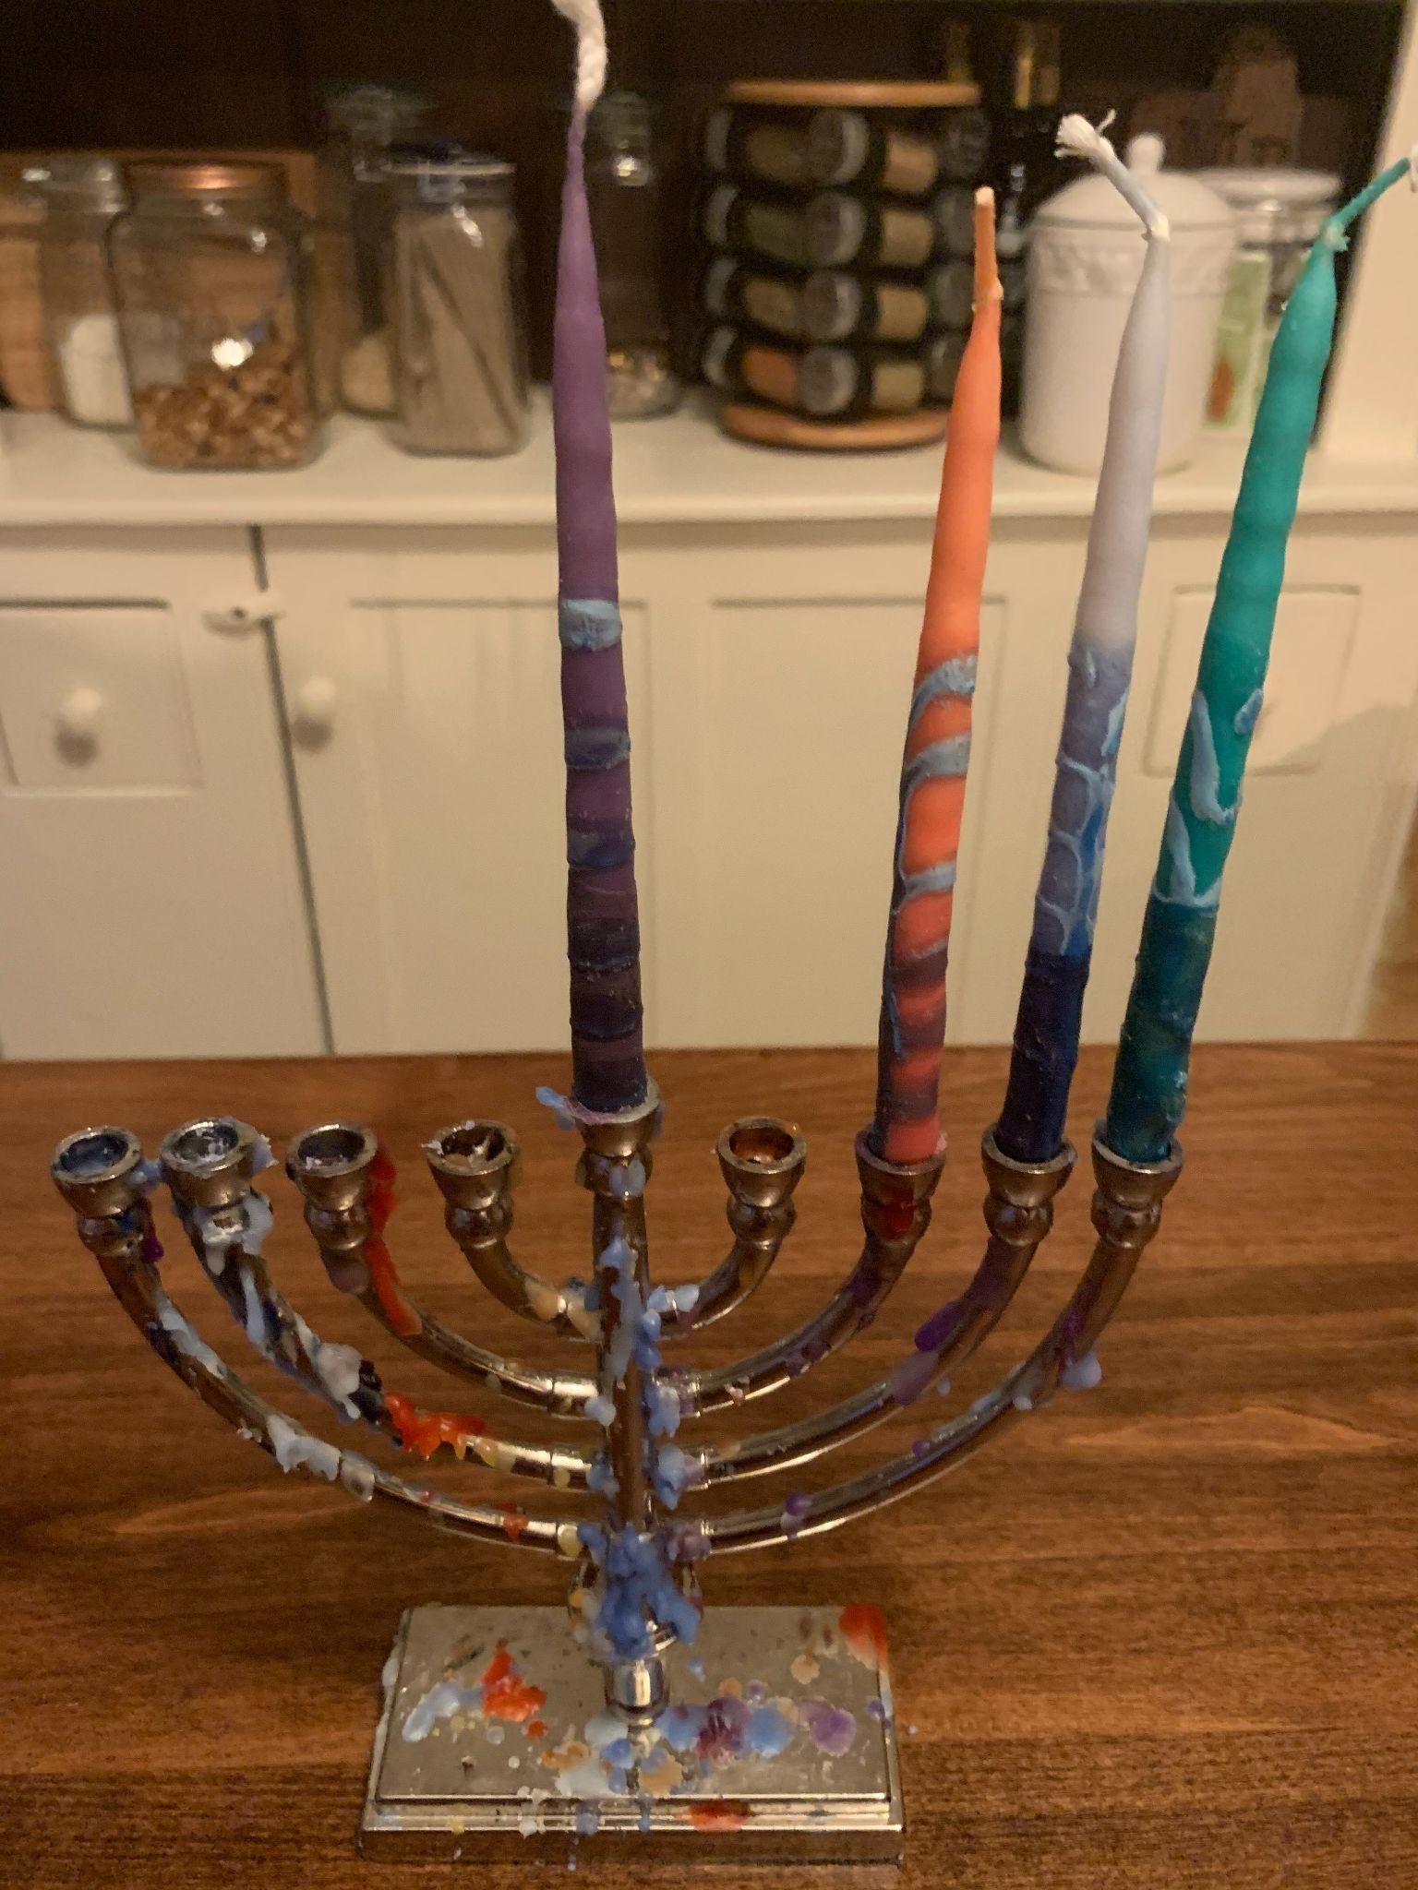
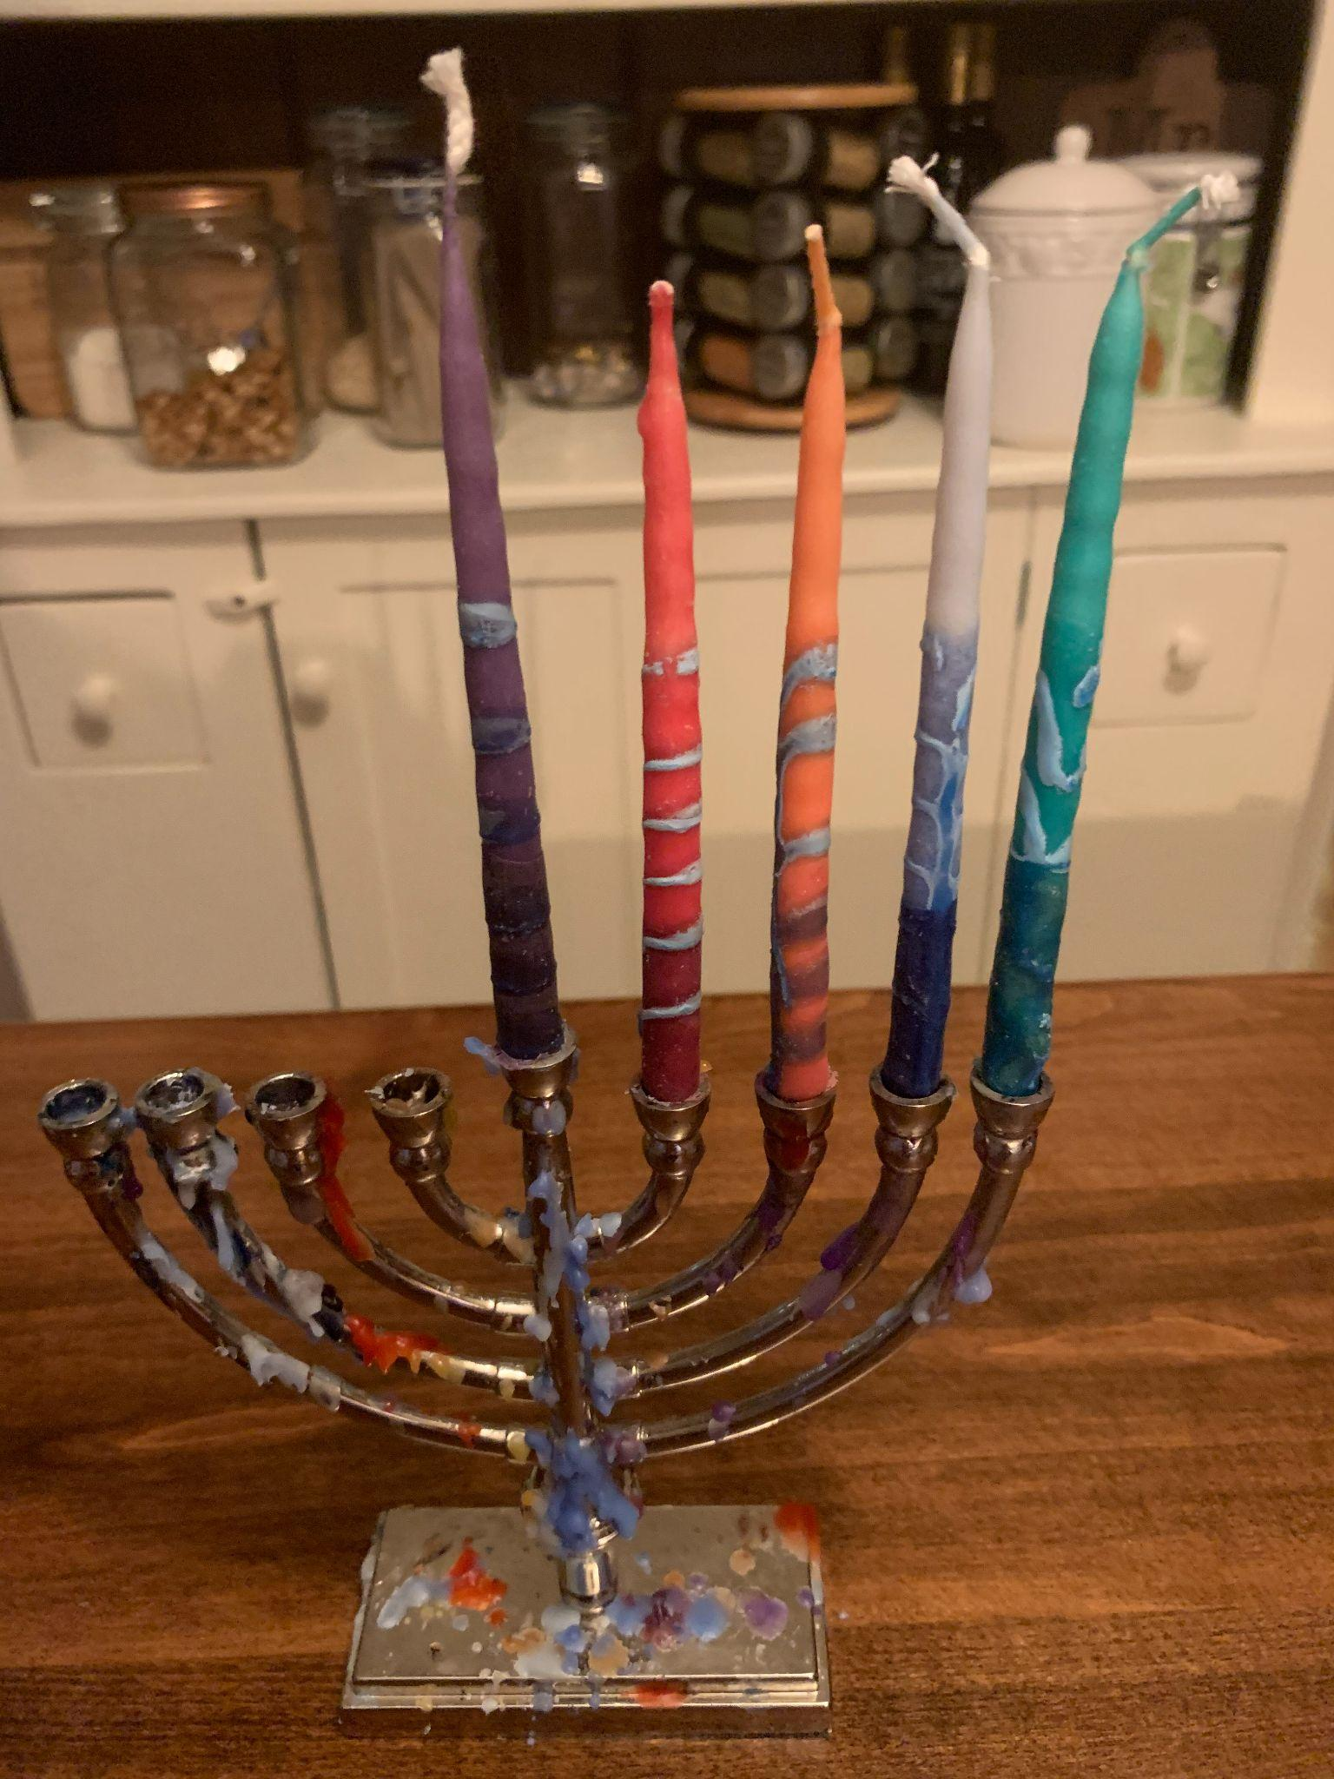
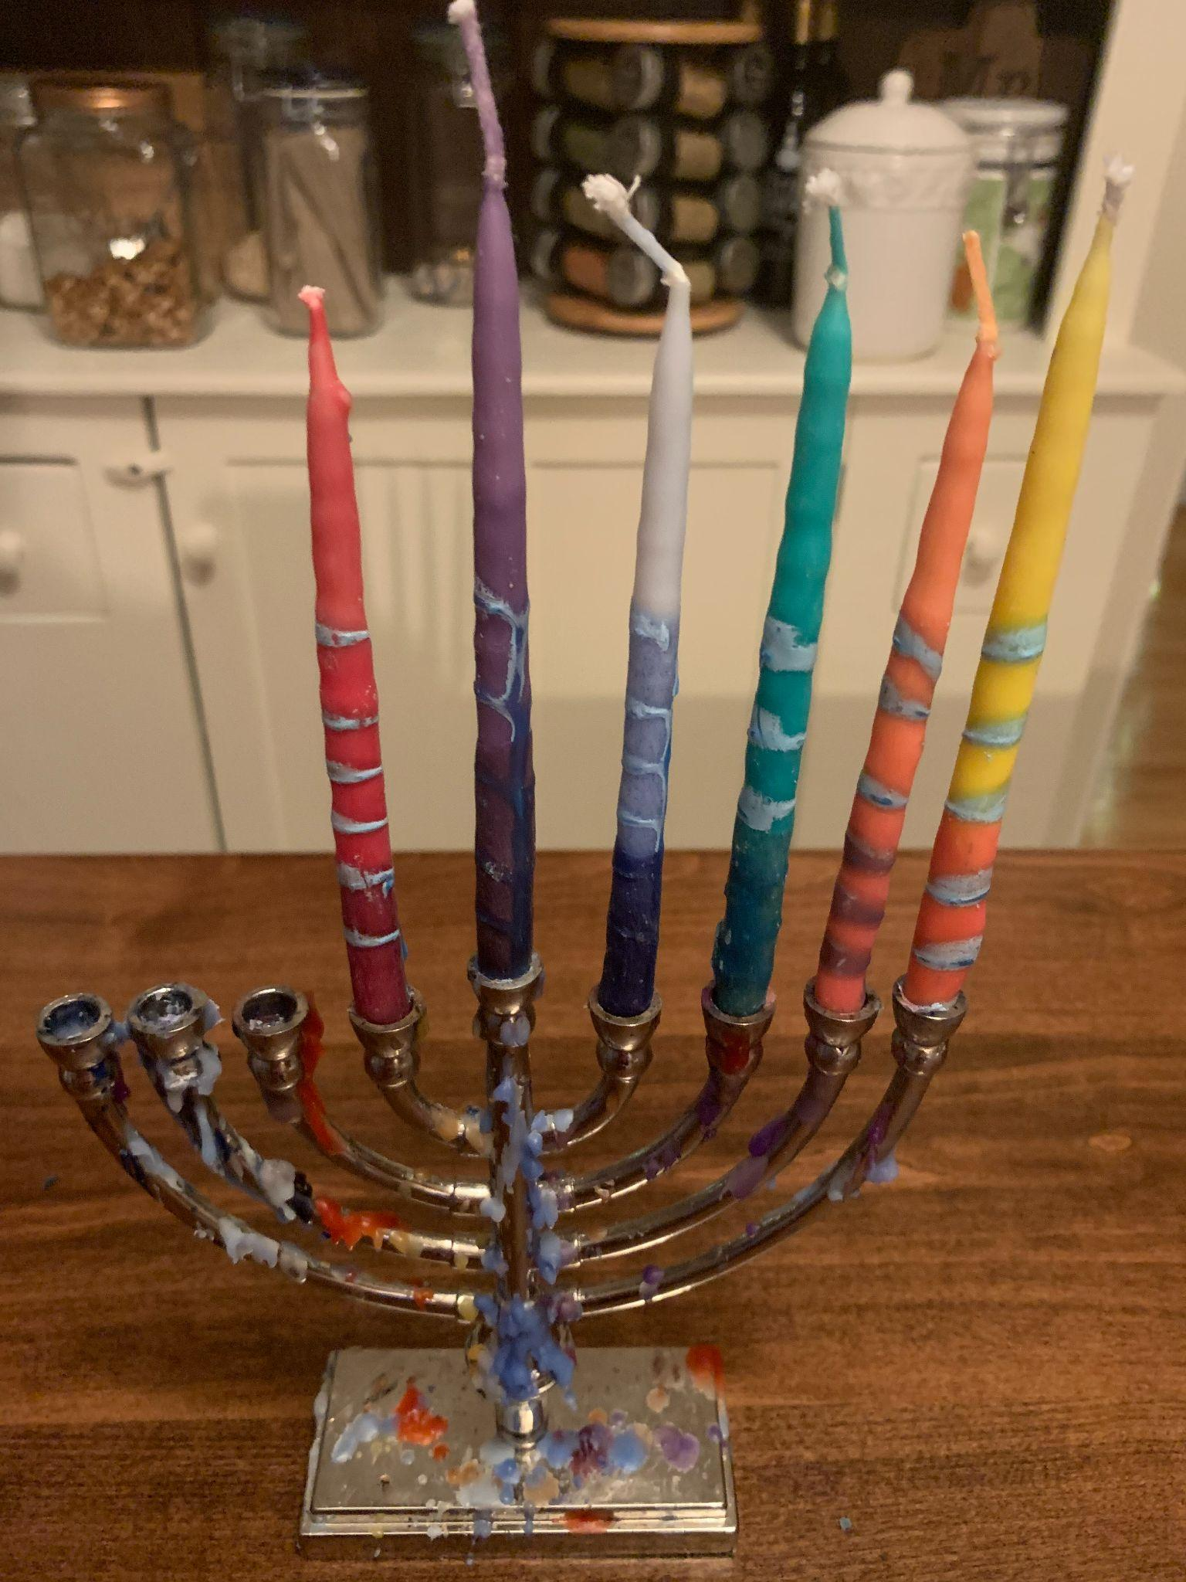
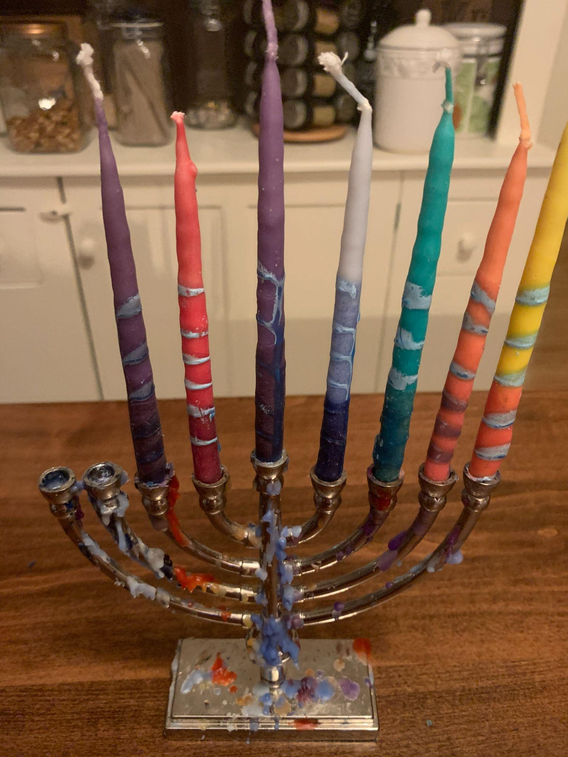
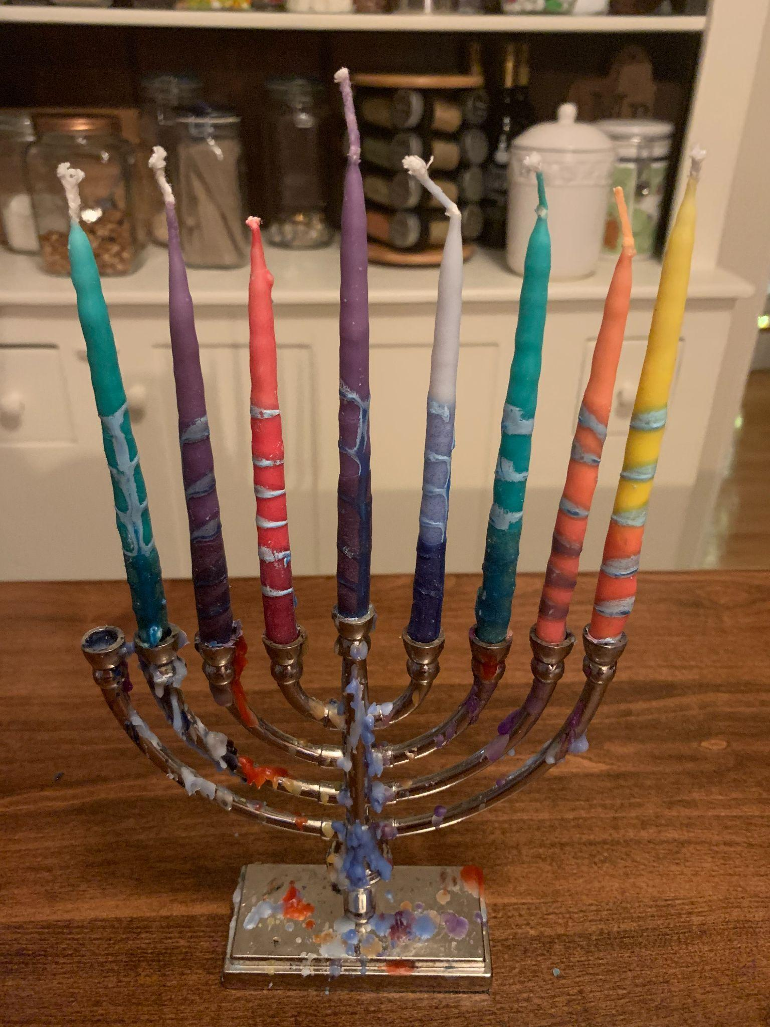
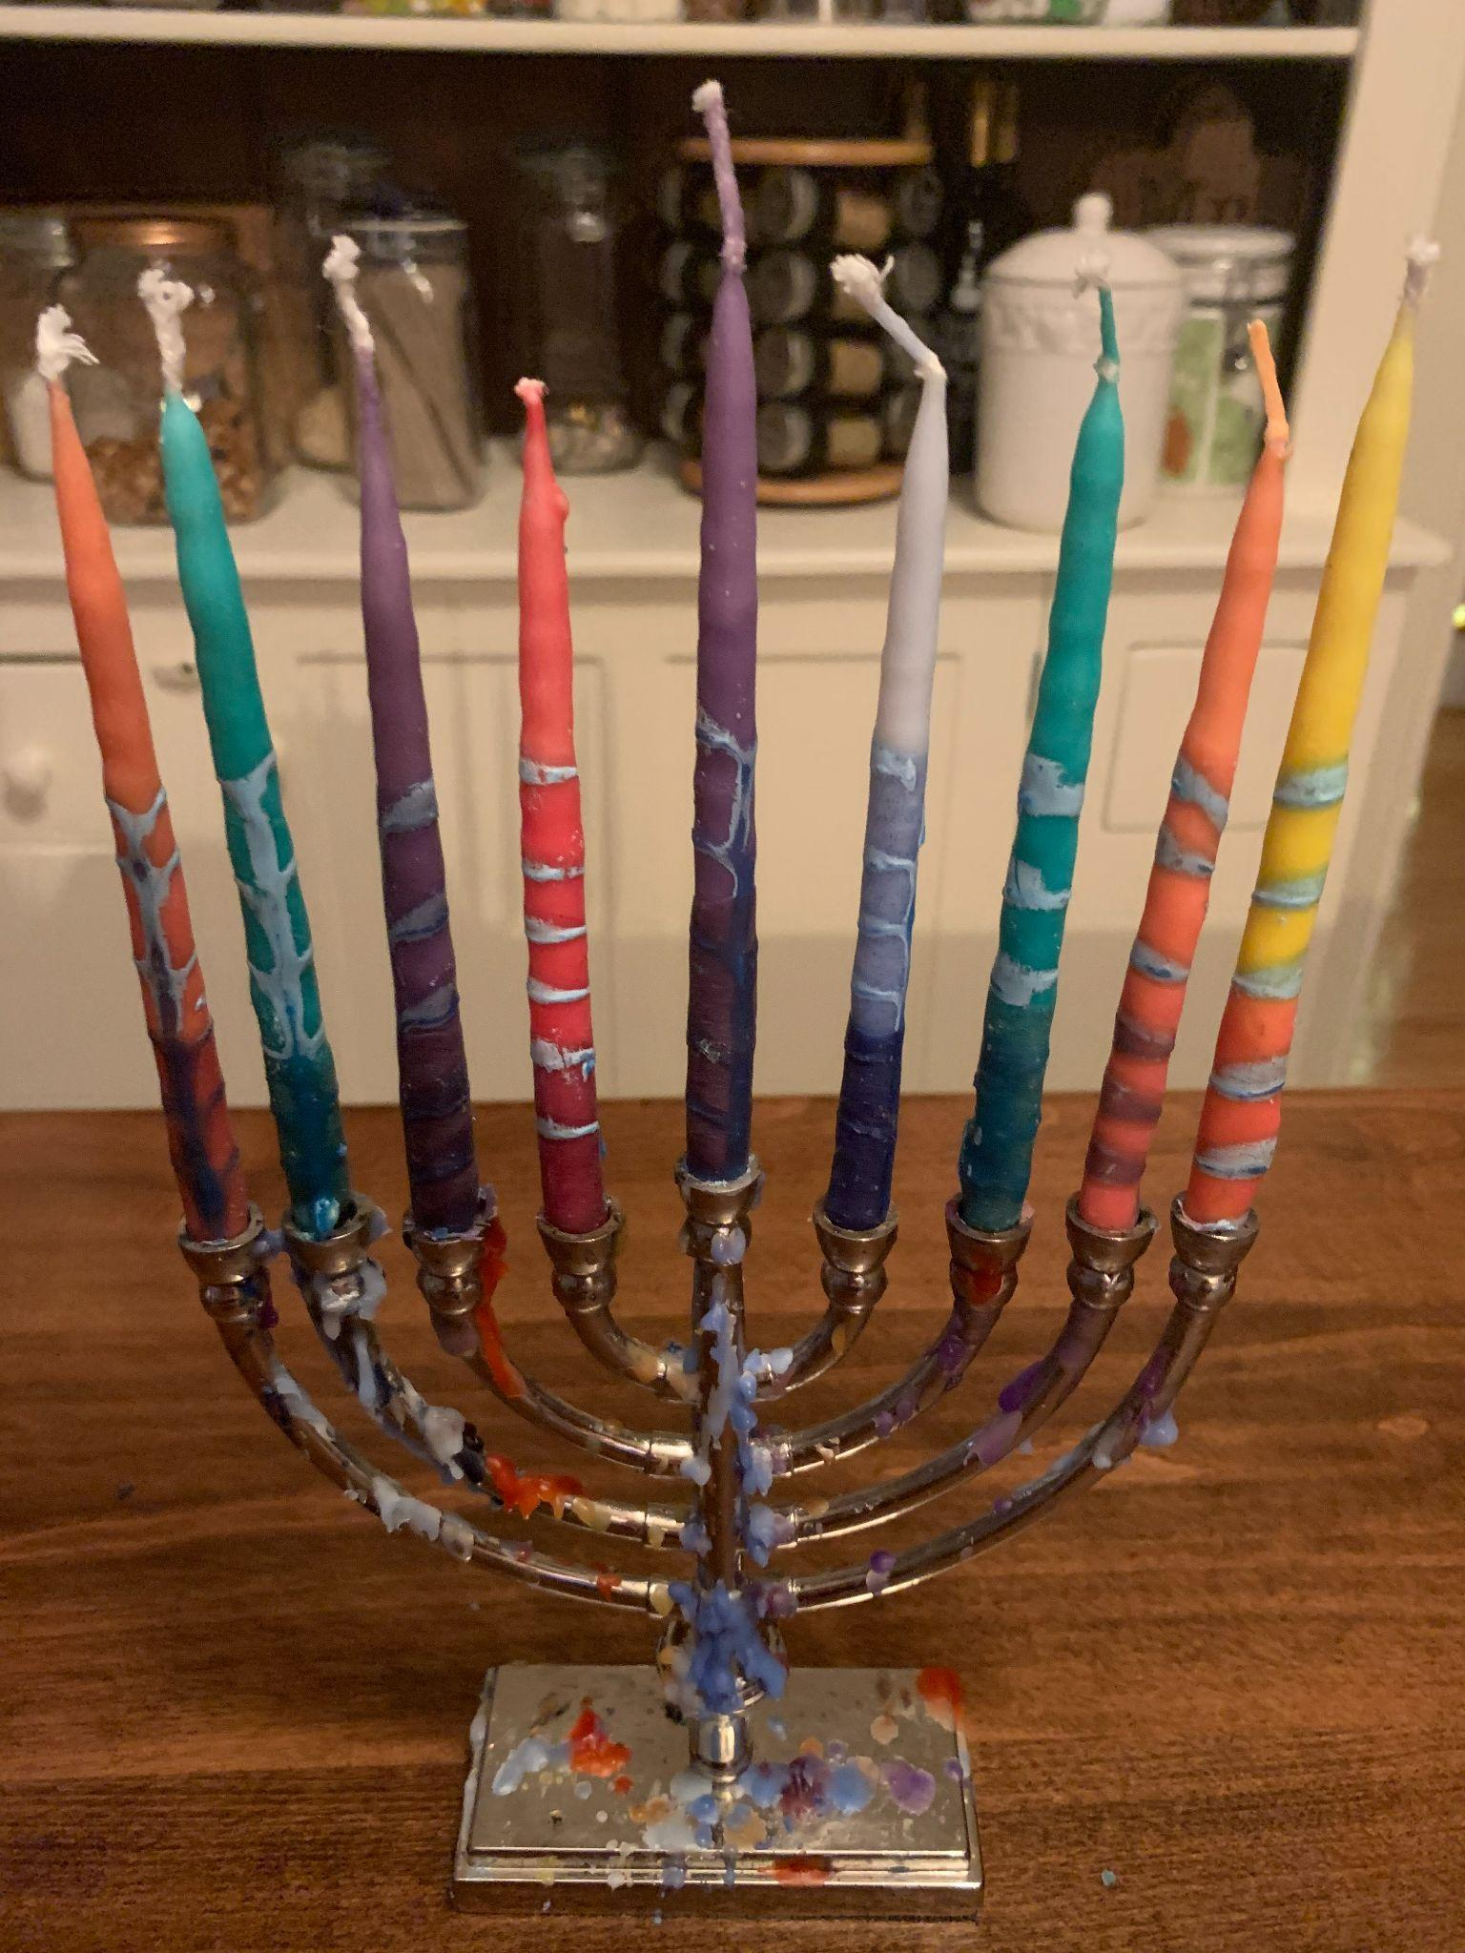
Happy Hanukkah!
Day 1
Day 2
Day 3
Day 4
Hanukkah is celebrated for 8 nights.
Each night when we light the Menorah we add one more candle.
On the first night we light 2 candles, the Shamash and the 1st candle. The second night we light 3, and so on.
How many candles do we need for all 8 nights?
Day 5
Day 6
Day 7
Day 8
4.OA.C5
Notes:
Week of December 19, 2022
Hanukkah

Slide 17
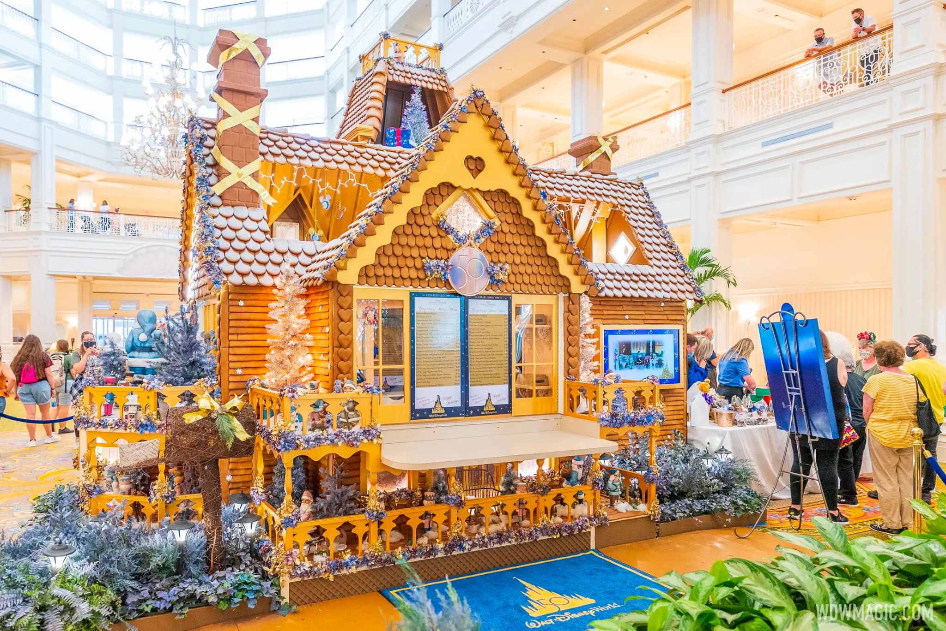
What do you think the PERIMETER of this gingerbread house is at The Floridian Resort in Disney?
Estimate the height.
Estimate how many bakers it took to create it!
4.MD.A3

Slide 18
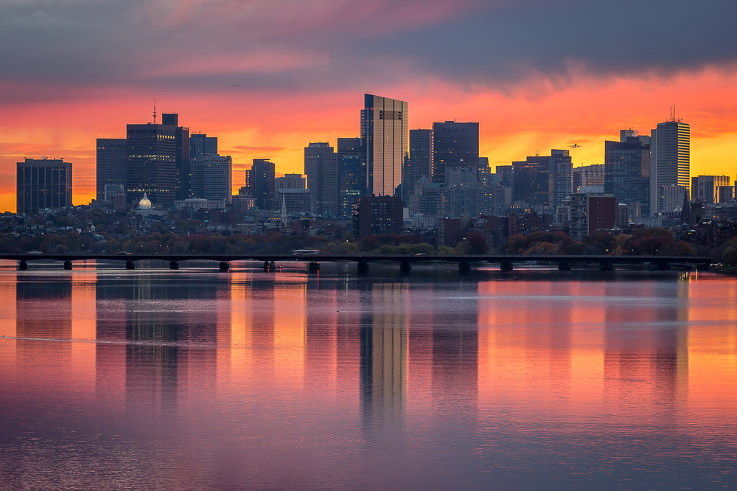
Today is the winter solstice!
It is the shortest day and the longest night of the year!
Today the sun rises at 7:10 AM and sets at 4:14 PM.
How many minutes of daylight do we have today?
4.MD.A1
Notes:
December 21, 2022
Winter Solstice

Slide 19
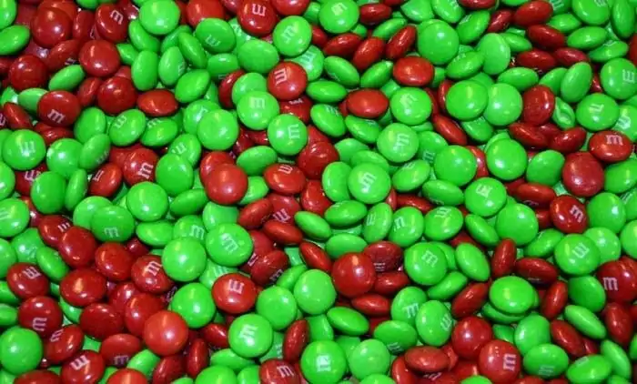
There are about 480 m&m’s per pound.
If there are 8 pounds of m&m’s here, what is possible?
4.OA.A3

Slide 20
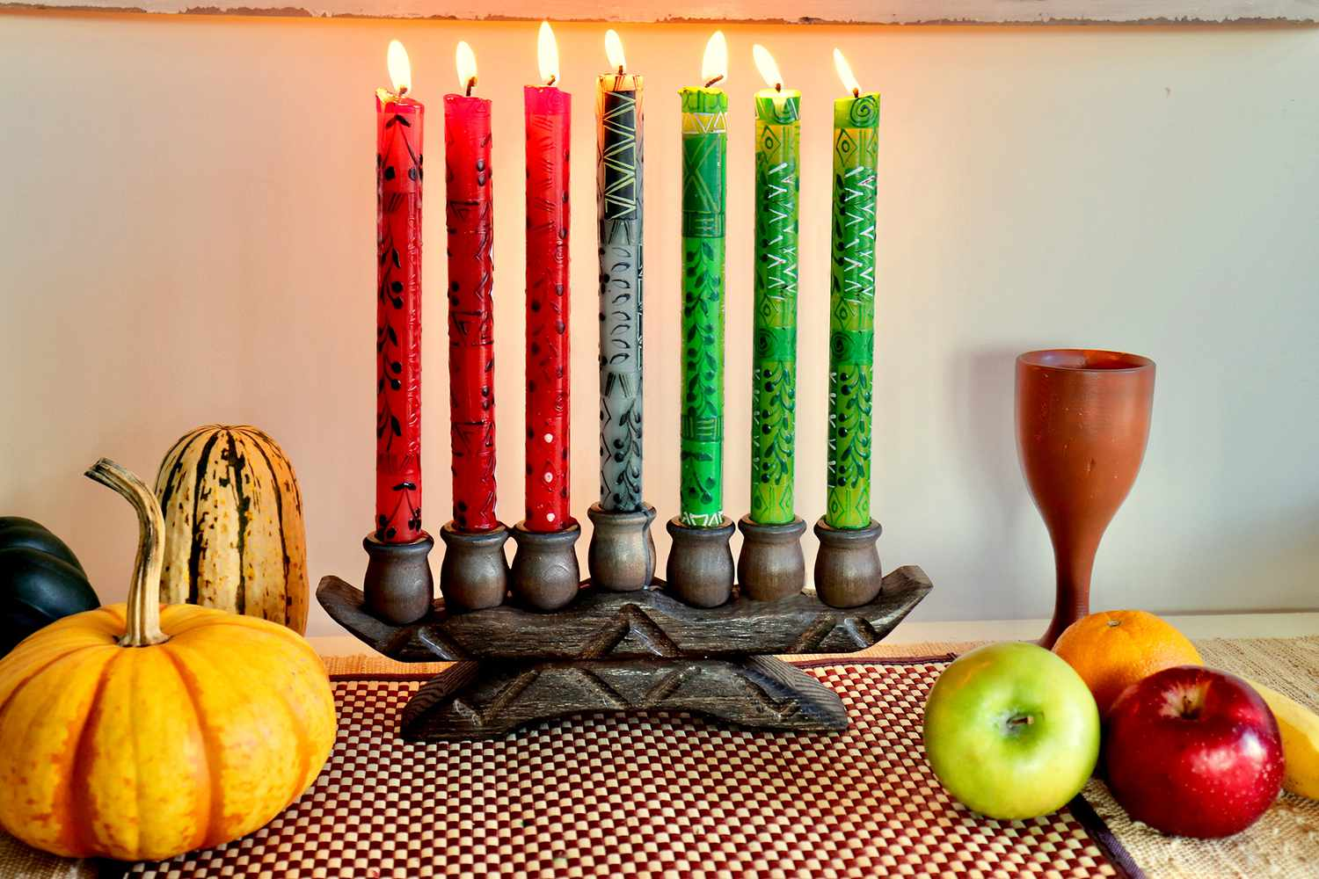
Happy Kwanzaa!
We light the Kinara for 7 nights.
On the first night we light 1 candle.
On the second night we light 2, and so on.
How many candles will we need for all 7 nights?
4.OA.C5

