Slide 1

American consumers spent $10,700,000,000 on Cyber Monday in 2021.
What is that number?
Do you think Americans will spend more or less in 2022?
Why?
3.NBT.A1
Notes:
Week of November 28, 2022

Slide 2
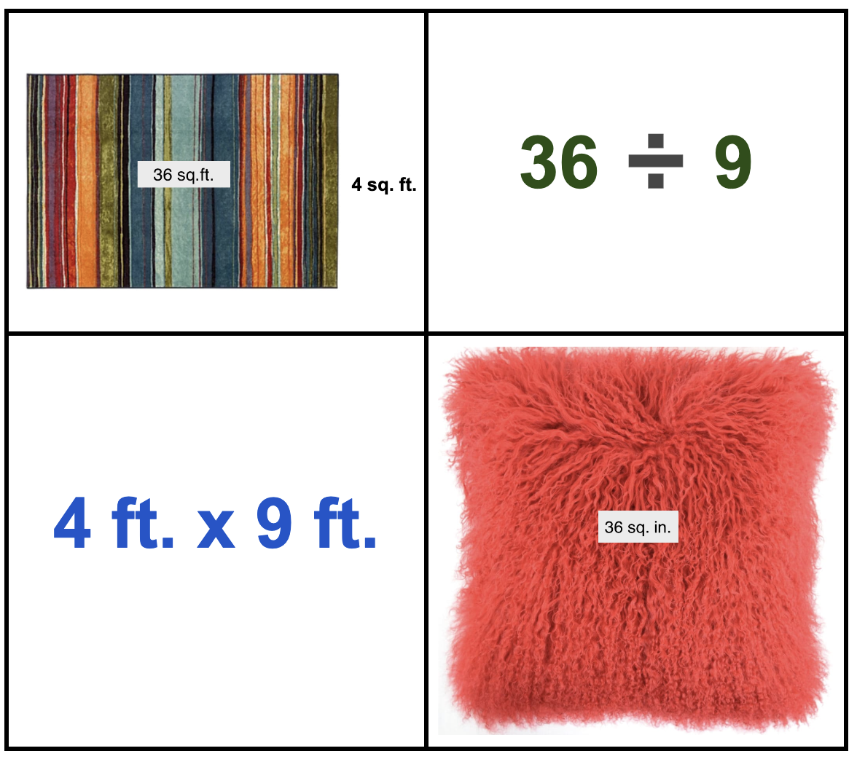
Which one doesn’t belong?
What do they all have in common?
3.OA.B6
Notes:
Top Left: only carpet area model
Top Right: only division expression, no msmt.
Bottom Left: only multiplication expression
Bottom right: only perfect square, inches

Slide 3

What is the same?
What is different?
3.G.A2

Slide 4
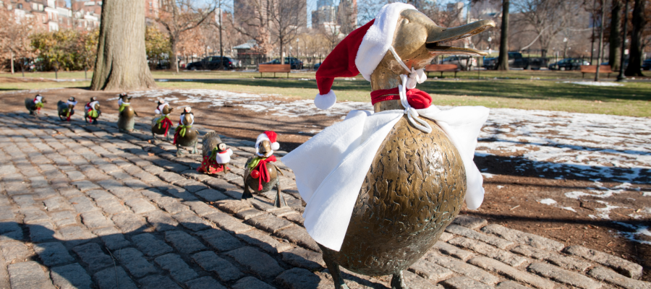
Happy December
12 - 12 - 2022
What can we say about the date today?
Can we see a pattern in the date?
3.OA.D9
Notes:
Digits add up to 12!
Five twos (when will that happen again?)

Slide 5
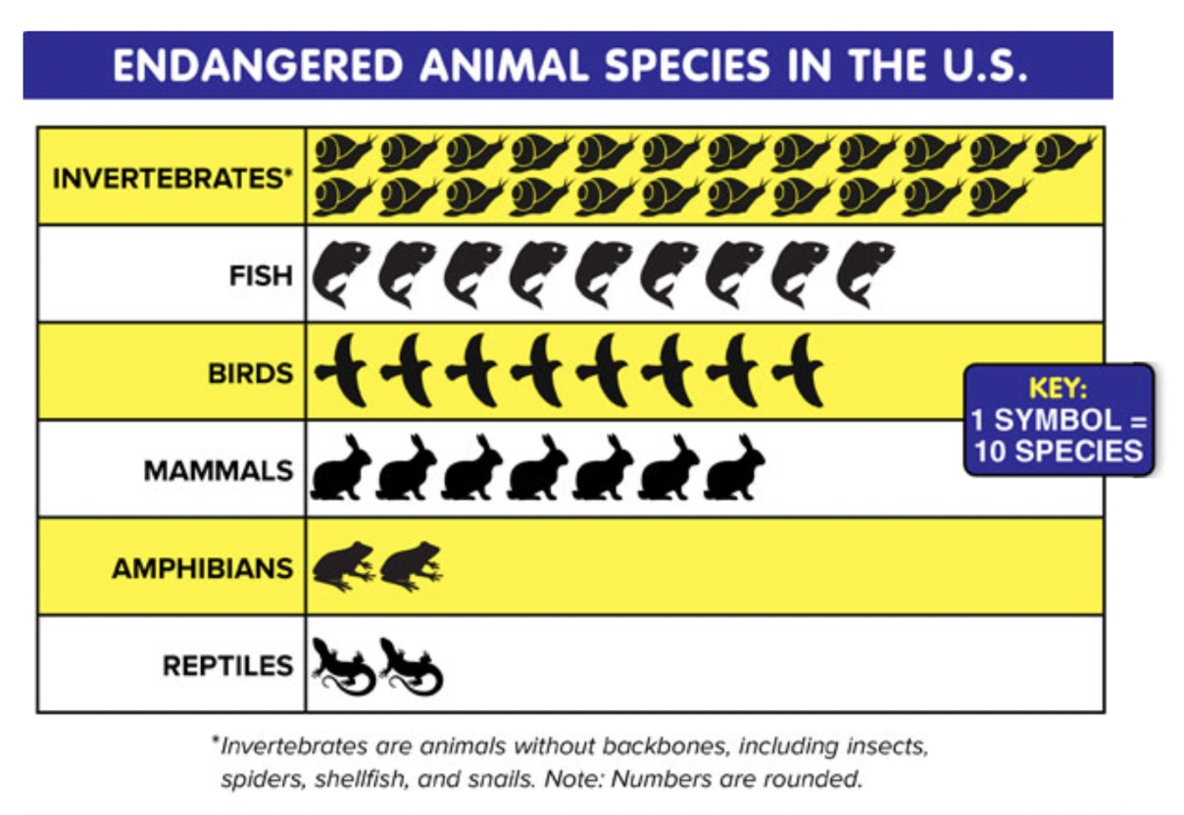
If this graph could talk, what would it say?
Why does it matter?
3.MD.B3

Slide 6
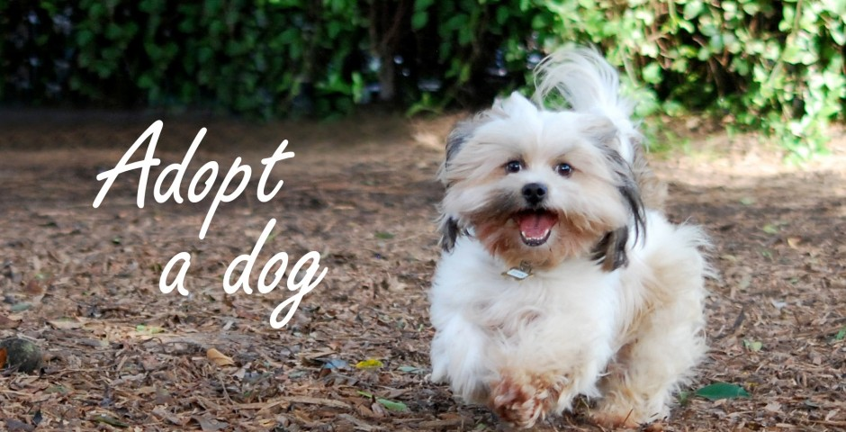
Today is National Shelter Pets Day!
The first animal shelter in the U.S. was formed in 1869.
How long ago was that?
How can we figure it out?
3.NBT.A2
Notes:
Week of December 5, 2022
National Shelter Pets Day

Slide 7
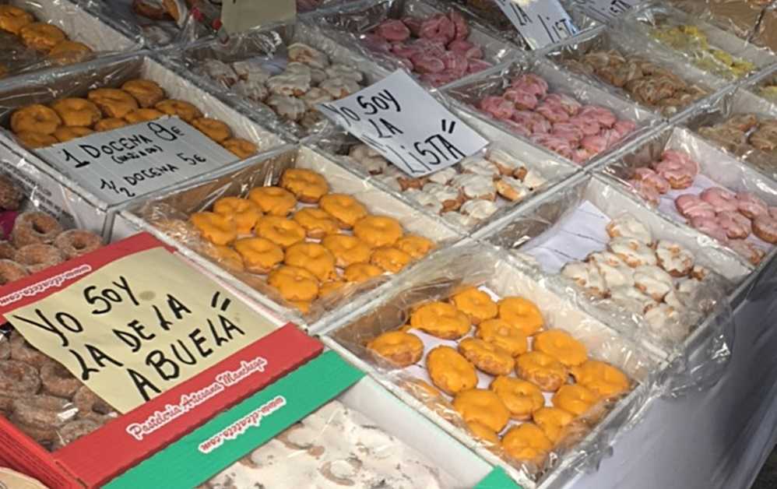
Today is Constitution Day in Spain!
How can we use
arrays
to determine how many rosquillas are in this bakery in Madrid?
3.OA.A3
1.G.A2
Notes:
December 6, 2022
Constitution Day ~ Spain

Slide 8
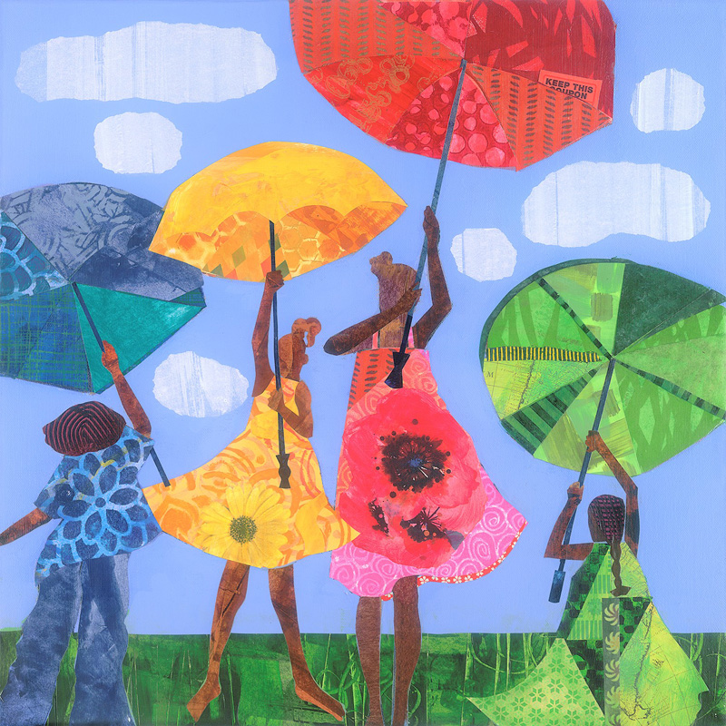
Where do we see fractions in “Flowers” by local artist Ekua Holmes?
What can we say about the partitions?
3.NF.A1

Slide 9
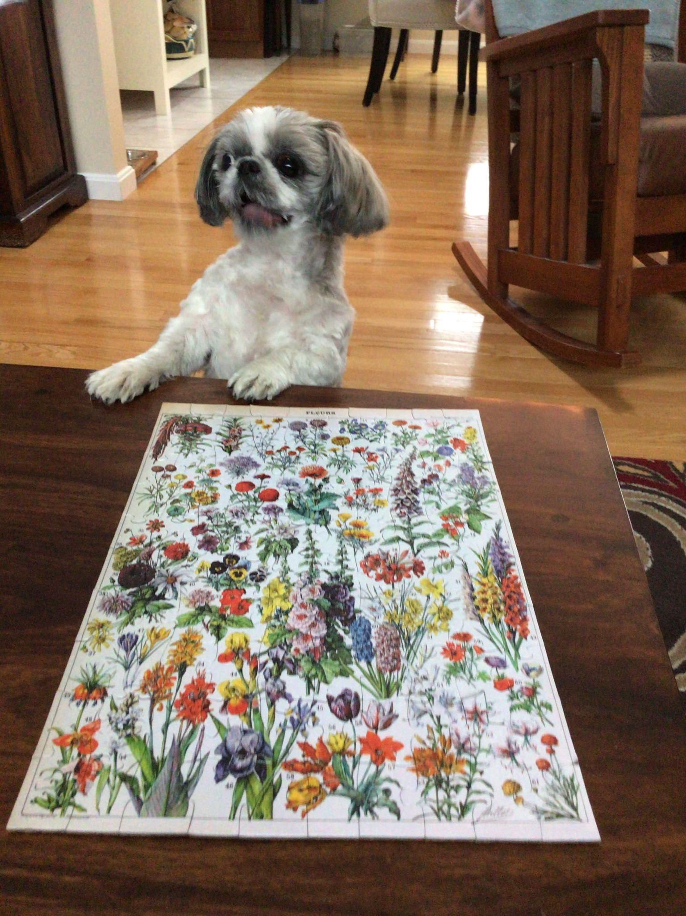
Lulu just finished this puzzle!
If we look closely, we can see that this puzzle is an array.
What is possible?
There are more than 50 pieces in this puzzle.
What could the dimensions be?
3.OA.A3

Slide 10
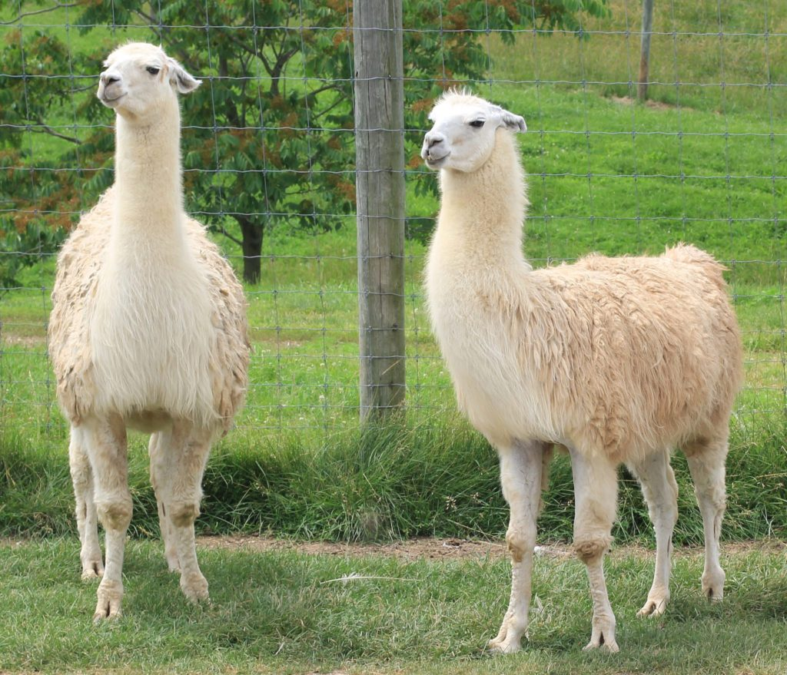
It’s International Llama Day!
A llama can weigh between 290 and 440 pounds.
Together these two llamas weigh 650 pounds.
What is possible?
3.NBT.A2
Notes:
December 9, 2022
International Llama Day

Slide 11
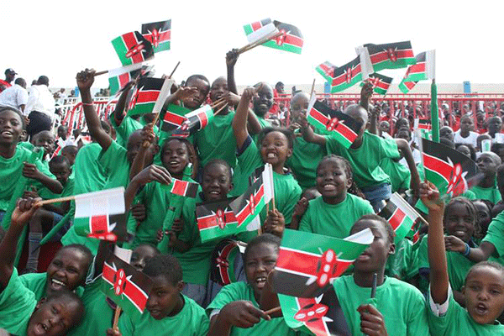
It’s Independence (Jamhuri) Day in Kenya!
On this day in 1964 Kenya became a republic!
How long ago was that?
Is that surprising to you?
3.NBT.A2
Notes:
Week of December 12, 2022

Slide 12

(4 + 5) x 9 < (4 x 9) + (5 x 9)
6 + 6 + 6 + 6 > 8 x 3
1,000 - 35 = 900 + 65
3.OA.B5

Slide 13
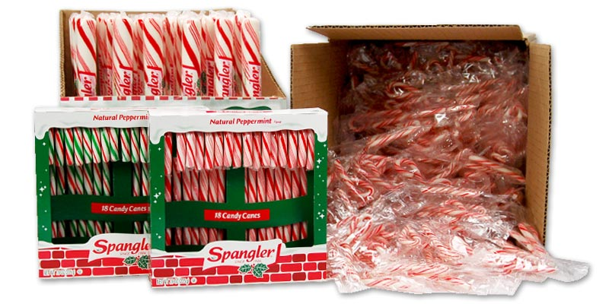
Would you rather . . .
18 giant candy canes, 2 boxes of regular candy canes,
or a case of tiny ones?
3.SMP.3

Slide 14
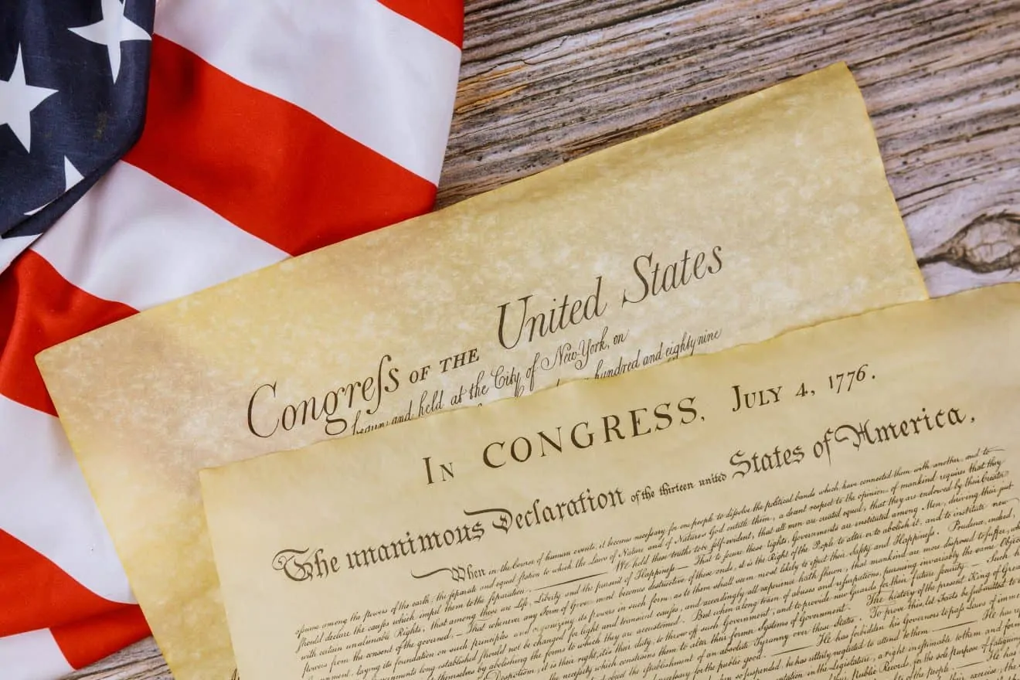
Today is Bill of Rights Day
The first amendments to the Constitution were ratified on December 15, 1791.
The 10 amendments protect the most basic rights of Americans, known as the Bill of Rights. It consists of notions like freedom of speech, freedom of religion, freedom of the press, the right to protest, and equal protection under the law.
How long ago was 1791?
3.NBT.A2
Notes:
Bill of Rights Day

Slide 15
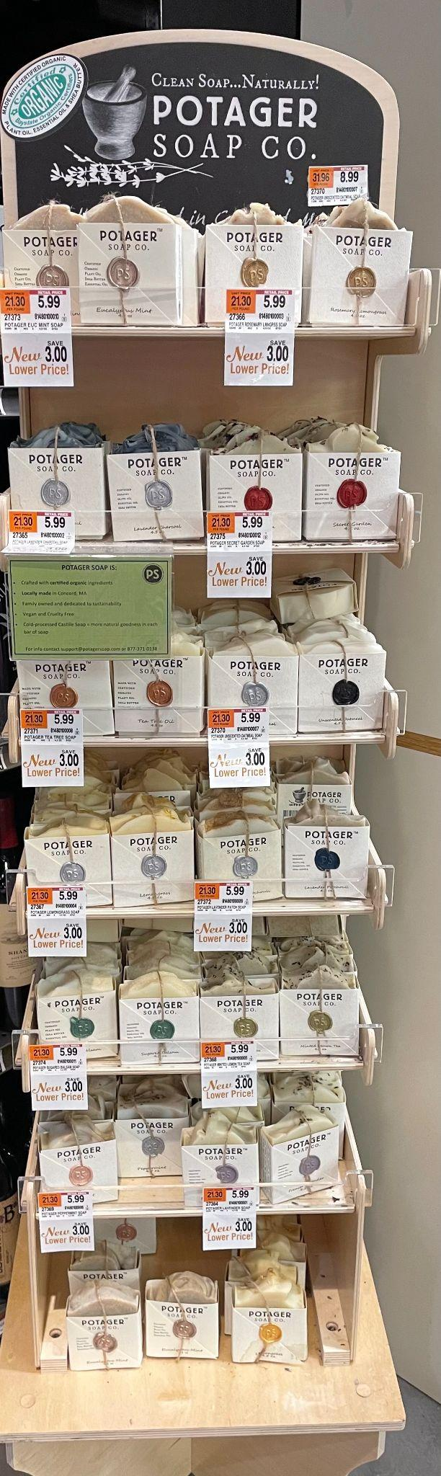
Where do we see arrays here?
How can we use arrays to figure out how many bars of soap are on the display?
3.OA.A3

Slide 16
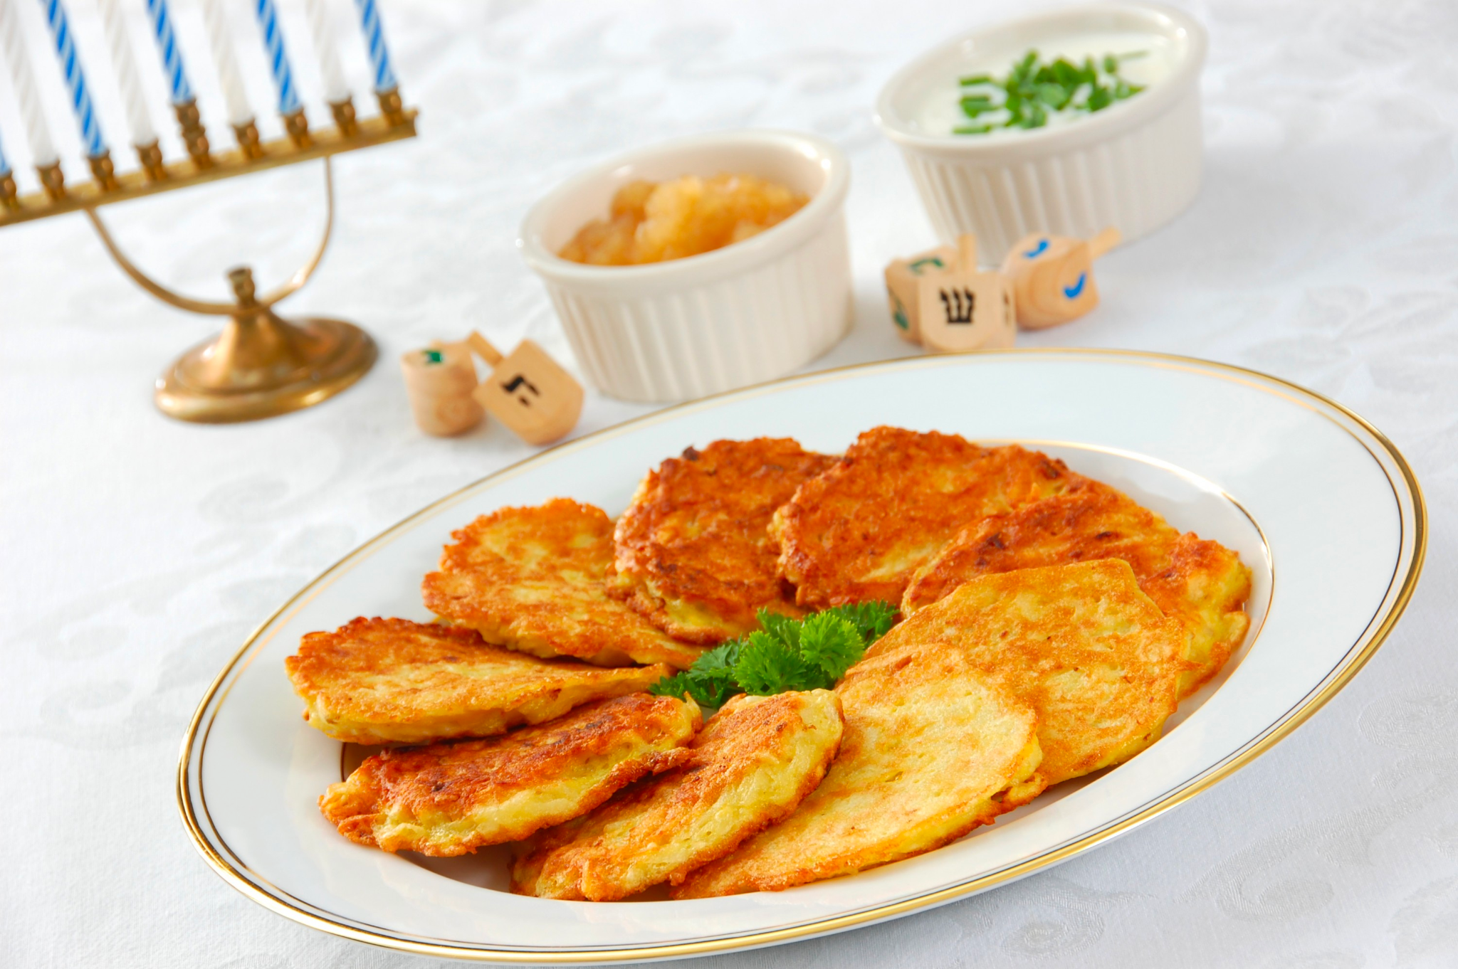
Happy Hanukkah!
What do we notice?
What do we wonder?
How many potato latkes would be on 2 plates?
3 plates? 4? 5?
Do we see a pattern?
3.OA.D9
Notes:
Week of December 19, 2022
Hanukkah

Slide 17
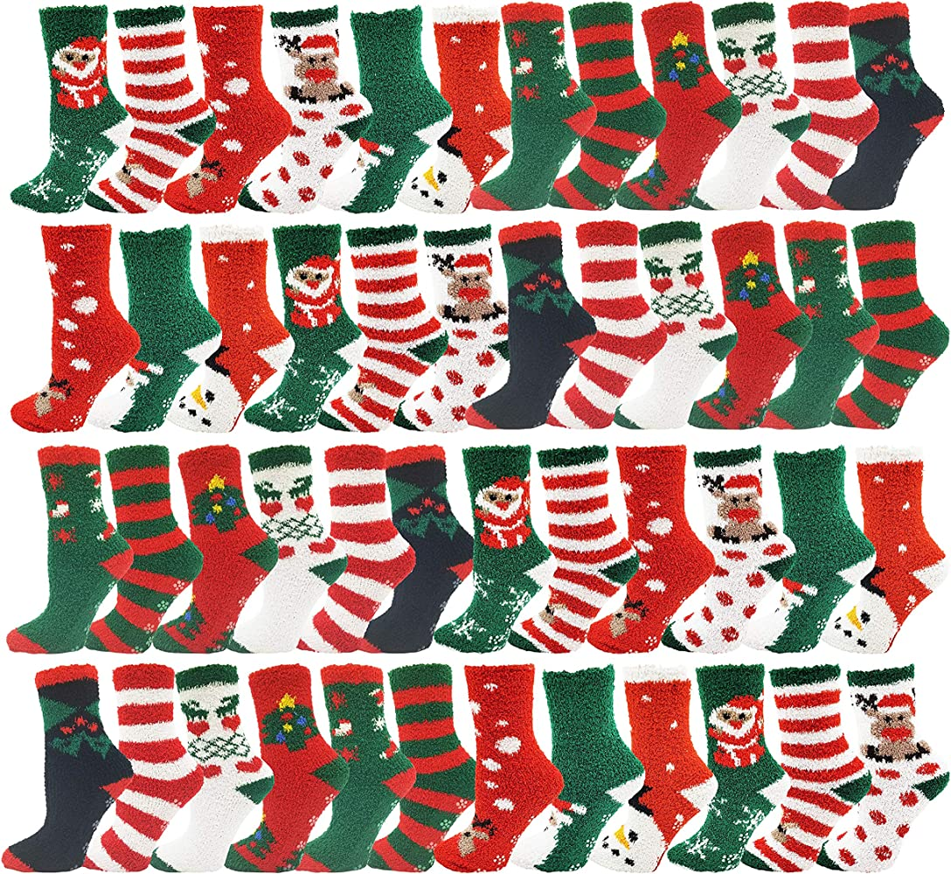
What do we notice?
What do we wonder?
How many socks?
How many pairs of socks?
How might we sort them?
3.OA.A3

Slide 18
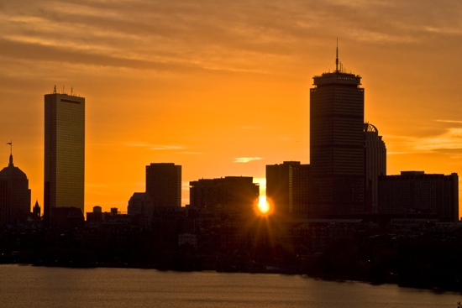
Today is the winter solstice!
It is the shortest day and the longest night of the year!
Today the sun rises at
7:10 AM and sets at 4:14 PM.
How much daylight?
How long is the night?
3.MD.A1
Notes:
December 21, 2022
Winter Solstice

Slide 19
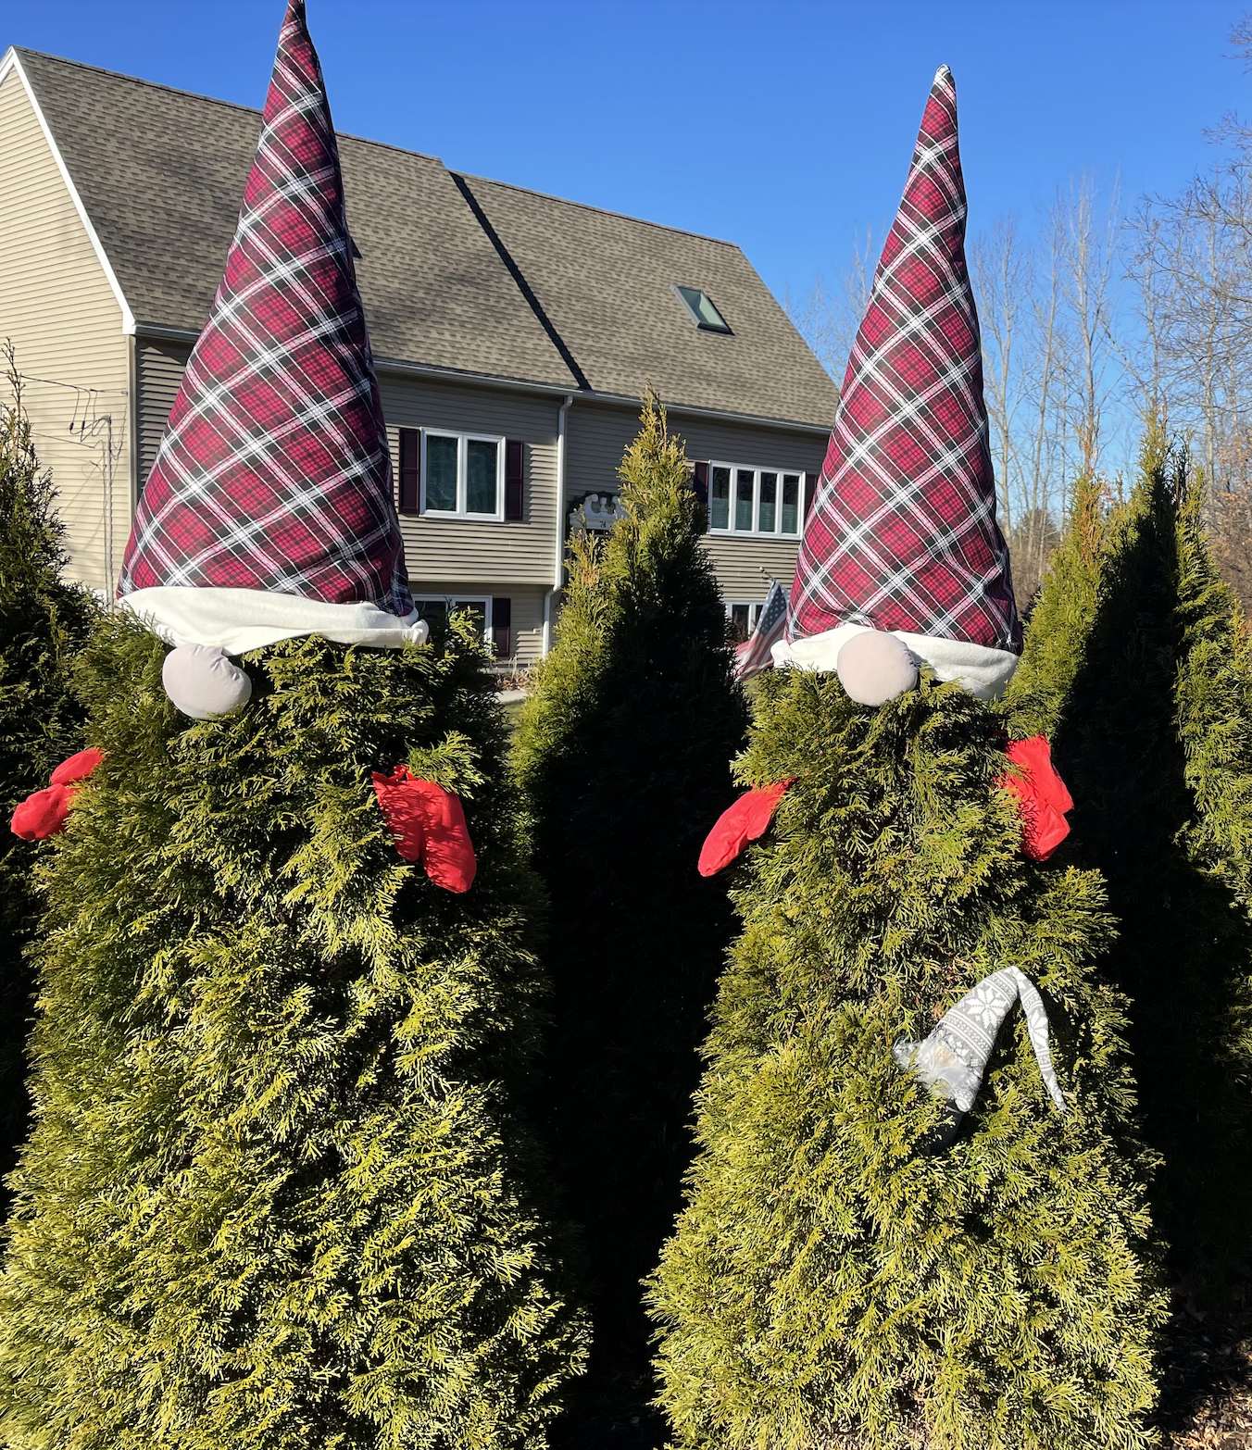
Yes, it’s gnome season!
If the Al (the little gray gnome) is 14 inches tall, how tall do you think the tree is?
How tall would both trees be?
3.MD.A2

Slide 20
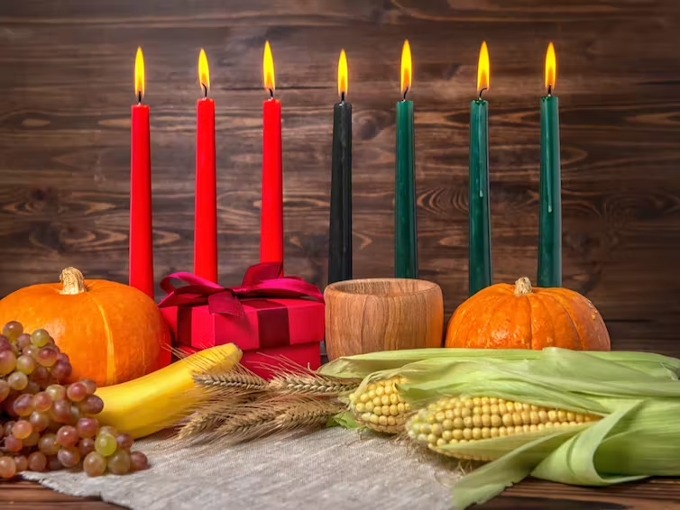
Happy Kwanzaa!
We light the Kinara for 7 nights.
On the first night we light 1 candle.
On the second night we light 2, and so on.
How many candles will we need for all 7 nights?
3.OA.D9

