Slide 1
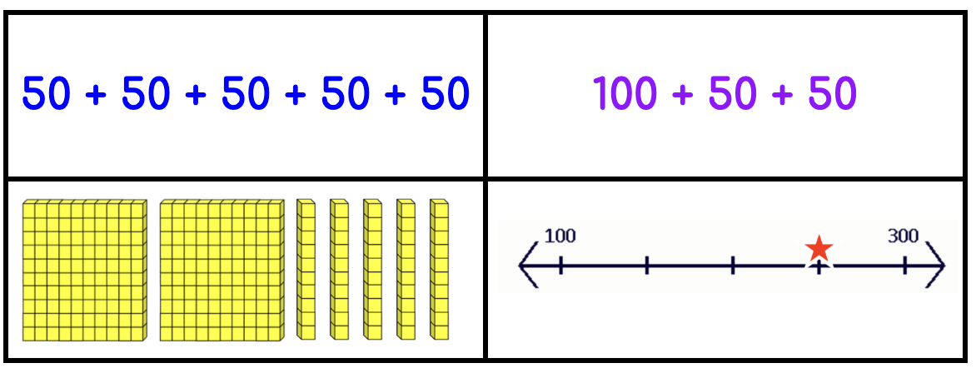
Which one does not belong?
2.NBT.A1
Notes:
Week of November 28, 2022
Top left: only one with the same addend (five addends)
Top right: not 250
Bottom left: only one with base ten block model
Bottom right: only number line representation

Slide 2
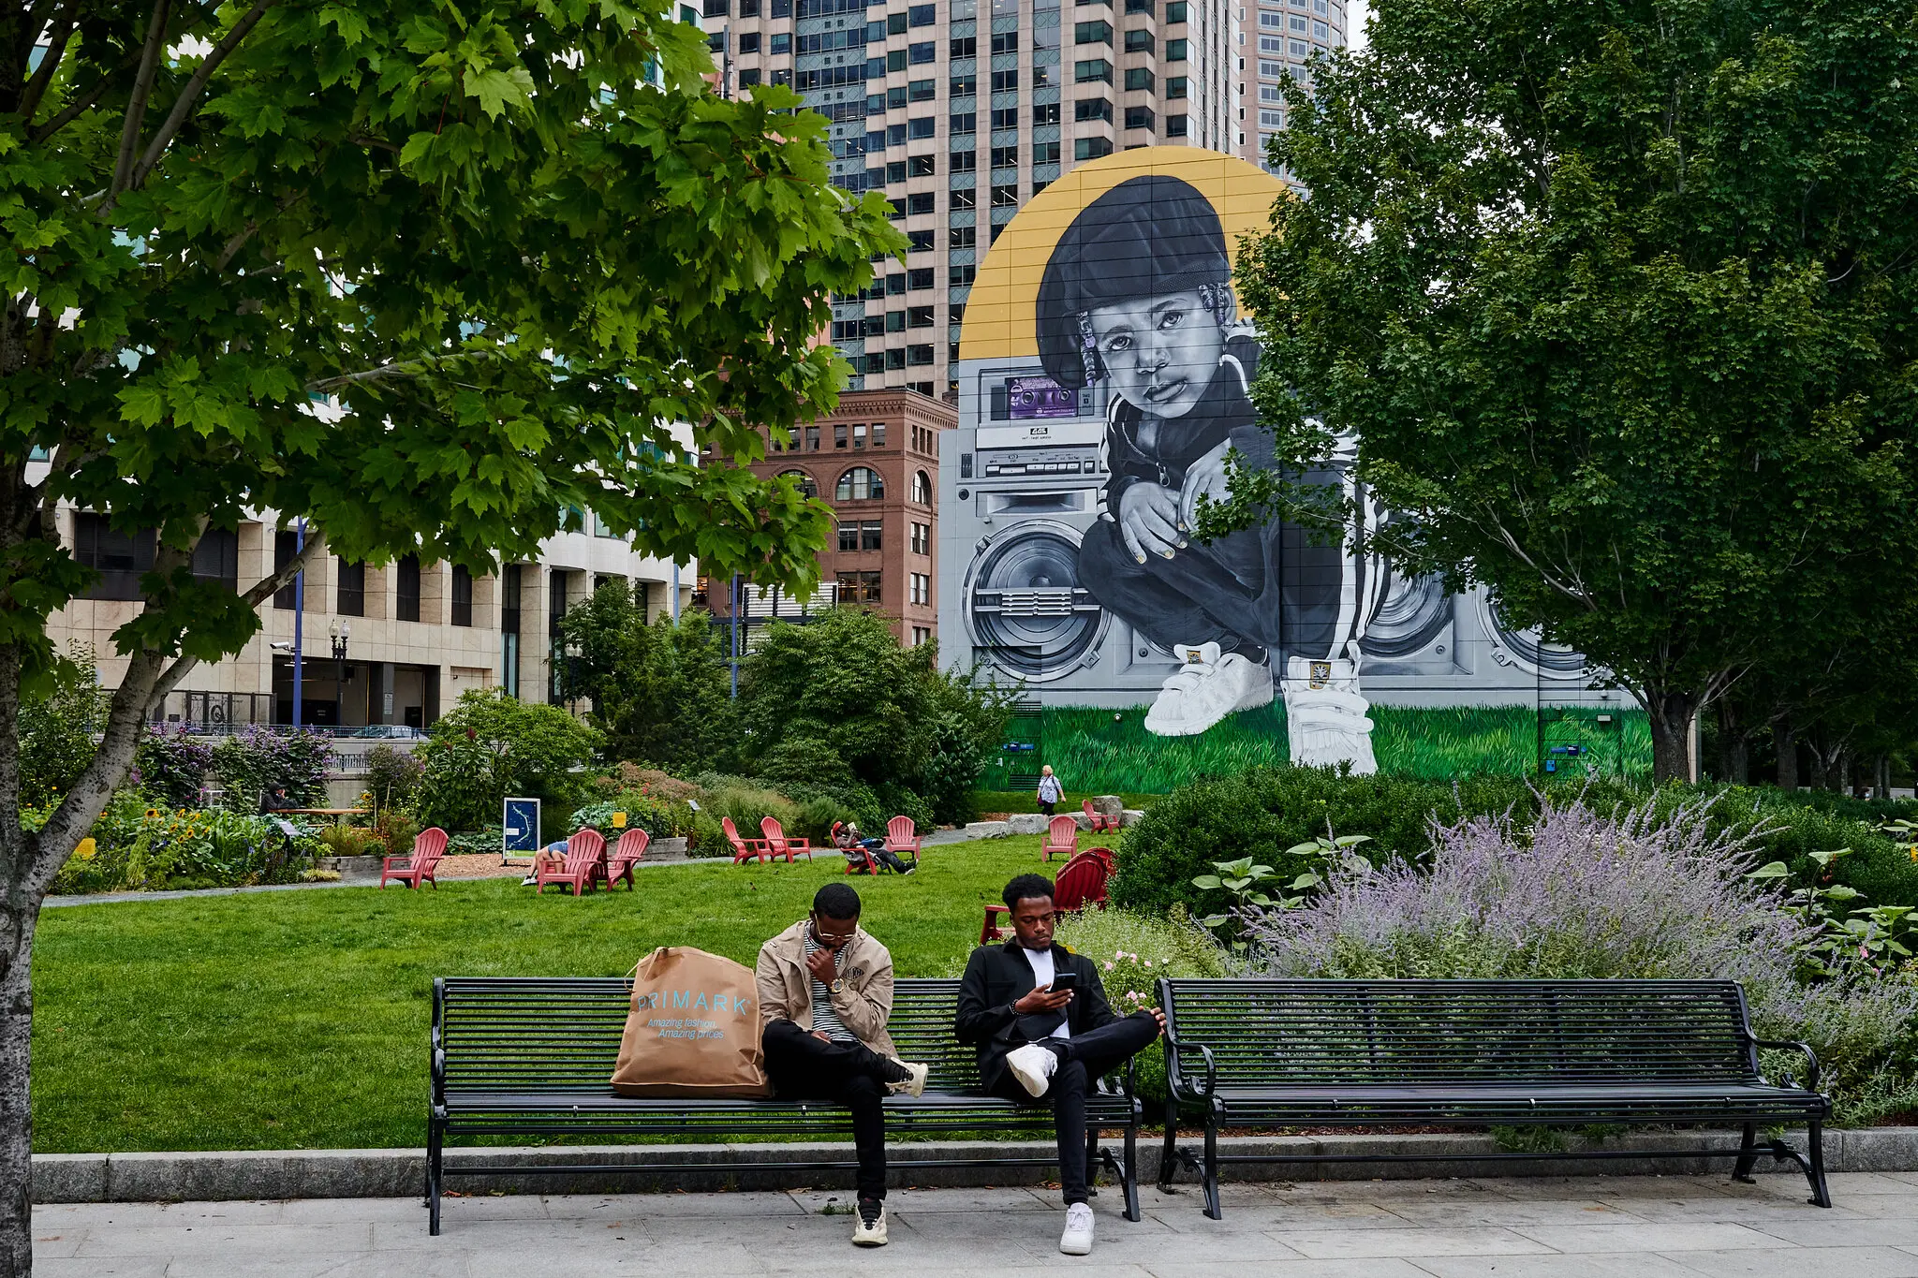
Look at this amazing mural in South Boston!
What do we think the height of this mural is?
Estimate!
2.MD.A3

Slide 3

What is the same?
What is different?
2.G.A1

Slide 4
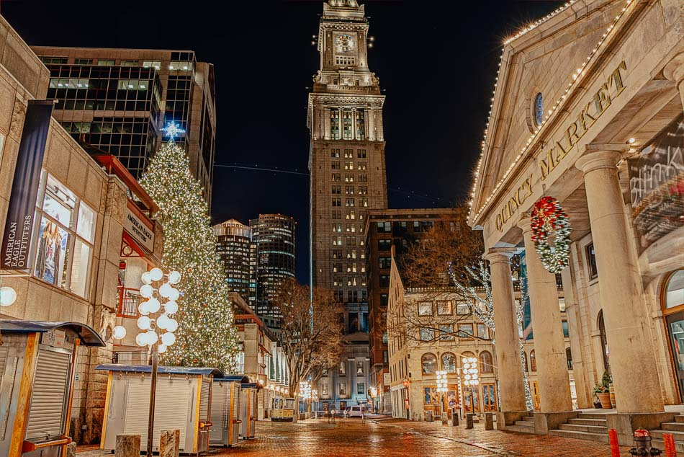
Happy December!
December is the 12th month of the year.
How many different expressions can we create that equal 12?
2.OA.B2

Slide 5
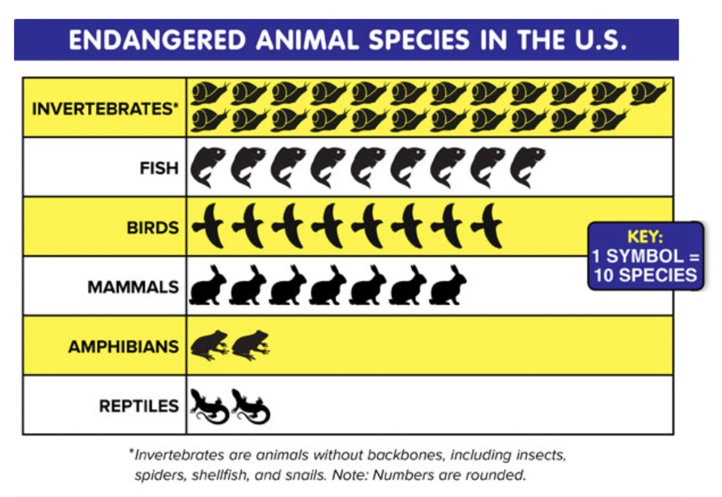
If this graph could talk, what would it say?
Why does it matter?
2.MD.D10

Slide 6
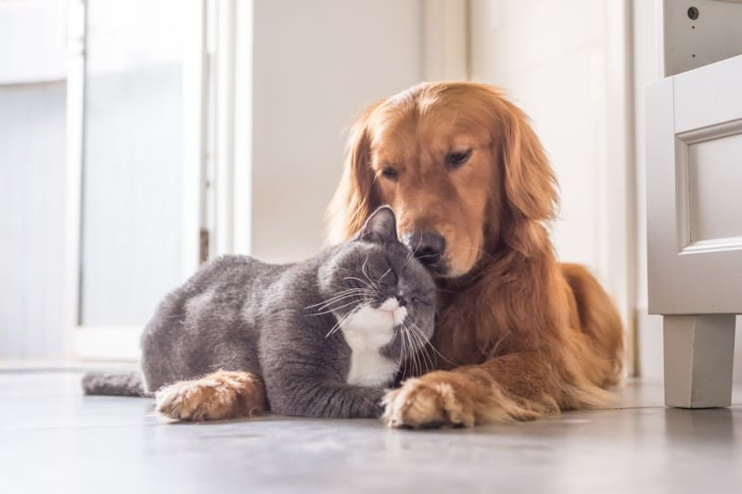
Today is National Shelter Pets Day!
The first animal shelter in the U.S. was formed in 1869.
How long ago was that?
How can we figure it out?
2.NBT.B7
Notes:
Week of December 5, 2022
National Shelter Pets Day

Slide 7
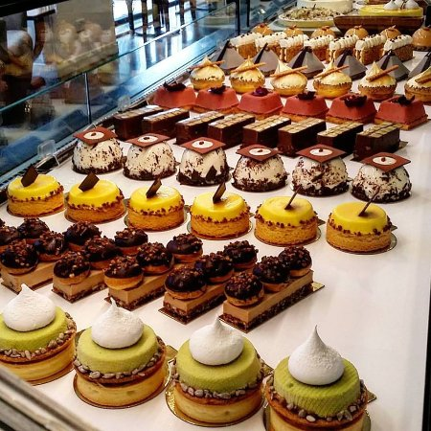
Today is Constitution Day in Spain!
How can we use
“groups of”
to determine how many sweets are in this bakery in Madrid?
2.OA.C4
1.G.A2
Notes:
December 6, 2022
Constitution Day ~ Spain

Slide 8
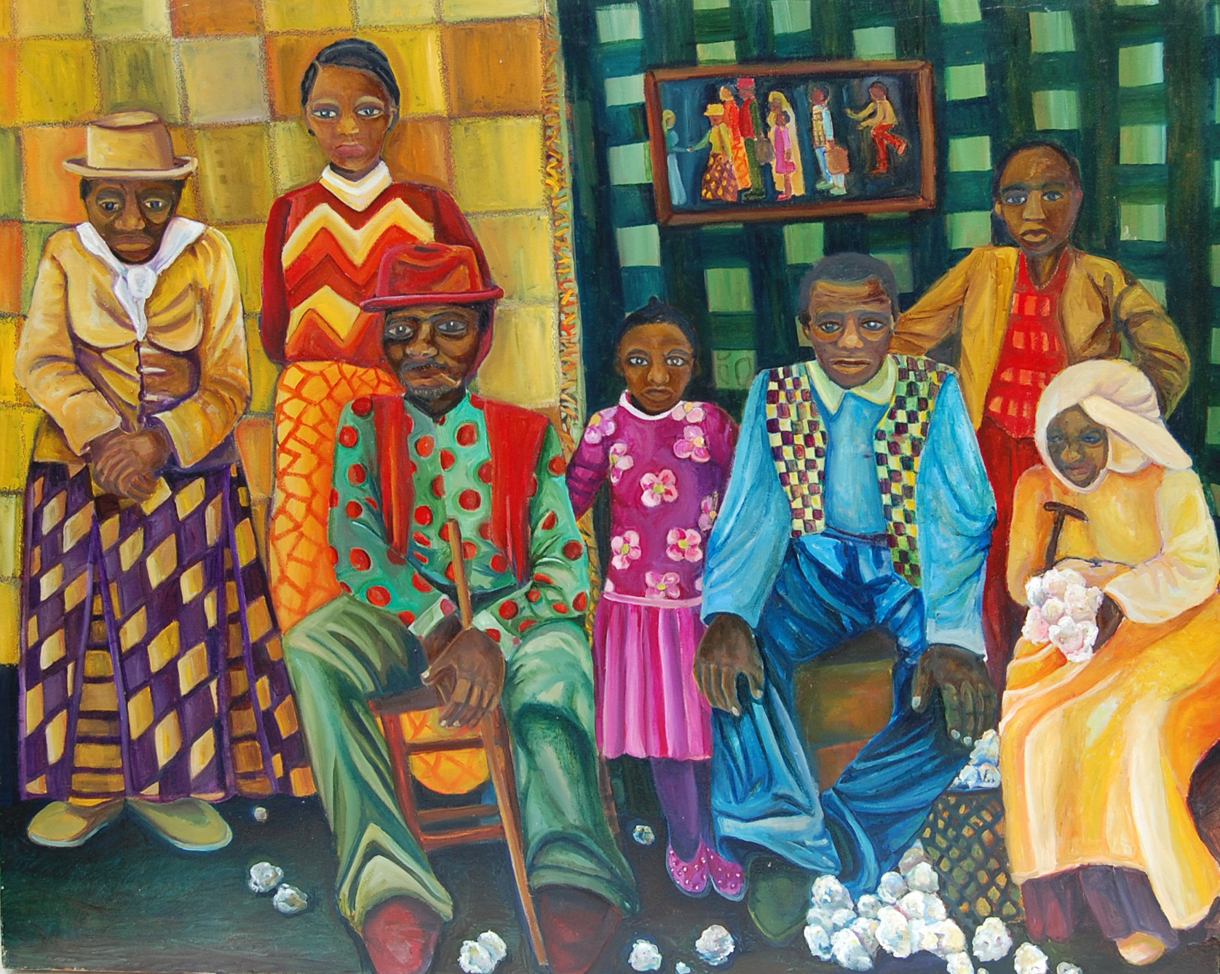
What math do we notice in this painting by South End artist Marilyn Jan Casey?
Sketch one of the shapes you see.
What does HALF of that shape look like?
What does a THIRD of the shape look like?
2.G.A3

Slide 9
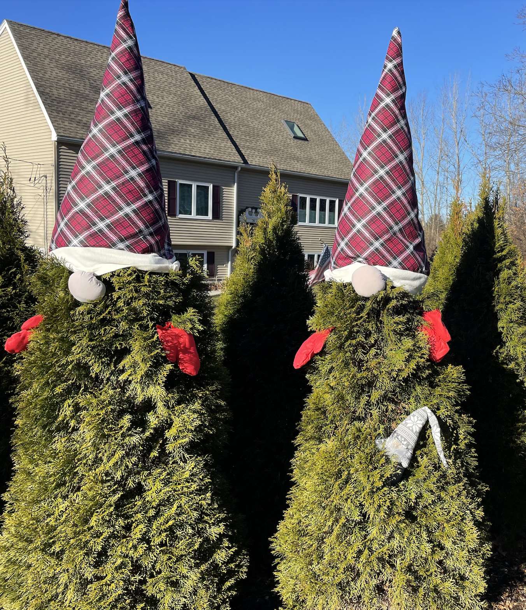
Yes, it’s gnome season!
If the Al (the little gray gnome) is 14 inches tall, how tall do you think the tree is?
How tall would both trees be?
2.MD.A3

Slide 10
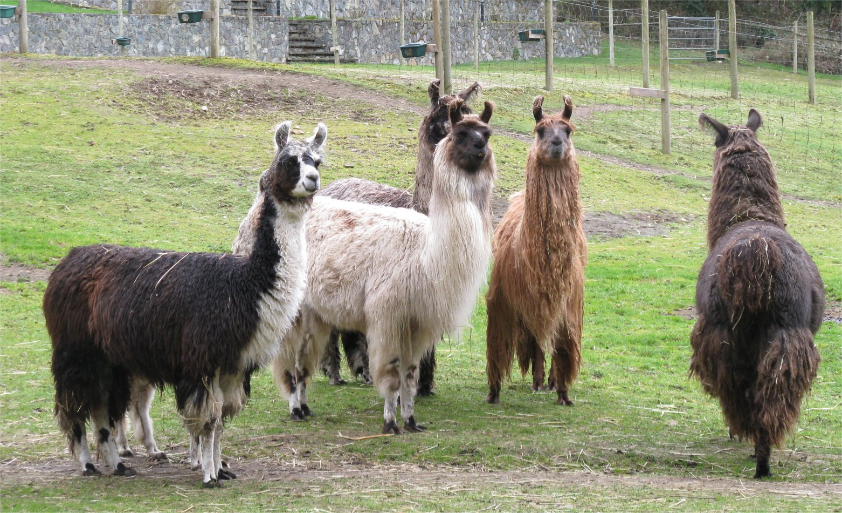
It’s International Llama Day!
How many llamas do we see here?
How many llama ears?
How many llama legs?
How do we know?
2.NBT.B5
Notes:
December 9, 2022
International Llama Day

Slide 11
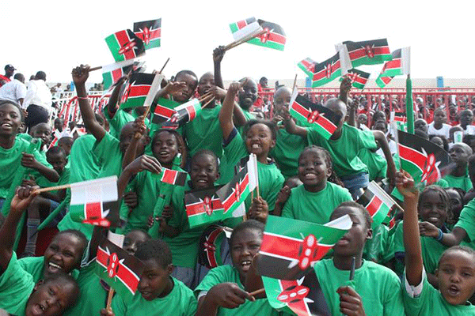
It’s Independence (Jamhuri) Day in Kenya!
On this day in 1964 Kenya became a republic!
How long ago was that?
Is that surprising to you?
2.NBT.B7
Notes:
Week of December 12, 2022

Slide 12
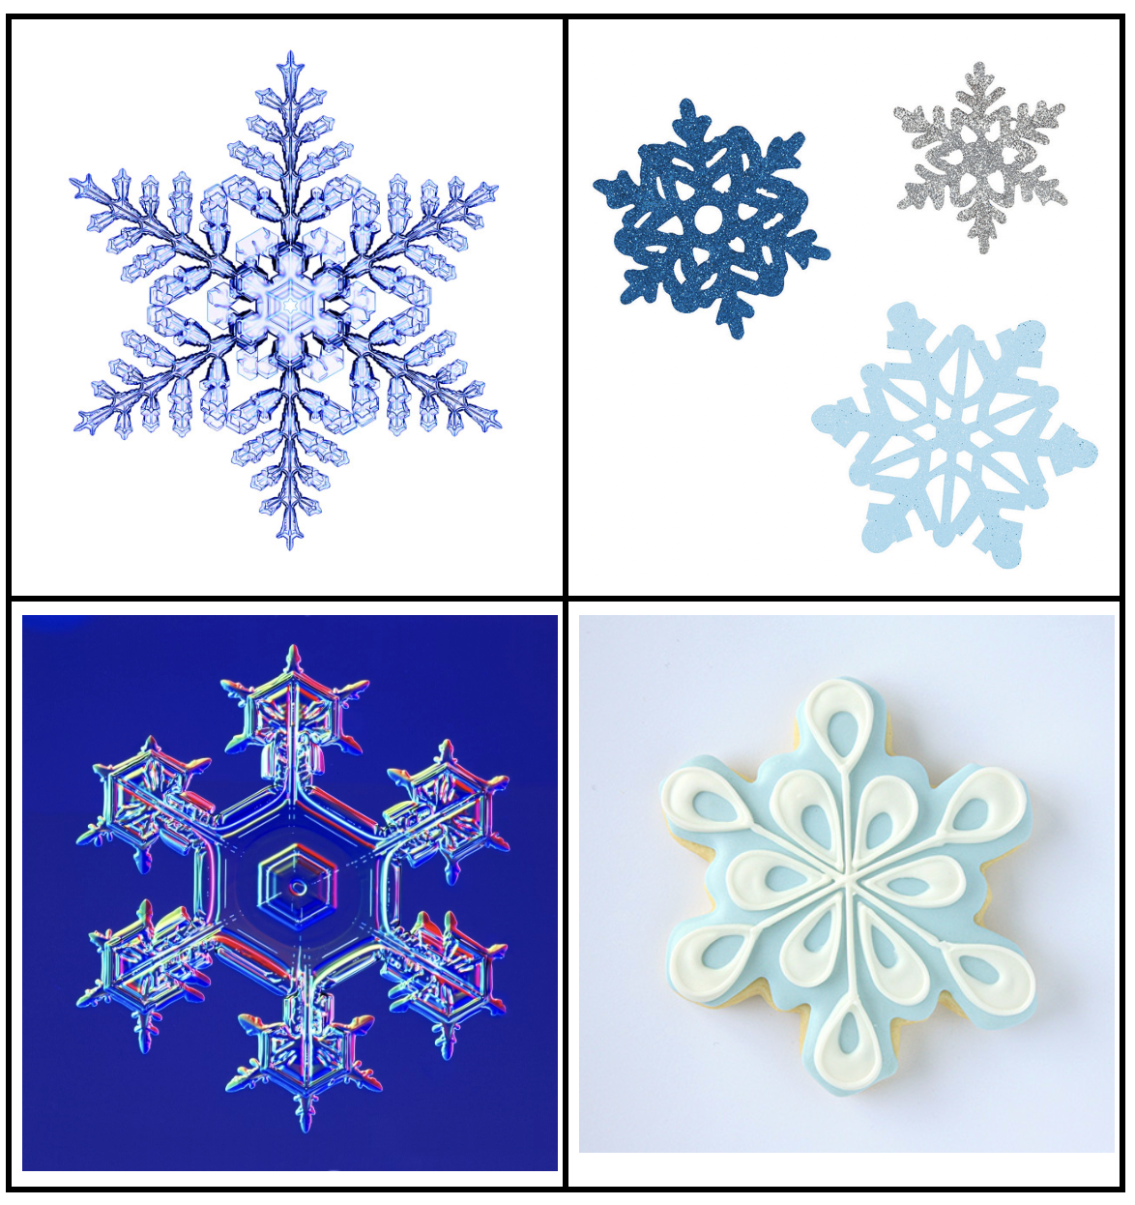
Which one doesn’t belong?
2.SMP.3

Slide 13
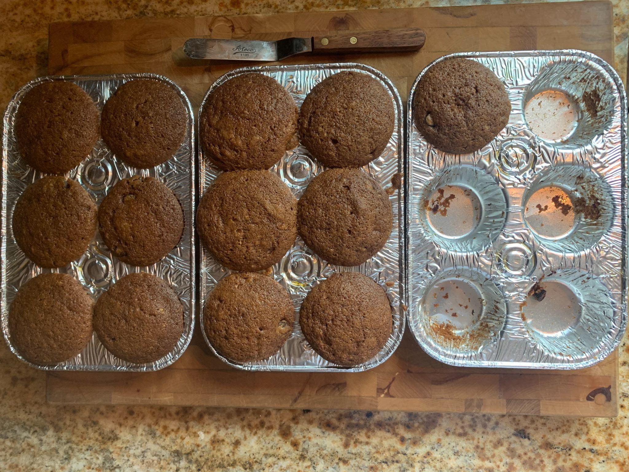
Cinnamon apple muffins
YUM!
How many were here before someone helped themself to the muffins?
What interesting expressions can we write to match this photo?
2.OA.A4

Slide 14
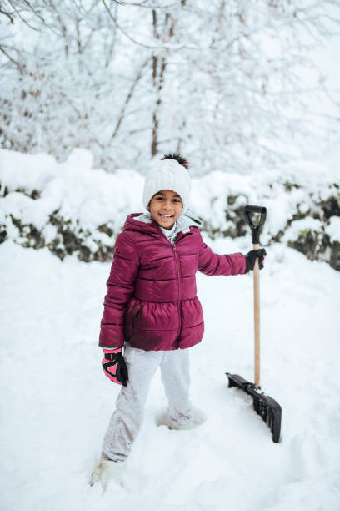
Would you rather….
Shovel a whole long sidewalk with 2 inches of snow
Or
A walkway to the front door with 8 inches of snow?
2.SMP.3

Slide 15

145 + 200 = 199 + 146
351 = 200 + 150 + 1
34 tens + 13 = 343
2.NBT.A4

Slide 16
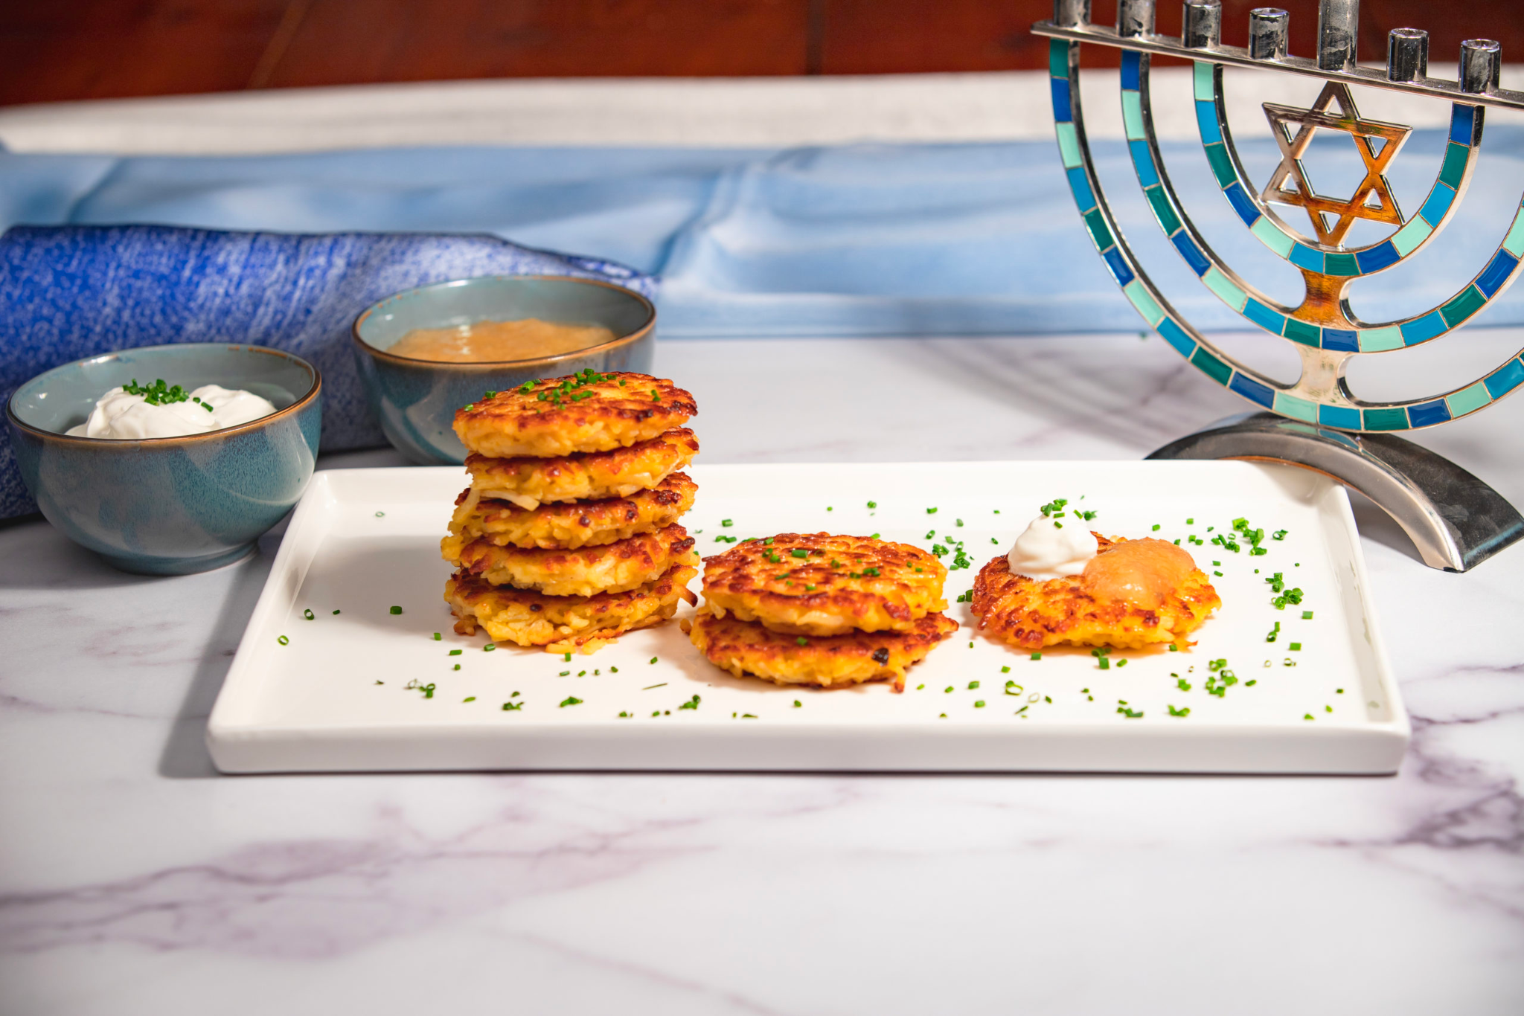
Happy Hanukkah!
What do we notice?
What do we wonder?
How many potato latkes would be on 2 plates?
3 plates? 4?
Do we see a pattern?
2.NBT.B5
Notes:
Week of December 19, 2022
Hanukkah

Slide 17
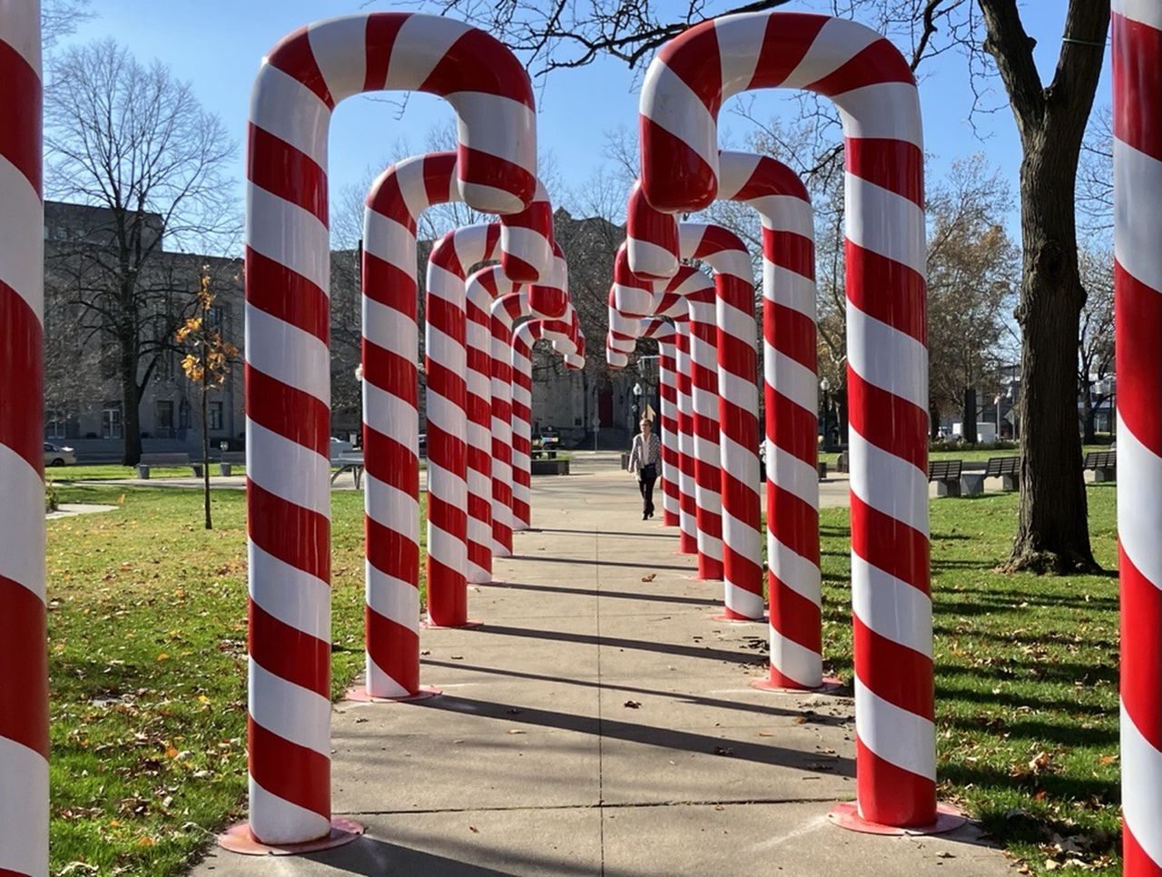
Estimate the height of one of these candy canes.
How do you know you’re close?
What strategy did you use?
2.MD.A3

Slide 18
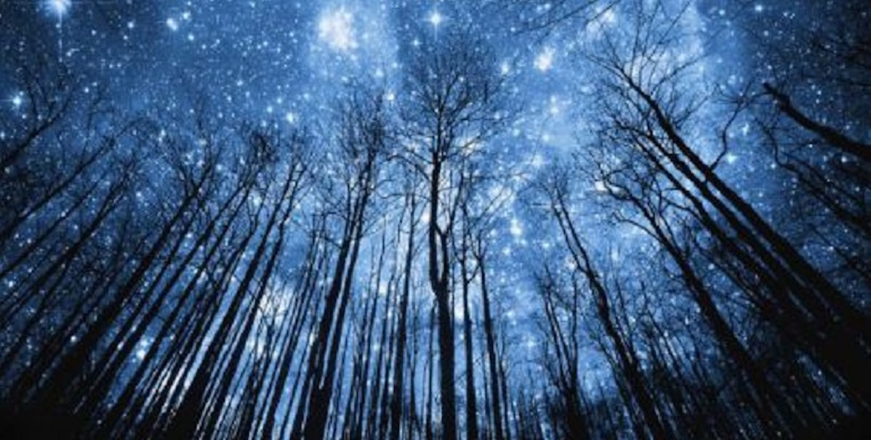
Today is the winter solstice!
It is the longest night of the year!
Today we have 15 hours of darkness!
So how many hours of daylight will we have?
2.OA.B2
Notes:
December 21, 2022
Winter Solstice

Slide 19
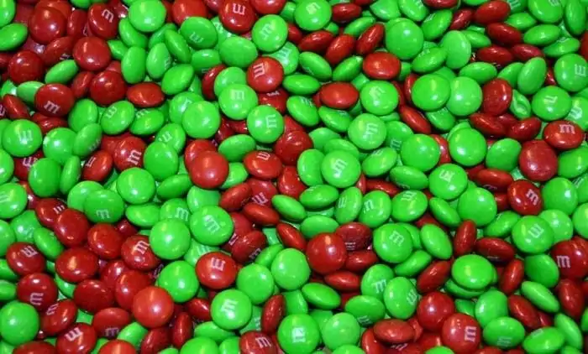
There are about 480 m&m’s per pound.
If there are 2 pounds of m&m’s here, what is possible?
2.NBT.B7

Slide 20
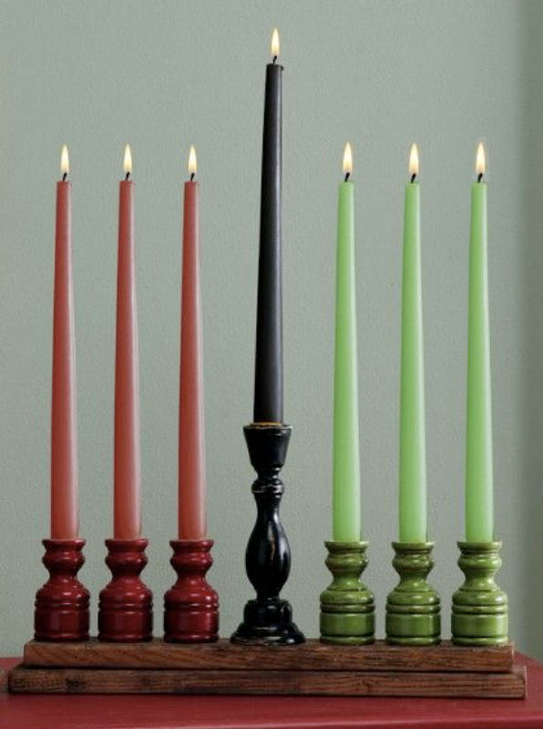
Happy Kwanzaa!
Kwanzaa is celebrated for 7 nights.
To light the kinara, we will need:
7 black candles
15 red candles
6 green candles
How many candles is that altogether?
2.NBT.B6

