Slide 1
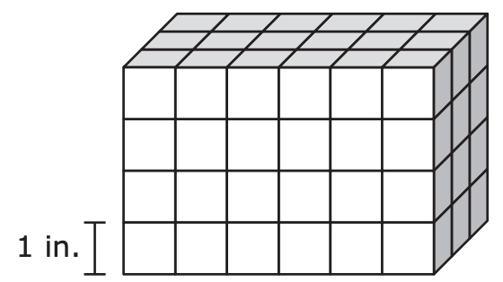
Which of the following expressions can be used to find the volume, in cubic inches, of the prism?
A. 6 + 4 + 3
B. 6 × 4 × 3
C. (6 × 4) + 3
D. 6 × (4 + 3)
What can we say about this prism?

Slide 2
What can we say about the number
18.495?
What is 18.495 rounded to the nearest
whole number?

Slide 3
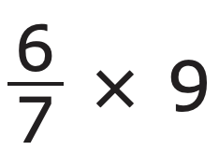
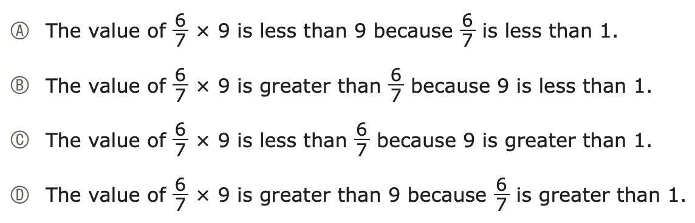
What can we say about ?
Which of the following statements is correct?

Slide 4
What can we say about this expression?
Which of the following expressions has a value of 5?
A. 64 ÷ (2 × 4 − 3)
B. (64 ÷ 2) × 4 − 3
C. 64 ÷ (2 × 4) − 3
D. 64 ÷ 2 × (4 − 3)
64 ÷ 2 × 4 − 3
Can we add one set of parentheses to the expression so that the value of the new expression is 5?

Slide 5
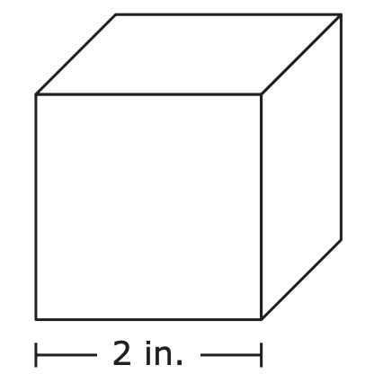
A student has a set of cubes. Each cube has an edge length of
2 inches, as shown.
What is the total number of cubes the student used to make the figure?
A. 3
B. 6
C. 8
D. 12
The student used the cubes to build a figure that has a volume of
24 cubic inches.

Slide 6

sixty-three and five hundred forty-six thousandths
What does this number look like?
Where would we see this number in the real world?

Slide 7

What can we say about
Can we think of what might be equivalent?
Which of the following expressions is equivalent?
A. 5 × 1 ÷ 2
B. 5 × 2 ÷ 1
C. (5 × 1) ÷ (5 × 2)
D. (5 × 2) ÷ (5 × 1)

Slide 8
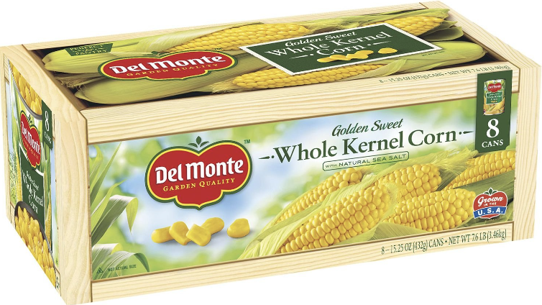
A factory worker packed 1,576 cans of corn into boxes.
The worker put 8 cans of corn into each box.
What is the total number of boxes the worker packed?
A. 160
B. 176
C. 192
D. 197
What is possible?

Slide 9
4 × (5 + 2)
4 x 5 + 2
Which of the following is equivalent to the expression:
4 × (5 + 2)
A. 11
B. 22
C. 28
D. 40
What is the same?
What is different?

Slide 10
Which of the following statements are correct?
Select the two correct answers.
A. The value of the 3 in 4,358 is ten times the value of the 3 in 6,932.
B. The value of the 3 in 4,358 is one-tenth the value of the 3 in 6,932.
C. The value of the 3 in 4,358 is one-hundredth the value of the 3 in 6,932.
D. The value of the 3 in 1,783 is ten times the value of the 3 in 6,932.
E. The value of the 3 in 1,783 is one-tenth the value of the 3 in 6,932.
F. The value of the 3 in 1,783 is one-hundredth the value of the 3 in 6,932.

Slide 11
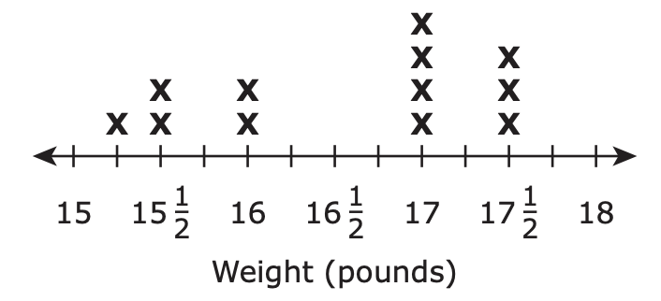
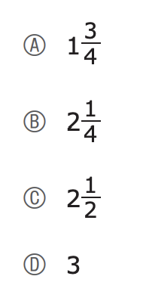
What is possible?
Weights of Monkeys!
What is the difference, in pounds, between the monkey with the greatest weight and the monkey with the least weight?

Slide 12
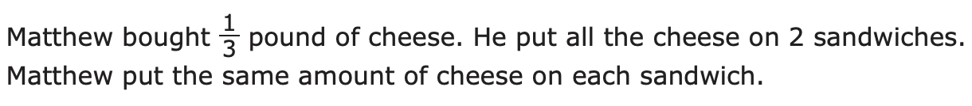
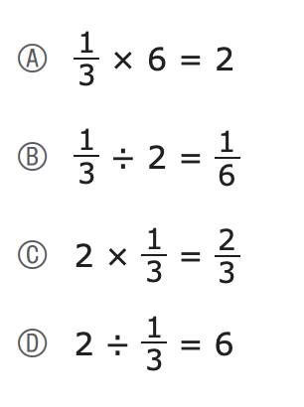
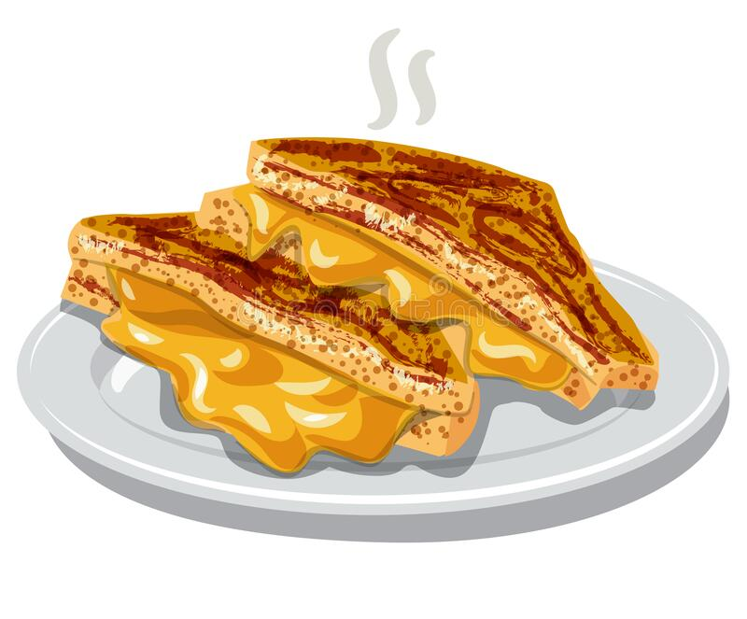
Where’s the math?
Which of the following equations shows the amount of cheese, in pounds, on each sandwich?

Slide 13
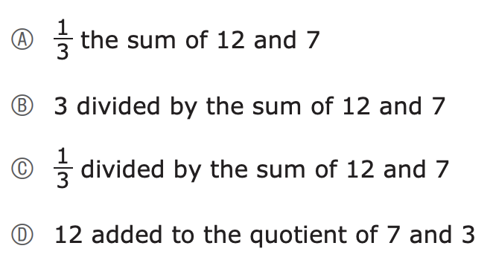
Let’s think about
7 times the difference of 12 and 3 and (12 + 7) ÷ 3
Which of the following numerical expressions is equivalent to the expression:
7 times the difference of 12 and 3
A. 7 × 12 − 3
B. 12 − 3 × 7
C. (7 × 12) − 3
D. (12 − 3) × 7
Which of the following word expressions is equivalent to the numerical expression:
(12 + 7) ÷ 3

Slide 14
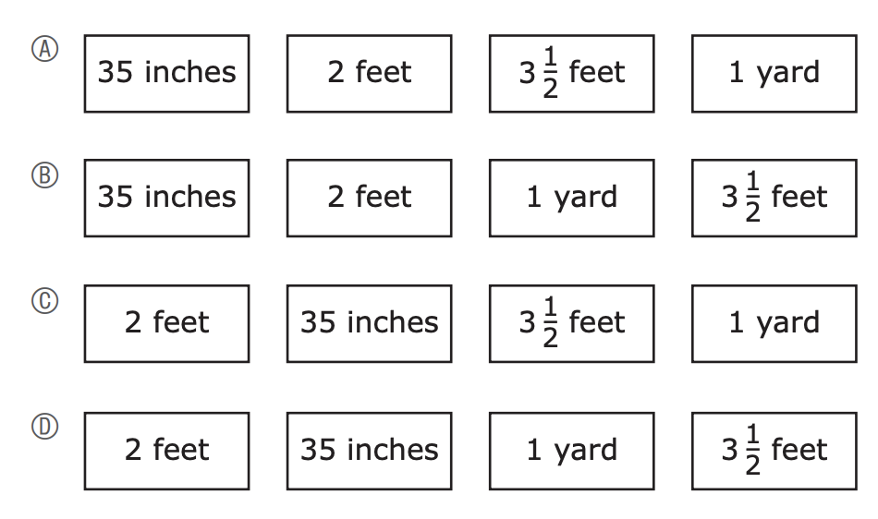
Which one shows the measurements ordered from least to greatest length?
Hmmm….. What can we say about these measurements?

Slide 15
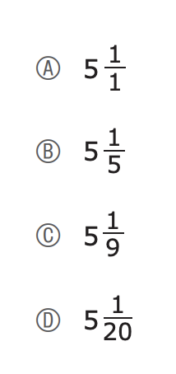
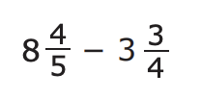
What strategy would you use to solve this?

Slide 16
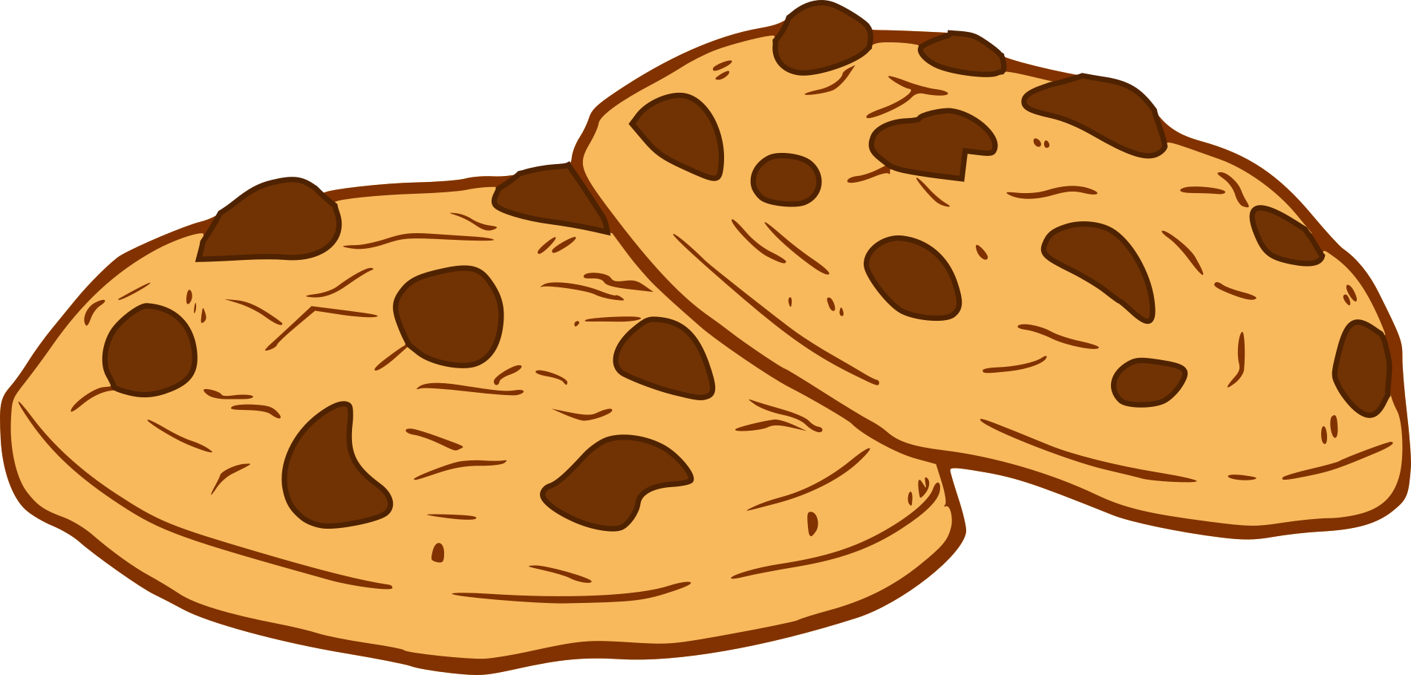
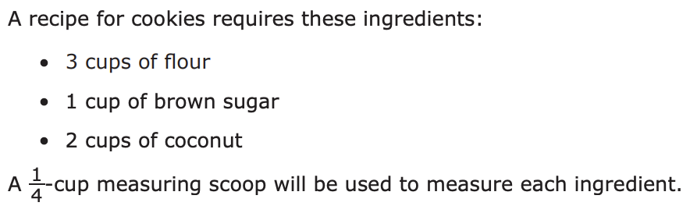
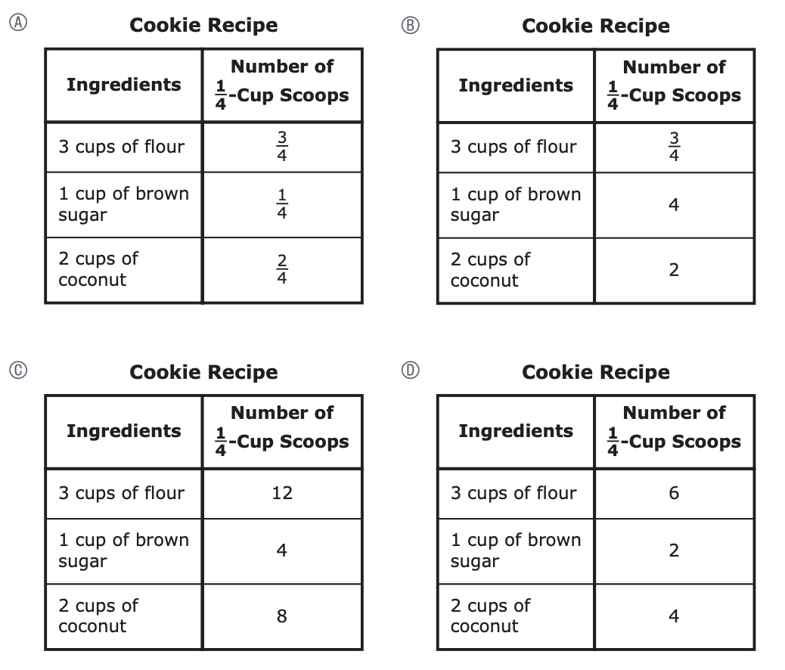
How can we use ONLY a quarter-cup scoop?
Which of the following tables shows the correct number of one-fourth-cup scoops for each ingredient needed to make the cookies?

Slide 17
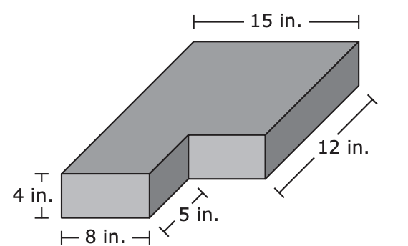
A three-dimensional figure is composed of two rectangular prisms. The figure and some of its dimensions are shown.
What can we say about the volume?
What is the volume, in cubic inches, of the three-dimensional figure?
A. 880
B. 720
C. 496
D. 160

Slide 18
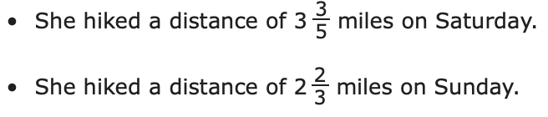
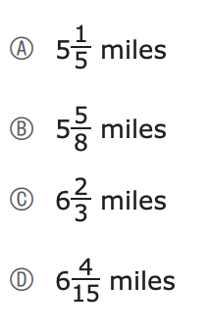
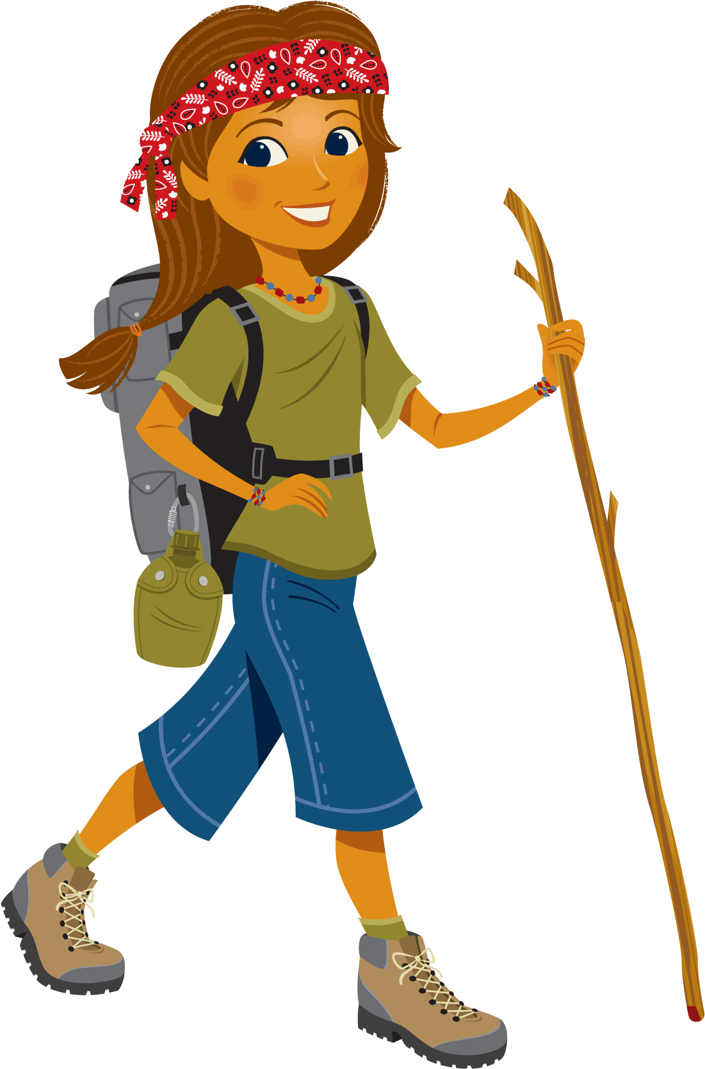
Beatriz hiked on Saturday and Sunday.
What can we say about her total distance?
What is the total distance Beatriz hiked on both days?

