Slide 1
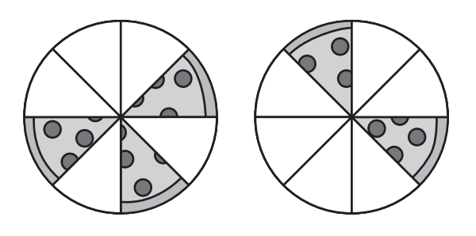
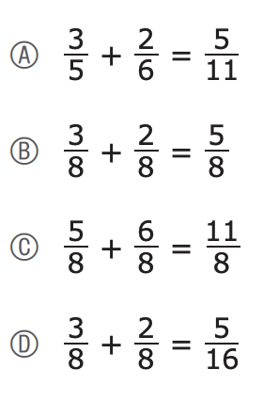
A family ordered two pizzas for dinner. Both pizzas were the same size. Each slice of pizza was the same size.
Which of these equations shows how to find the fraction of a whole pizza that was remaining?
This diagram shows the amount of pizza remaining after dinner.
What do we notice?

Slide 2
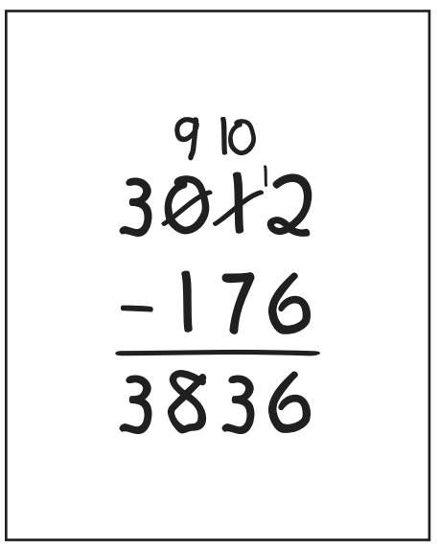
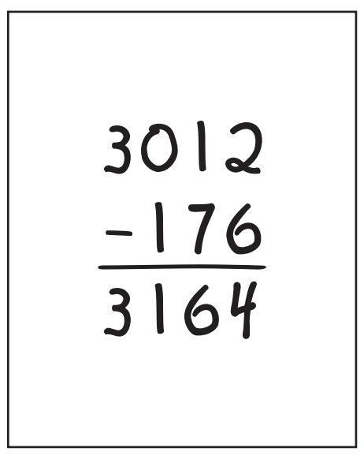
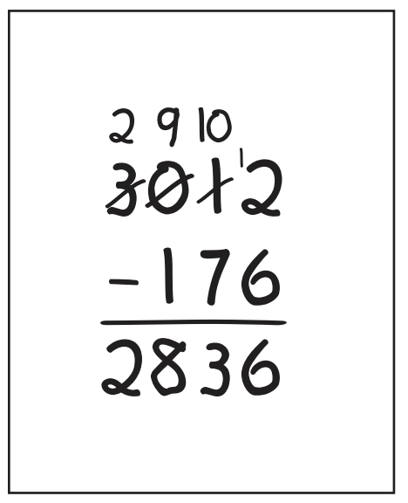
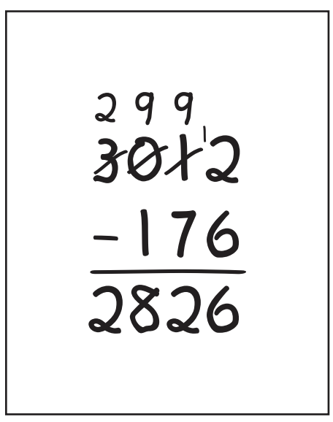
Claire correctly worked out the answer to a subtraction problem. Which of these could be Claire’s problem and work?

Slide 3
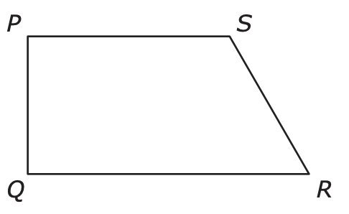
Which line segments and angles did a student use to create the figure?
Select the two correct answers.
A. line segment PR
B. line segment PQ
C. line segment QS
D. angle SPQ
E. angle SQR
F angle QSR
What can we say about the line segments and angles in this figure?

Slide 4
9,176
In which of these numbers does the 7 have a value that is ten times the value of the 7 in 9,176?
A. 2,473
B. 3,724
C. 4,327
D. 7,432
What can we say about this number?

Slide 5
Which of these comparisons are correct?
Select the two correct answers.
A. 0.29 < 0.8
B. 0.29 > 0.8
C. 0.29 = 0.8
D. 0.8 < 0.29
E. 0.8 > 0.29

Slide 6
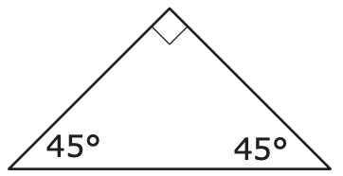
What can we say about this triangle?
How many lines of symmetry does the triangle have?

Slide 7
Which of these statements are correct?
A. 36 ÷ p = 4 has a related multiplication fact of p × 4 = 36.
B. 36 ÷ p = 4 has a related multiplication fact of 36 × p = 4.
C. s ÷ 7 = 5 has a related multiplication fact of s × 5 = 7.
D. s ÷ 7 = 5 has a related multiplication fact of 7 × 5 = s.
E. 72 ÷ 12 = a has a related multiplication fact of a × 12 = 72.
F. 72 ÷ 12 = a has a related multiplication fact of a × 72 = 12.

Slide 8
What can we say about the areas of the garden and the patio?
GARDEN
PATIO
35 sq.ft.
4 ft.
5 ft.
8 ft.
What can we say about the perimeters?
The area of the flower bed is less than the area of the garden.
The perimeter of the flower bed is equal to the perimeter of the patio.
What could be the length and the width?
🌺🌺🌺🌺🌺🌺🌺🌺🌺
🌼 FLOWER BED 🌼
🌸🌸🌸🌸🌸🌸🌸🌸🌸

Slide 9
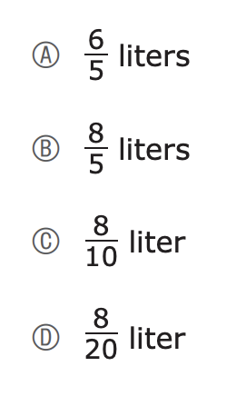

How much does she drink in two mornings?
Three mornings? How much in four morning?

Slide 10
🏀
😄🐳
A teacher has 8 sheets of stickers for decorating posters.
• Each sheet has 10 stickers.
• Each poster will have exactly 3 stickers.
What is the greatest number of posters the teacher can decorate?
A. 25 posters
B. 26 posters
C. 27 posters
D. 28 posters
What do we notice?
What do we wonder?

Slide 11

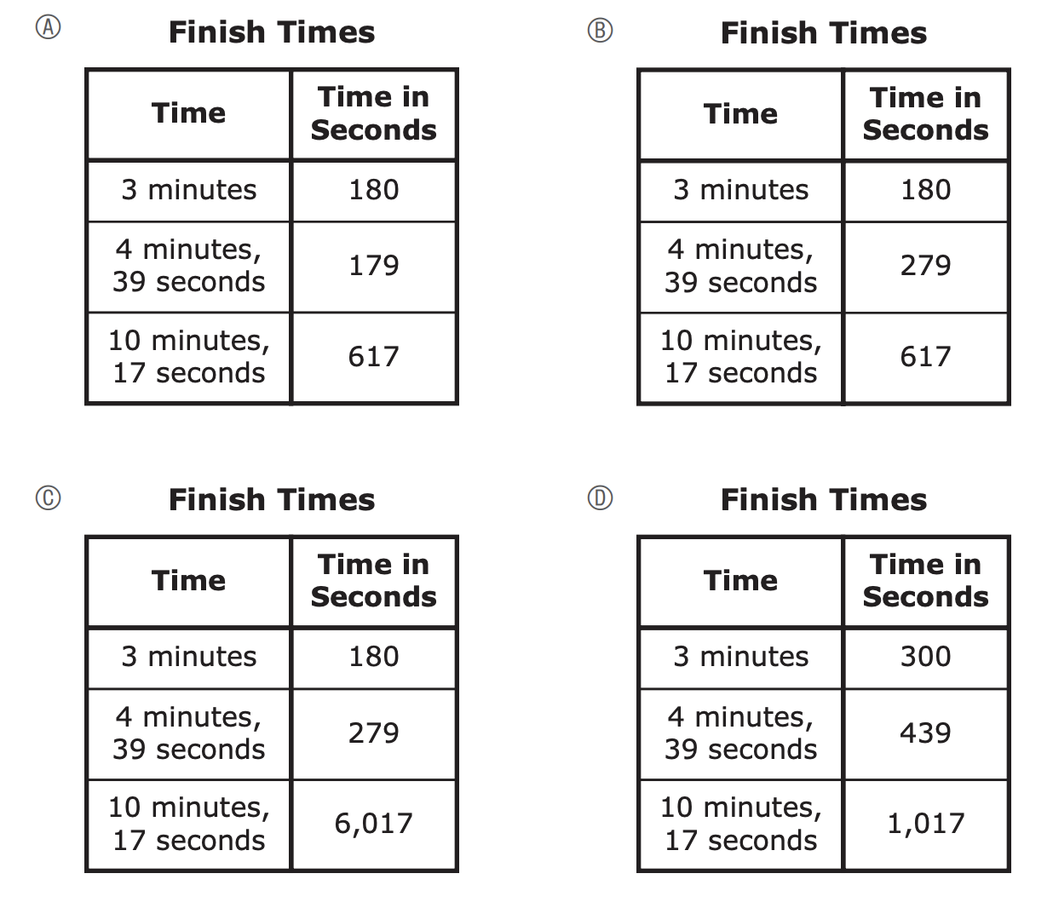
A student’s finish times for three races are:
3 minutes
4 minutes, 39 seconds
10 minutes, 17 seconds
Which table shows the student’s finish times, in seconds, for the three races?

Slide 12
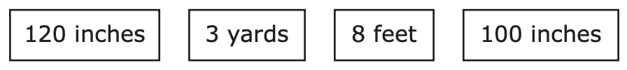
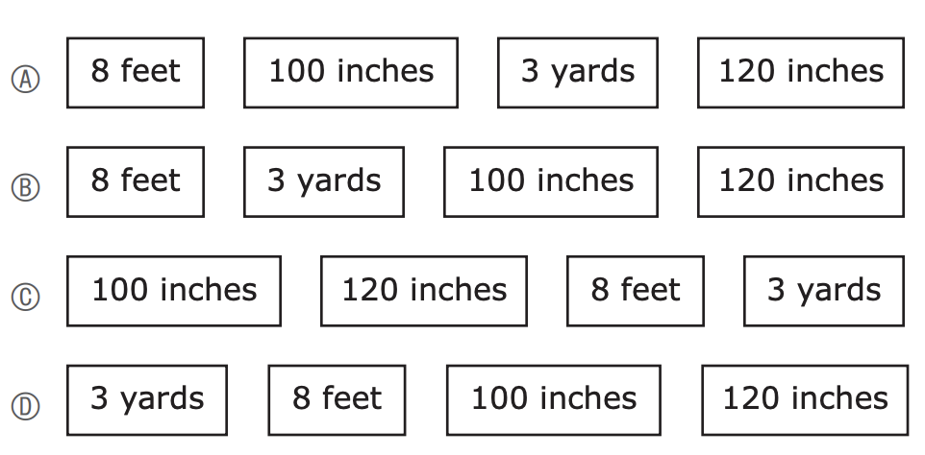

The distances of a student’s four softball throws were recorded
using different units of measurement,
Which of these shows the distances of the softball throws in the correct order from least to greatest?

Slide 13
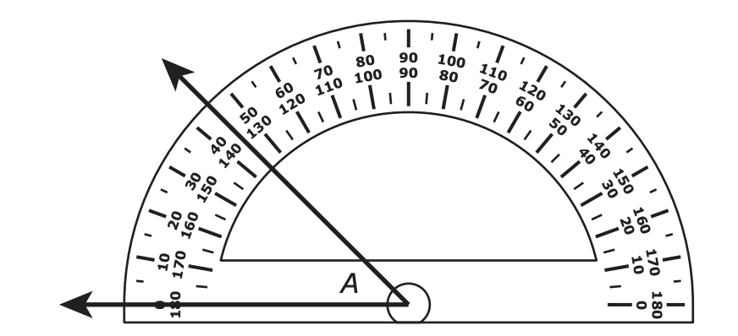
What can we say about angle A?

Slide 14

What do we notice?
What do we wonder?

Slide 15
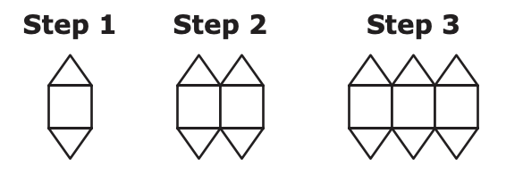
What can we say about this pattern?
A. What is the total number of triangles in Step 4 of the pattern?
B. What is the total number of squares in Step 6 of the pattern?
C. What is the total number of triangles in Step 9 of the pattern?
D. One step in the pattern will have a total of 64 triangles. What is the total number of squares in that step?

Slide 16
What can we say about the number 142,839?
Which of these sentences are correct? Select the three correct answers.
A. The number 142,839 rounded to the nearest thousand is 142,000.
B. The number 142,839 rounded to the nearest thousand is 143,000.
C. The number 142,839 rounded to the nearest ten thousand is 140,000.
D. The number 142,839 rounded to the nearest ten thousand is 150,000.
E. The number 142,839 rounded to the nearest hundred thousand is 100,000.
F. The number 142,839 rounded to the nearest hundred thousand is 200,000.

Slide 17
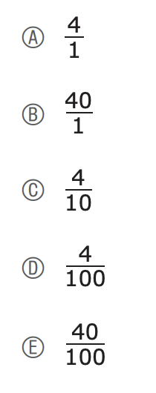
What can we say about these fractions?
Which two fractions are equivalent?
Select the two correct answers.

Slide 18
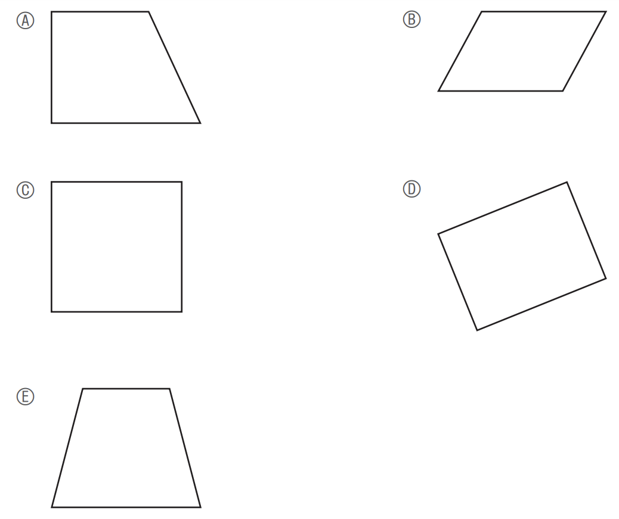
Which of these shapes appear to have at least one pair of parallel sides and at least one pair of perpendicular sides?
Select the three correct shapes.
What is the same? What is different?

Slide 19
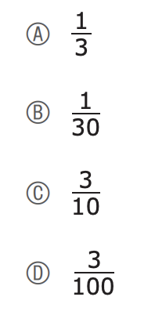
What can we say
about these fractions?
Which of these fractions is equivalent to 0.3?

Slide 20

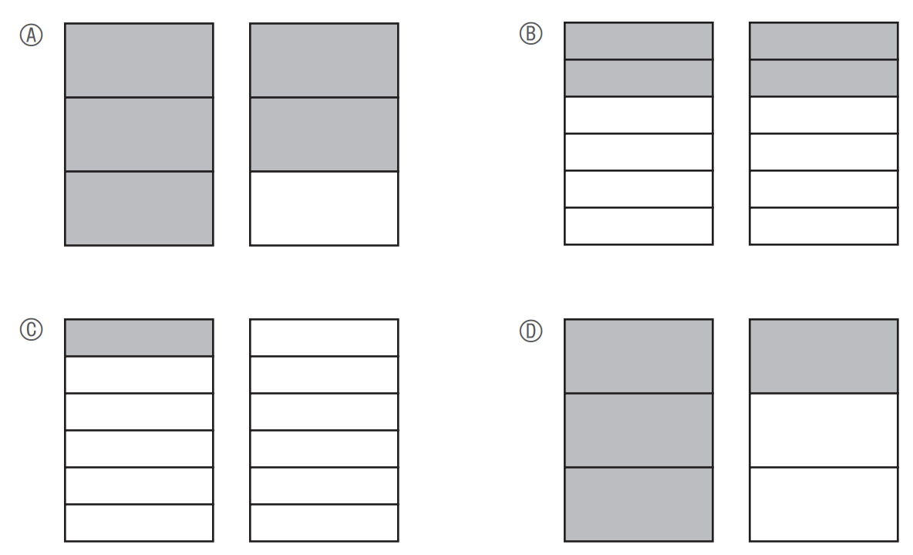
Can we visualize this expression?
Which fraction model is shaded to show the product of this expression?

