Slide 1
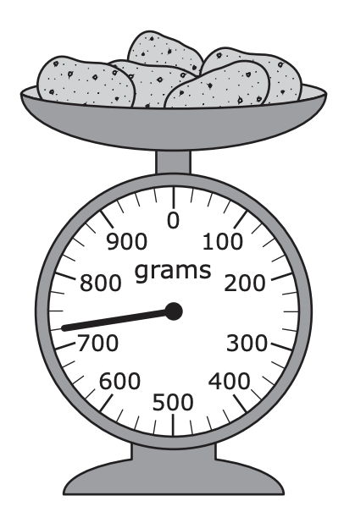
What do we notice?
What is the total mass, in grams, of the potatoes?
A. 700 grams
B. 725 grams
C. 750 grams
D. 775 grams

Slide 2

36 ÷ 9 = p
A. There were 36 players on each team. There were 9 teams. What was the total number of players on all the teams?
B. There were 36 players on a team. Then, 9 players left the team. What is the total number of players on the team now?
C. There were 36 players on a team. Then, 9 players joined the team. What is the total number of players on the team now?
D. There were 36 players on a team. The players were split equally into 9 groups. What was the total number of players in each group?
Let’s think of a story problem to match this equation.
A coach used this equation to solve a problem.
Which of these could be the problem the coach solved?

Slide 3
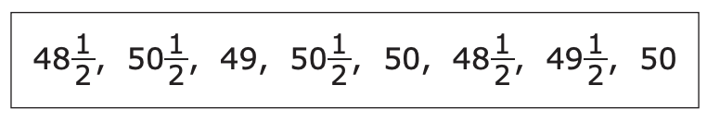
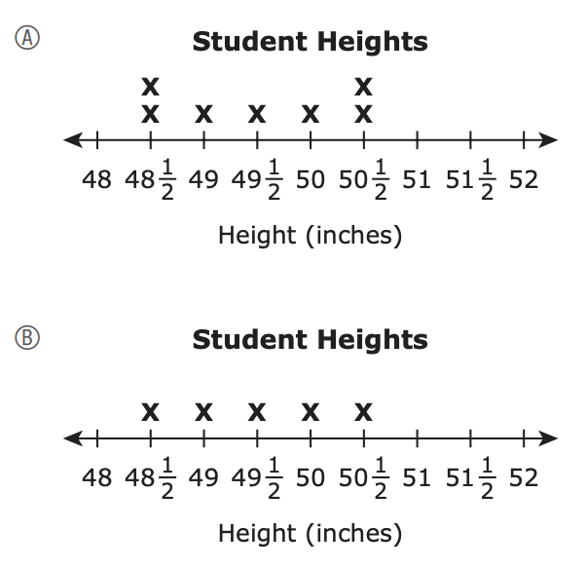
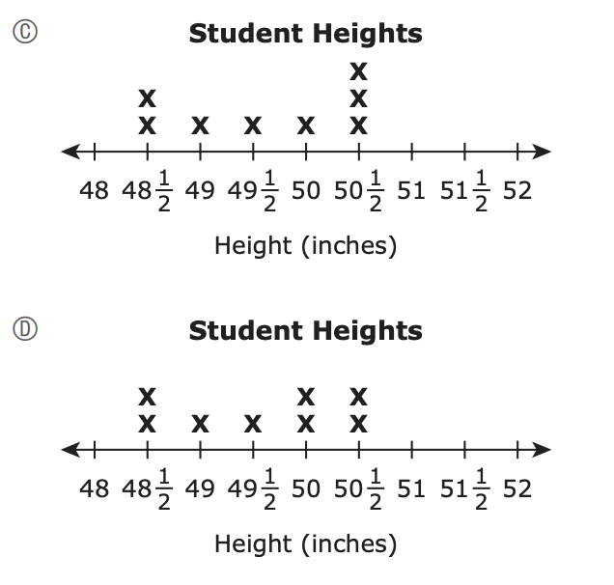
What is possible?
The heights, in inches, of 8 students
Which line plot shows this?

Slide 4
I’m thinking of a number, when I round it to the NEAREST HUNDRED
it is 500
A. The number 324 rounded to the nearest hundred is 300.
B. The number 324 rounded to the nearest hundred is 400.
C. The number 186 rounded to the nearest hundred is 100.
D. The number 186 rounded to the nearest hundred is 200.
E. The number 242 rounded to the nearest hundred is 200.
F. The number 242 rounded to the nearest hundred is 300.
What is possible?
Which of these statements are correct?
Select the three correct answers.
Notes:
What is possible?

Slide 5

Which of these equations are true? Select the 3 correct answers.
A. 9 × 8 = 72
B. 9 × 7 = 72
C. 35 ÷ 5 = 8
D. 35 ÷ 5 = 7
E. 9 × 7 = 56
F. 8 × 7 = 56

Slide 6
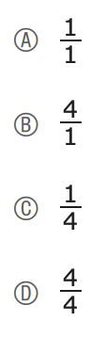
Which of these fractions is equivalent to the number 4?

Slide 7
Which multiplication equation could we have used to solve the division equation?
A. 18 × 3 = n
B. n × 18 = 3
C. n = 3 × 18
D. 18 = 3 × n
18 ÷ 3 = n
Can we use multiplication to solve this division equation?

Slide 8
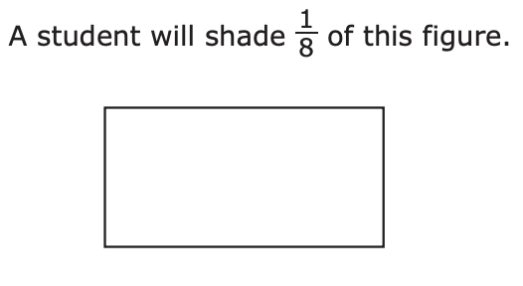
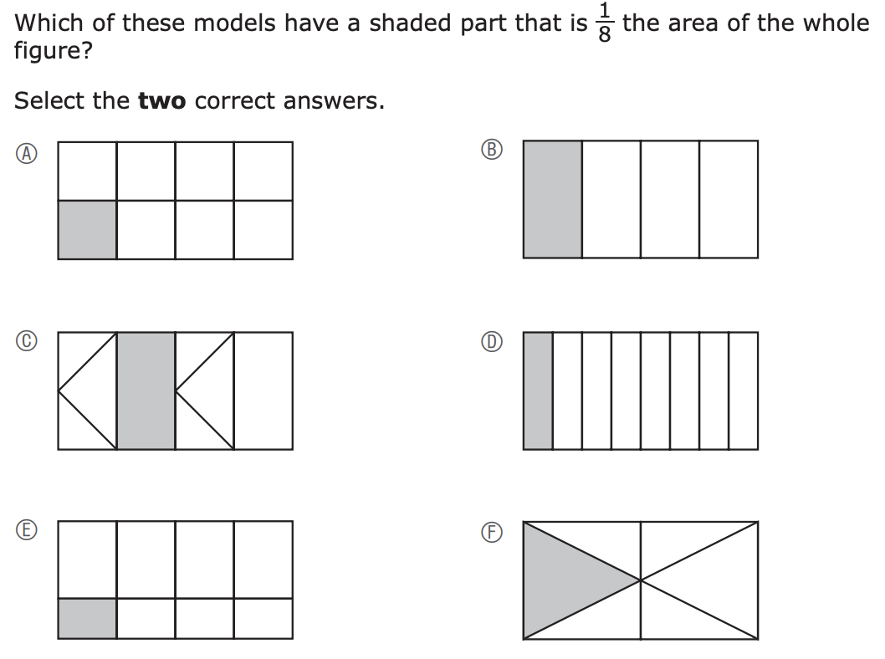
What might that look like?

Slide 9
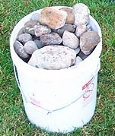
A science class collected rocks in a park.
The students put all of the rocks into 5 buckets.
They put 70 rocks into each bucket.
What was the total number of rocks the students collected?
A. 350 rocks B. 280 rocks
C. 35 rocks D. 14 rocks

Slide 10
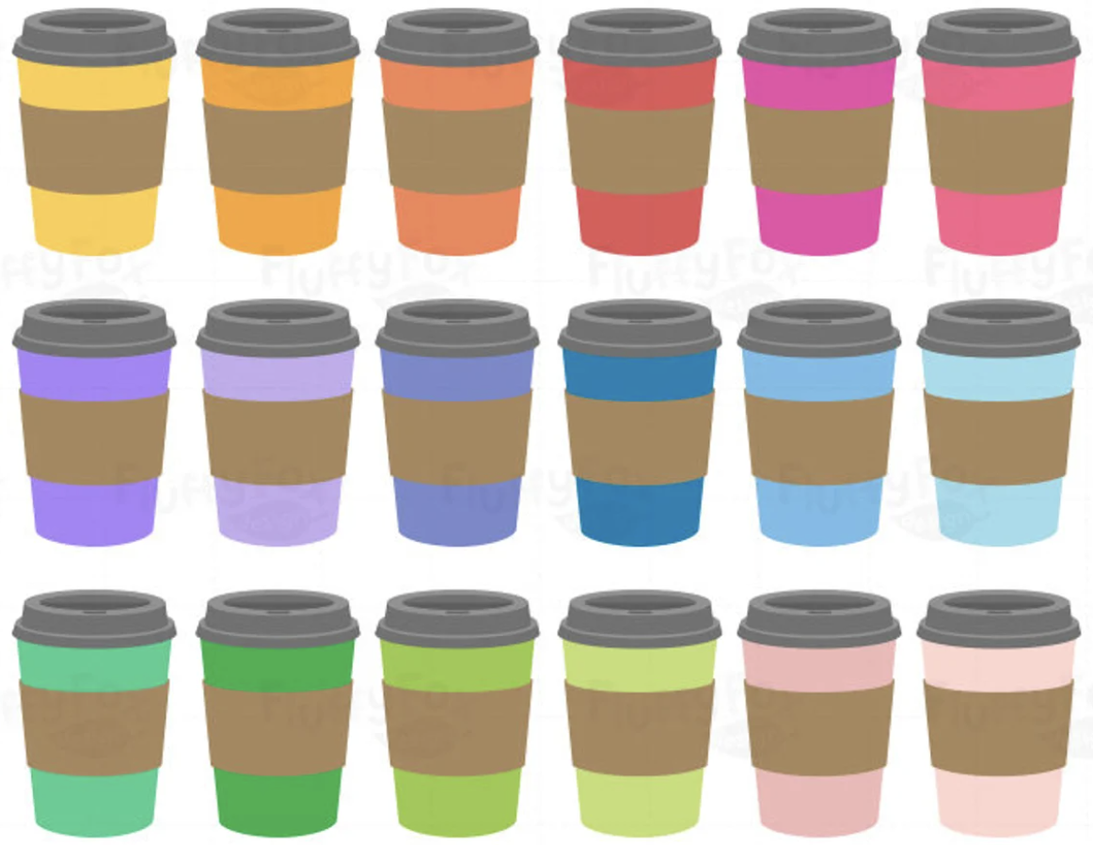
Cups of coffee were served at a parent meeting at a school.
The number of cups served, rounded to the nearest hundred, was 200.
Which of these numbers could be the actual number of cups of coffee served? Select the two correct answers.
A. 109
B. 267
C. 152
D. 254
E. 231

Slide 11
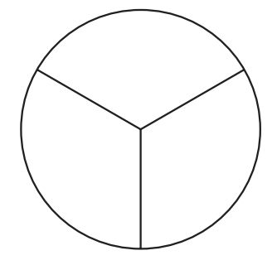
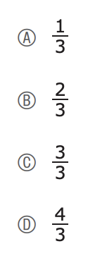
Which fraction of the area of the whole circle is one part?

Slide 12
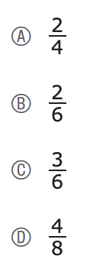
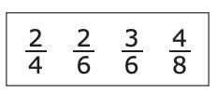
What do we notice about these fractions?
Which fraction in the box is not equal to the other fractions in the box?

Slide 13
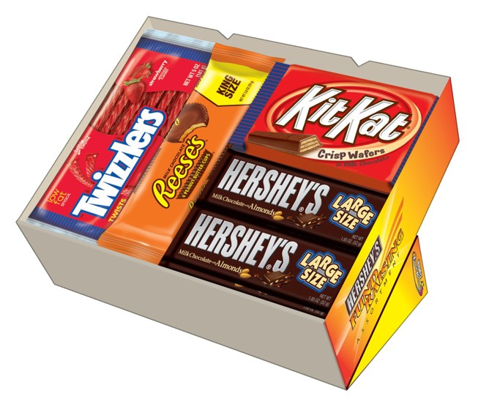
A student sold candy bars on Monday, Tuesday, and Wednesday.
What is the total number of candy bars the student sold on Wednesday?
A. 39
B. 58
C. 86
D. 211
She sold a total of 125 candy bars over the three days.
She sold 67 candy bars on Monday.
She sold 19 candy bars on Tuesday.

Slide 14
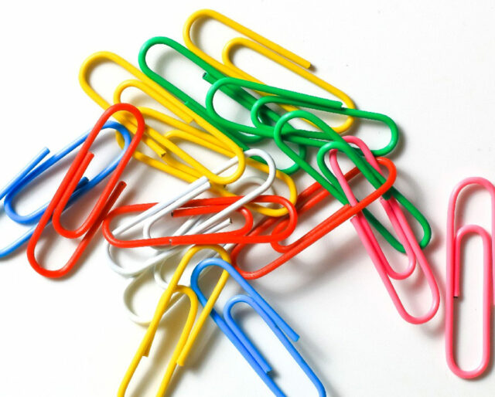
Evan used exactly 20 paper clips to make an array.
Which of these could be the array Evan made?
A. 2 rows of 20 paper clips
B. 4 rows of 6 paper clips
C. 5 rows of 4 paper clips
D. 10 rows of 10 paper clips
What is possible?

Slide 15

There are 48 students in a library. The students are working in groups.
Which equation can be used to find n, the number of groups of students working in the library?
A. 48 ÷ 6 = n
B. n ÷ 6 = 48
C. 48 × 6 = n
D. n × 48 = 6
Each group has 6 students.
What do we know?

