Slide 1
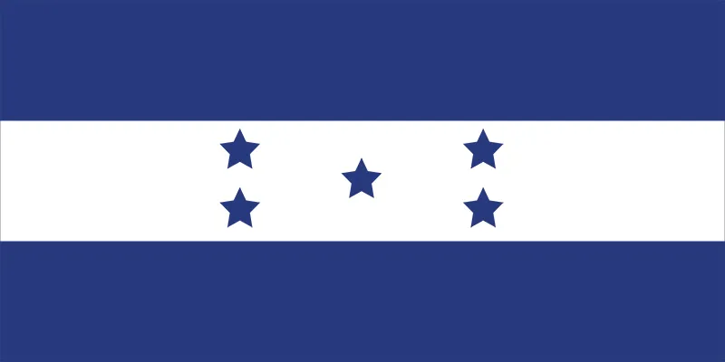
Happy Morazan Day in Honduras!
What can we count on this flag? What shapes do we see?
K.G.A2
Notes:
Week of October 3, 2022

Slide 2
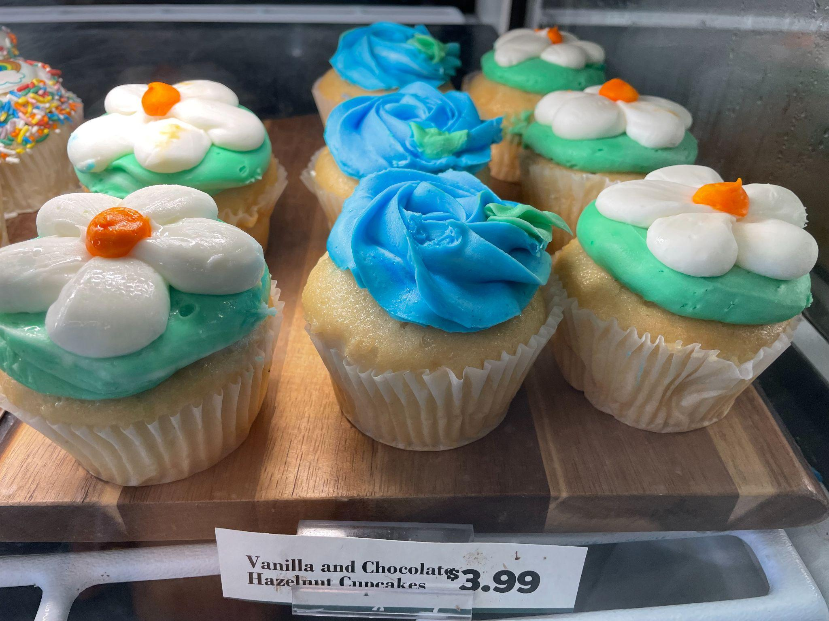
How many cupcakes?
How do we know?
How can we count them?
K.CC.B4

Slide 3
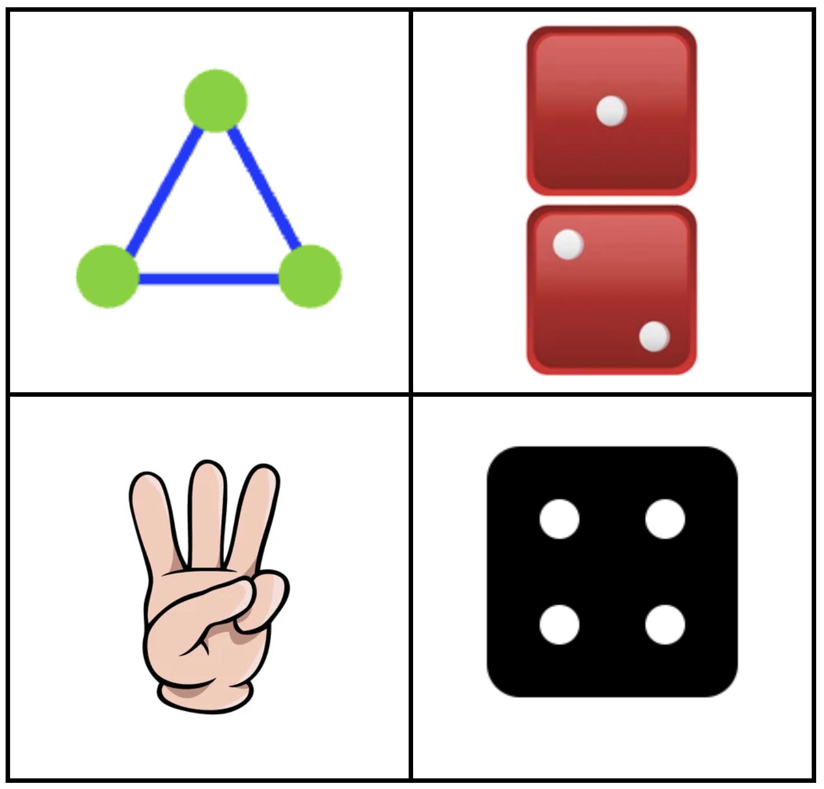
Which one doesn’t belong?
K.CC.C6
Notes:
Top left: only shape with dots on the outside
Top right: not one object
Bottom left: not shape
Bottom right: not 3

Slide 4
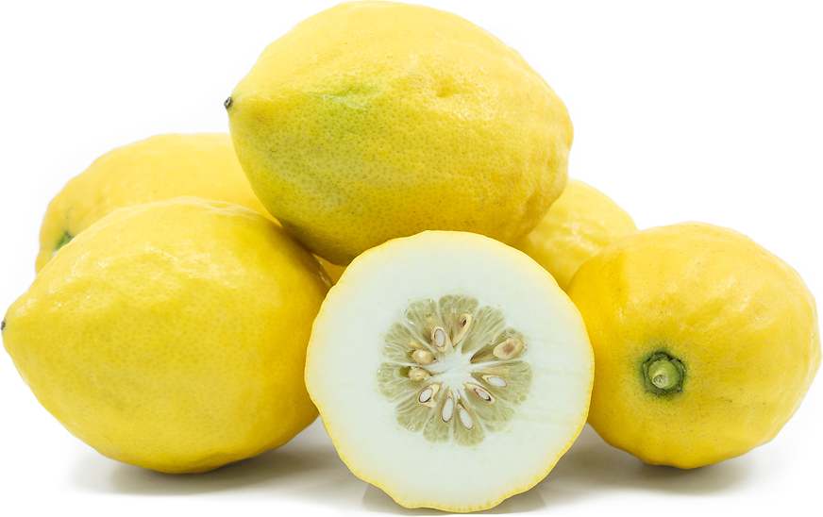
Happy Sukkot!
How many Etrogs are here?
How do we know?
K.CC.B5
Notes:
October 9, 2022
Sukkot

Slide 5
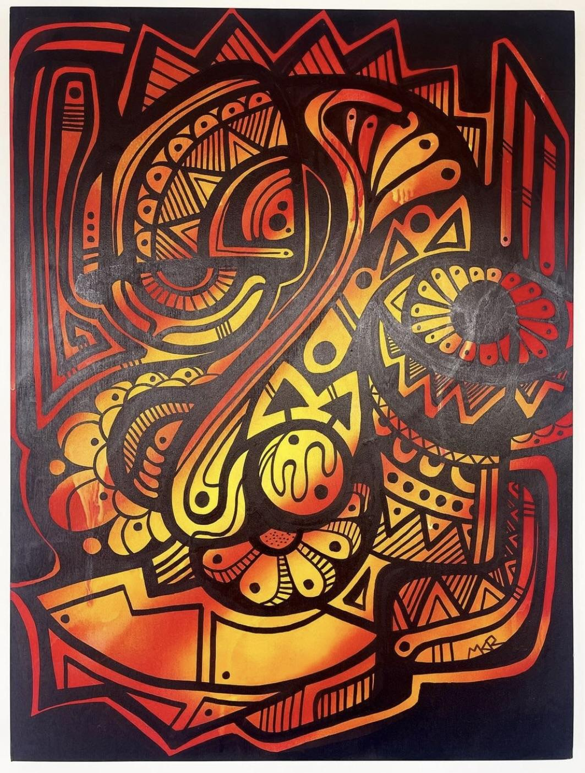
Let’s Celebrate Indigenous Peoples Day with Mr. Ginga’s beautiful “Gather 001”
Let’s talk about the shapes we see.
K.G.A2
Notes:
Week of October 11, 2022
Indigenous Peoples Day

Slide 6
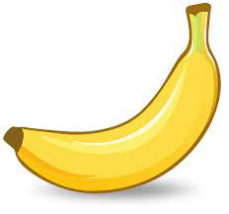
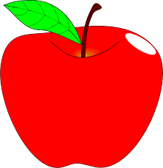
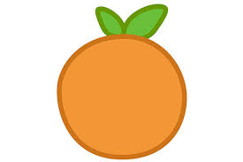
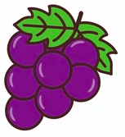
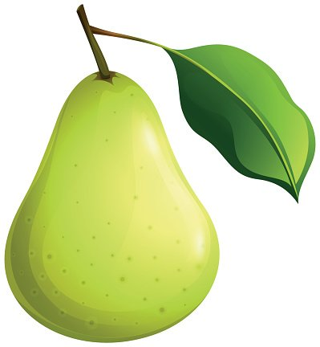
If this chart could talk, what would it say?
K.MD.B3

Slide 7
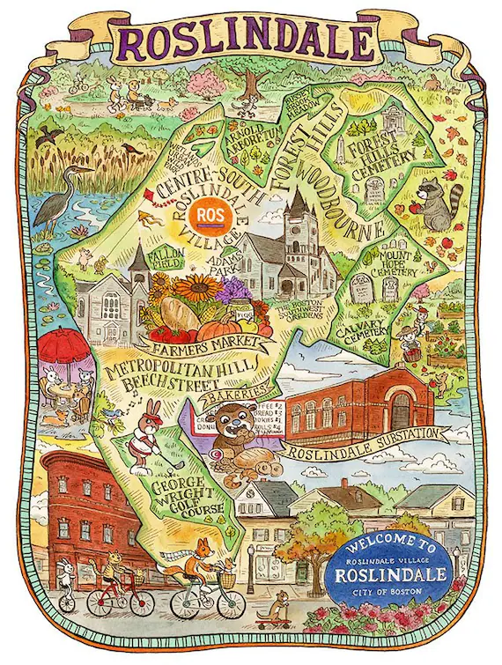
What do we notice?
What do we wonder?
What can we say about what we see?
Let’s use the words
above, below
and next to
K.G.A1

Slide 8
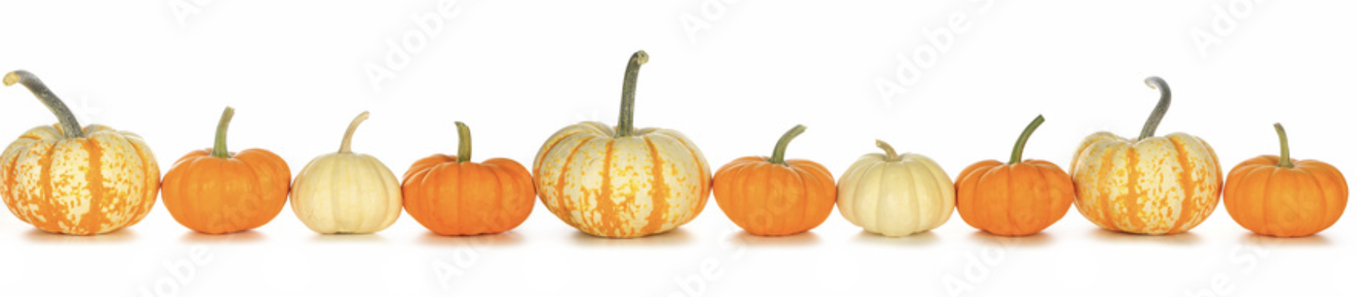
What do we notice?
What do we wonder?
Are there more orange pumpkins or white ones?
K.CC.C6

Slide 9

It’s National Heroes Day in Jamaica.
What shapes do we see in Jamaica’s flag? How many do we see?
K.G.B4
Notes:
Week of October 17, 2022
Jamaica National Heroes Day

Slide 10
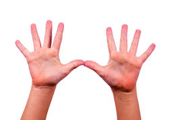
How many DIFFERENT ways can we show 5 with your fingers?
How many DIFFERENT ways can we show 6?
K.OA.B5

Slide 11
What is the same? What is different?
K.G.B4

Slide 12
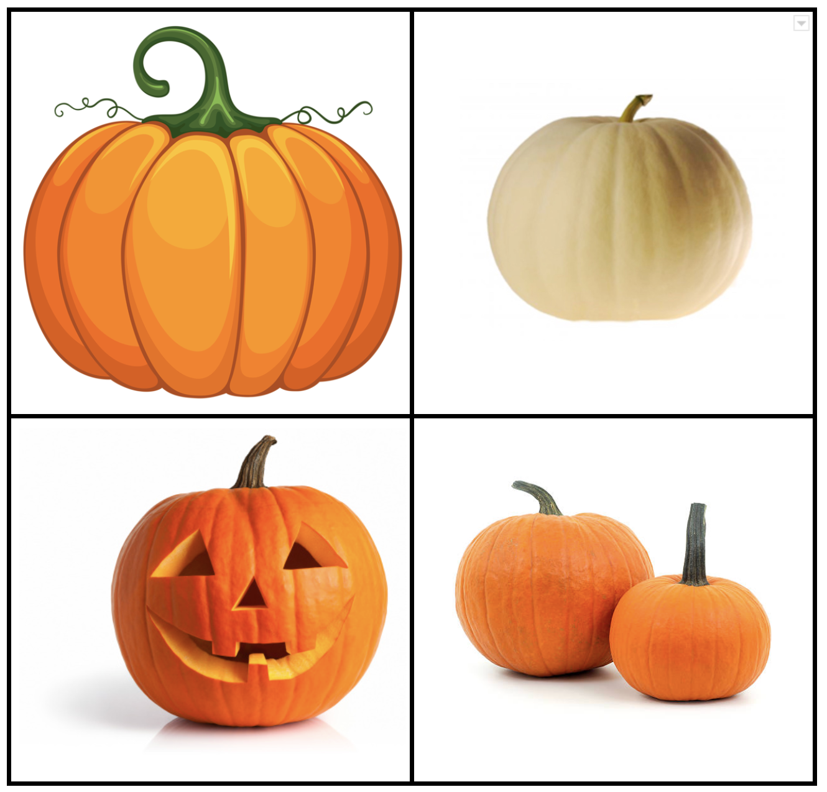
Which one doesn’t belong?
K.MD.A1
Notes:
Top left: not a real pumpkin
Top right: not orange pumpkin
Bottom left: only carved pumpkin
Bottom right: not one pumpkin

Slide 13
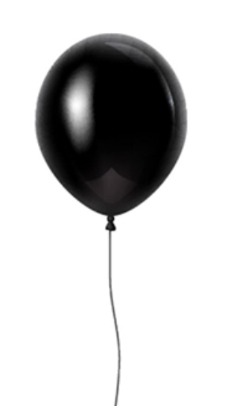
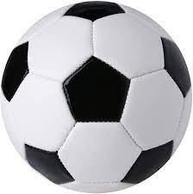
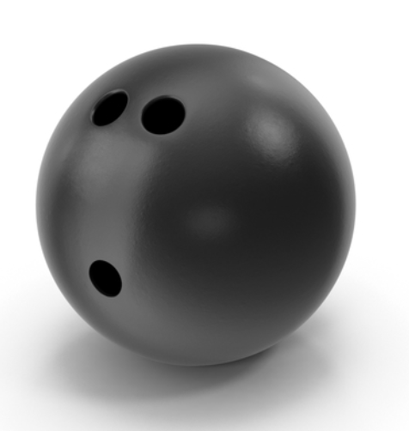
What is the same, what is different?
How can we compare these objects?
K.MD.A2

Slide 14
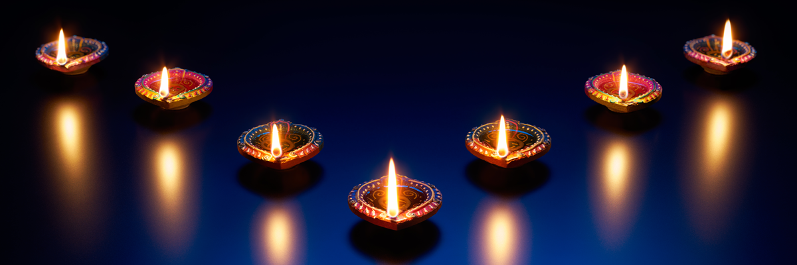
Happy Diwali!
How many lights do we see here?
How can we count them?
K.CC.C5
Notes:
Week of October 24, 2022

Slide 15
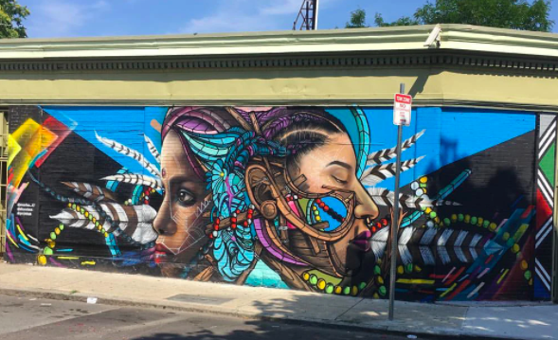
What are some of the shapes we see in this Jamaica Plain mural?
Can we sketch them?
K.G.A2

Slide 16
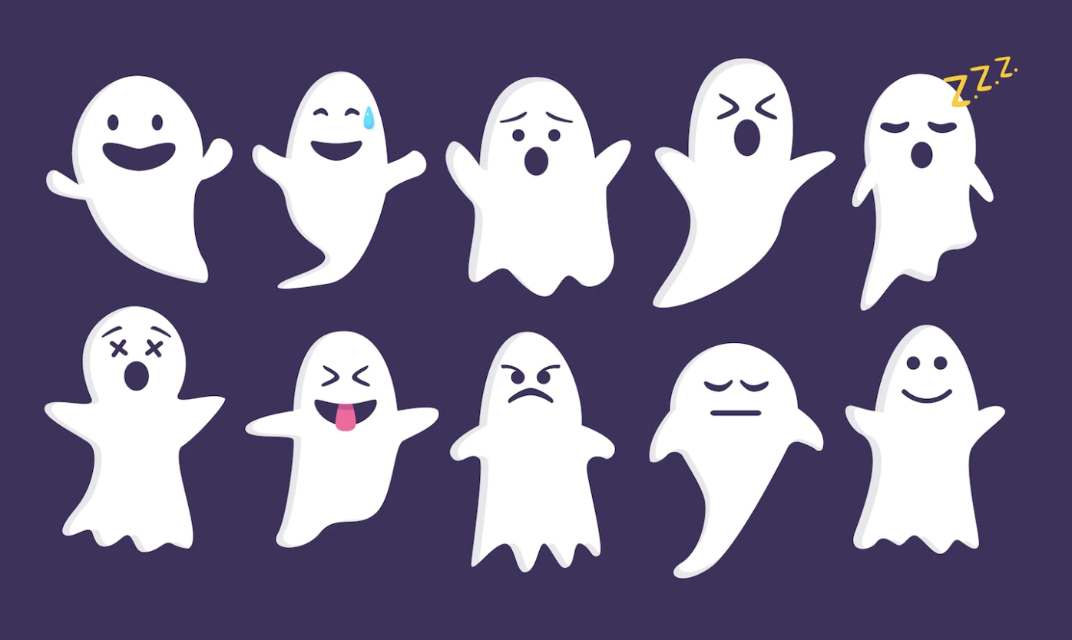
What do we notice?
How many different ways can we count them?
K.CC.B5

Slide 17
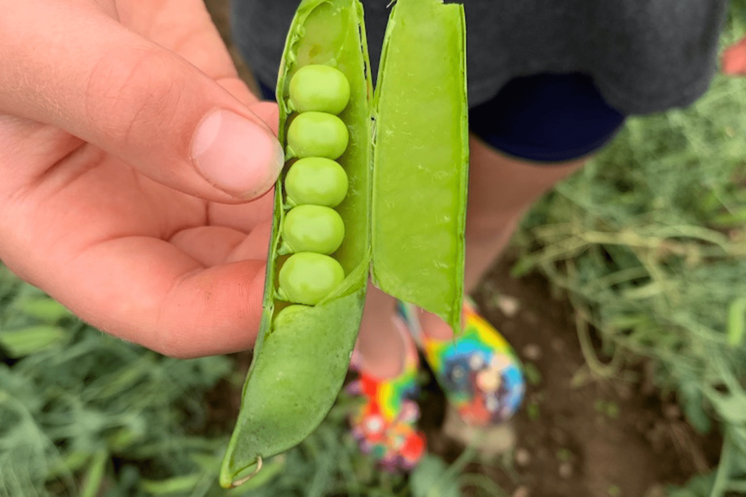
Wow! Look at this pea pod at Land’s Sake Farm!
How many peas do we see?
How many don’t we see?
K.CC.B4

Slide 18
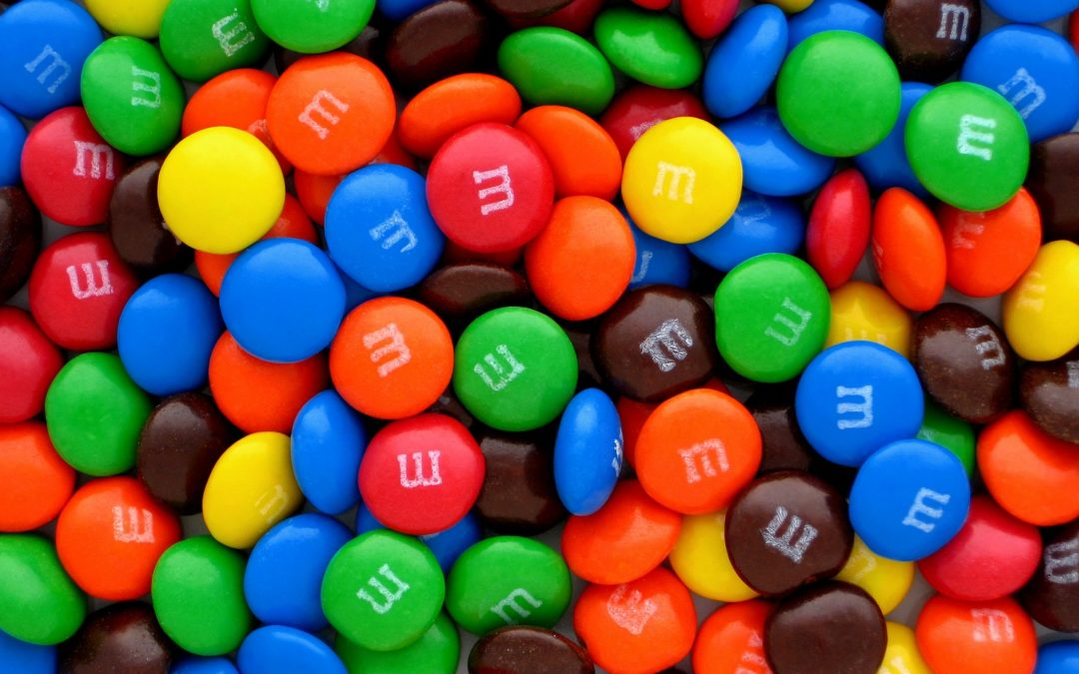
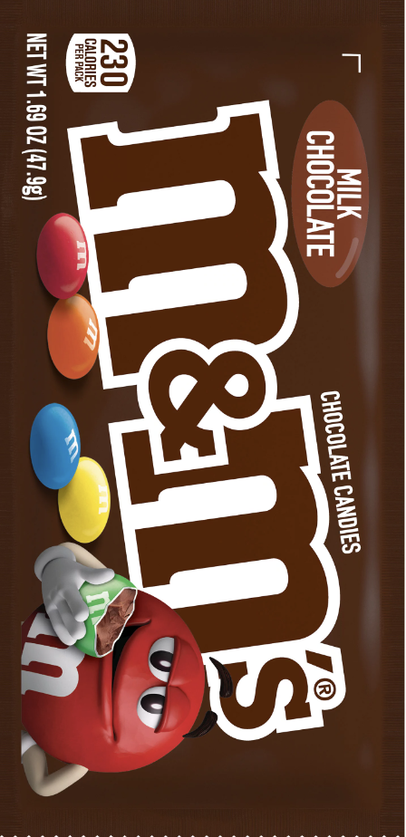
Would you rather have a handful of m&m’s or a bag of m&m’s?
K.SMP.3

