Slide 1
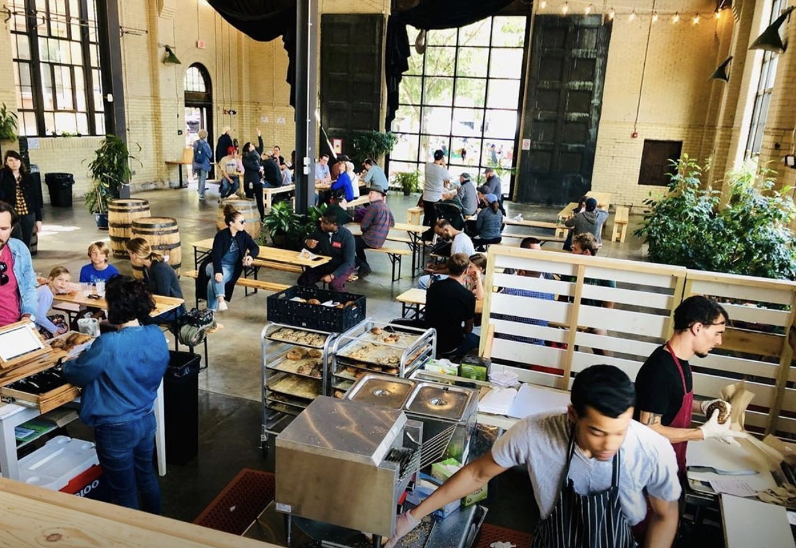
Exodus Bagels in Roslindale serves up to 800 bagels each morning.
How many bagels will they sell in two mornings?
Three?
A week?
3.NBT.A3
Notes:
Week of October 3, 2022

Slide 2


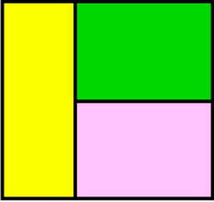
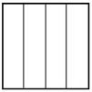
Which one doesn’t belong?
3.G.A2
Notes:
Top

Slide 3
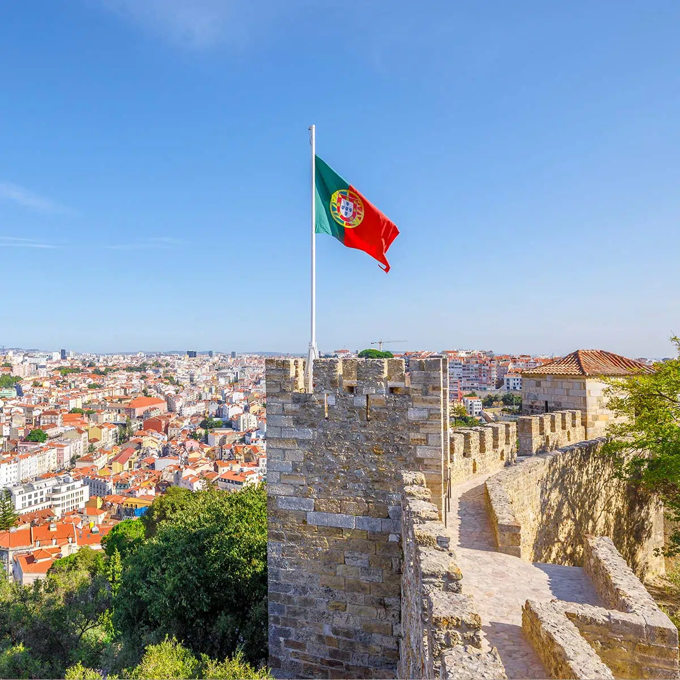
It’s Portugal Republic Day!
On this day in 1920 a republican government was formed.
How long ago was 1920?
What are some strategies we can use to solve this?
3.NBT.A2
Notes:
October 5, 2022
Portugal Republic Day

Slide 4
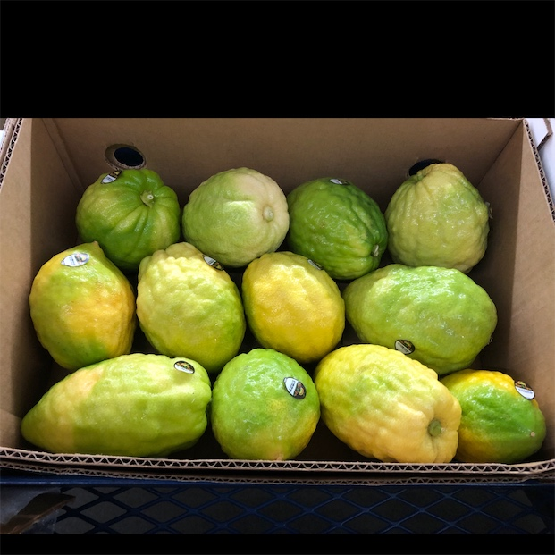
These little citrus fruits are Etrogs
Happy Sukkot!
How many are here in the crate?
Can we write a multiplication expression to match our thinking?
How many would be in 2 crates? 3? 10?
3.OA.A3
Notes:
October 9, 2022
Sukkot

Slide 5
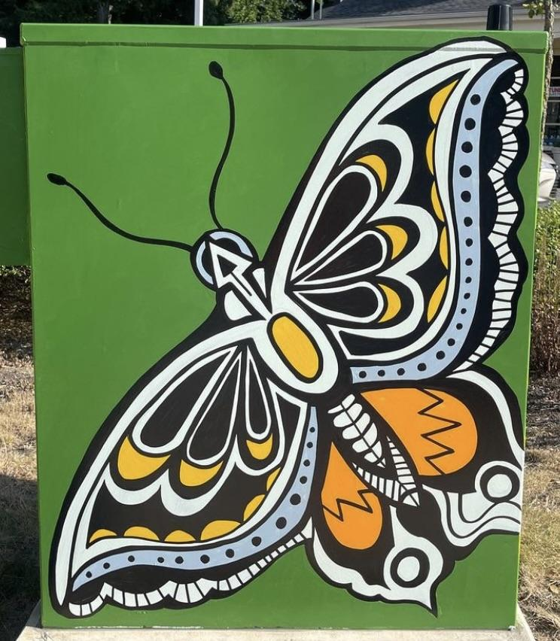
Celebrate National Indigenous Peoples Day with Mr. Ginga’s beautiful art.
This Swallowtail Butterfly mural is painted on an electrical box!
The height is 30”
The width is 24”
What can we say about perimeter?
3.MD.D8
Notes:
Week of October 11, 2022
Indigenous Peoples Day

Slide 6
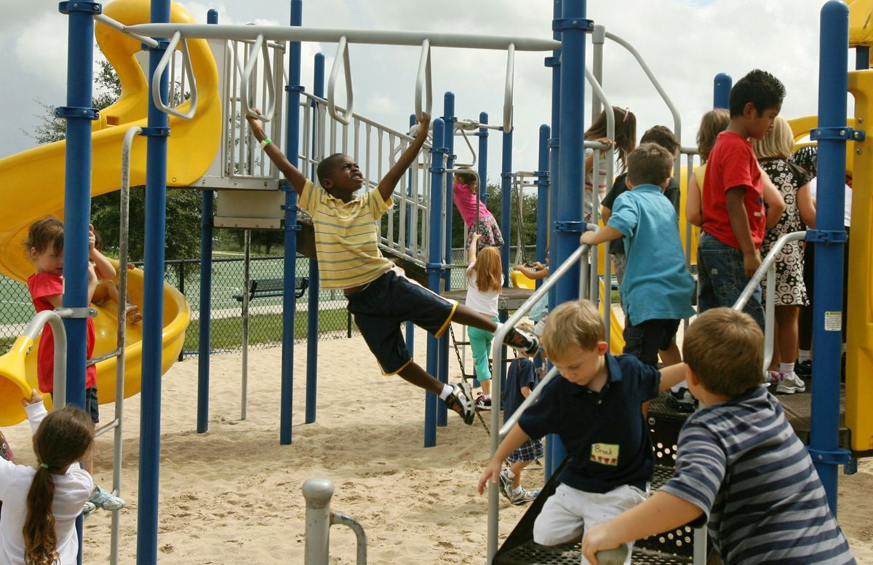
Would you rather
Have 1 hour of recess at the end of every day
Or 25 minutes of recess in the morning and 25 minutes after lunch.
3.MD.A1

Slide 7
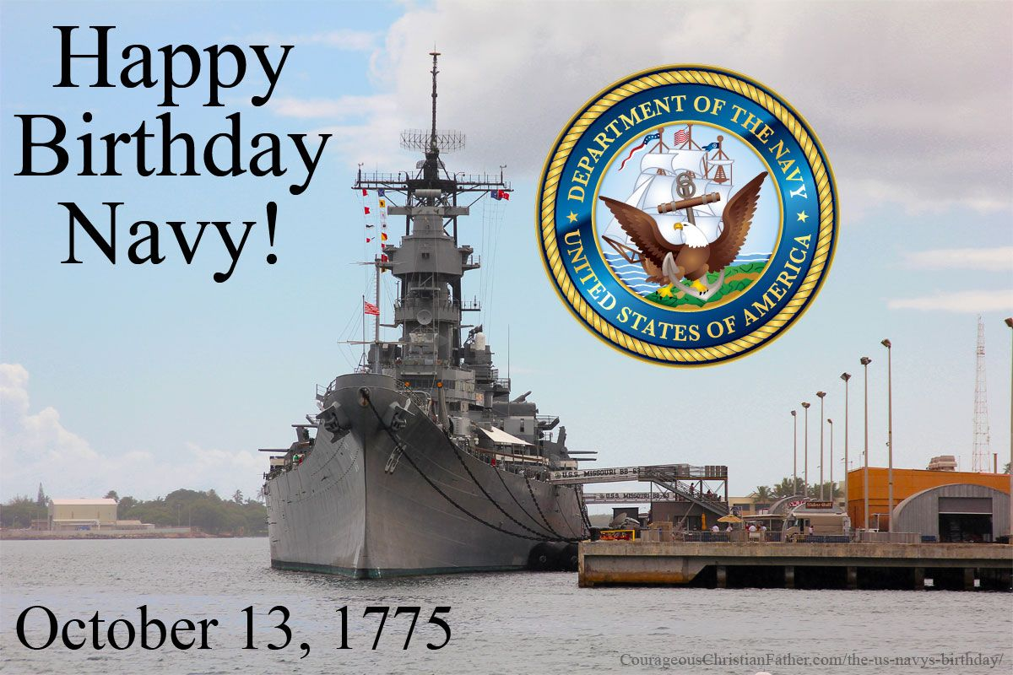
The US Navy was founded in 1775.
How long ago was that?
What strategies can we share?
3.NBT.A2
Notes:
October 13, 2022
US Navy Birthday

Slide 8

6 x 4 = 3 x 8
8 x 2 = 4 x 6
3 x 5 x 2 = 2 x 15
2 x 4 x 3 = 6 x 3
3.OA.B5

Slide 9

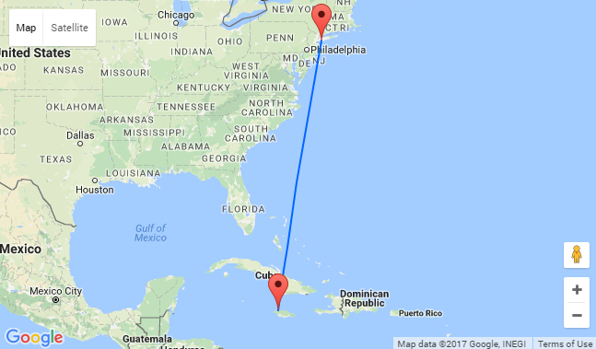
It’s National Heroes Day in Jamaica
The flight from Boston to Jamaica takes 4 hours and 5 minutes.
If our flight takes off at 11:30 AM, what time will we land?
How many minutes is that altogether?
3.MD.A1
Notes:
Week of October 17, 2022
Jamaica National Heroes Day

Slide 10
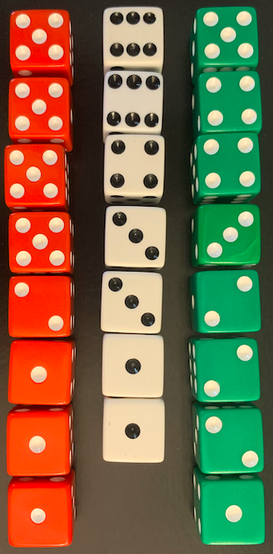
Where’s the math?
Write and solve as many expressions as you can to match this photo.
3.OA.D9

Slide 11
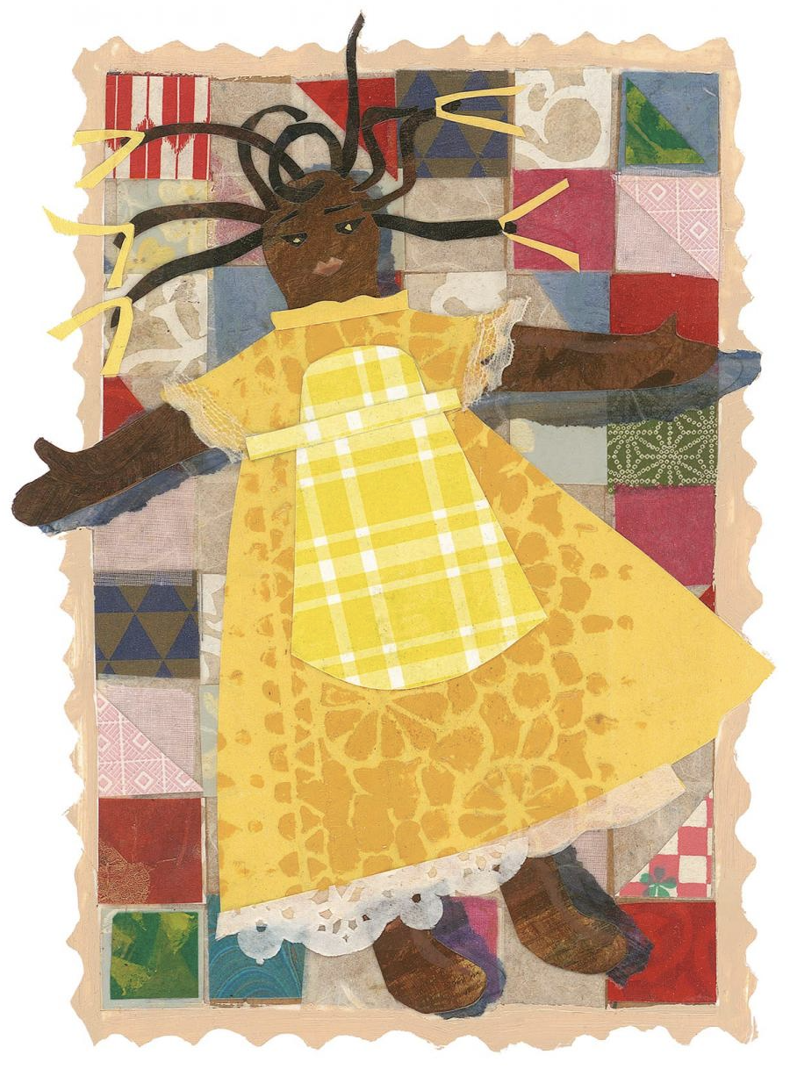
Where do we see an array in this piece by Roxbury artist Ekua Holmes?
What can we say about this array?
© Ekua Holmes.
3.MD.C5

Slide 12
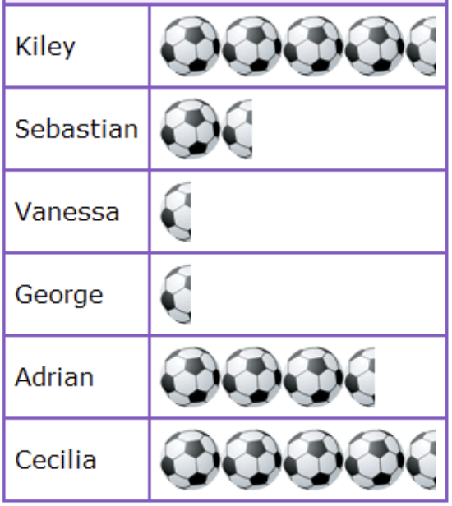
What do we notice?
What do we wonder?
What is possible?
3.MD.B3

Slide 13
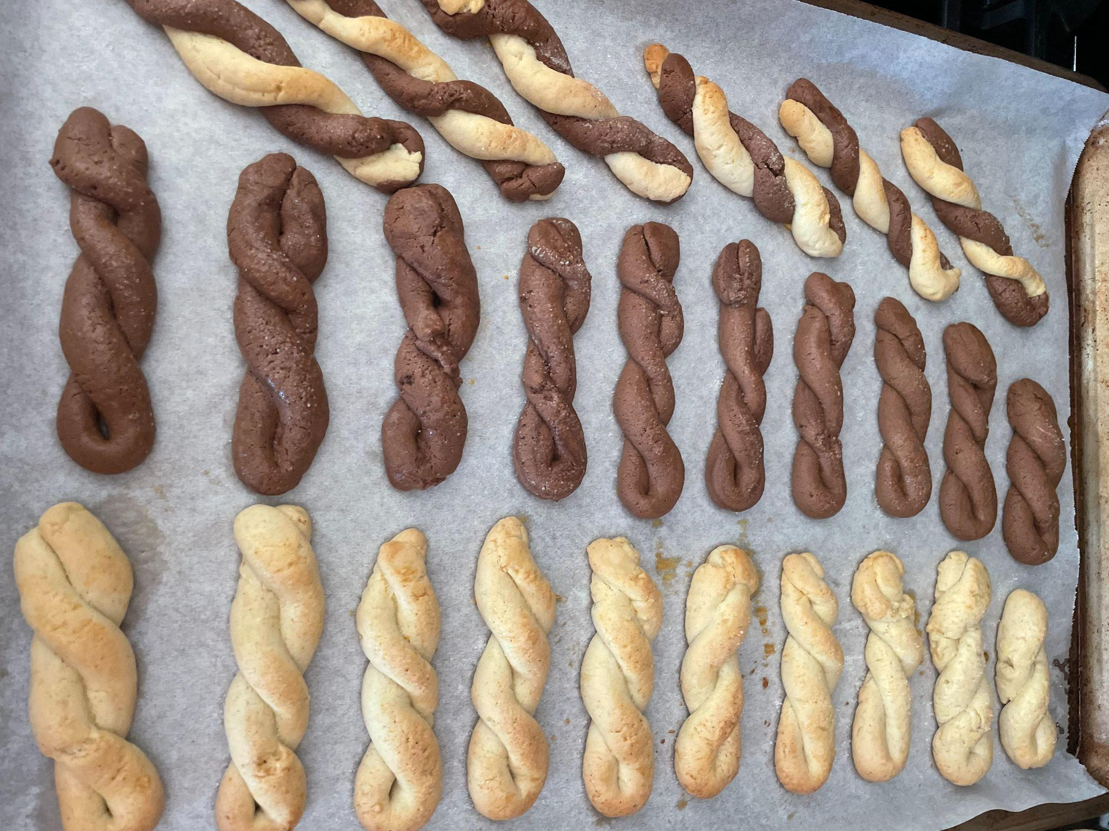
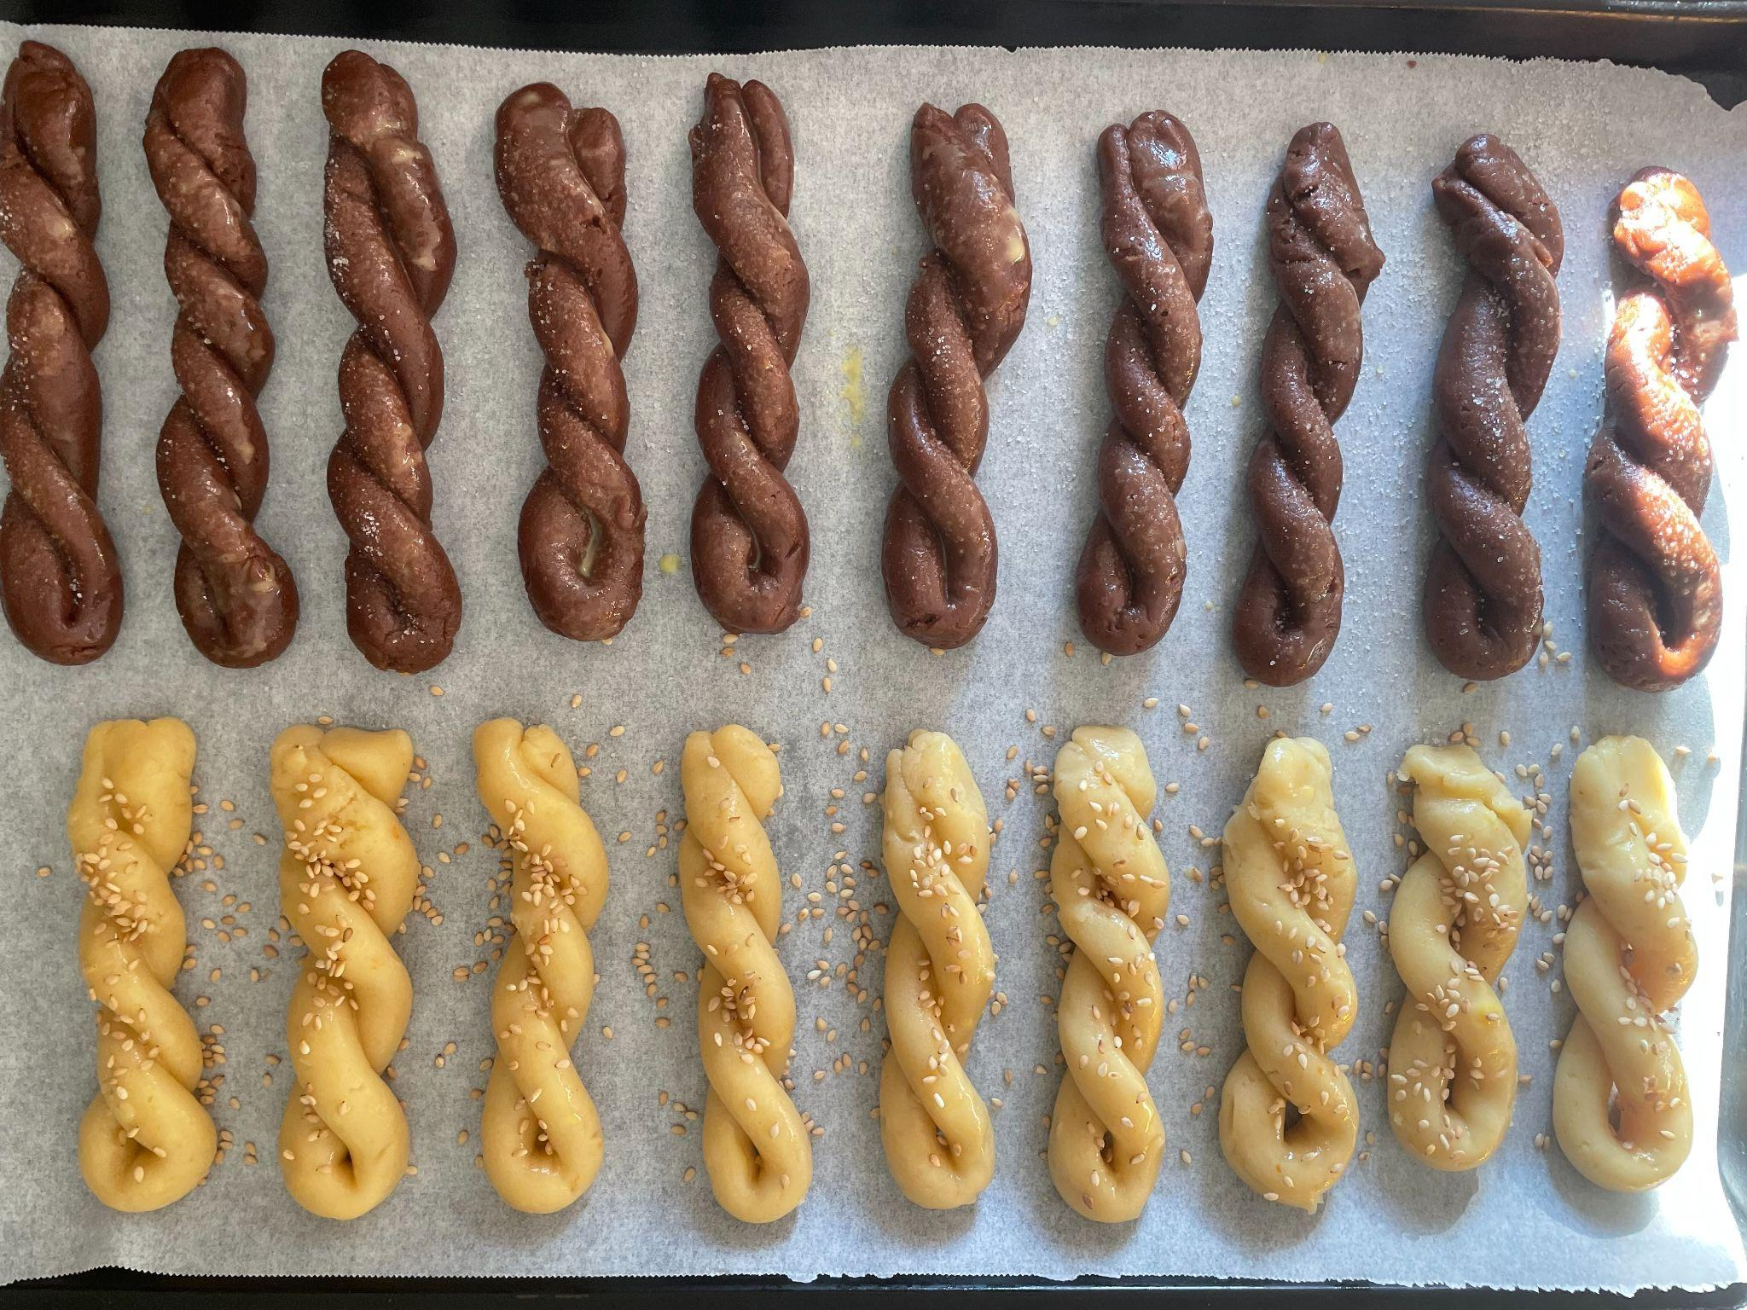
Koulourakia, yum!
We put them into the oven at 3:15, they take 20 minutes to bake.
What time were they done?
We put another tray in at 3:45, what time were they done baking?
3.MD.A1

Slide 14
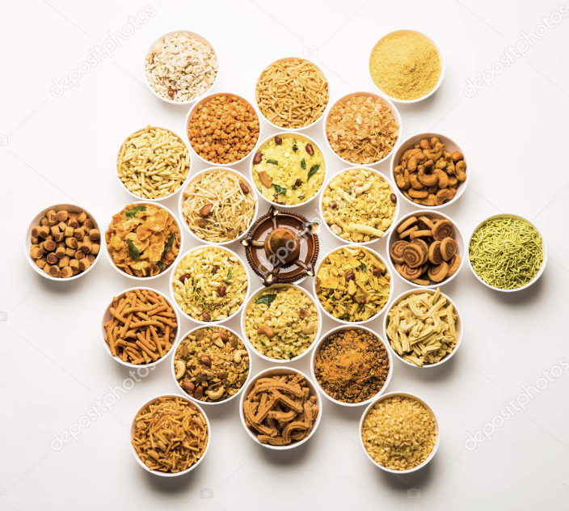
Happy Diwali!
How many sweet dishes do we see here?
Is there a pattern we can use to count efficiently?
Write an expression to match your math thinking.
3.OA.D8
Notes:
Week of October 24, 2022
Diwali

Slide 15
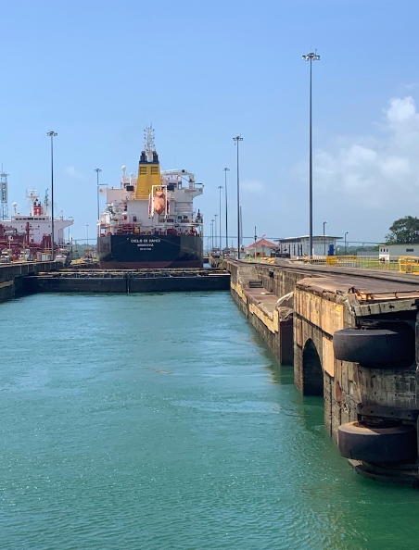
The Panama Canal is about 65 kilometers long.
In this picture we are going through the Pedro Miguel Locks, 9 km from where we started in Balboa.
How much farther do we have to travel?
Estimate how long it will take to travel through the Panama Canal?
Pedro Miguel Locks, Miraflores, Panama
3.OA.D8

Slide 16
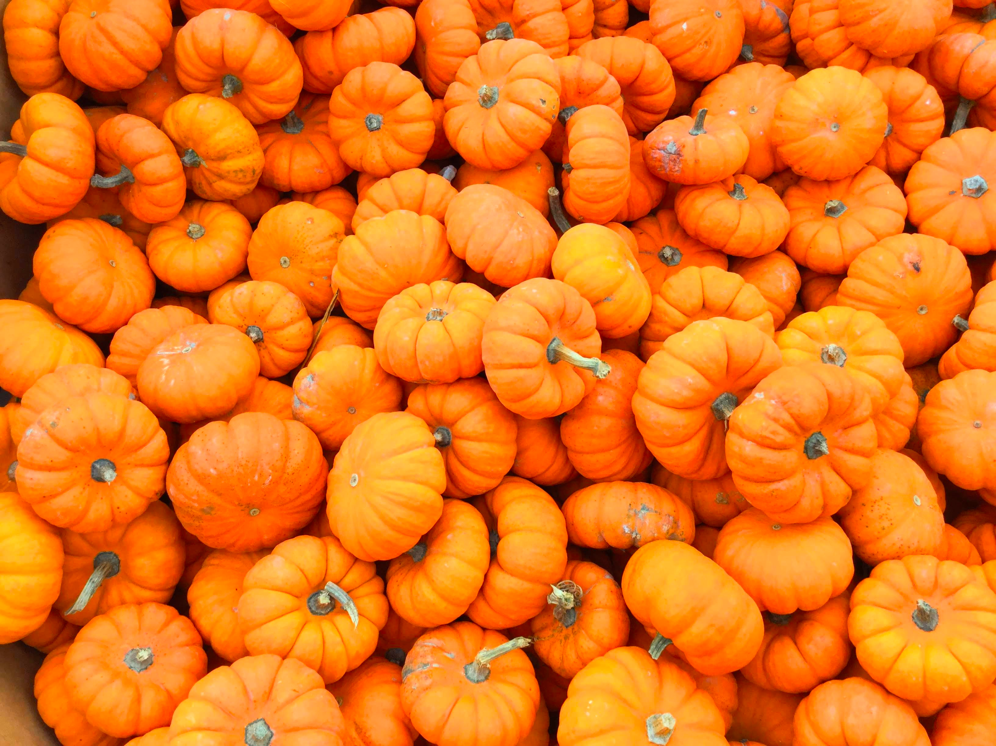
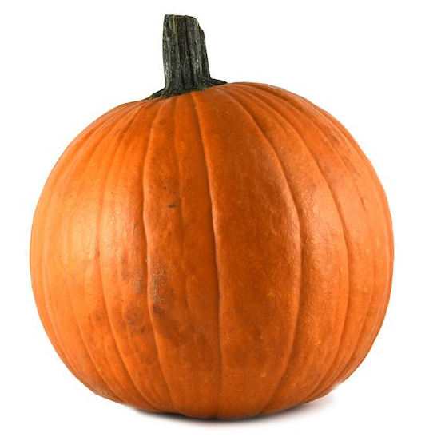
Would you rather …
carry a whole bucket of tiny pumpkins or one really big pumpkin across the field?
3.MD.A

Slide 17
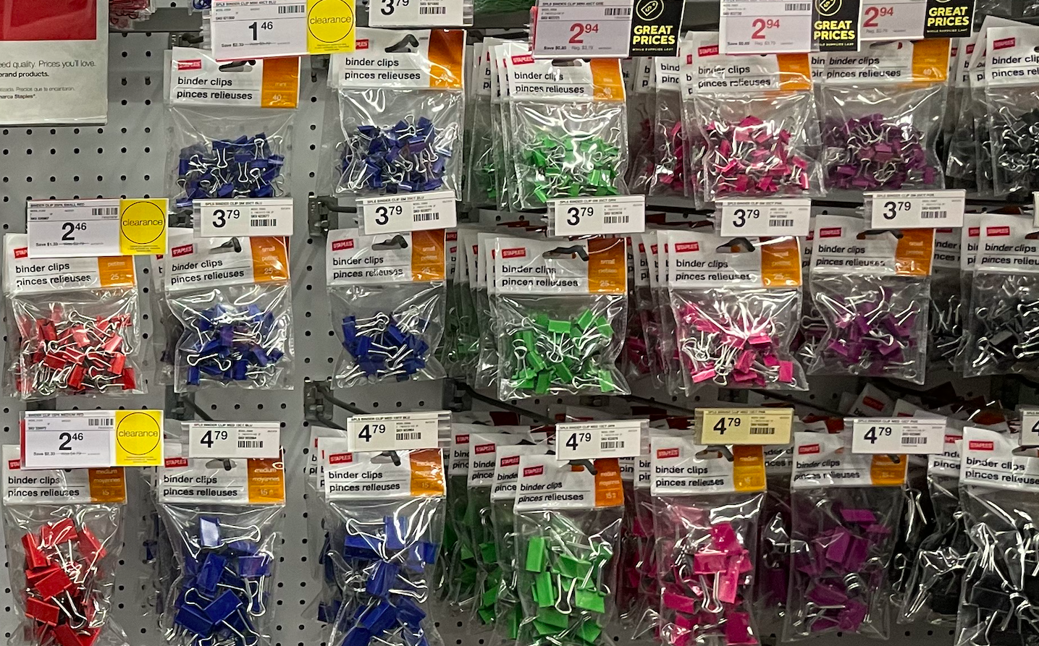
What MATH statements can you make from this photo?
Write an equation to match your thinking!
3.OA.D8

Slide 18
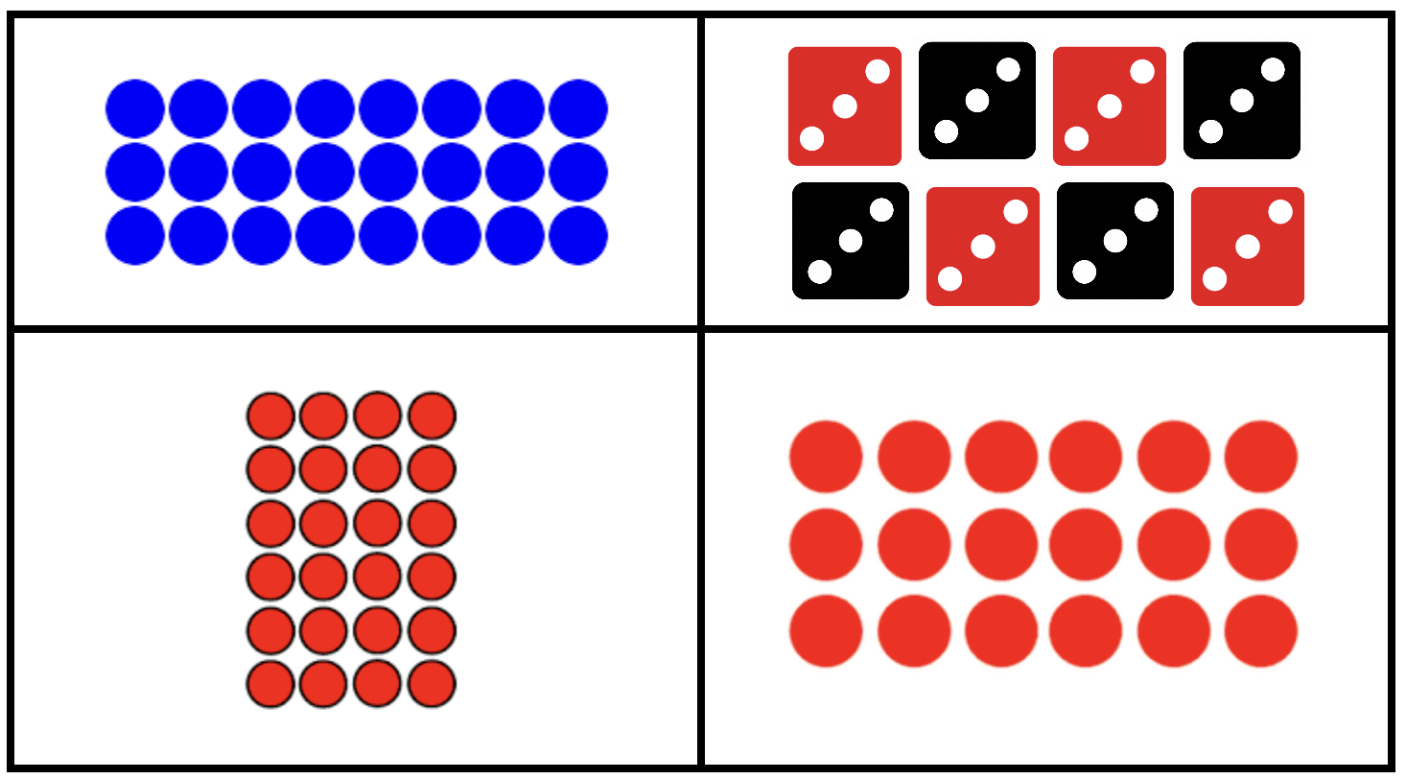
3.OA.B
Notes:
WHICH ONE DOES NOT BELONG?
Top Left: no red
Top Right: not a dot array
Bottom Left: no groups of 3
Bottom Right: not 24

