Slide 1
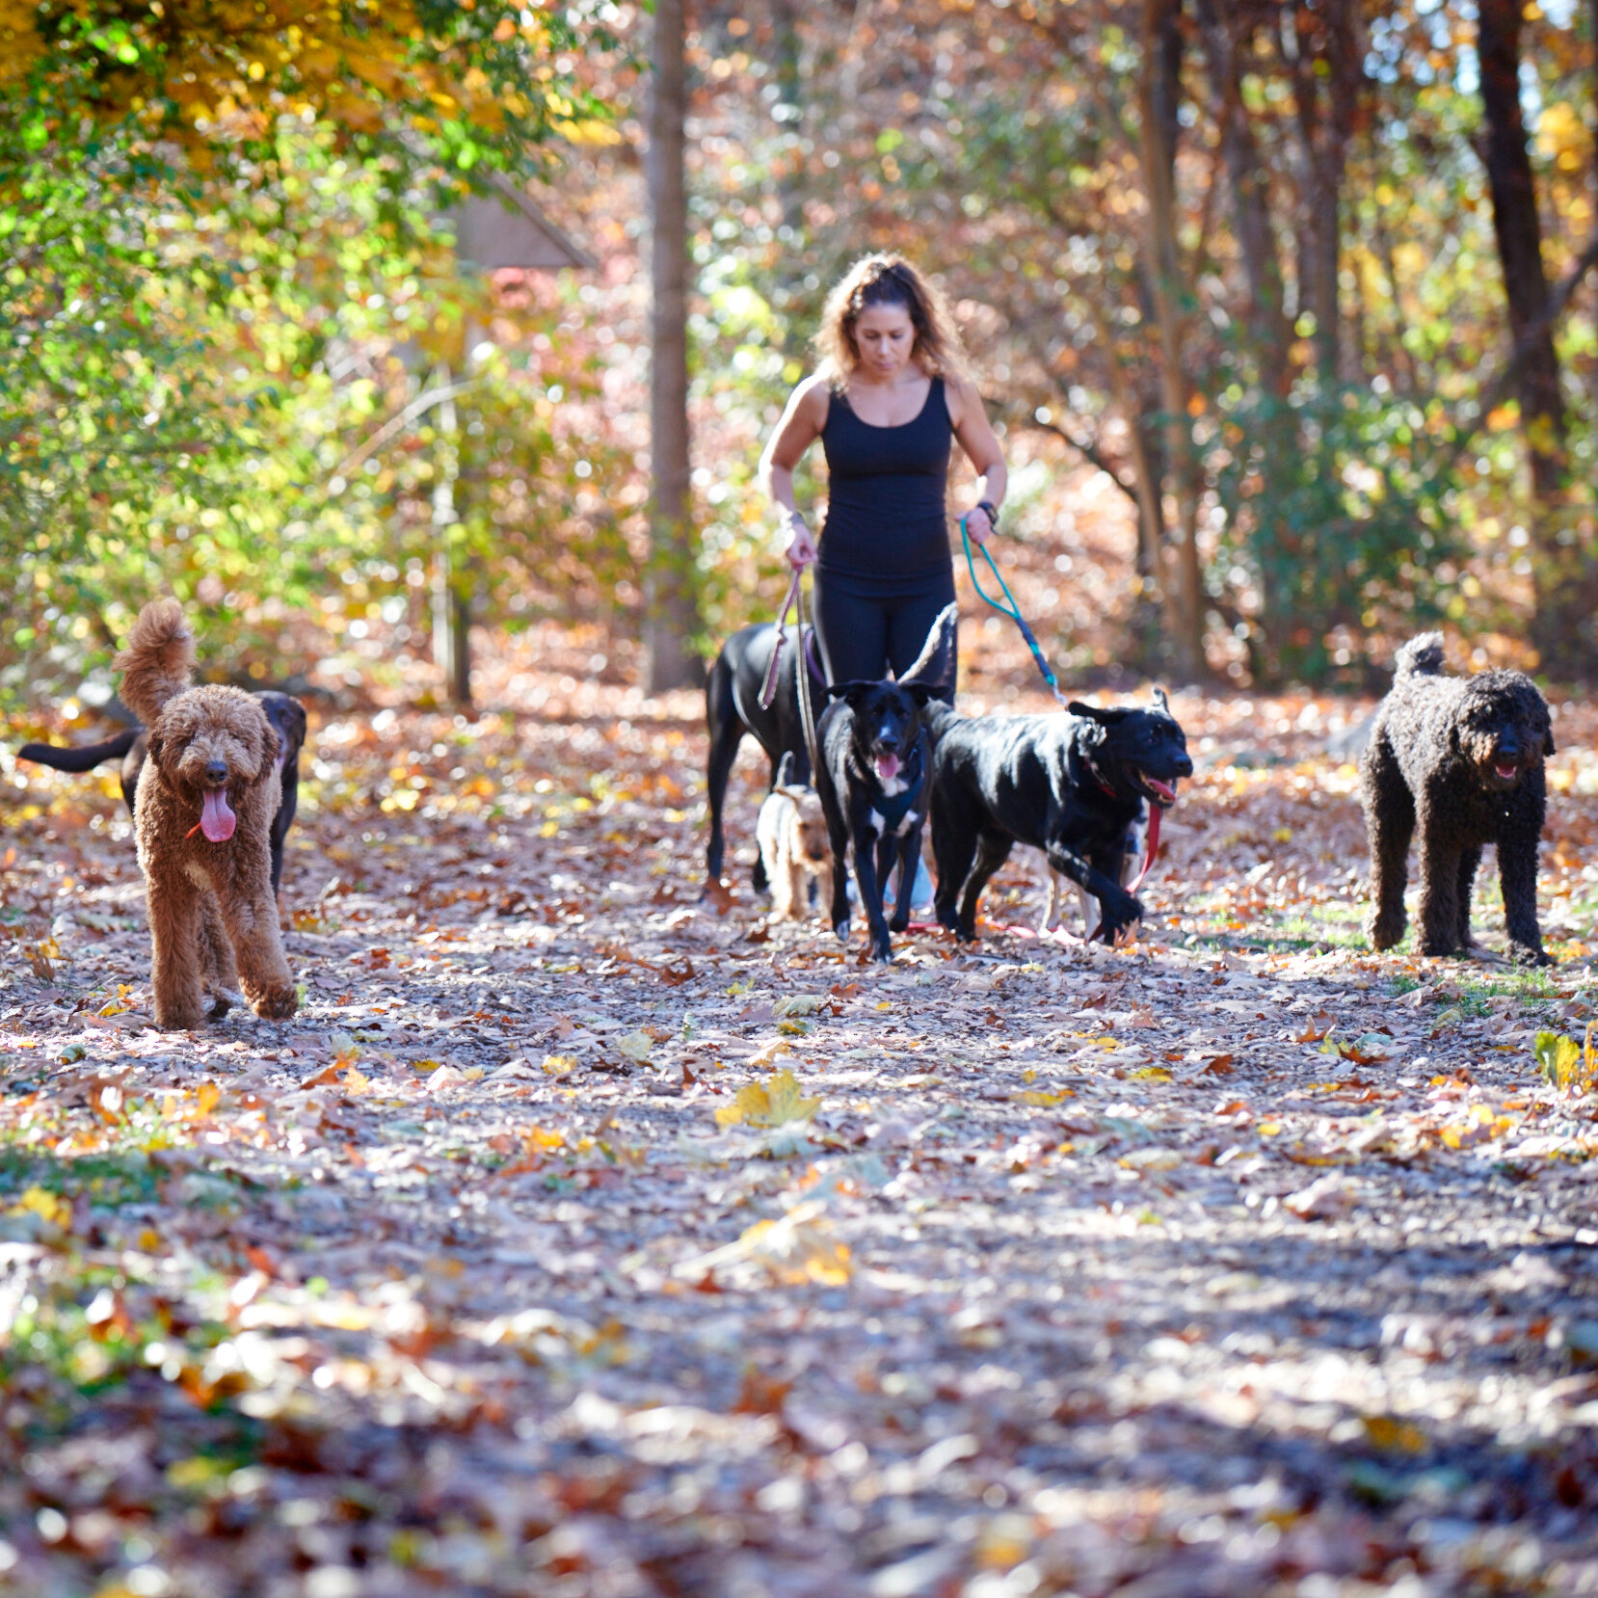
Dog walkers are on the Reservoir Walking Trail every day.
If 14 feet walk by, how many dogs and people could there be?
2.OA.A1
Notes:
Week of October 3, 2022

Slide 2
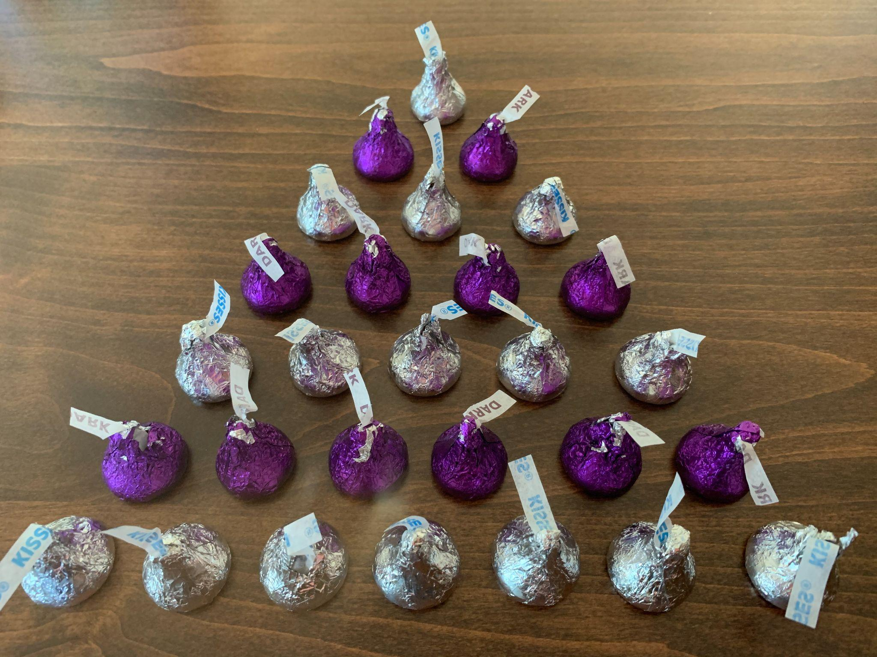
How many kisses are here?
Write an expression to match your mathematical thinking.
2.OA.C

Slide 3
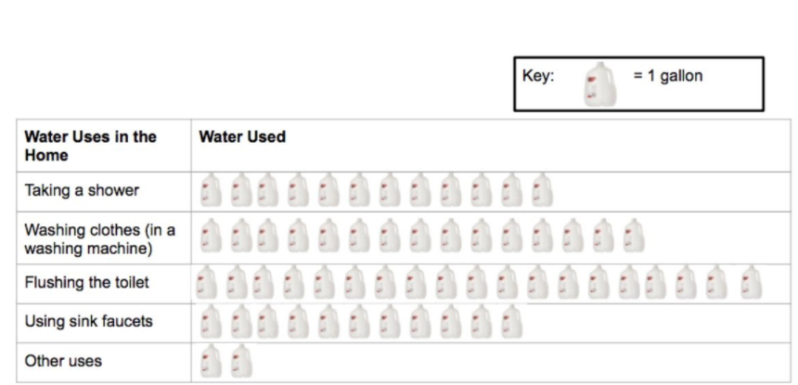
If this pictograph could talk,
what would it say?
2.MD.D10

Slide 4
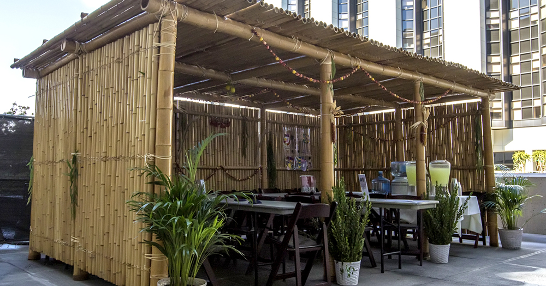
Happy Sukkot! What do you notice? What do you wonder?
What math questions can we ask?
Estimate how many stalks of bamboo are here!
2.NBT.A
Notes:
October 9, 2022
Sukkot

Slide 5
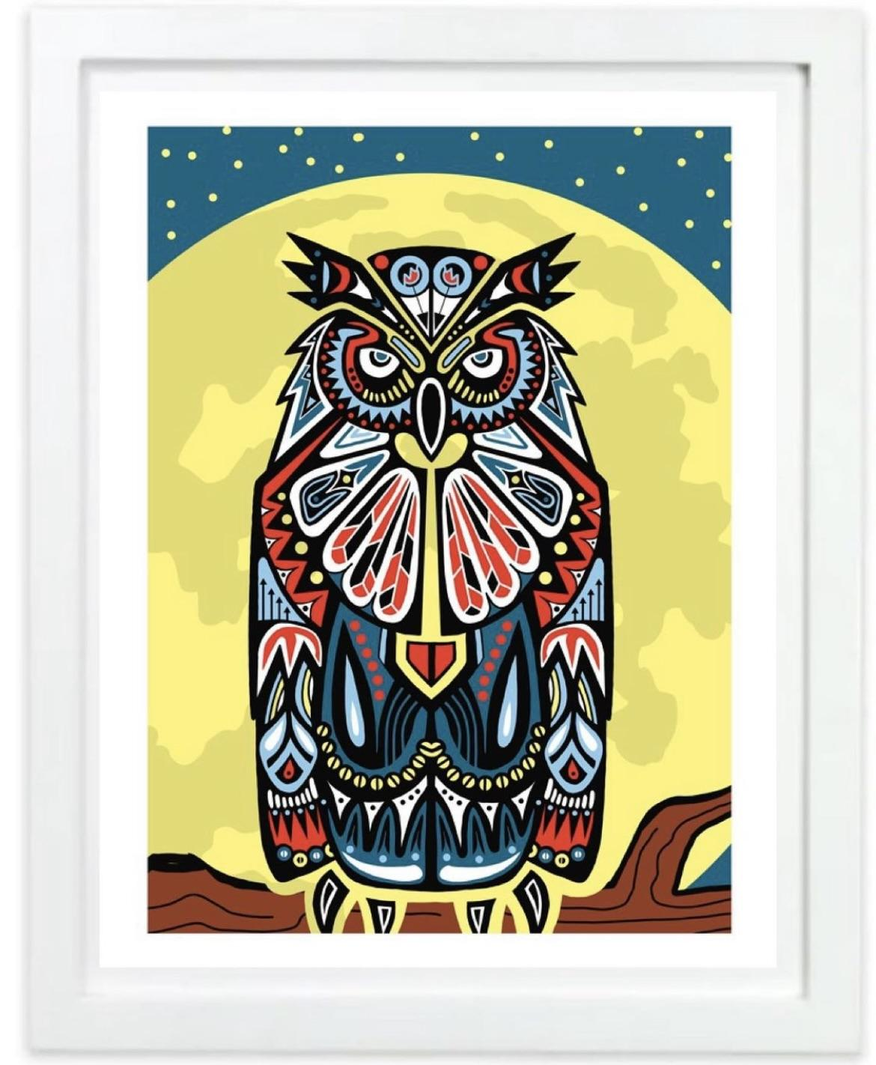
Let’s celebrate Indigenous Peoples’ Day with some of Mr. Ginga’s beautiful art!
Look at all of the amazing shapes in “The Guardian Owl.”
Sketch one of them.
Now sketch a shape that is like it in ONE way.
What shape do you have?
2.G.A1
Notes:
Week of October 11, 2022
Indigenous Peoples’ Day

Slide 6
Which one doesn’t belong?
45 | 90
54 | 75
2.NBT.A

Slide 7
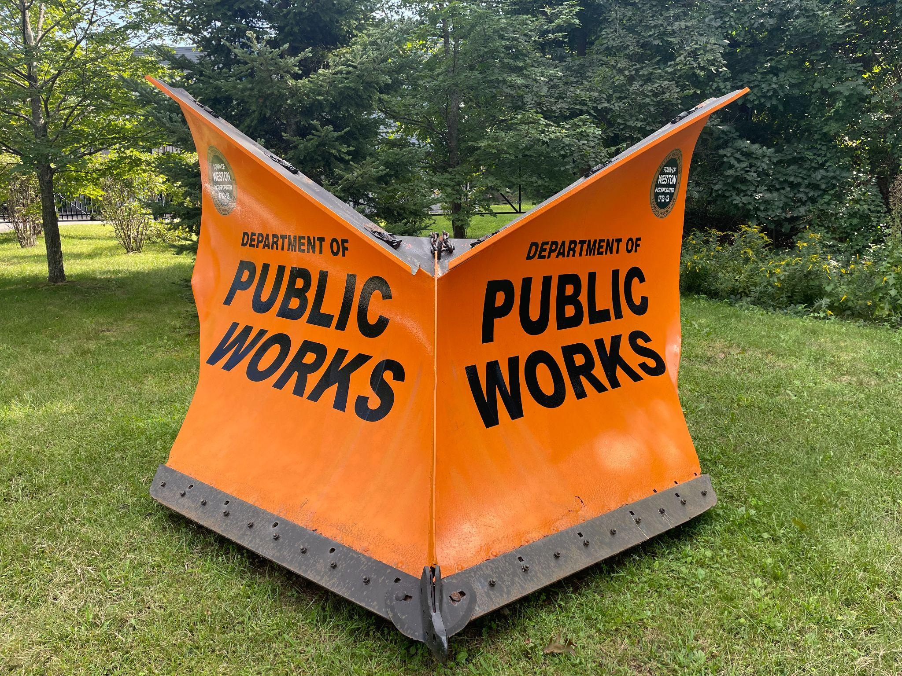
How much do you think this plow weighs?
3,217 pounds.
What is the value of the 2 in this number?
The 1?
7?
3?
2.NBT.A1

Slide 8
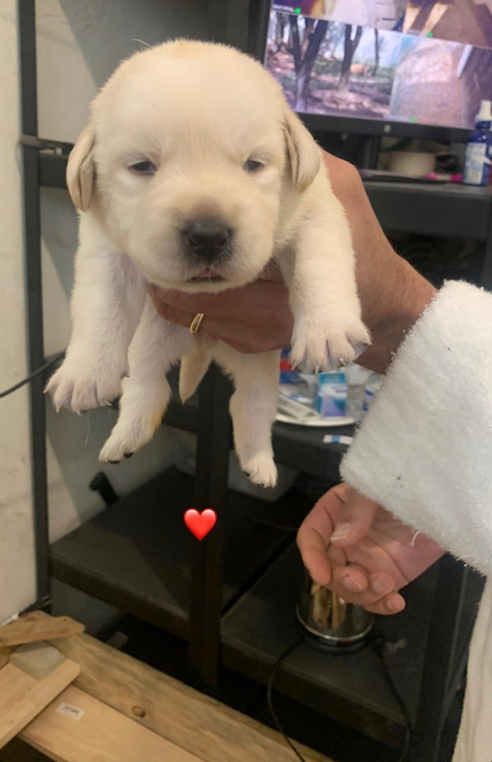
Hello Daphne!
Daphne is 2 weeks old and she weighs 34 ounces.
Her weight is going to DOUBLE in the next week.
How much will she weigh?
How did you solve it?
2.NBT.B5

Slide 9

15 + 10 = 25
15 + 11 = 25 - 1
15 + 12 = 25 + 2
15 + 13 = 30 - 3
2.NBT.A4
Notes:
Week of October 17, 2022

Slide 10
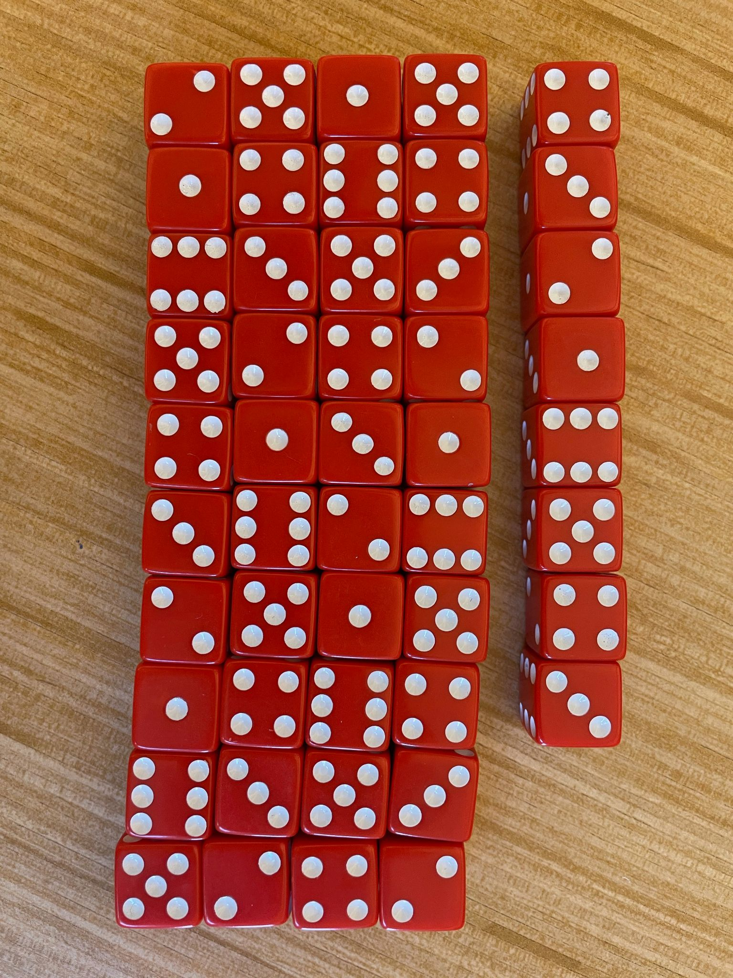
An array of dice!
What can we say about the dice?
How can we count them?
What patterns can we see?
2.OA.C4

Slide 11
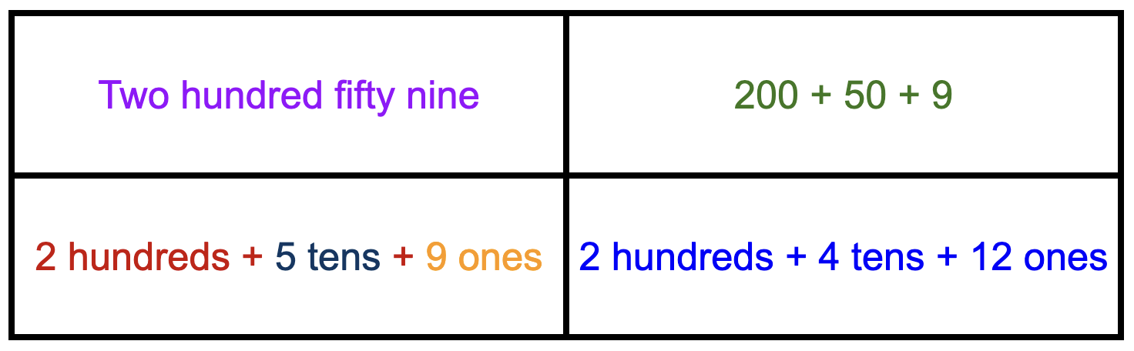
Which one does not belong?
2.NBT.A1
Notes:
Top Left: No numerals
Top Right: No words
Bottom Left: Mix of numbers and words with different colors
Bottom Right: Not 259

Slide 12
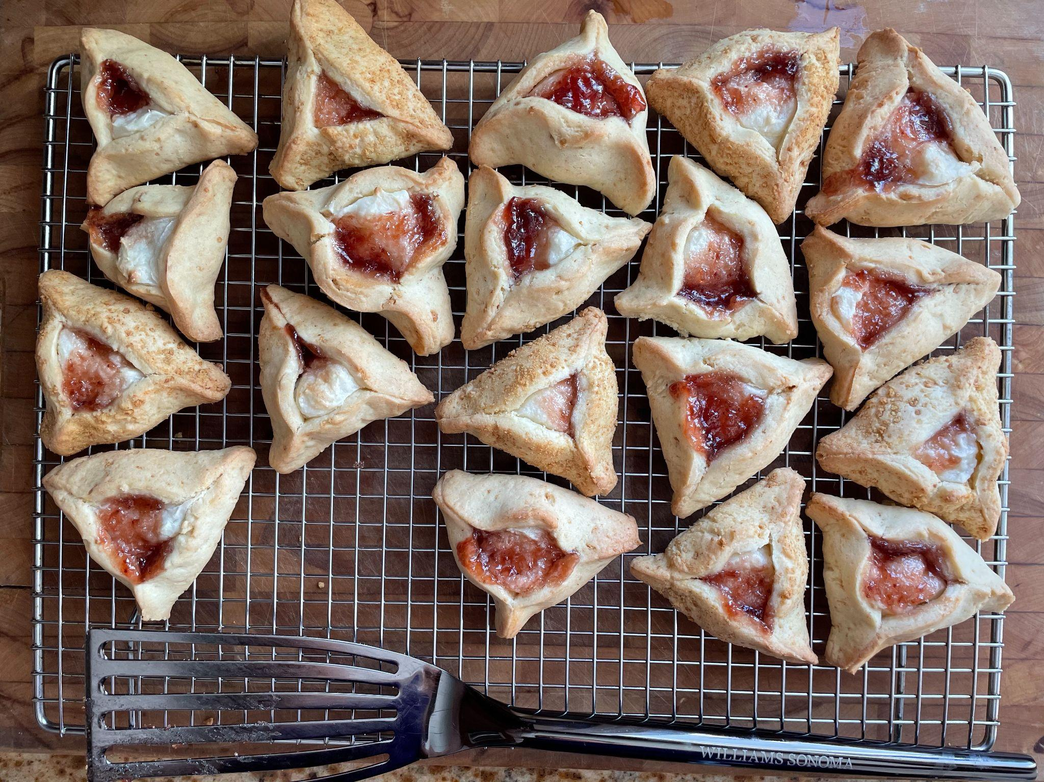
Yum!
What shapes could we create with 2 of these cookies?
3 of them?
4? 5? 6?
2.G.A1

Slide 13
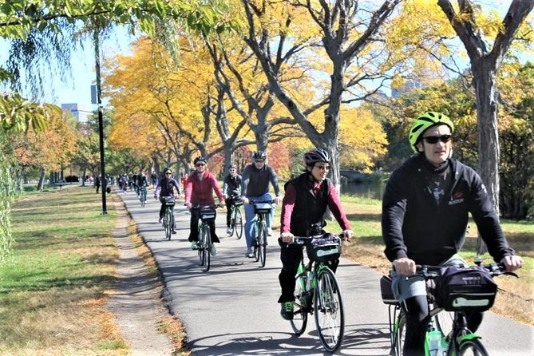
Biking in Boston!
If we counted 64 WHEELS go by, how many BIKERS were there?
If we counted 64 BIKERS, how many WHEELS were there?
2.NBT.B5

Slide 14
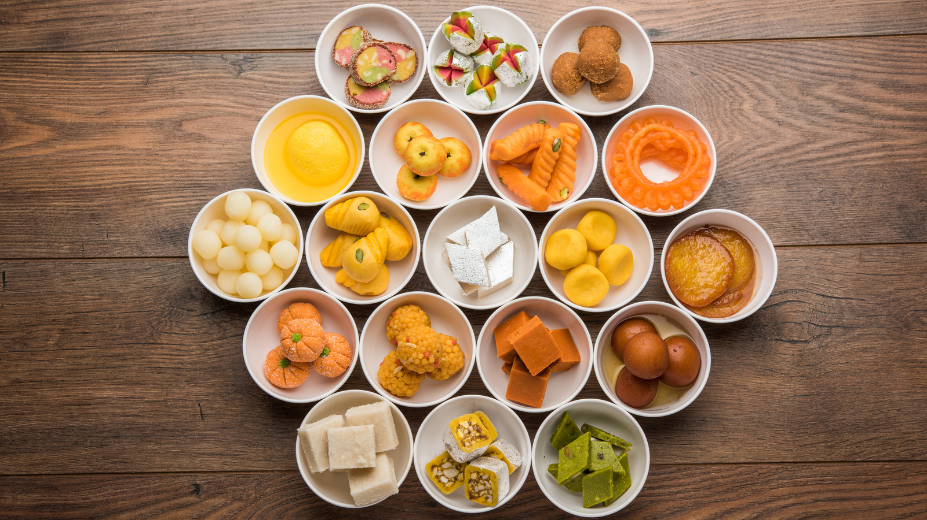
Happy Diwali!
Wow! There’s a lot of math we can see in these traditional Diwali sweets.
Write an expression to match your math thinking.
2.OA.A1
Notes:
Week of October 24, 2022
Diwali

Slide 15
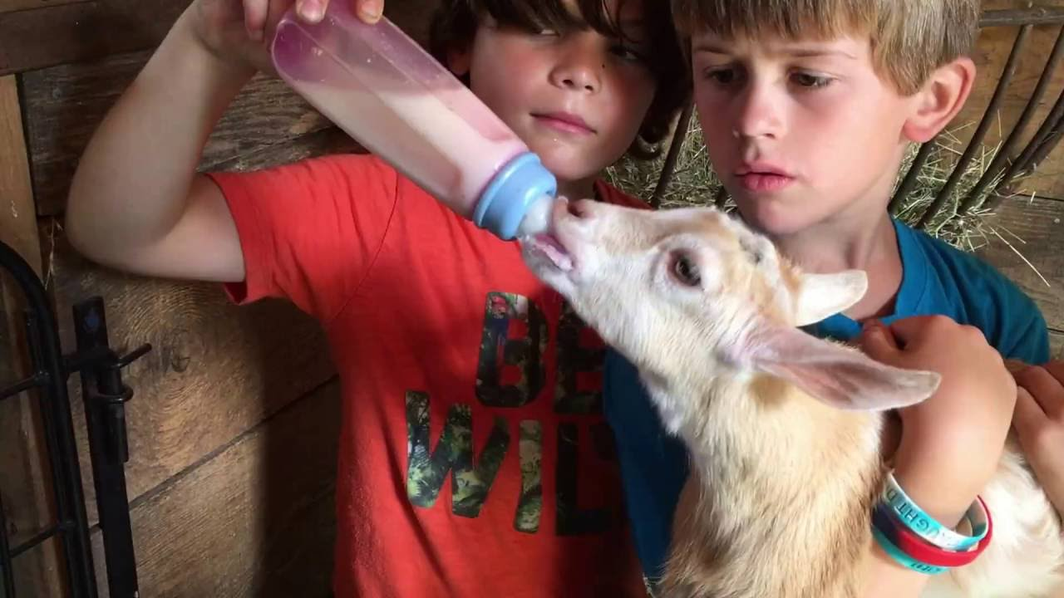
This baby goat at Land’s Sake Farm is 2 months old.
About how many days old is she?
2.MD.C7

Slide 16
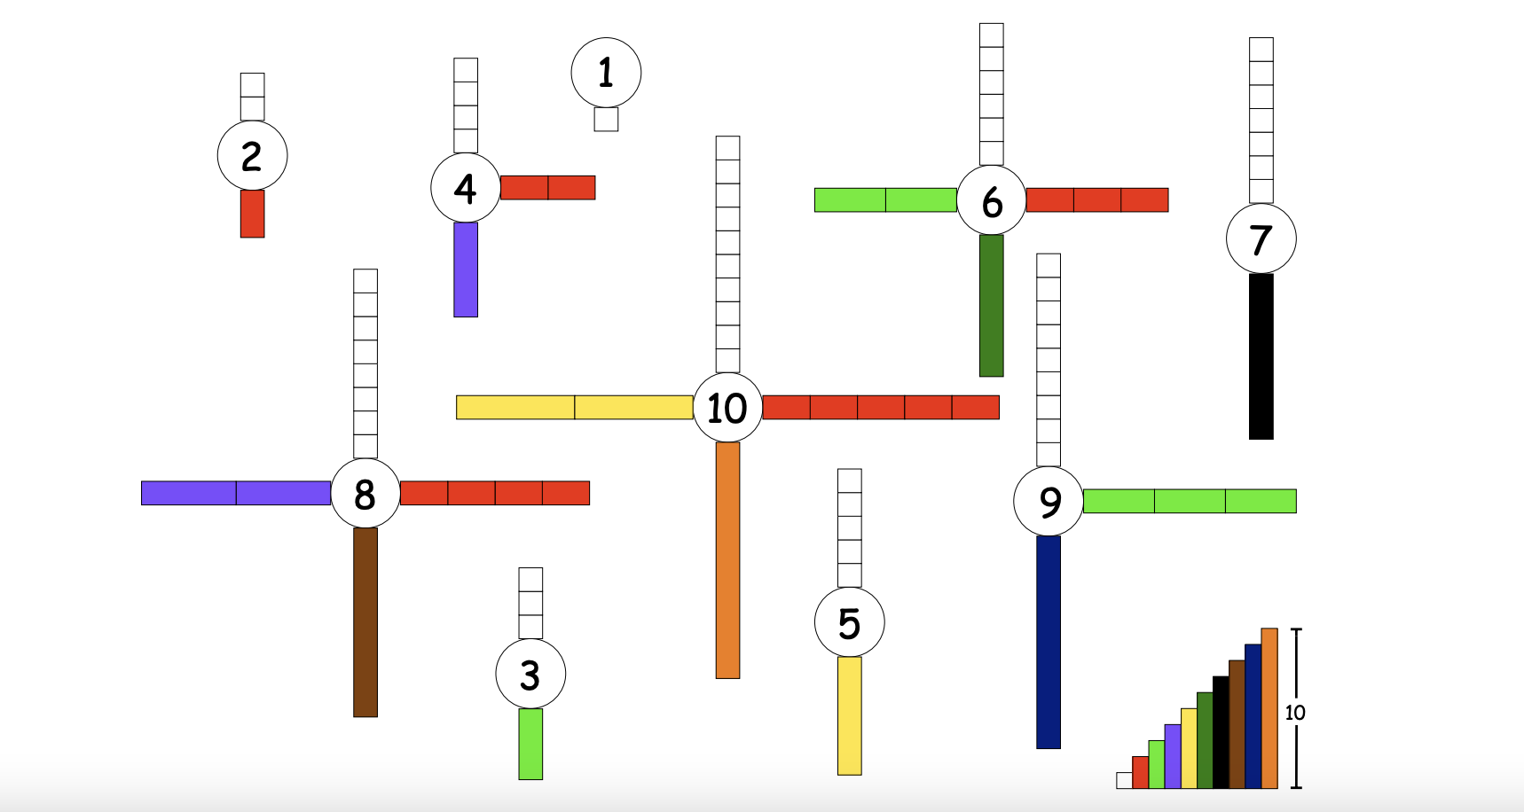

What do we notice? What do we wonder? What is going on in this data visualization?
2.OA

Slide 17
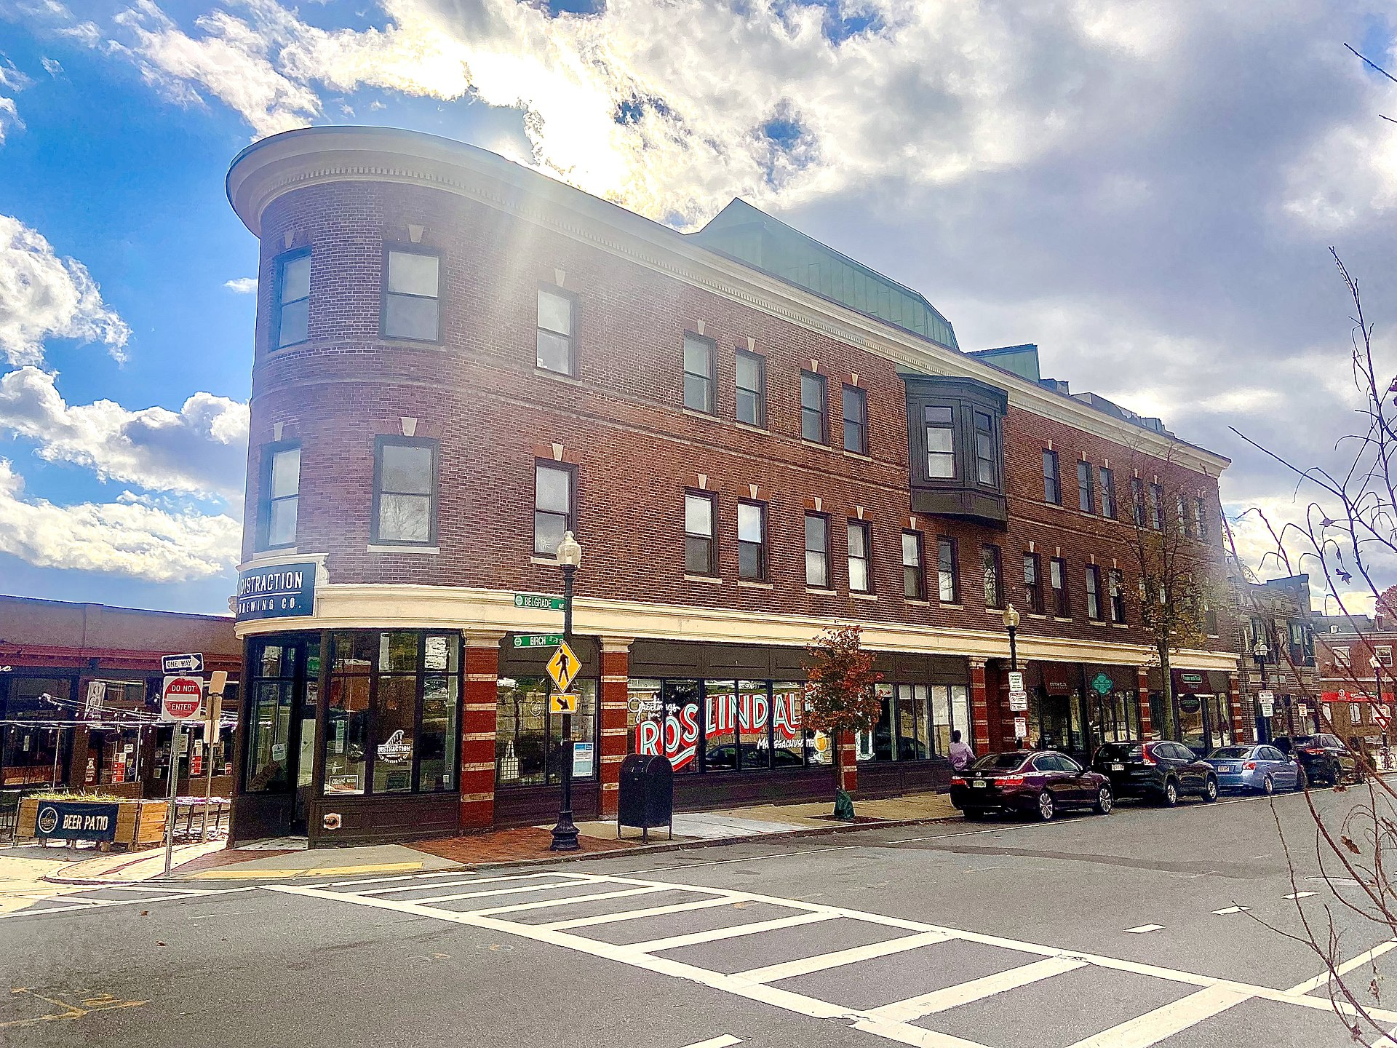
This building is a famous landmark in Roslindale Square
How many windows do we see?
How many don’t we see?
How do we know?
2.NBT.A2

Slide 18
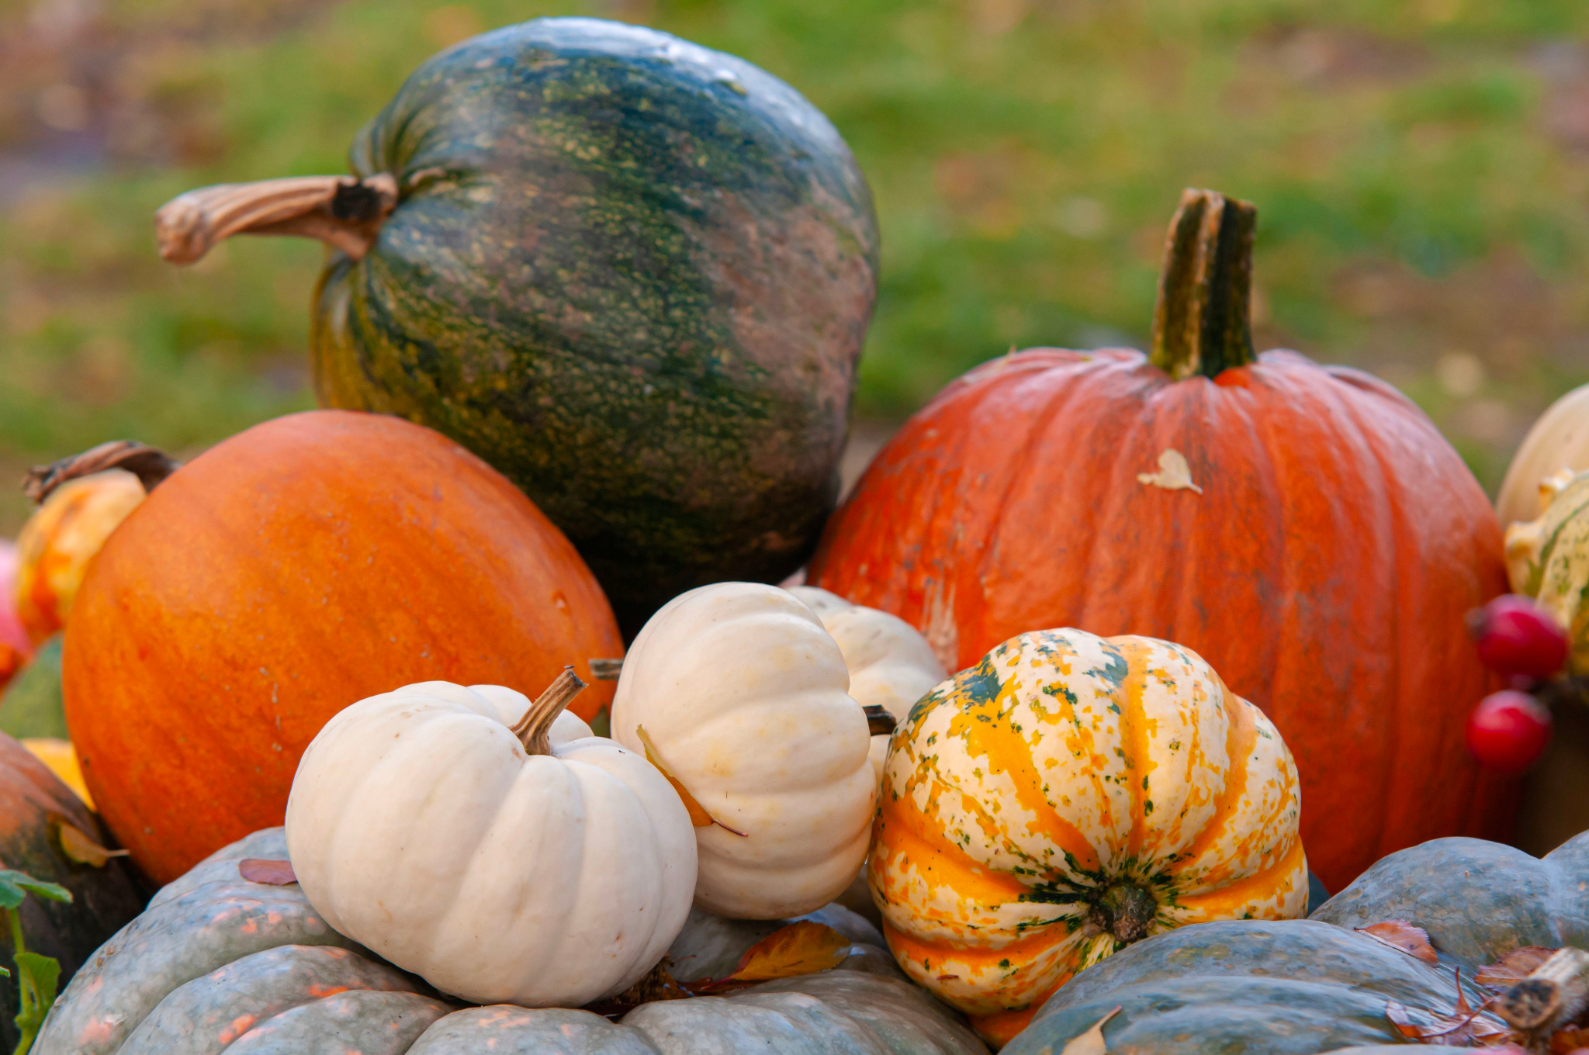
If the green pumpkin weighs 4 pounds, what might the other pumpkins weigh?
4 pounds
2.MD.A

