Slide 1

Bats are totally awesome!
5.NBT.B6
Did you know … there are over 1,400 species of bats worldwide?
Let’s find factor pairs of 1,400! Can we find all of them?
Notes:
Week of October 31, 2022

Slide 2
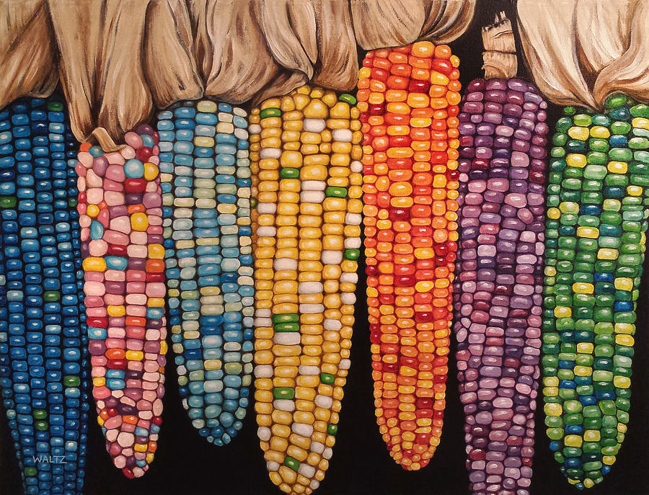
It’s Native Corn Season!
Estimate how many kernels on one ear of corn!
How many on seven ears?
100 ears?
200 ears?
Do we see any patterns here?
5.NBT.A2

Slide 3

Today is Japan Culture Day!
The current population of Japan is 125,600,000
The current population of the United States is 331,900,000
How many more people live in the U.S. than in Japan?
5.NBT.B7
Notes:
November 2, 2022
Japanese Culture Day

Slide 4
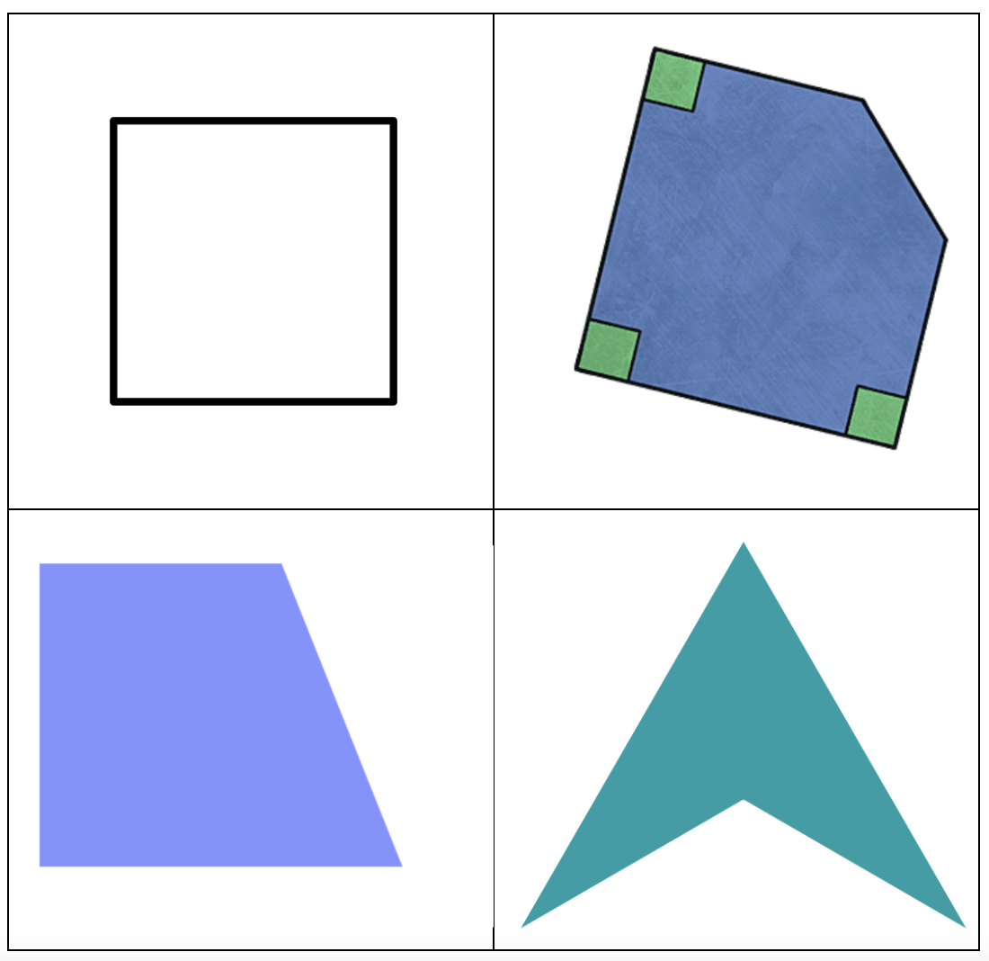
Which one doesn’t belong?
5.G.B3
Notes:
Top left: only regular polygon, all four sides and angles are equal
Top right: not a quadrilateral
Bottom left: 4 sides, none them equal
Bottom right: only concave quadrilateral

Slide 5

It is Flag Day in Panama!
The Panama canal is 80 kilometers long, it shortens the journey from the Atlantic to the Pacific by 15,000 kilometers.
How many meters is that?
About how many miles is that?
There are three sets of locks along the canal. The locks bring the vessels to/from 26 meters above sea level.
What can we say about that height?
5.MD.A1
4.NBT.B6
Notes:
November 4, 2022
Panama Flag Day

Slide 6
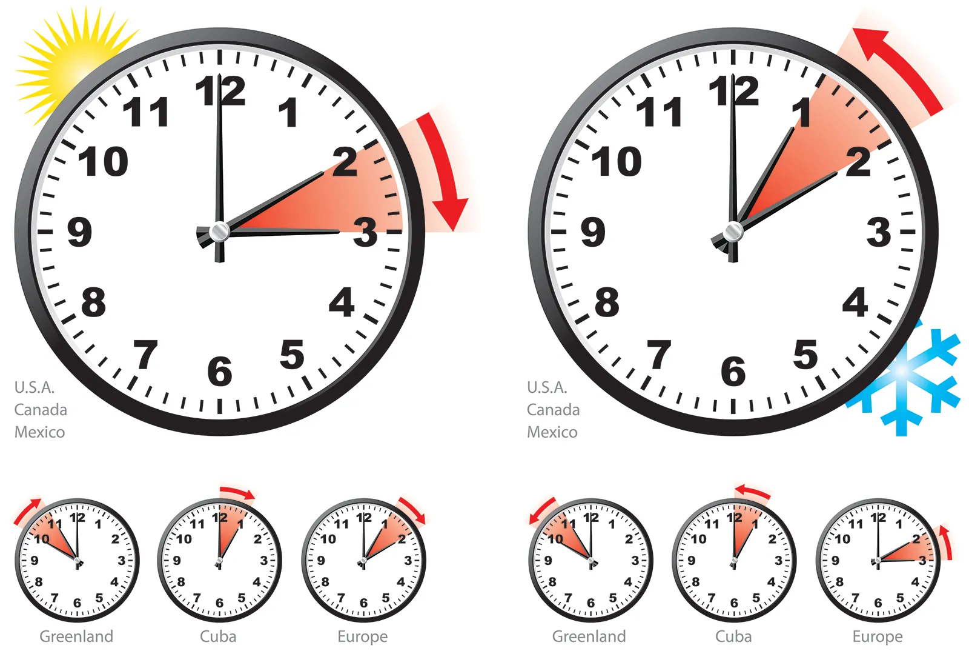
It is daylight savings time!
What do these clocks represent?
How long until we can set our clocks forward again?
How many days?
How many hours?
Daylight saving time in Massachusetts ends at
2:00 AM on Sunday, November 6
It will begin again on Sunday, March 12, 2023
5.MD.A1
Notes:
Week of November 7, 2022

Slide 7
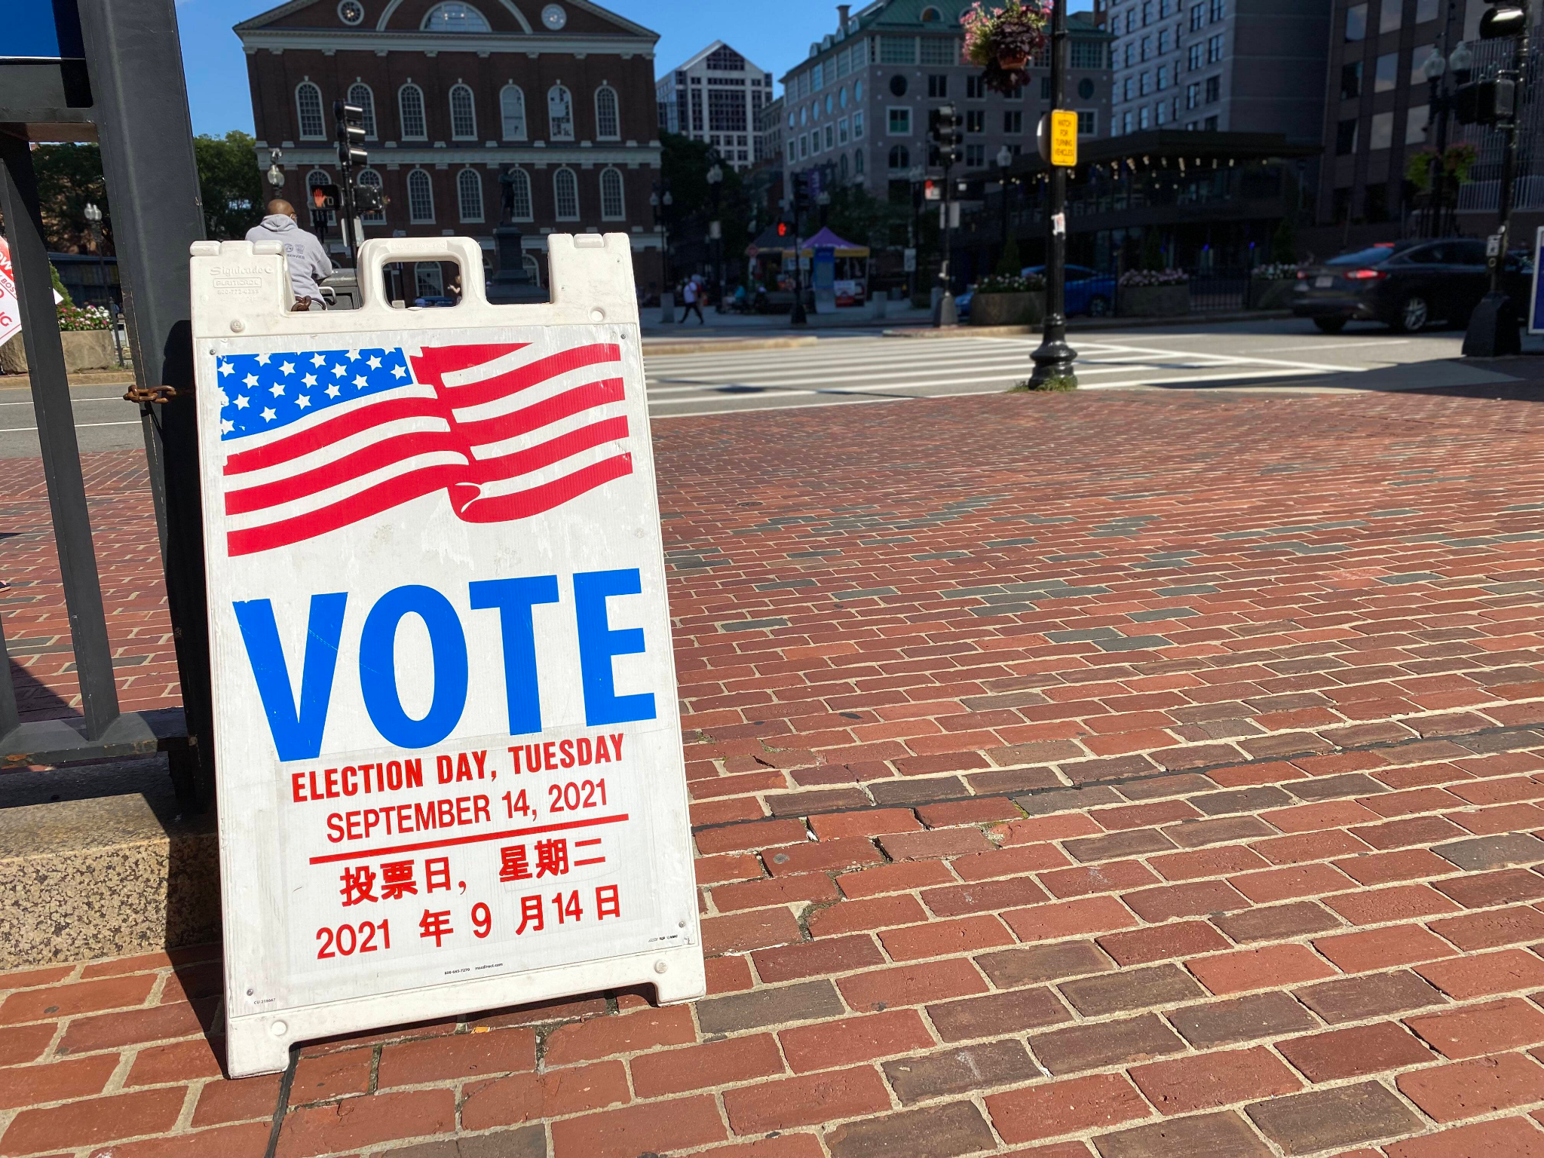
Today is Election Day!
Americans first began the custom of weekday voting in 1845, when Congress passed a federal law designating the first Tuesday following the first Monday in November as Election Day.
Before then, states were allowed to hold elections any time they pleased within a 34-day window before the first Wednesday in December.
What does that mean? A 34-day window?
5.MD.A1
Notes:
November 8, 2022
Election Day

Slide 8
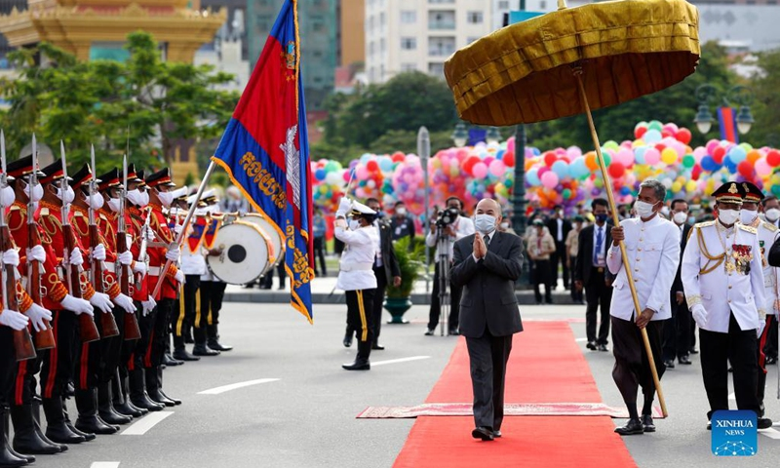
Happy Independence Day in Cambodia!
Cambodia gained independence from France in 1953.
How long ago was that?
What mental math strategy did you use?
5.NBT.B7
Notes:
November 9, 2022
Independence Day ~ Cambodia

Slide 9

Veteran’s Day, originally Armistice Day (1921), began as a universal recognition to the ending of World War I fighting at 11 a.m., November 11, 1918.
The 11th hour of the 11th day of the 11th month.
What can we say about 11?
Is there a divisibility rule for 11? How and why does it work?
5.NBT.B6
Notes:
November 11, 2022
Veteran’s Day

Slide 10
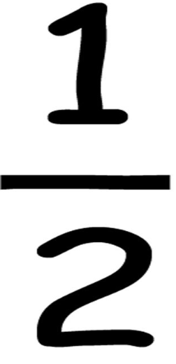
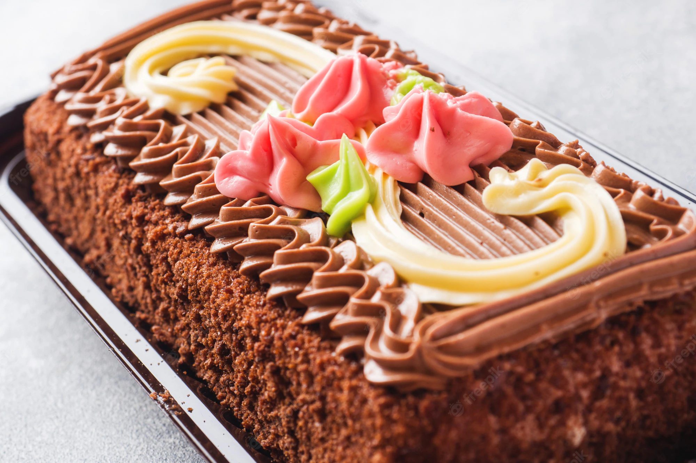
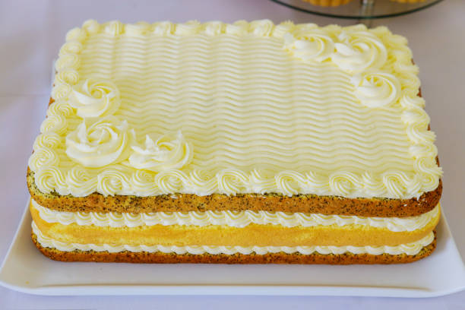
Would you rather have a birthday cake
that is 1 ft. x ft.
or
8 in. x 12 in.
5.NF.B6
Notes:
Week of November 14, 2022

Slide 11
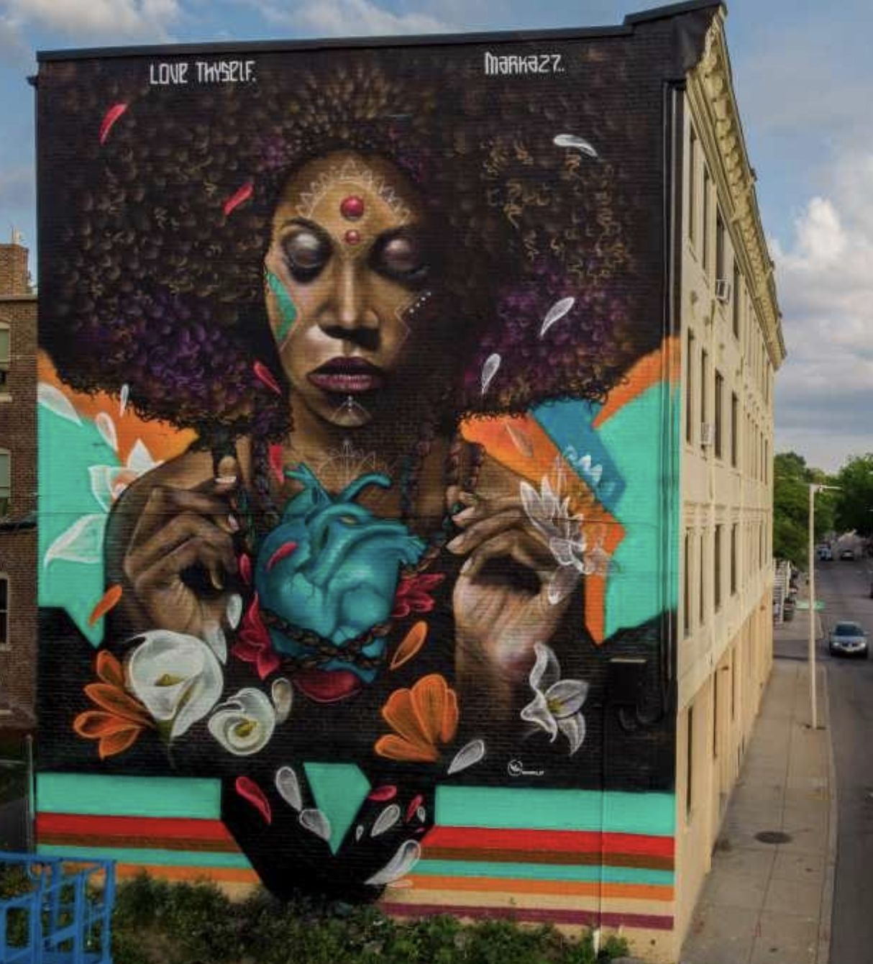
Love Thyself,
by Victor "Marka27" Quiñonez
is painted on the side of 4-story building in Dorchester.
How high is this building? Estimate.
The mural is 43.5 feet high!
How many inches would that be?
About how many meters is that?
5.MD.A1
Notes:
Week of November 14, 2022

Slide 12
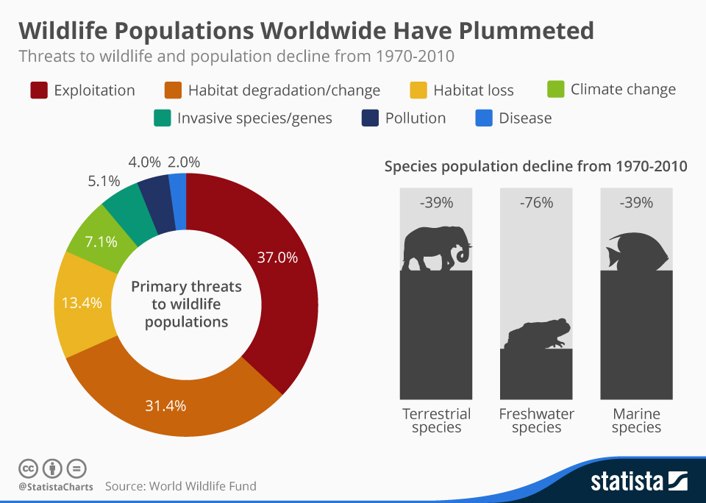
If this data visualization could talk, what would it say?
Why does it matter?
5.MD.B

Slide 13
Function!
Input
Output
5 | 13
7 | 17
10
15
 | 39
 | 45
99
What’s going on in this table?
Can we complete it?
5.OA.B3

Slide 14
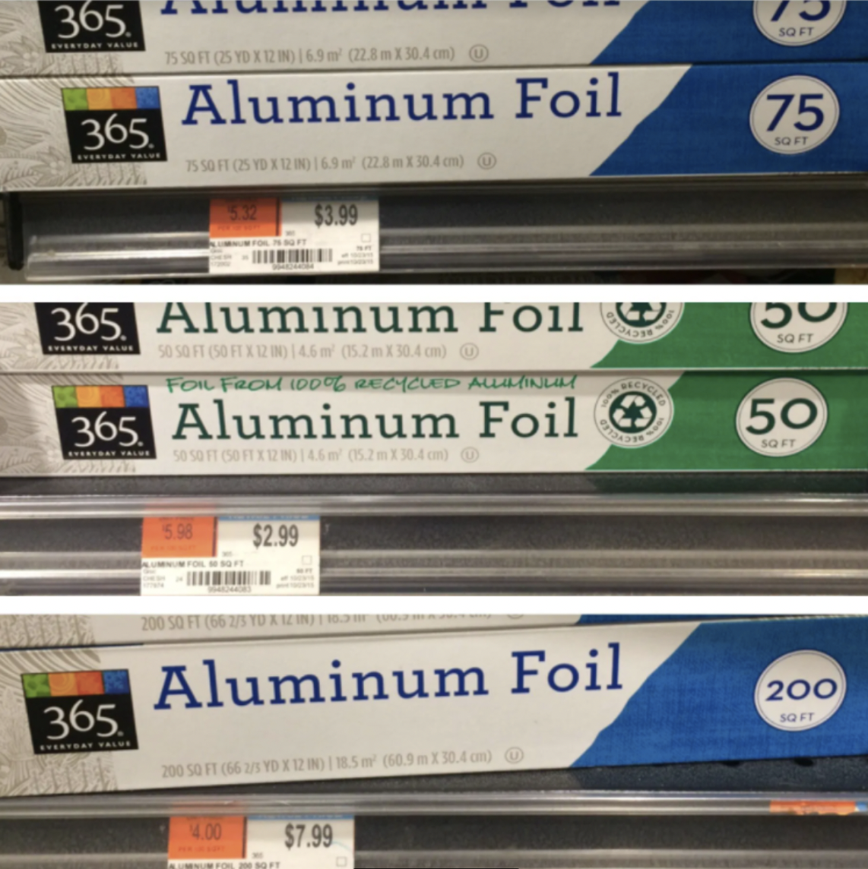
Would you rather…
Which is the better foil buy?
How do we know?
5.NF.B5

Slide 15
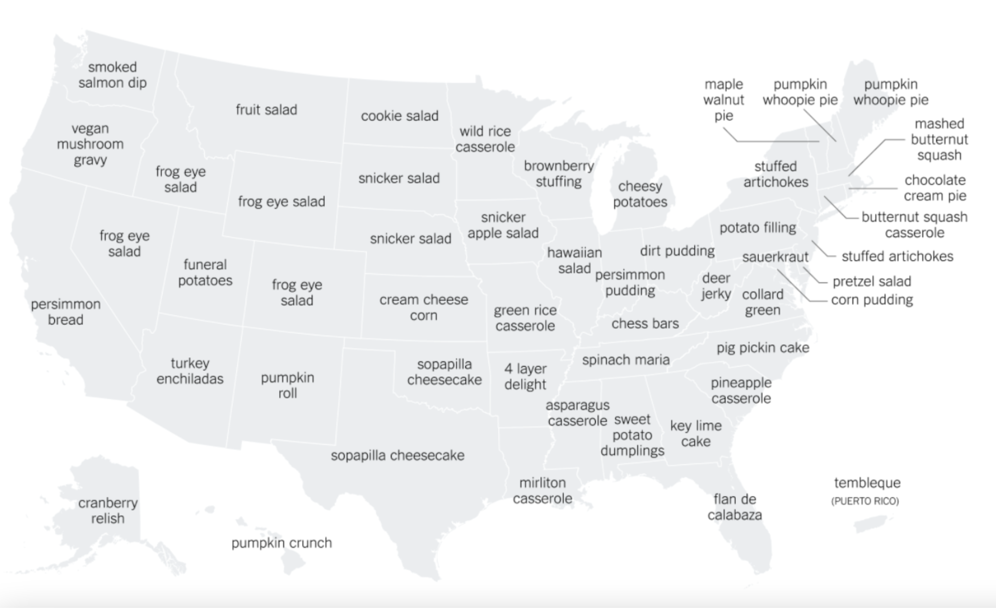
This map shows the most “distinct” Thanksgiving side dish by state as determined by the number of Google searches during the week of Thanksgiving.
What’s going on in this data visualization?
Source: New York Times
5.MD.B
Notes:
Week of November 21, 2022

Slide 16
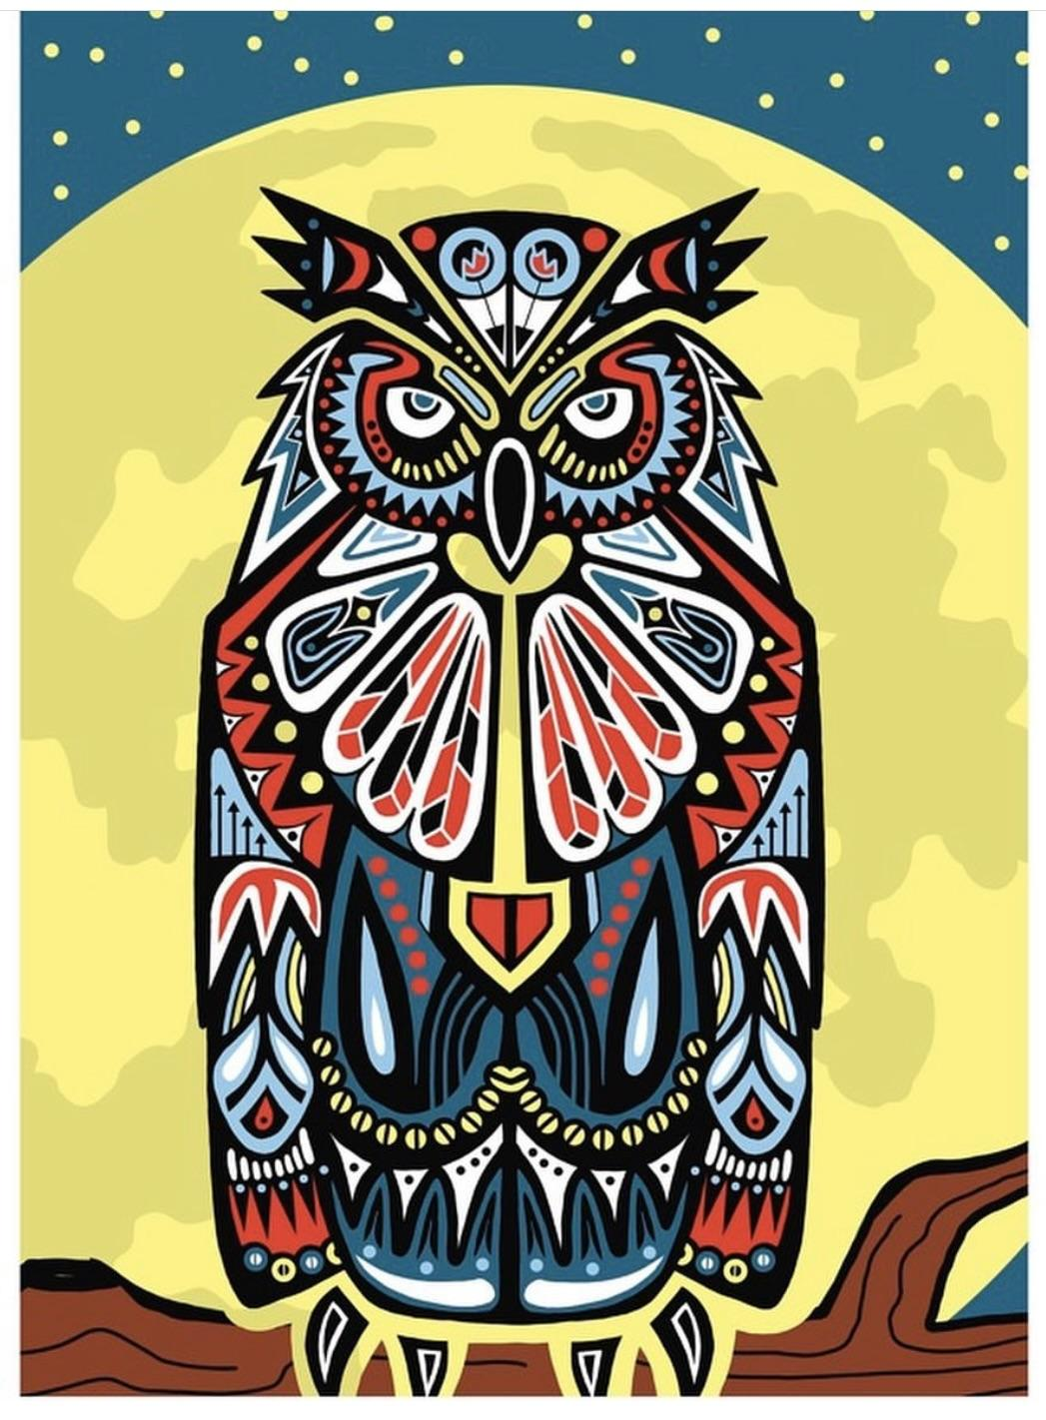
“Guardian Owl”
Jake Ginga
Let’s talk about the geometry we see here.
Do we see any symmetry?
Choose an interesting shape in this piece.
Sketch it.
Now sketch a shape that shares ONE attribute, and is different in another way.
5.G.B3

Slide 17
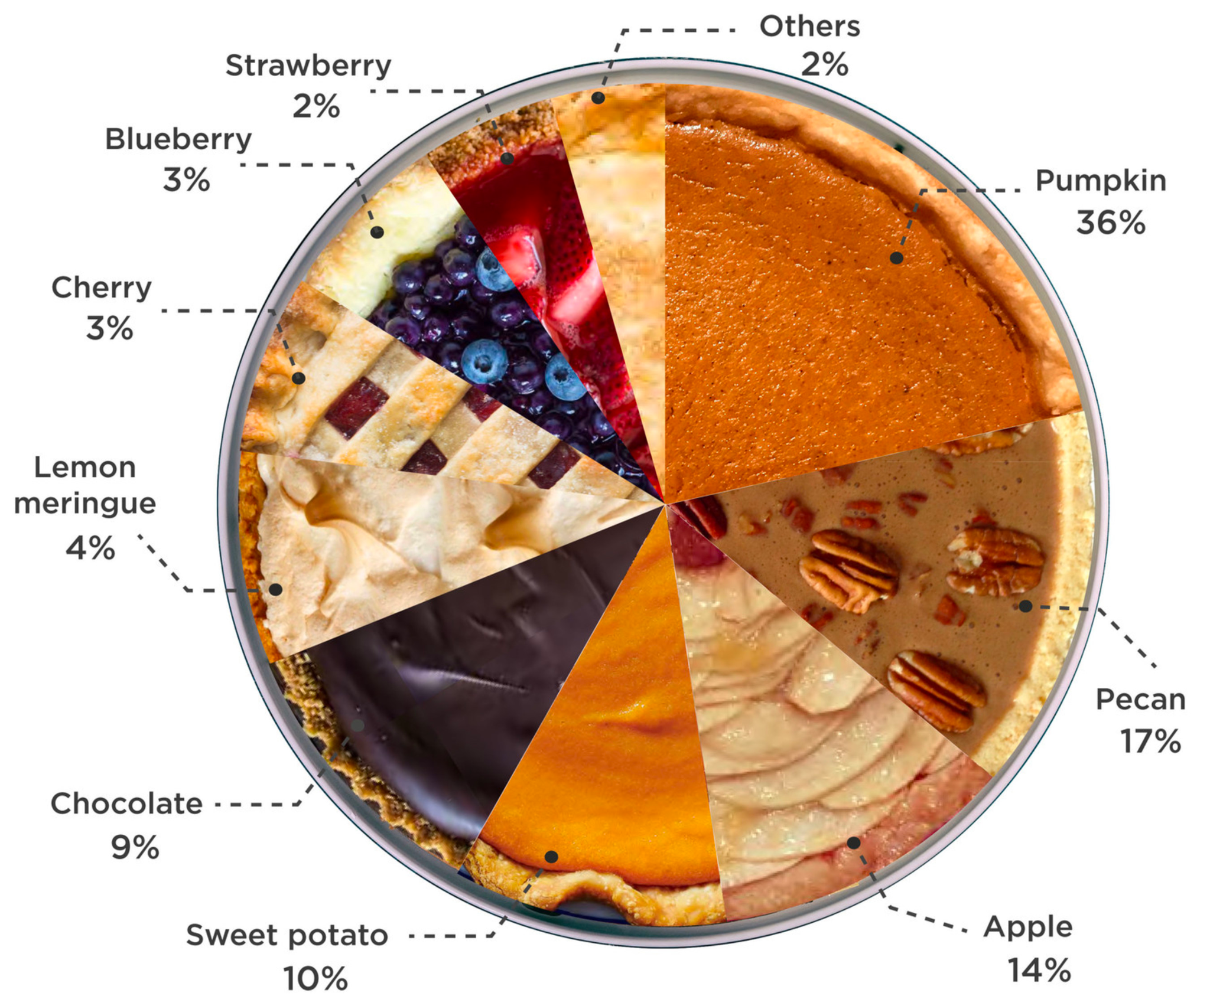
If this “pie” chart could talk, what would it say?
5.NF.A

