Slide 1
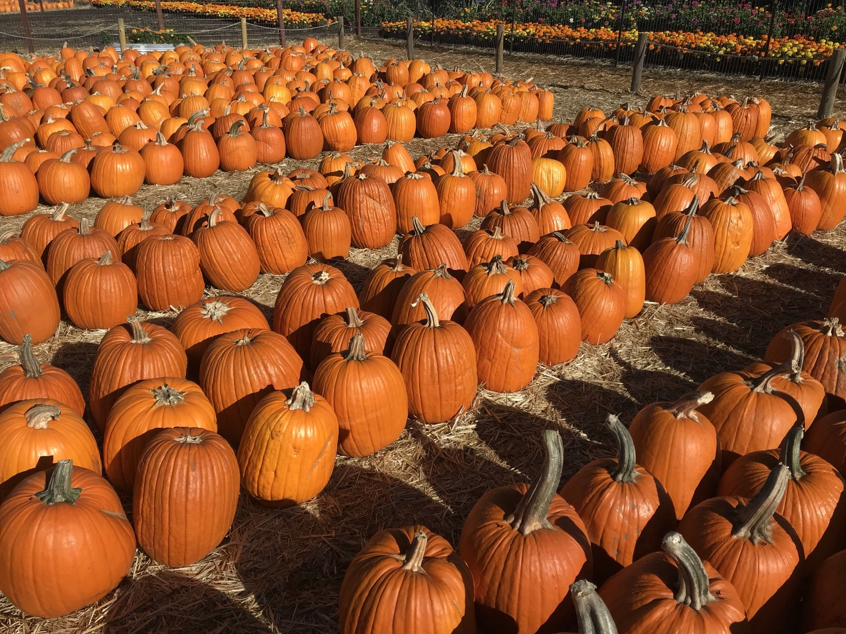
Happy Halloween
How can we use arrays to figure out how many pumpkins are on the farm.
3.OA.A3
Notes:
Week of October 31, 2022

Slide 2
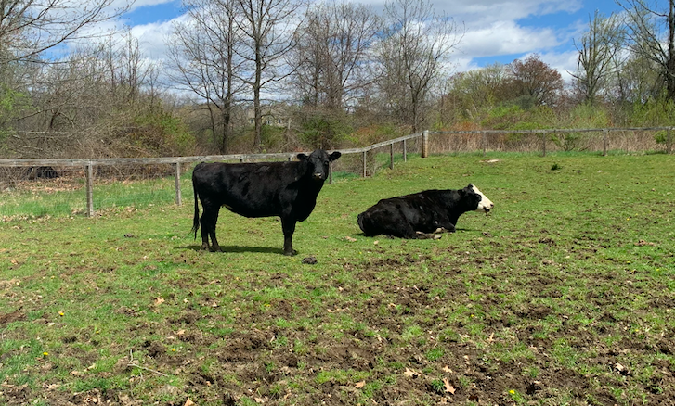
Our neighbors, Boris and Natasha, are cows.
He weighs 2,400 pounds and she weighs 1,550 pounds. How much more does Boris weigh?
3.NBT.A2

Slide 3
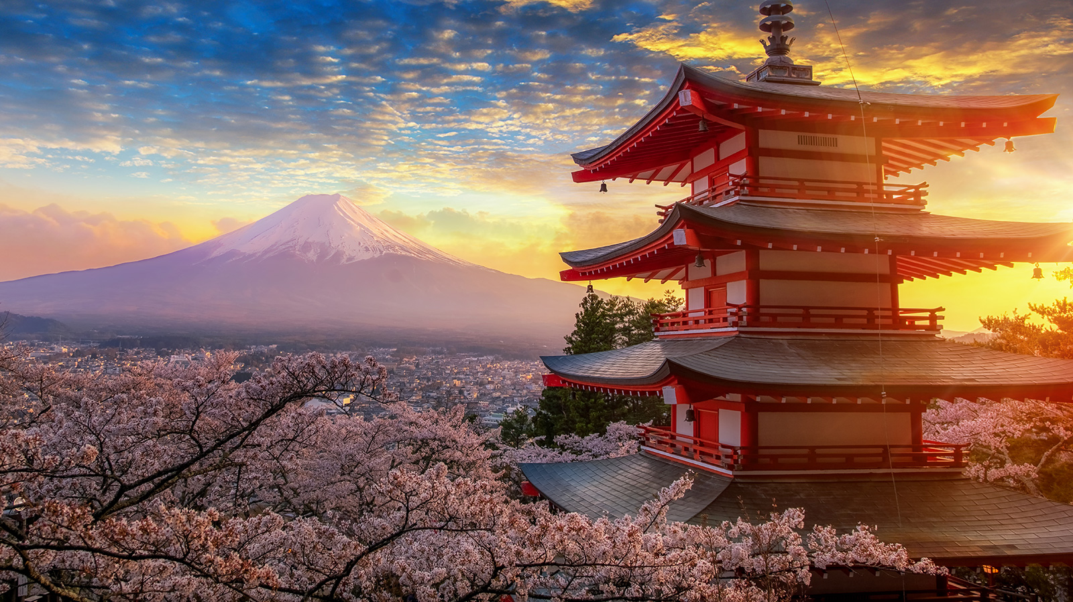
Today is Japanese Culture Day!
The current population of Japan is 125,578,549
What can we say about this number?
3.NBT.A
Notes:
November 2, 2022
Japanese Culture Day

Slide 4
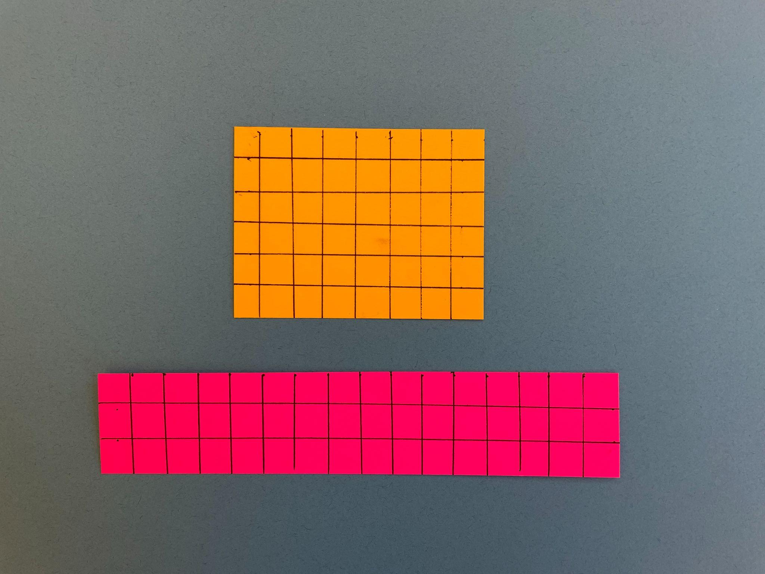
What is the same?
What is different?
3.MD.C7

Slide 5
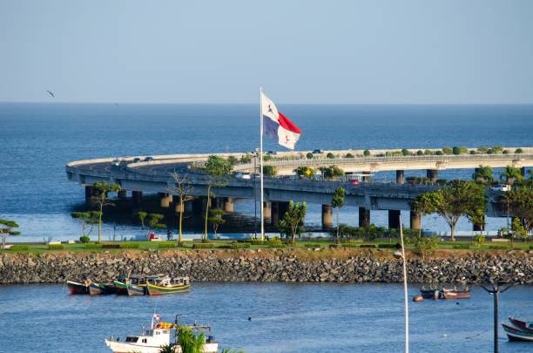
It is Flag Day in Panama!
The Panama Canal is 80 kilometers long.
It takes 8-10 hours to sail through the canal.
What can we say about that?
3.OA.A3
Notes:
November 4, 2022
Panama Flag Day

Slide 6
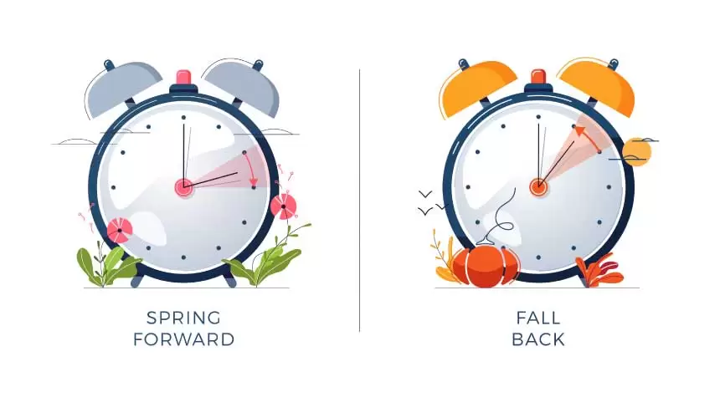
What does that mean?
What do these clocks represent?
How long until we can set our clocks forward again?
It is daylight savings time!
Daylight saving time in Massachusetts began at
2:00 AM on Sunday, March 13 and ends at
2:00 AM on Sunday, November 6
3.MD.A1
Notes:
Week of November 7, 2022

Slide 7
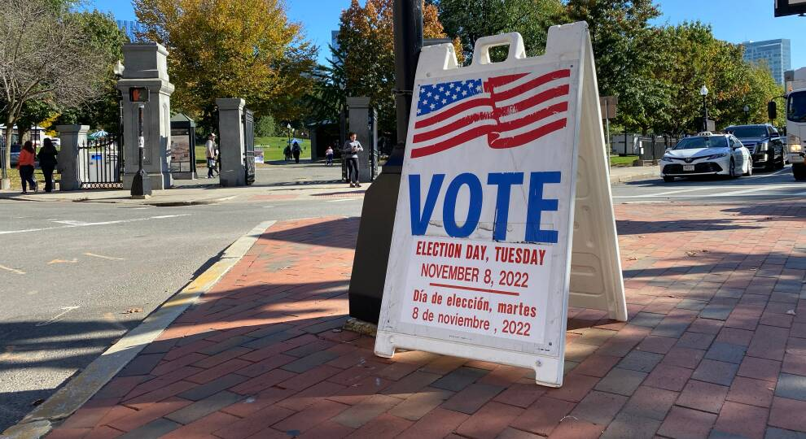
It’s Election Day!
Americans first began the custom of weekday voting in 1845, when Congress passed a federal law designating the first Tuesday following the first Monday in November as Election Day.
How long ago was 1845?
3.NBT.A2
Notes:
November 8, 2022
Election Day

Slide 8
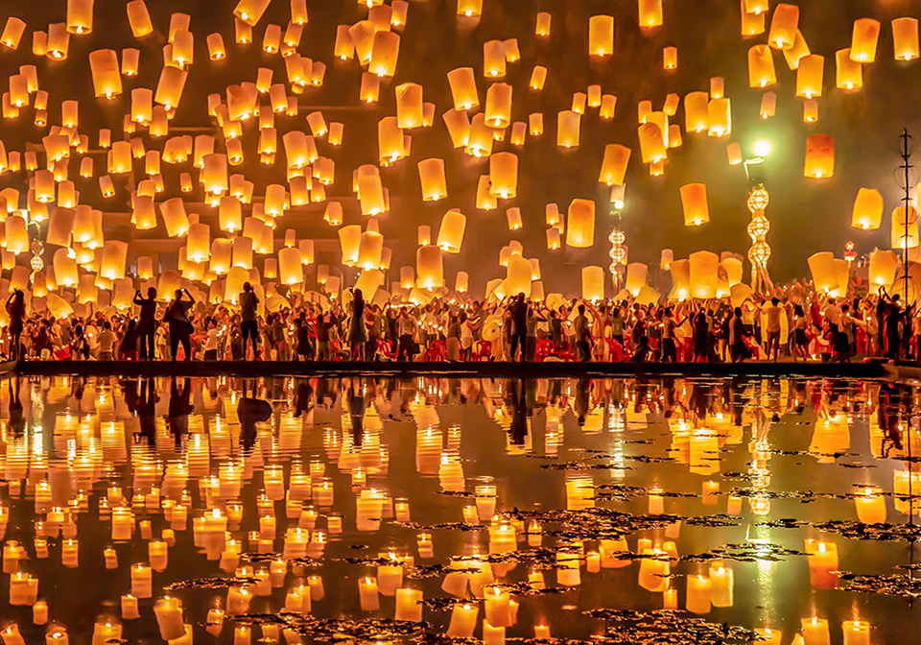
Today is the Yi Peng Lantern Festival in Thailand
Estimate how many lanterns are here.
Did you add the reflection into your estimation?
How can we count them efficiently?
3.NBT.A1
Notes:
November 9, 2022
Yi Peng Lantern Festival ~ Japan

Slide 9
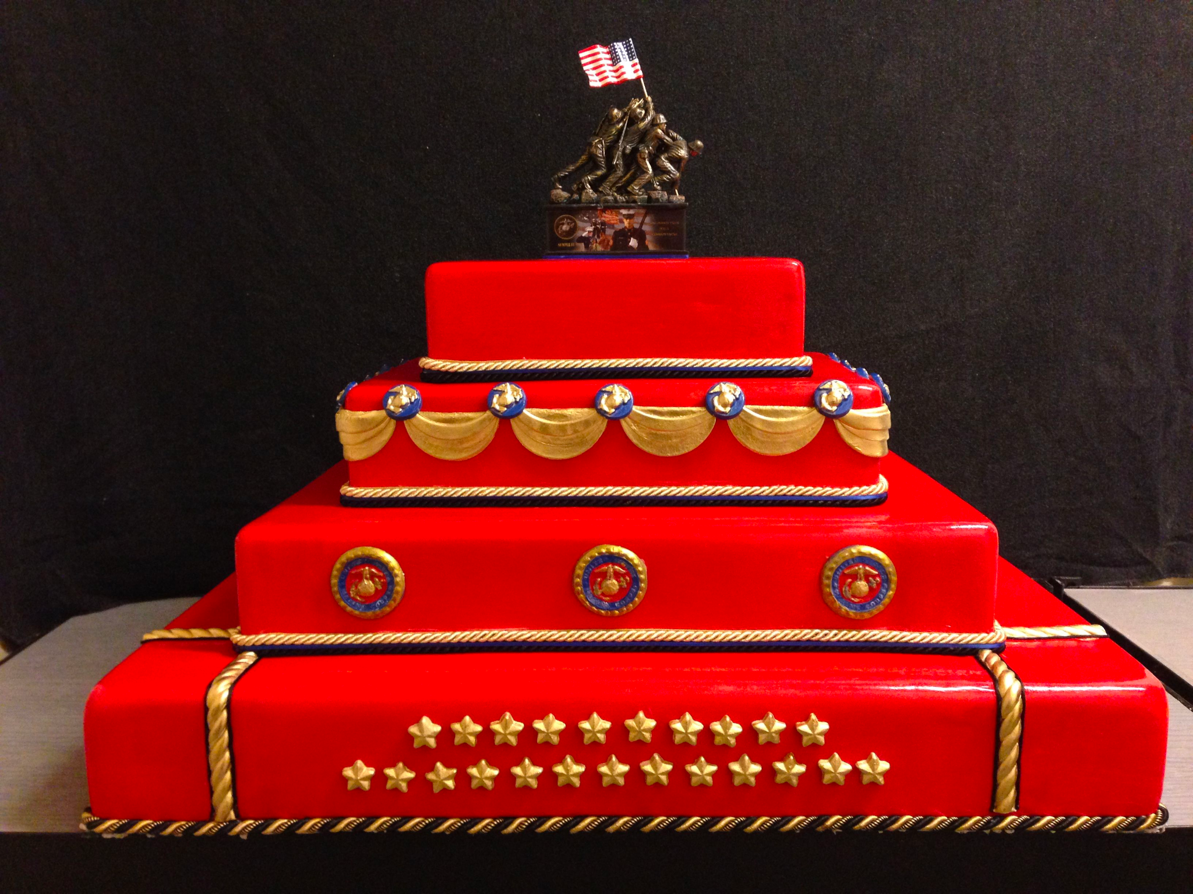
Happy Birthday to the U.S. Marine Corps
The length and width of the bottom cake is
20 inches x 16 inches.
What might the dimensions of the other three cakes be?
What can we way about the AREA of the cake?
How many people would that serve?
3.MD.C7
Notes:
November 10, 2022
Marine Corps Birthday

Slide 10
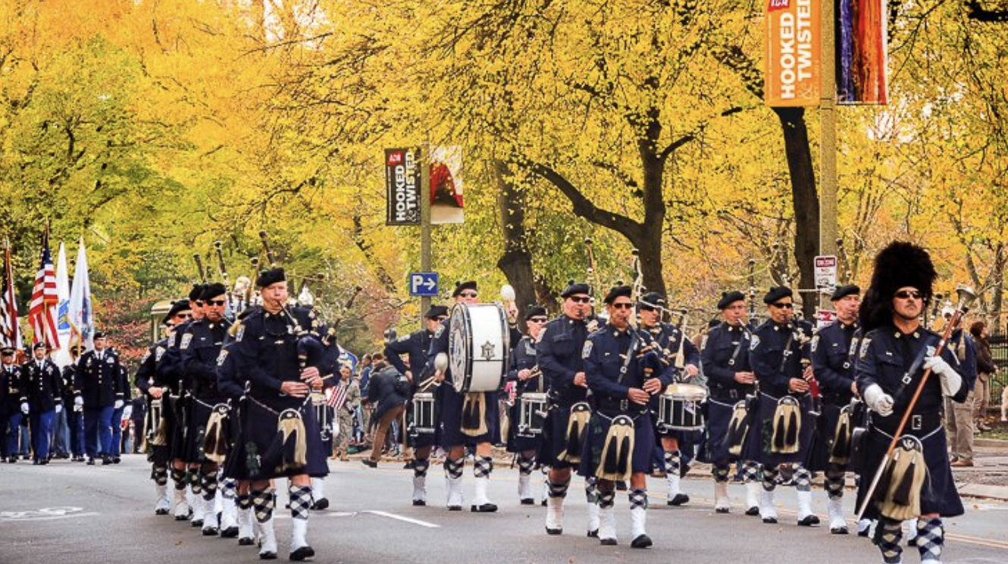
The first celebration of Veteran’s Day was in 1947 in Birmingham, Alabama.
How long ago was that?
3.NBT.A2
Notes:
Week of November 14, 2022

Slide 11
What is the same? What is different?
3.G.A1

Slide 12
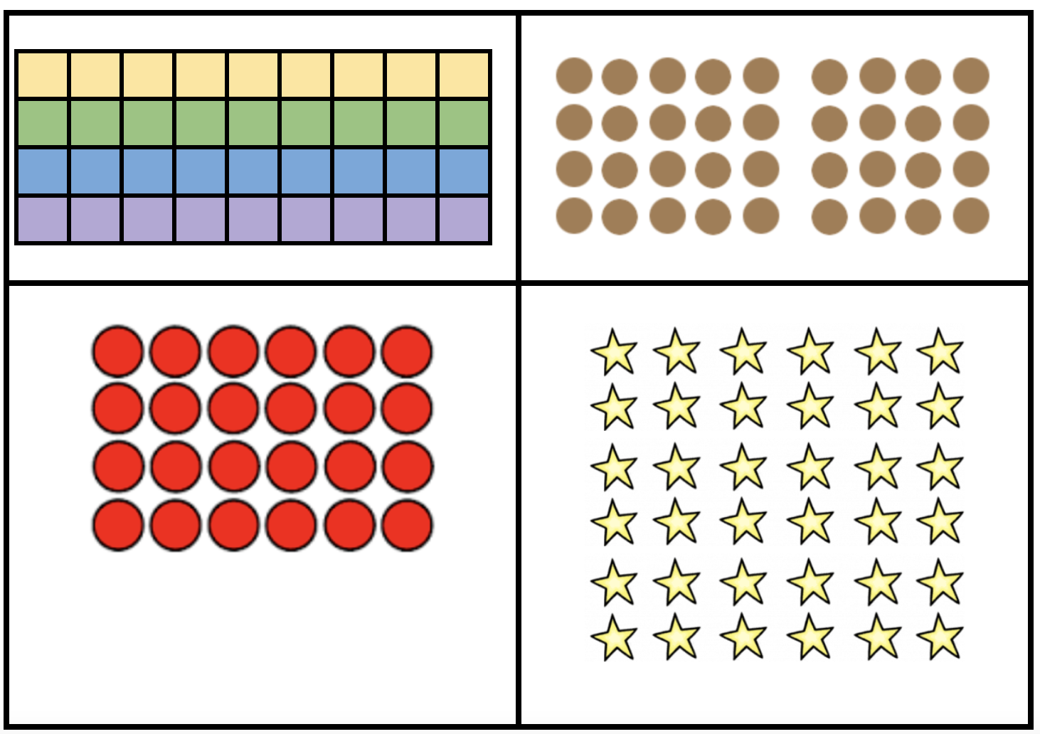
Which one does not belong?
3.MD.C5
Notes:
Top Left: only area model, not one color
Top Right: only separated array (2 arrays)
Bottom Left: not 36
Bottom Right: only square array (6x6)

Slide 13
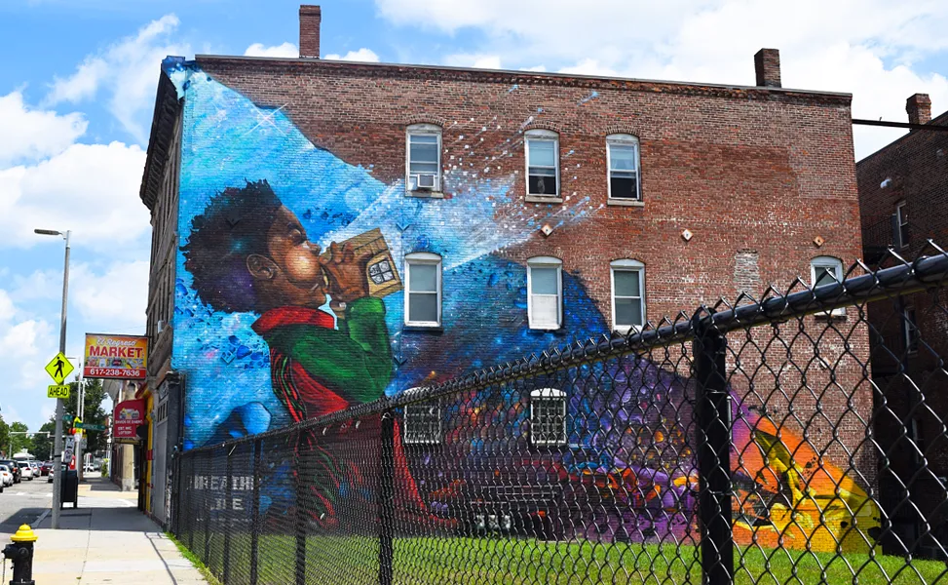
Estimate how tall the boy in this Dorchester mural is.
Breathe Life ~ Rob “ProBlak” Gibbs, Dorchester
3.MD.A2

Slide 14
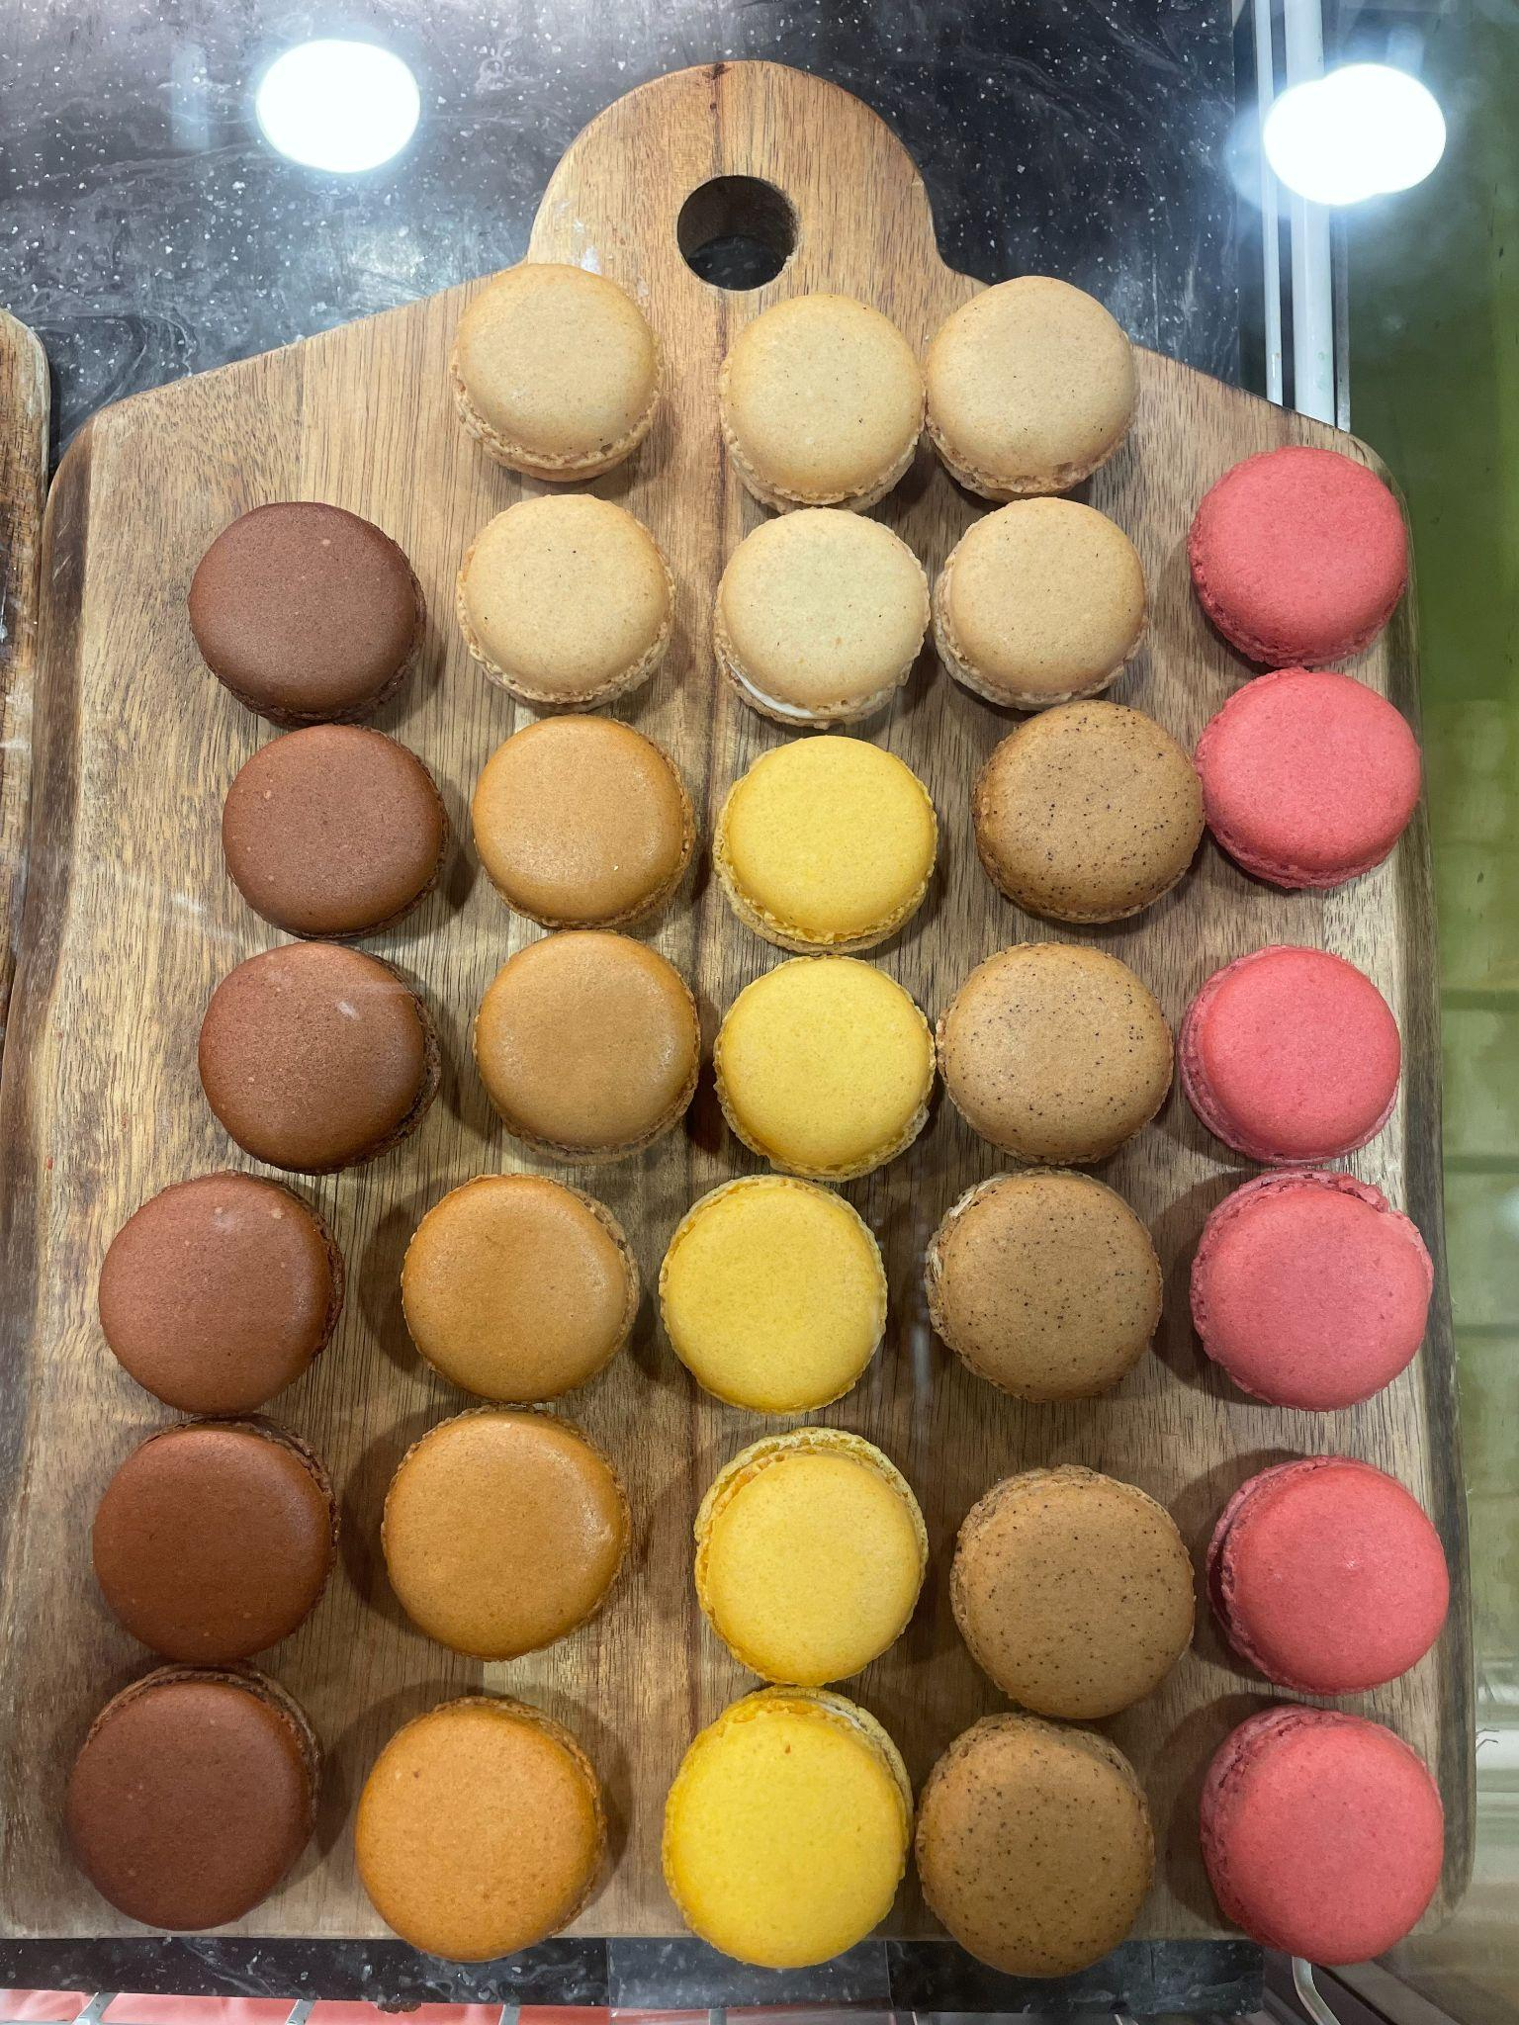
Where do we see arrays?
How many different expressions can we record to match our mathematical thinking?
3.MD.C7

Slide 15
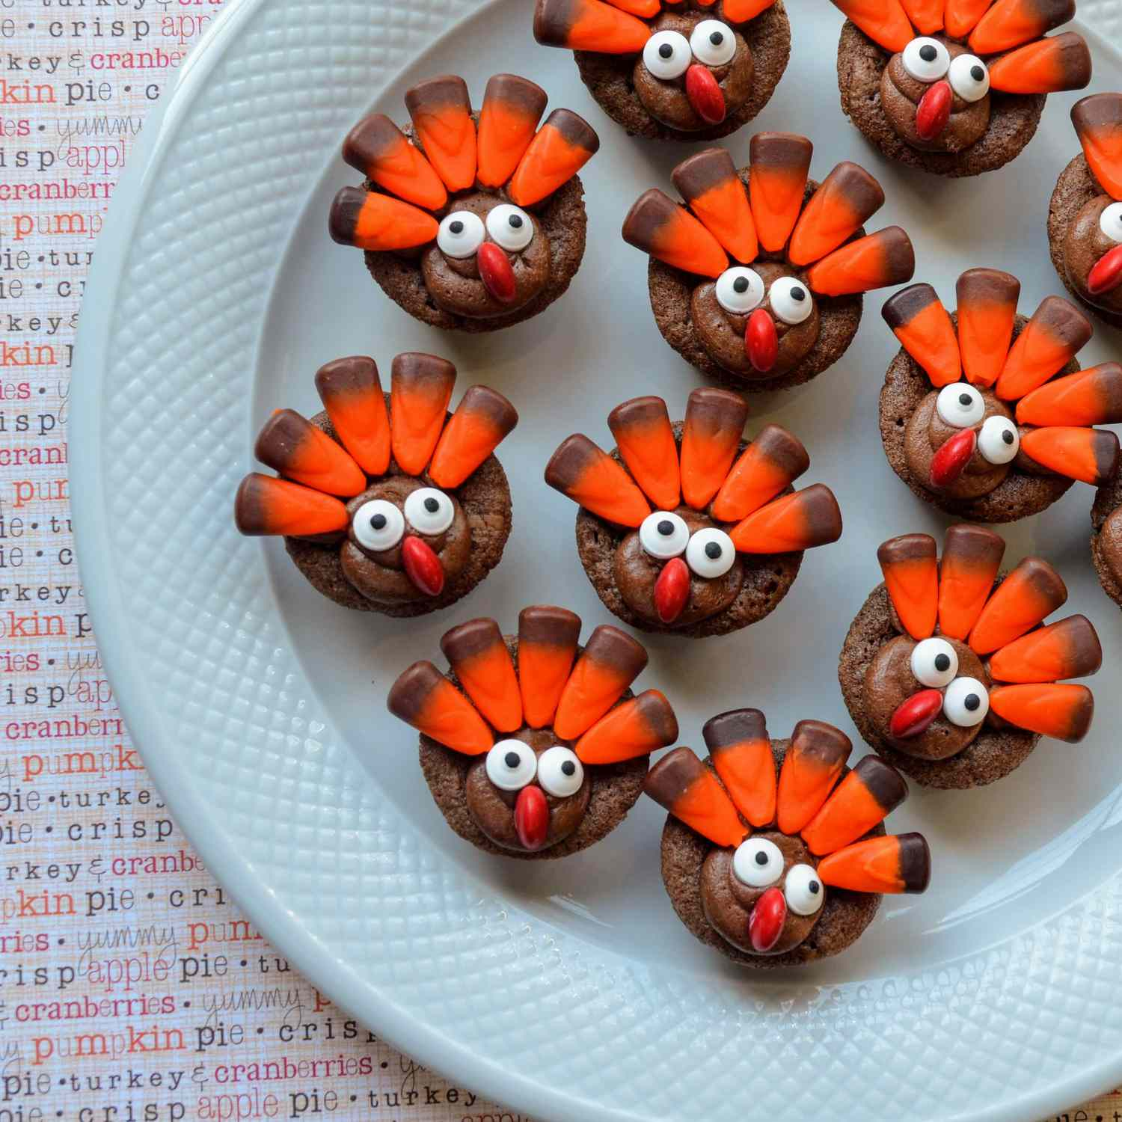
How many turkey brownies?
How many turkey eyes?
How many turkey feathers?
Write an expression to match the math!
3.OA.A3
Notes:
Week of November 21, 2022

Slide 16
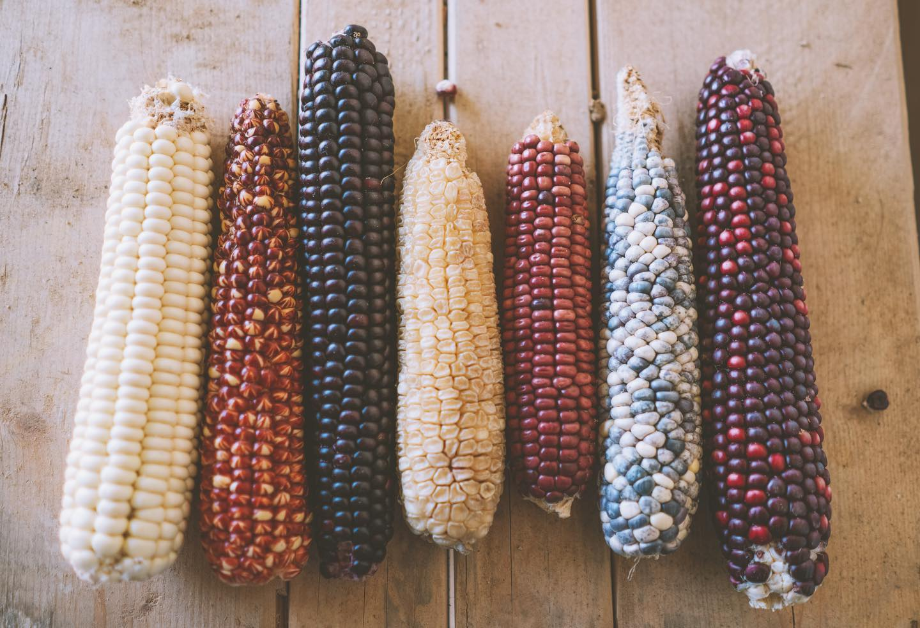
Beautiful Native Corn!
Estimate how many kernels on one ear of corn?
How many would be on two?
All seven?
3.OA.B5

Slide 17
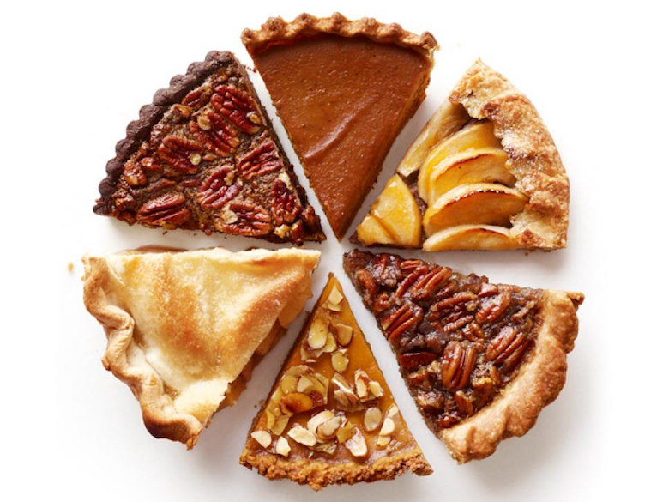
Where do we see fractions?
What can we say about them?
3.NF.A1

