Slide 1
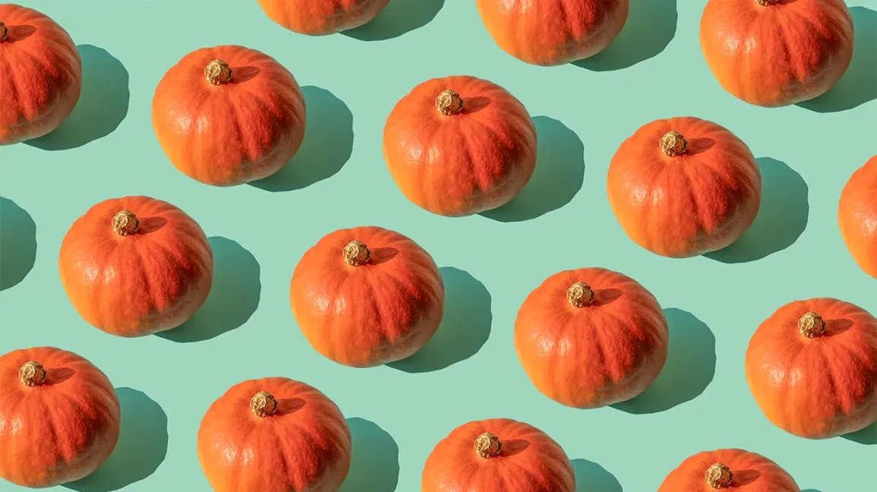
How many pumpkins are here?
If each pumpkin weighs 5 pounds,
how much do they weigh altogether?
1.OA.B5
Notes:
Week of October 31, 2022

Slide 2
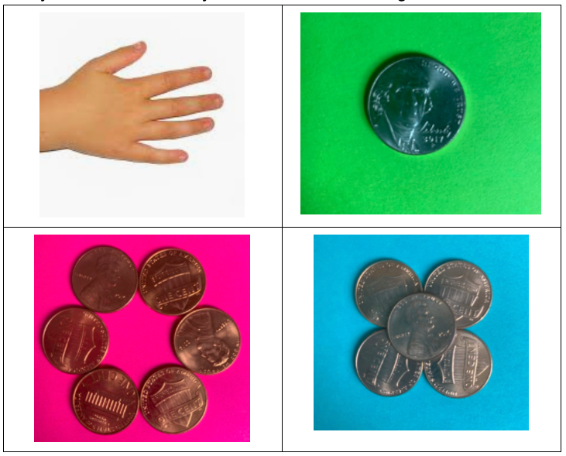
Which one doesn’t belong?
1.MD.D5

Slide 3
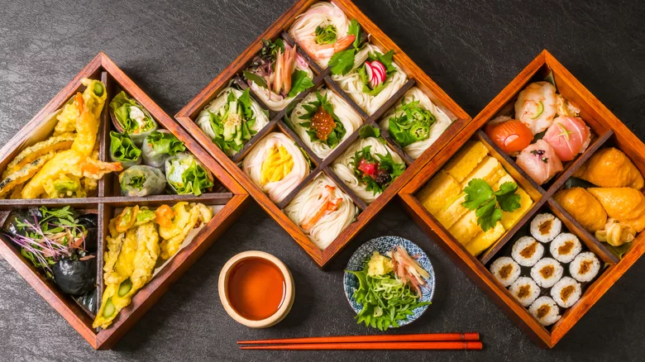
It’s Japanese Culture Day!
What do we notice?
What do we wonder?
What can be counted?
What shapes do we see?
Do we see any patterns?
Describe them.
1.G.A1
Notes:
November 2, 2022
Japanese Culture Day

Slide 4
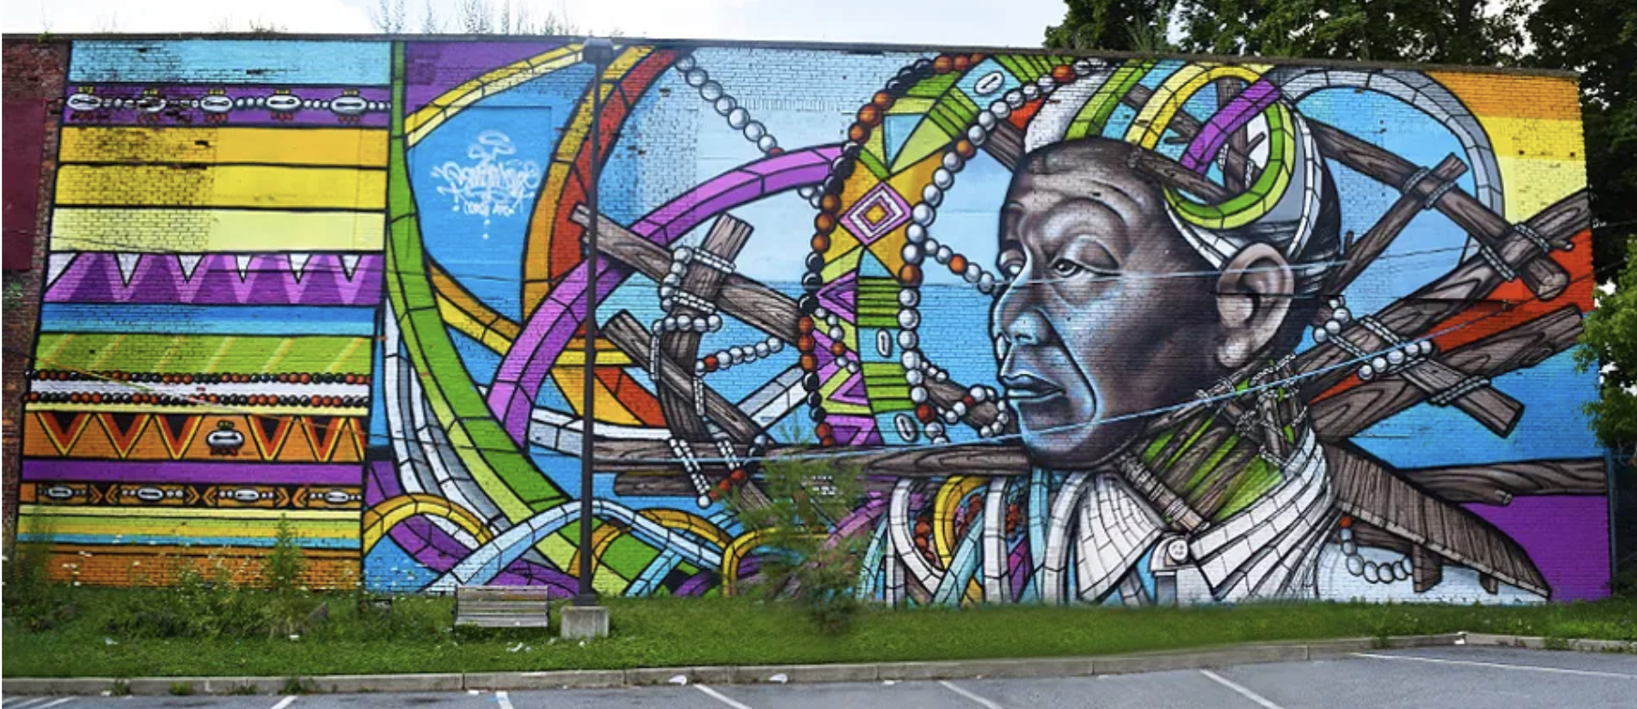
What shapes do we see in Powerful Knowledge?
What would happen if we put two of the shapes together?
1.G.A1

Slide 5
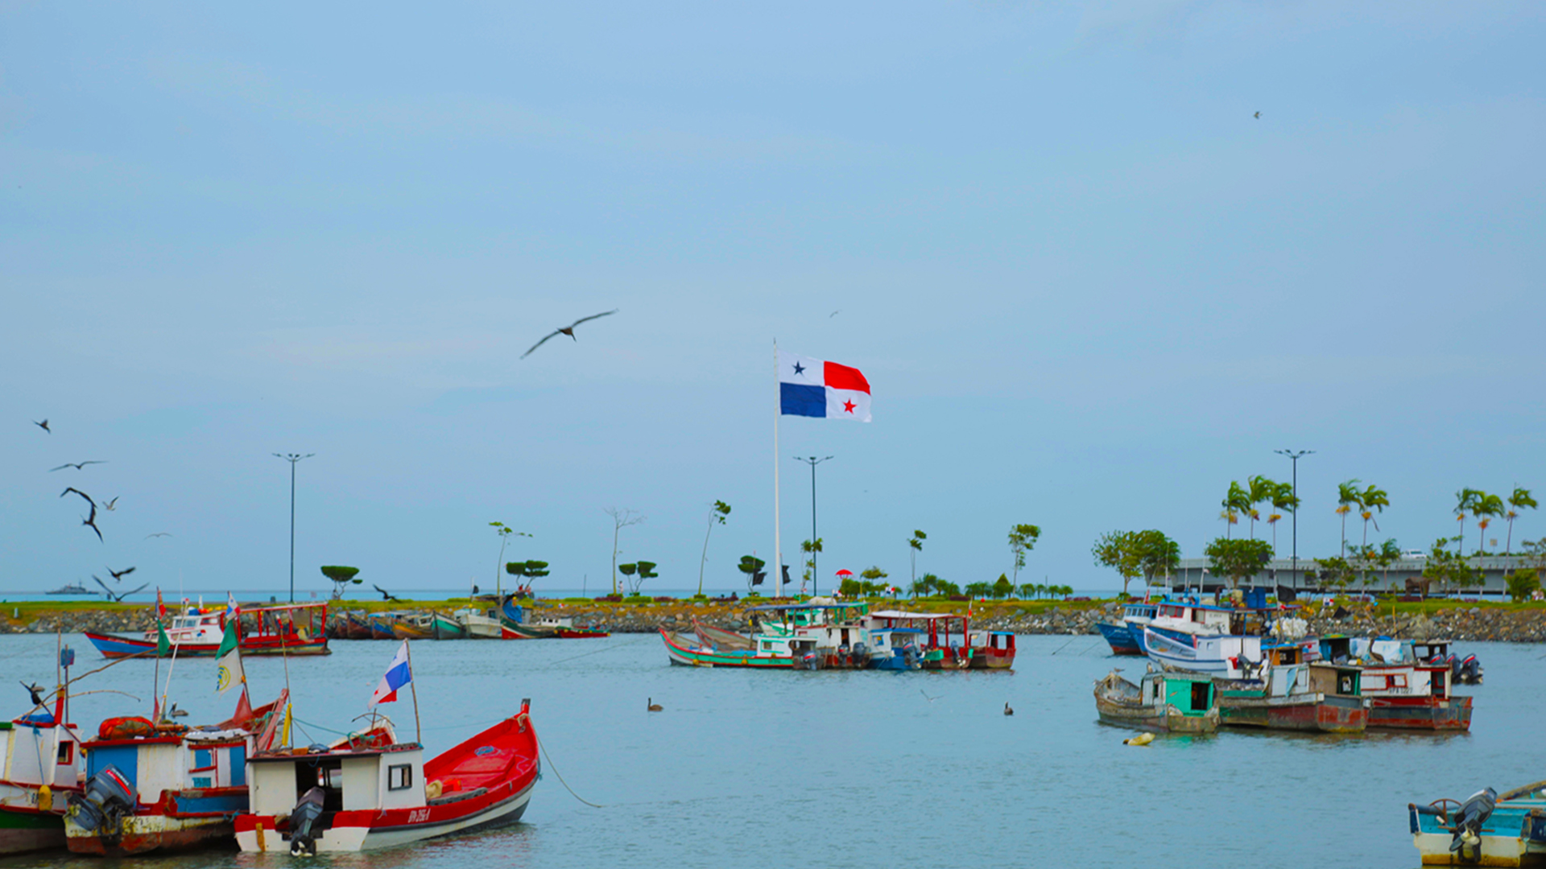
Happy Flag Day in Panama!
The Panama Canal is 50 miles long.
What can we say about the number 50?
How many different ways can we count to 50?
1.NBT.A1
Notes:
November 4, 2022
Panama Flag Day

Slide 6
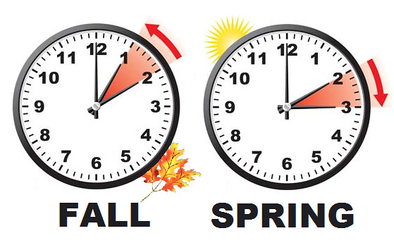
It is daylight savings time!
What does that mean?
What do these clocks represent?
1.MD.B3
Notes:
Week of November 7, 2022

Slide 7

Estimate how many buttons are here?
How many stars are on each button? So, how many stars might be here altogether?
1.NBT.C4
Notes:
November 8, 2022
Election Day

Slide 8
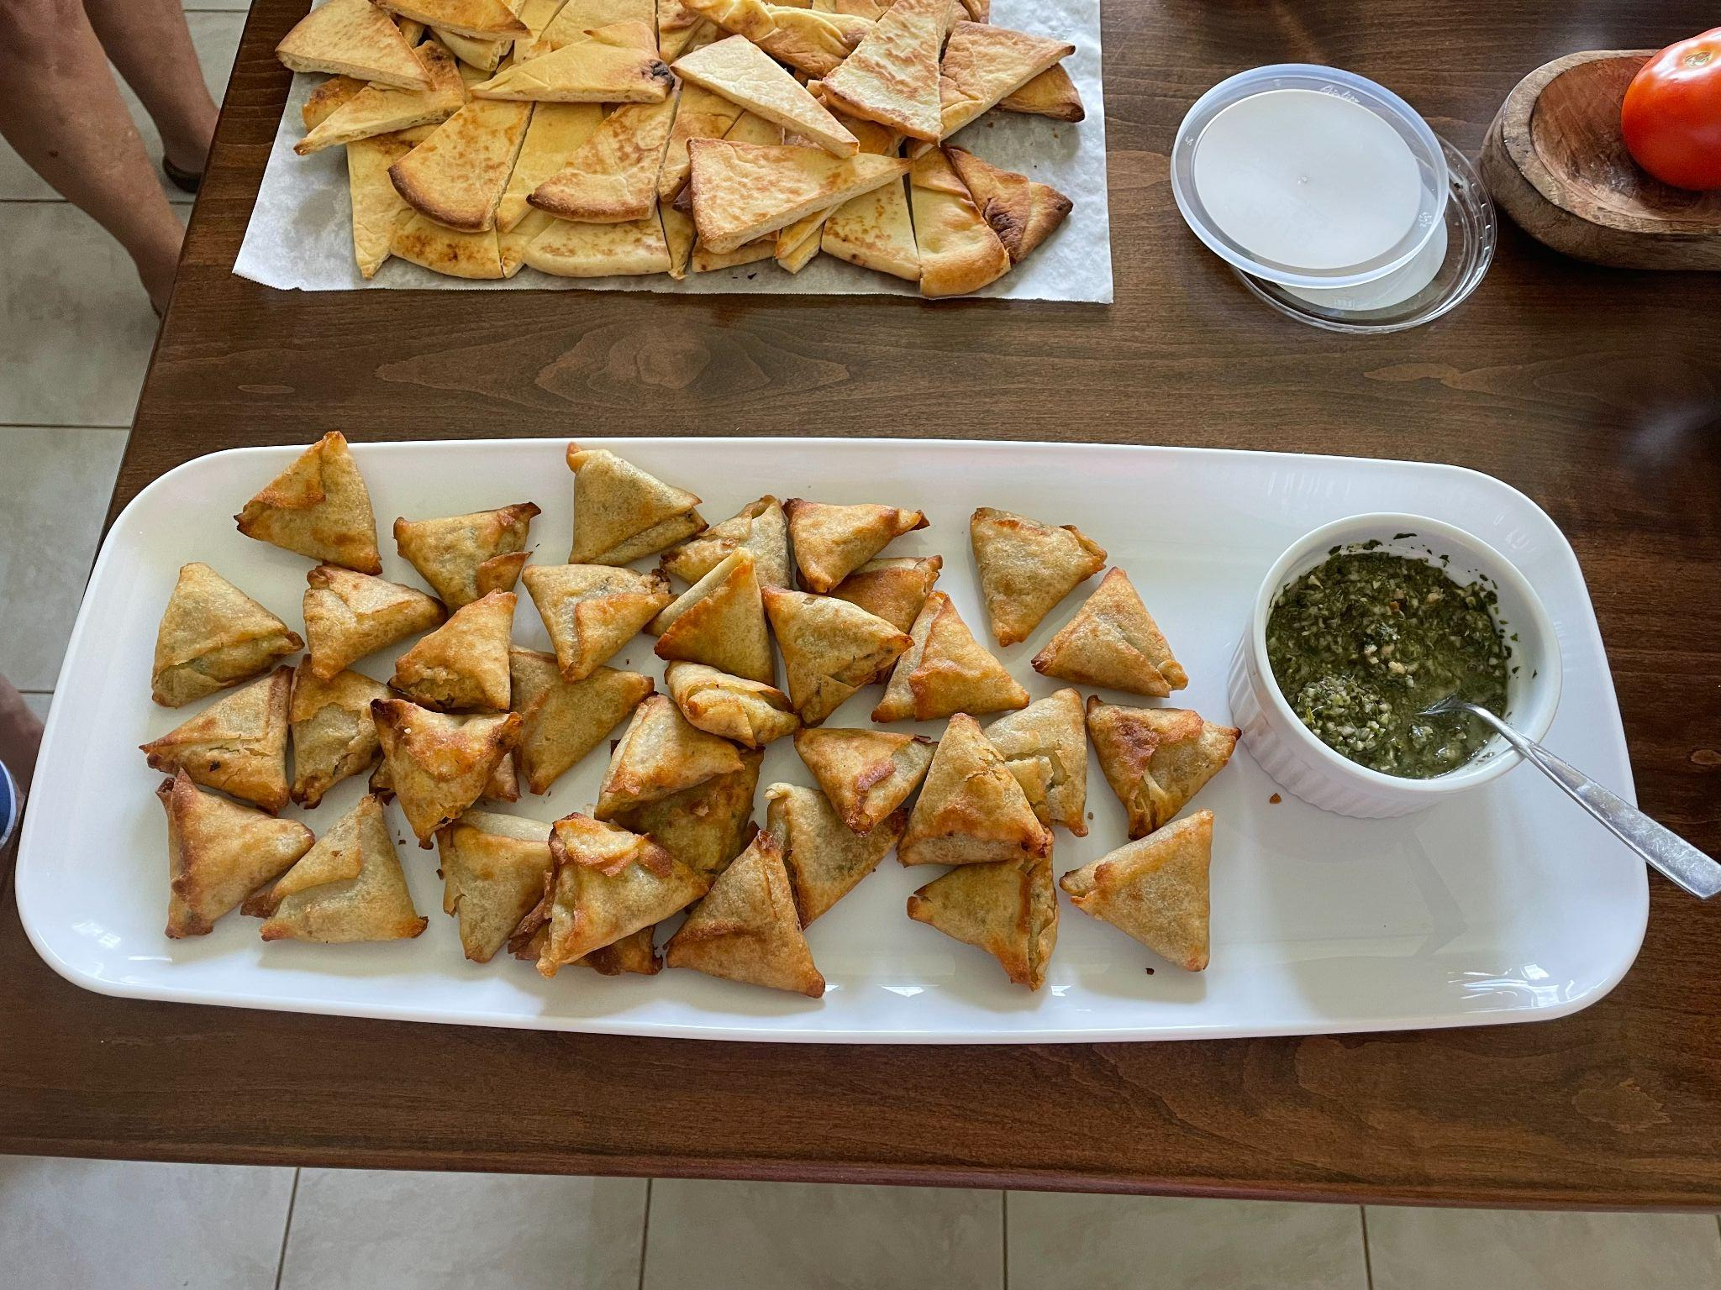
Samosas!
Where’s the math?
How many Samosas do we see?
What shape are they?
What shape would they be if we partitioned them?
1.G.A3

Slide 9

How many flags are here?
How many stars?
How many stripes?
How can we solve this?
1.NBT.C4

Slide 10
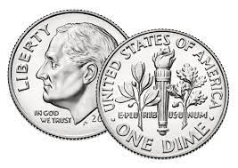
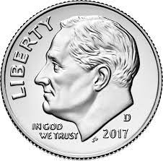
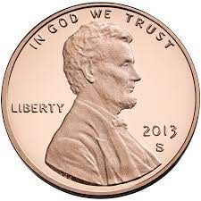

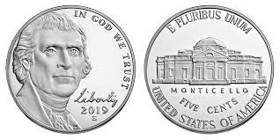
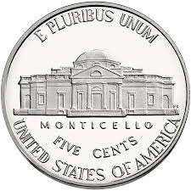
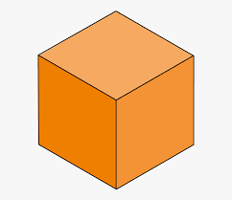
Which one doesn’t belong?
20 + 10 + 10 + 10 + 1
1.MD.D5
Notes:
Week of November 14, 2022

Slide 11

10 + 5 = 5 + 10
10 + 6 = 9 + 7
10 + 8 = 9 + 8 + 1
10 + 10 = 8 + 2 + 1
1.OA.D7

Slide 12
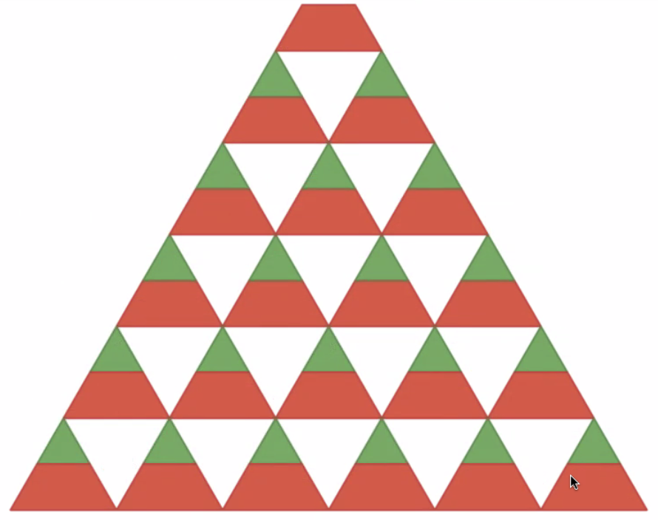
What patterns do we see in this block sculpture?
1.OA.C5

Slide 13
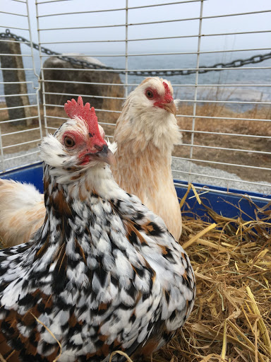
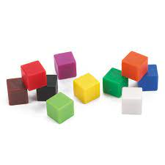
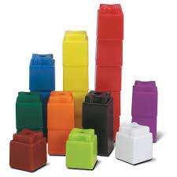

Hawk and Princess live at Land’s Sake Farm!
How would you measure them?
Would you use little cubes?
Connecting cubes?
Rulers?
1.MD.A2

Slide 14
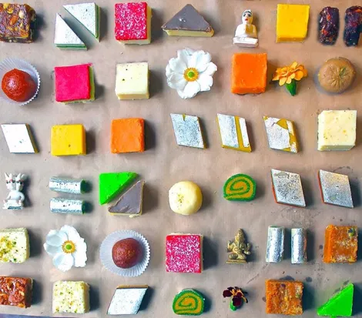
What fun shapes do we see in these traditional Indian Sweets?
How can we sort them?
How can we count them?
1.NBT.A1

Slide 15
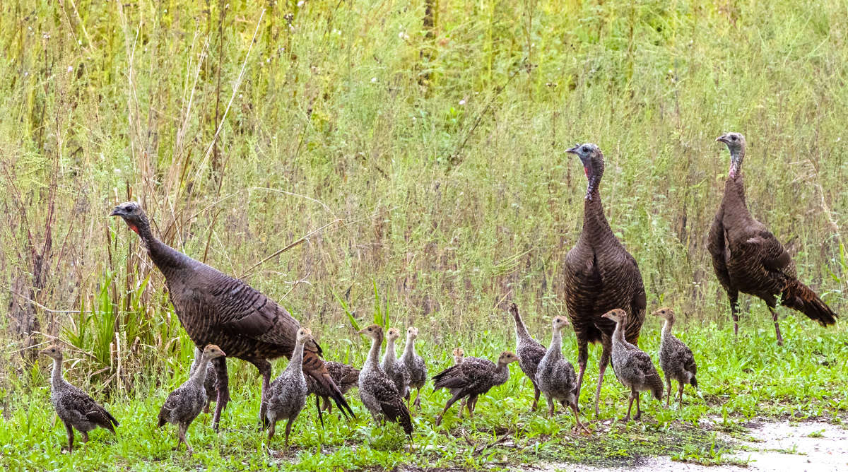
Look at all of these turkeys on the Rail Trail!
Let’s write an equation to match this photo!
1.OA.D8

Slide 16
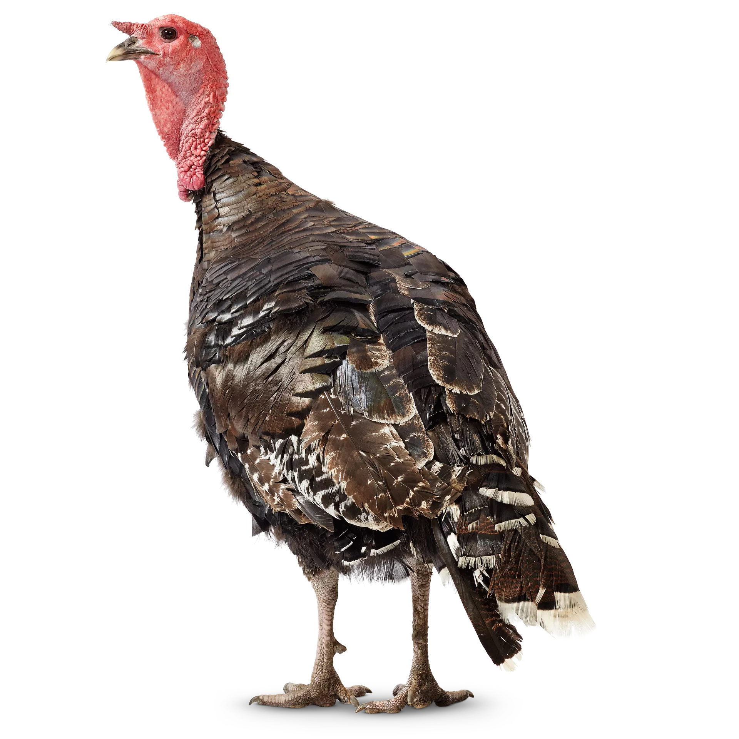
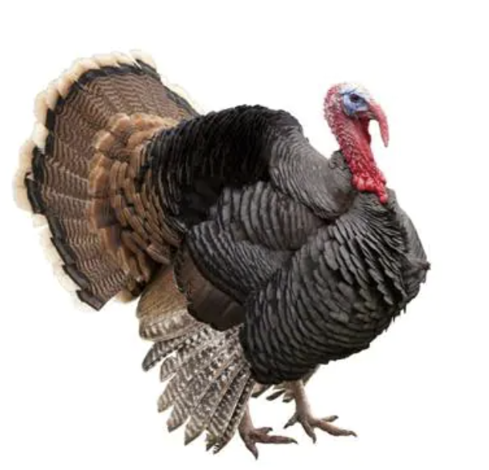
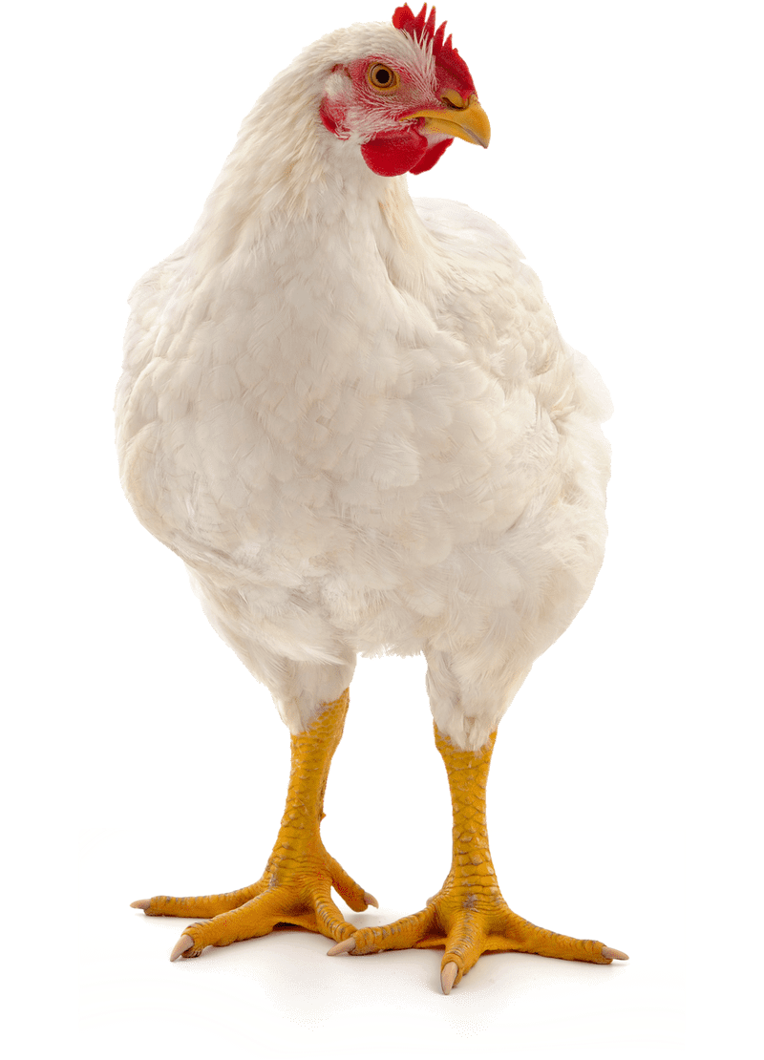
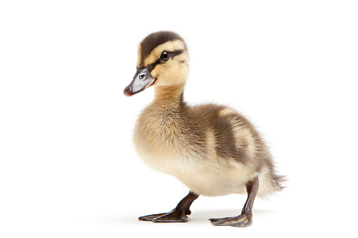
How can we compare these friends?
1.MD.A1
Notes:
Week of November 21, 2022

Slide 17
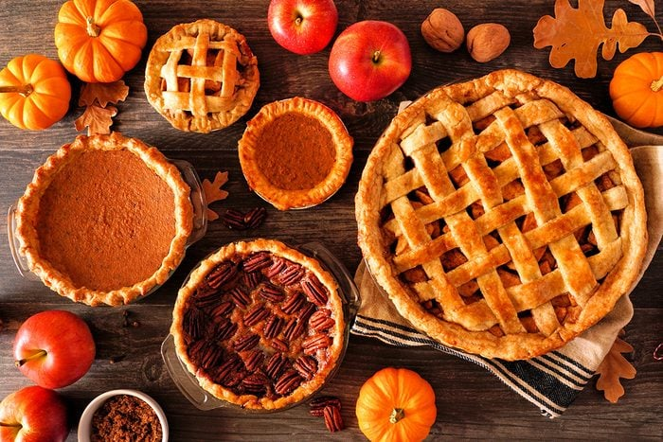
Happy Thanksgiving
What can be counted?
What shapes do we see?
1.G.A1

