Slide 1
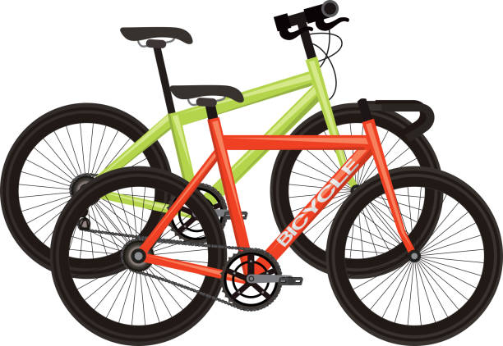
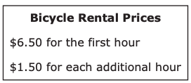
The prices for renting a bicycle from Leo’s Bike Shop are shown in this box.
What is the total price for renting a bicycle from Leo’s Bike Shop for 3 hours?
A. $8.00
B. $9.50
C. $12.50
D. $13.00

Slide 2
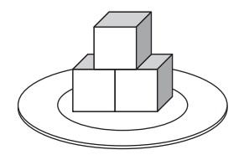
A server at a restaurant puts the same number of cubes of butter on each of 10 plates. One of the plates is shown.
All of the cubes of butter on the plate are visible.
Each cube of butter has a volume of 1 cubic inch.
What is the total volume, in cubic inches, of butter the server will need for the 10 plates?
What do we notice?
What do we wonder?

Slide 3

871.953
What can we say about this number?
What VALUE do each of the digits have?
Select the two correct answers.
A. 146.792
B. 219.73
C. 394.821
D. 429.13
E. 593.427
F. 652.49

Slide 4
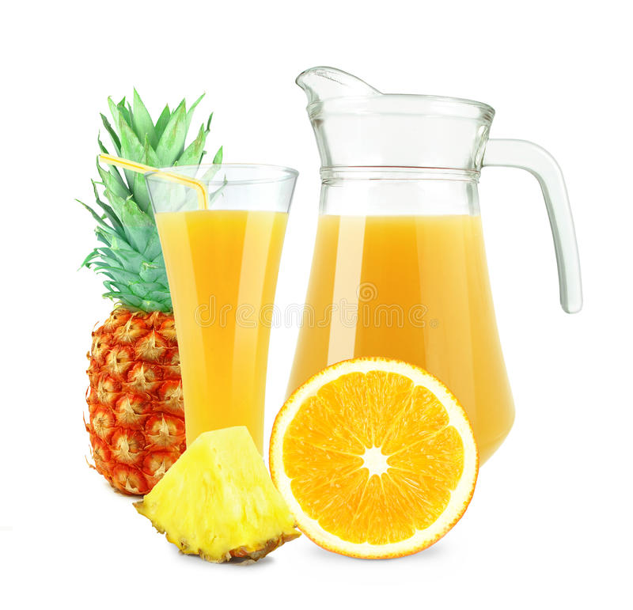
What is the total amount of fruit punch, in liters, that Charlotte made?
A. 1.0
B. 1.5
C. 1.05
D. 1.005
Charlotte added 550 milliliters of orange juice to 500 milliliters of pineapple juice to make fruit punch.
What can we say about that? (Think liters!)

Slide 5

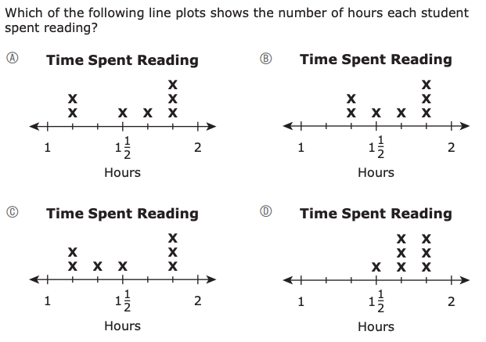

The number of hours that seven students spent reading are listed in this box.
What do we notice?
What do we wonder?

Slide 6

The length of a pencil is 13.8 centimeters.
How long is that?
What is that close to?
What is the length of the pencil rounded to the ones place?
A. 10 centimeters
B. 12 centimeters
C. 13 centimeters
D. 14 centimeters

Slide 7
Which of the following statements about quadrilaterals is true?
A. Every rhombus is also a square.
B. Every trapezoid is also a square.
C. Every rhombus is also a parallelogram.
D. Every trapezoid is also a parallelogram.
What do we know about QUADRILATERALS?

Slide 8
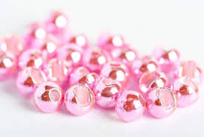
What is the total number of beads Olga ordered?
A. 1008
B. 2500
C. 3380
D. 3600
Olga ordered 144 packages of beads from a craft store.
Each package contains 25 beads.
ESTIMATE how many beads she ordered!

Slide 9
1,000,000,000
Which of the following expressions is equivalent to 1,000,000,000?
A. 10¹¹
B. 10¹⁰
C. 10⁹
D. 10⁸
Wow! That’s quite a number!
What do we know about this number?
How can we write this number using exponents?

Slide 10
375.933
What is 375.933 rounded to the nearest tenth?
What are some of the ways we can ROUND this number?

Slide 11
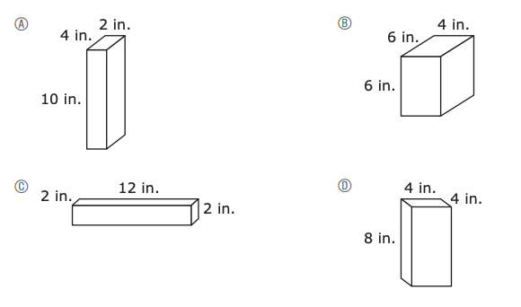
What can we say about these boxes?
What is the same?
What is different?
Which box has the greatest volume?

Slide 12
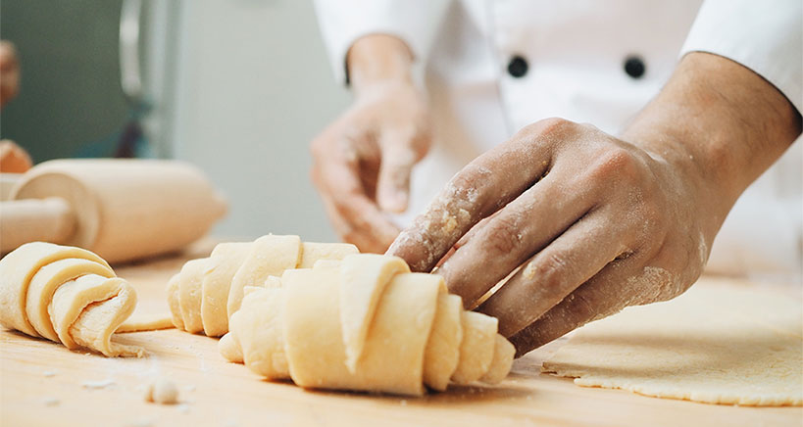
A baker weighed four batches of cookie dough, the weights are shown.
Which of the these lists shows the weights in order from least to greatest value?
A. 26 ounces, 2 pounds, 46 ounces, 3 pounds
B. 26 ounces, 46 ounces, 2 pounds, 3 pounds
C. 2 pounds, 3 pounds, 26 ounces, 46 ounces
D. 2 pounds, 26 ounces, 3 pounds, 46 ounces
• 2 pounds
• 46 ounces
• 3 pounds
• 26 ounces

Slide 13
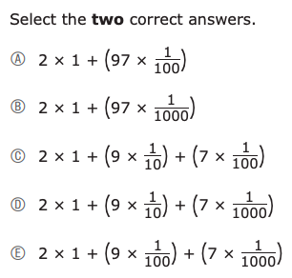
2.097
Which of the following expressions are equivalent to this decimal number?
What does this number look like in expanded form?

Slide 14
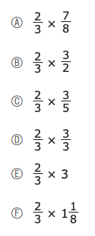

What do we notice about these expressions?

Slide 15

What do we notice about these fractions?
Which of the fractions can be multiplied by 5 to get a product that is LESS THAN 5?

Slide 16
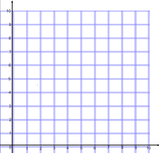
The location of point B on a coordinate plane is represented by the ordered pair (8, 4).
What does that look like? Where is that point?
Which of the following statements describes the location of
point B on the coordinate plane?
A. Point B is 4 units to the right of the origin and 8 units up from the origin.
B. Point B is 8 units to the right of the origin and 4 units up from the origin.
C. Point B is 4 units to the left of the origin and 8 units down from the origin.
D. Point B is 8 units to the left of the origin and 4 units down from the origin.

Slide 17
6 × 4 − (5 + 3) ÷ 2
What is the value of this expression?
A. 0
B. 8
C. 11
D. 20

Slide 18
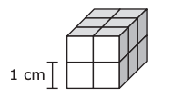

What is the volume, in cubic centimeters, of the prism?
A right rectangular prism is made of cubes, with no gaps or overlaps. Each cube has a side length of 1 centimeter, as shown.
What can we say about this prism?

