Slide 1
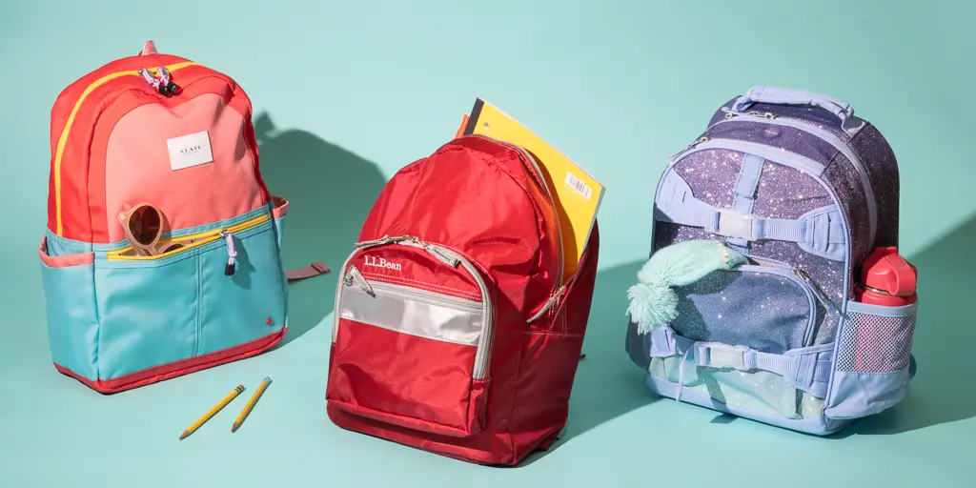
What do we notice? What can we count?
K.CC.B4
Notes:
Week of August 31, 2022

Slide 2
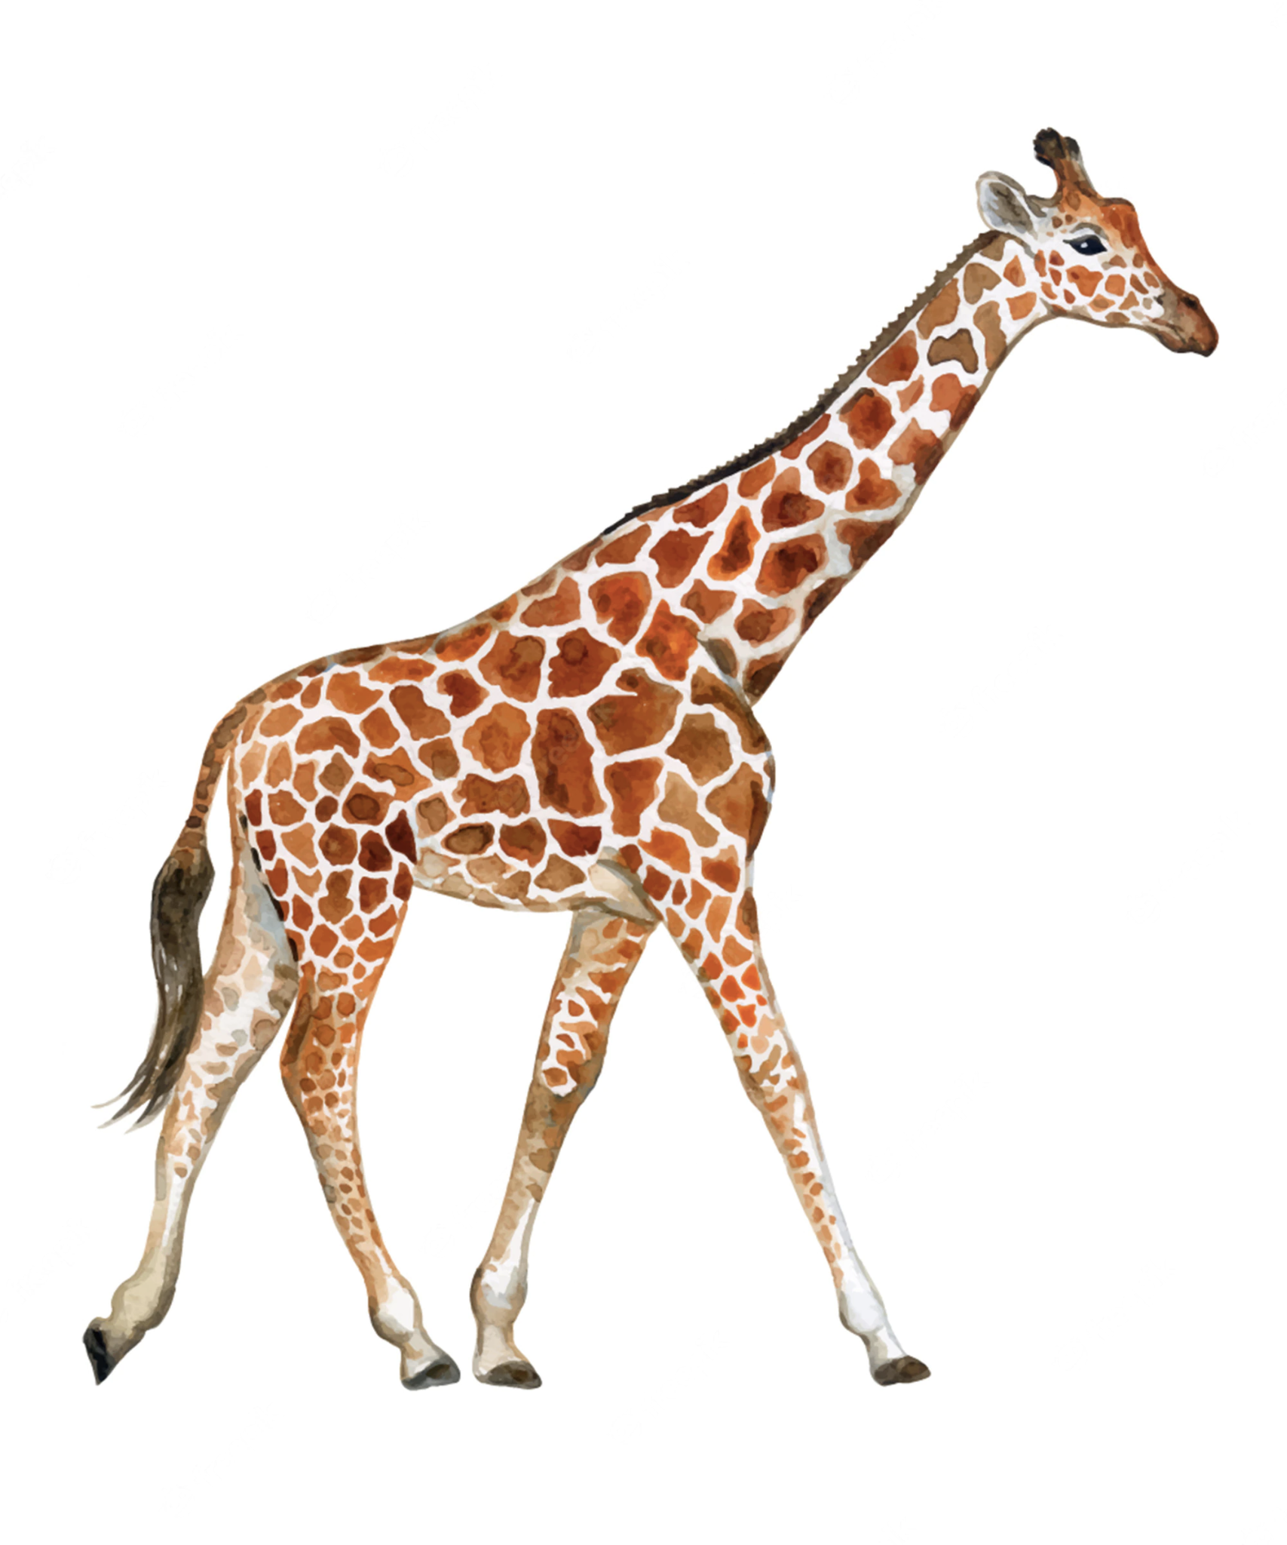
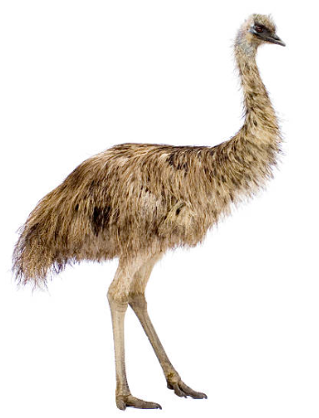
How can we compare the giraffe and the emu?
K.MD.A2

Slide 3
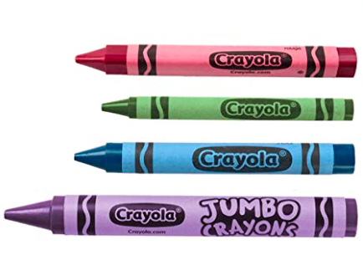
What can we say about these crayons?
K.MD.A1

Slide 4
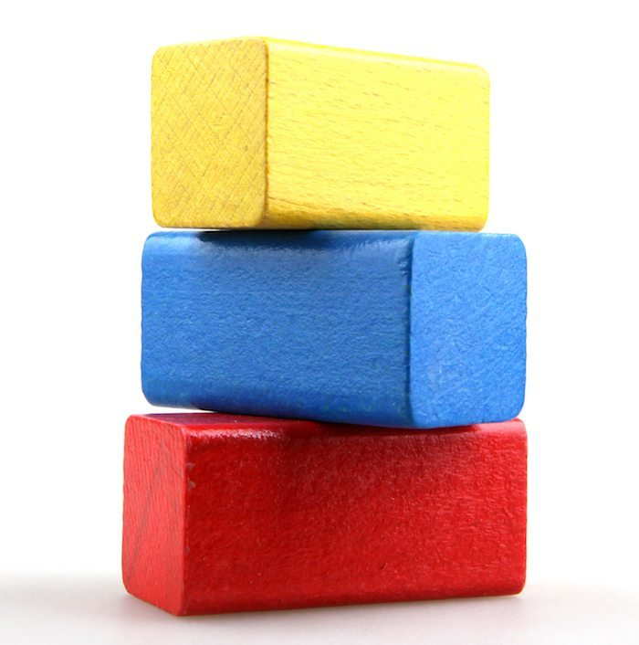
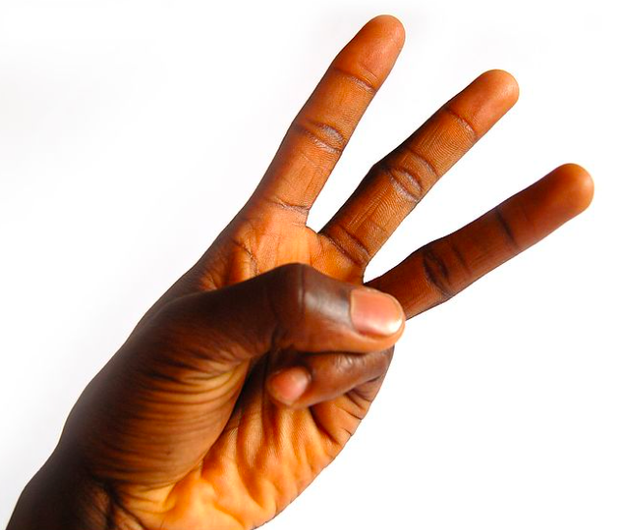
What is the same? What is different?
K.CC.B5
Notes:
Week of September 6, 2022

Slide 5
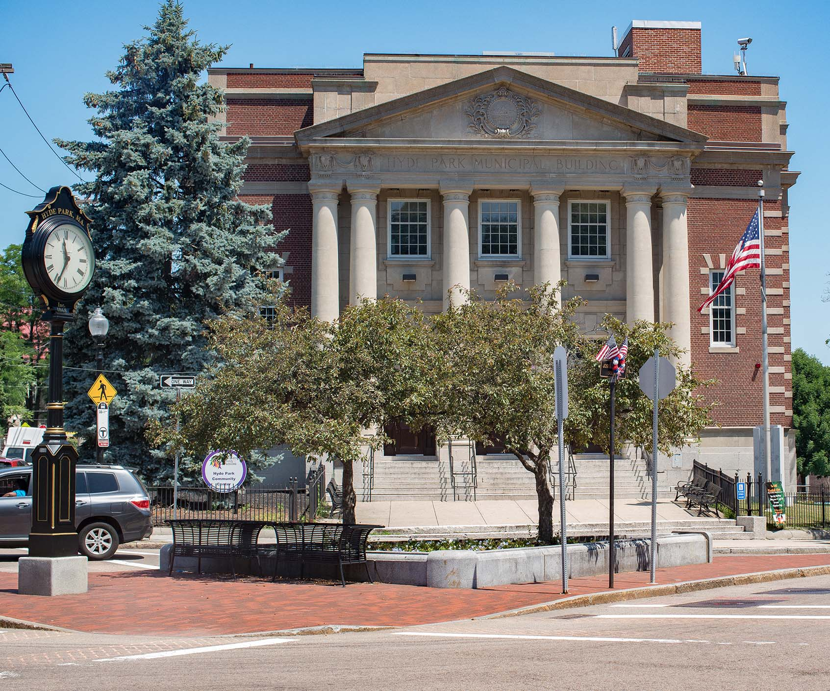
Do you see the triangle in this photo?
What other shapes do you see?
K.G.A2

Slide 6
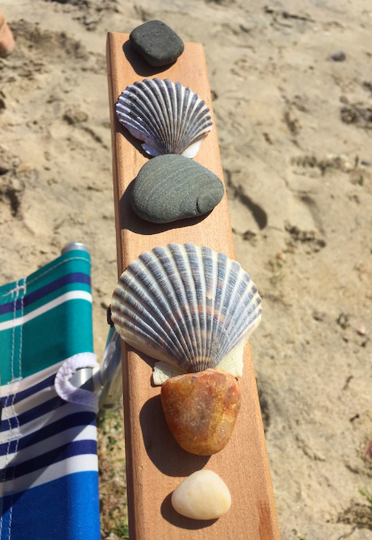
What math can you see in this picture?
Are there more shells than rocks?
How do you know?
K.CC.C6

Slide 7
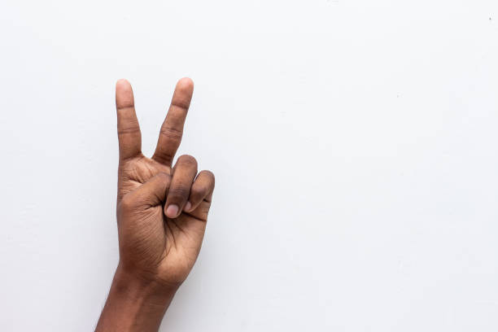
Here is a way to show 2 with your fingers.
Can you find another way to show 2?
How many different ways are there?
K.CC.B4

Slide 8
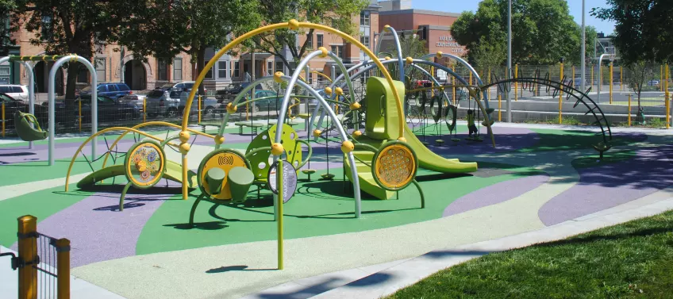
How many CIRCLES do we see?
How can we count them?
K.CC.B4
Notes:
Week of September 12, 2022

Slide 9
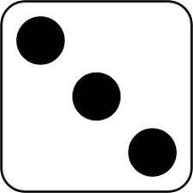
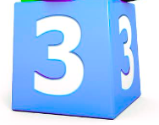

What can we say about these dice?
What is the same? What is different?
K.CC.C7

Slide 10
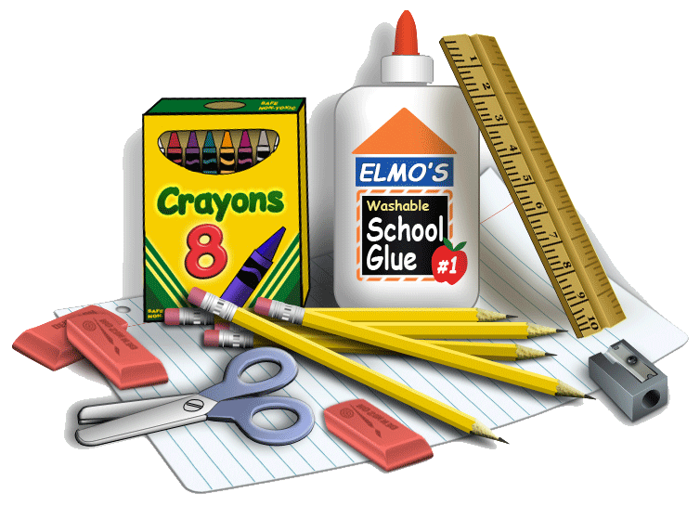
Use words like
ABOVE BELOW BESIDE
IN FRONT OF
BEHIND
and
NEXT TO
To describe these school supplies
K.G.A1

Slide 11
What is the same? What is different?
K.G.B4

Slide 12

Let’s celebrate Constitution Day!
What can we count on this flag from 1787?
K.CC.B4
Notes:
September 16, 2022
Constitution Day Celebration!
The Continental Congress adopts the following: Resolved: that the flag of the United States be thirteen stripes, alternate red and white; that the union be thirteen stars, white in a blue field, representing a new constellation.

Slide 13
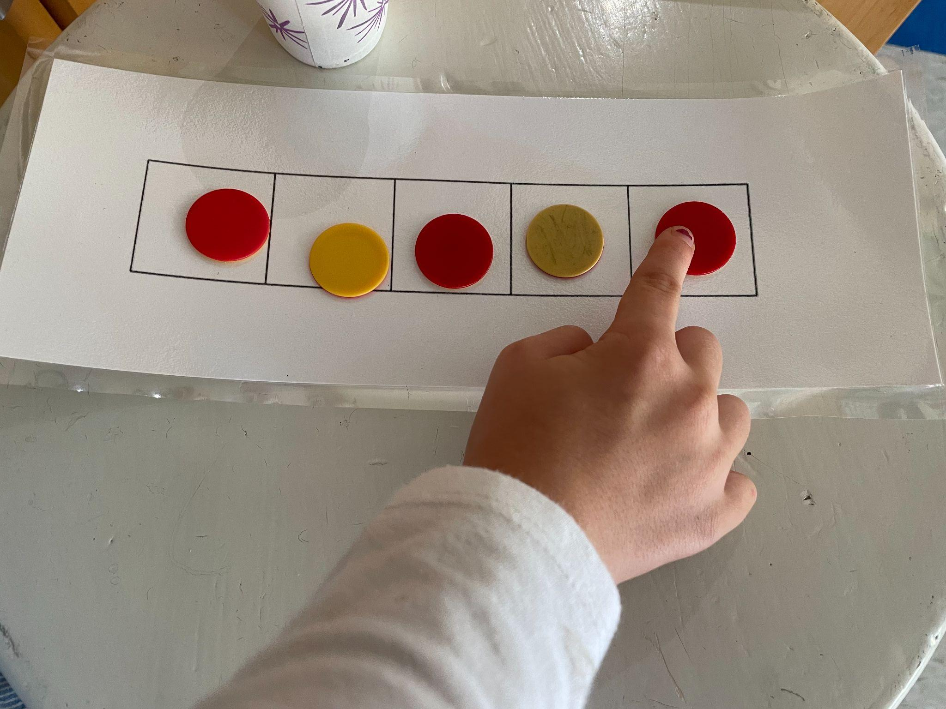
Are there more yellow counters or more red counters?
How many more?
K.CC.C6
Notes:
Week of September 19, 2022

Slide 14
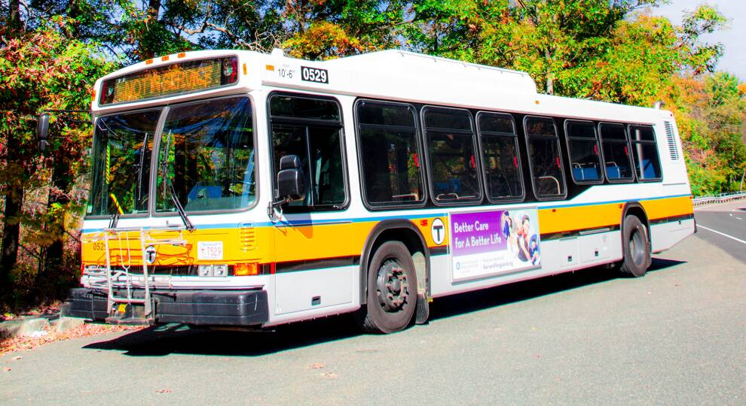
What can we count on this MBTA Bus?
What shapes do we see?
K.G.A2

Slide 15
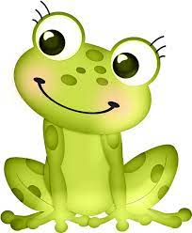
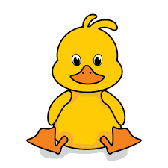
Are there more frogs or more ducks?
K.CC.C6

Slide 16
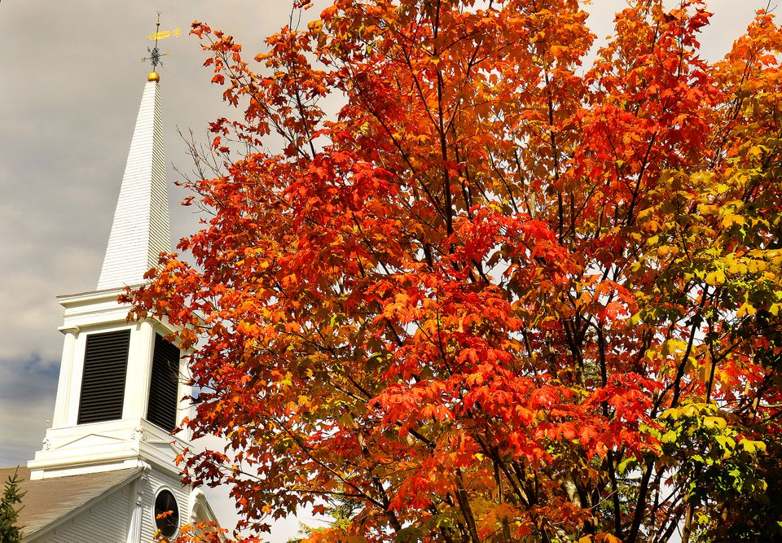
It’s the Fall Equinox!
Today we have 12 hours of day and 12 hours of night.
Let’s count to 12!
What can we find 12 of in our classroom?
K.CC.A1
Notes:
September 22, 2022
Fall Equinox

Slide 17

How many bags are on the wall at Brother’s Market?
How do you know?
Are there some we cannot see?
K.CC.B5

Slide 18
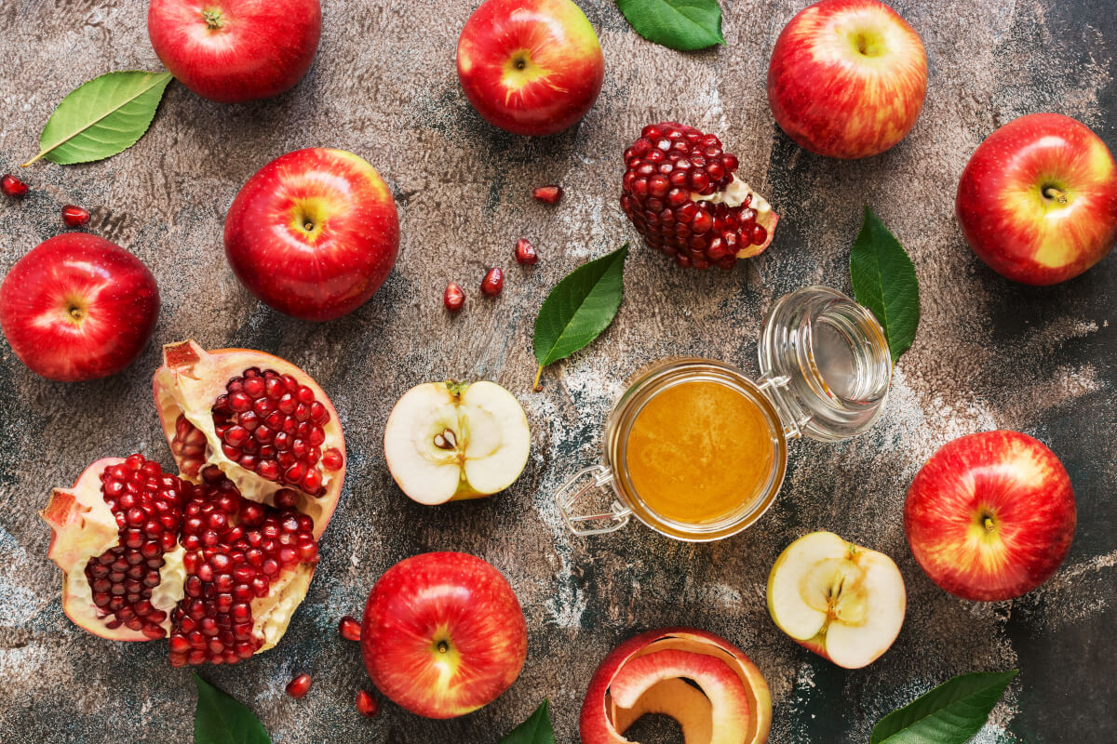
Happy Rosh Hashanah!
What can we count in this picture?
K.CC.B4
Notes:
Week of September 27, 2022

Slide 19
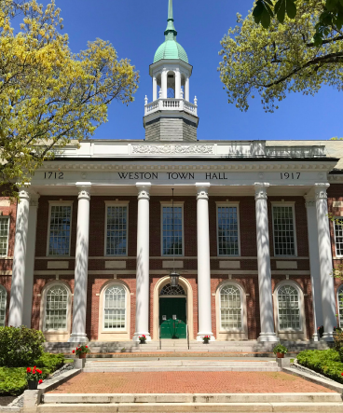
What can we count in this photo?
What shapes do we see?
K.G.A2

Slide 20
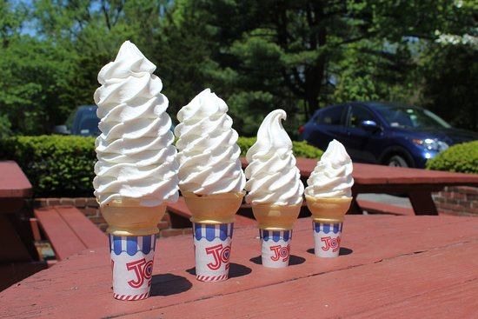
What can we say about these ice-cream cones at Dairy Joy?
How many are there?
What if we took 1 away?
What if we added 1?
K.OA.A1

Slide 21
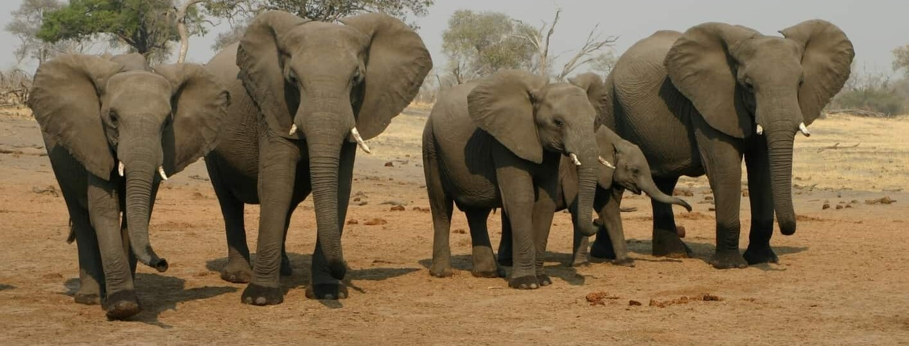
Happy Botswana Day!
How many elephants? How many elephant tusks? How many elephant ears?
K.CC.B4
Notes:
September 30, 2022
Botswana Day

