Slide 1
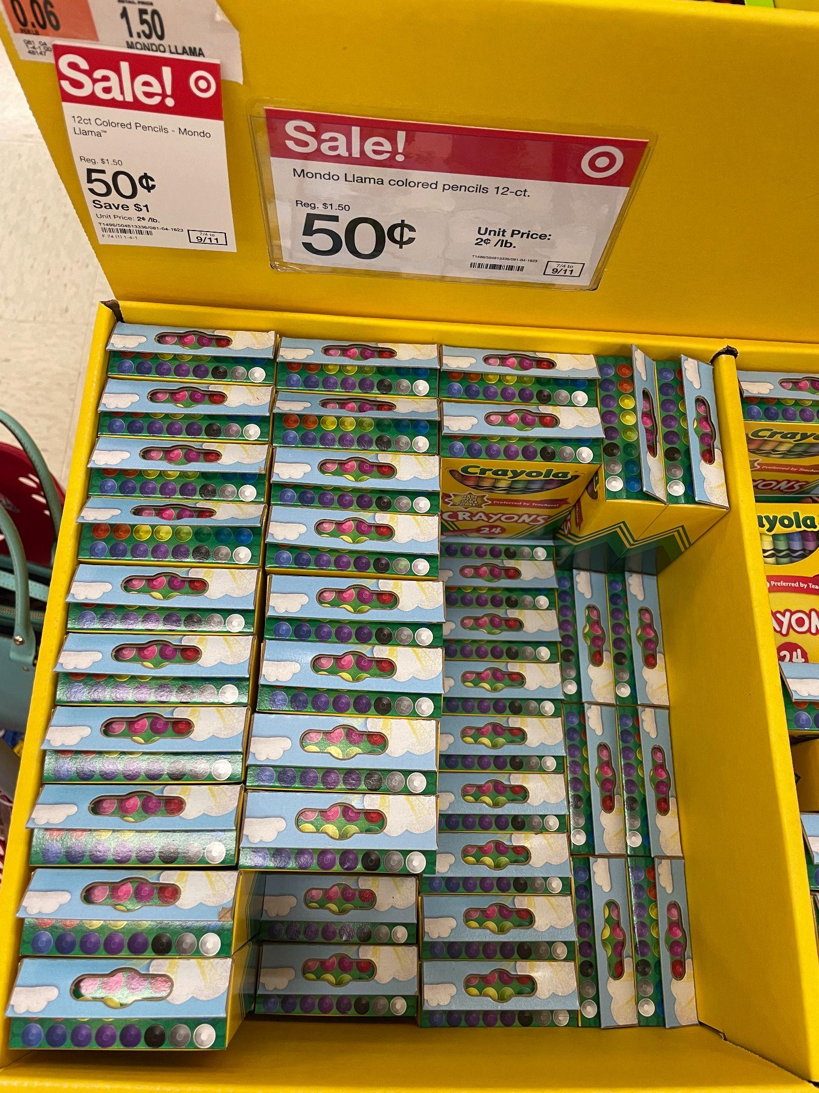
Happy Back-to-School!
Estimate how many boxes of crayons are here.
How much would they cost together?
How many individual crayons would that be?
5.NBT.B5
Notes:
Week of August 31, 2022

Slide 2
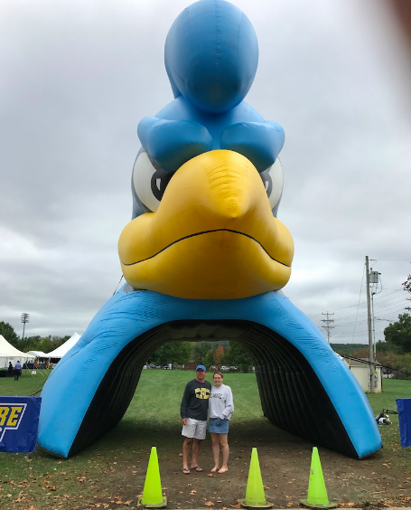
Go Blue Hens!
Estimate the height of the University of Delaware Blue Hen.
Mark (in the blue shirt)
is about 6 feet tall.
What is a too low estimate?
What is a too high estimate?
How many feet? How many inches?
5.MD.A1

Slide 3
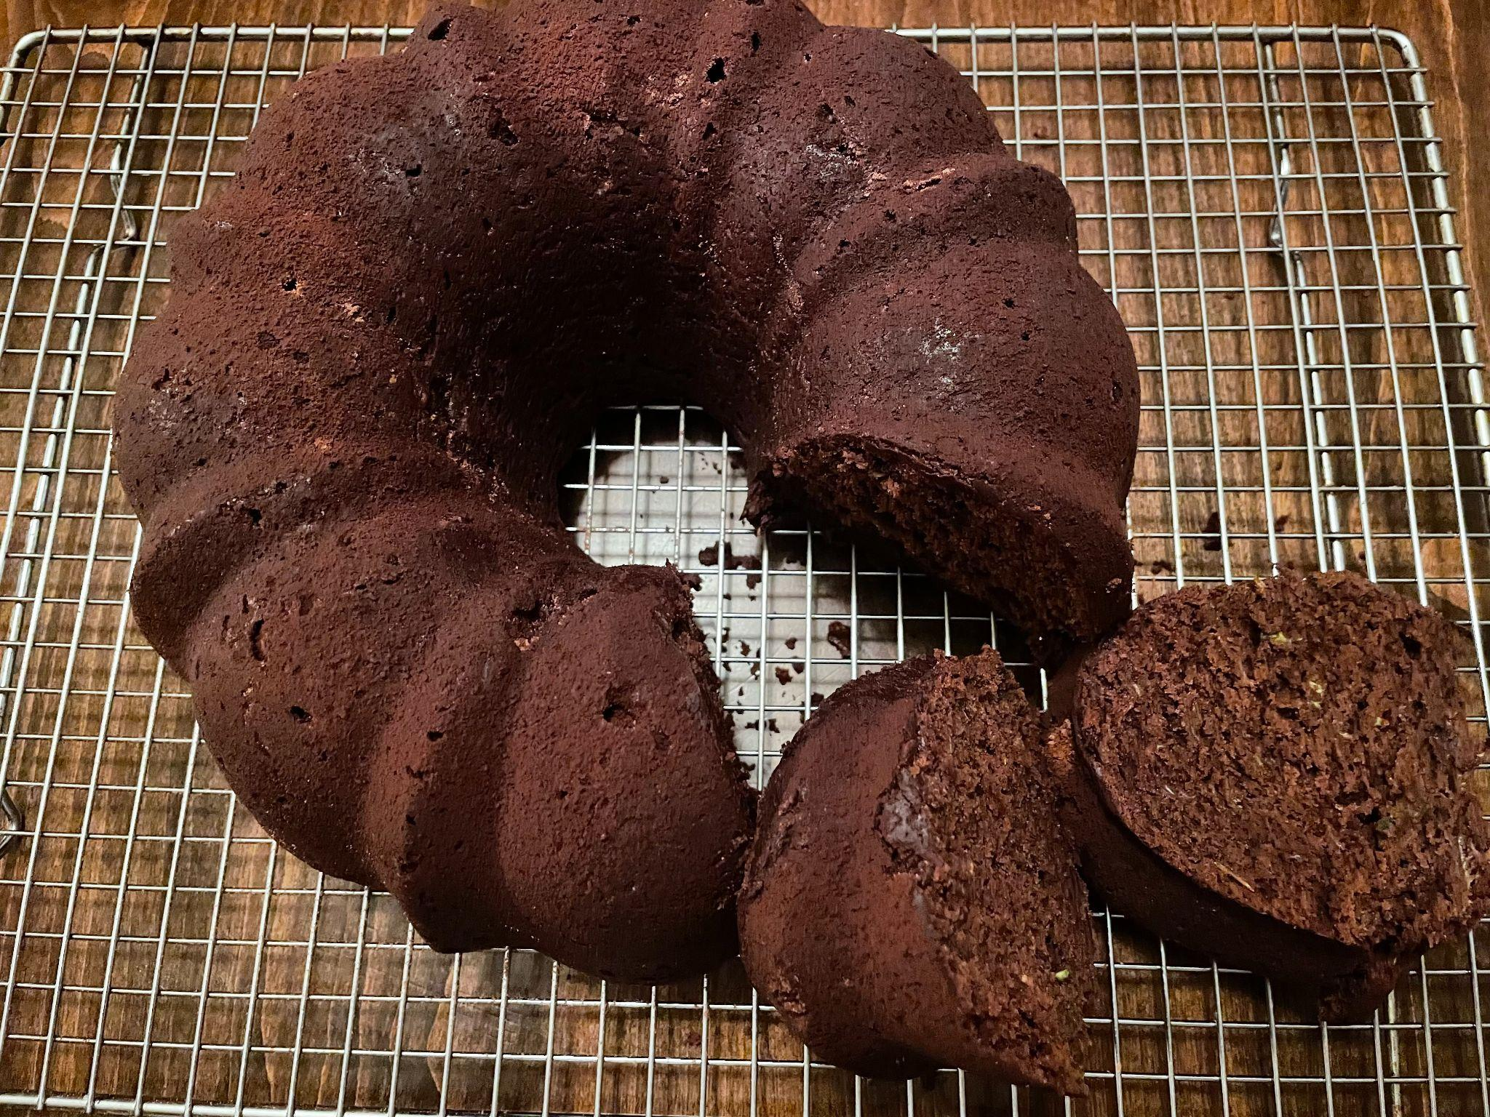
Chocolate Zucchini Cake
Yum!
About what fraction of the cake has NOT been cut?
How do you know?
5.NF.A2

Slide 4
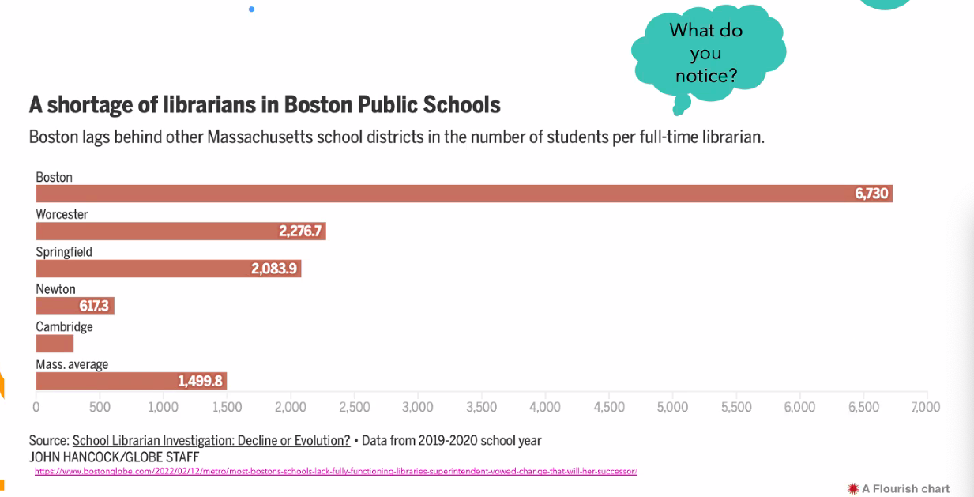
5.MD.B
Notes:
Week of September 6, 2022

Slide 5
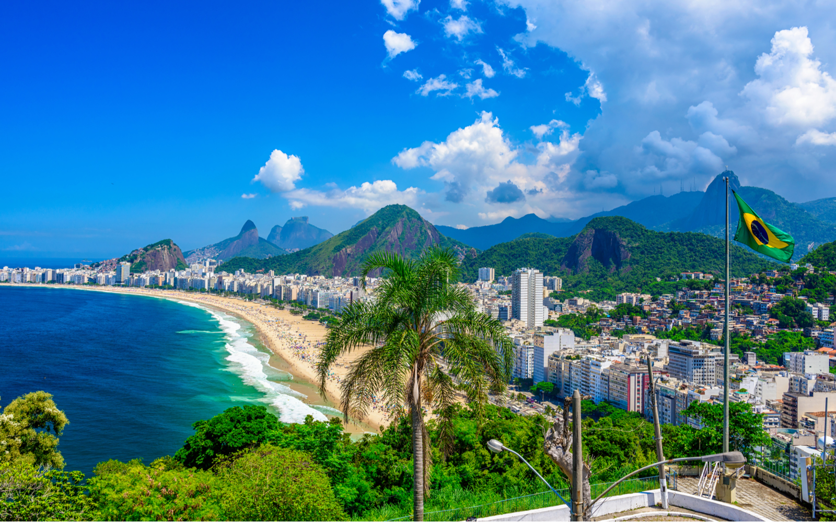
Happy Independence Day Brazil!
The current population of Brazil is 215,808,656
What can we say about this number?
What are some factors of 215,808,656?
5.NBT.A
Notes:
September 7, 2022
Brazil Independence Day

Slide 6
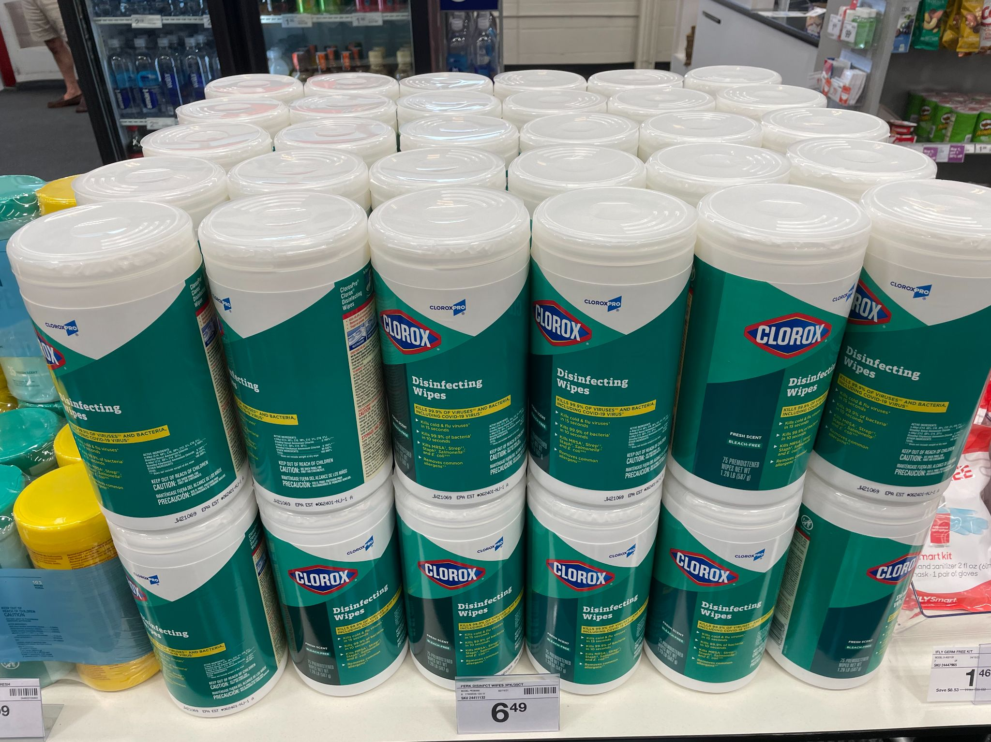
How many containers of Clorox Wipes?
There are 75 wipes per container.
How many altogether?
Write an expression to match your thinking.
About how much would they ALL cost?
5.OA.A1
Notes:
Week of June 7, 2021

Slide 7
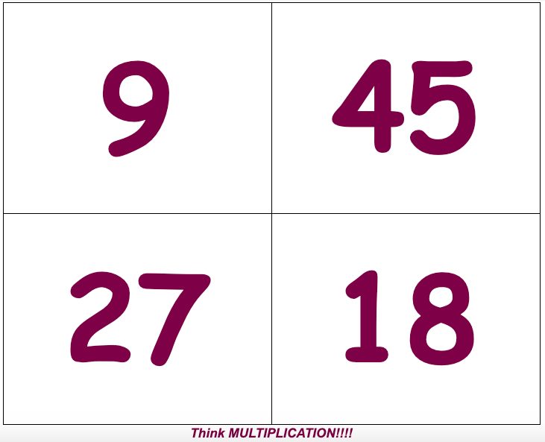
Which one doesn’t belong?
5.NBT.B5

Slide 8
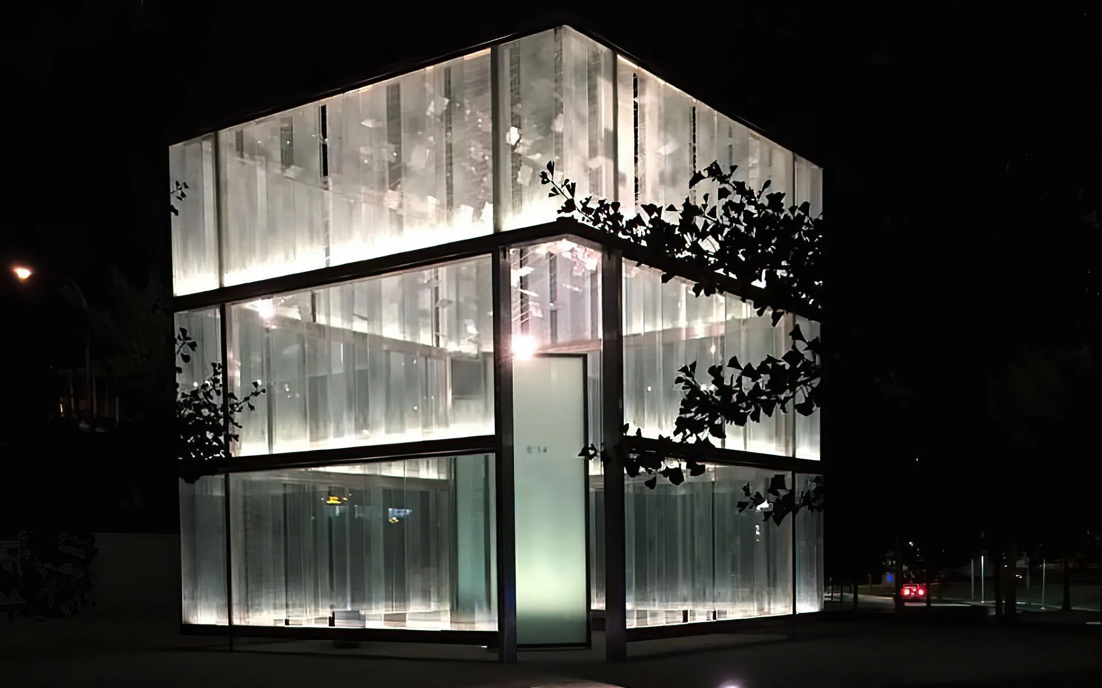
911 Memorial at Logan Airport
The 911 memorial takes the shape of a 20-by-20 foot glass cube.
There are 6 window panes across each of the 3 levels.
How many window panes are on this memorial?
How wide is each window pane?
5.NBT.B5, MDA1
Notes:
Week of September 12, 2022
911 Memorial

Slide 9
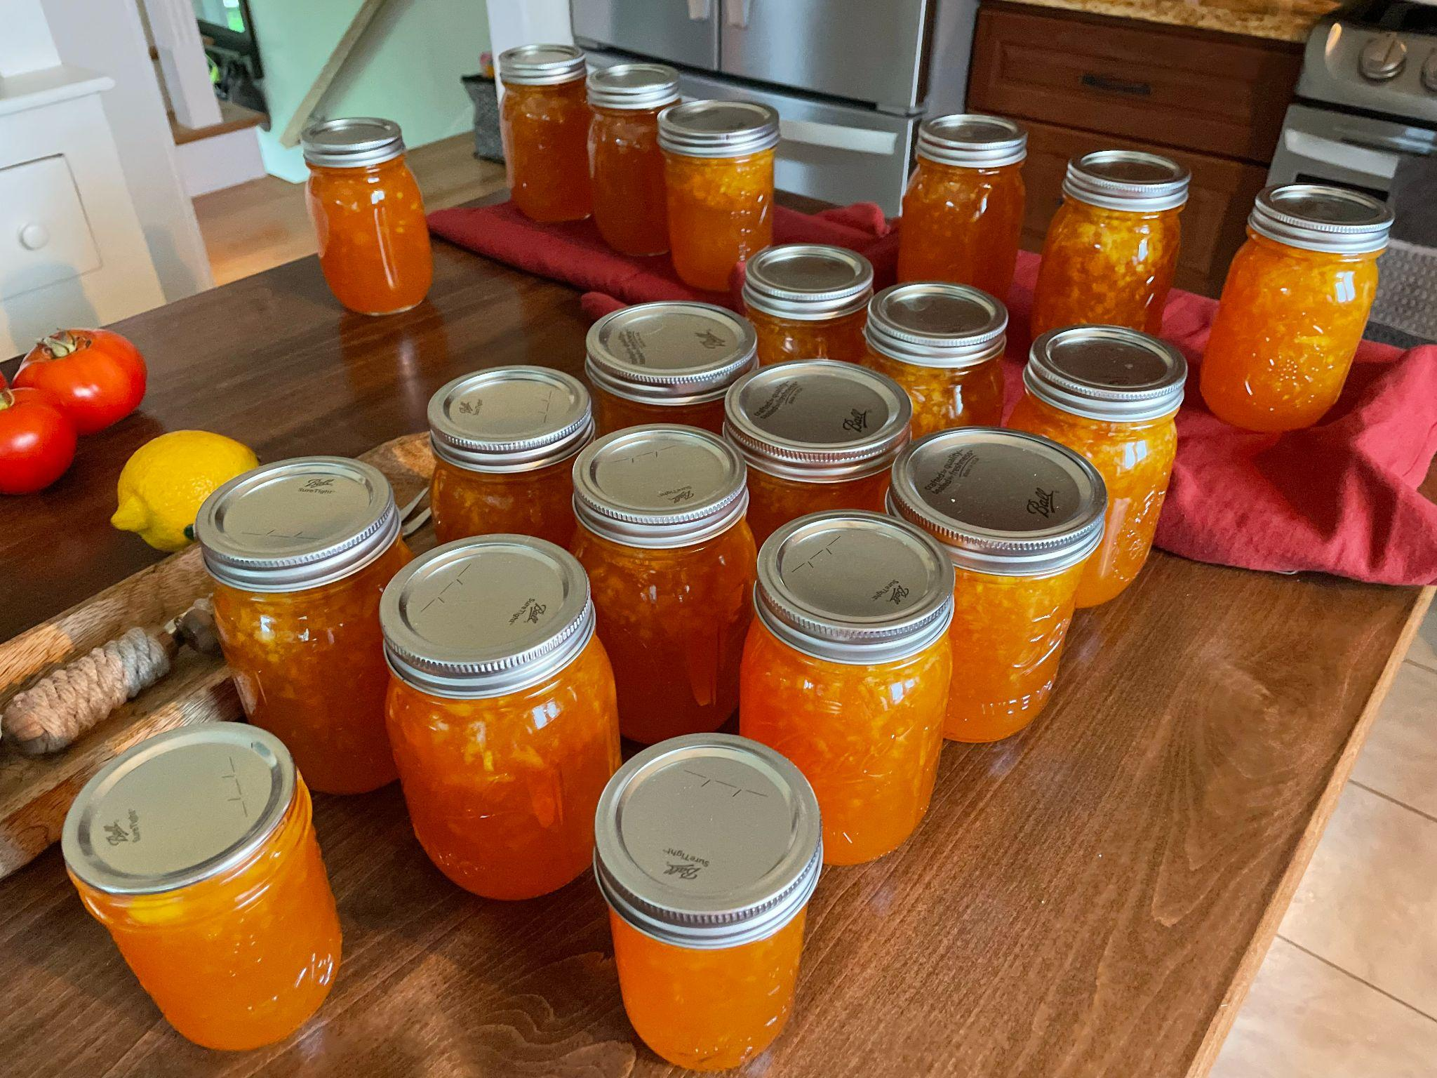
Each one of these jars of jam takes 2 ½ cups of peaches to make.
How many cups of peaches did we use?
How many quarts? Gallons?
4 cups = 1 quart
8 cups = half gallon
16 cups = 1 gallon
5.NF.A2, MD.A1

Slide 10
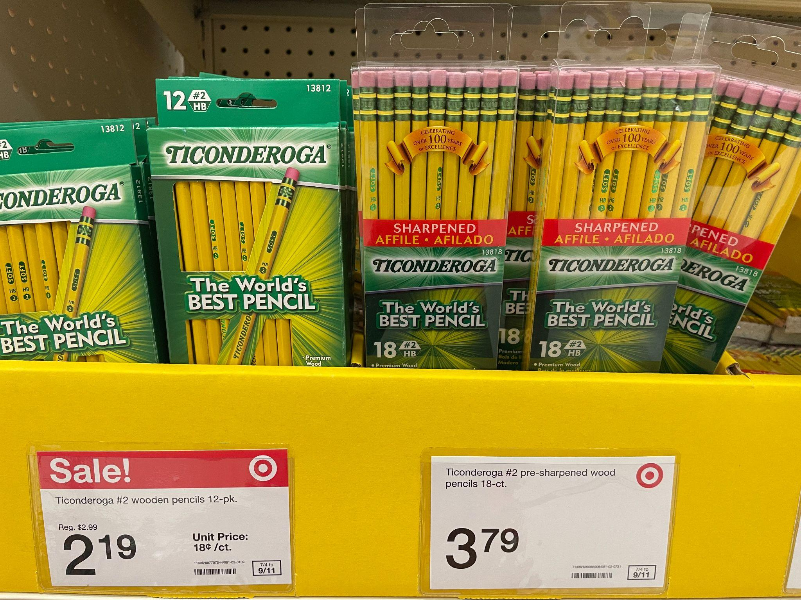
Would you rather …
5.NBT.B7

Slide 11
Now draw a shape that is DIFFERENT from the shape in 1 way, but the SAME in another way.
How are they DIFFERENT?
How are they ALIKE?
Sketch this shape?
What is it?
5.G.B3

Slide 12
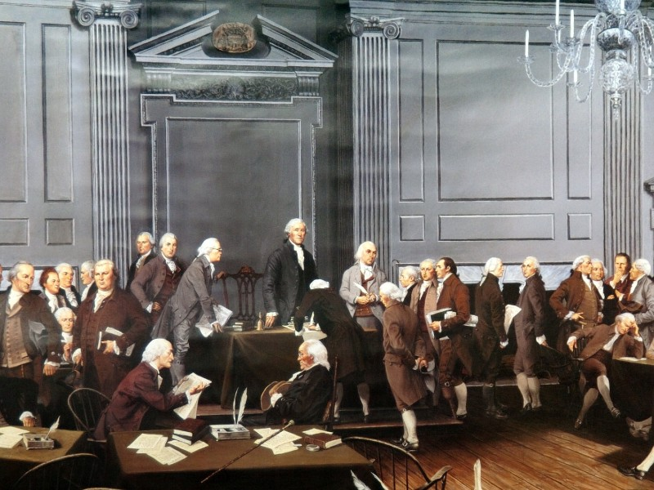
The Constitution was signed in Philadelphia on September 17, 1787.
How long ago was that? How can we use mental math to figure it out?
How many years?
How many months?
How many days?
5.MD.A1
Notes:
September 16, 2022
Constitution Day

Slide 13
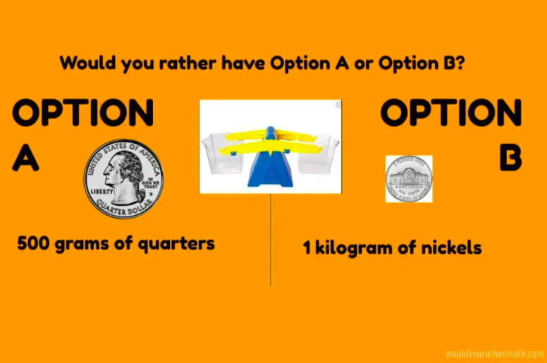
Would you rather…
1000 grams = 1 kilogram
5.MD.A1
Notes:
Week of September 19, 2022

Slide 14
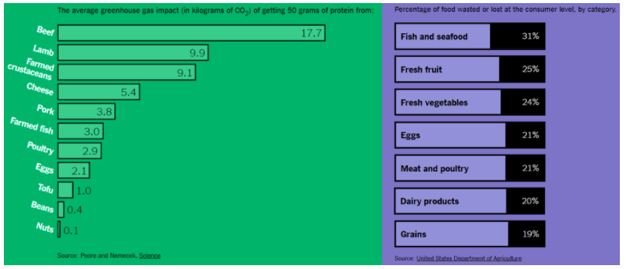
What do you notice? What do you wonder? Why does it matter?
What would you name this graph?
5.MD.B

Slide 15
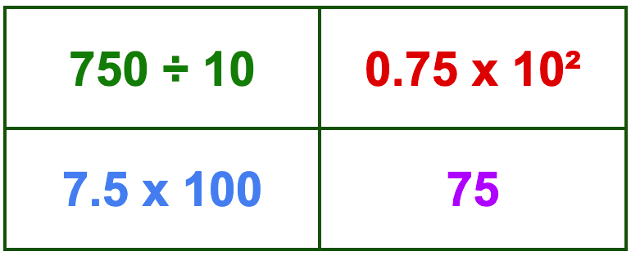
Which one does not belong?
5.NBT.A2
Notes:
Top left: (75) not multiplication
Top right: (75) only exponent
Bottom left: (750) not 75
Bottom right: (75) not expression

Slide 16
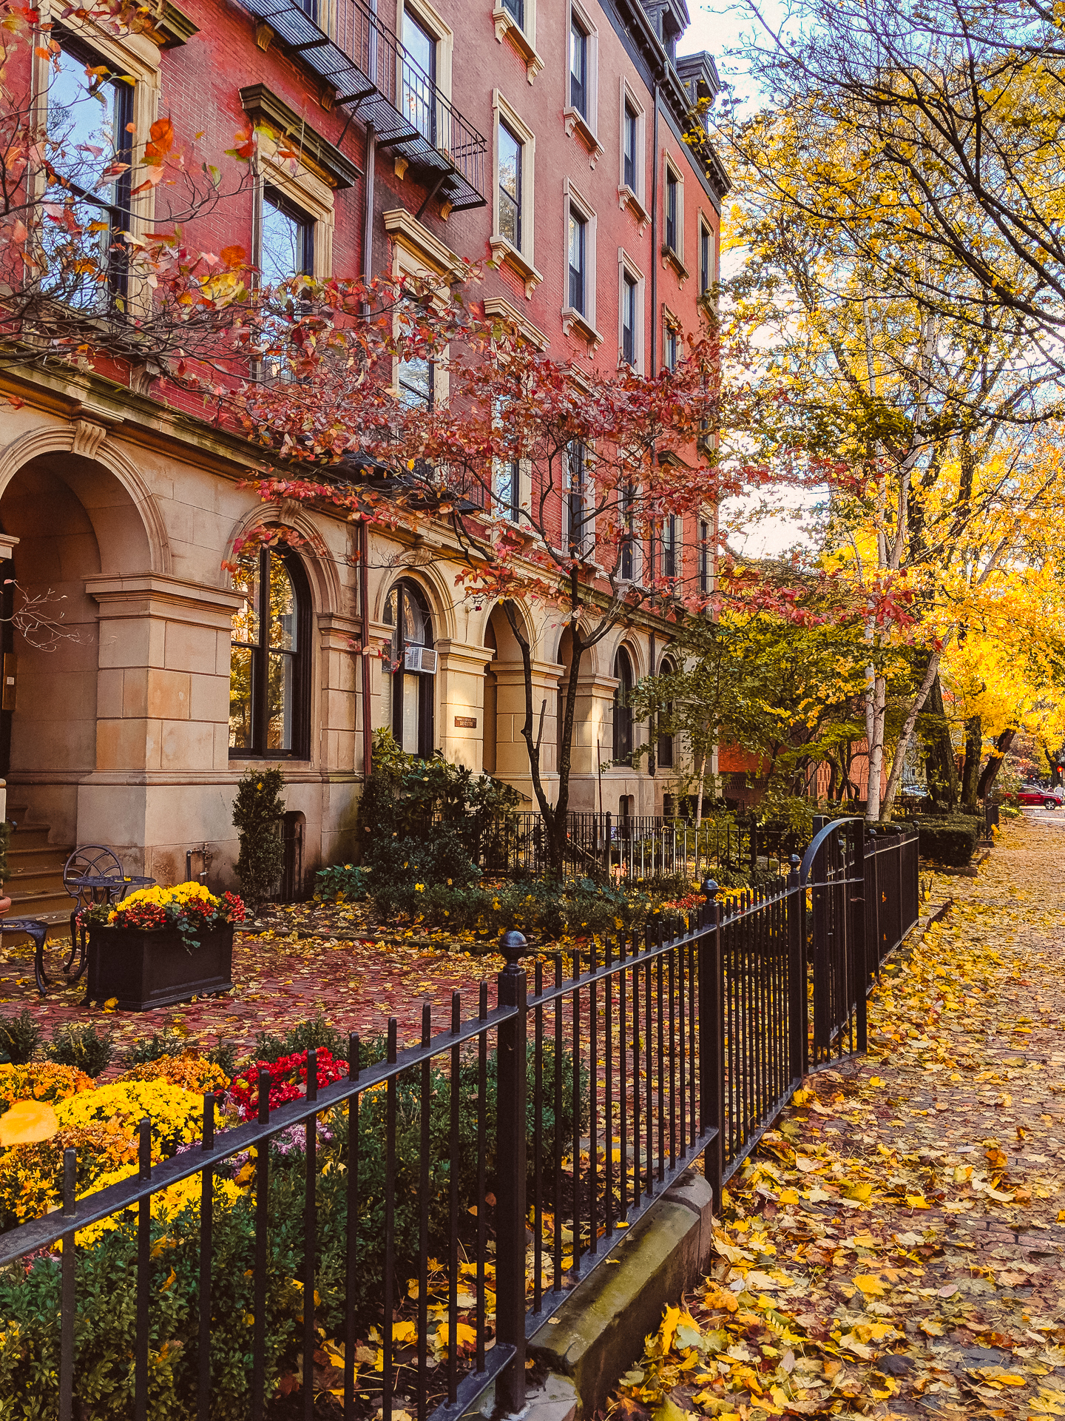
Today is the Fall Equinox!
Today the sun rises at 6:29AM and sets at 6:39PM.
The Winter Solstice is 3 months away, the sun will reach its most Southerly point. The sun will rise at 7:05AM and set at 4:15PM.
What is the difference in daylight hours between the Equinox and the Solstice?
About how many minutes of daylight do we lose every day?
5.MD.A1
Notes:
September 22, 2022
Fall Equinox

Slide 17
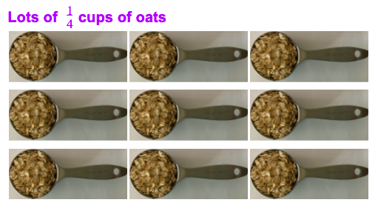
We are making oatmeal cookies, we need a lot of oats!
Can you write an addition number sentence to match this picture?
Can you write a multiplication number sentence to match?
5.NF.B6

Slide 18
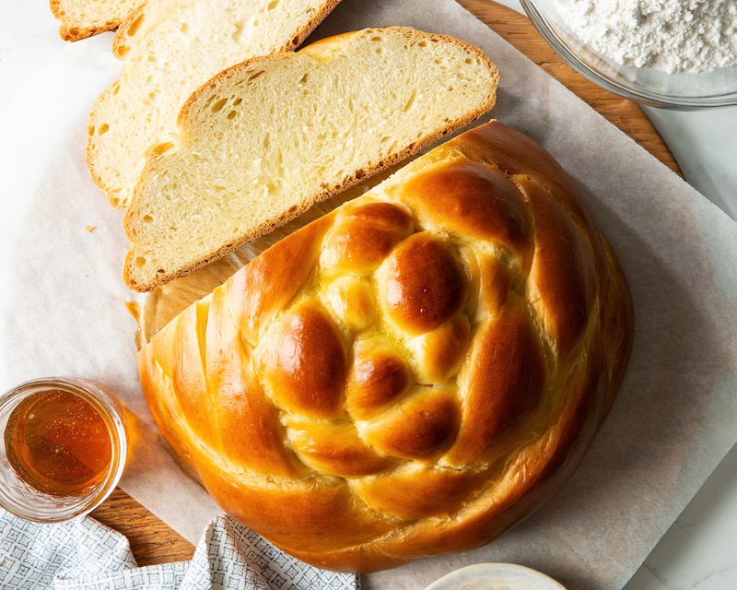
Happy Rosh Hashanah!
What fraction of the round Challah has been cut away?
What fraction of the Challah remains on the board?
How do you know?
5.NF.A2
Notes:
Week of September 27, 2022
Rosh Hashanah

Slide 19
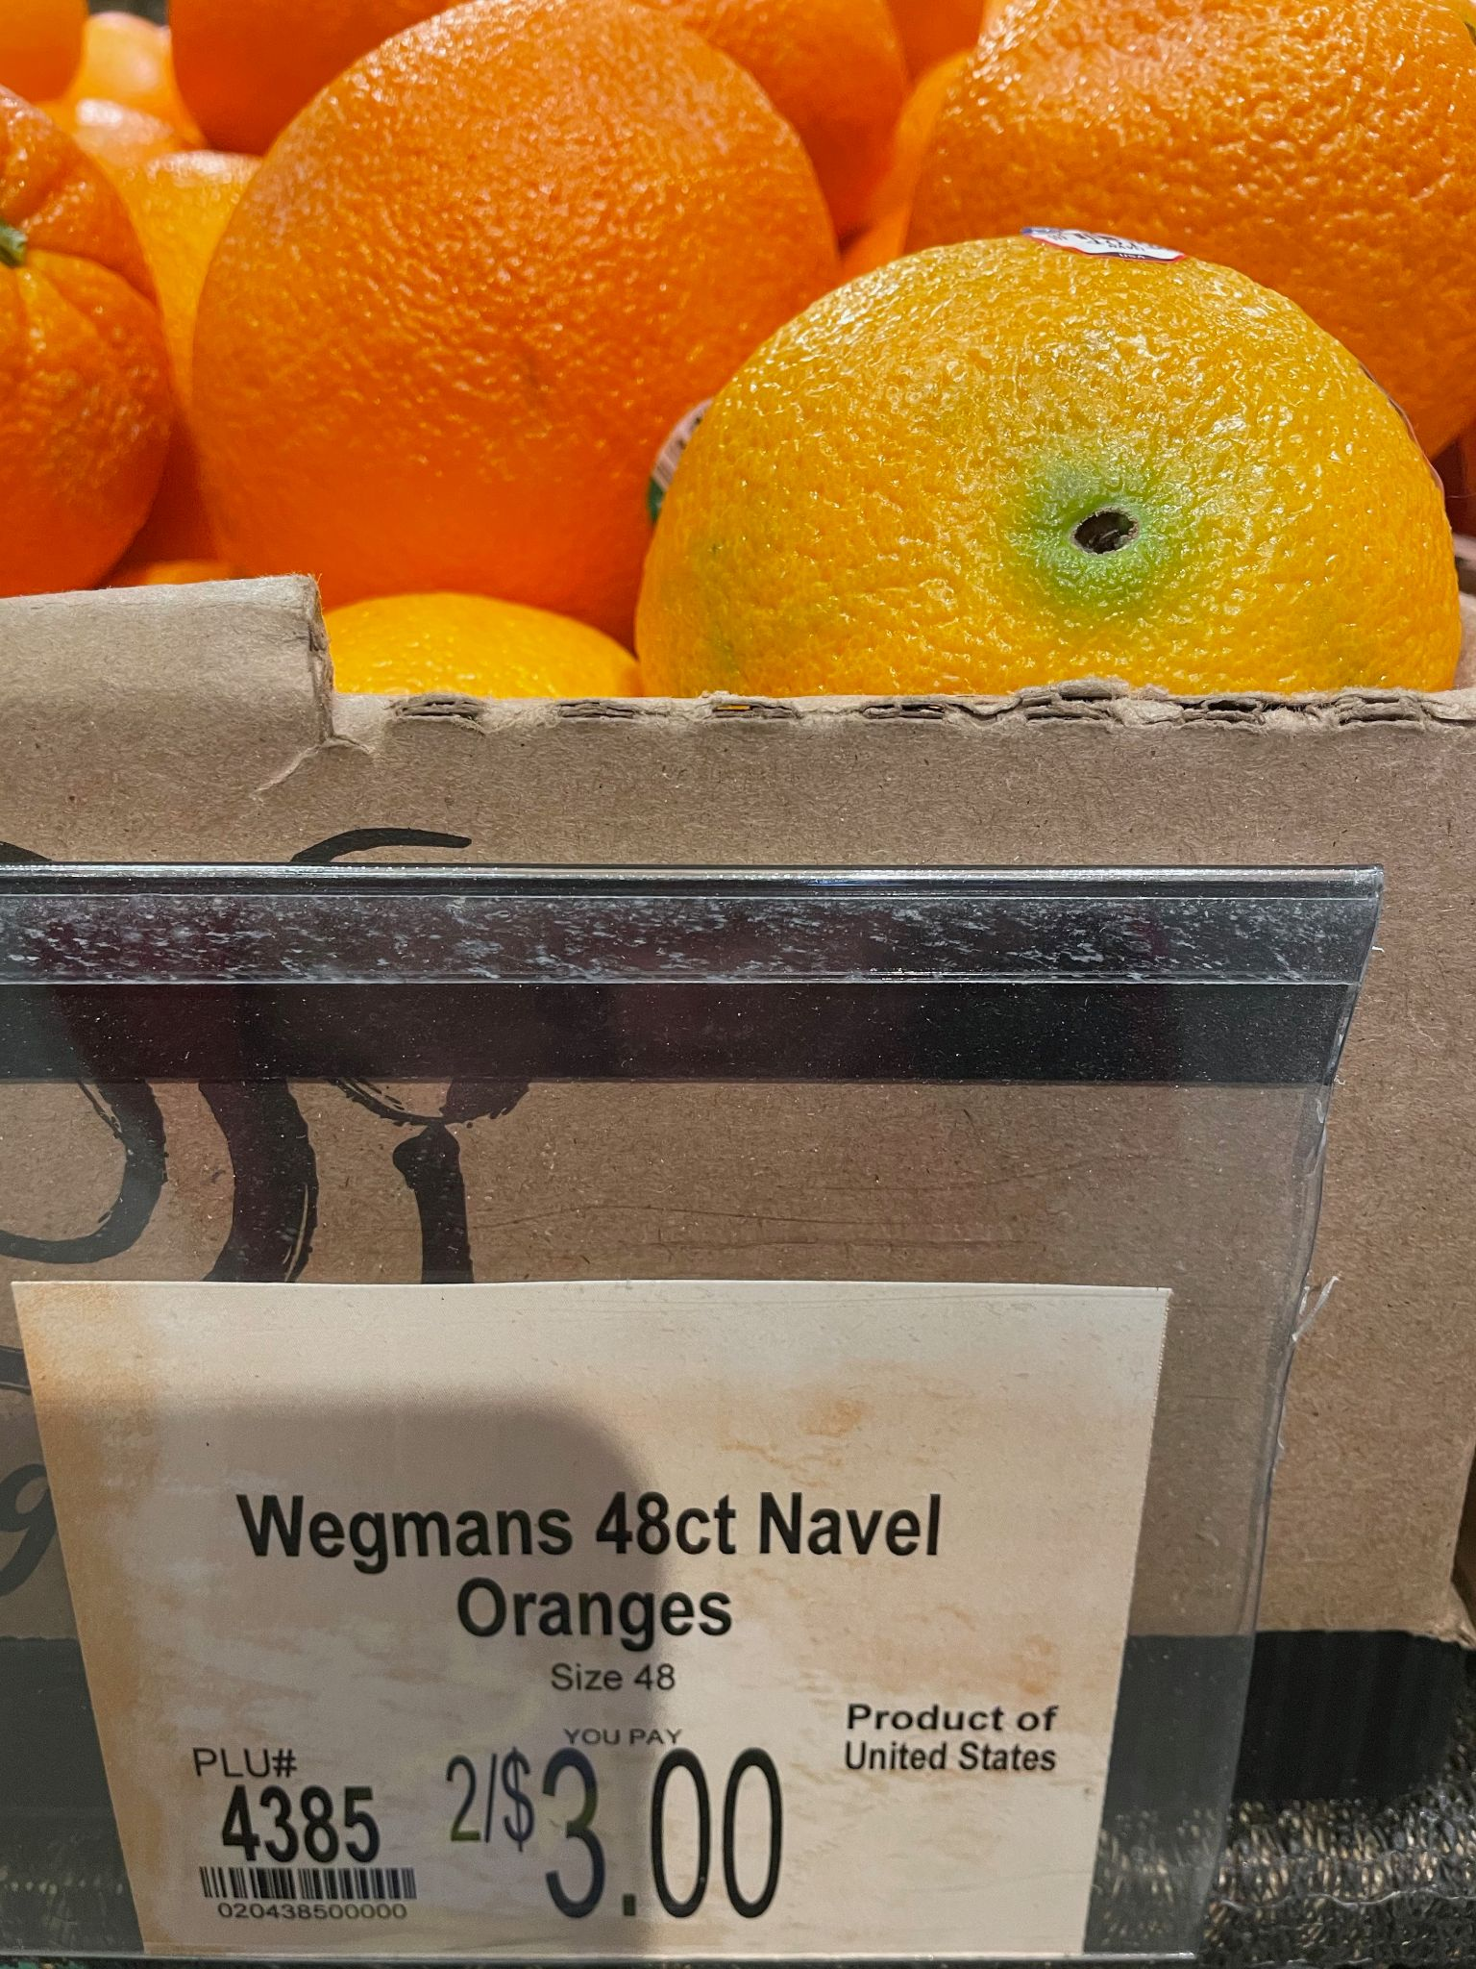
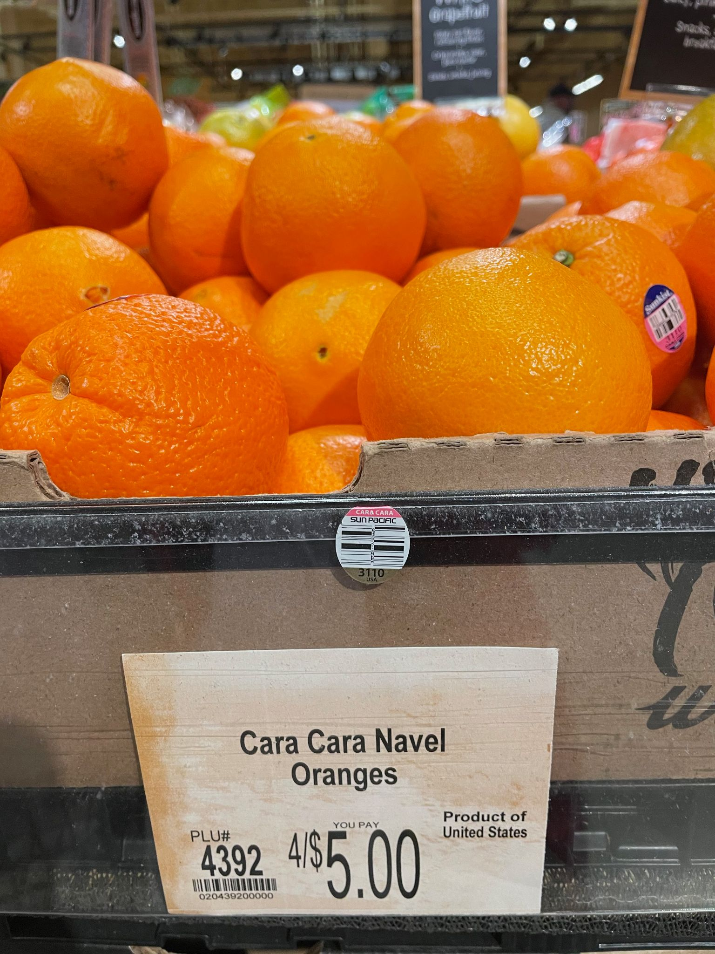
Would You Rather?
or
5.NBT.B7

Slide 20
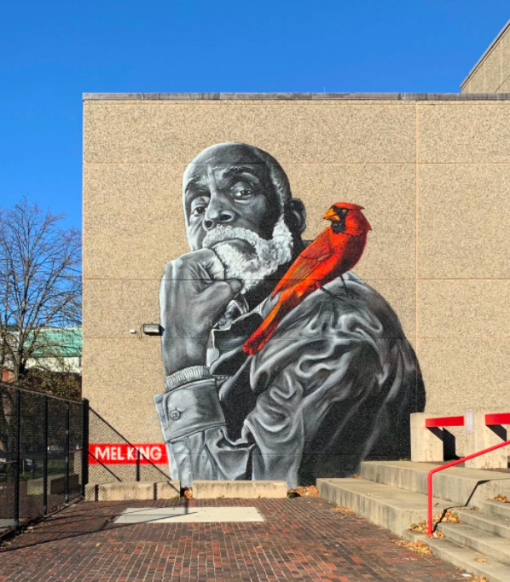
The cardinal, in this Roxbury mural, is about 10 feet long from his tail feathers to the tip of his head.
An actual cardinal is between 8 and 9 inches long.
How many times bigger is the one in the mural?
5.MD.A1
75 Malcolm X Boulevard in Roxbury photo by @happastreetart

Slide 21
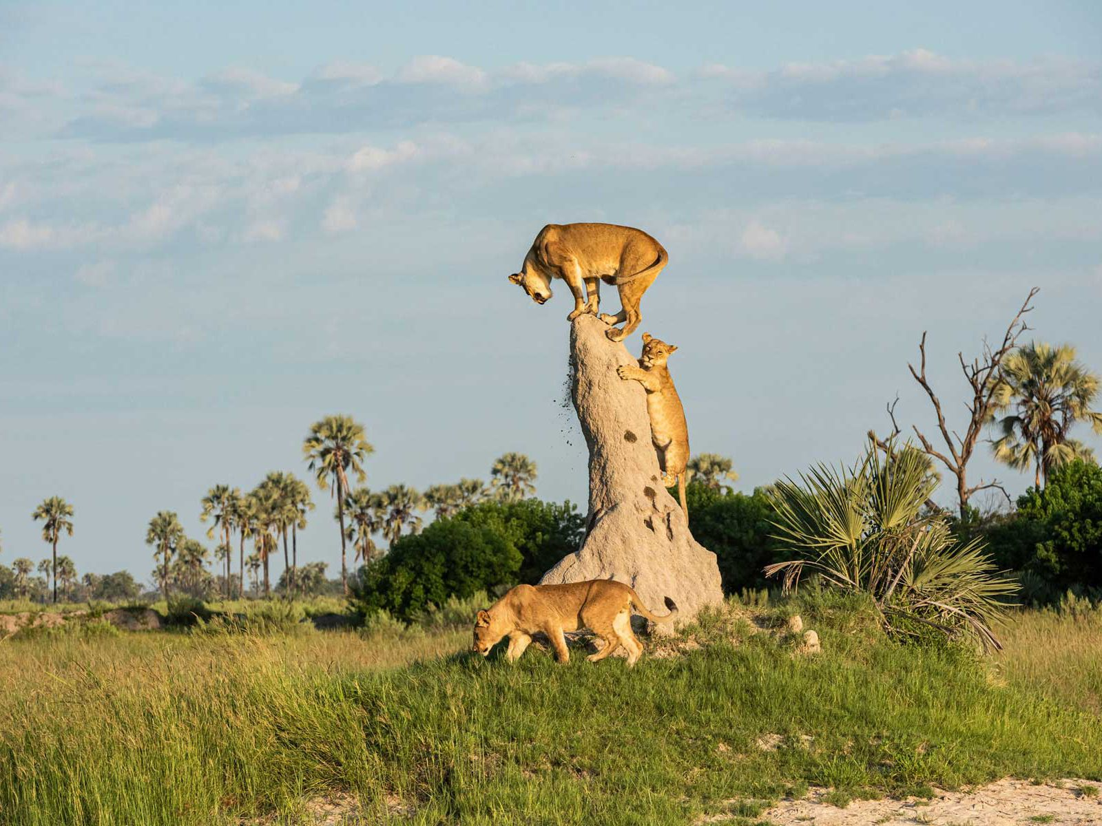
Happy Independence Day Botswana!
The current population of Botswana is 2,351,700
What can we say about this number?
What are some factors of 2,351,700
5.NBT.B6
Notes:
September 30, 2022
Botswana Day

