Slide 1
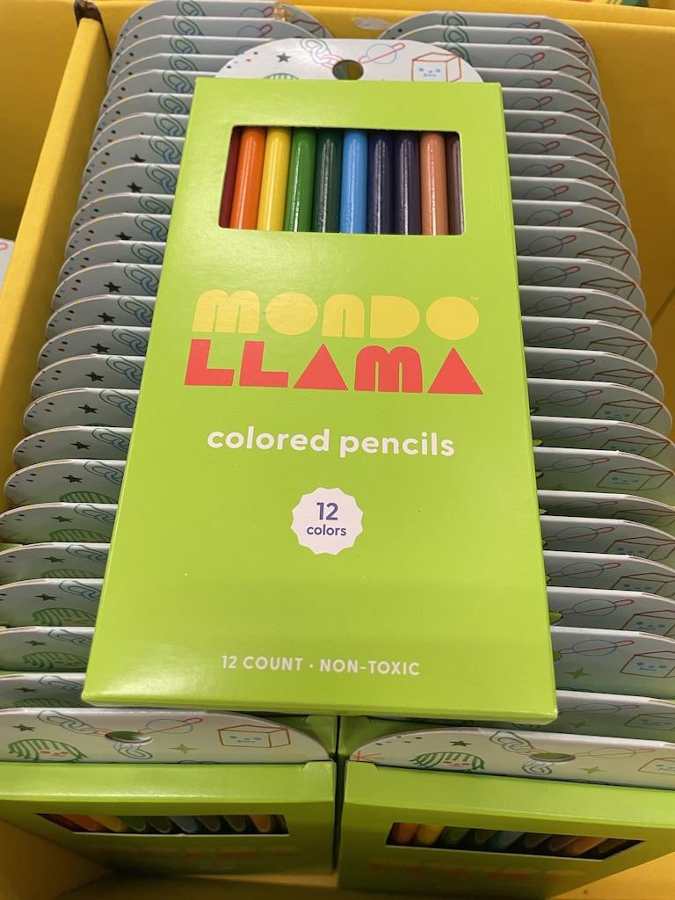
What can we say about these packs of pencils
Estimate how many packs are on display.
Estimate how many pencils.
How can we use mental MATH to solve this?
4.OA.A2
Notes:
Week of August 31, 2022

Slide 2
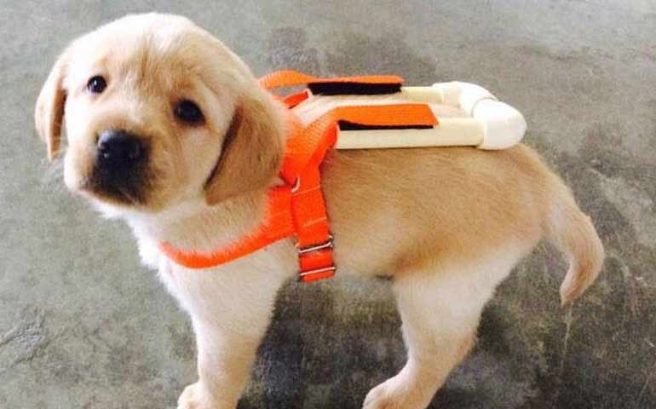
It’s National Guide Dog Month!
This guide dog puppy in training weighs only 9 pounds.
How many ounces is that?
What are some strategies we can use to solve this?
There are 16 ounces in a pound!
4.MD.A1

Slide 3
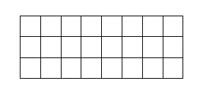
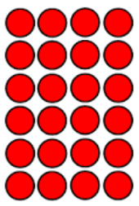
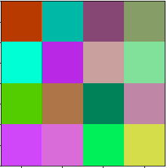
Which one doesn’t belong?
4.OA.B4
Notes:
Top left: only odd factor (3)
Top right: only distributive (2x10)(2x2)
Bottom left: not 24, not rectangle
Bottom right: not array of squares

Slide 4
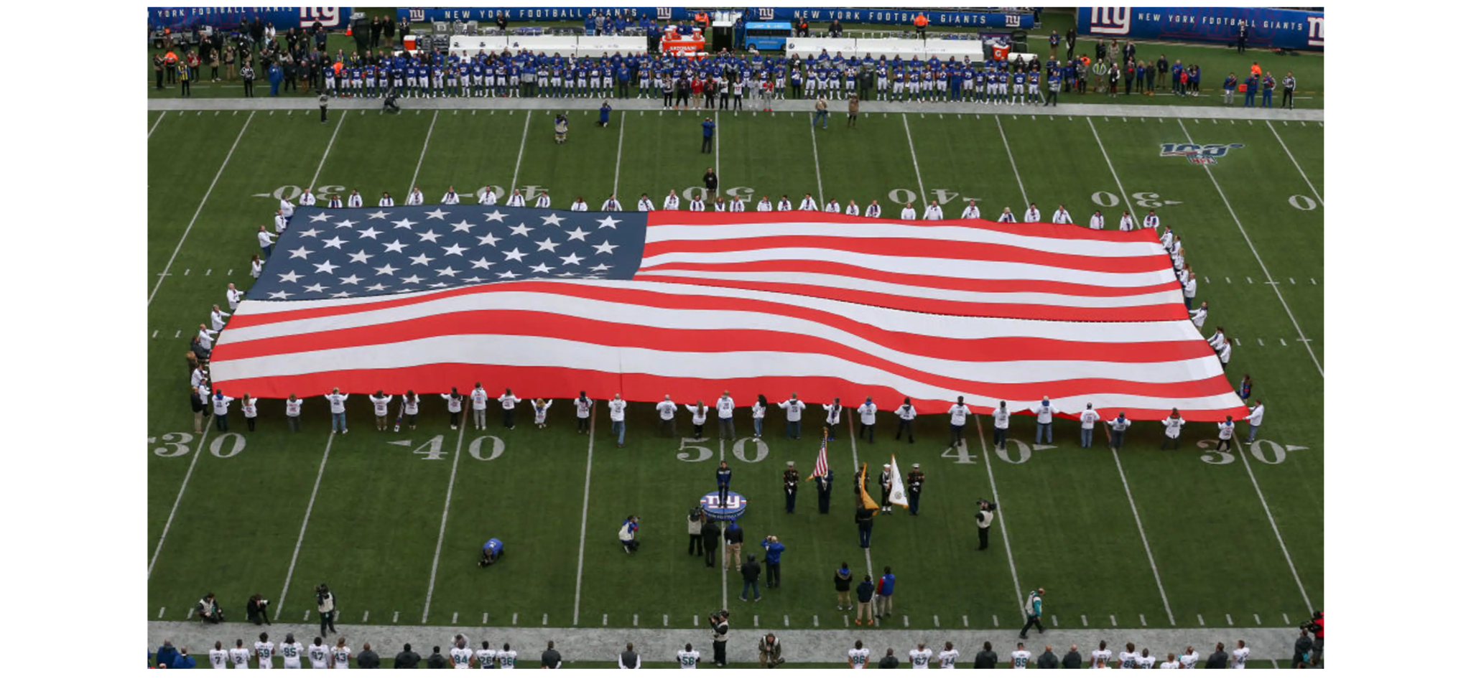
Wow! Look at this amazing American flag at the NY Giants game!
I wonder how big it is?
What might the perimeter be? How about the area?
4.MD.A3
Notes:
Week of September 6, 2022

Slide 5
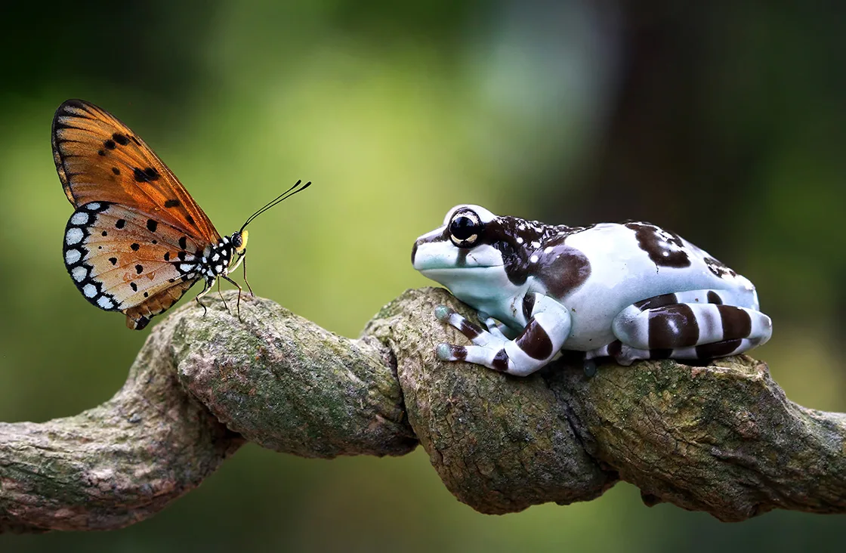
It’s Independence Day in Brazil!
The Amazon Rainforest is known to be home to
427 mammal species, 1,300 bird species,
378 species of reptiles, and more than 400 species of amphibians.
Species are still being discovered every year.
How many species are in the Amazon altogether?
4.NBT.B4
Notes:
September 7, 2022
Brazil Independence Day

Slide 6
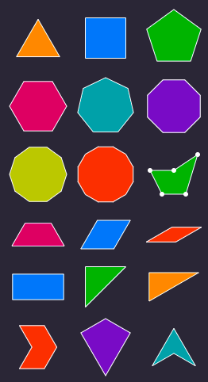
Pick 2!
What attribute do they have in common?
What is different?
Prove it!
4.G.A2

Slide 7
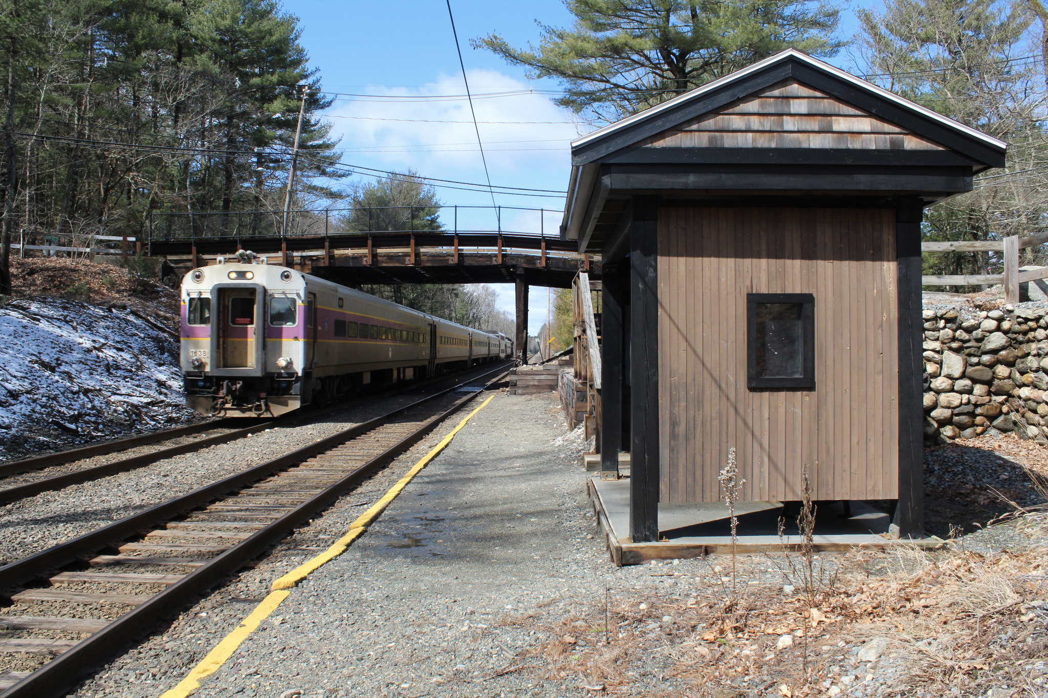
It takes 42 minutes to get from Weston to Boston via the MBTA, it is an 18 ½ mile ride and was $9.75 one way.
How long would the round-trip ride take?
How many miles is that?
How much would it cost?
The Silver Hill Commuter Rail Station was closed in 2020.
4.MD.A1

Slide 8
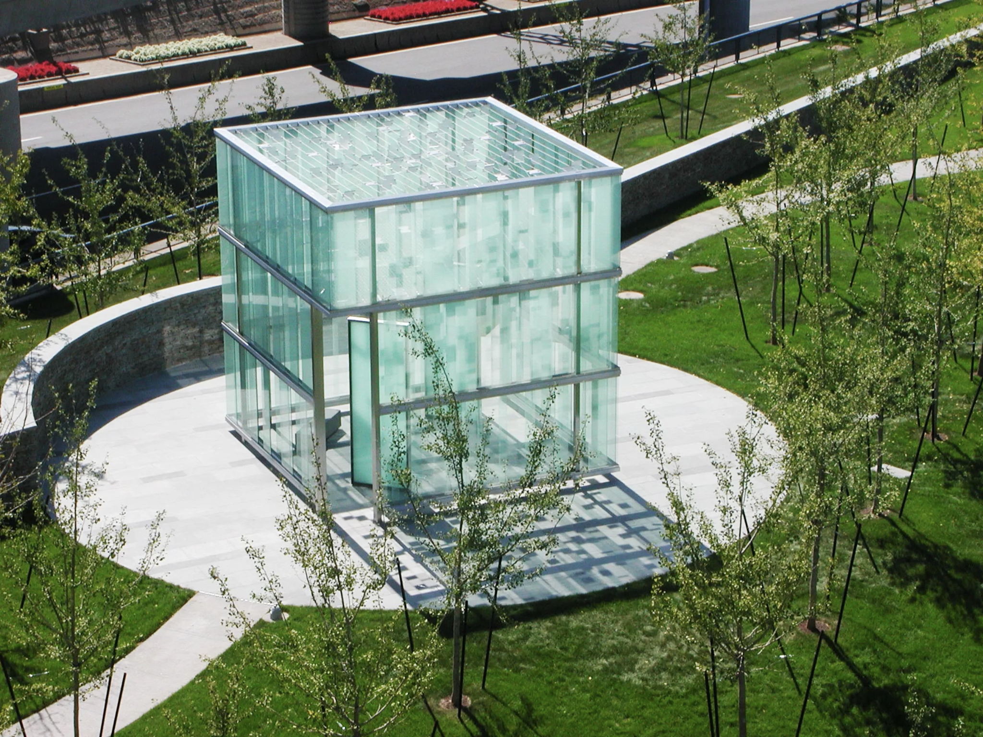
This is the 911 Memorial at Logan Airport
The memorial takes the shape of a 20-by-20 foot glass cube.
What is the perimeter of the memorial?
In feet?
In inches?
4.MD.A3
Notes:
Week of September 12, 2022
911 Memorial

Slide 9
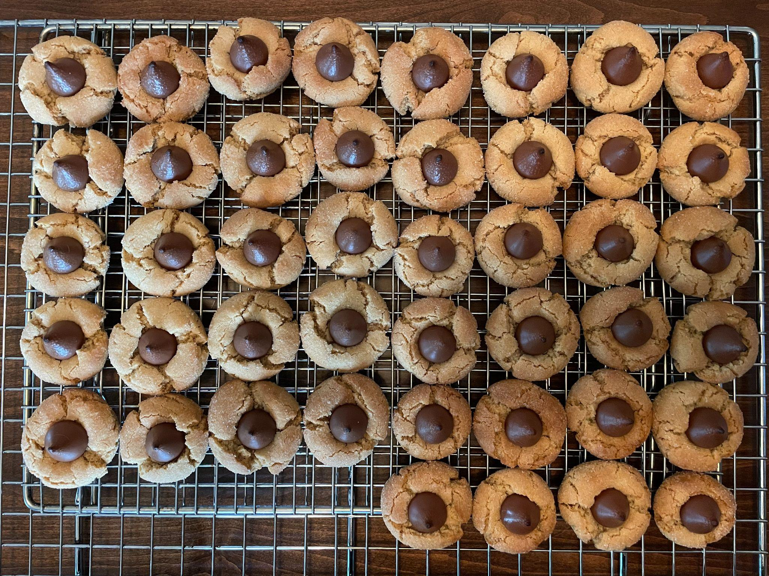
Fresh Cookies
Yum!
Where do you see arrays in these cookies?
How many different ways can you represent your mathematical thinking?
4.OA.A1

Slide 10
Now draw a shape that is DIFFERENT from the shape in 1 way, but the SAME in another way.
How are they DIFFERENT?
How are they ALIKE?
Sketch this shape?
What is it?
3.G.A1

Slide 11
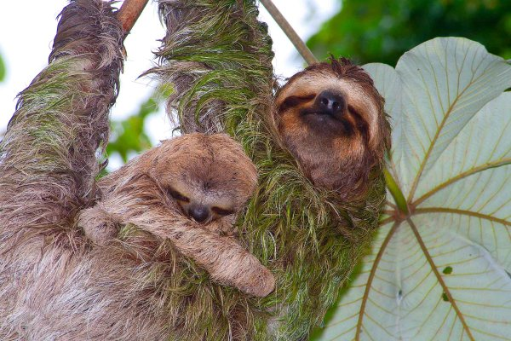
It’s Independence Day in Costa Rica
Costa Rica is home to two kinds of sloths.
Sloths have an extremely low metabolic rate, which means they move at a languid, sluggish pace through the trees. On average, sloths travel 41 yards per day.
How far will they travel in one week?
Two weeks?
Do you see a pattern!
4.OA.A2
Notes:
September 15, 2022
Costa Rica Independence Day

Slide 12
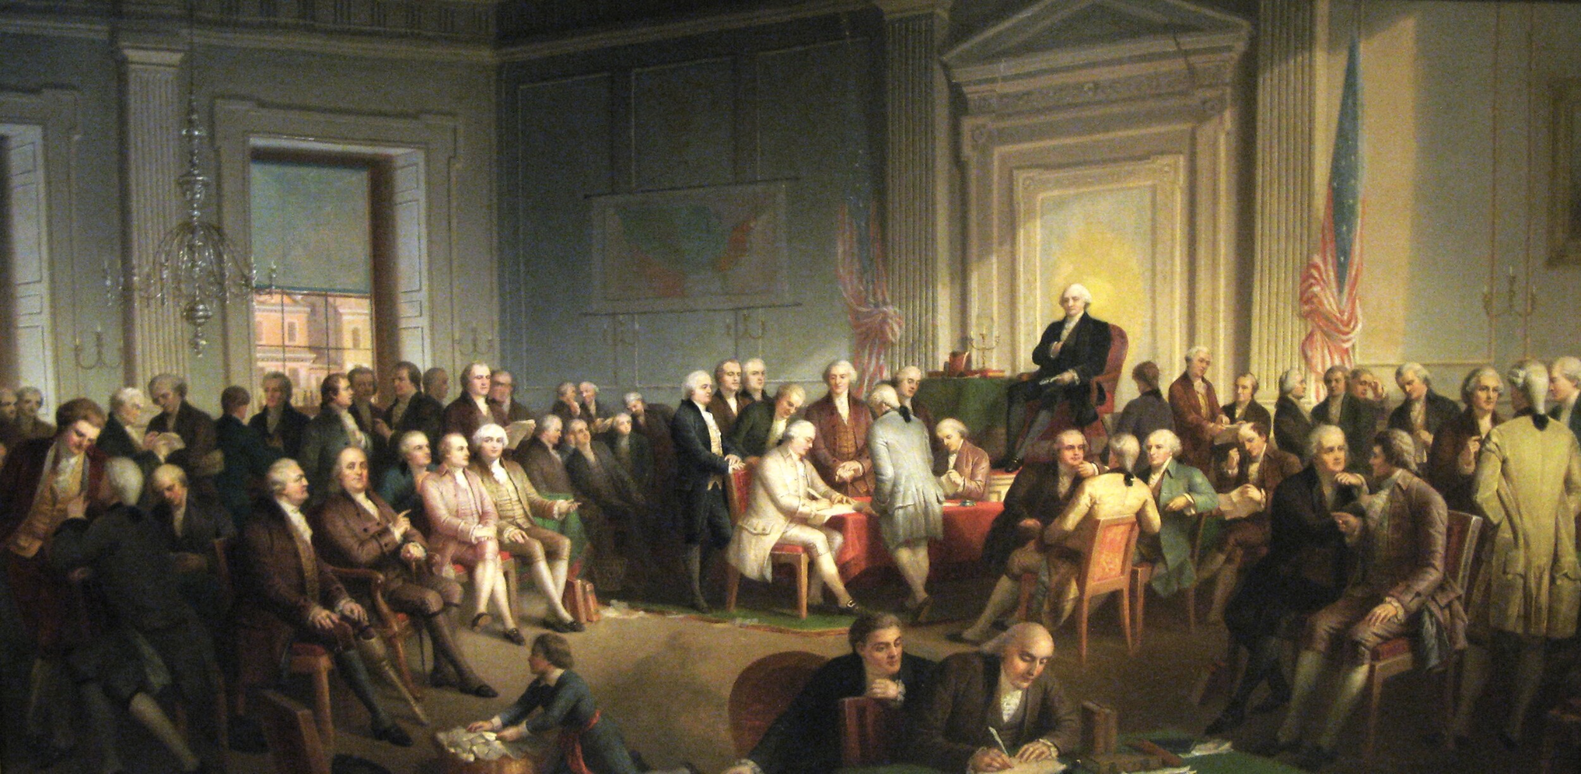
4.NBT.A4, MD.A1
The Constitution was signed at the Constitutional Convention in Philadelphia in 1787. How long ago was that? How can we use mental math to figure it out? How many years? How many months?
Notes:
September 16, 2022
Constitution Day Celebration

Slide 13
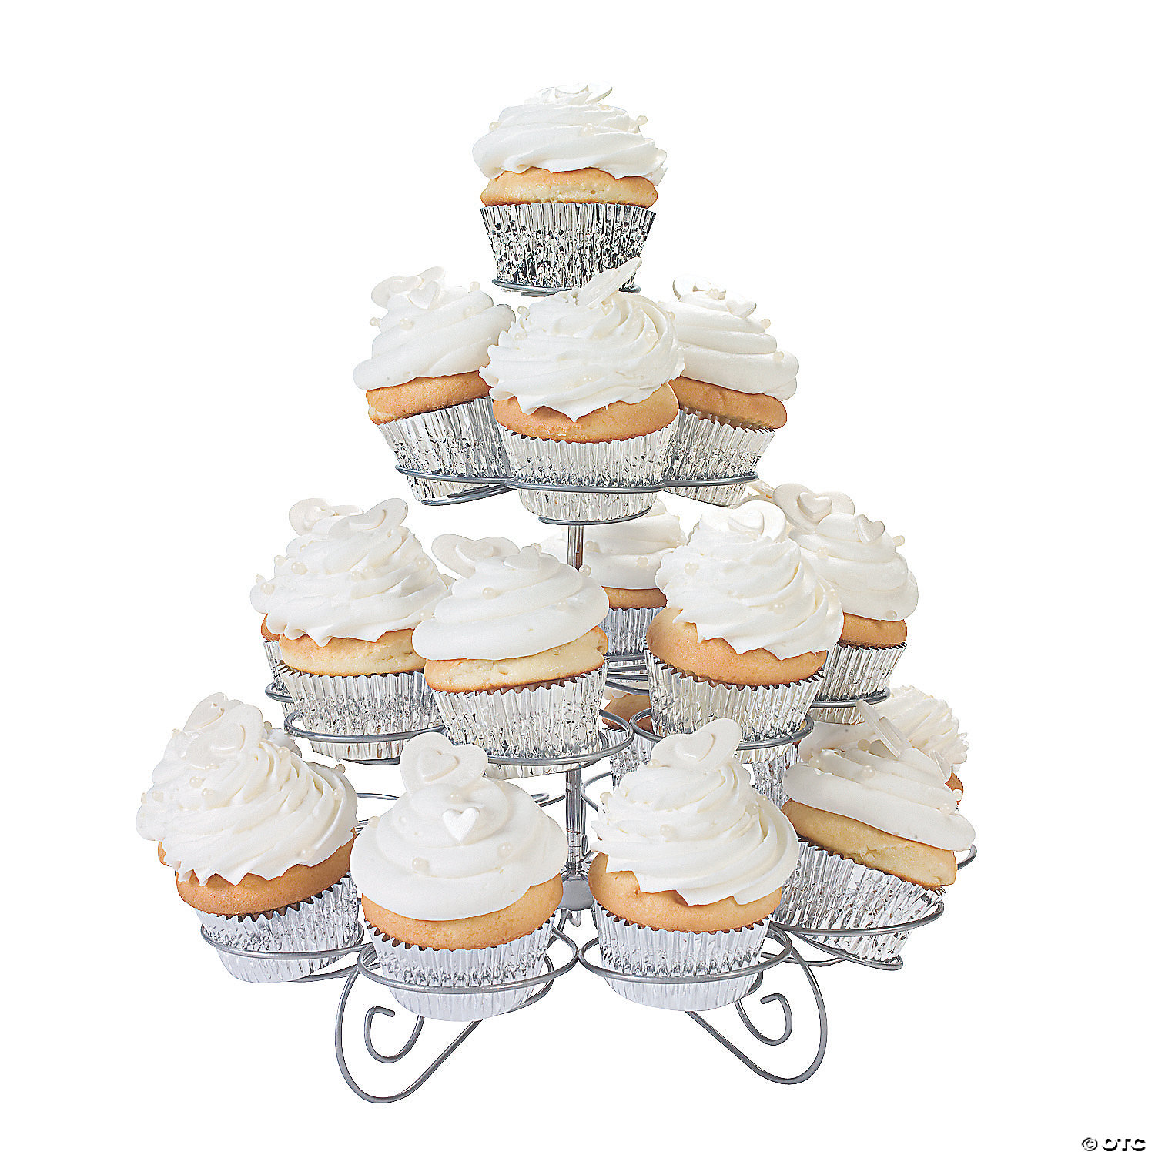
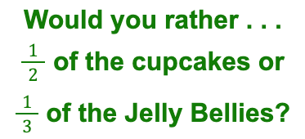
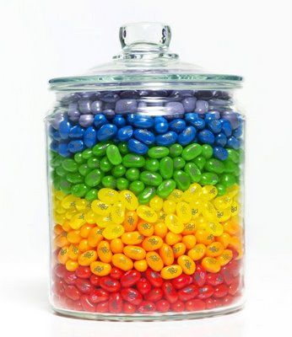
3.NF.A1
Notes:
Week of September 19, 2022

Slide 14
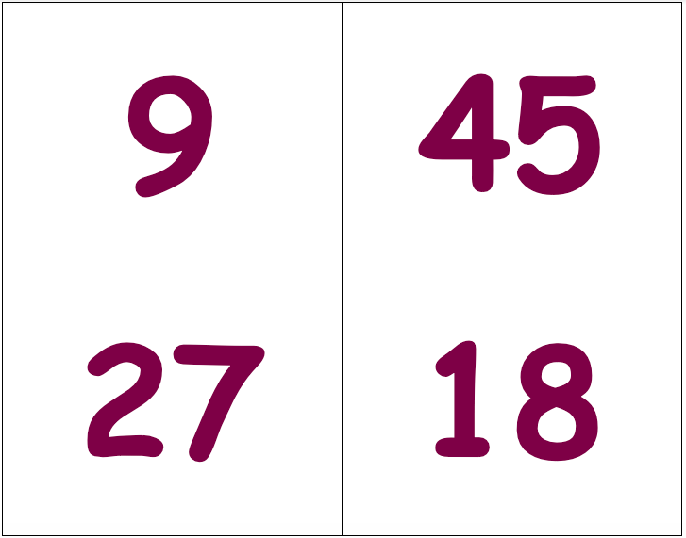
Which one doesn’t belong?
4.OA.A4

Slide 15
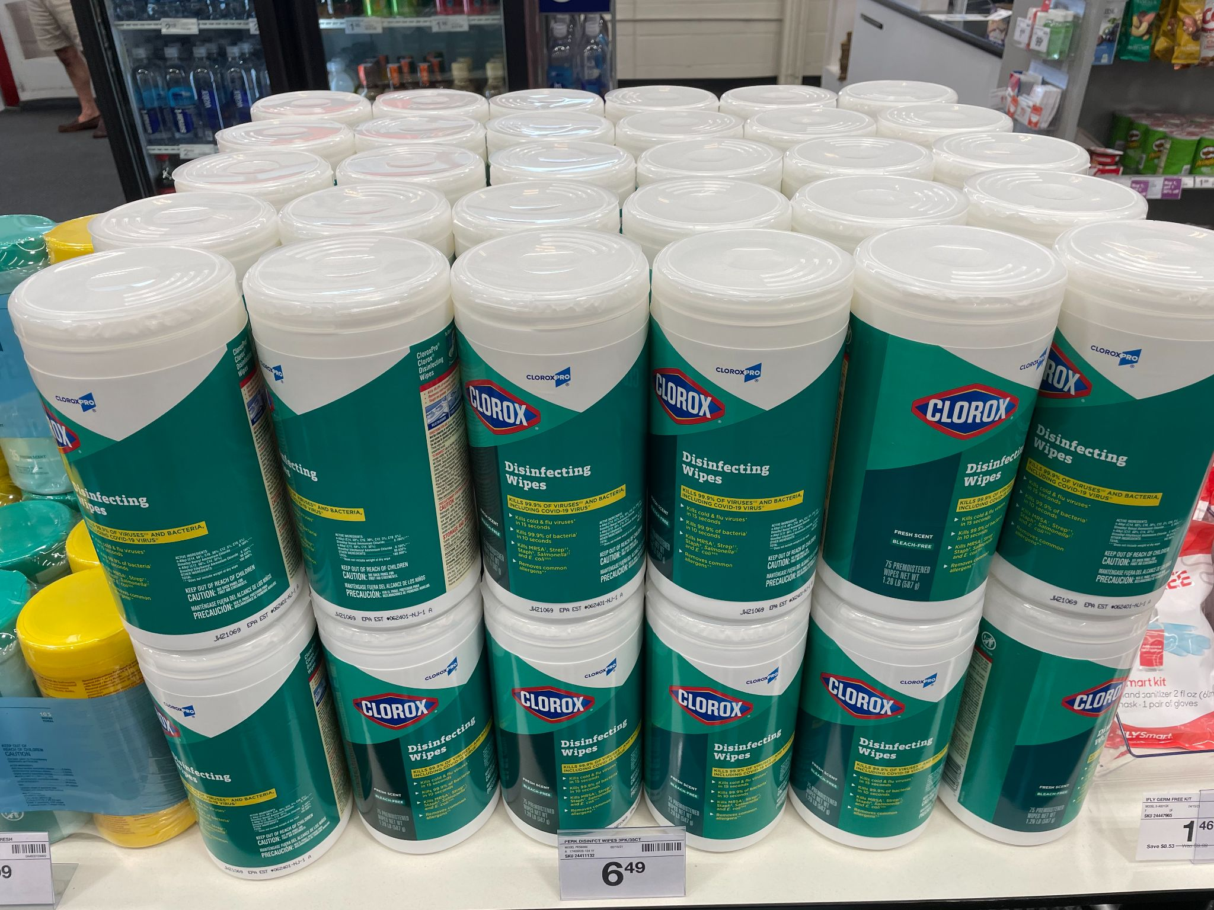
How many tubs of Clorox?
What would a multiplication sentence look like to match this photo?
4.MD.A3

Slide 16
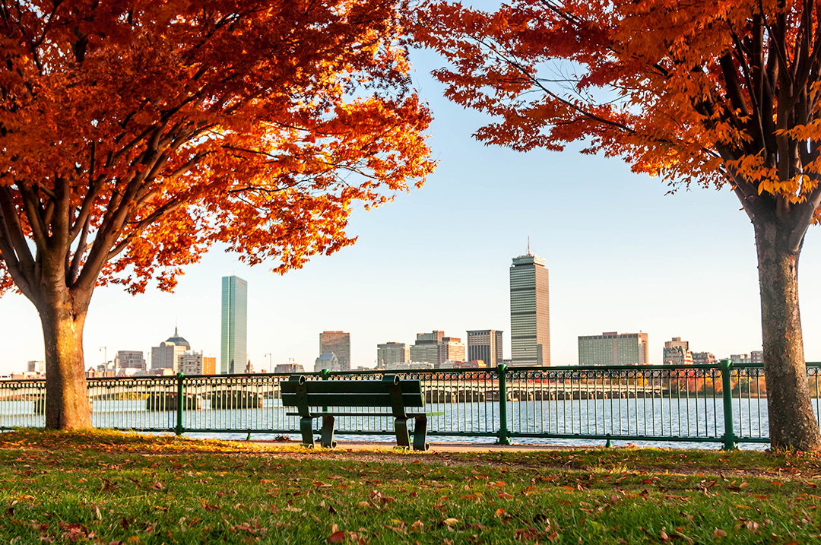
It’s the Fall equinox!
What does EQUINOX mean?
The Spring Equinox is only 6 months away?
About how many days is that?
Estimate how many hours that would be!
4.MD.A1
Notes:
September 22, 2022
Fall Equinox

Slide 17
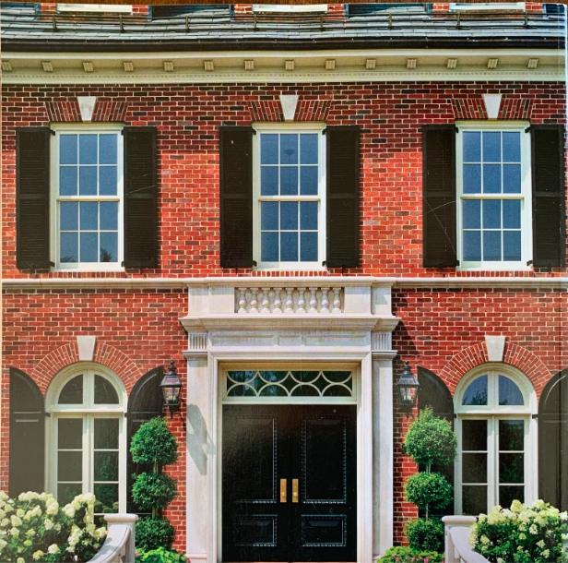
Where do you see symmetry in this picture?
What other math topics (multiplication!) can you describe?
4.G.A3

Slide 18
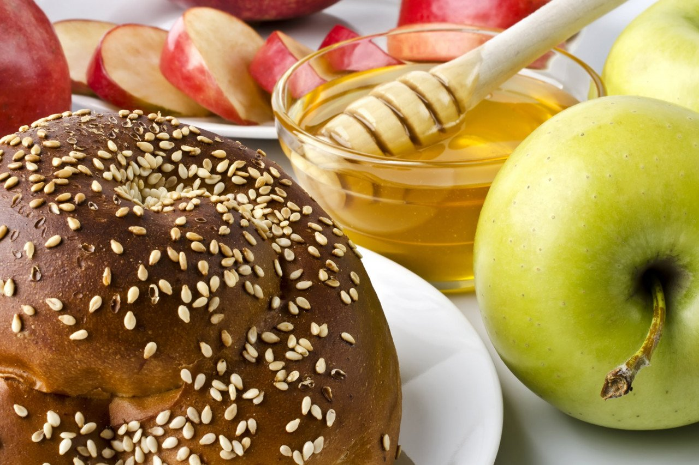
Happy Rosh Hashanah
According the Hebrew Calendar this is the New Year 5783.
How many different expressions can we create that equal 5,783?
3.NBT.A1
4.OA.A3
Notes:
Week of September 27, 2022
Rosh Hashanah

Slide 19
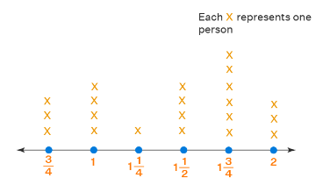
What do we notice?
What do we wonder?
What is possible?
4.MD.B4

Slide 20
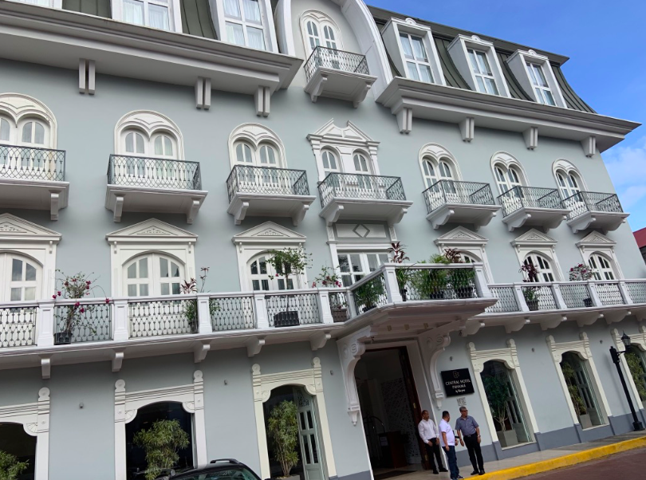
How many different shapes do you see here?
What mathematical questions can you ask and answer?
(Think multiplication!)
4.G.A2

Slide 21
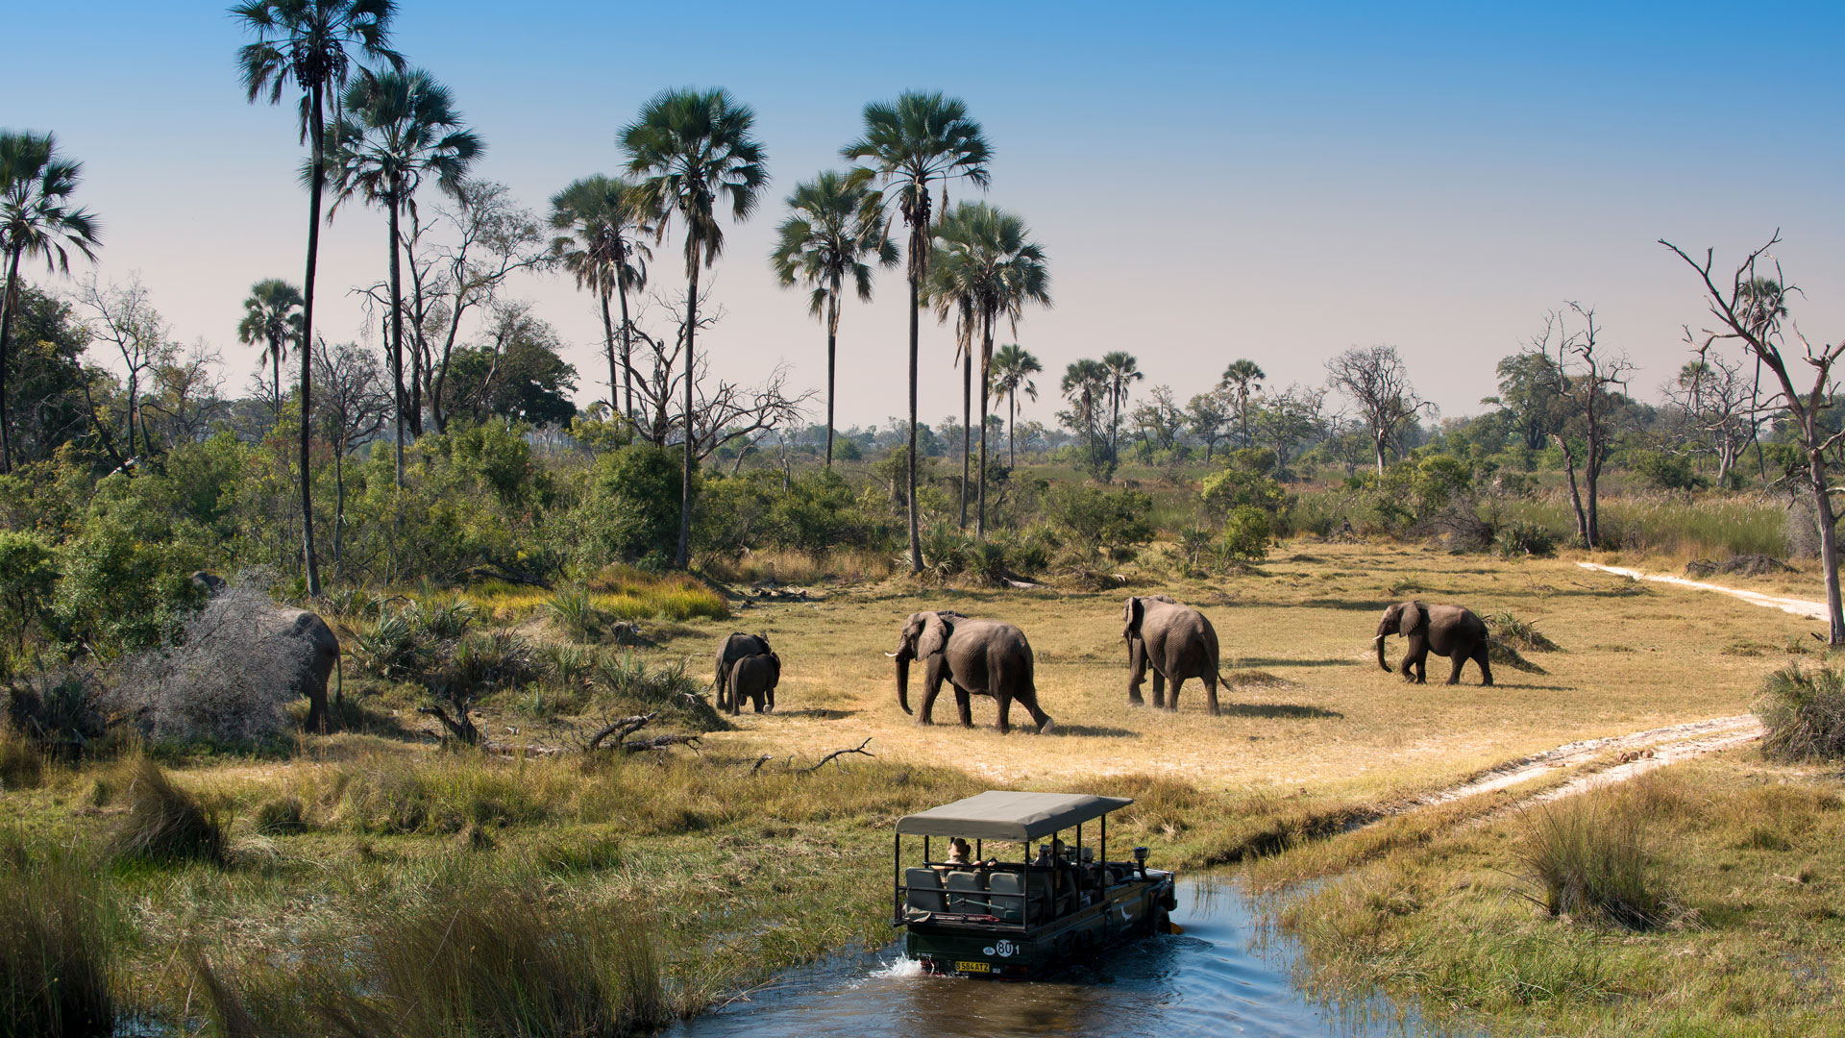
Happy Independence Day Botswana!
The highest point in Botswana is 4,888 feet (1,490 meters) in the hills north of Lobatse in southeastern Botswana; the lowest point is 2,170 feet (660 meters) at the country’s easternmost point, in the Limpopo valley.
What is the difference between the highest and lowest points in Botswana?
4.NBT.A4
Notes:
September 30, 2022
Botswana Day

