Slide 1
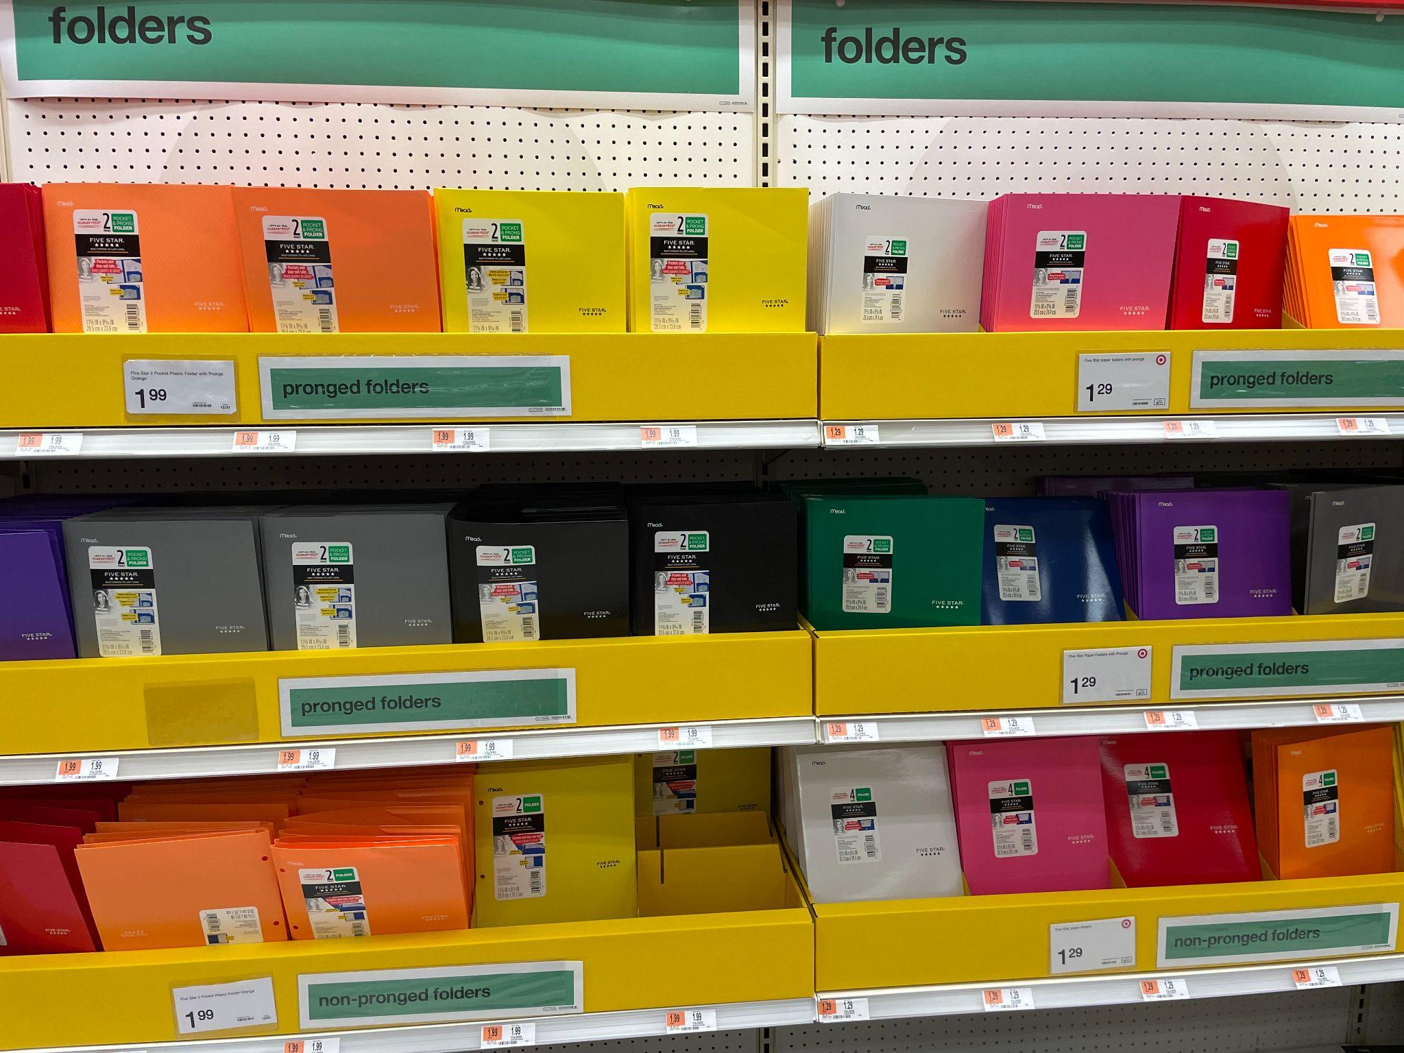
Look at all of these folders?
Estimate how many are here.
How many of each color?
Write as many MATH SENTENCES as you can to match your thinking!
3.OA.A3
Notes:
Week of August 31, 2022

Slide 2
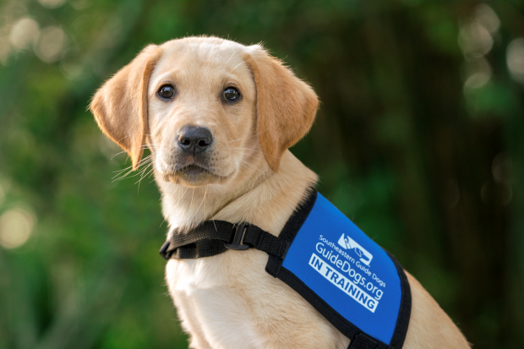
It’s National Guide Dog Month!
When Guide Dog puppies are
24 weeks old
they need
19 weeks of basic skills training and then
12 weeks of guiding training.
How many weeks is that altogether?
How many different ways can we solve this?
3.NBT.A2
Notes:
September 1, 2022
National Guide Dog Month

Slide 3
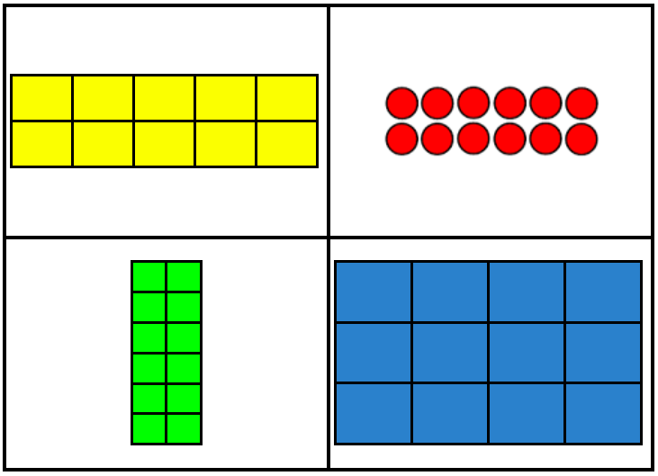
Which one does not belong?
3.MD.C5
Notes:
Top left: not 12
Top right: not square array
Bottom left: not horizontal
Bottom right: not 2 rows/columns

Slide 4
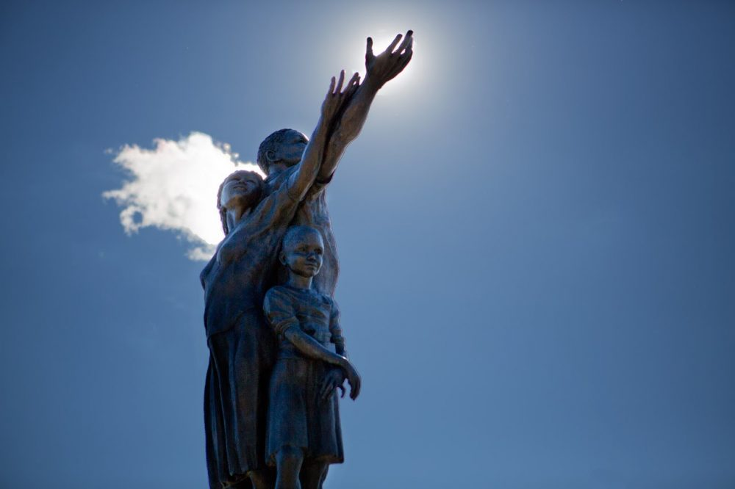
“Gateway to Boston” in Mattapan Square was created in 2005.
How long ago was that?
How do we know?
3.NBT.A2
Notes:
Week of September 6, 2022

Slide 5
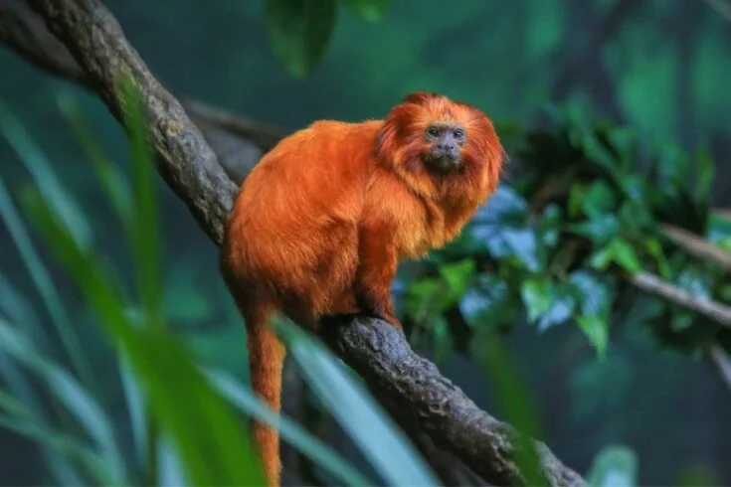
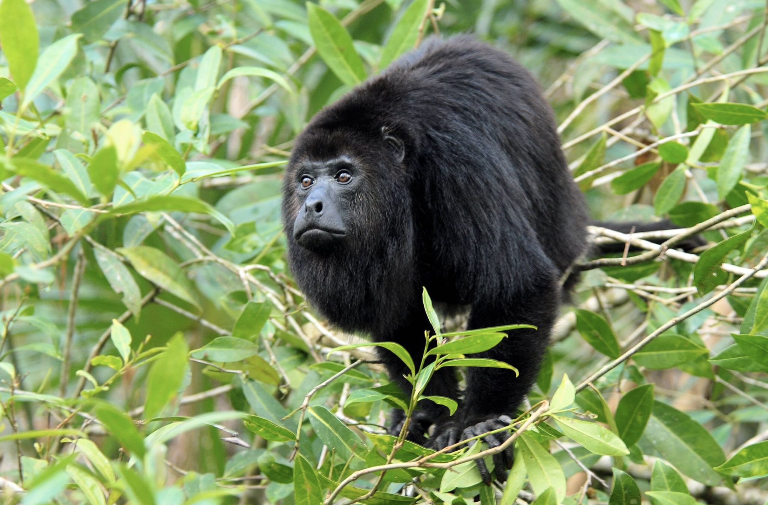
Happy Independence Day Brazil!
The smallest monkey in the Amazon Rainforest is the Pygmy Marmoset
weighing between 6 - 9 pounds.
The largest monkey in the Amazon rainforest is the Black Howler
weighing between 24 and 26 pounds.
What can we say about their difference in weight?
3.MD.A2
Notes:
September 7, 2022
Brazil Independence Day

Slide 6

259 + 10 = 249 + 20
465 + 30 = 20 + 445
349 - 30 = 359 - 40
3.OA.D9

Slide 7
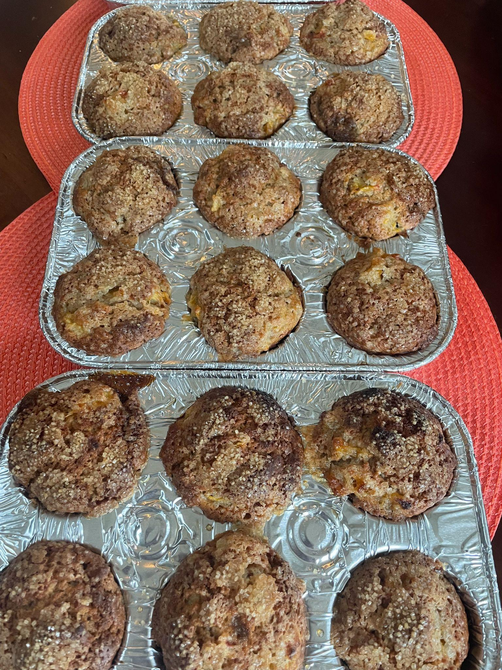
Fresh baked muffins… YUM!
How many different number sentences can we create to match this photo?
3.OA.A3

Slide 8
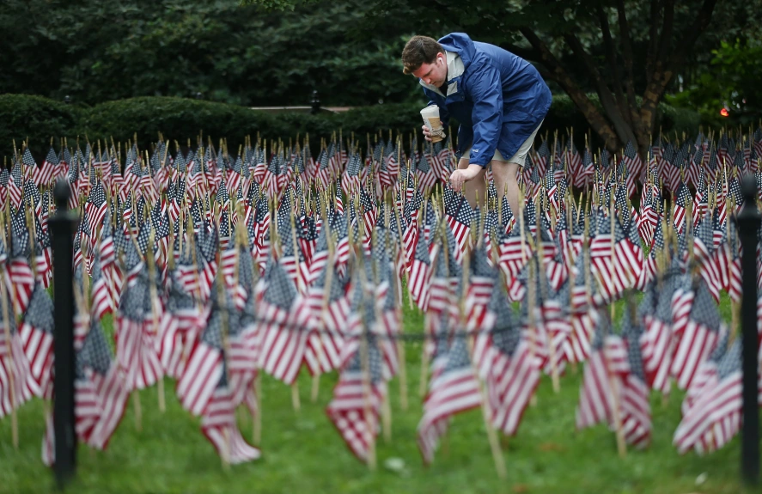
There are 2,997 flags planted here in a Boston 911 Memorial.
What do we know about the number 2,997.
What does it round to?
3.NBT.A1
Notes:
Week of September 12, 2022
September 11th Memorial

Slide 9
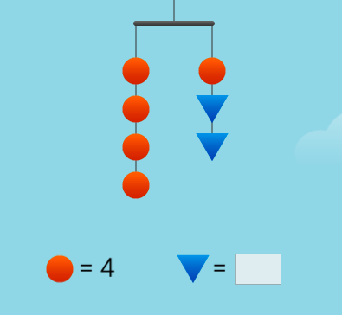
This is a mobile, it is perfectly BALANCED.
If you know the circle weighs 4 ounces, how can you figure out the weight of the triangles?
3.OA.D9

Slide 10
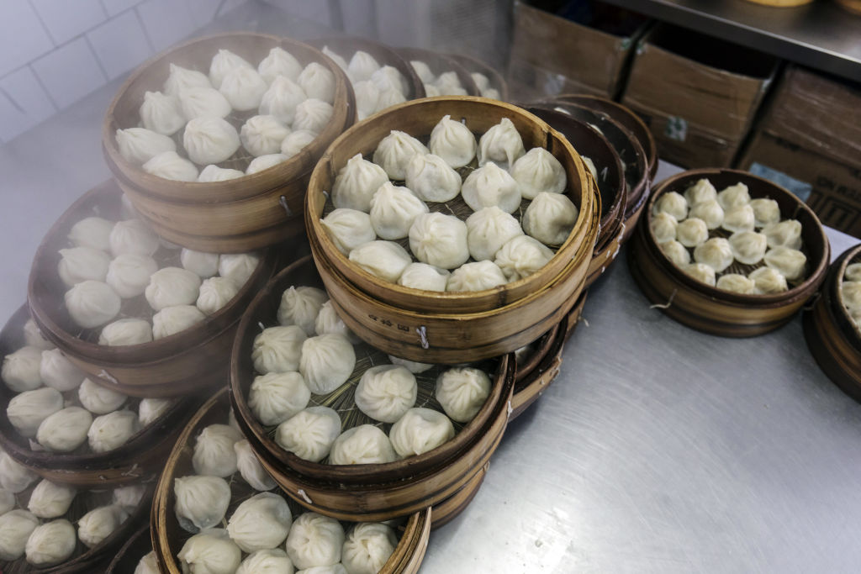
Estimate how many dumplings are here.
How can you use MATH to help you get really close?
3.NBT.A1

Slide 11


What is the same? What is different?
3.G.A1

Slide 12
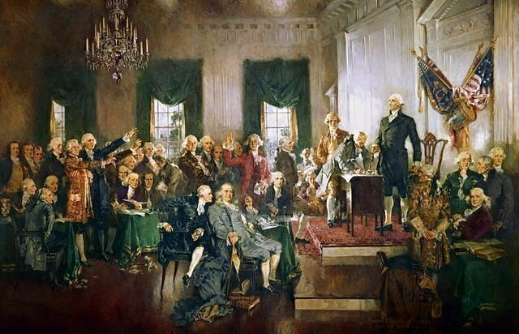
It’s Constitution Day!
Estimate how many delegates attended the Constitutional Convention in Philadelphia in 1787.
There were 55 delegates, but only 39 signed the Constitution!
How many did not sign?
How can you solve this using mental math?
3.NBT.A2
Notes:
September 16, 2022
Constitution Day Celebration

Slide 13
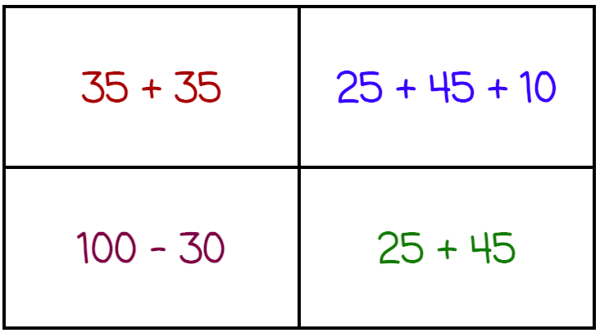
Which one does not belong?
3.NBT.A2
Notes:
Week of September 19, 2022
Top left: not different addends/subtrahends (double)
Top right: not two addends/subtrahends
Bottom left: not addition
Bottom right: not 70

Slide 14
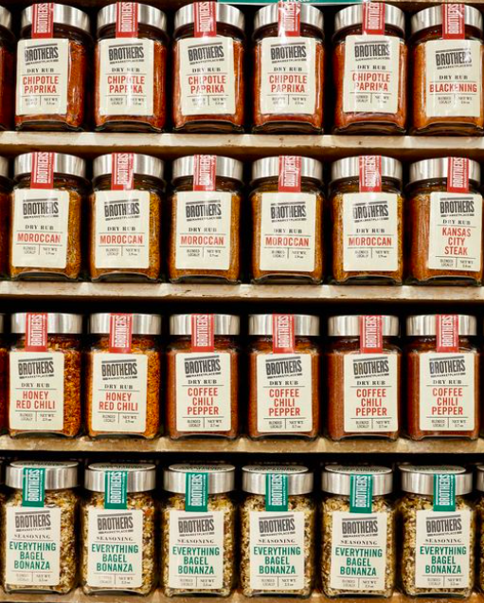
How many different kinds of pepper are on this display at Brother’s Market?
How many of each flavor?
How many altogether?
What about the jars we cannot see?
3.OA.A3

Slide 15
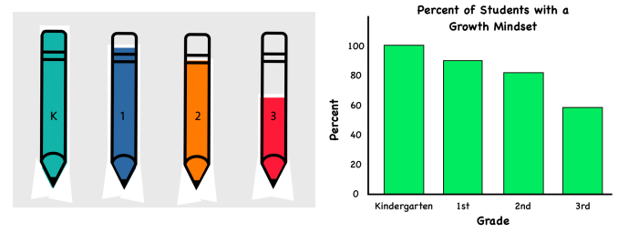
What do you notice?
What do you wonder?
What is going on in this data visualization?
3.MD.B3

Slide 16
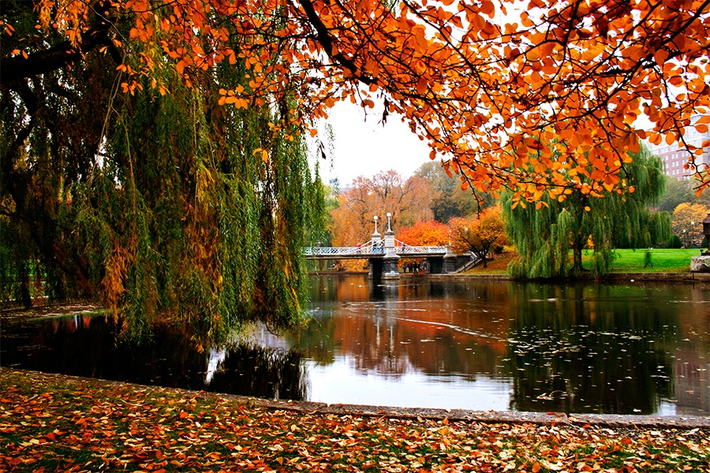
It’s the Fall equinox!
What does EQUINOX mean?
The Spring Equinox is only 6 months away?
About how many days is that?
3.MD.A1
Notes:
September 22, 2022
Fall Equinox

Slide 17
What can you say about these rectangles?
3.G.A2

Slide 18
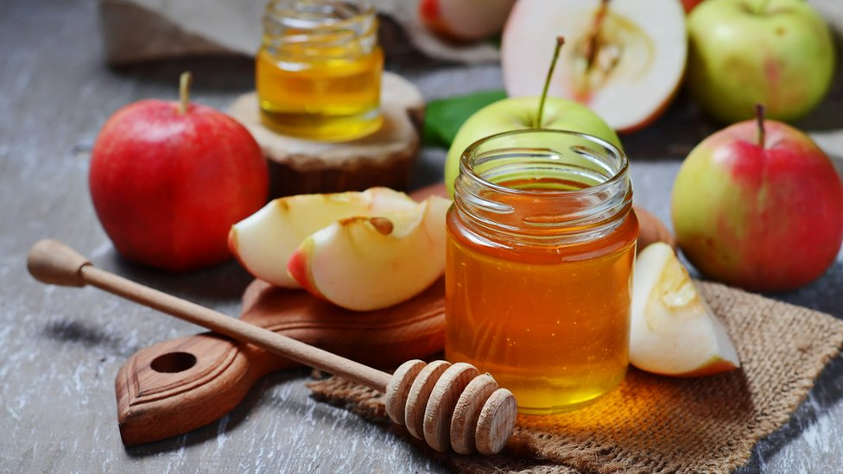
Happy Rosh Hashanah 5783!
According the Hebrew Calendar this is the New Year 5783.
What can we say about the number 5,783?
3.NBT.A1
Notes:
Week of September 27, 2022
Rosh Hashanah

Slide 19
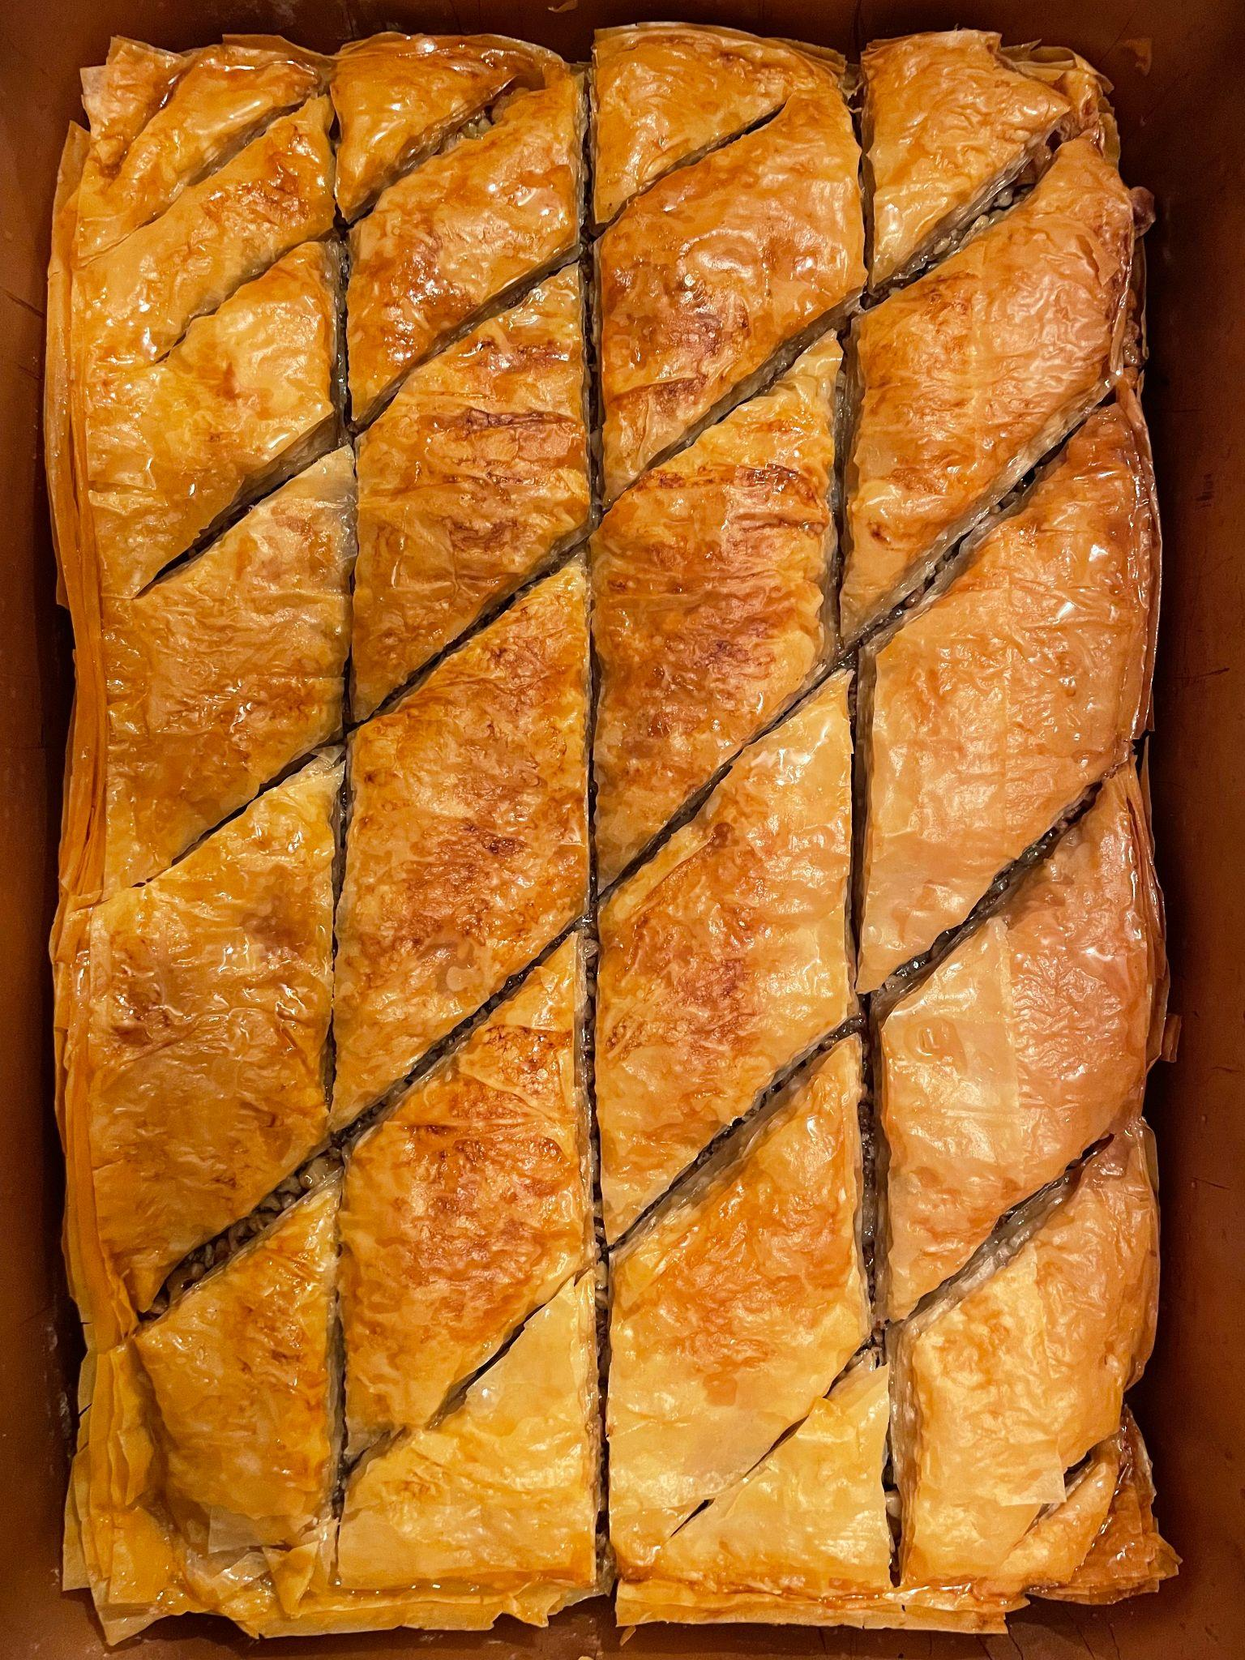
Baklava … Yum!
What can we say about the shapes we see?
How many pieces are here?
How do we know?
Write a number sentence to match your thinking.
3.OA.D8

Slide 20
Now draw a shape that is DIFFERENT from the shape in 1 way, but the SAME in another way.
How are they DIFFERENT?
How are they ALIKE?
Sketch this shape?
What is it?
3.G.A1

Slide 21
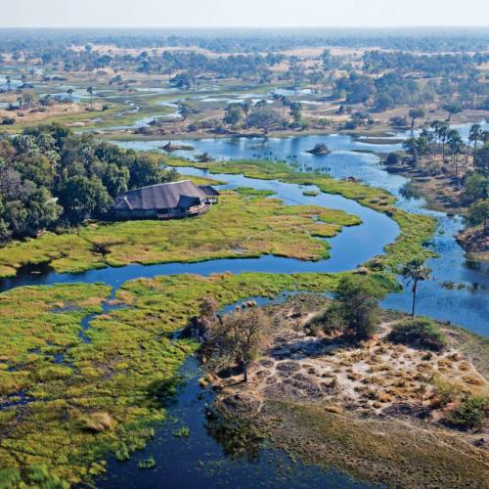
Happy Independence Day Botswana!
Botswana gained independence from British rule in 1966.
How long ago was that?
How do you know?
3.NBT.A2
Notes:
September 30, 2022
Botswana Day

