Slide 1
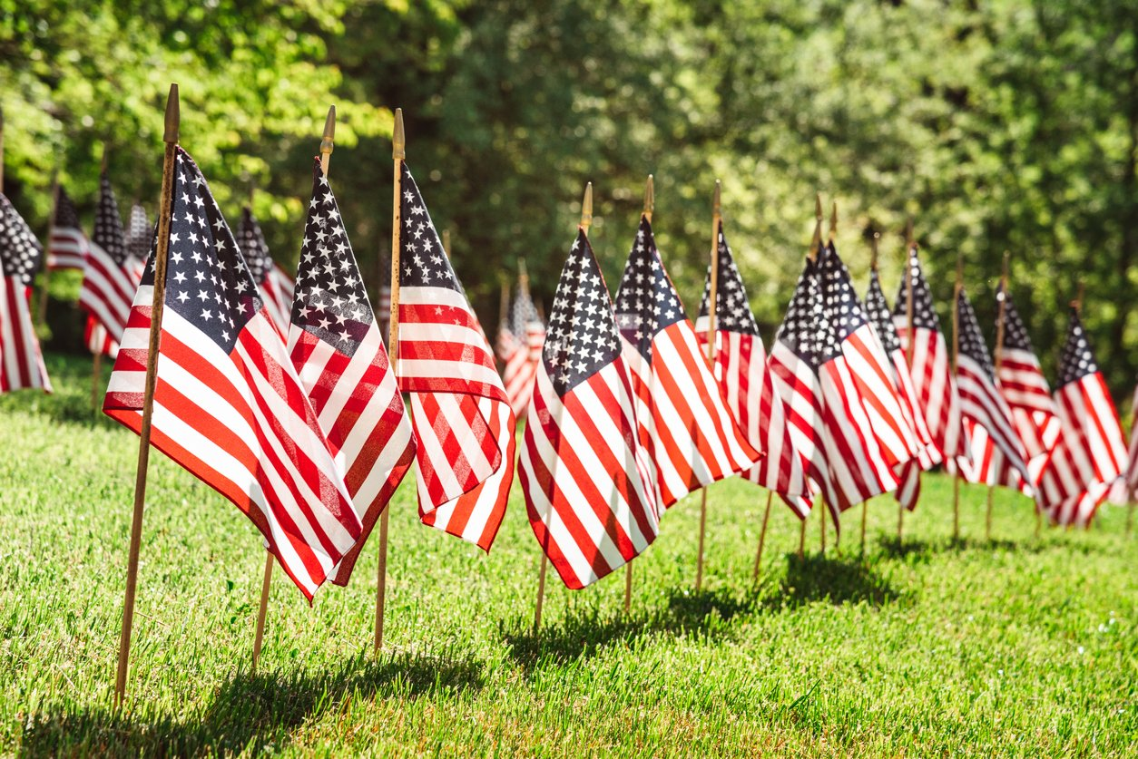
Memorial Day
Do you think there are more than 10 flags here or less?
More than 20?
How do you know?
K.CC.C6
Notes:
Week of May 31, 2022

Slide 2
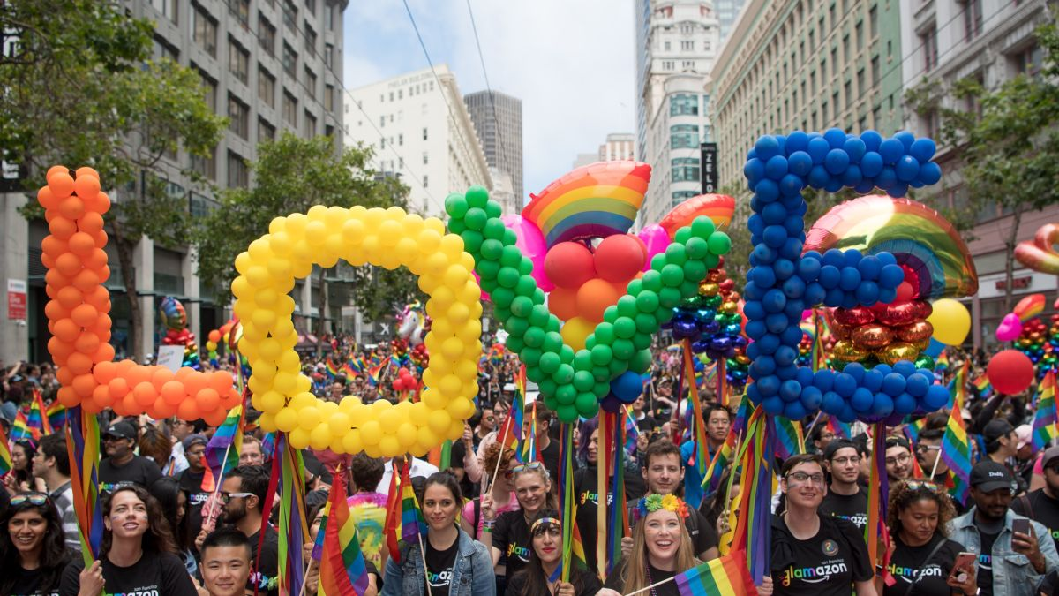
There are more than 100 balloons in each letter of LOVE!
How many ways can we count to 100?
What is the fastest way?
What is the slowest way?
K.CC.A1
Notes:
June is Pride Month!

Slide 3
Which one doesn’t belong?
K.G.A2,3

Slide 4
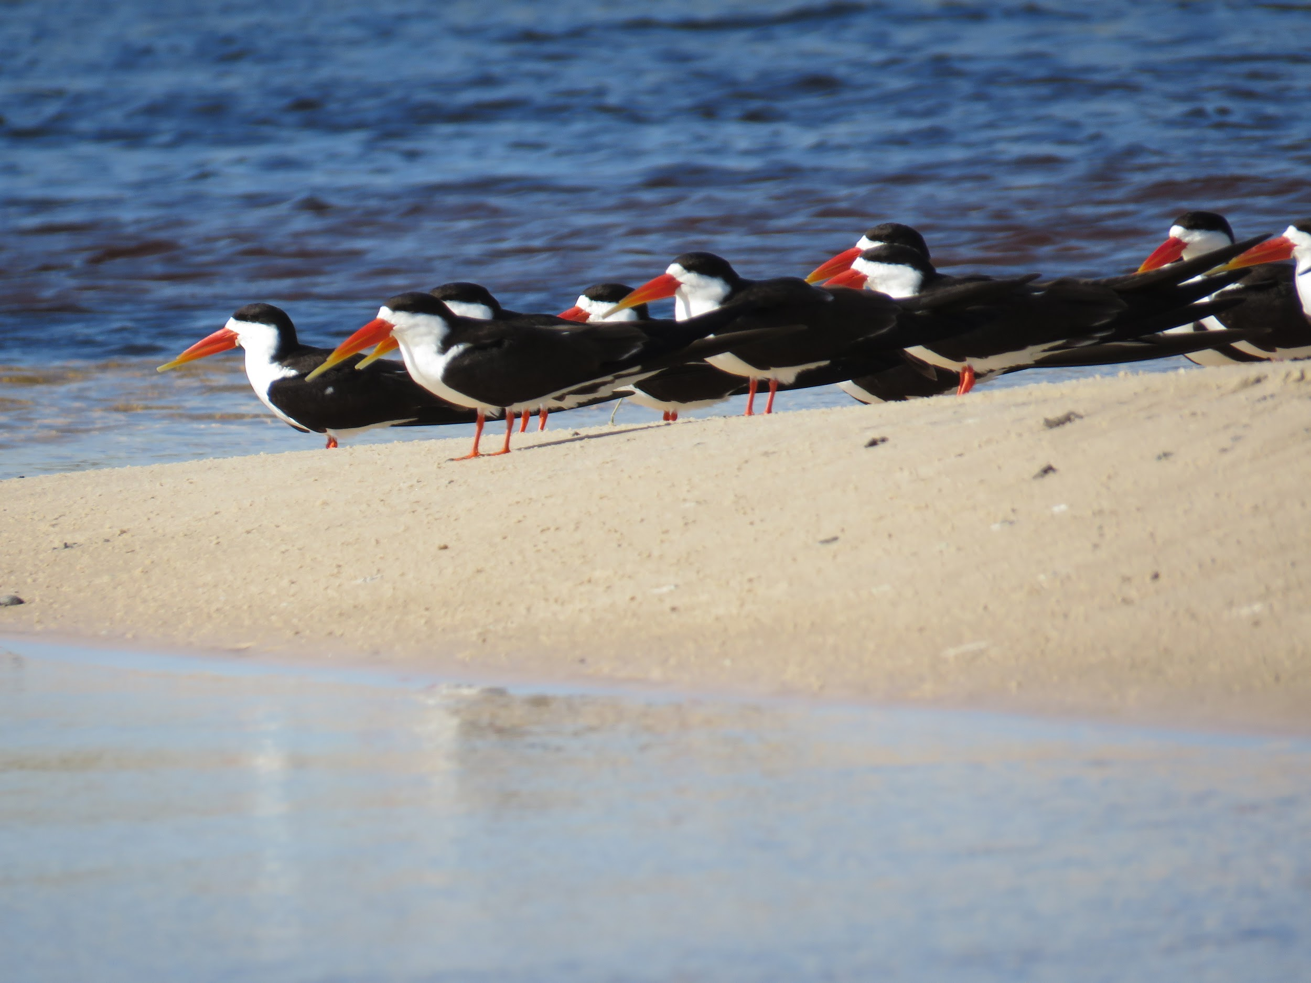
These are African Skimmers.
There are 9 you can see.
There are 20 altogether.
How many are missing from the picture?
Okavango Delta, Botwswana (C.Manousaridis)
K.OA.A2

Slide 5
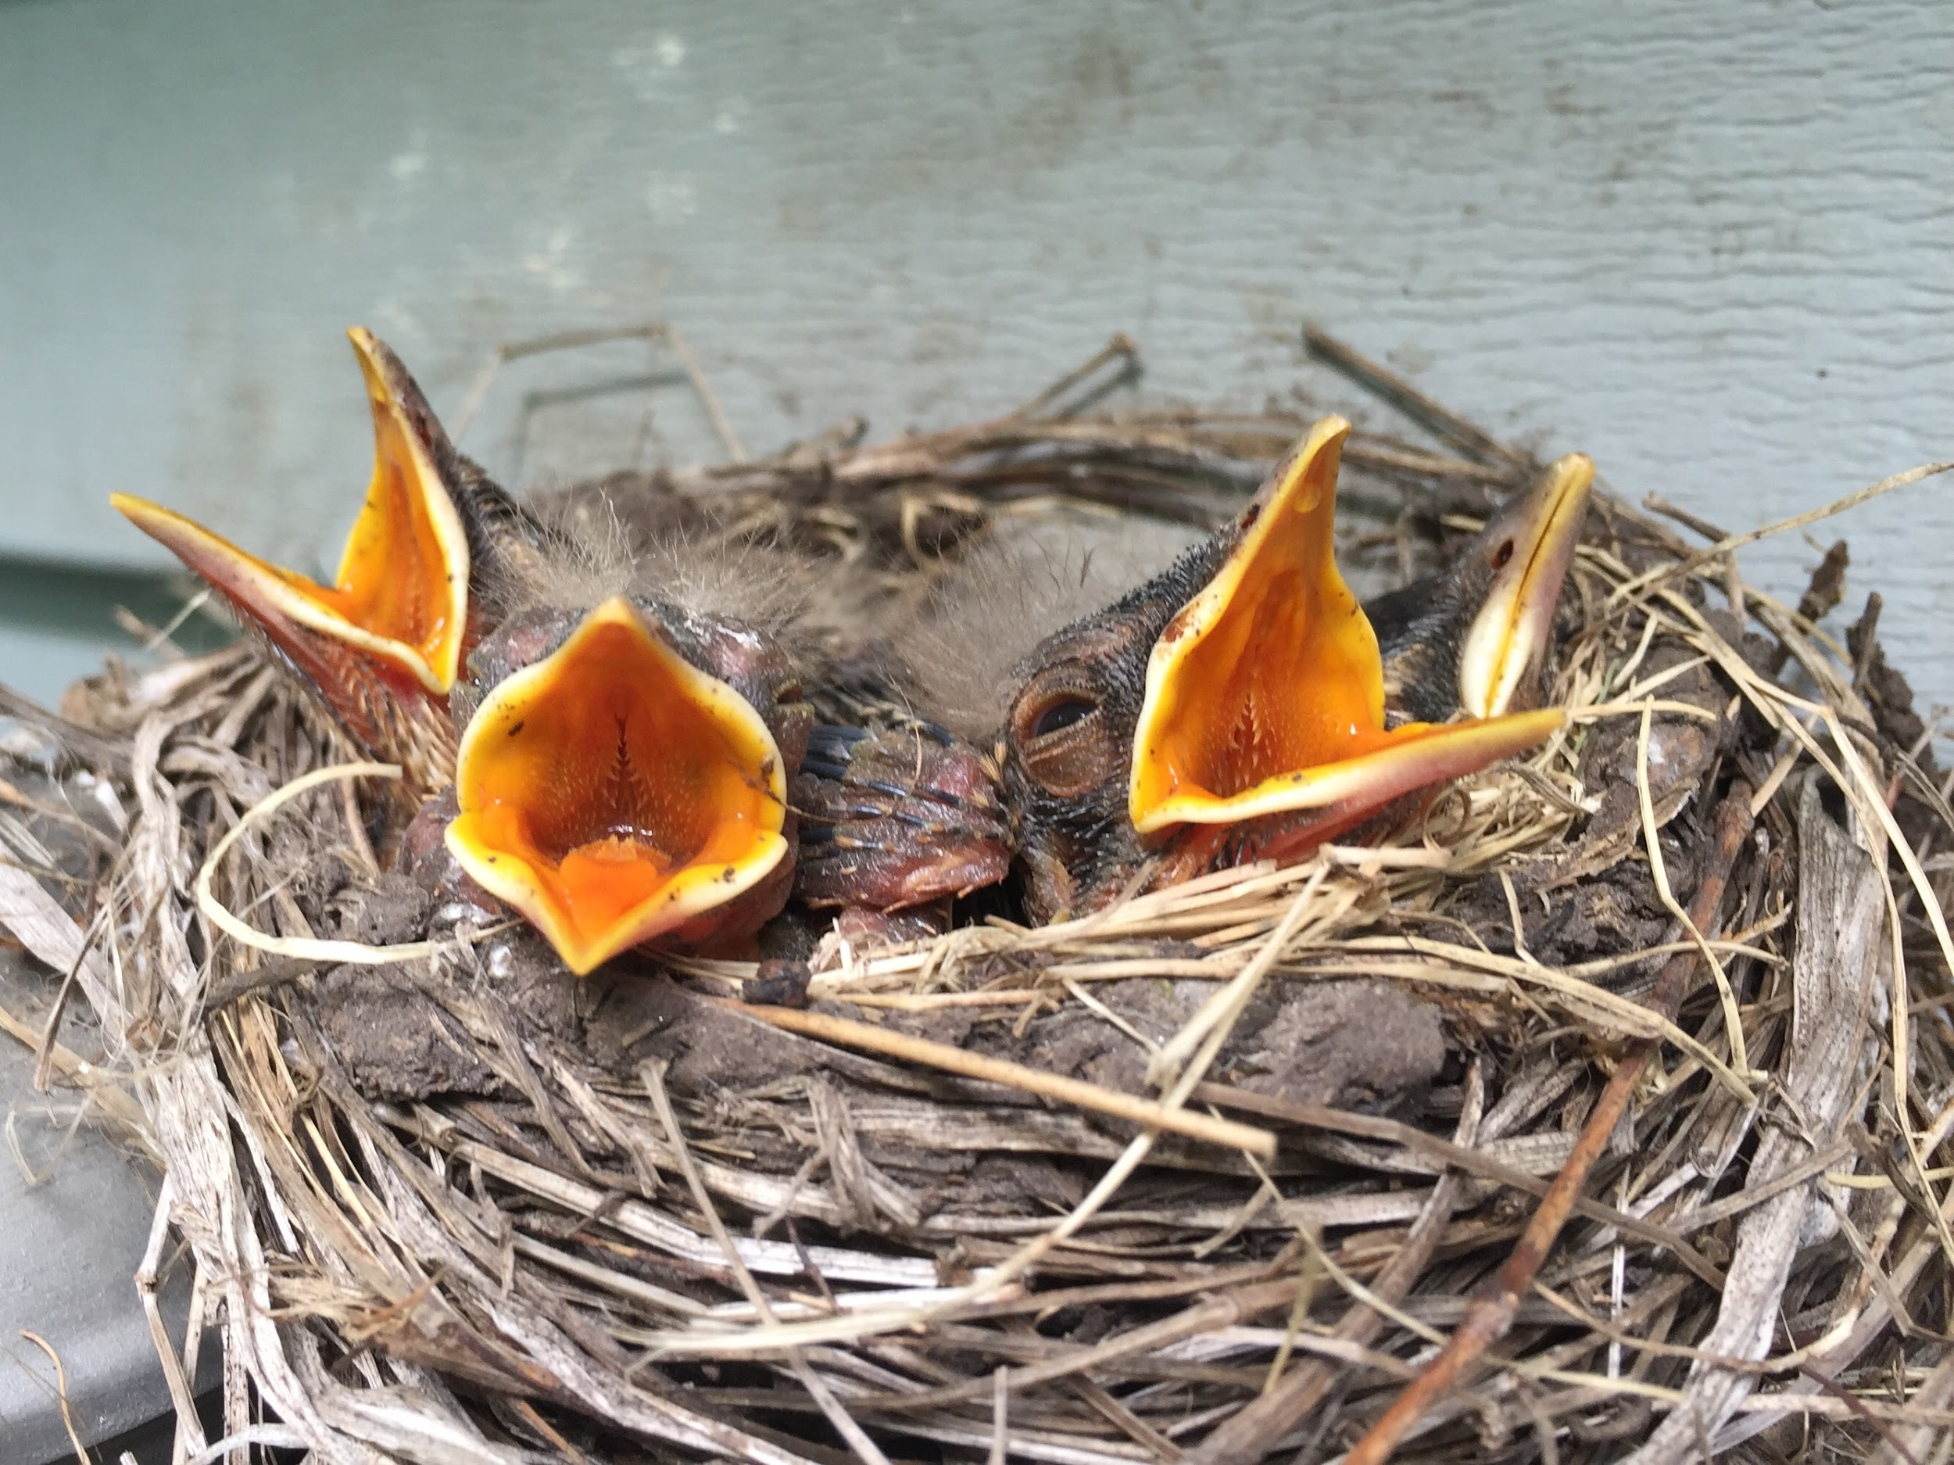
4 Baby Robins are in the nest!
If they each eat 2 worms every day, how many worms does Mama Robin need to get?
K.OA.A2

Slide 6
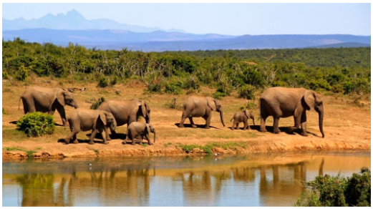
How many elephants are in the picture? How many more would make 10?
Can you write a number sentence to show that?
K.OA.A4
Notes:
Week of June 6, 2022

Slide 7

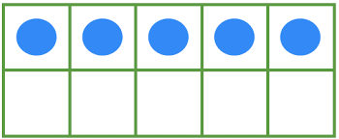
What is the same? What is different?
+ 5
K.NBT.A1

Slide 8
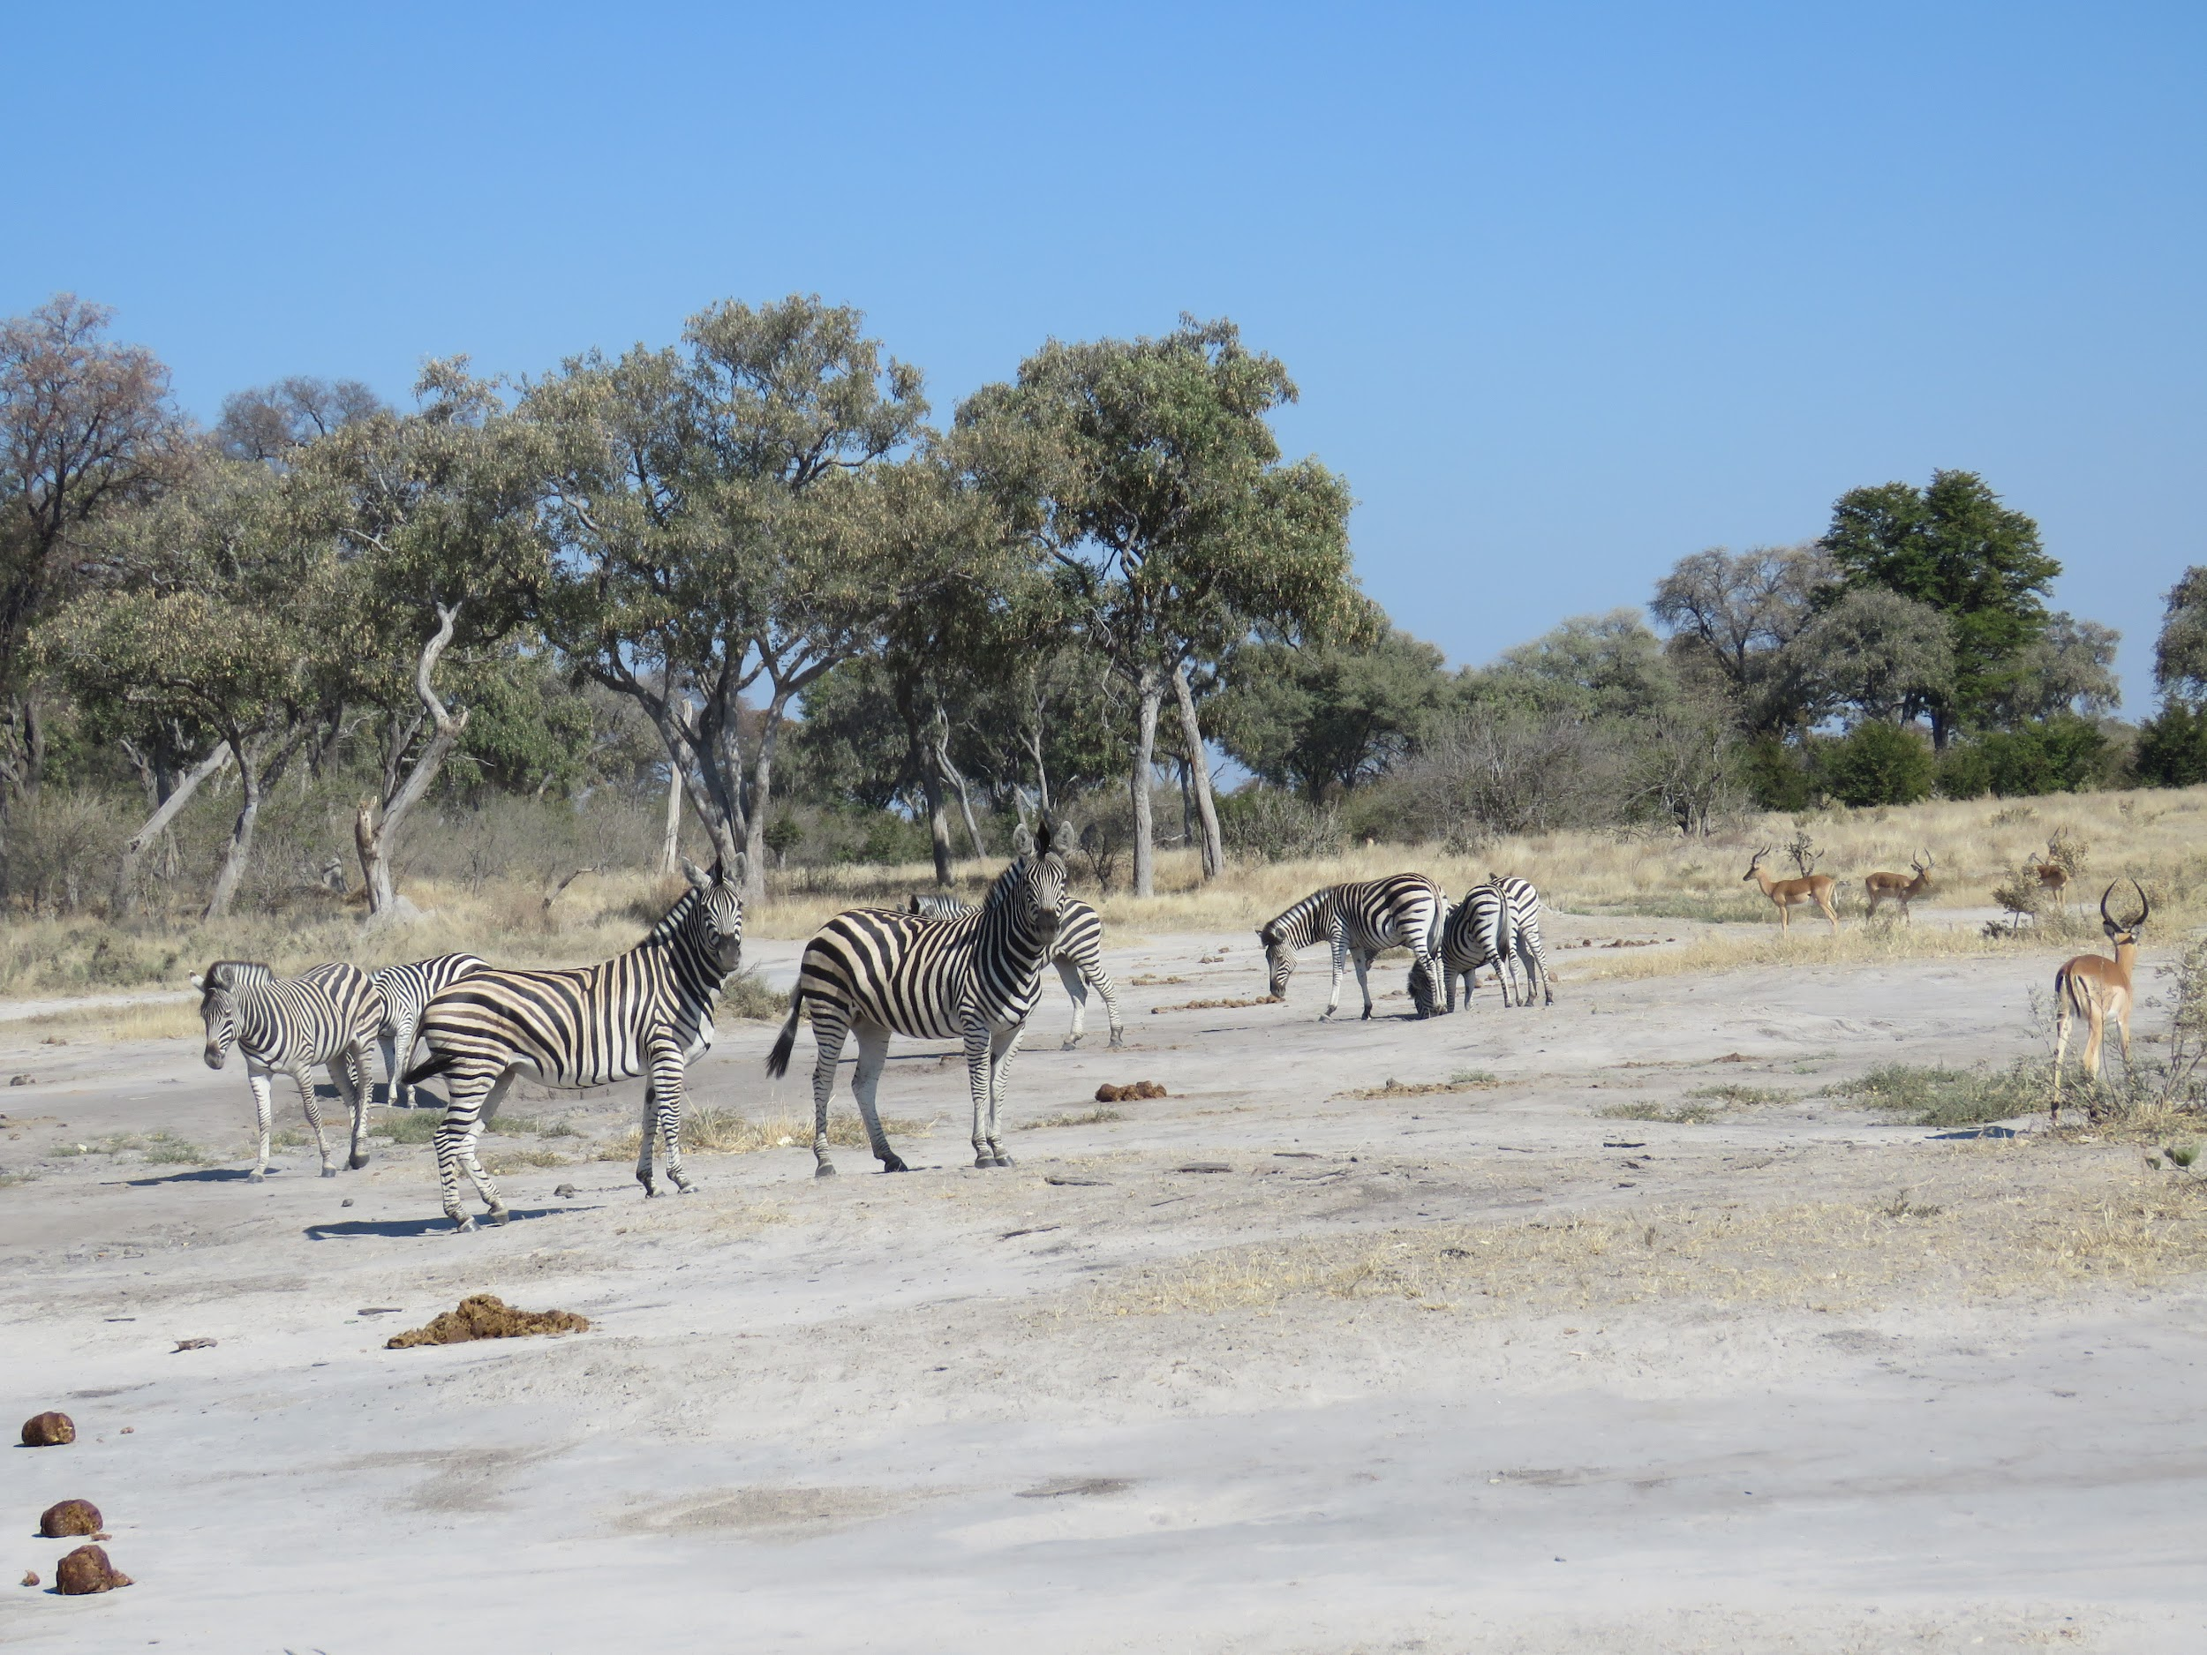
How many zebras do you see?
How many gazelles do you see?
Write a number sentence to show how many animals are here.
K.OA.A1
Moremi Wildlife Reserve, Botswana (C.Manousaridis)

Slide 9
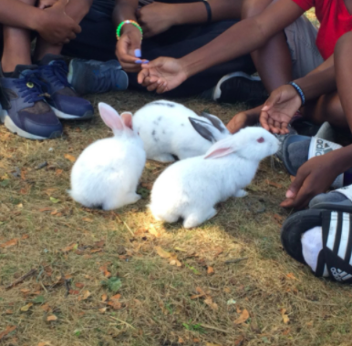
Bunnies at Land’s Sake Farm!
If there are 3 bunnies, how many legs do they have altogether?
What if 2 more bunnies hopped in?
What if there were 10 bunnies?
K.OA.A1

Slide 10
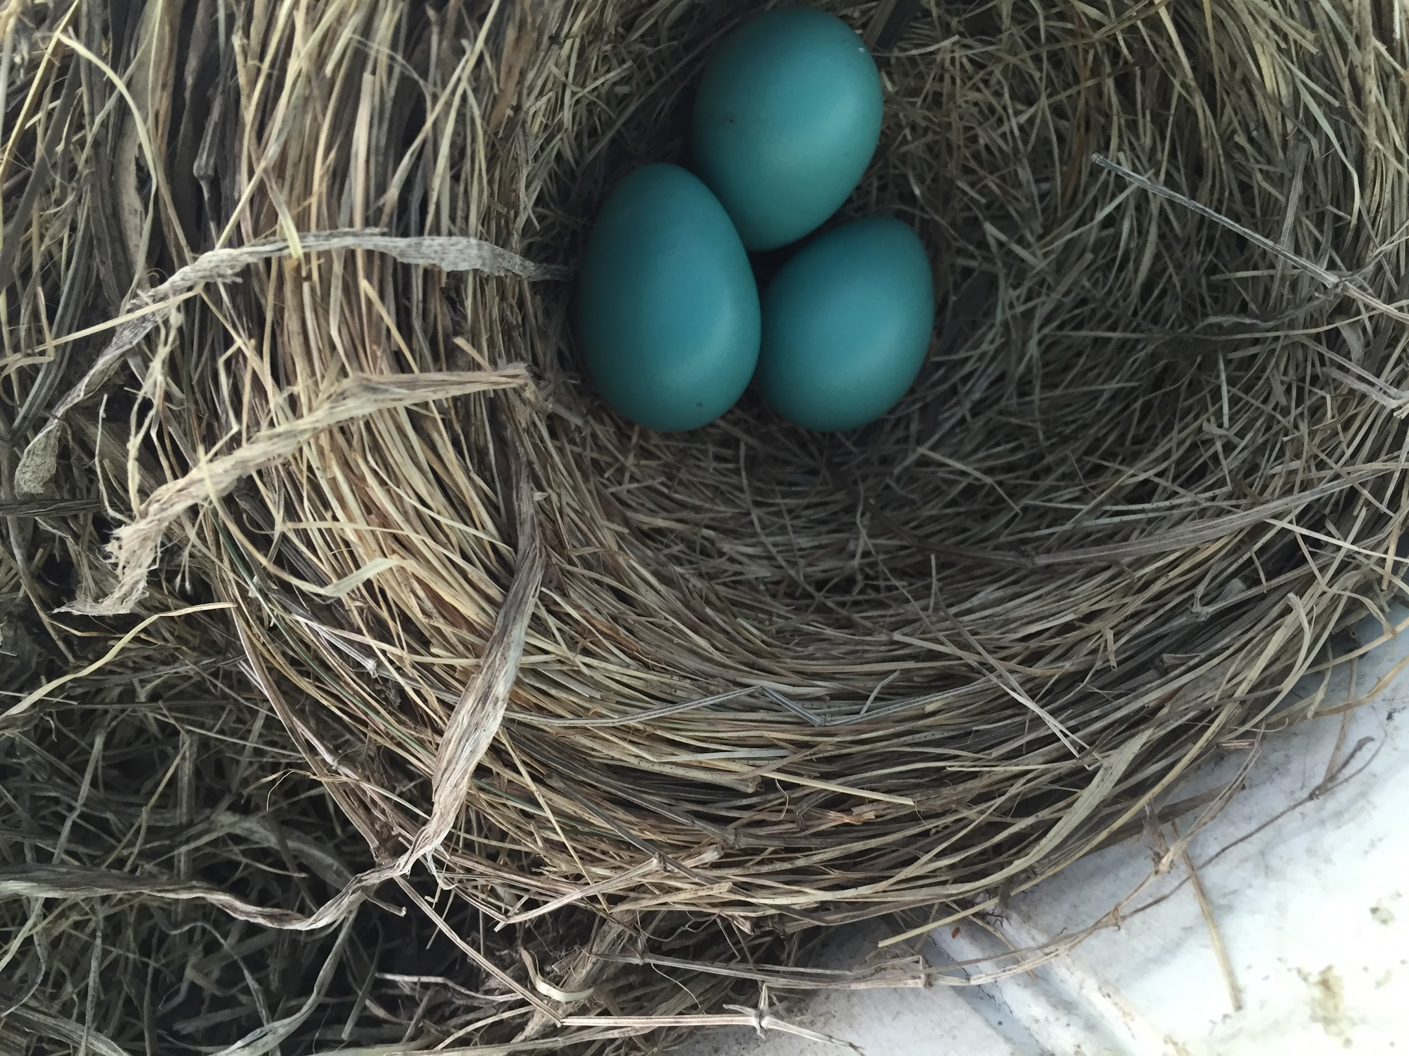
Mama Robin has a nest in our tree!
How many eggs?
Each robin egg weighs 3 grams,
how many grams do they weigh together
K.OA.A3

Slide 11
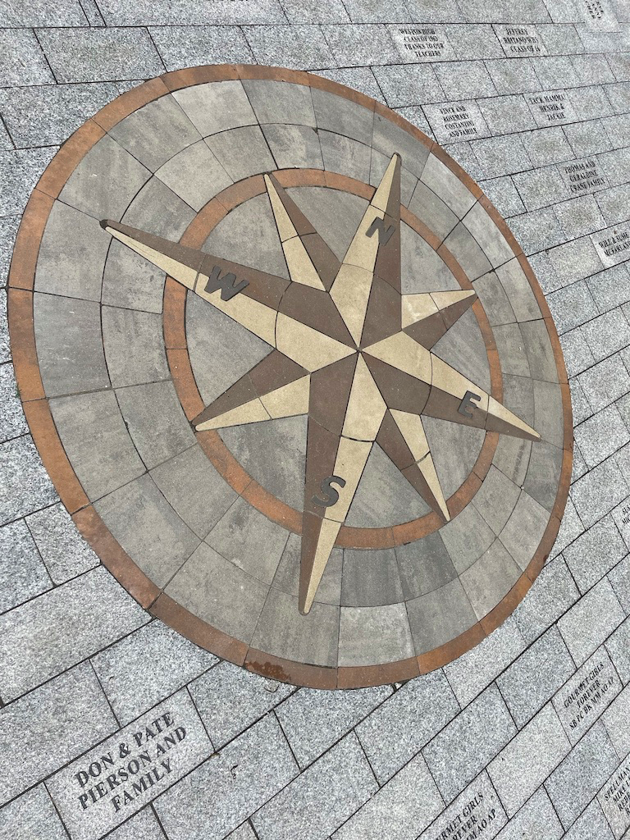
What fun shapes do you see in this compass rose along the Legacy Trail?
Can you sketch them?
K.G.A2
Notes:
Week of June 13, 2022

Slide 12

Happy Flag Day!
What can we count?
How many red stripes? How many white ones?
How many stars?
How can we count them?
K.CC.B4
Notes:
June 14, 2022
Flag Day

Slide 13

6 + 6 = 10 + 1
13 = 10 + 3
5 + 6 = 10 - 4
K.OA.A3

Slide 14
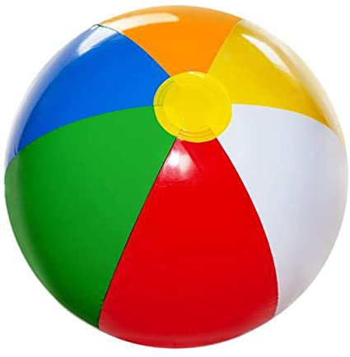
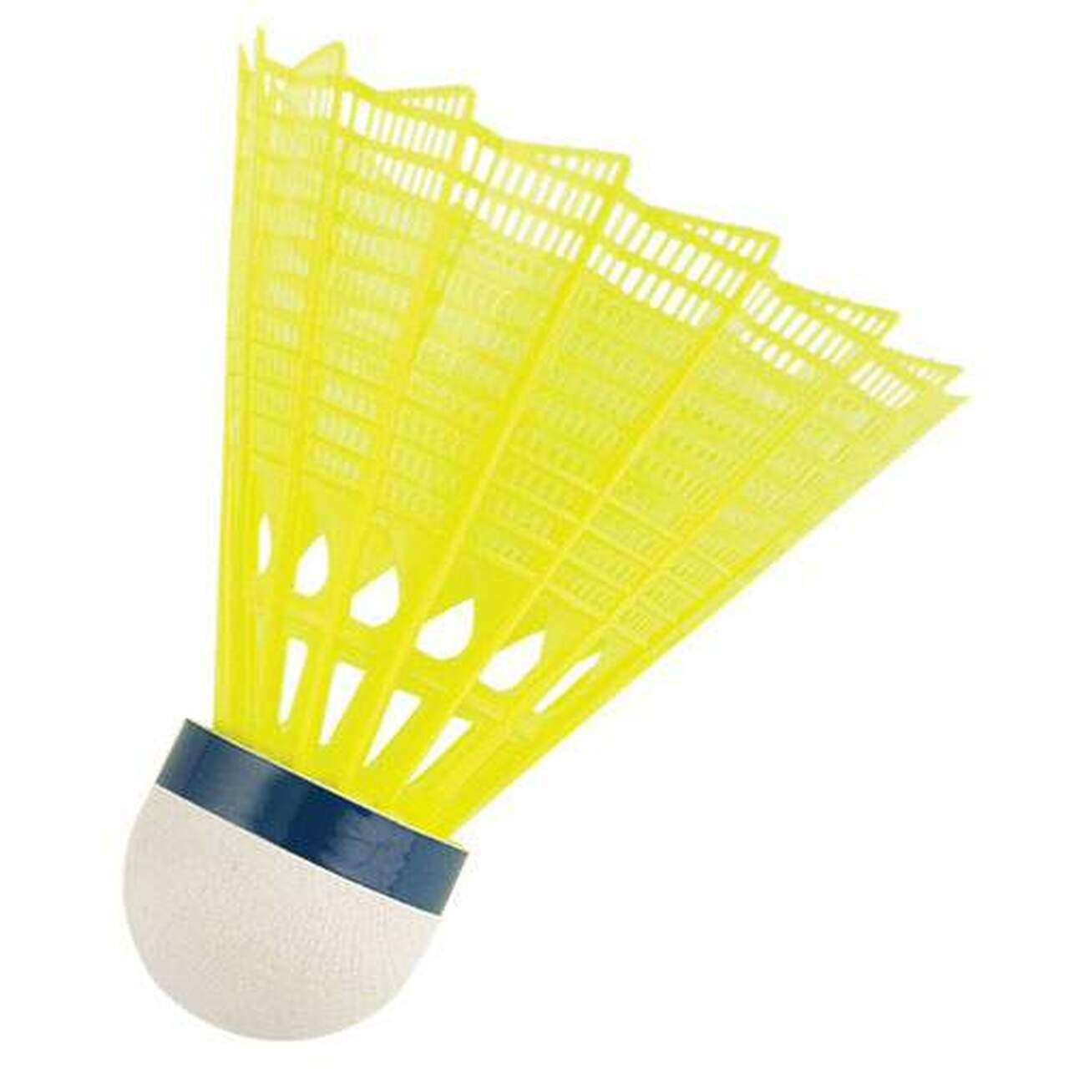
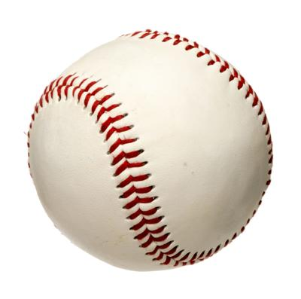
What can we say about these three?
K.MD.A2

Slide 15
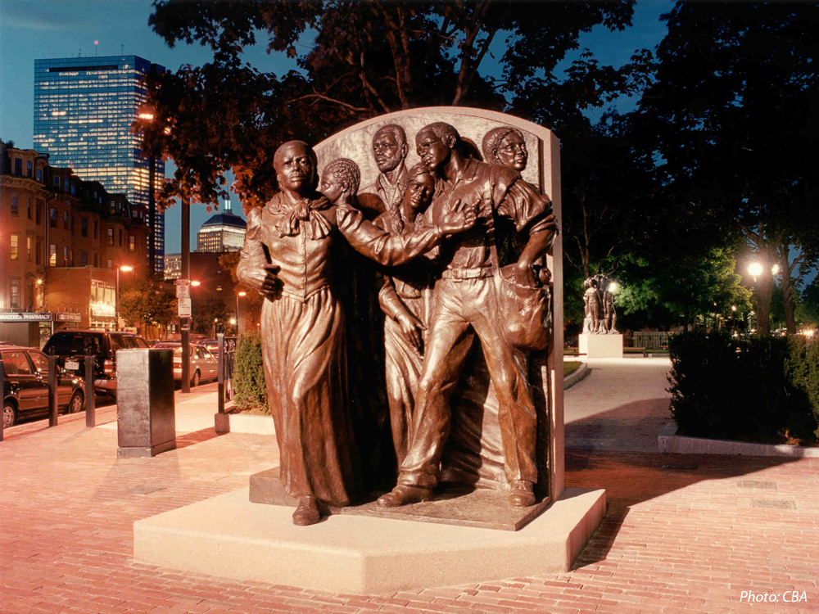
Harriet Tubman is leading 5 people North to freedom in this monument.
How many different ways can we make 6?
How many different number sentences can we create to show what we know?
Harriet Tubman Park, South Boston
K.OA.A3
Notes:
Juneteenth

Slide 16
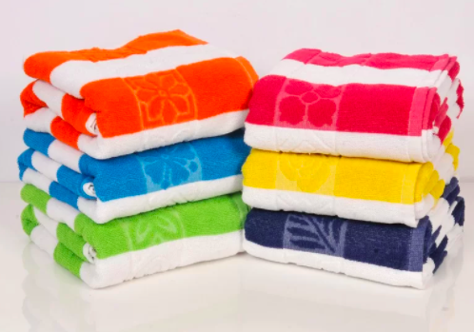
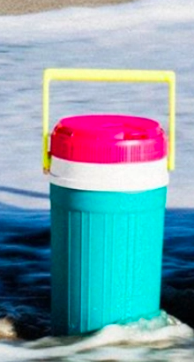
Would you rather….
Carry the giant beach towels or the jug of lemonade?
K.SMP.3
Notes:
Week of June 21, 2022

