Slide 1
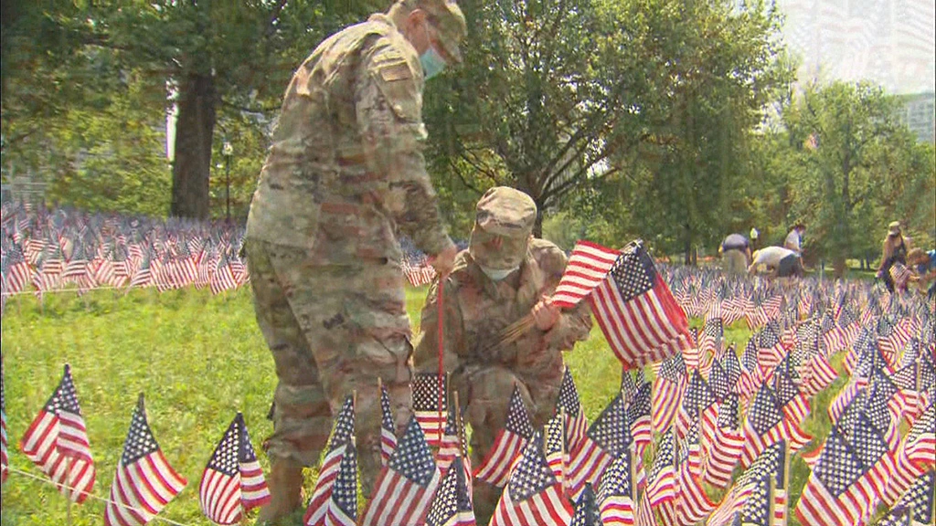
Volunteers placed 37,342 American Flags on the Boston Common to commemorate Memorial Day.
Create an equation using at least TWO operations to equal 37,342.
5.NBT.B7
Notes:
Week of May 31, 2022

Slide 2
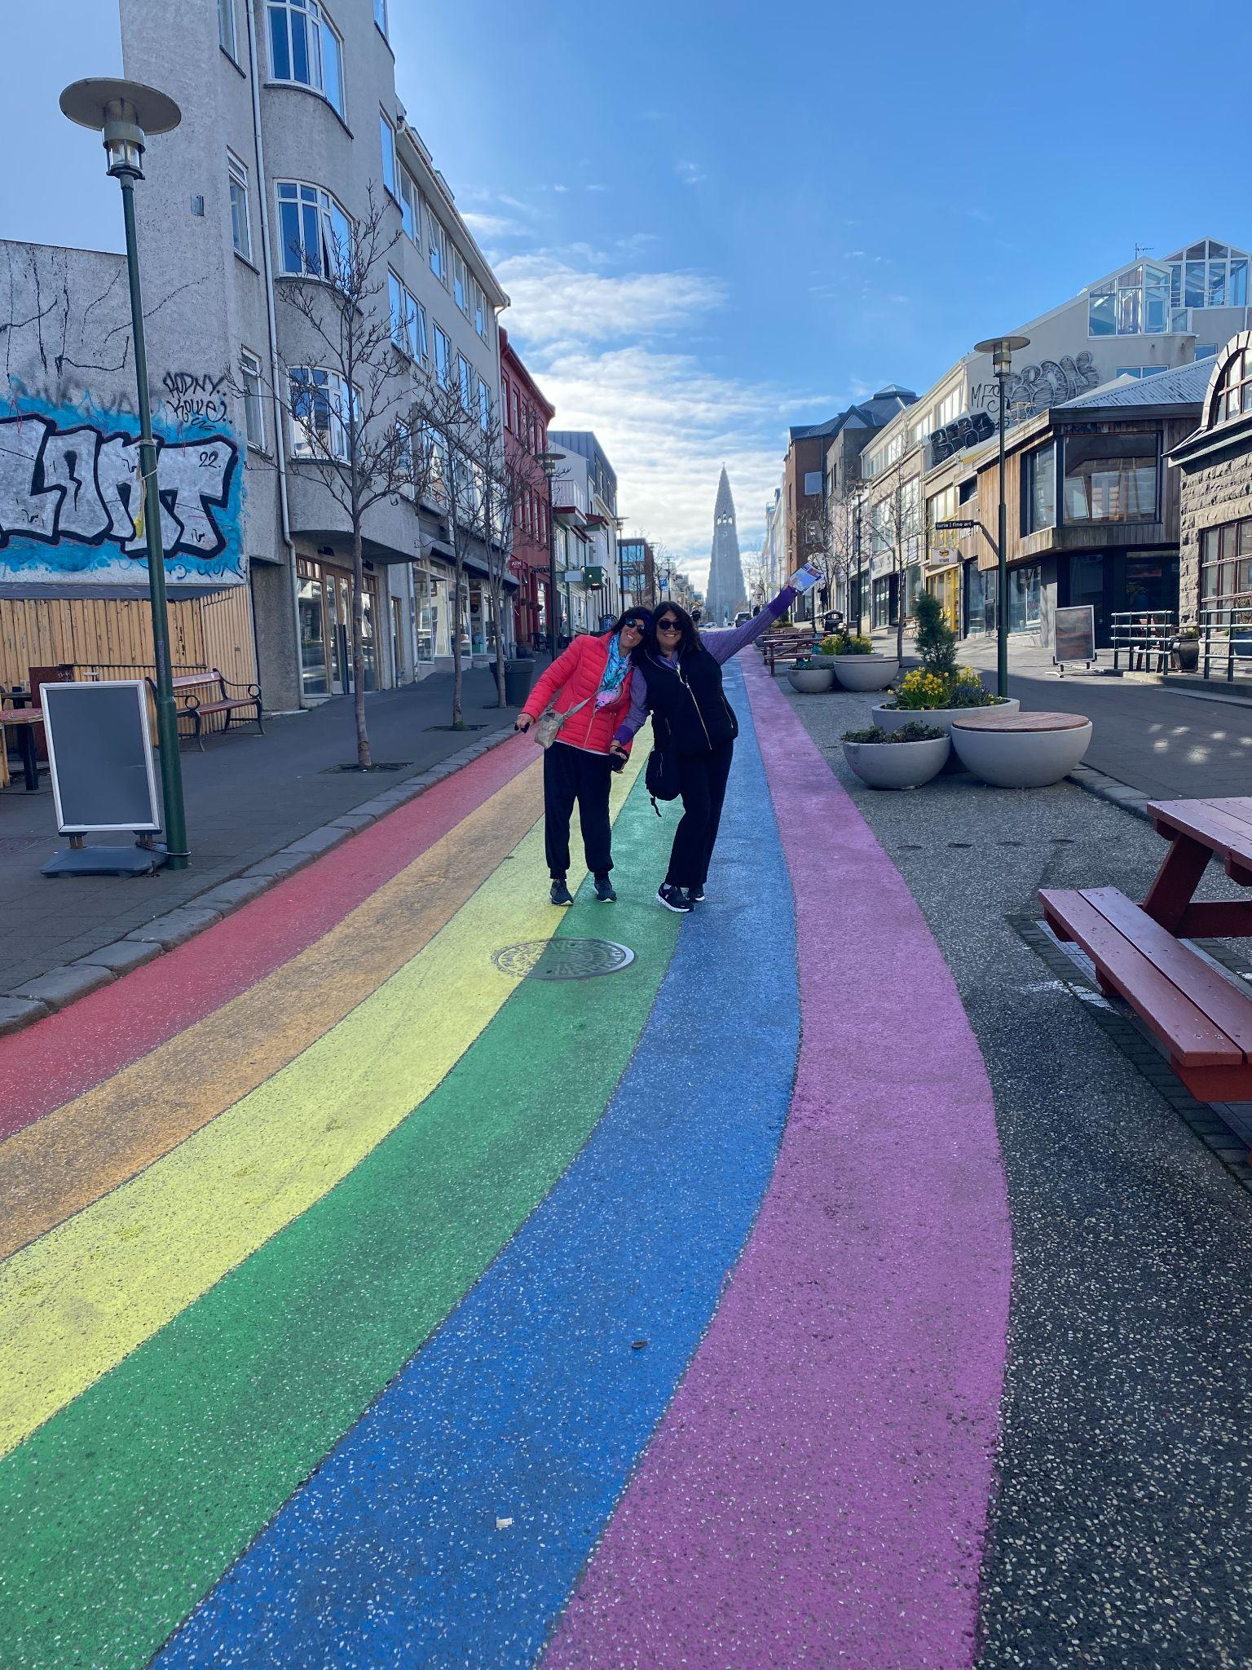
Reykjavik Rainbow Street, Skólavörðustígur
The mayor of Reykjavik, residents and guests painted this road to celebrate Pride Month in 2019 (it was originally painted in 1999!)
The street is 105 meters long and 6 meters wide.
One liter of paint covers an area of 6.5 square meters.
How much paint did they use OF EACH COLOR?
5.NBT.B7
Notes:
June is Pride Month

Slide 3
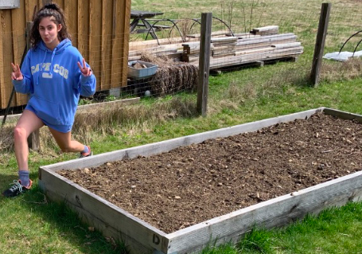
Celia just filled her garden with soil!
How many cubic feet of soil did she use?
The garden is
6 ft x 12 ft
AND…
6 inches high
5.MD.C5

Slide 4
Which one doesn’t belong?
2.54 meters | 254 centimeters
254 inches | 2 m + 54 cm
5.MD.A1

Slide 5
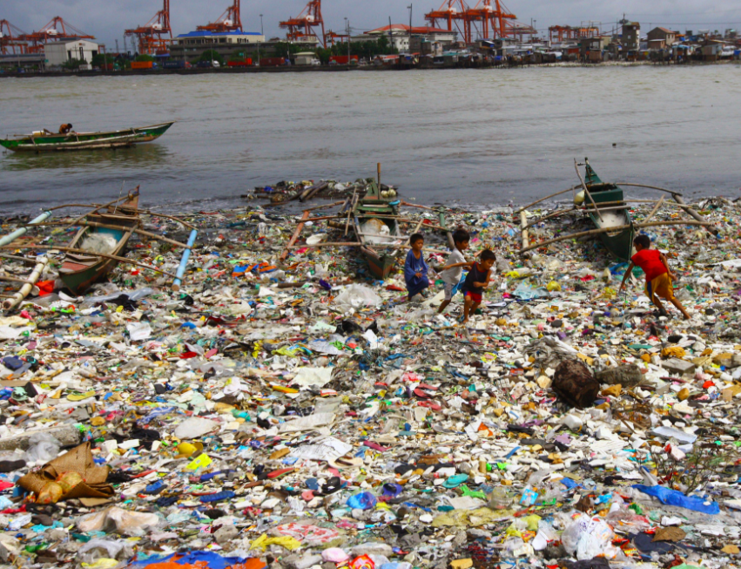
In ONE day, volunteers picked up 54,260 pieces of plastic on a beach in Manila Bay, Philippines.
If they did this EVERY day for a month (an average month has 30 days), how many pieces of trash will they pick up? About how much in a year (365 days).
Do you think it will help clean the beaches in Manila Bay?
5.NBT.B5

Slide 6
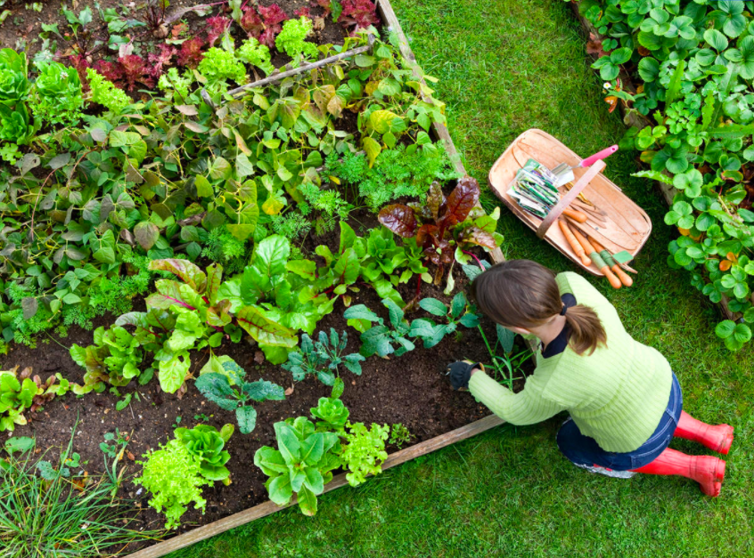
Mrs. M. and her daughter Celia are creating vegetable gardens.
Mrs. M.’s garden is
20 ft. by 45 ft.
Celia’s garden is
25 ft. by 40 ft.
Celia says “my garden has a bigger area so I can grow more lettuce.”
Is she right?
5.NBT.B5
Notes:
Week of June 6, 2022

Slide 7
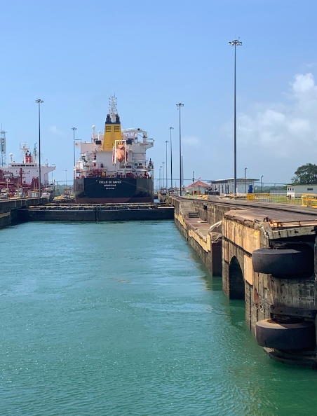
The Panama Canal is about 65 kilometers long.
In this picture we are going through the Pedro Miguel Locks, 9 km and almost 2 hours from where we started in Balboa!
How much farther do we have to travel?
Estimate how long it will take to travel through the Panama Canal?
Pedro Miguel Locks, Miraflores, Panama
5.NBT.B

Slide 8
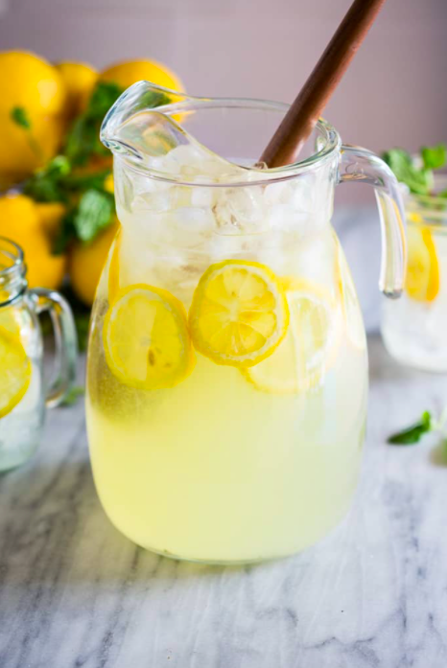
Here is a half-gallon of lemonade, yum!
How many cups are in a half-gallon?
8
We are going to serve this lemonade in one-half cup Mason Jars.
How many serving will we get?
What if the jars only hold one-third cup of lemonade (think about the ice!)?
5.NF.B7

Slide 9
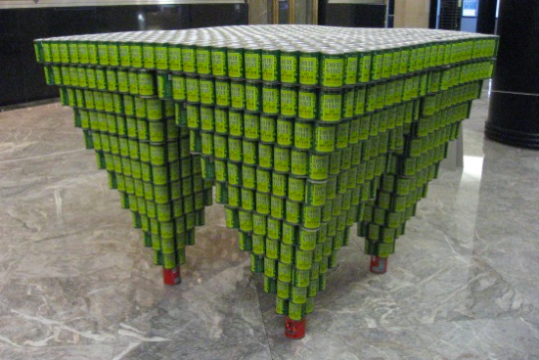
This sculpture is made entirely of canned green beans (and 4 cans of tomatoes!)
What mathematical patterns do you see here?
How can you figure out how many cans are in the sculpture?
OK, so figure it out!!!
YummyMath
5.NBT.B5

Slide 10
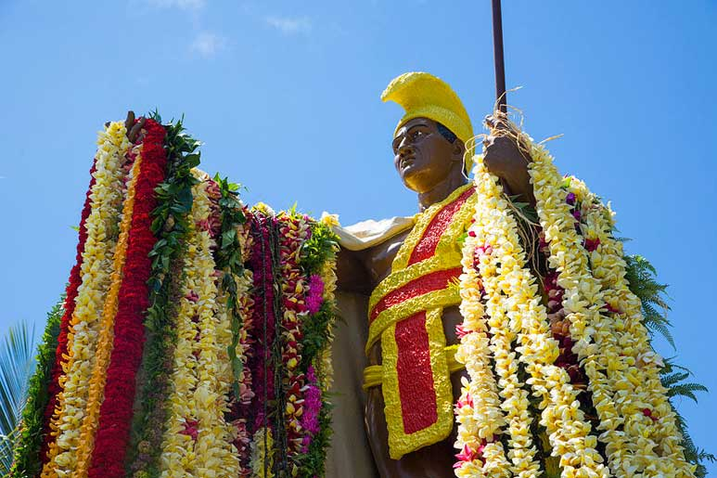
It’s King Kamehameha Day in Hawaii!
Kamehameha was trained as a warrior and his legendary strength was proven when he overturned the Naha Stone, which reportedly weighs between 2.5 and 3.5 tons. Legend had it that whoever had the strength to move the Naha Stone would rule the Hawaiian Islands.
ABOUT How heavy is 2.5 - 3.5 tons?
How many pounds is that?
5.MD.A1
Notes:
June 10, 2022
King Kamehameha Day in Hawaii

Slide 11
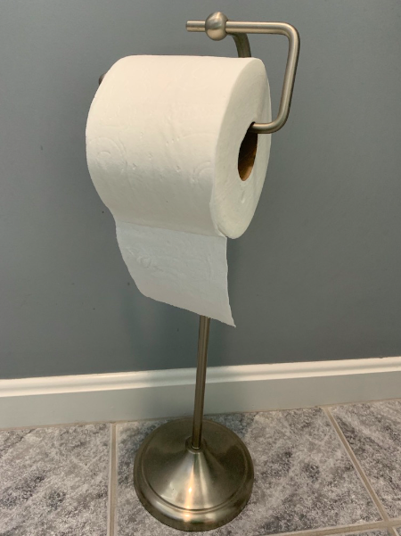
How long is the roll of toilet paper?
What is an estimate that is too long?
What is too short?
What is your “just right”estimate?
There are 396 sheets per roll.
Each sheet is 10.5 centimeters.
396 sheets x 10.5 centimeters = 4,158 centimeters
4,158 centimeters = 41.58 meters (about 41 and a half meters)
How long is that? How tall is that?
It is 39 meters from 1st to 3rd base on a baseball field
The Statue of Liberty is 45 meters
A 12-story building is around 40 meters
5.NBT.B7
Notes:
Week of June 13, 2022

Slide 12
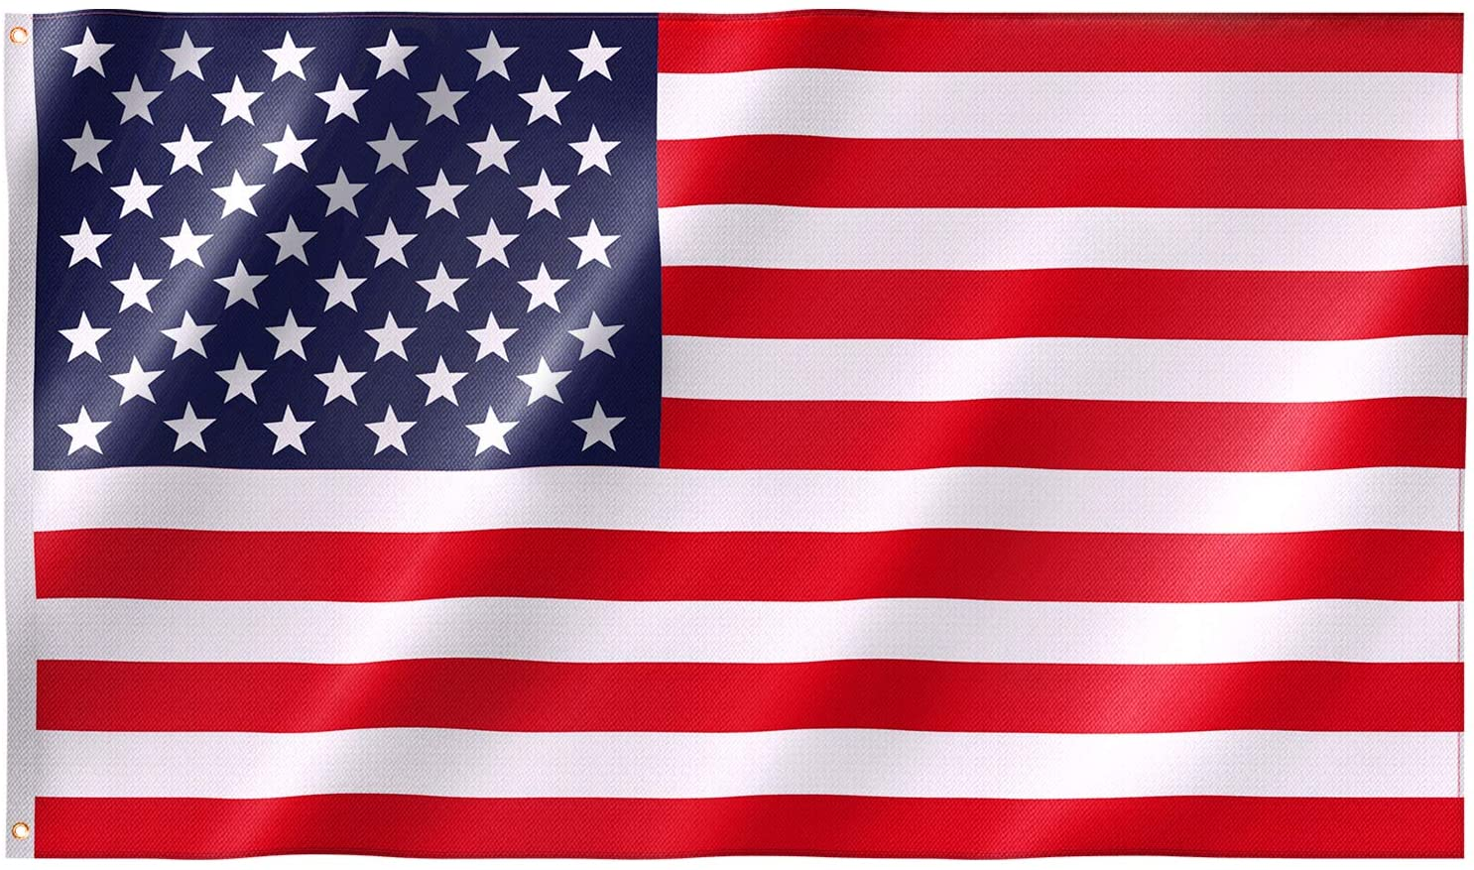
Happy Flag Day!
What GEOMETRY do you see in our flag?
Estimate the size of the INTERIOR angles in the stars?
What about the REFLEX angle “around” the point of the star?
5.MD.C
Notes:
Week of June 14, 2021

Slide 13
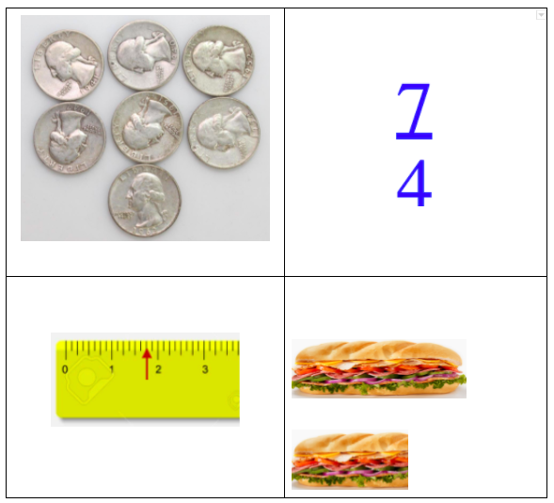
Which one does not belong?
5.NF.A2

Slide 14
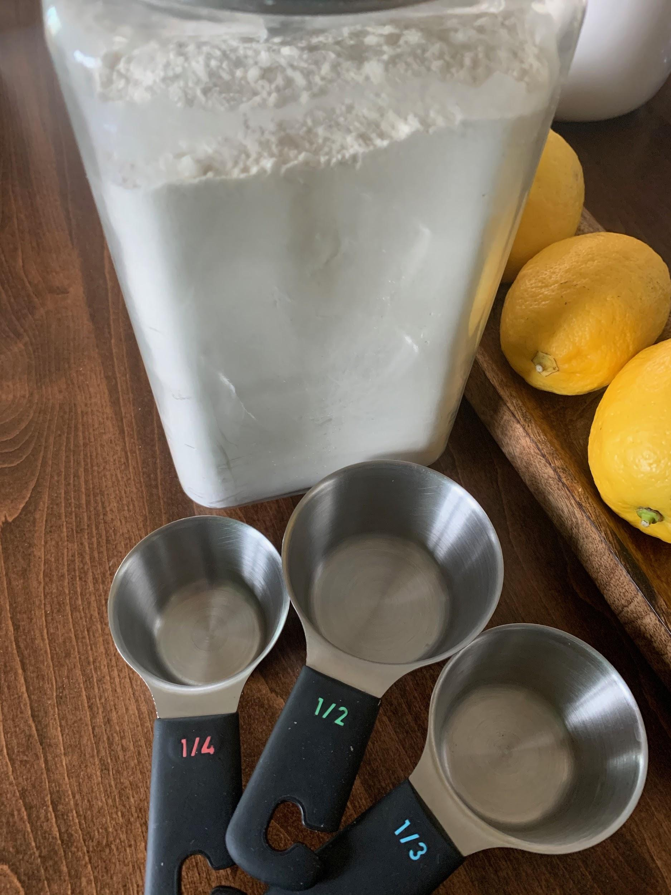
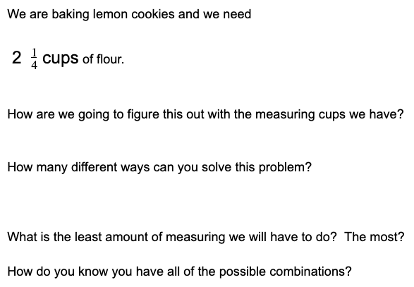
Help us bake cookies!
5.NF.B6

Slide 15
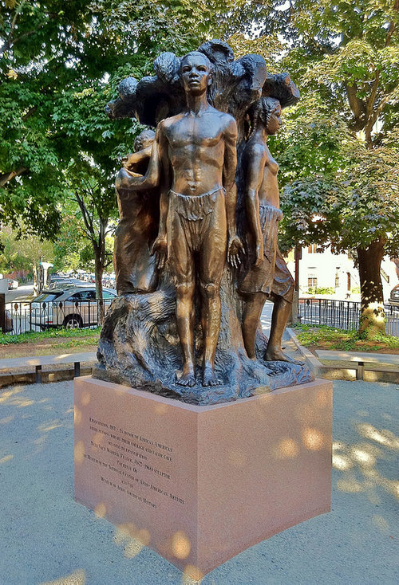
June 19th is celebrated and commemorated in the United States as the anniversary of when enslaved persons in parts of Texas first learned of their liberation in 1865. Juneteenth, as this annual event is named, is observed in Boston and all over our nation in a festive and poignant way with food, art, music, dance and remembrance of the history of slavery and freedom.
The EMANCIPATION monument in Harriet Tubman Park stands nearly 10 feet tall.
How many times taller is it than you? (Think fractions!)
Emancipation by Meta Vaux Warrick Fuller
5.NF.B6

Slide 16
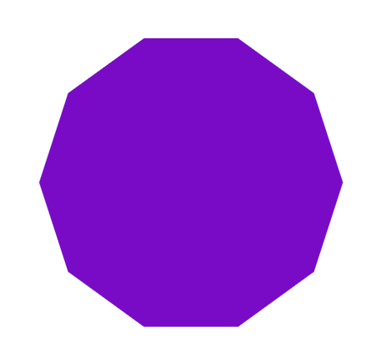
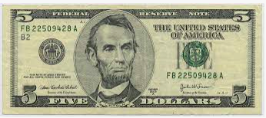

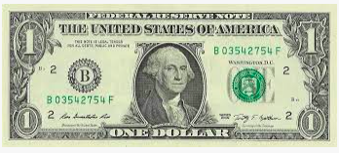
Which one doesn’t belong?
200 x 0.05
 | 100 ➗ 0.10
5.NBT.B7

