Slide 1
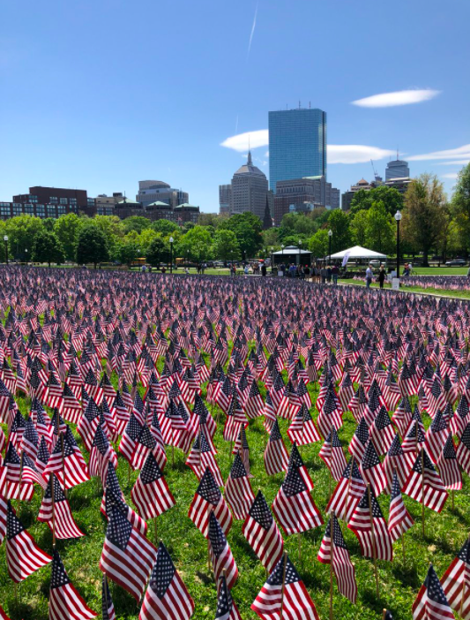
Volunteers placed 37,342 American Flags on the Boston Common to celebrate Military Heroes for Memorial Day.
37,342
How many thousands is that?
What can you say about each of the digits?
2.NBT.A1
Notes:
Week of May 31, 2022

Slide 2
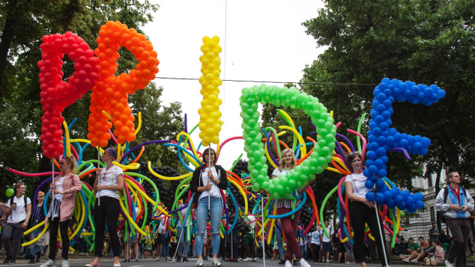
Wow! Look at all of the balloons at this
Pride Parade in Vienna, Austria!
There are over 100 balloons in the “I” letter in PRIDE!
So what is possible?
How many might there be altogether?
Create some fun equations to show your mathematical thinking!
2.NBT.B7
Notes:
June is Pride Month!

Slide 3

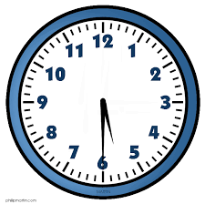
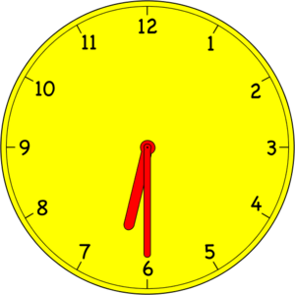
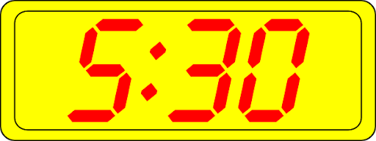
Which one doesn’t belong?
2.MD.C7

Slide 4
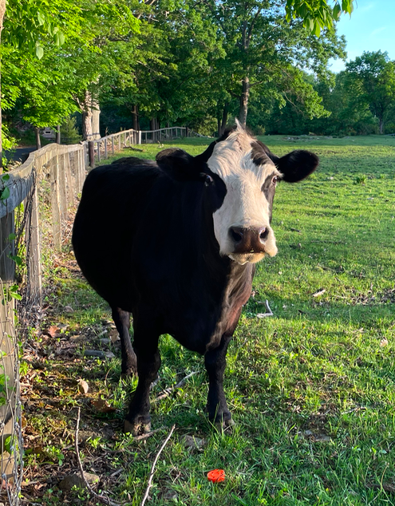
An average cow weighs about 1,200 pounds. That’s big number!
Can you write a number sentence that equals 1,200?
2.OA.A1

Slide 5
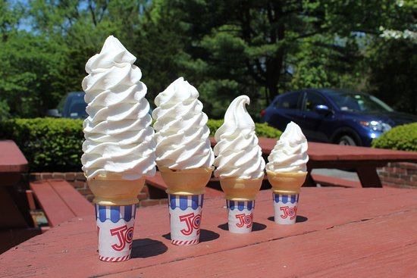
Ice cream at Dairy Joy!
The smallest cone is $2.50 and the largest one is TWICE as much.
What might the middle two sizes cost?
2.MD.C8

Slide 6

9 dimes and 11 pennies > 1 dollar
10 dollars and 7 quarters = 12 dollars
1 dollar + 23 dimes + 13 pennies < 3 dollars
2.MD.C8
Notes:
Week of June 6, 2022

Slide 7
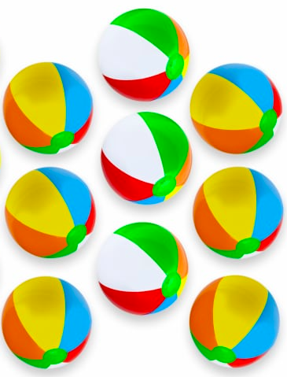
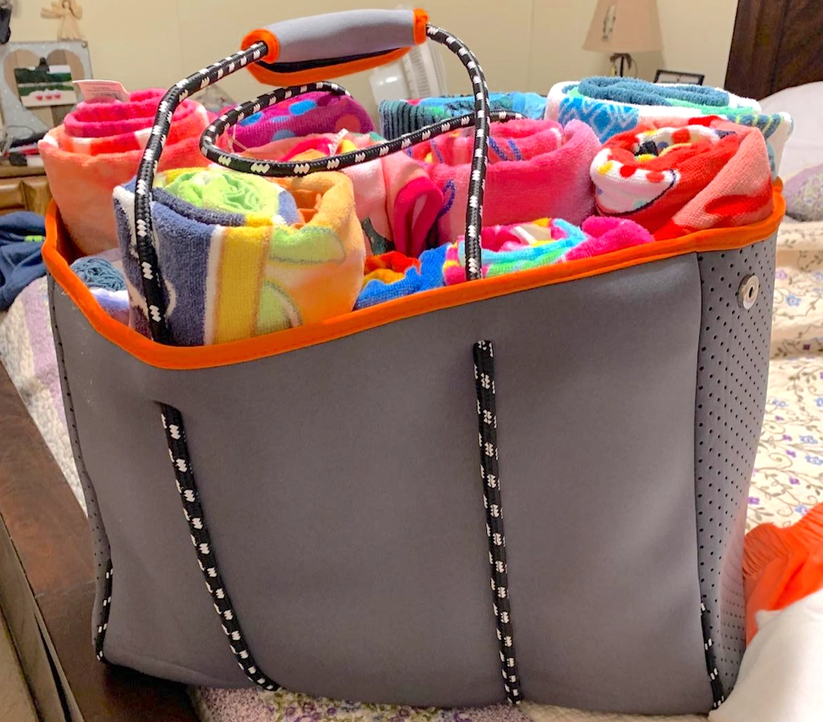
Would you rather . . .
Carry 9 beach towels or 9 beach balls?
2.SMP.3

Slide 8
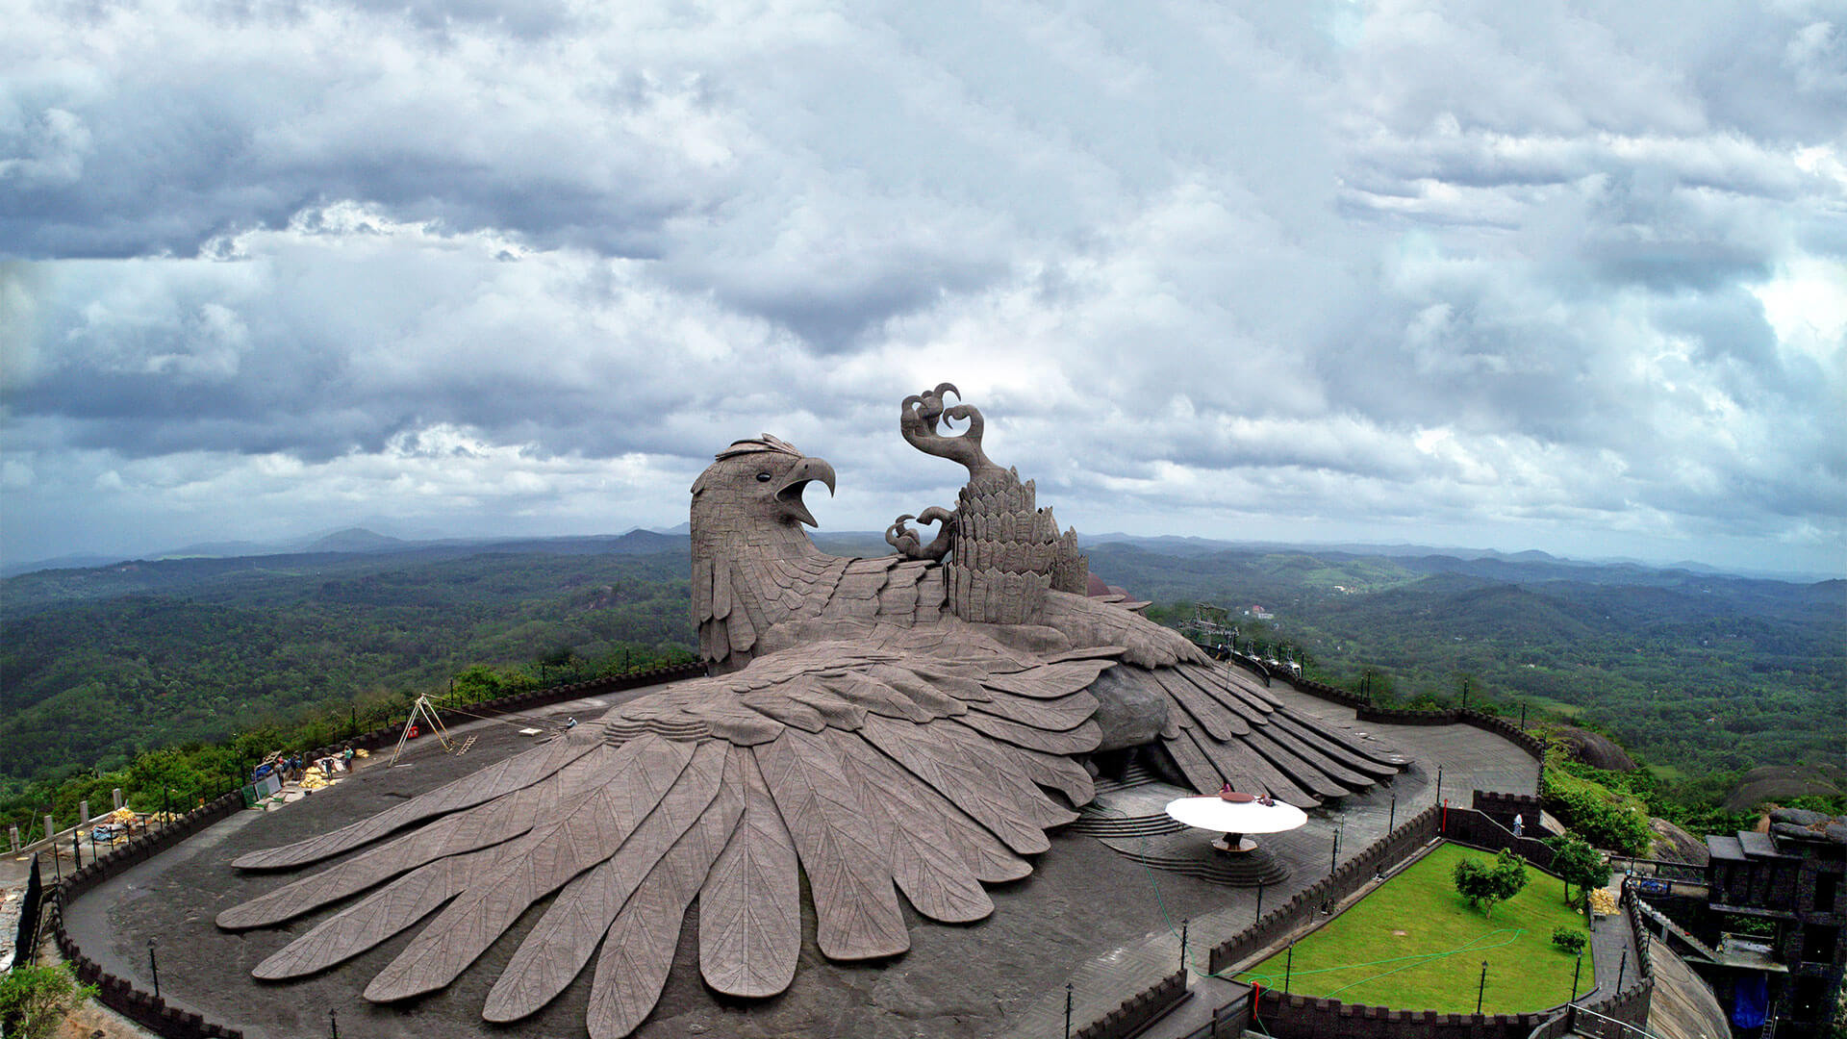
The World’s Largest Bird Sculpture Sits Atop a Rolling Hillside in Kollam, India in the Jetayu Nature Park.
This giant bird is 200 feet long, 150 feet wide, and 70 feet high!
How long is 200 feet?
2.MD.B5

Slide 9
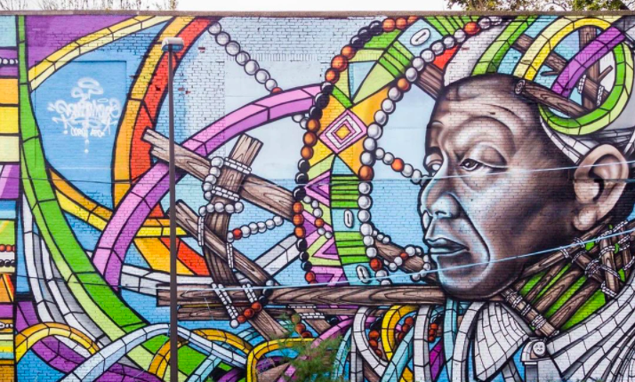
There are some very interesting shapes in this mural!
Pick two and find ONE way they are the same, and ONE way they are different.
2.G.A1

Slide 10
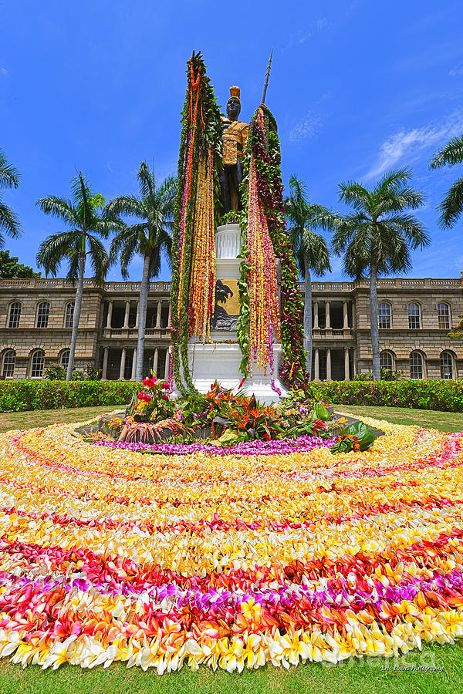
It’s King Kamehameha Day
In Hawaii!
This statue to the great warrior, diplomat, and leader stands in front of Aliiolani Hale, the Hawaii State Supreme Court.
It was dedicated in 1883.
How long ago was that?
How can we figure it out?
2.NBT.B7
Notes:
June 10, 2022
King Kamehameha Day in Hawaii

Slide 11
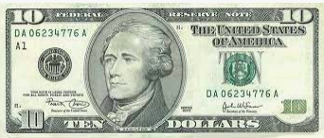
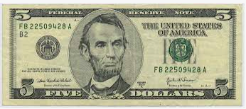
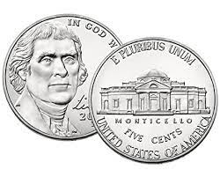

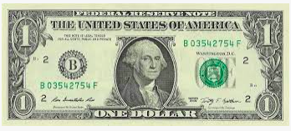
Which one doesn’t belong?
2.MD.C8
Notes:
Week of June 13, 2022

Slide 12
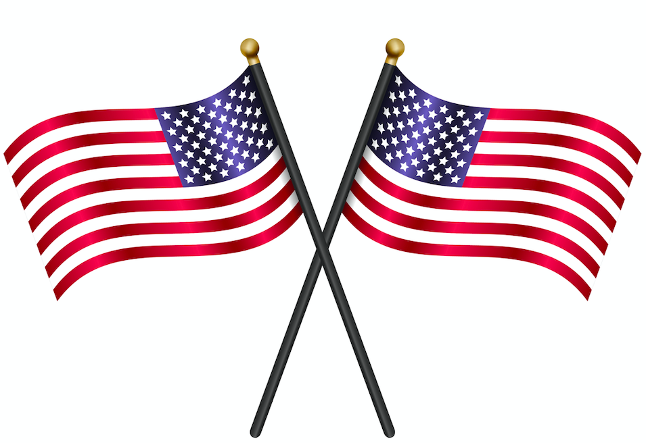
Happy Flag Day!
How many stars?
How many stripes?
How many on two flags? Three flags? Four?
Create an equation to match your thinking!
2.OA.C3
Notes:
June 14, 2022
Flag Day

Slide 13
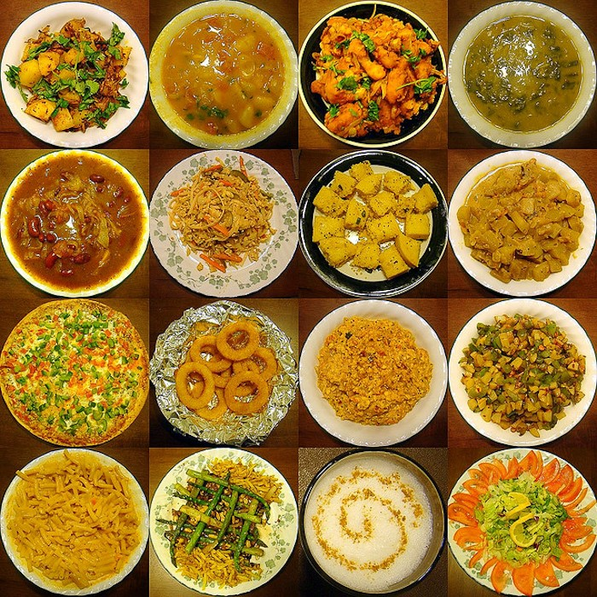
What can we say about this display of Indian Foods?
Where’s the math?
How many different number sentences can we create to match this photo?
2.OA.B2
Notes:
Week of June 14, 2021

Slide 14
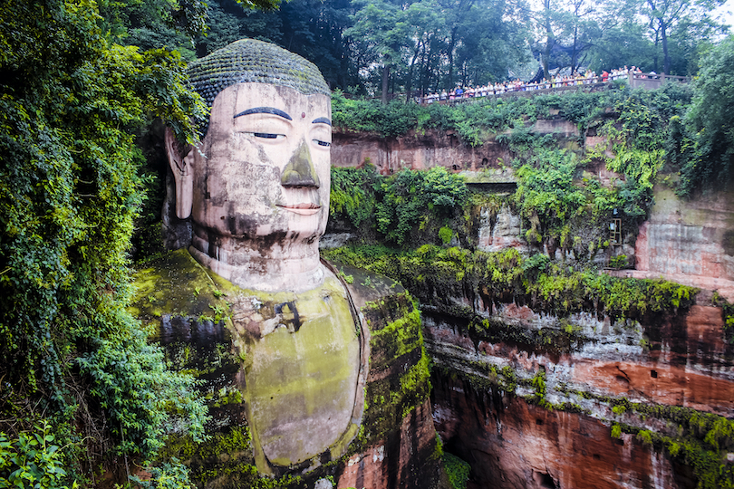
The Leshan Giant Buddha was built during the Tang Dynasty, some time between 690 and 705.
How old is this Giant Buddha?
How do you know?
Do you wonder how big it is? (Look at the people on the observation deck!)
2.NBT.B9
Leshan, China, Baoyan Zeng

Slide 15
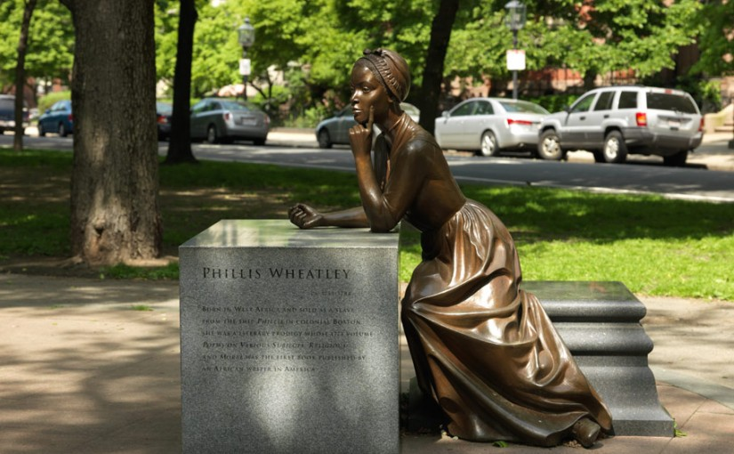
Phillis Wheatley was a very famous poet, she was also a slave in a wealthy home in Boston in the 1700s.
This statue of Phillis Wheatley by Meredith Gang Bergmann was created in 2003.
How long ago was that?
How can you use mental math to figure it out?
Phillis Wheatley Statue on Commonwealth Avenue, Boston
2.NBT.B7
Notes:
Juneteenth 2022

Slide 16
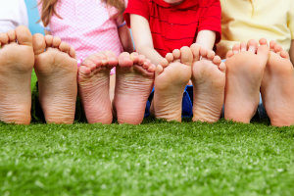
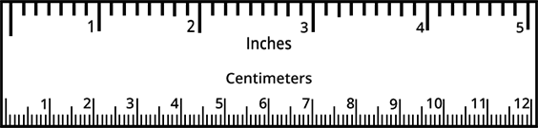
Would you rather
Measure your foot in INCHES or CENTIMETERS?
2.MD.A3
Notes:
Week of June 21, 2022

