Slide 1
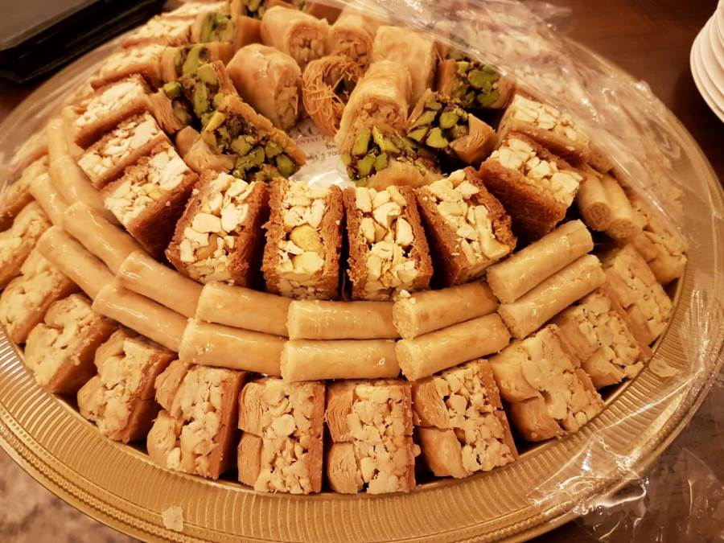
Today is the celebration of
Eid Al-Fitr
Look at all of these yummy sweets!
Describe some of the shapes you see?
How many sweets do we see?
How many don’t we see?
How can we count them?
K.CC.A1
Notes:
Week of May 2, 2022
Eid al-fitr

Slide 2
Which one does not belong?
K.G.B4

Slide 3
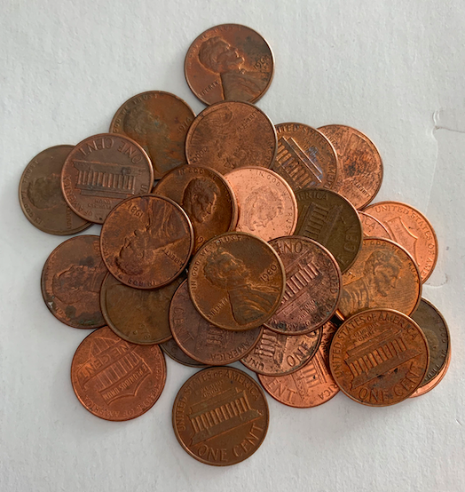
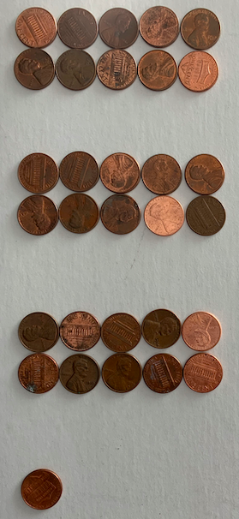
Here is a pile of pennies.
Let’s estimate!
How many coins?
How many is too many?
How many is too few?
K.NBT.A1

Slide 4
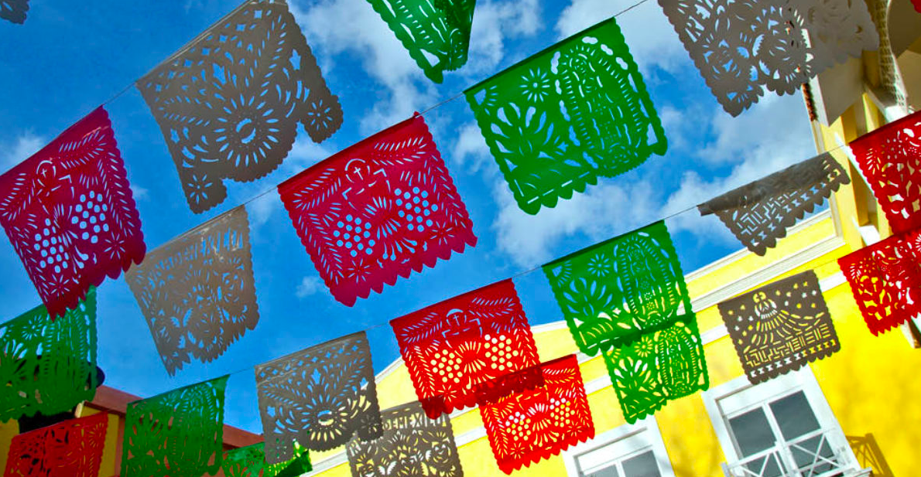
How many Los Papeles Picados do we see? How can we group them to count?
K.MD.B3
Notes:
May 5, 2022
Cinco de Mayo

Slide 5
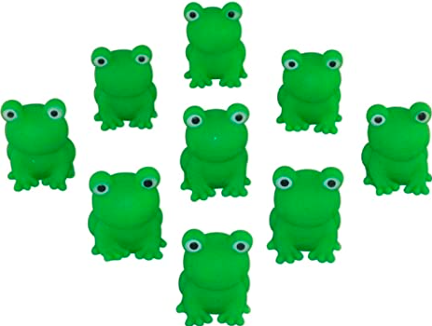
How many froggies?
How do you see them?
Write a number sentence to match your thinking.
K.OA.A1

Slide 6
Which one doesn’t belong?
5 = 1 + 4 | 5 = 8 - 3
1 + 2 + 2 = 5 | 6 = 4 + 2
K.OA.A2
Notes:
Week of May 9, 2022

Slide 7
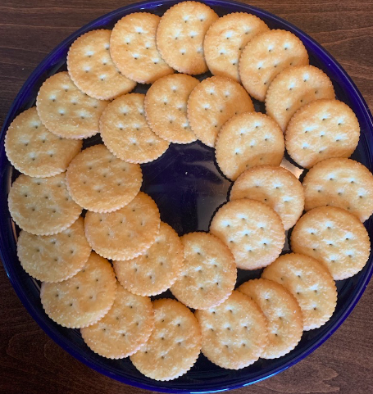
How Many Crackers?
How many in each circle?
What number sentence matches your thinking?
K.CC.B5

Slide 8
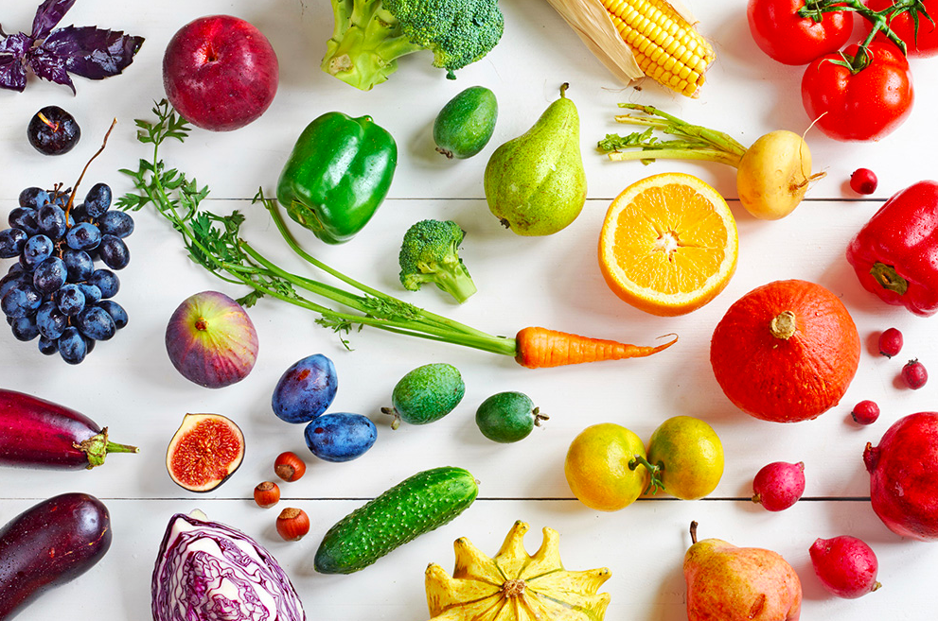
How would you sort and count these fruits and vegetables?
K.MD.B3

Slide 9
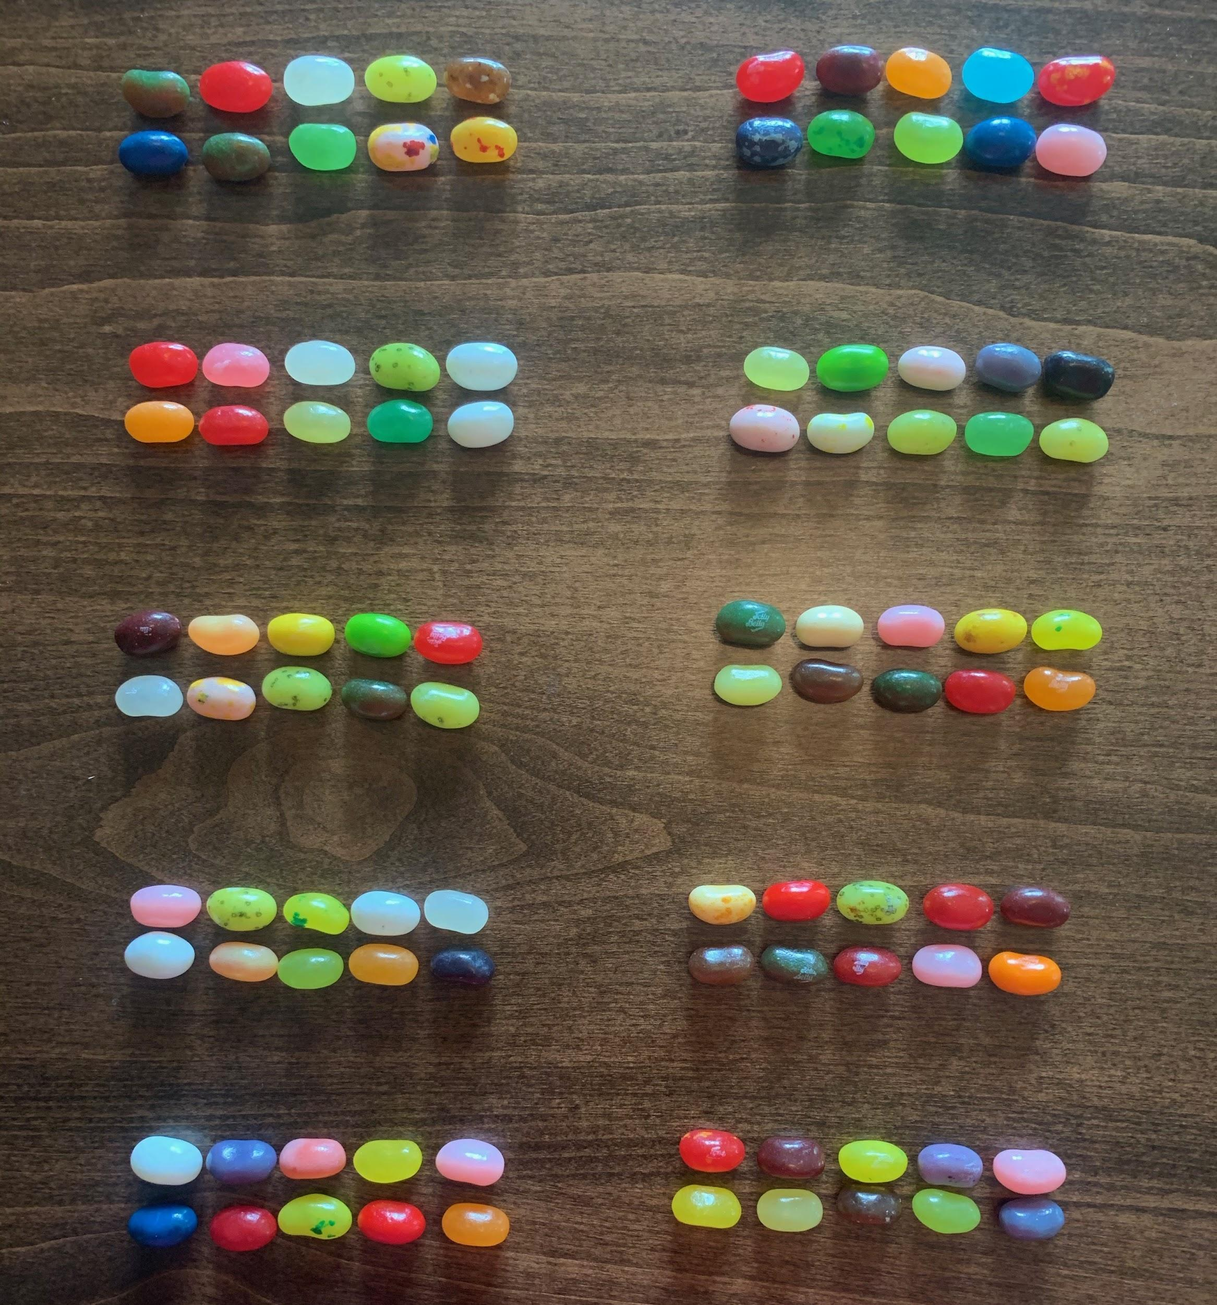
How many Jelly Bellies?
How can you count them?
What if we took 1 away?
K.CC.A1

Slide 10
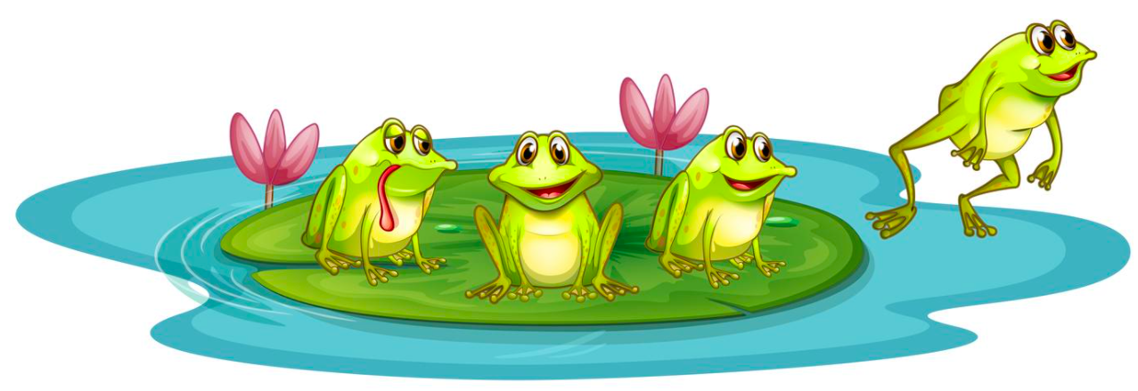
How many froggies? How many froggy eyes?
How many legs?
Can you create a number sentence to match?
K.OA.A2

Slide 11
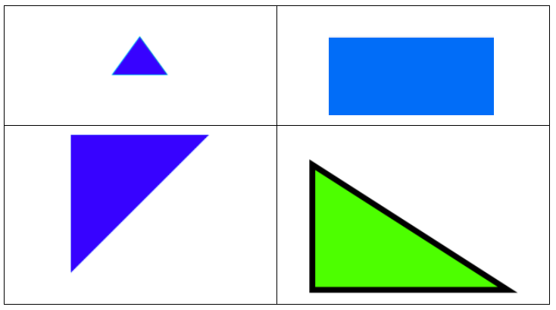
Which one doesn’t belong?
K.G.B4
Notes:
Week of May 16, 2022

Slide 12
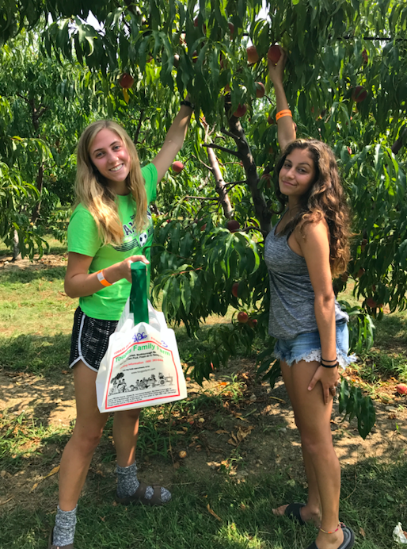
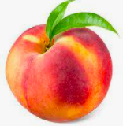
Delaney and Celia went peach picking!
Delaney
Celia
Who picked more peaches?
How many more?
K.CC.A6

Slide 13
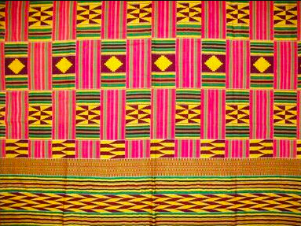
Describe some of the shapes you see in this African kente cloth.
Can we draw them?
K.G.A2

Slide 14
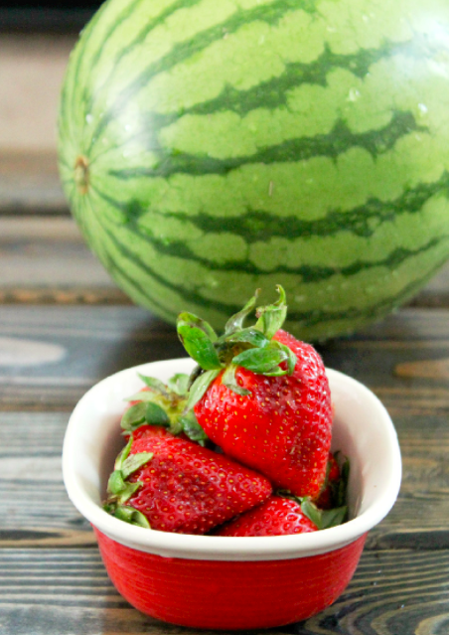
How can we compare these two fruits?
What can we measure?
K.MD.A1

Slide 15
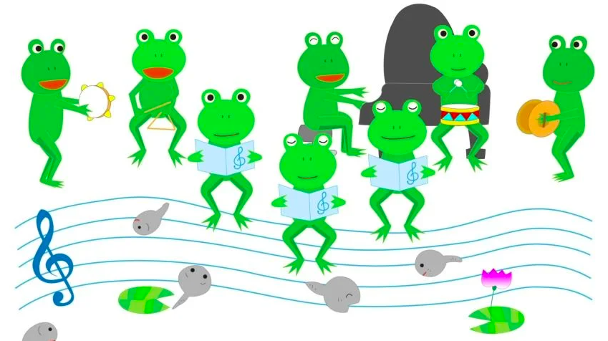
How many different number sentences can you create to match this picture?
K.OA.A1

Slide 16
Which one doesn’t belong?
7 = 3 + 3 + 1 | 7 =
5 + 2 = 7 | 7 = 8 - 1
K.OA.A3
Notes:
Week of May 23, 2022

Slide 17
What different shapes can we make with triangles?
K.G.B6

Slide 18
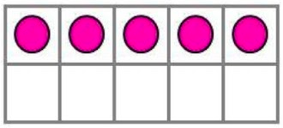
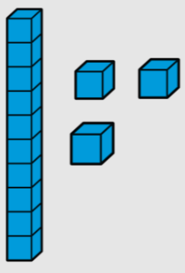
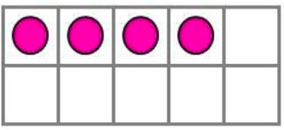
What is the same? What is different?
K.CC.C6

Slide 19
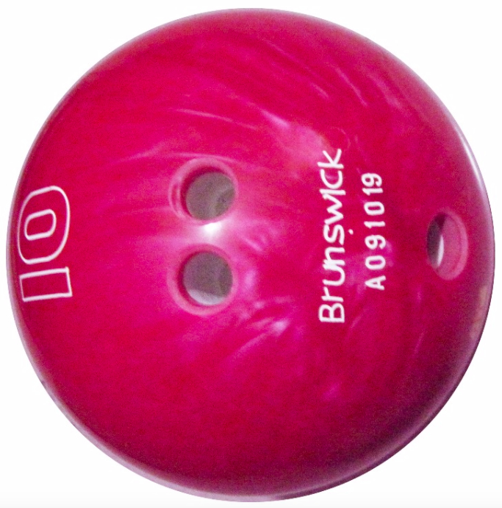

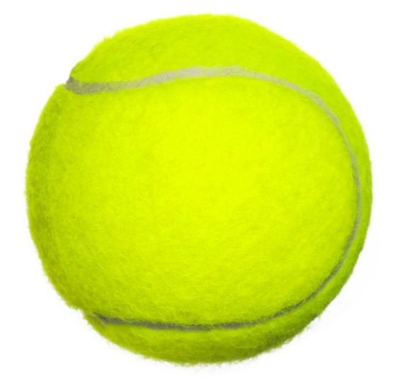
How can we compare
the balls?
K.MD.A2

Slide 20
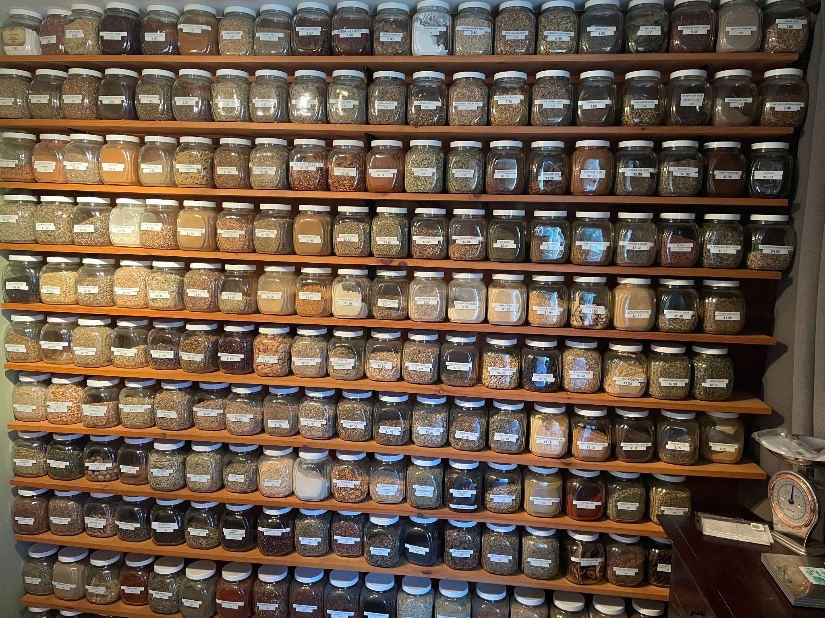
How can we use skip counting by 10s to estimate?
K.CC.A1

