Slide 1
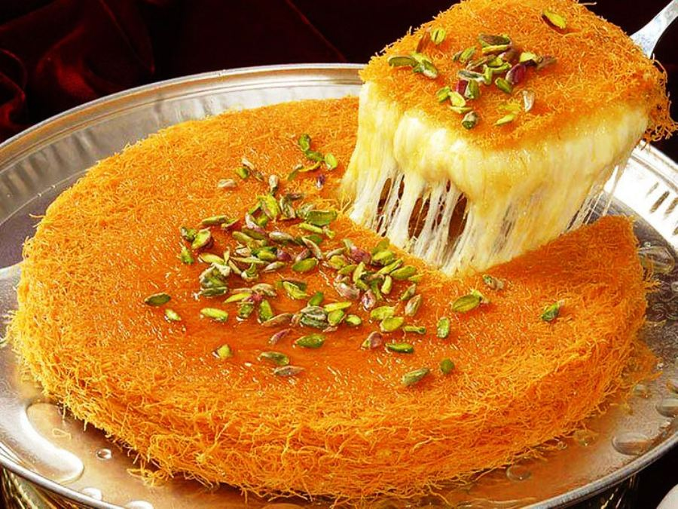
Eid Al-Fitr Celebration
Estimate what fraction of this yummy Knefeh is cut out.
Justify your estimation with math!
5.NF.A
Notes:
Week of May 2, 2022
Eid Al-Fitr

Slide 2
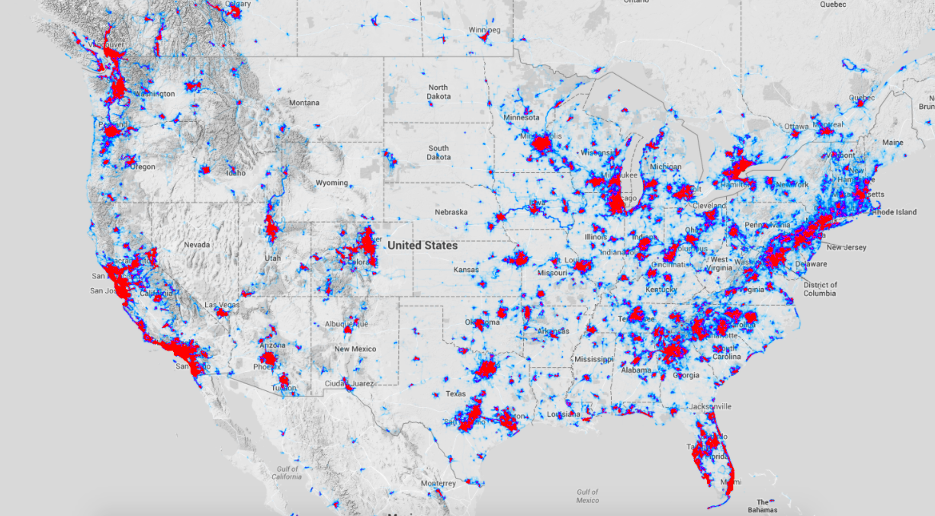

Millions of Americans Run and Bike
What do you notice, what do you wonder, why does it matter?
Notes:
What do you notice?
What do you wonder?
Why does it matter?

Slide 3
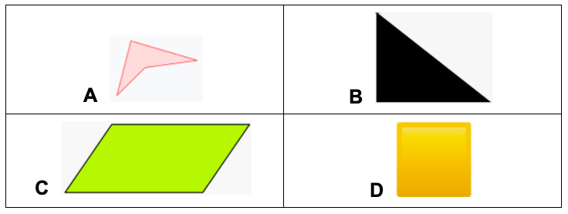
Which one doesn’t belong?
5.G.B3,4

Slide 4
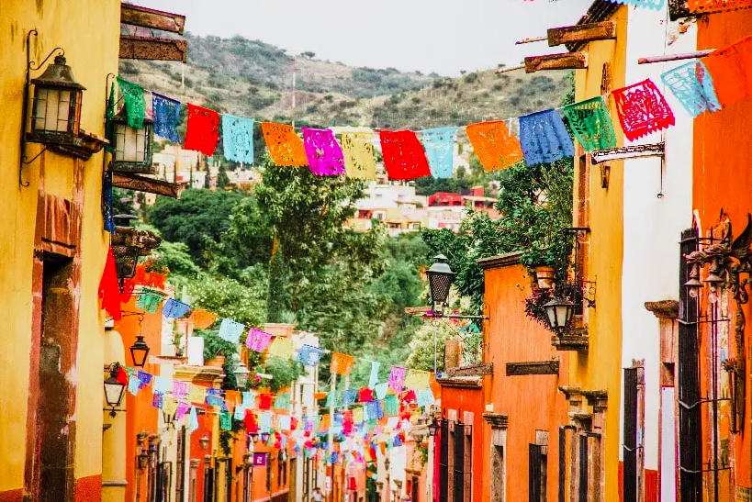
Happy Cinco de Mayo!
How many Los Papeles Picados do we see?
How can we estimate using math?
5.NBT

Slide 5
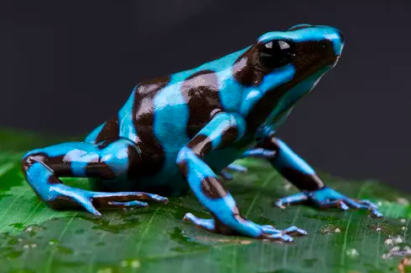
It’s Froggy Friday!
There are more than 6,000 species of FROGS in the world!
In the past 50 years, more than 500 amphibian species have experienced population declines worldwide, and 90 of them have gone extinct.
What fraction statements can you make about this?
5.NF.B3

Slide 6
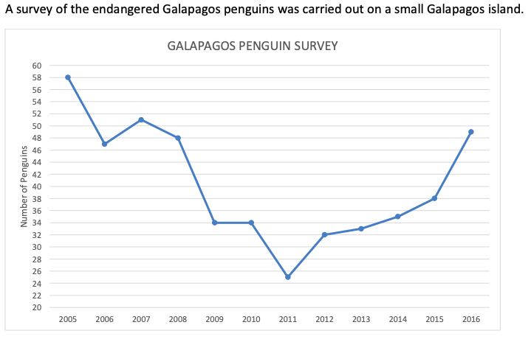
What’s going on in this graph?
What do you notice?
What do you wonder?
Why does it matter?
5.MD.B
Notes:
Week of May 9, 2022

Slide 7
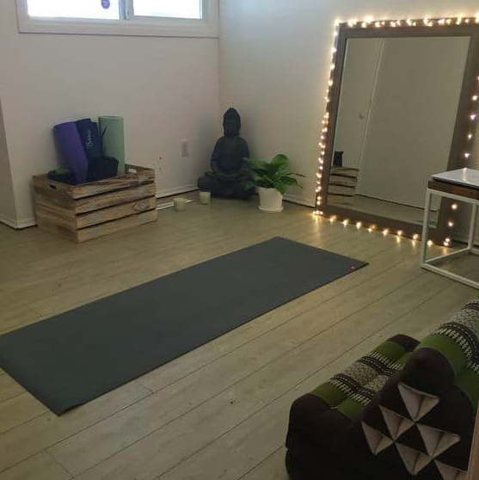
We are building a yoga studio in the basement!
We only have 120 square feet of wood flooring, so the AREA of the studio is going to be 120 square feet.
What are the possible dimensions?
(length and width)
5.MD.C

Slide 8
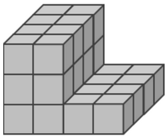
Check out this figure. Pretty interesting!
Jonny decided to break this into 2 rectangular prisms to find the volume.
What do you think he did?
Volume is the measure of all the blocks!
L x W x H
5.MD.C4

Slide 9

Add 8 and 7, then multiply by 2 = 8 + 7 x 2
6 x 30 > 5 x 3 x 2
7 x 4 - 3 = 7 x (4 - 3)
5.NF.B5

Slide 10
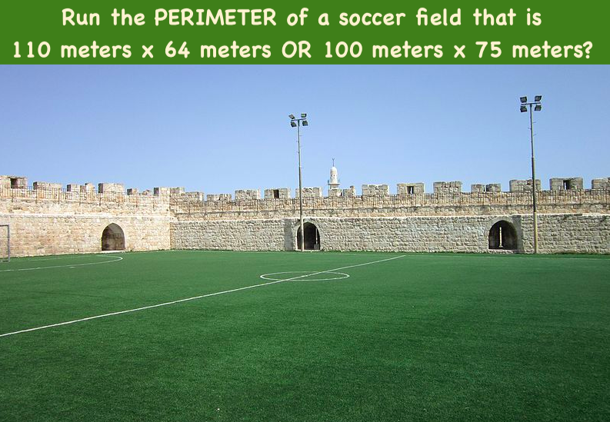
Would you rather ...
5.MD.C

Slide 11
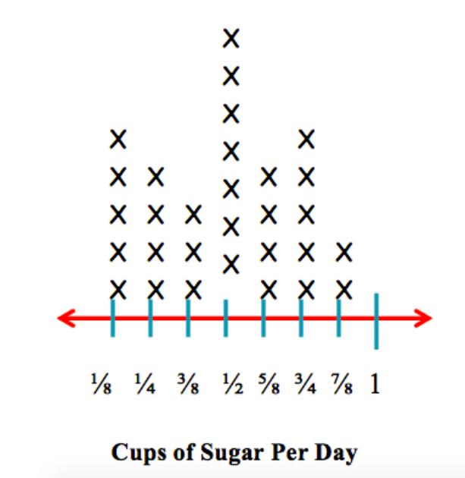
What’s going on in this graph?
What do you notice?
What do you wonder?
What could this be?
5.MD.B
Notes:
Week of May 16, 2022

Slide 12
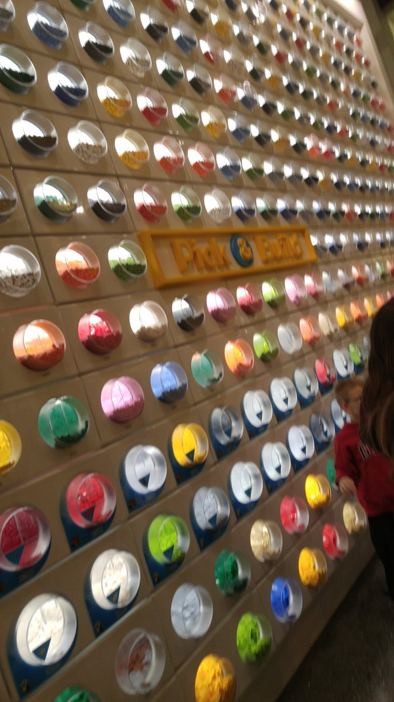
This is a picture of the Lego pick-a-brick wall at the Lego store in the Mall of America.
What do you notice?
What do you wonder?
How many Lego bins are there?
What is too low?
Too high?
What is your ESTIMATE?
5.NBT.B5

Slide 13
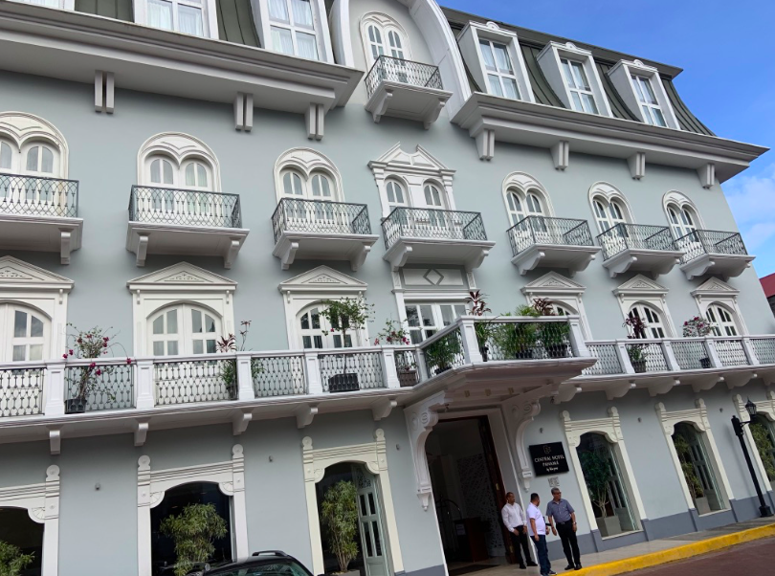
Where is the math in this picture?
How many different mathy statements and equations can you make?
Think about arrays and shapes, multiplication and symmetry!
5.G.B

Slide 14
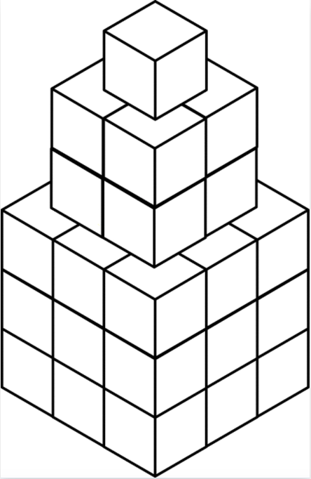
Crazy Figure!
What do you notice about this figure?
What is the VOLUME of this figure?
Write an equation to match what you are thinking?
Is there another way to solve it?
5.MD.C4

Slide 15
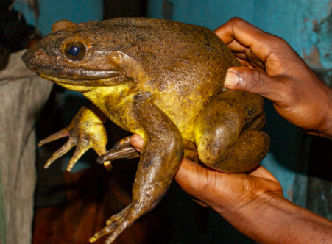
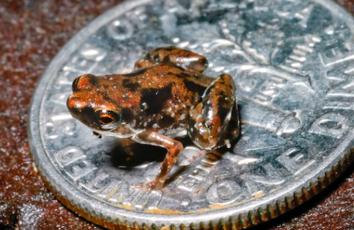
Heaviest frog in the world v. lightest frog in the world
The Goliath Frog from Cameroon can weigh up to 7.2 Pounds
This frog is from Papua New Guinea and weighs only .00455 of an ounce. What does that mean?
How can you compare them?
5.MD.A1

Slide 16
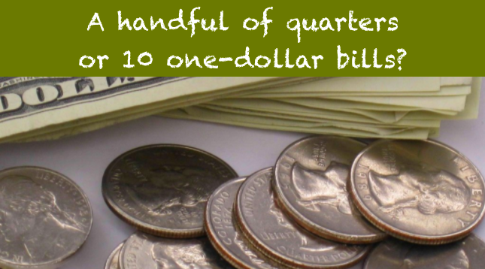
Would you rather . . .
5.NBT.A
Notes:
Week of May 23, 2022

Slide 17



47 < x 47
x 8 > 8 x
61 x > 61
Explain your reasoning!
5.NF.B5

Slide 18
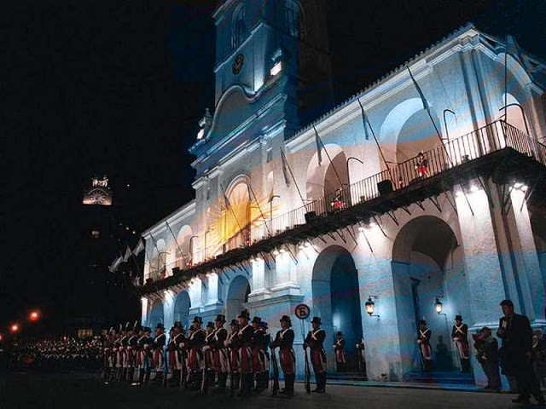
Dia de la Revolucion de Mayo!
It’s Revolution Day in Argentina!
The current population of Argentina is 45.96 million people! What does that mean?
About one-third of the population lives in the Buenos Aires Metropolis. What can we say about that?
5.NBT.A2
Notes:
May 25, 2022
Revolution Day, Argentina

Slide 19
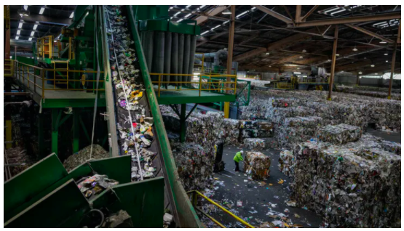
Recology’s largest San Francisco recycling plant handles
500 to 600 tons daily.
About how many tons does this recycling plant handle each year?
5.NBT.B5

Slide 20
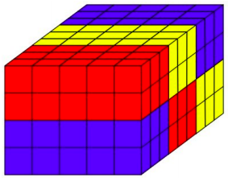
How many different equations can you write to illustrate the volume of this prism?
5.MD.C4
Notes:
Week of May 3, 2021

