Slide 1
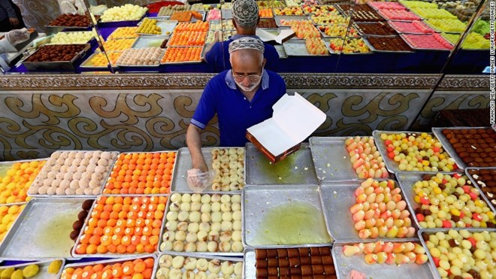
Today is the celebration of Eid Al-Fitr
Where do we see arrays in this bakery?
How can we use them to determine how many traditional sweets are here?
Create an equation to match your thinking.
4.NBT.B5
Notes:
Week of May 2, 2022
Eid Al-Fitr

Slide 2



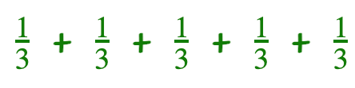
Which one does not belong?
 | + +
x 5
4.NF.B4

Slide 3

Where do you see fractions?
What fraction comparisons can you make?
4.NF.A2

Slide 4

Describe the shapes you see in this Mexican mandala.
Use as much rich vocabulary as you can!
Do you see any symmetry?
4.G.A2
Notes:
Cinco de Mayo

Slide 5
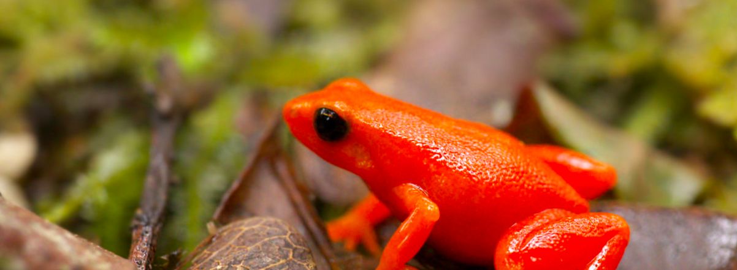
The Golden Mantella Frog lives exclusively in a 4 square mile area in the Moramanga region of Madagascar.
It is critically endangered.
Sketch what 4 square miles looks like. How many square feet is that?
4.MD.A1

Slide 6
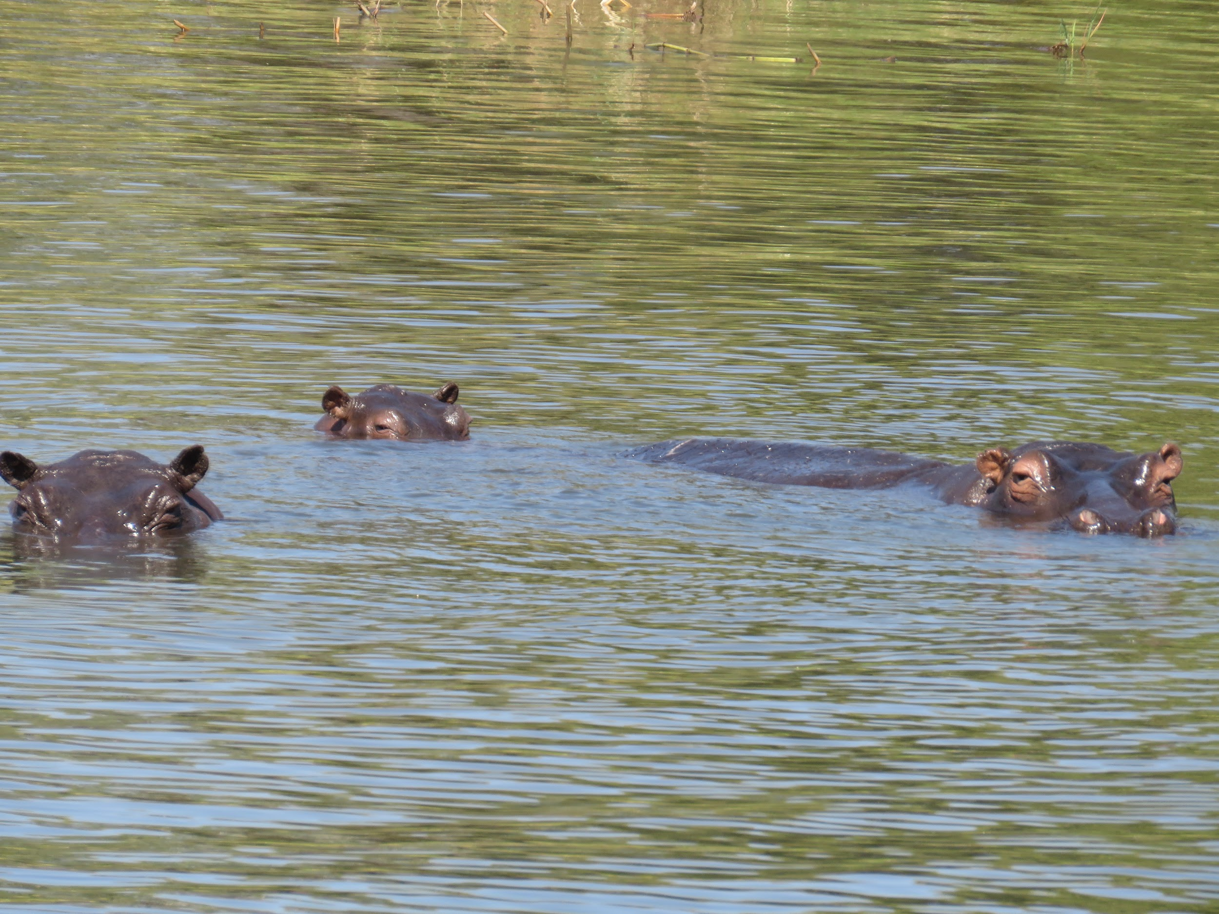
These Hippos at the Gwembe Reserve in Zimbabwe are living large!
Estimate what fraction of their bodies are underwater!
4.NF.A
Notes:
Week of May 9, 2022

Slide 7
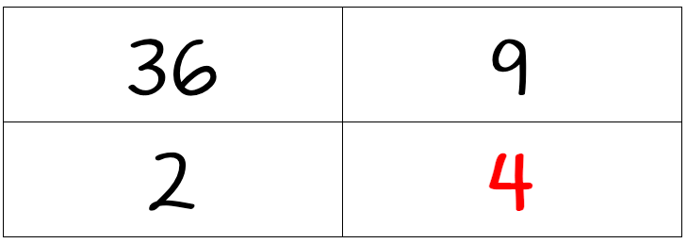
Which one doesn’t belong?
4.OA.B4

Slide 8
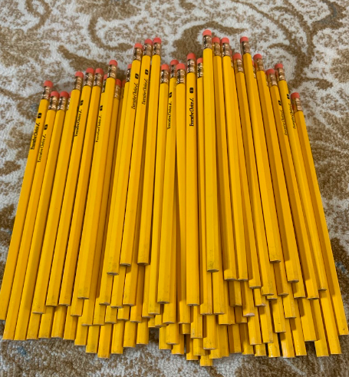
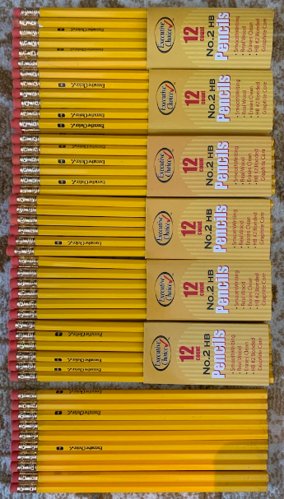
How many pencils are in the pile?
What is a too high estimate?
Too low? Just right?
4.OA.A3

Slide 9

Yay!! You won FIRST PLACE at the STEM Fair!
Would you rather . . . $20 right now OR $2 a day for the next 2 weeks
4.OA.2

Slide 10
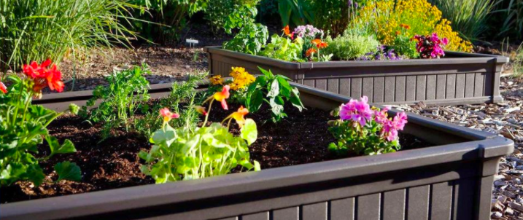
Celia and Jonny are building raised bed gardens.
Celia’s garden is
8 ft. x 10 ft. and Jonny’s is 16 ft. x 20 ft.
Jonny said “my garden is TWICE the size of yours!
Celia was NOT happy about that.
Is he right? Prove that he is right, or wrong!
4.NBT.B5

Slide 11
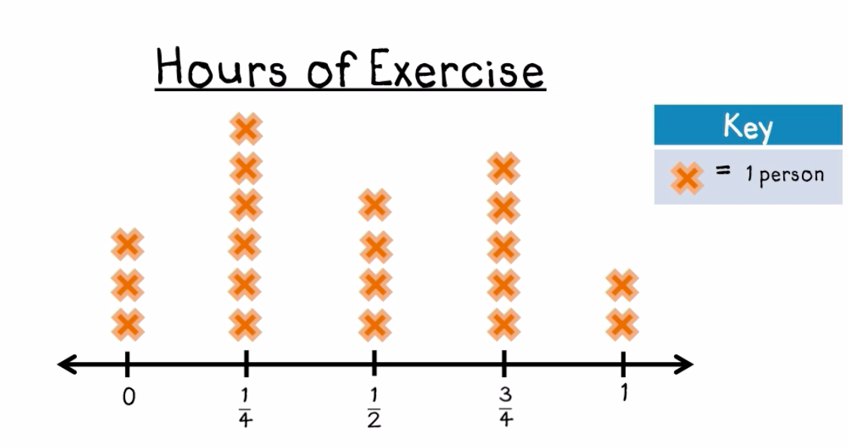
What do you notice in this LINE PLOT?
What do you wonder? Why does it matter?
4.MD.B4
Notes:
Week of May 16, 2022

Slide 12
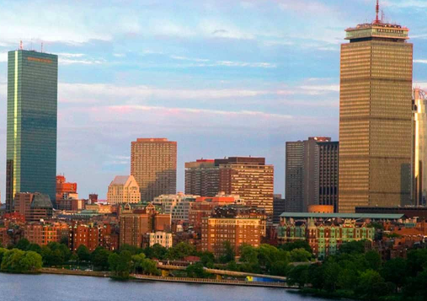
The distance between the Hancock Tower and the Prudential Center is .7 miles.
How far is that?
How many feet is that?
(There are 5280 feet in a mile)
Estimate!!
How can you solve this?
4.NBT.B5

Slide 13
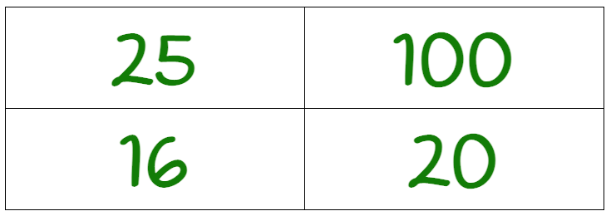
Which one doesn’t belong?
4.OA.B4

Slide 14
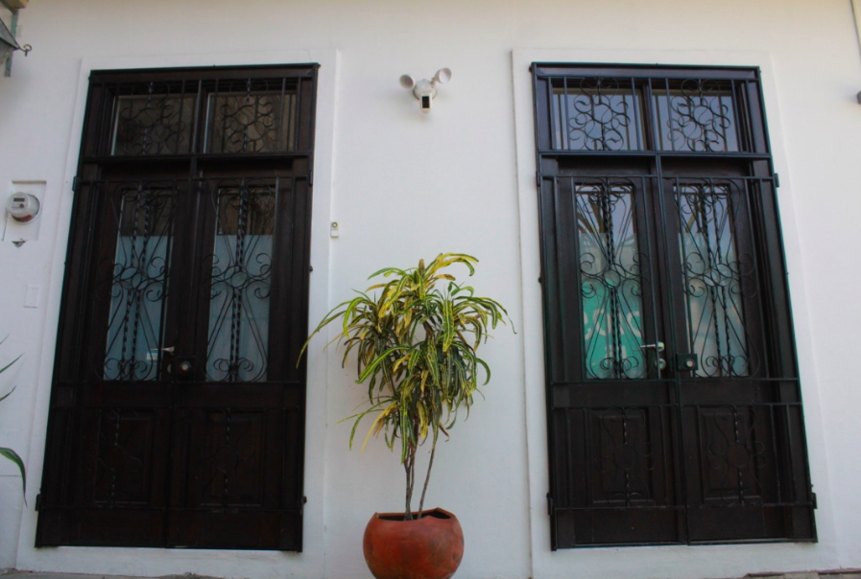
Where do you see symmetry in this picture?
What other math topics can you point out?
4.G.A3

Slide 15
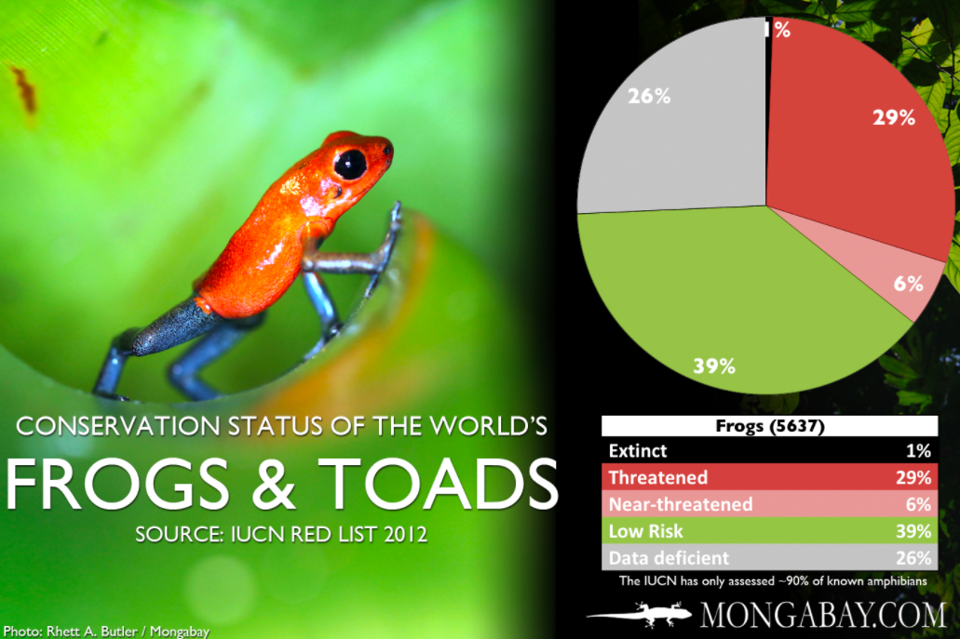
What’s going on in this graph?
If this graph could talk, what would it say?
Why does it matter?
4.MD.B

Slide 16



True or false?
4.NF.B3
Notes:
Week of May 23, 2022

Slide 17
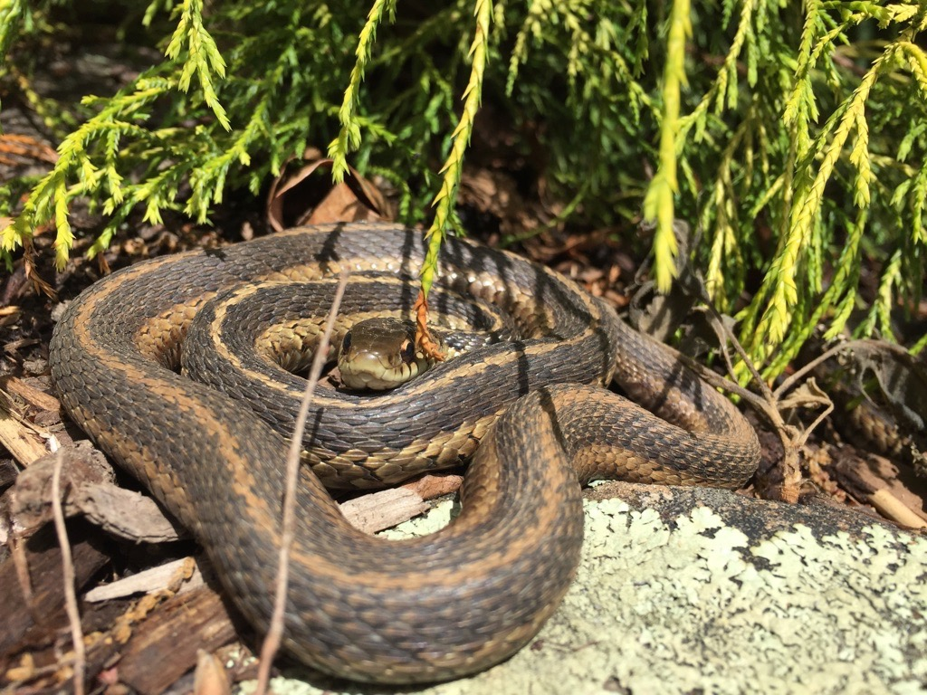
Meet Jimmy, our friendly garter snake.
Garter snakes are typically 3 to 4 feet long.
How many inches is that?
4.MD.A1

Slide 18
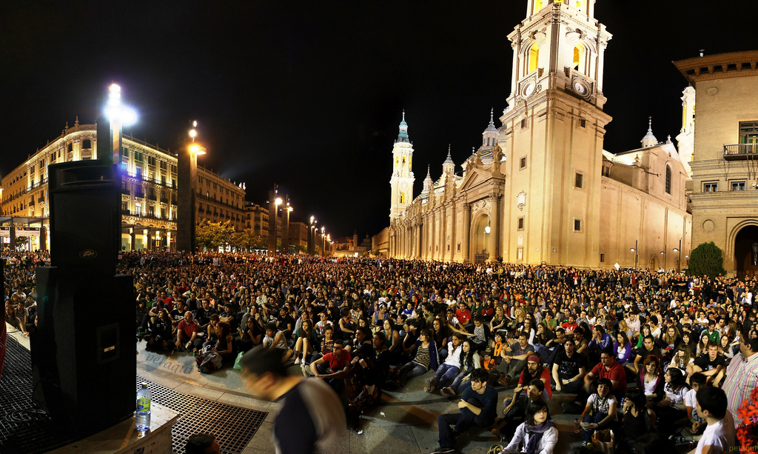
Dia de la Revolucion de Mayo!
Argentina covers an area of 2,780,425 km², making it the largest Spanish-speaking nation in the world by area.
Round 2,780,425 to the nearest
Million
Hundred thousand
Ten thousand
Thousand
4.NBT.A3
Notes:
May 25, 2022
Revolution Day, Argentina

Slide 19
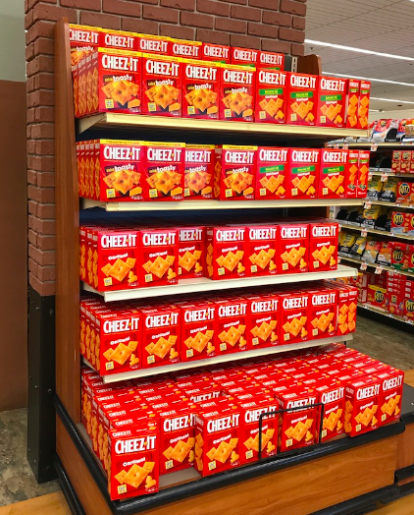
Wow! Look at all those boxes of Cheez-Its!
How many are there?
How can you figure it out?
How many different number sentences can you write to represent the problem?
4.NBT.B5

Slide 20
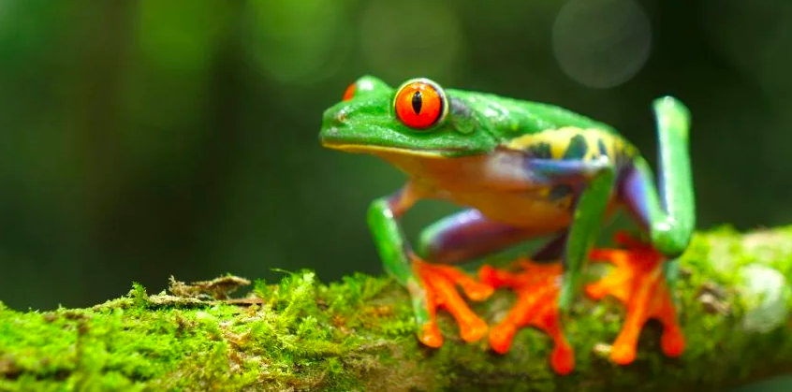
The rainforests of Brazil have the highest amphibian species count at 1,022.
Columbia is next at 771 species.
Then Ecuador with 626 species.
And Peru with 572 species.
What can you say about these populations?
How can you compare them?
4.NBT.A2,3

