Slide 1
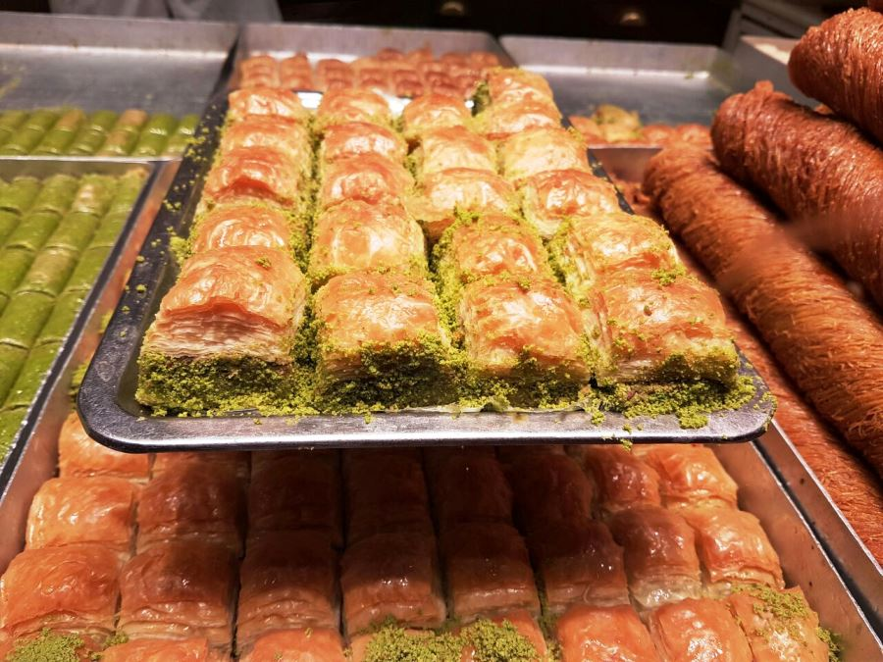
Today is the celebration of Eid Al-Fitr
How many pastries are on this tray?
How many more are on the tray below it?
Create an equation to match your thinking!
3.OA.D8
Notes:
Week of May 2, 2022
Eid Al-Fitr

Slide 2
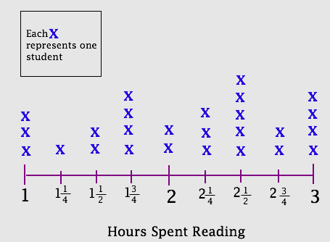
What’s going on in this graph?
What do you notice?
What do you wonder?
What questions do you have?
Why does it matter?
3.MD.B4

Slide 3
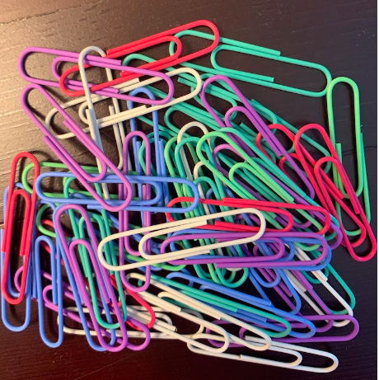
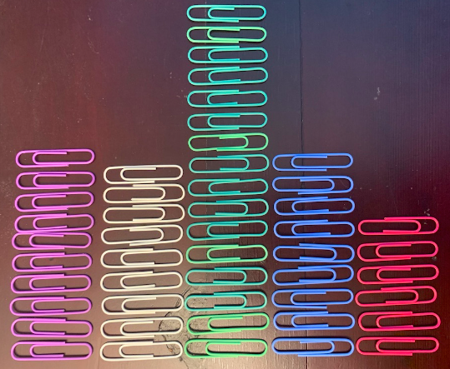
How many paperclips are in the pile?
What is too low?
What is too high?
What is your ESTIMATE?
3.MD.B

Slide 4
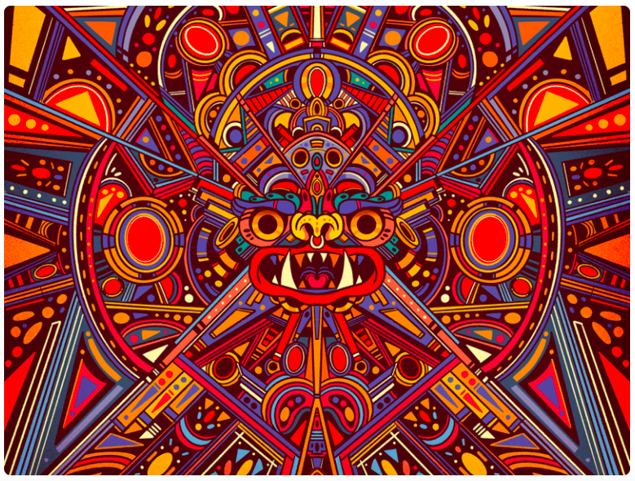
When we look closely at this Mexican art by Pequeno Capitan, we can see many different shapes.
Pick a shape, then find another one that has one attribute that is the SAME and one attribute that is different.
3.G.A1
Notes:
Cinco de Mayo

Slide 5
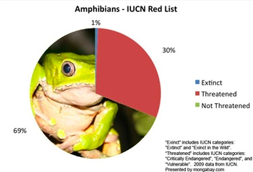
What’s going on in this graph?
What do you notice?
What do you wonder?
Why does it matter?
3.MD.B

Slide 6
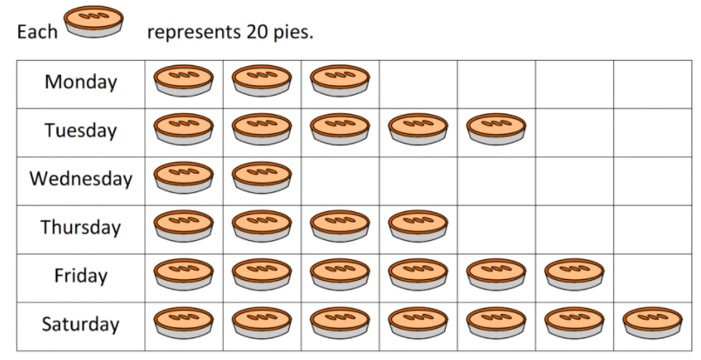
If this graph could talk, what would it say?
What’s a good name for this graph be?
3.MD.B3
Notes:
Weed of May 9, 2022

Slide 7
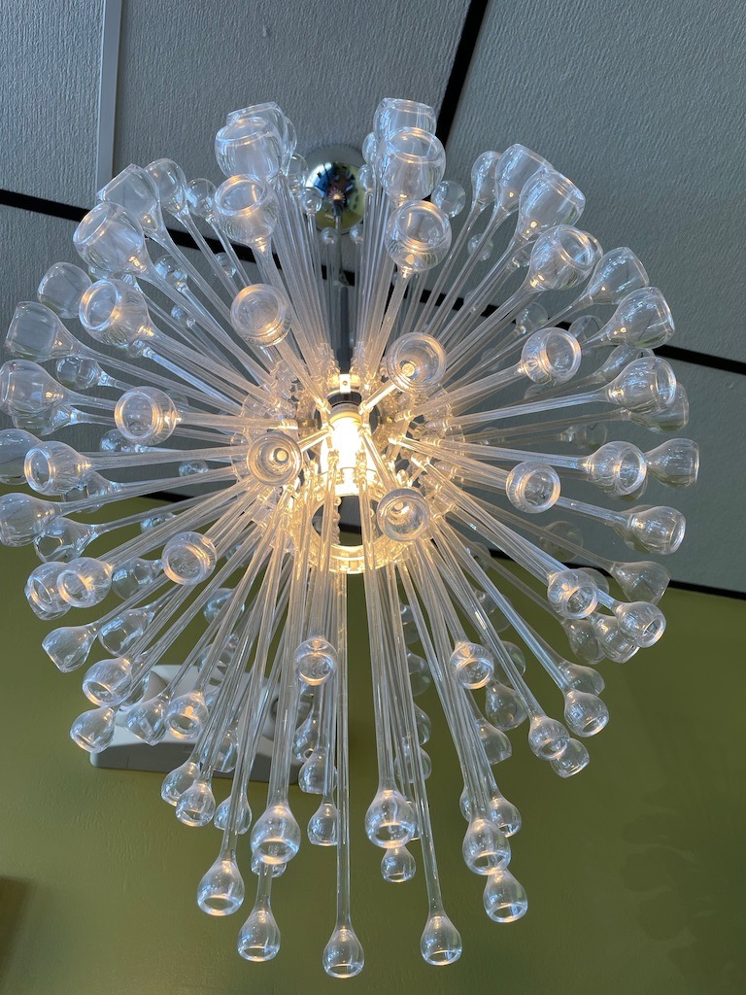
Wow! Look at that light!
What math questions can we ask?
What kinds of estimates can we make?
3.NBT.A1

Slide 8




Justify your reasoning!
3.NF.A3

Slide 9
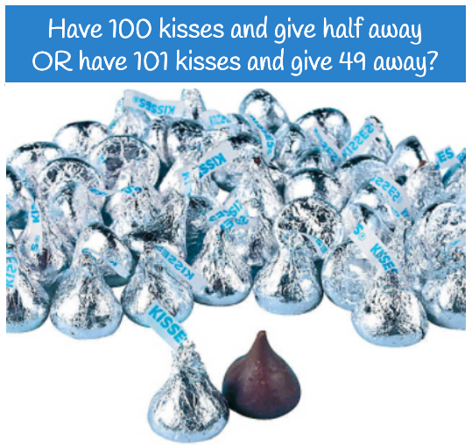
Would you rather...
3.OA.A2

Slide 10
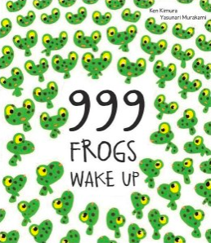
999 Frogs!
I wonder how many legs that would be?
How can we figure it out?
3.OA.B5

Slide 11
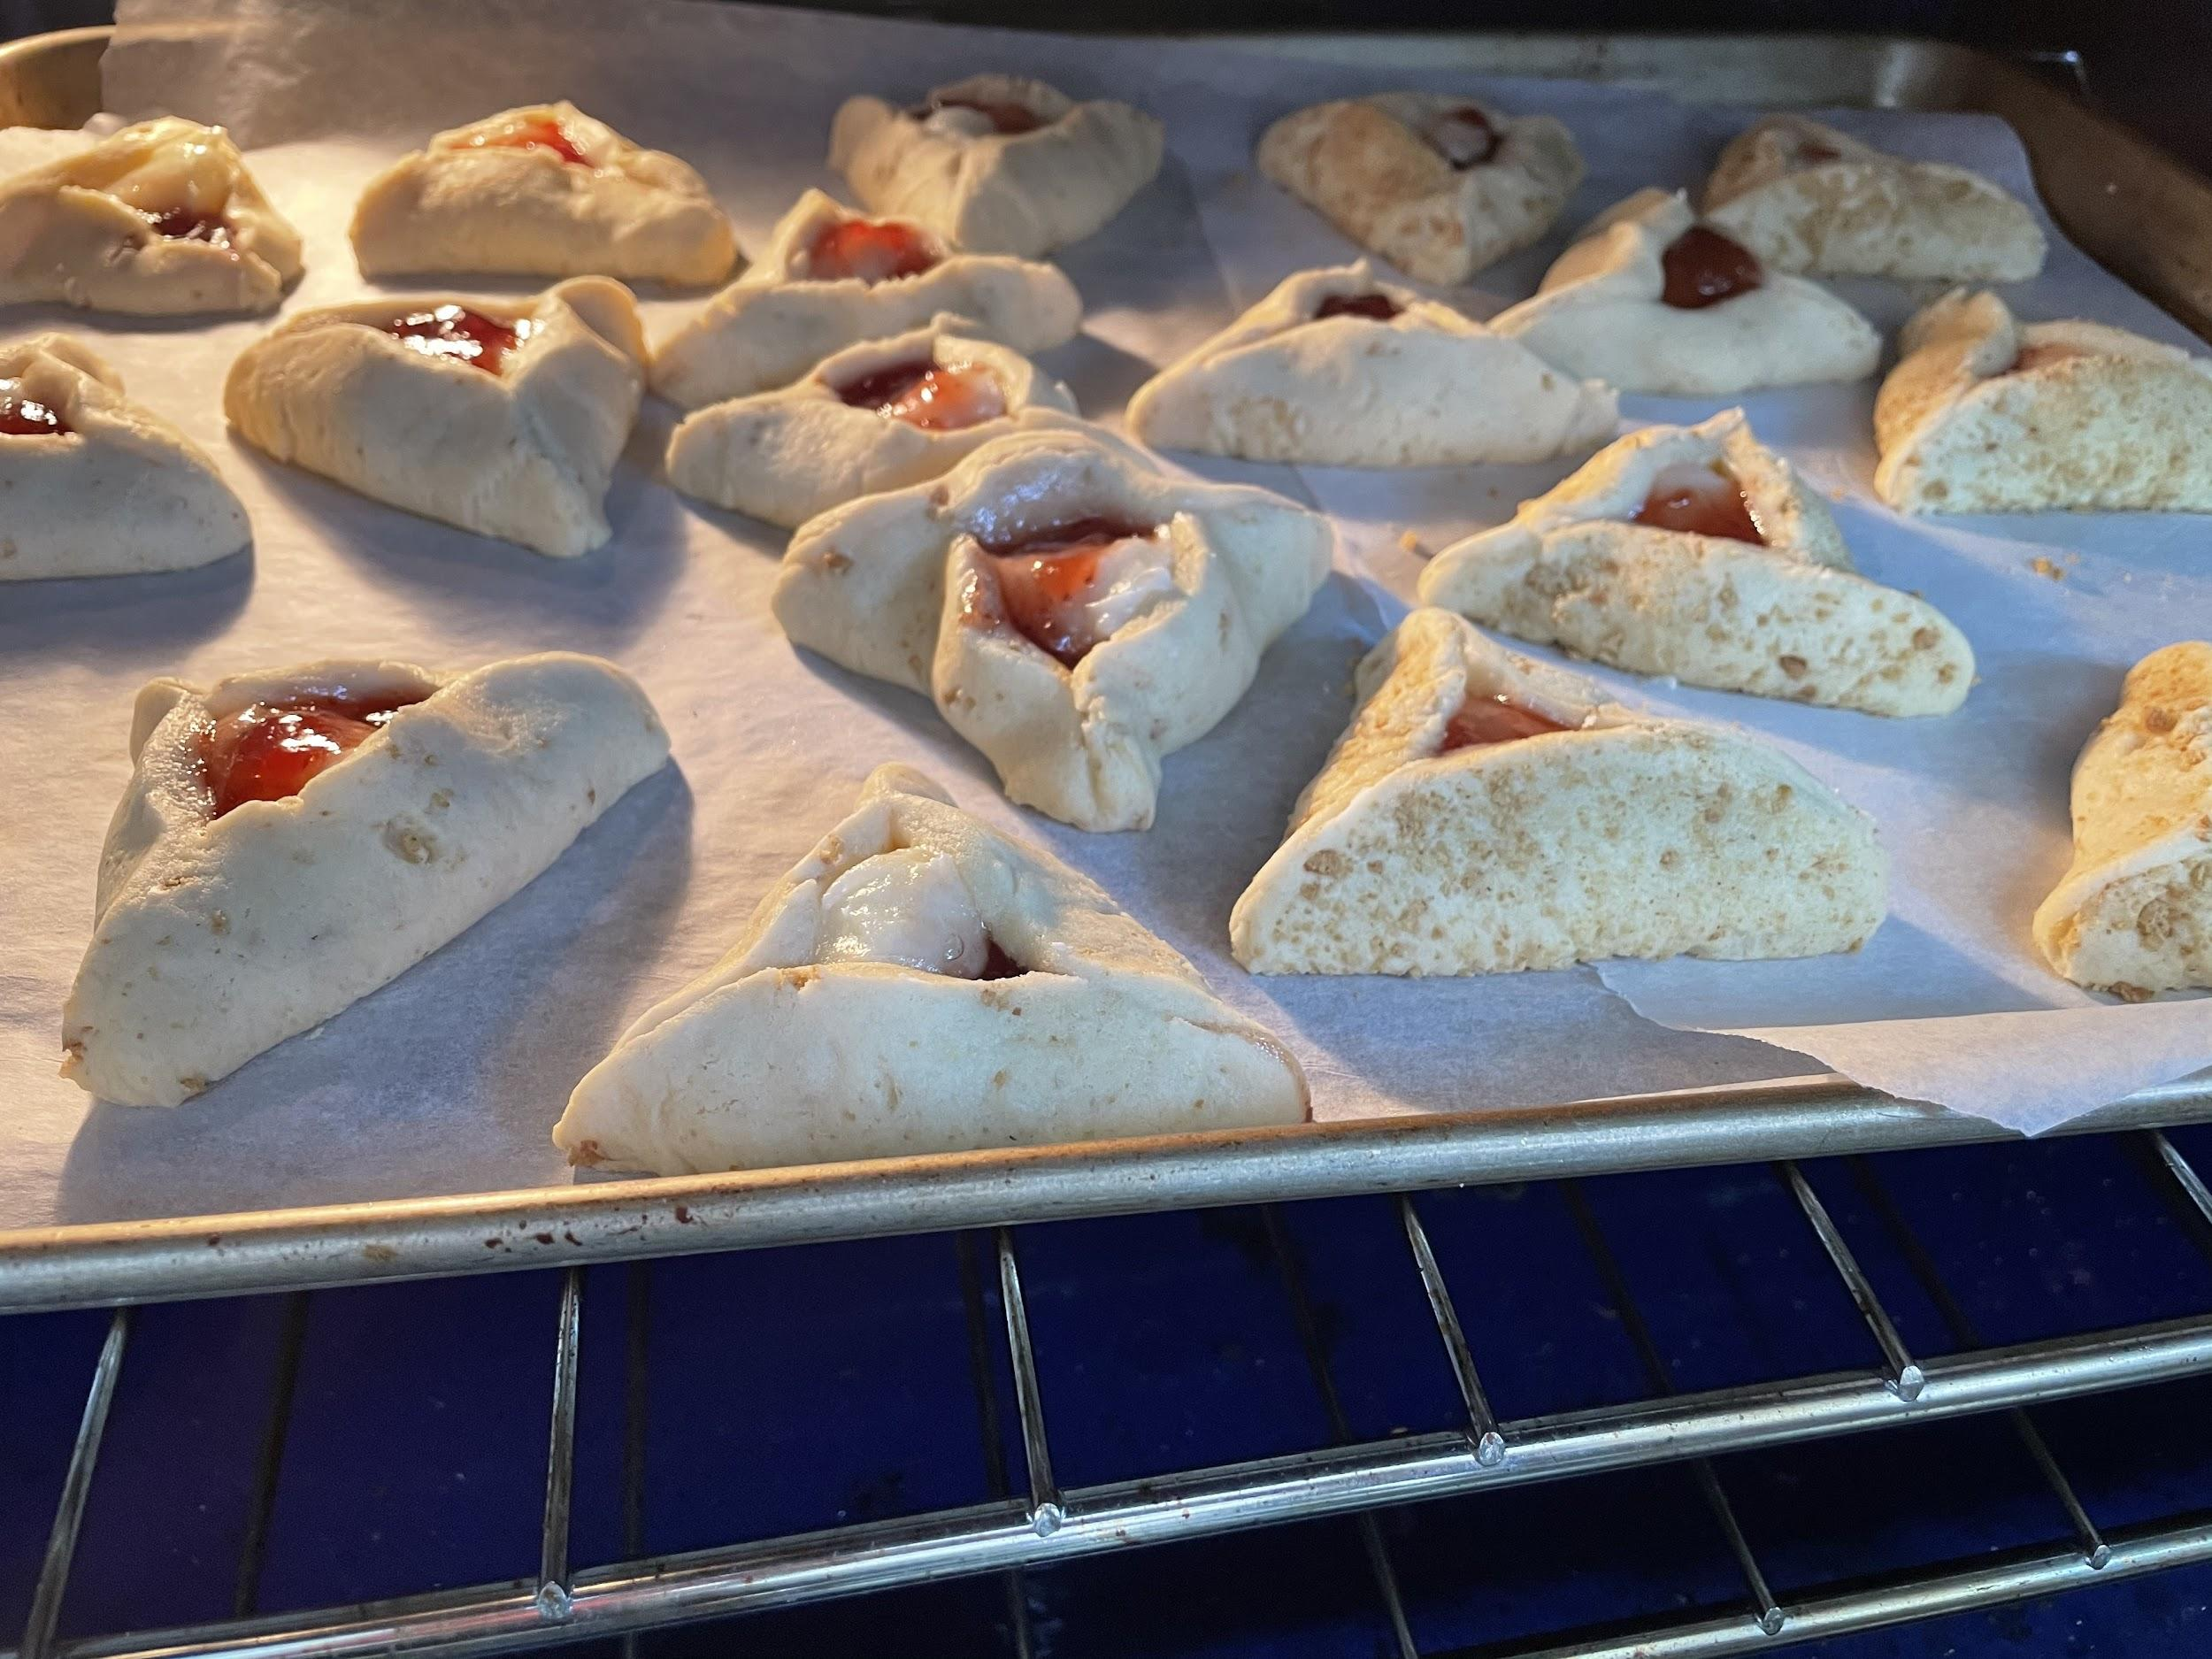

We just put these cookies in the oven.
They need to bake for 15 minutes
What time should we take them out of the oven?
3.MD.A1
Notes:
Week of May 16, 2022

Slide 12
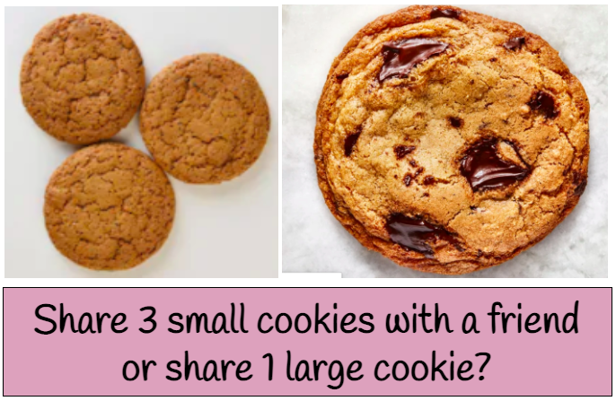
Would you rather...
3.NF.A1

Slide 13
Which one doesn’t belong?
3.G.A1

Slide 14
These 2 rectangles have different perimeters.
What do they have in common?
Can you find another rectangle that would also have this in common?
Perimeter = 20 ft
Perimeter = 28 ft
2 ft
4 ft
12 ft
6 ft
3.MD.D8

Slide 15
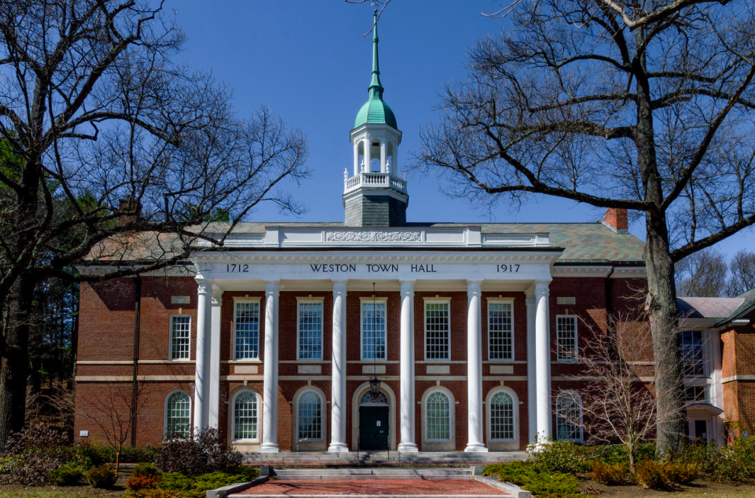
What do the numbers mean?
How old is the Weston Town Hall?
Where do you see arrays?
How can you use arrays to figure out how many window panes are here?
What would that equation look like?
3.NBT.A2

Slide 16
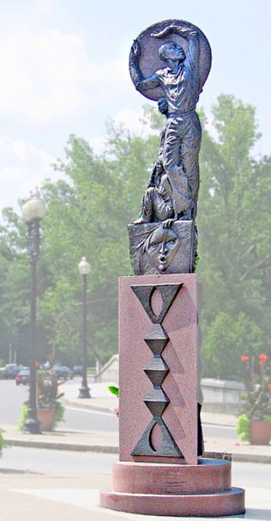
The “Rise” monument in Mattapan stands 19 feet tall.
How much taller is it than you?
How many times taller is it, or how many of YOU is it?
3.OA.D9
Notes:
Week of May 23, 2022

Slide 17

9 x 80 = 90 x 8
100 ÷ 2 > 5 x 4 x 2
8 x (5 + 2) < (8 x 5) + (8 x 2)
Prove it!
3.OA.B

Slide 18
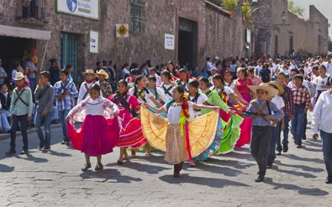
Happy Revolution Day Argentina!
Argentina’s May Revolution started on May 25 in 1810. Argentina had been part of Spanish colonial rule since 1516!
How long was Argentina under Spanish rule?
Create an equation to match your thinking!
3.NBT.A2
Notes:
May 25, 2022
Revolution Day, Argentina

Slide 19
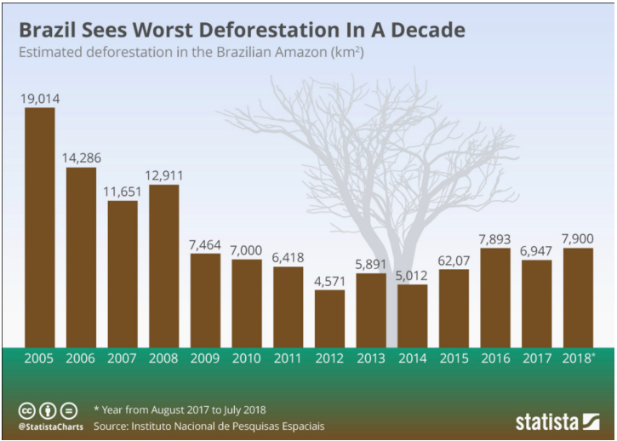
What do you notice?
What do you wonder?
What is going on in this data visualization?
3.MD.B

Slide 20
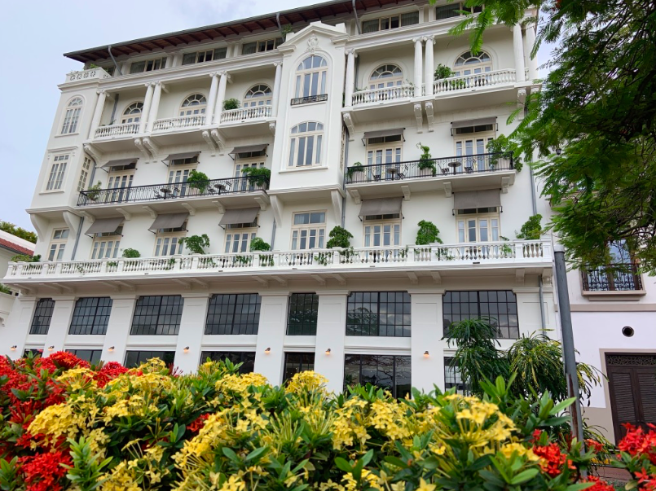
What math connections can we see in this picture?
Shapes?
Arrays?
Parallel lines?
3.G.A1

