Slide 1
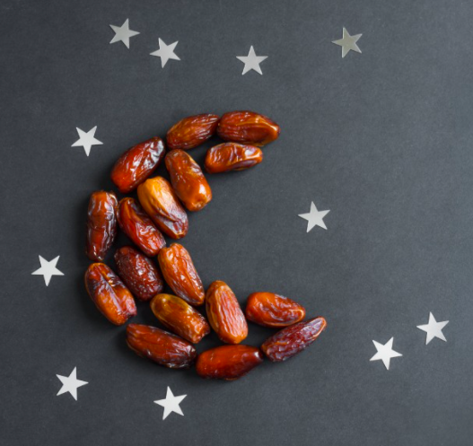
Dates are yummy Ramadan treats!
How many dates make up the moon?
10 + ____ = ____
How many stars?
10 + ____ = ____
K.NBT.1
Notes:
Week of April 4, 2022
Ramadan

Slide 2
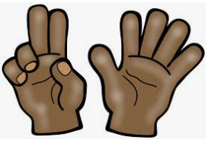
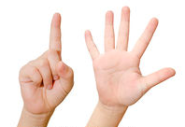
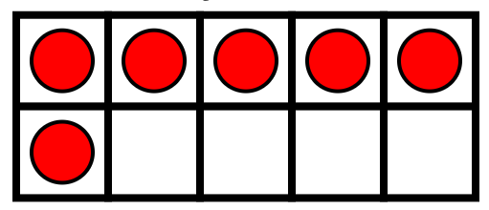

Which one doesn’t belong?
K.CC.4 OA.3.5

Slide 3
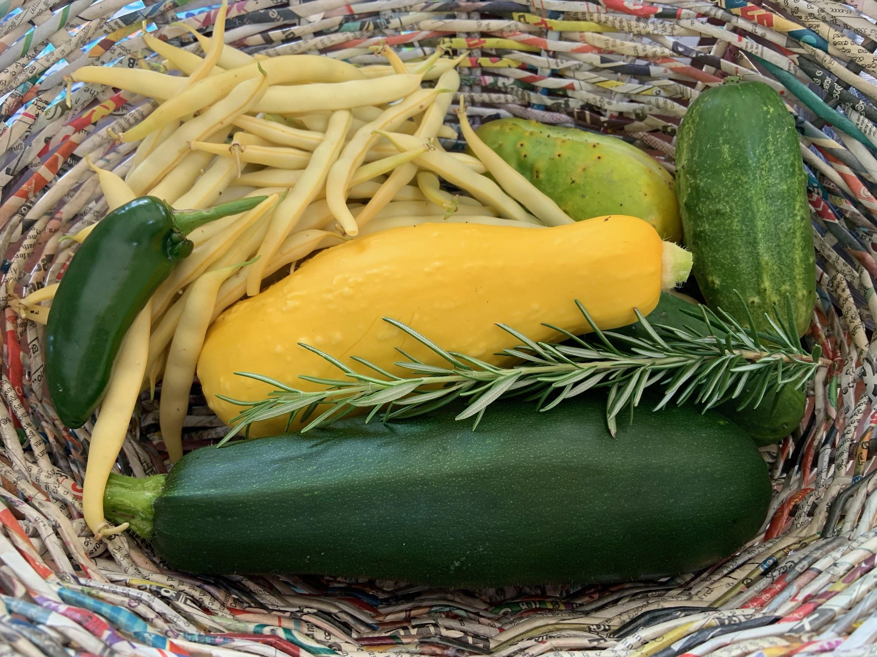
How would you sort these vegetables?
How many beans do you think are here?
Which vegetable weighs the most?
Which is the lightest?
K.CC.1.4.5.6. MD.1.2

Slide 4
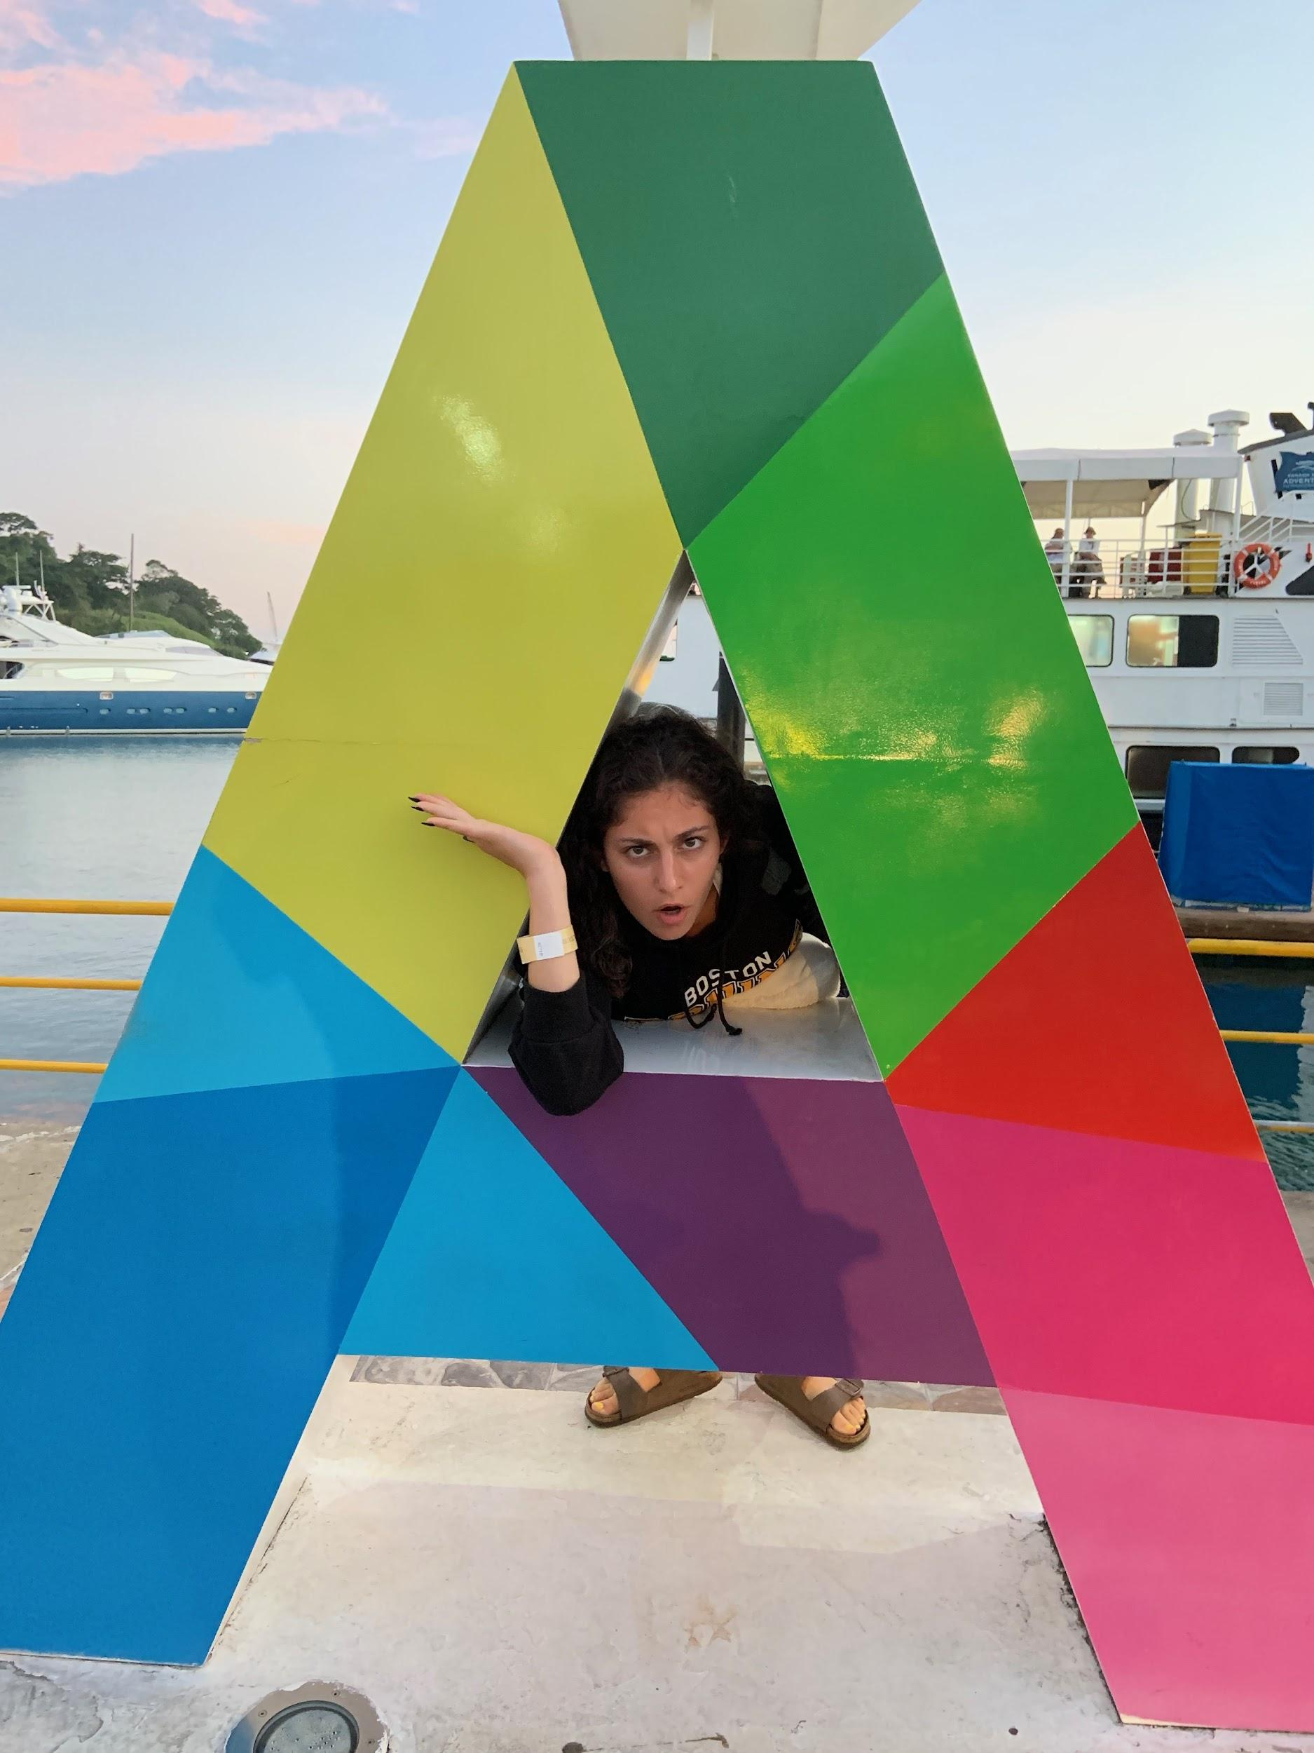
What are some of the shapes you see here?
Describe them.
How are they the same?
How are they different?
K.G1.2.3.4

Slide 5
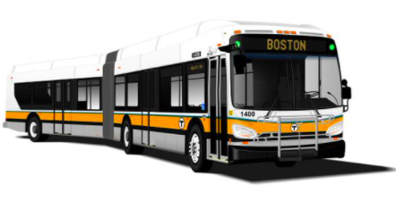
How many wheels do you see?
How many DON’T you see?
Can you write a number sentence to match your thinking?
K.OA.A

Slide 6
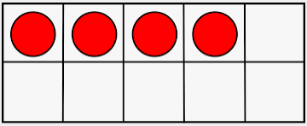
Which one doesn’t belong?
K.G.2.3.4
Notes:
Week of April 11, 2011

Slide 7
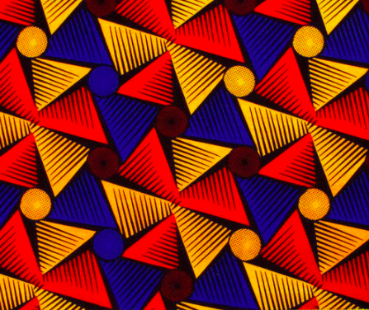
Let’s talk about the patterns we see in this Ankara fabric.
What shapes do we see?
What colors do we see?
K.G.1.2.3

Slide 8
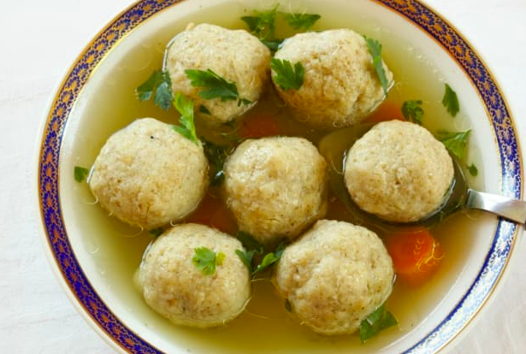
How many matzo balls are in the soup?
How many different number sentences can you create to match the bowl of soup?
K.OA.1

Slide 9
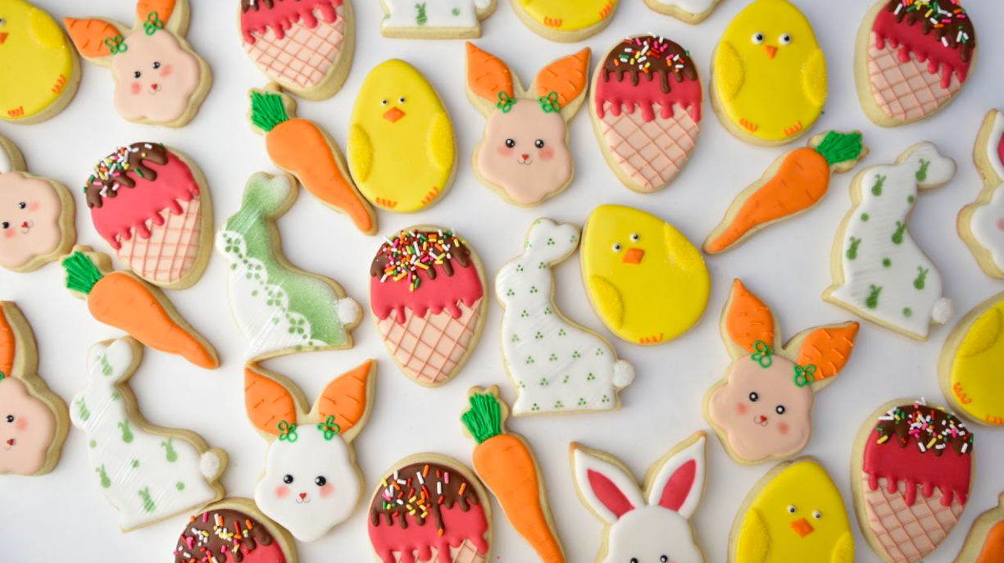
What interesting shapes do you see? How would you sort them?
K.G.1

Slide 10
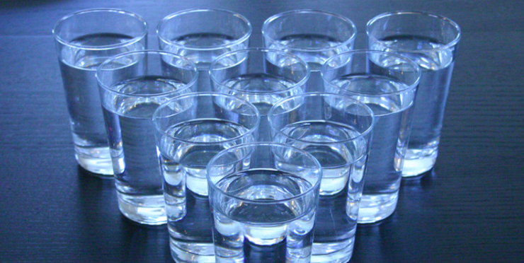
How many glasses of water are here?
Write a number sentence to match your thinking.
K.OA.3
Notes:
Week of April 25, 2022

Slide 11
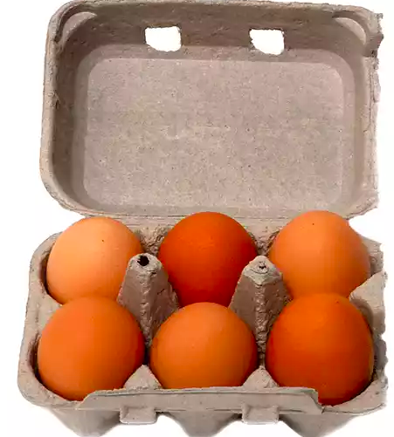
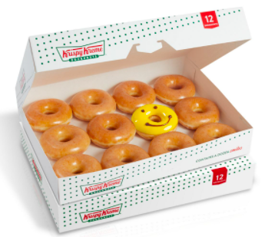


Which one doesn’t belong?
 | 10 + 2
K.NBT.1

Slide 12
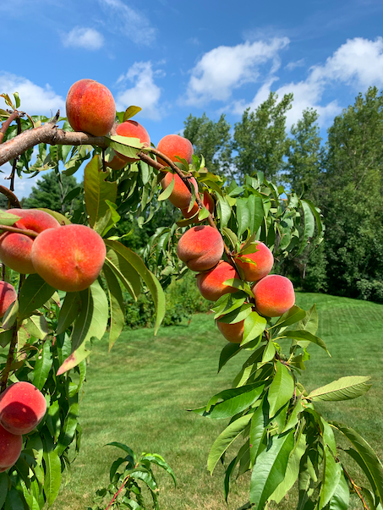
How many peaches might be on the tree?
How can you count them?
K.NBT.5

Slide 13
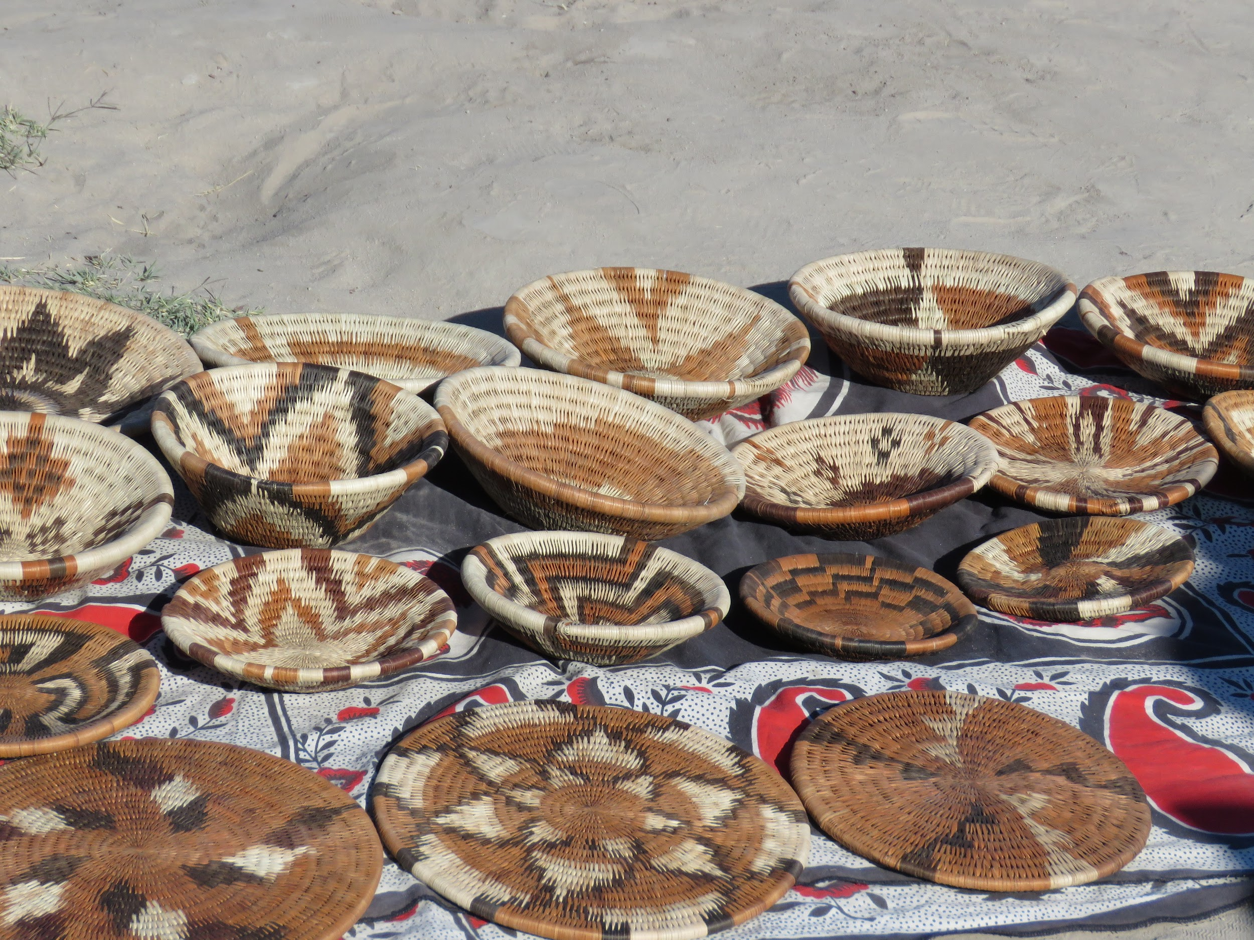
What interesting shapes do you see?
Can you draw some of them?
How would you sort these baskets?
K.G.2

Slide 14
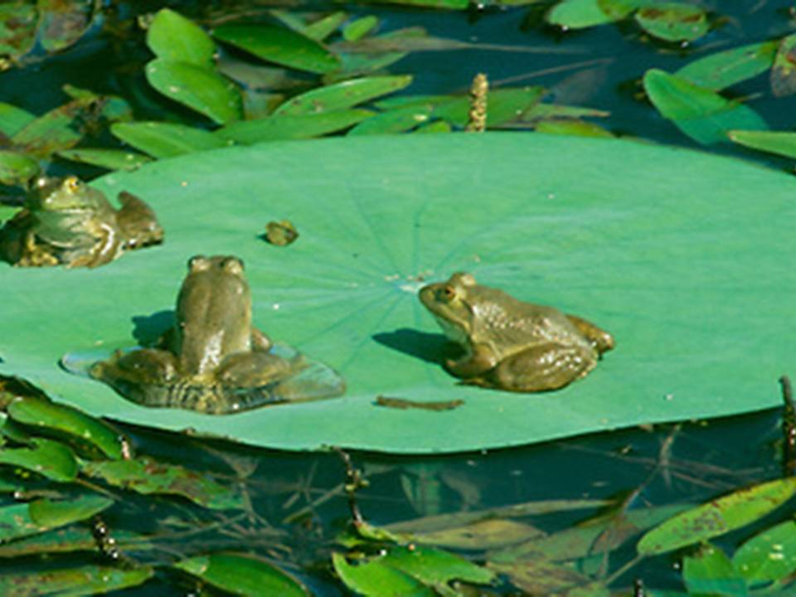
It’s Froggy Friday!
How many frogs are on the lily pad?
How many more will make 10 frogs?
K.OA.4

