Slide 1
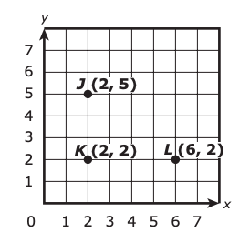
What do we notice?
What do we wonder?
A student will add point M on the grid so that points J, K, L, and M are the vertices of a rectangle.
What will be the coordinates of point M?
A (2, 6) B (5, 2) C (5, 6) D (6, 5)

Slide 2
Which show a numerical expression and a word expression that are equivalent? (There are 3!)
6 × 5 + 3 is equivalent to “add 3 to the product of 6 and 5”
5 + 6 + 3 is equivalent to “add 3 to the product of 6 and 5”
5 × (3 + 6) is equivalent to “add 3 and 6, then multiply by 5”
5 + 6 + 3 is equivalent to “5 greater than the sum of 6 and 3”
3 × 6 × 5 is equivalent to “5 greater than the sum of 6 and 3”
6 × 5 + 3 is equivalent to “5 times as large as the product of 3 and 6”

Slide 3

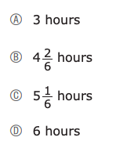
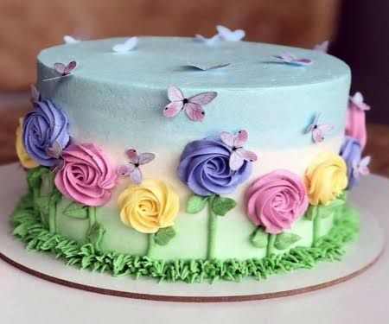

Slide 4
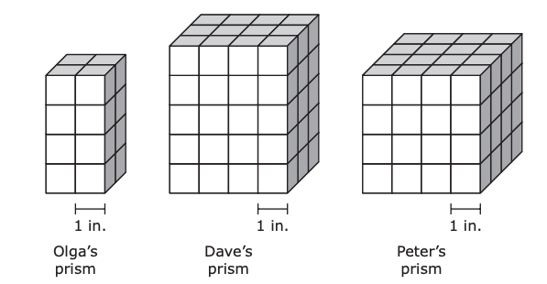
What can we say about the VOLUME of these prisms?
What is the volume, in cubic inches, of Olga’s prism?
What is the difference in volume, in cubic inches, between Dave’s prism and Olga’s prism?
Peter claims that the volume of his prism is 16 cubic inches. Is Peter correct?

Slide 5
Which show a number rounded to the nearest hundredth?
Select the three correct answers.
A. 10.826 rounds to 10.82
B. 10.826 rounds to 10.83
C. 23.647 rounds to 23.64
D. 23.647 rounds to 23.65
E. 54.182 rounds to 54.18
F. 54.182 rounds to 54.19

Slide 6

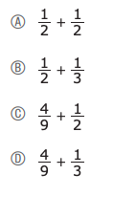
Which is closest to the value of the expression?
What can we say about this expression?
What do we notice?

Slide 7

What do we notice about these patterns?
Curt wrote a number pattern.
• He used the rule “to get from each number to the next, add 4.”
• The first number in his pattern is 1.
Kristy wrote a different pattern.
• She used the rule “to get from each number to the next, add 2.”
• The first number in her pattern is 1.
Which of the following statements is true about both Curt’s and Kristy’s number patterns?
A. All the numbers are odd. B. All the numbers are even.
C. The number 2 is in both patterns. D. The number 3 is in both patterns.

Slide 8
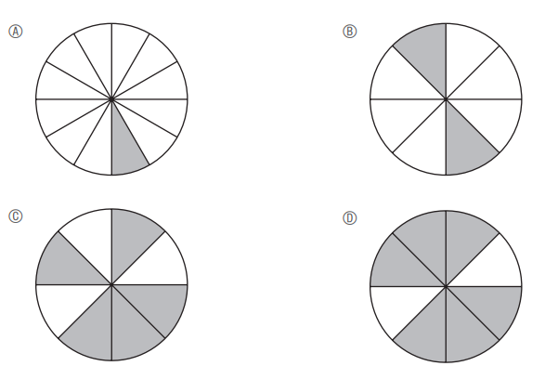

Which of the fraction models shows the product of the expression
What can we say about these fraction models?

Slide 9
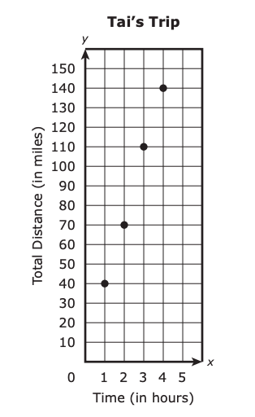
What do we notice?
What do we wonder?
Based on the graph, what is the total distance, in miles, Tai drove in the first 3 hours?
A. 40 B. 70
C. 110 D. 140

Slide 10
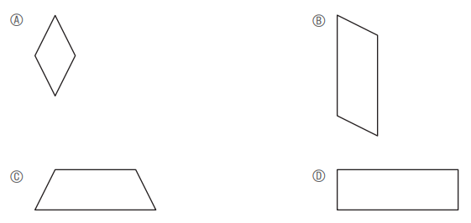
What can we say about these shapes?
Which of the shapes appears to be a rhombus?

Slide 11
A. 3.372 < 3.381
B. 3.372 > 3.381
C. 3.381 < 3.368
D. 3.381 > 3.368
E. 3.368 < 3.372
F. 3.368 > 3.372
Which show a correct comparison?
Select the three correct answers.

Slide 12
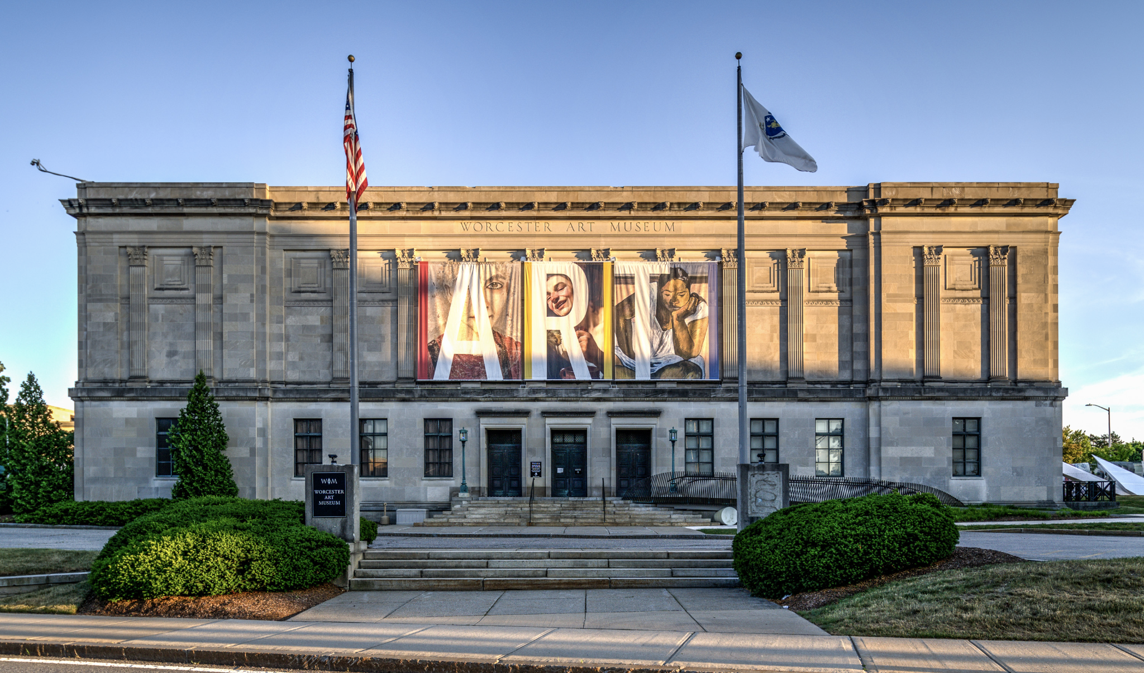
Estimate the number of visitors the museum receives during a month.
Use your answer to write an expression that can be used to predict the total number of visitors the museum would receive in m months.
Use your answer to predict the total number of visitors the museum would receive in 12 months.
A museum receives an average of 488 visitors per day.
The museum is open every day.

Slide 13
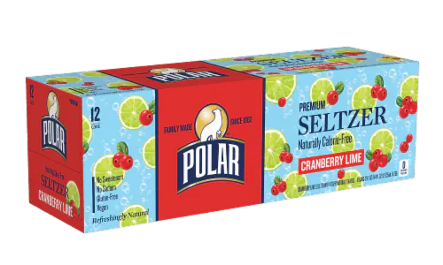
A case of seltzer has 12 cans.
Each can holds 360 milliliters.
What is the total number of liters of seltzer in the case?
A 3.00 liters B 4.32 liters
C 30.0 liters D 43.2 liters

Slide 14

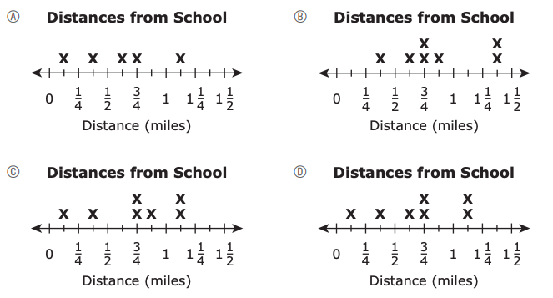
The distances, in miles, that seven students live from school are shown.
What do you notice about these distances?
What do you wonder?
Which of the following line plots shows the distances the seven students live from school?

Slide 15
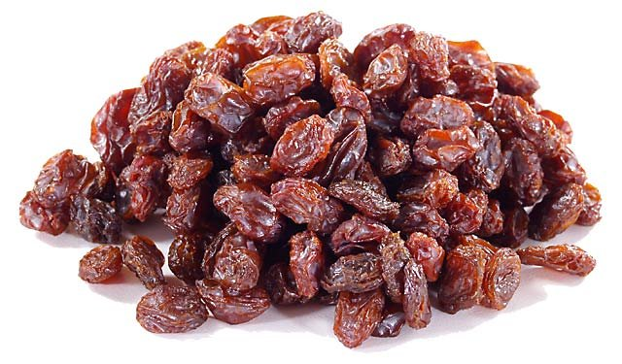
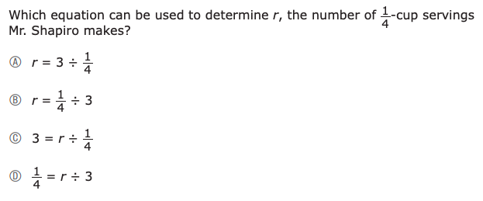
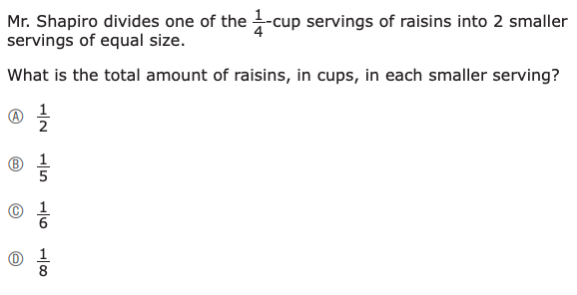

Slide 16
What can we say about this expression?
(10 + 4 × 3) + 5 × 2
What is the value?
A. 32
B. 52
C. 54
D. 94

Slide 17
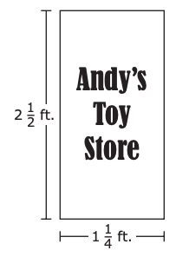
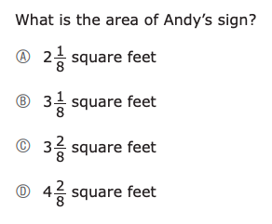
Andy is painting a sign for his toy store.
What can we say about the size of the sign?
Think area and perimeter!

Slide 18

The value of the 5 in
40.52
is how many times the value of the 5 in
115.78?

Slide 19

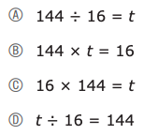
There are 144 pages in a book.
Colton will read 16 pages of the book each night.
What MATH expressions can we create to match this situation?
Which equation can be used to find t, the total number of nights it will take Conner to read the entire book?

