Slide 1
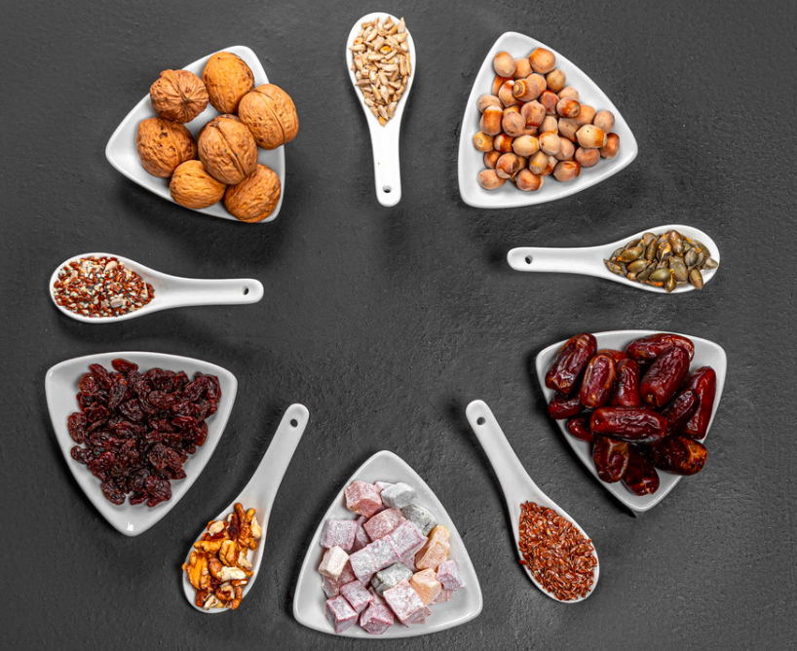
Dates and nuts are traditional foods served during Ramadan.
What fractions do you see here?
How many different fraction number sentences can you create with this photo?
5.NF.2
Notes:
Week of April 4, 2022

Slide 2
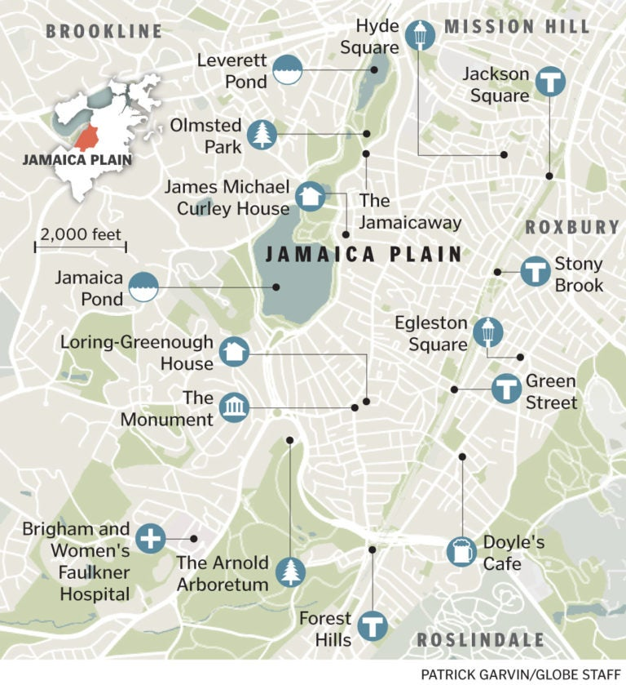
What do we notice?
What do we wonder?
About how far is it from Jamaica Pond to Hyde Square?
How do you know?
What other distances can we estimate?
5.NF.B5

Slide 3
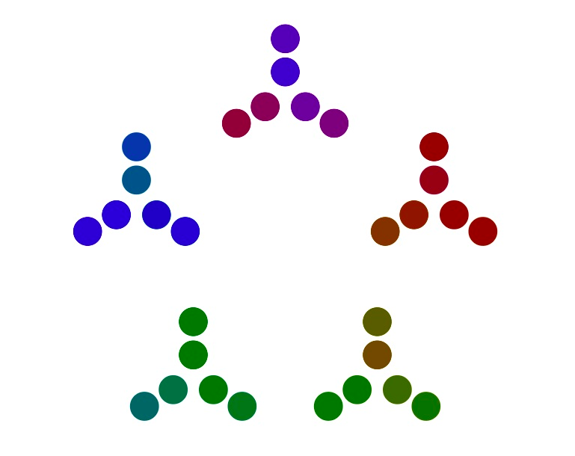
What can you
say about this number representation?
Think PRIME FACTORIZATION
5.OA

Slide 4
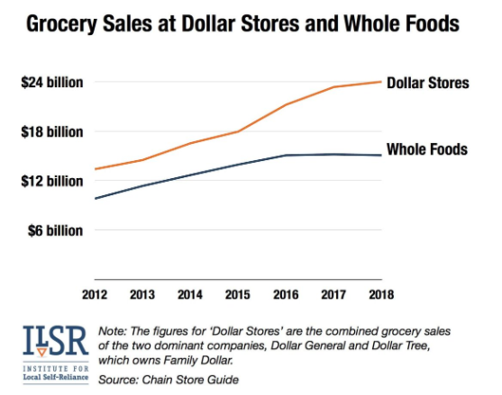
What do you notice
What do you wonder?
Why does it matter?
5.MD.B

Slide 5
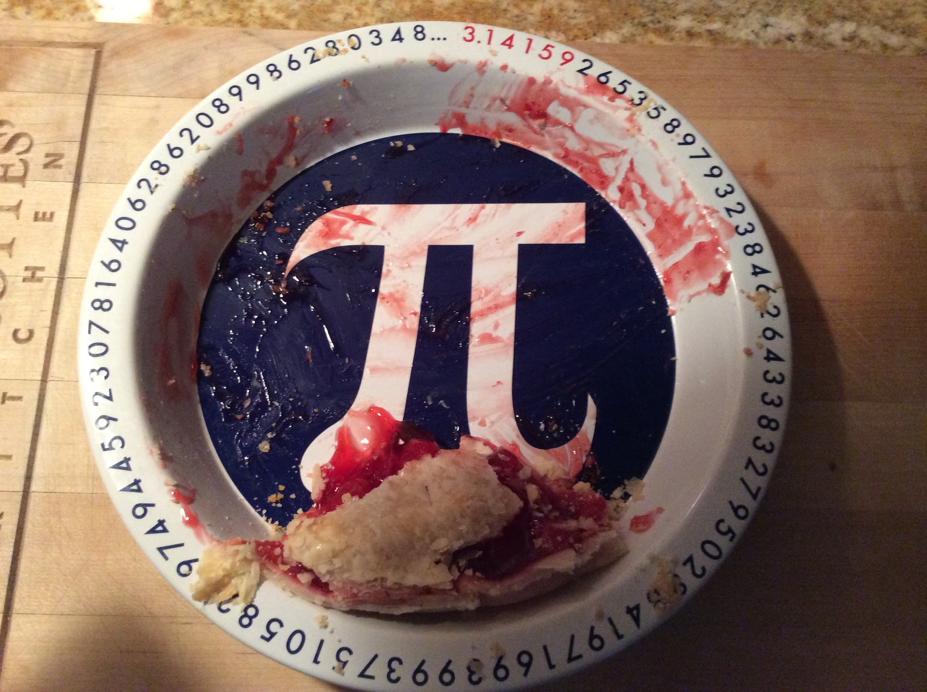
About what fraction of the pie is here?
5.NF.A

Slide 6

Would you rather… practice your violin every other day for 15 minutes,
OR practice for one hour once/week?
5.NBT.B
Notes:
Week of April 11, 2022

Slide 7
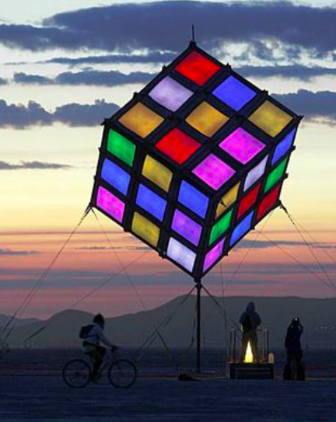
What do notice?
What do you wonder?
How many cubes IF the kite is a solid cube?
How many cubes IF the inside is empty?
How many cubes are painted with 3 colors? 2 colors? 1 color?
5.MD.C3,4

Slide 8
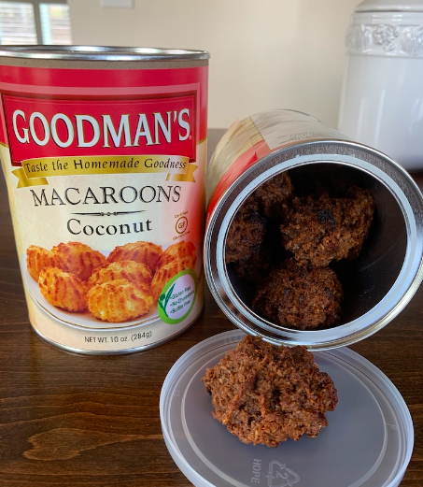
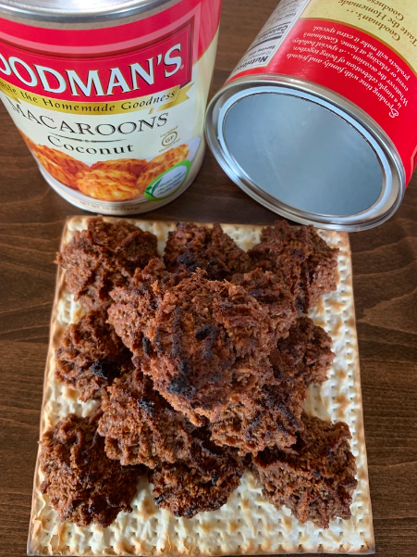
How many macaroons are in BOTH cans?
What is an estimate that is too low?
Too high?
Just right?
9 + 4 + 1 + 1 = 15
15 x 2 = 30
30 Macaroons!
5.OA

Slide 9


Would you rather . . .
$10.99
$9.99
Lindt Gold Bunny & Friends, 4 pk./1.7 oz. Lindt Gold Bunny, 9.6 oz.
5.NBT.B7

Slide 10

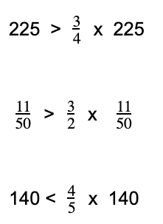
Prove it!
5.NF.B5
Notes:
Week of April 25, 2022

Slide 11
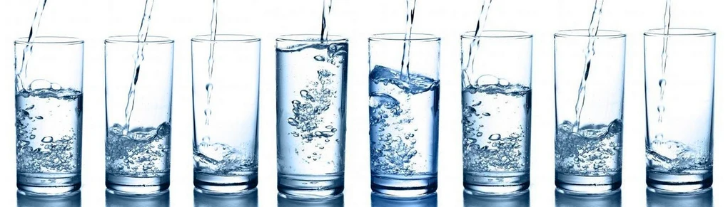
About how many FULL glasses of water
are here?
Write an addition sentence with fractions
to prove it!
5.NF.A2

Slide 12
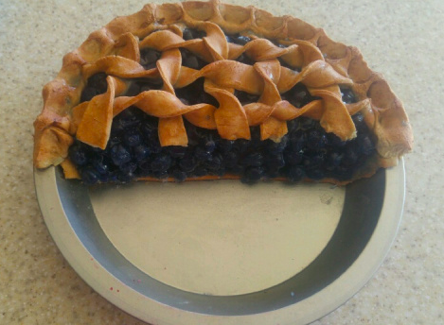
There’s half of the pie left over! Yay!
I have to share it with 3 of my friends.
What fraction of the WHOLE PIE are we each going to get?
5.NF.B7

Slide 13

Yad Vashem ~ יָד וַשֵׁם
A Memorial and a Name
Established in 1953, Yad Vashem is the second most visited site in Israel.
It is located on the western slope of Mount Herzl, also known as the Mount of Remembrance, a height in western Jerusalem, 804 meters above sea level.
About how many feet is 804 meters?
How do you know?
5.MD.A1
Notes:
April 28, 2022
Yom Hashoah

Slide 14

More than a quarter of the 200 plus poison dart frog species are listed as threatened or critically endangered.
What does this mean mathematically? ABOUT how many species are endangered?
5.NF.A2

