Slide 1
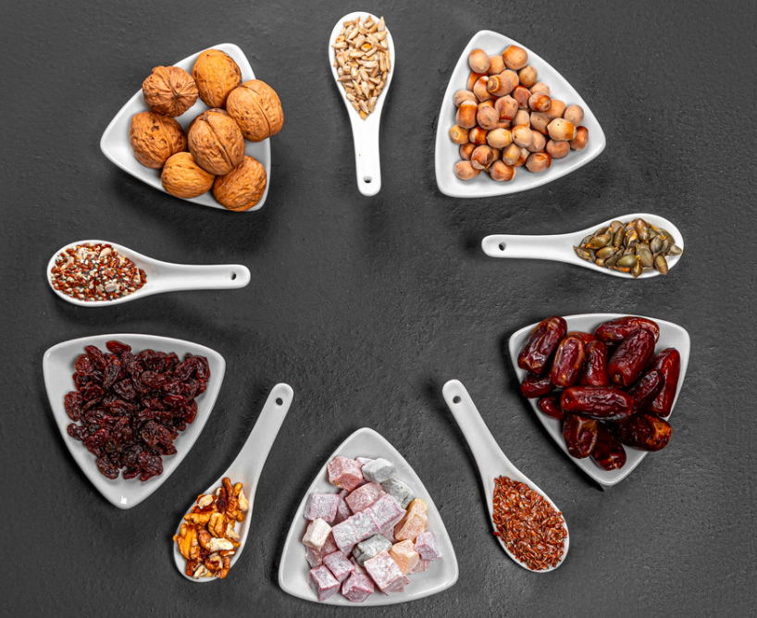
Dates and nuts are traditional foods served during Ramadan.
What fractions do you see here?
How many different fraction number sentences can you create with this photo?
5.NF.A2
Notes:
Week of April 4, 2022

Slide 2
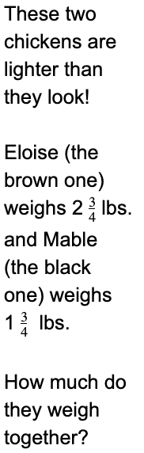
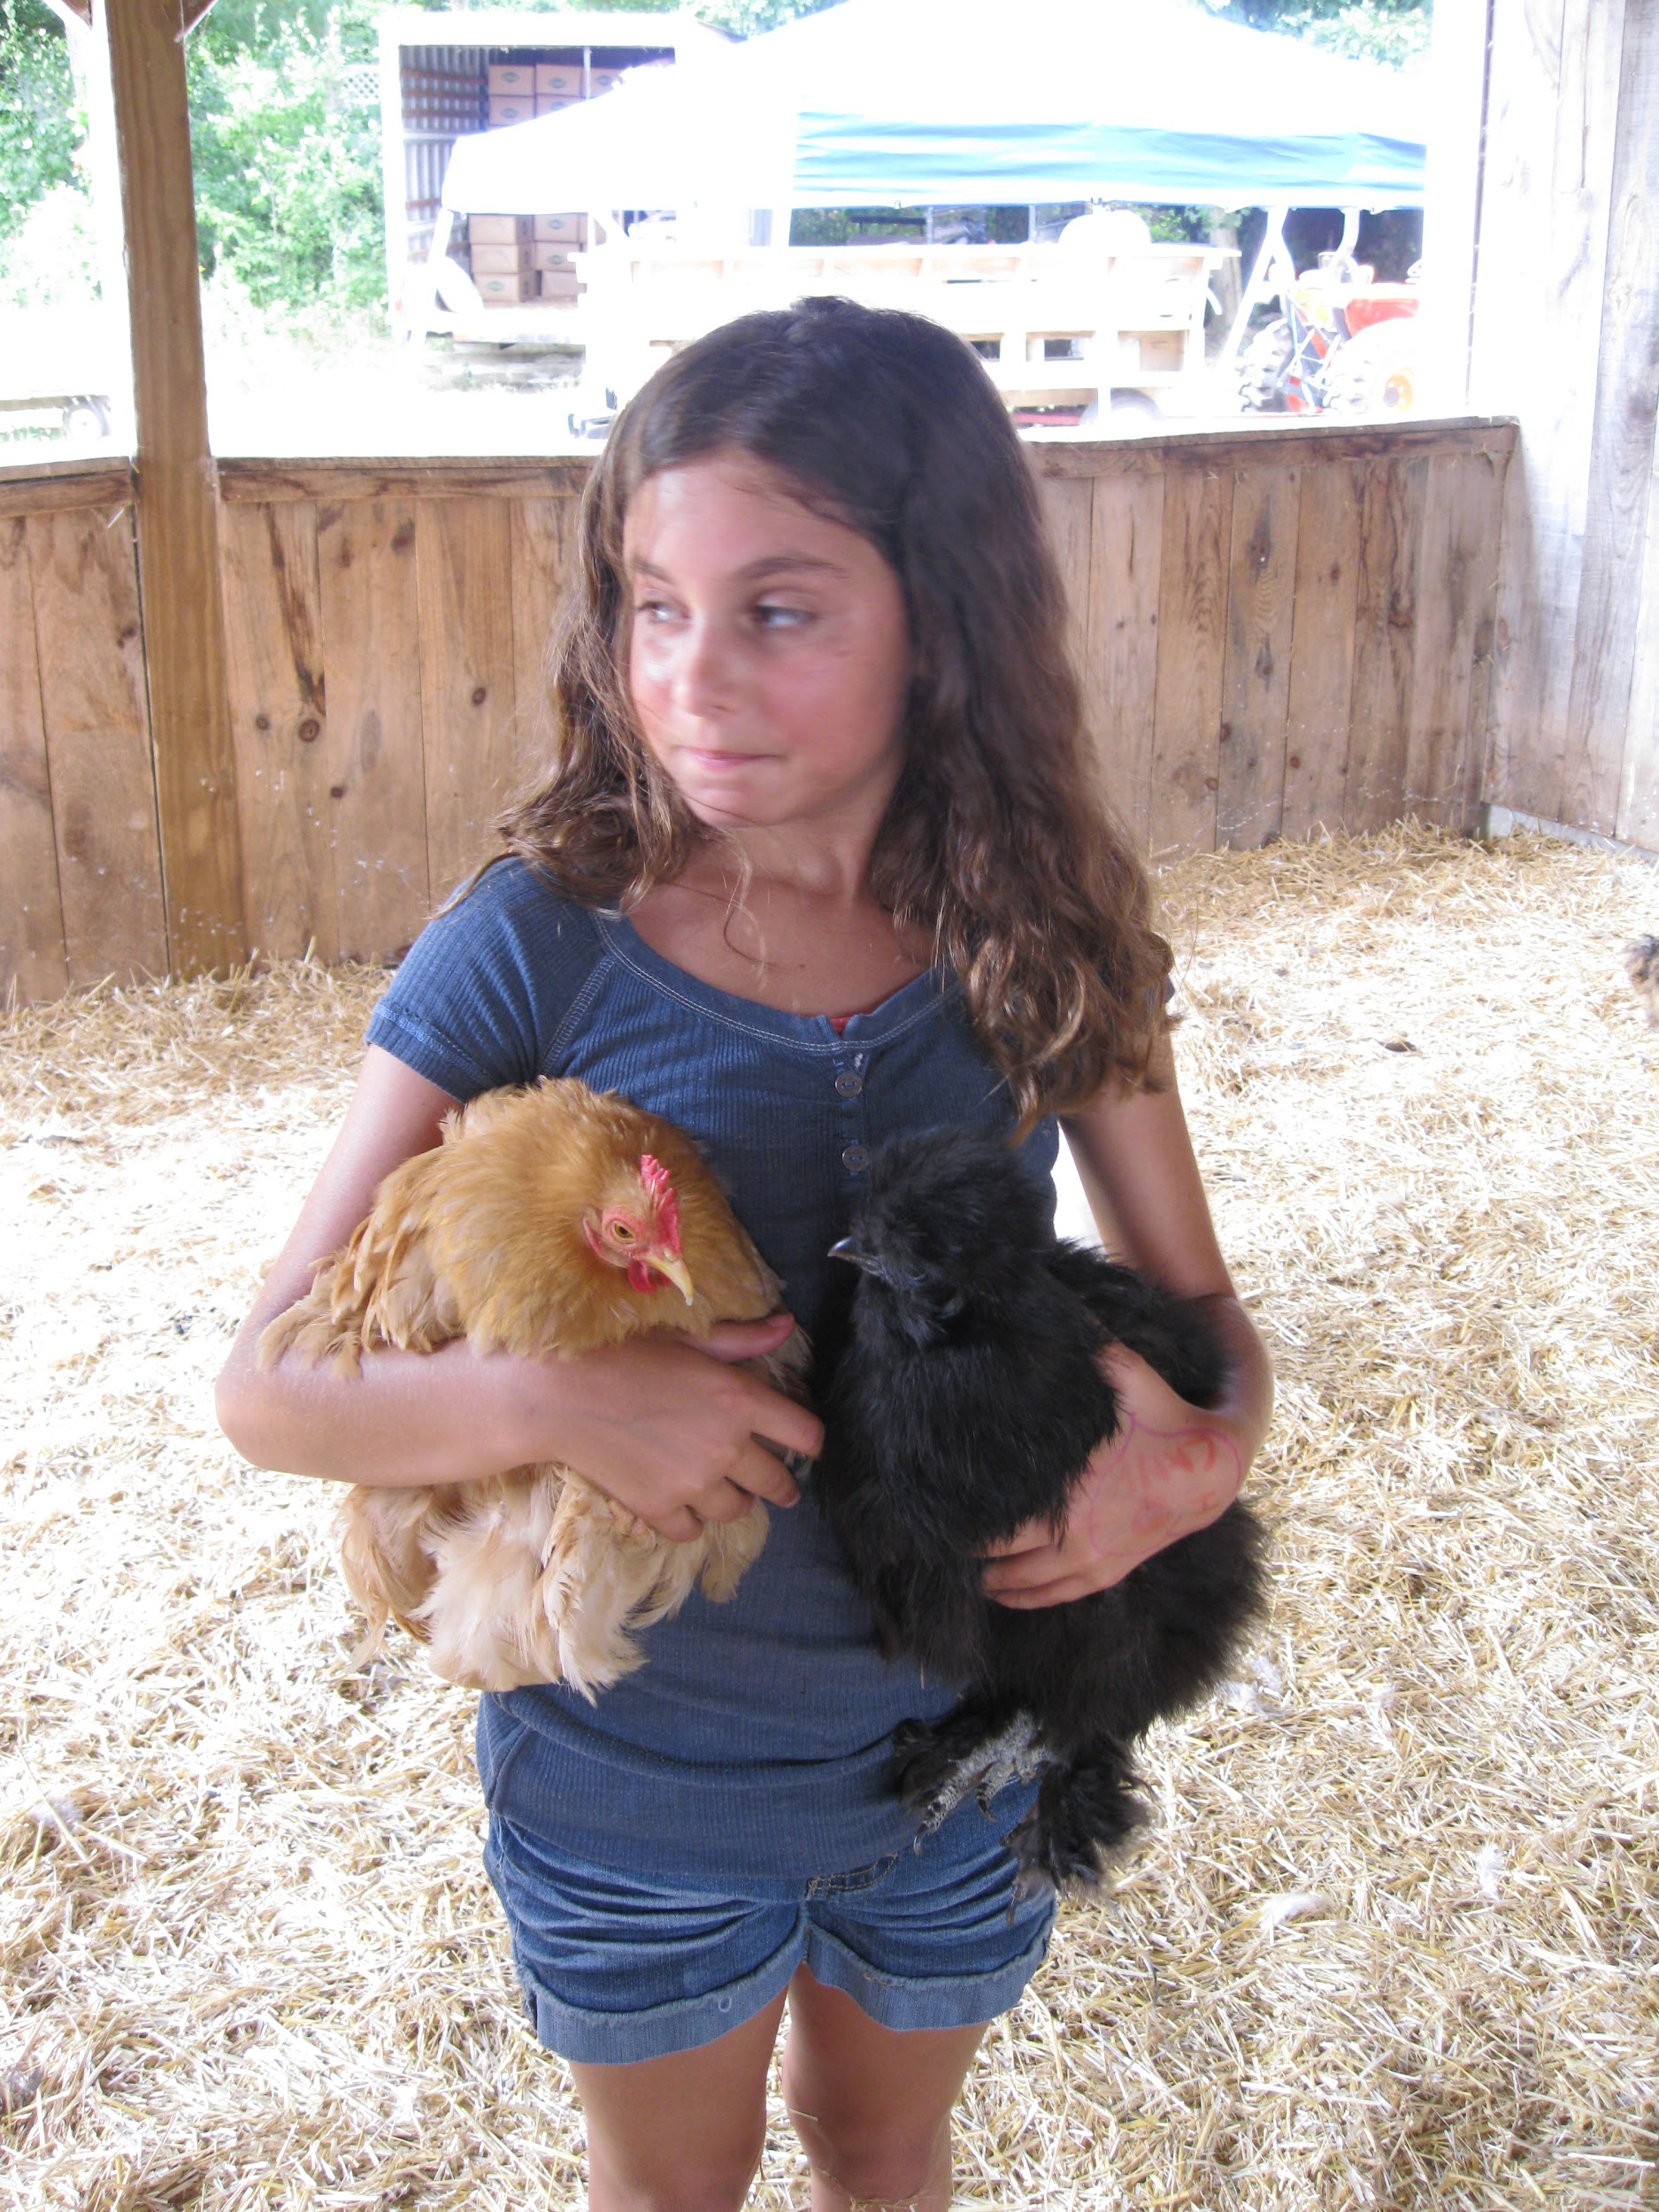
4.NF.B3

Slide 3
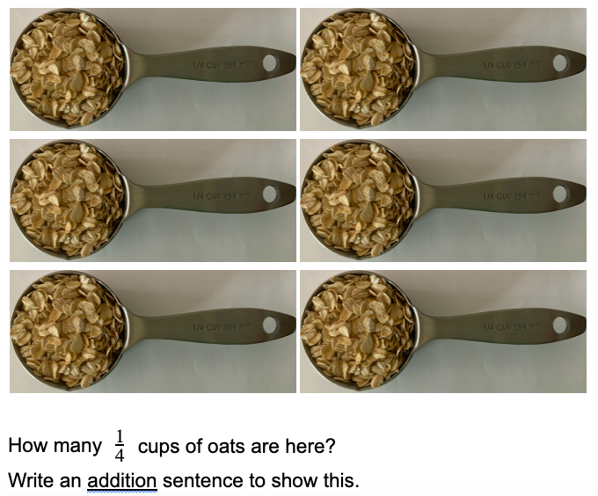
4.NF.B4

Slide 4


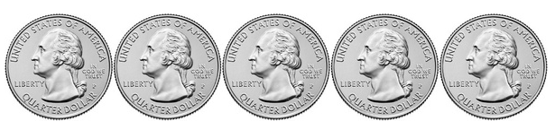
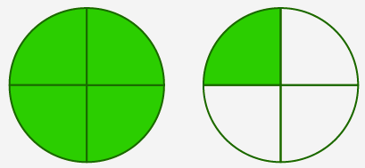
Which one doesn’t belong?
+
4.NF.A

Slide 5
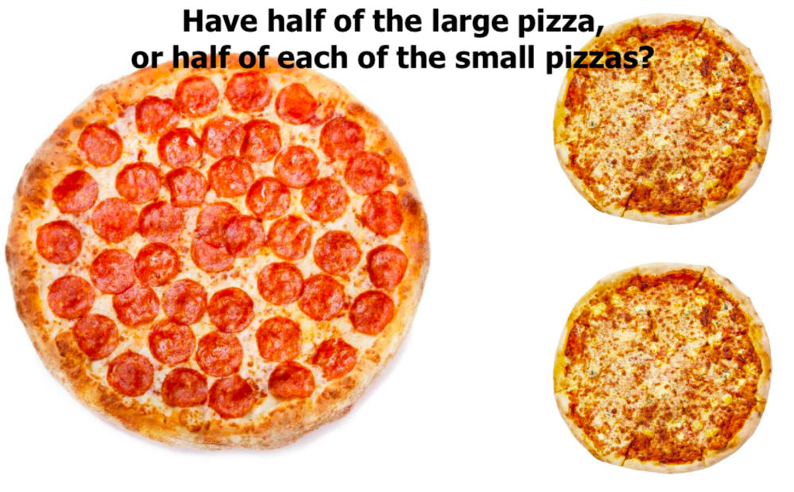
Would you rather . . .
4.NF.A

Slide 6
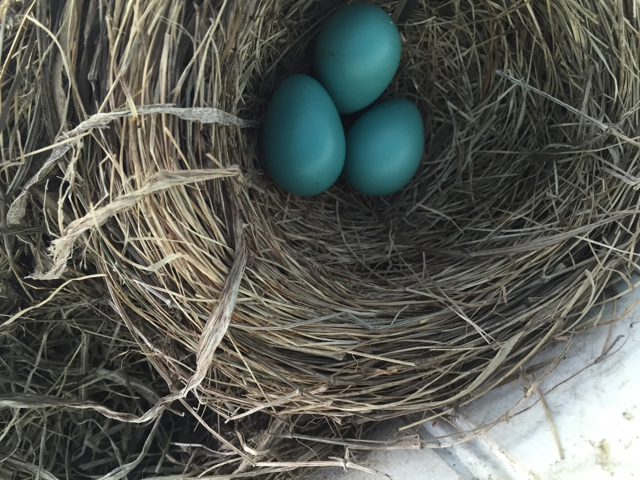
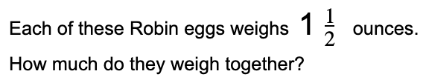
4.NF.B4
Notes:
Week of April 11, 2022

Slide 7
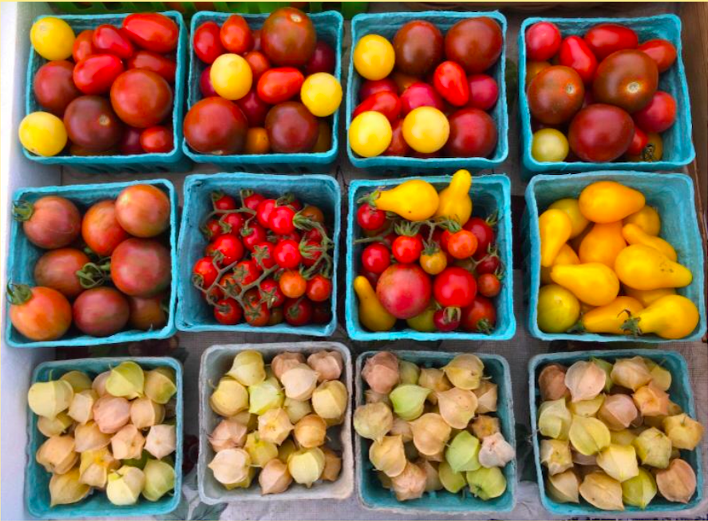
What math do you see here?
Do you see any fractions?
4.NF

Slide 8
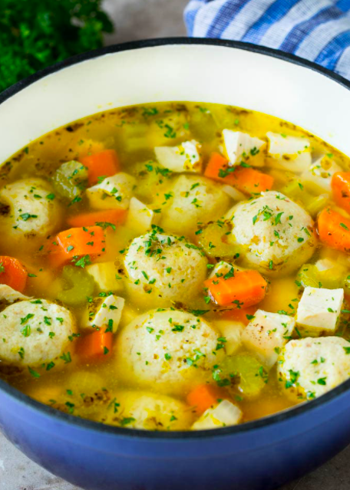
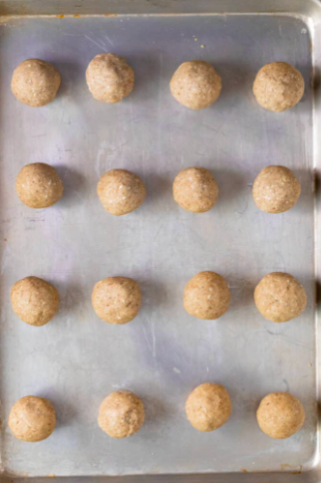
How many matzo balls are in the soup?
Estimate!
What might be too low? Too high? Just right?
4.OA.A3

Slide 9
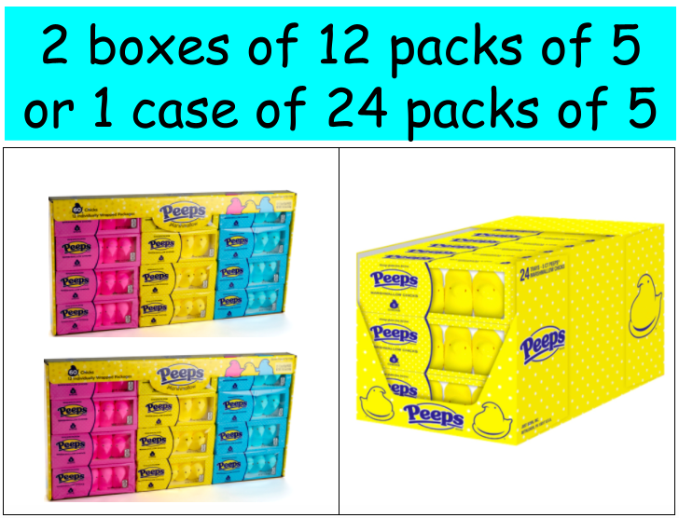
$19.50
$9.99 each
4.OA.A3

Slide 10
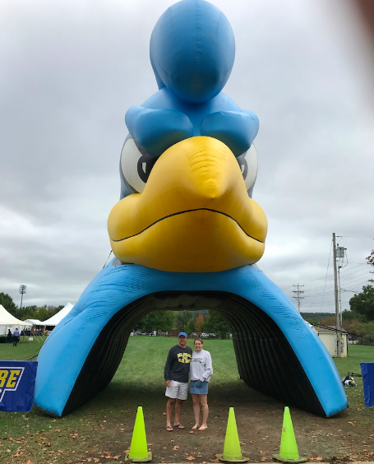
How tall is the University of Delaware BLUE HEN?
HINT! Mark (in the blue shirt) is about 6 feet tall, what fraction of the hen might he be?
4.NF.B3
Notes:
Week of April 25, 2022

Slide 11
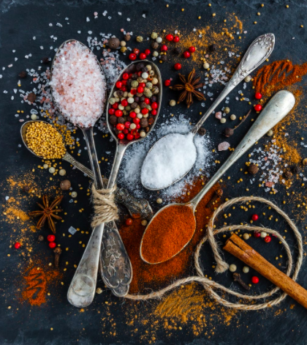
What FRACTIONS can you see in this picture?
4.NF.A2

Slide 12
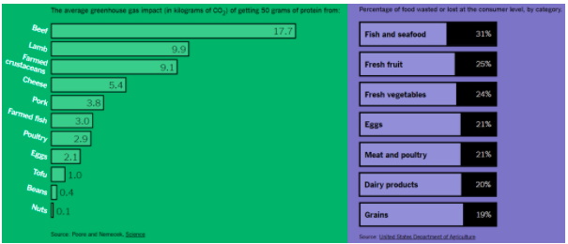
What do you notice? What do you wonder?
Why does it matter?
4.MD.B
Notes:
What effect does what we eat, and the food we waste, have on the environment?

Slide 13
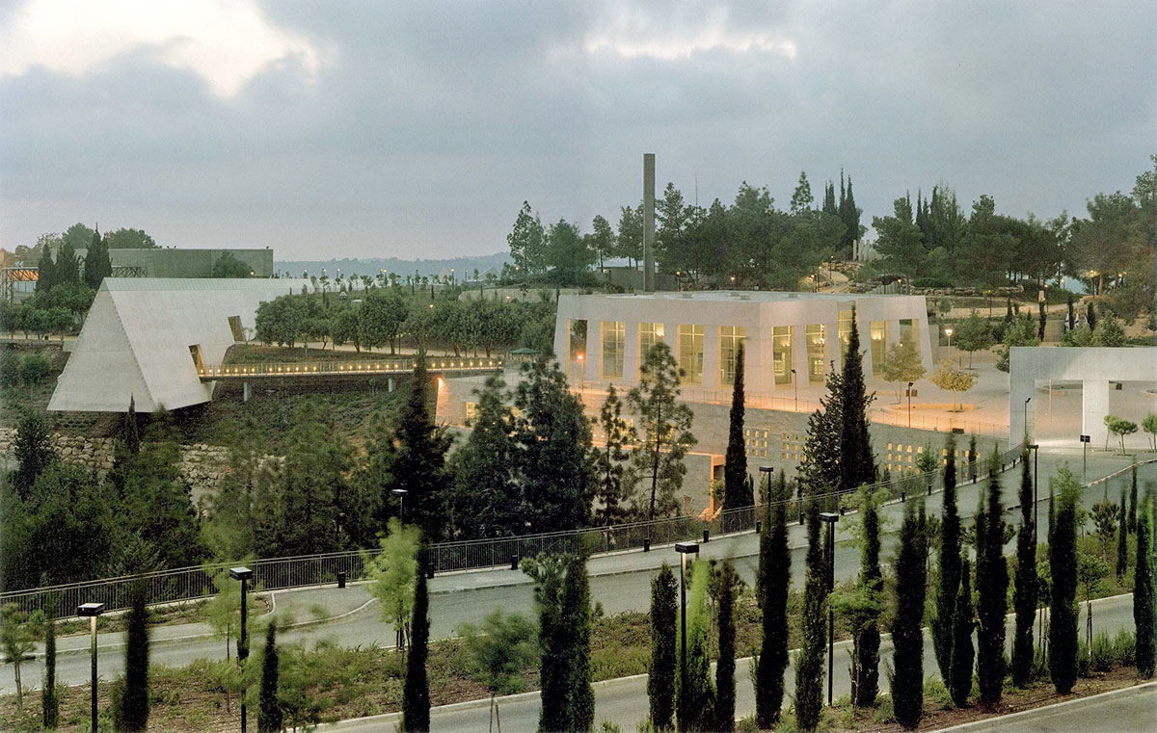
Yad Vashem ~ יָד וַשֵׁם ~ A Memorial and a Name
Yad Vashem is the second most visited site in Israel.
This Holocaust Memorial Museum was established in 1953.
How can we use mental math to figure out how long ago that was?
4.NBT.B4
Notes:
April 28, 2022
Yom Hashoah

Slide 14
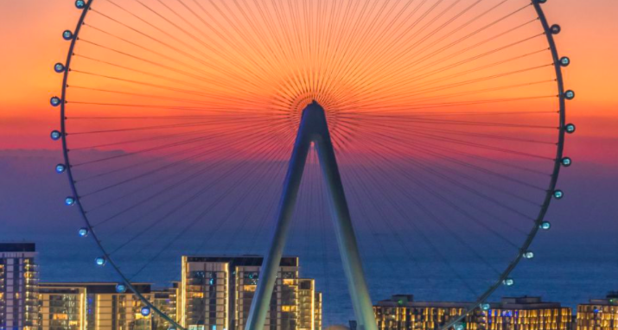
Ain Dubai (the eye of Dubai) is the world’s highest observation wheel.
It will take 48 minutes to make a full rotation! What fraction of an hour is that?
4.MD.A1

