Slide 1
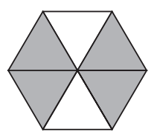

Which of these fractions represents the part of the shape that is shaded?
What do we notice?
What do we wonder?

Slide 2
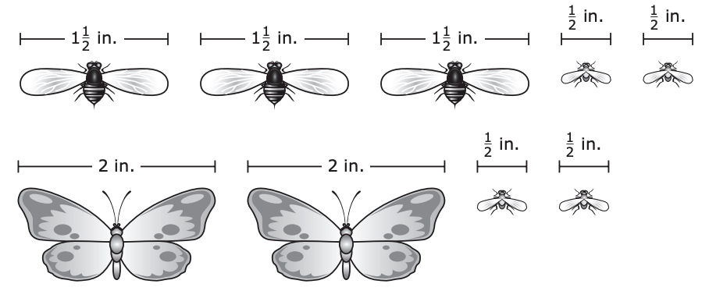
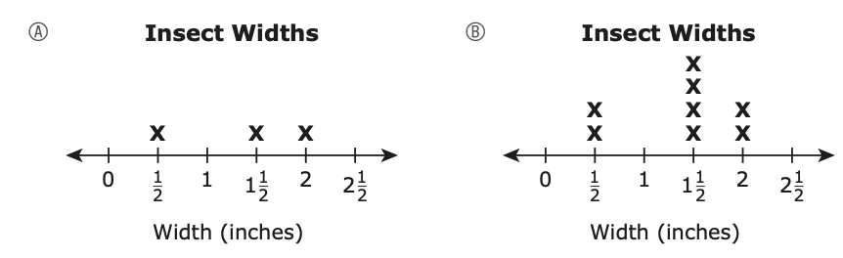
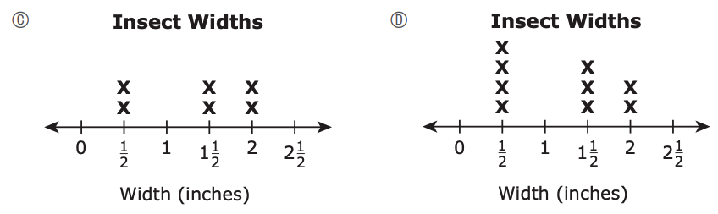
What do we notice about the widths of these insects?
Which line plot shows the number of insects with each width?

Slide 3
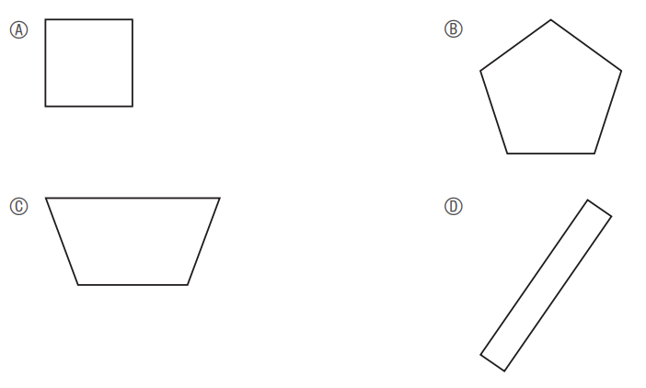
What’s the same? What’s different?
Which of these is a quadrilateral that is not a rectangle?

Slide 4

How much change should Harry get back?
A. $6
B. $8
C. $12
D. $14
Harry bought 2 books.
Each book cost $4.
He paid with a $20 bill.

Slide 5

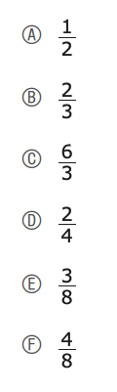

What do we know about this fraction?
What are some equivalent fractions?
Select the three correct answers.

Slide 6
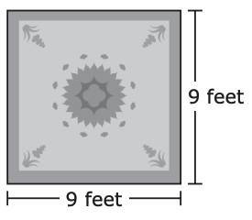
A green rug is in the shape of a square, as shown.
A blue rug is in the shape of a rectangle.
The blue rug has the same perimeter as the green rug, but it has a different length and a different width.
What could be the length and width, in feet, of the blue rug?
What can we say about this rug?
Think area and perimeter!
What is the perimeter of the rug?

Slide 7
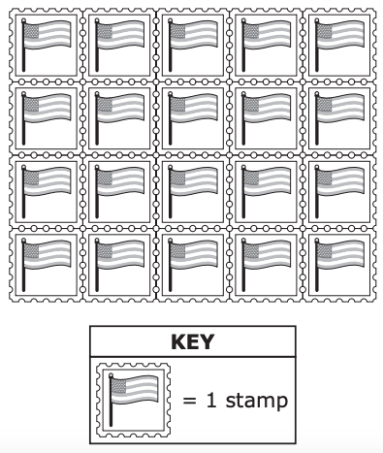
The post office sells pages of stamps. Each page has the same number of stamps.
One page of stamps is shown.
Christa bought 6 pages of stamps.
How many stamps did Christa buy in all?

Slide 8
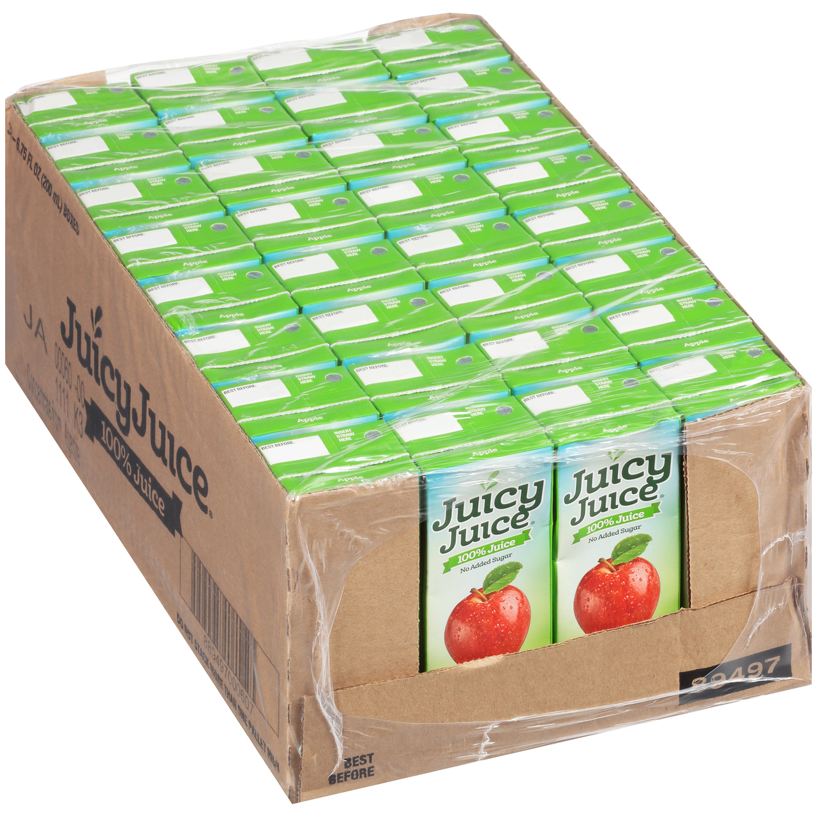
Can you write an expression for:
A. A student has 56 juice boxes. A cooler will hold 7 juice boxes. How many coolers are needed to hold all of the juice boxes?
B. A student has 56 juice boxes. Of the 56 juice boxes, 7 juice boxes are fruit punch. How many juice boxes are not fruit punch?
C. A student has 56 juice boxes. He will give 7 juice boxes to his brother. How many juice boxes will the student have remaining?
D. A student has 56 juice boxes. He will buy 7 more juice boxes at the store. How many juice boxes will the student have after he gets home from the store?
E. A student has 56 juice boxes. The juice boxes are in packages. Each package has 7 juice boxes. How many packages of juice boxes does the student have?
Which of these problems can be solved using this division expression?
56 ÷ 7

Slide 9
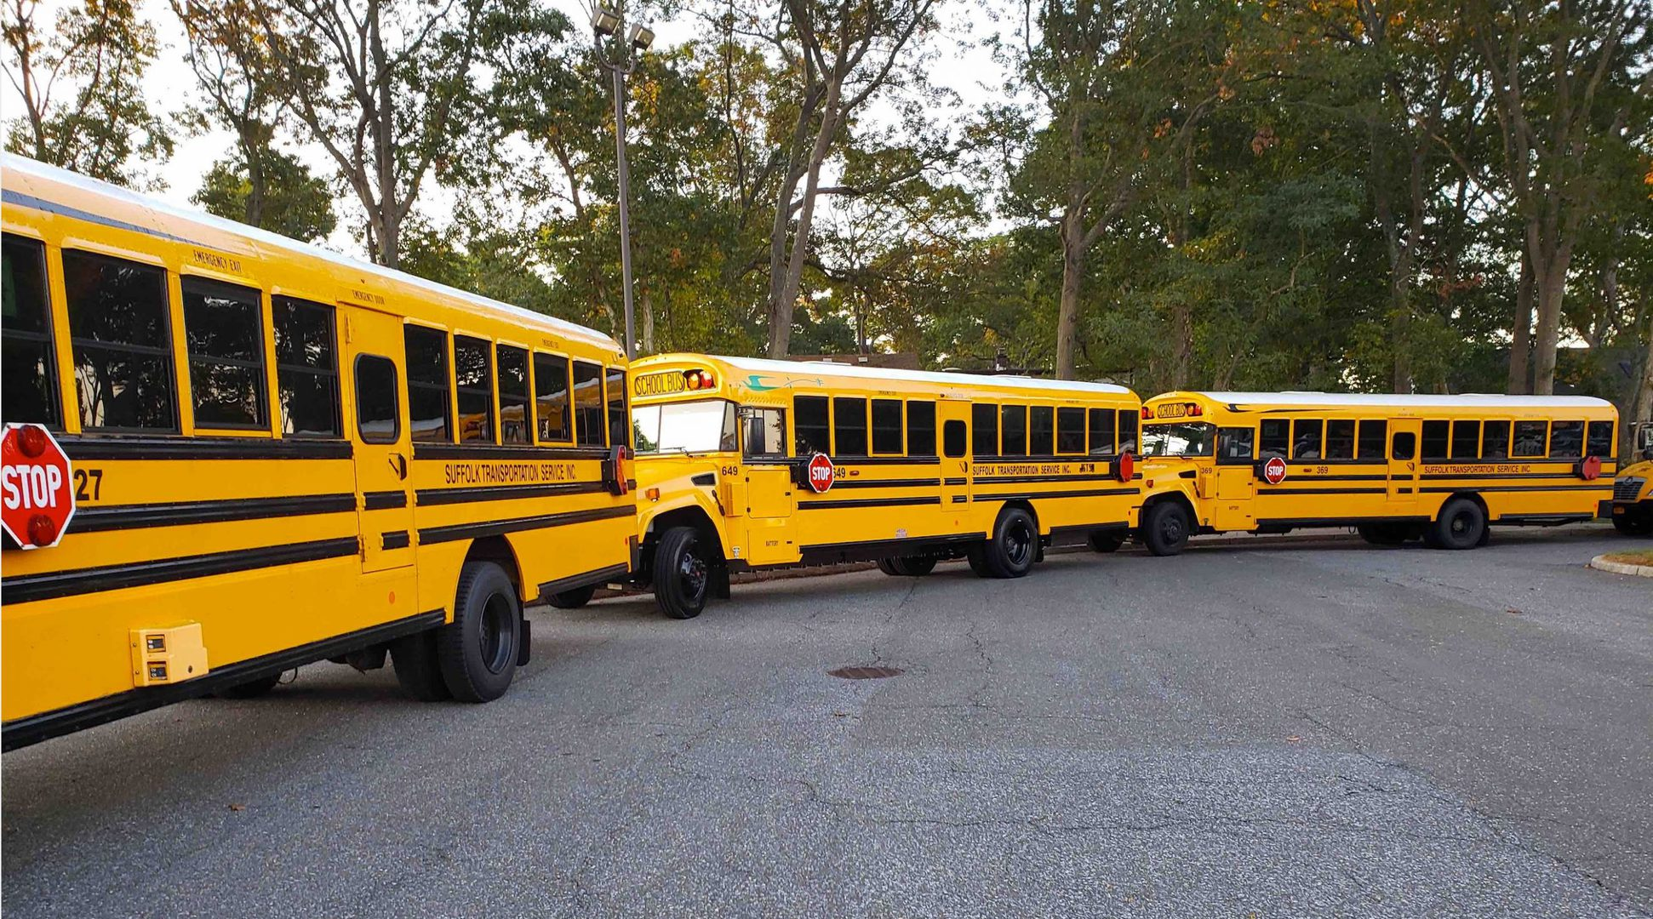
The students at a school went on a field trip.
The school used 4 buses for the field trip.
There were 60 students on each bus.
What was the total number of students who went on the field trip?

Slide 10

What is the missing number that makes this number sentence true?
A. 2
B. 7
C. 11
D. 18

Slide 11
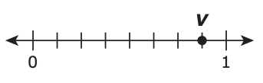

Which fraction shows where point V is on the number line?

Slide 12

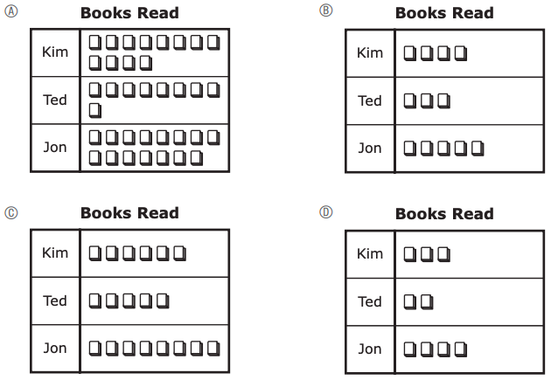
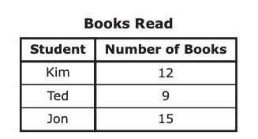
This table shows the number of books read by three students during the school year.
What do we notice?
What do we wonder?
Which picture graph shows the number of books read by each student during the school year?

Slide 13

I’m thinking of a number that rounds to 90!
What’s possible?
Which number rounds to 90 when rounded to the nearest 10?
A. 84 B. 97
C. 85 D. 96

Slide 14
A. (2 + 15) + (4 + 15)
B. (6 × 5) + (6 × 10)
C. (6 × 5) + (6 × 7)
D. (6 × 6) + (6 × 7)
What can we say about these expressions?
Sergio and Tameka want to find the solution to this equation. 6 × 15 = ?
Which of the expressions above can Sergio use to help him find the solution to the equation?
What number belongs in the ? to make the equation true?
Tameka says she can use this expression to solve the same equation. (6 × 7) + (6 × 8)
Is Tameka correct?

Slide 15
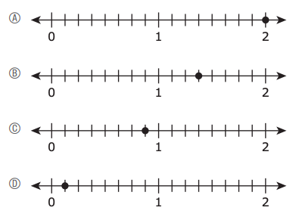
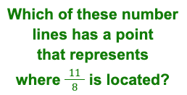
What do we notice?

Slide 16
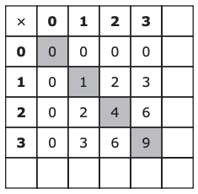
Maya made a pattern by shading some numbers on a multiplication table.
What do we notice about her pattern?
What is the next number she will shade in?

Slide 17
16 ÷ 2 = g
Which of these can also be used to find
the value of g?
A. g × 2 = 16
B. 2 ÷ 16 = g
C. g ÷ 2 = 16
D. 16 × 2 = g
Can we record another number sentence in this
fact family?

Slide 18

Jessica has 3 vases. She wants to put the same number of flowers in each vase.
She has 27 flowers altogether.
Jessica wrote this number sentence to find out how many flowers to put in each vase.
3 × ? = 27
What is the missing number that makes Jessica’s number sentence true?
A. 6 B. 7
C. 8 D. 9
Write an number sentence to represent this situation.

Slide 19


A figure is divided into four equal parts.
Which fraction of the total area of the figure is one part?

