Slide 1
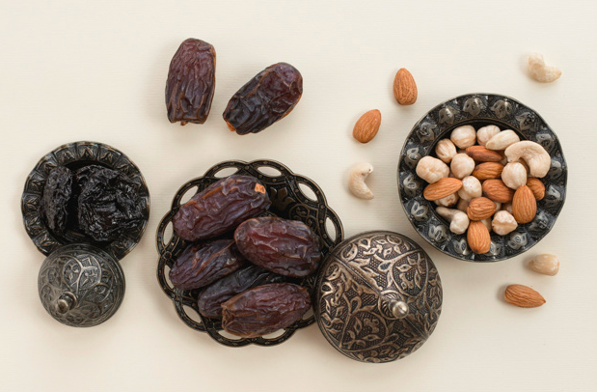
Dates and Almonds are traditional Ramadan treats.
Dates weigh an average of 24 grams each.
How many might be in this bowl?
How many grams altogether?
3.MD.A2
Notes:
Week of April 4, 2022
Ramadan

Slide 2

Would you rather
3.MD.A2

Slide 3
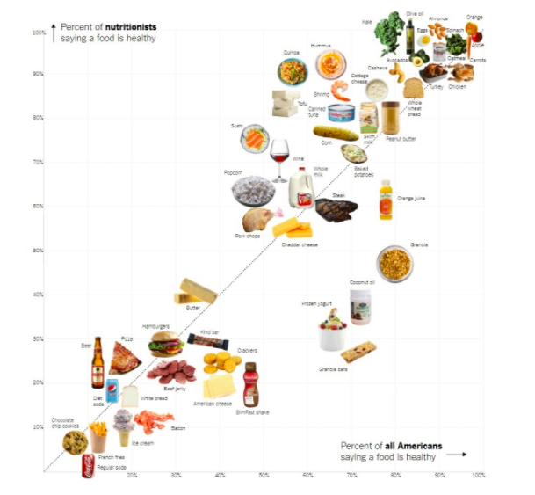
What do you notice?
What do you wonder?
Why does it matter?
What is a good name for this graph?
3.MD.B

Slide 4
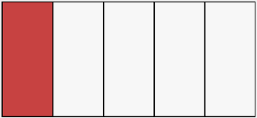
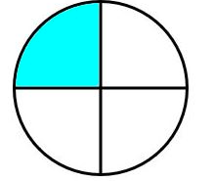


Which one doesn’t belong?
3.NF.A3

Slide 5
Now draw a shape that is DIFFERENT from the shape in 1 way, but the SAME in another way.
How are they DIFFERENT?
How are they ALIKE?
Sketch this shape?
What is it?
3.G.A1

Slide 6
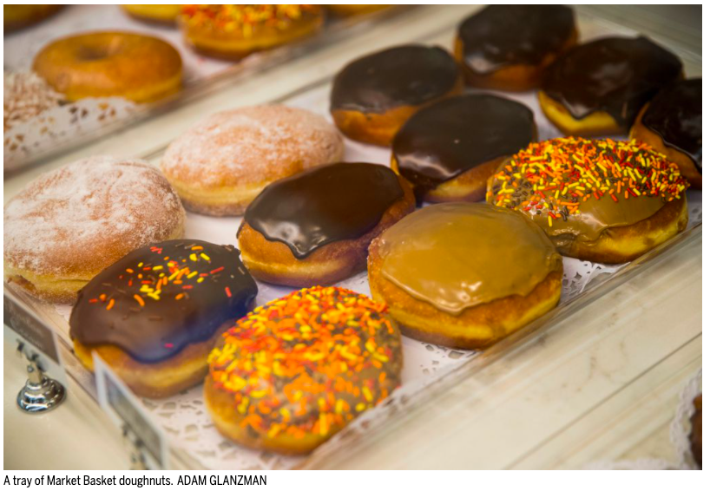
Donut Madness at Market Basket!
Which donut will win?
Will Honey Glazed win again this year, or maybe Boston Creme?
Market Basket started with 16 donut flavors.
What can you say about the number 16? How many different ways can you make 16?
3.OA.D
Notes:
Week of April 11, 2022

Slide 7
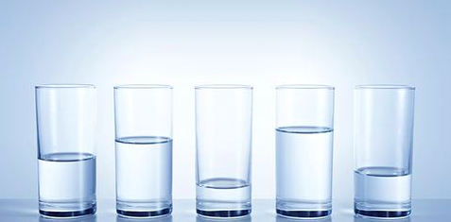
Do you see any fractions here?
Estimate what fraction of the whole glass is full.
3.NF.A3

Slide 8
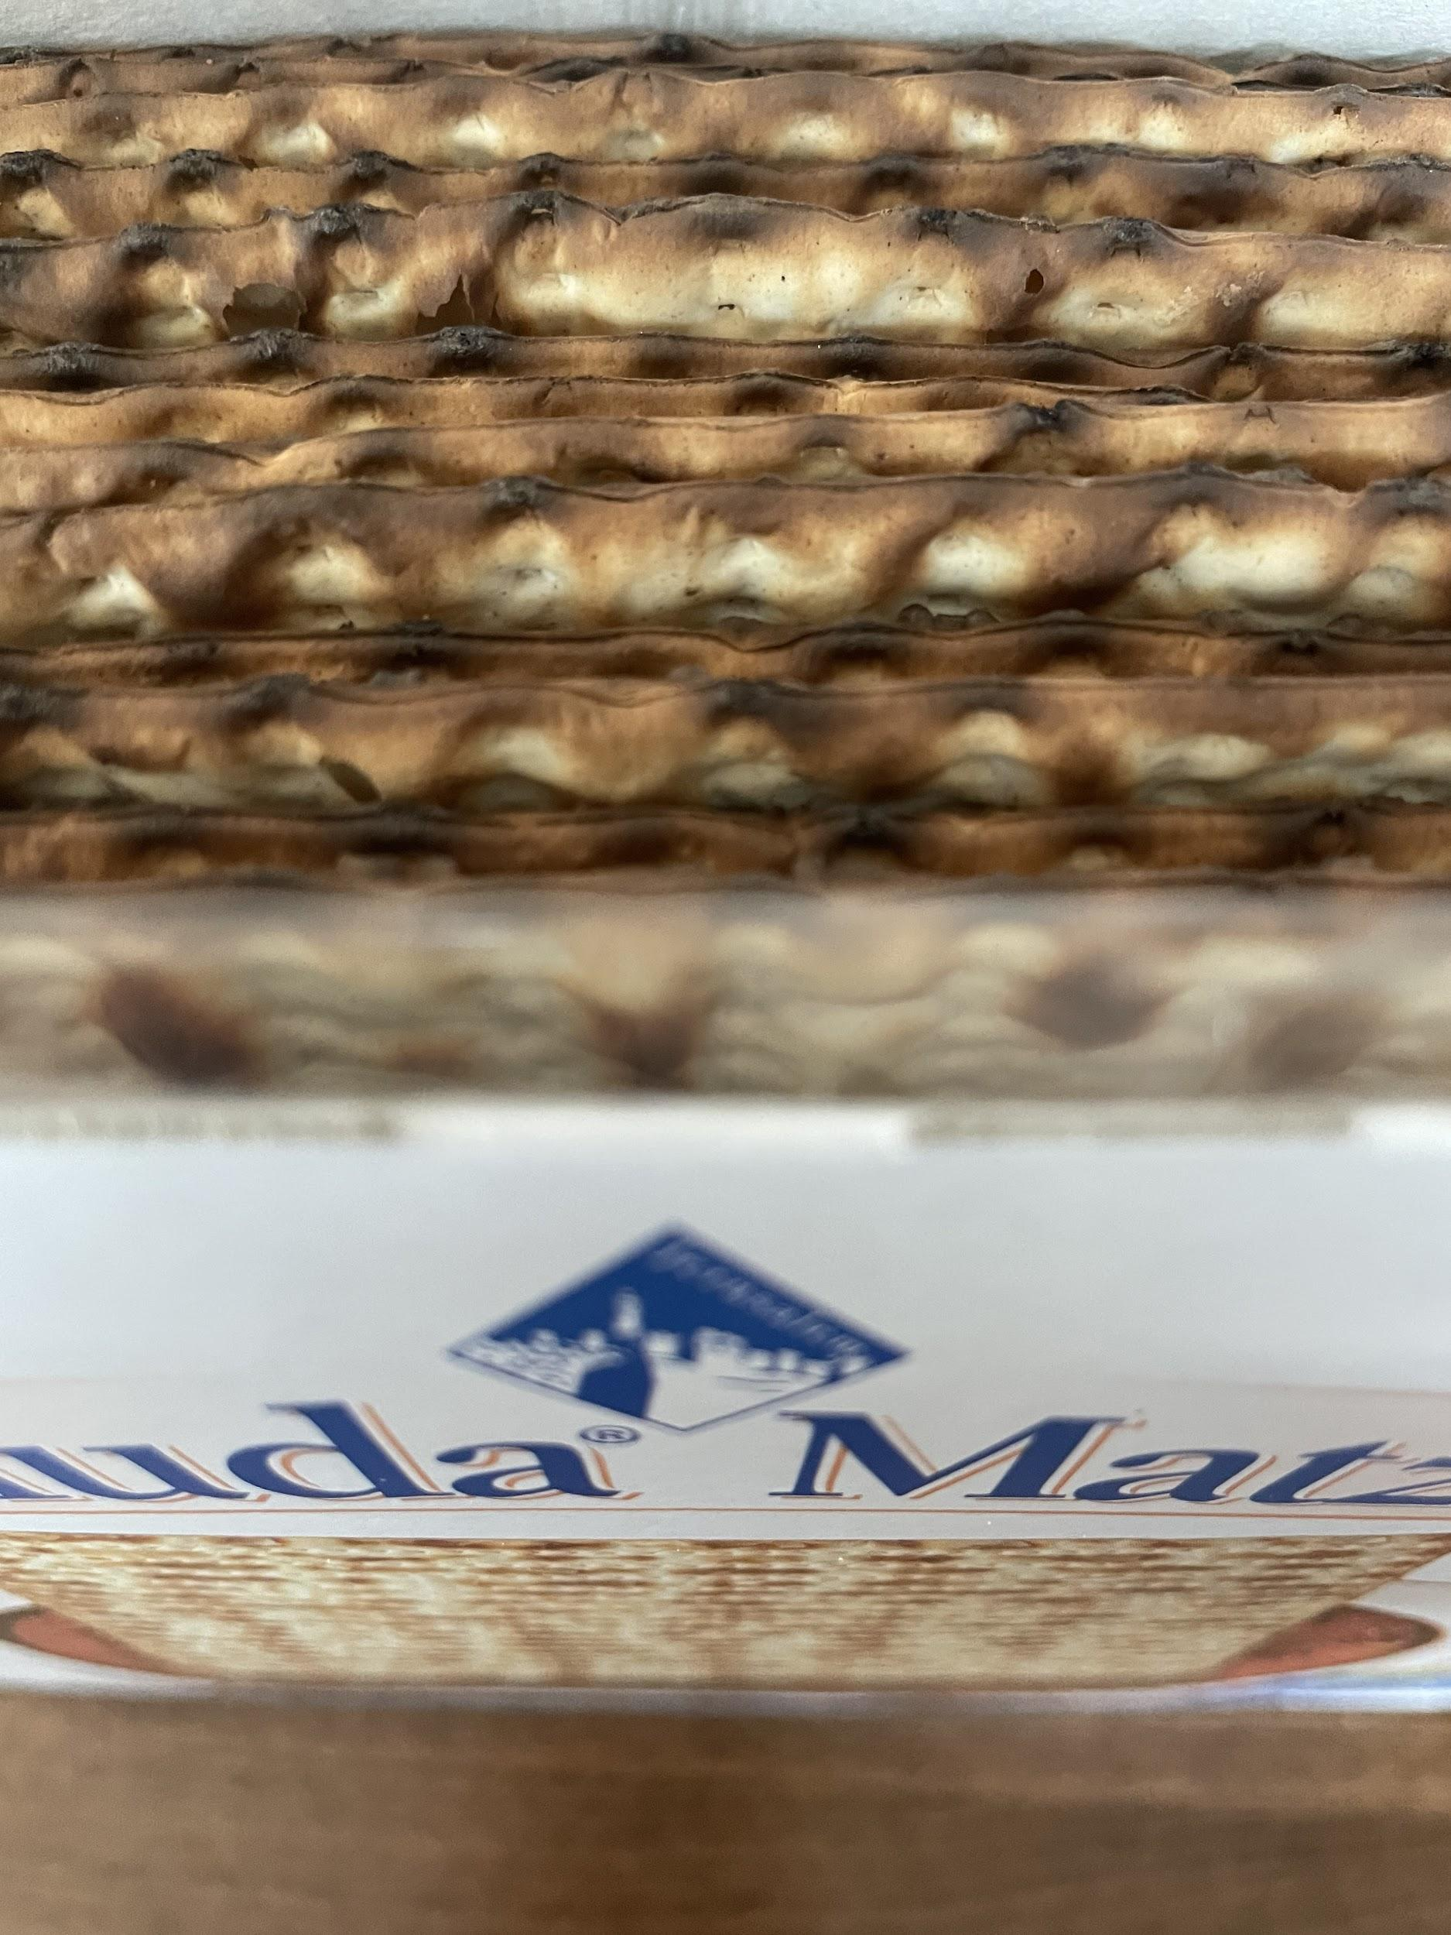
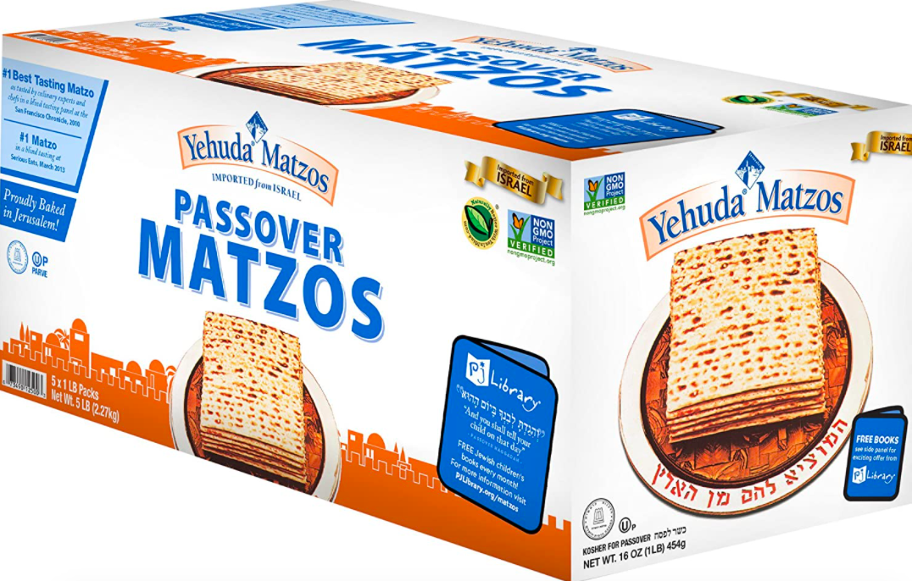
How many pieces of matzo in each box?
There are 14!
How many in a case of 5 boxes?
3.OA.A3

Slide 9
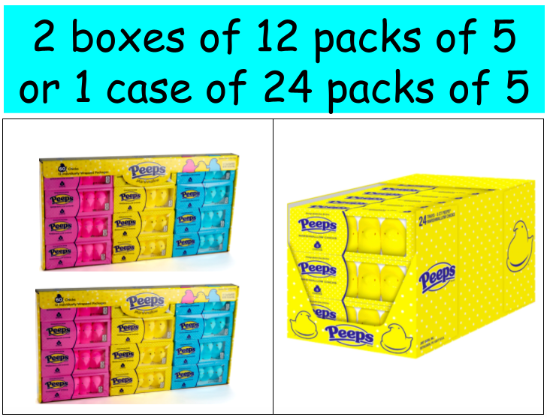
$19.50
$9.99 each
3.OA.A3

Slide 10
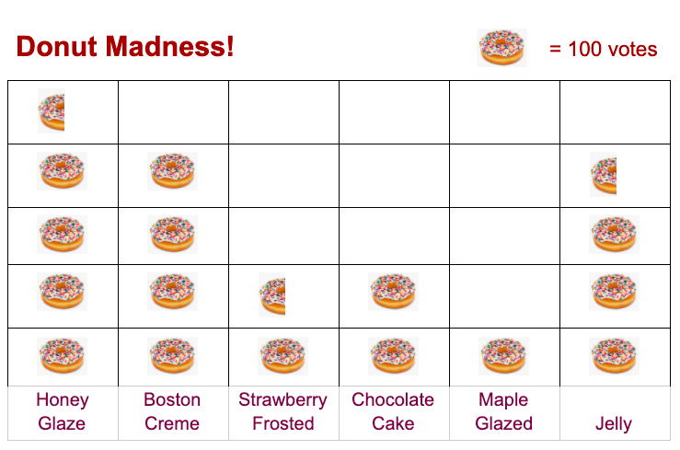
What’s going on in this graph?
What questions do you have?
3.MD.B3
Notes:
Week of April 25, 2022

Slide 11
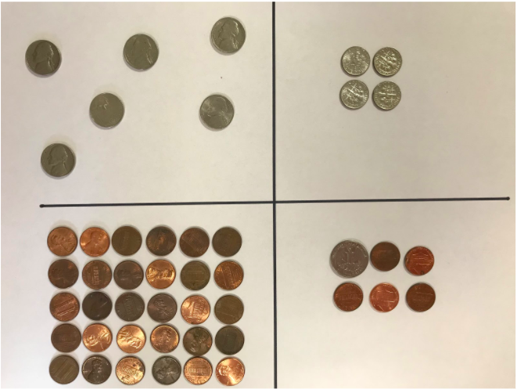
Which one doesn’t belong?
3.MD

Slide 12
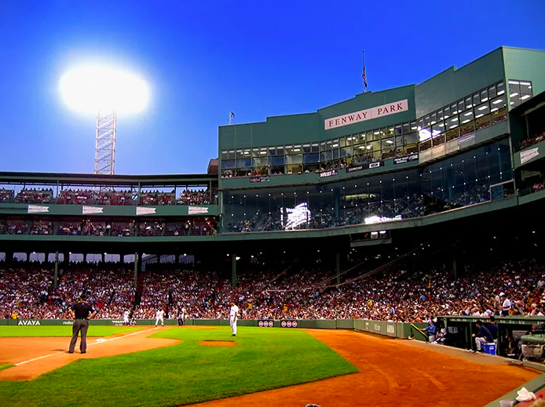
Fenway Park has a capacity of 37,731 fans!
At the beginning of the 2021 baseball season, because of Covid, seating for Red Sox games was only 4,500 fans.
How much less is that than full capacity?
3.NBT.A2

Slide 13
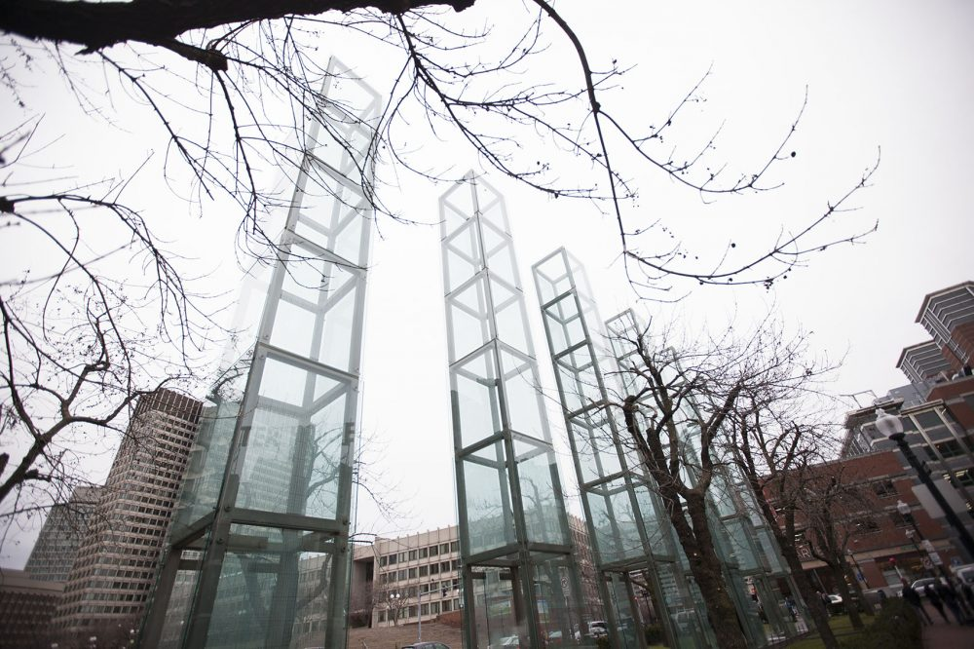
The Holocaust Monument in Boston is made up of 6 towers that each stand 54 feet tall.
How many feet is that in total?
3.MD.A2
Notes:
April 28, 2022
Yom Hashoah

Slide 14
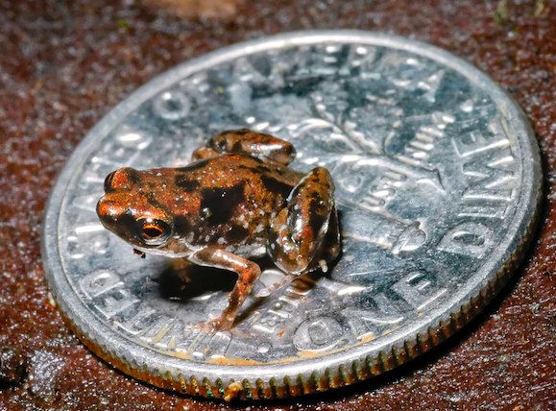
The smallest frog in the world can be found in the rain forests of Papua New Guinea.
Here he is sitting on a dime, he measures only 7 millimeters.
How small is that?
What can you compare that to?
3.MD.A2

