Slide 1
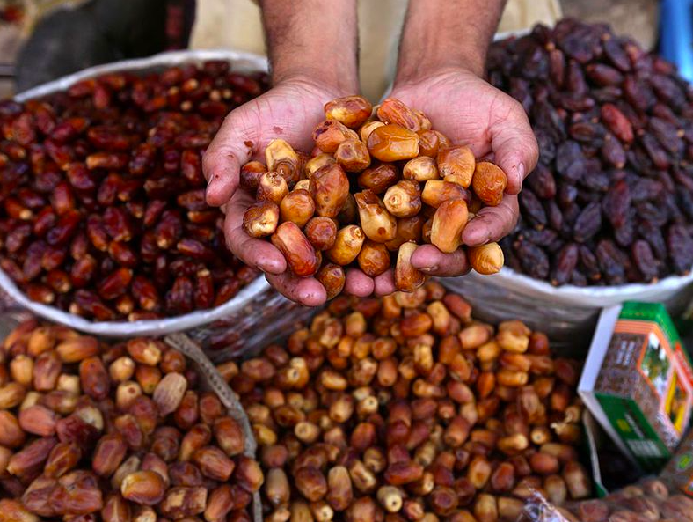
Dates are traditional snacks during Ramadan.
This handful of dates weighs about a half a pound.
How much might all of these dates weigh?
2.OA.B3
Notes:
Week of April 4, 2022
Ramadan

Slide 2
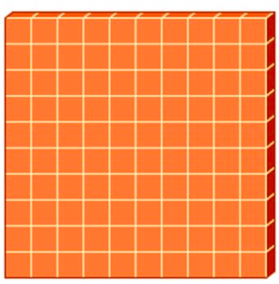


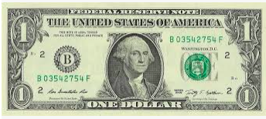
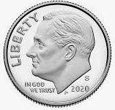
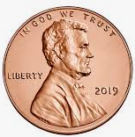
Which one doesn’t belong?
2.NBT.B4

Slide 3
Draw this shape.
Now draw a shape that is DIFFERENT from the shape in 1 way, but the SAME in another way.
How are they DIFFERENT?
How are they ALIKE?
2.G.A1

Slide 4
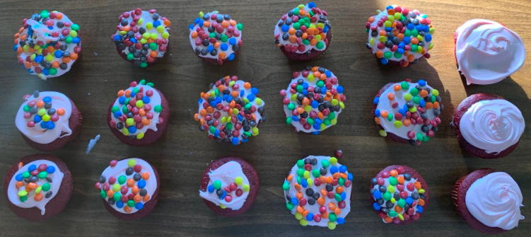
Where’s the Math?
2.OA.C4
Notes:
Week of March 8, 2021

Slide 5

The Hood Milk Bottle is 40 feet tall.
If you are about 4 feet tall, how much taller is it than you?
How many TIMES taller is it than you?
2.MD.A4

Slide 6
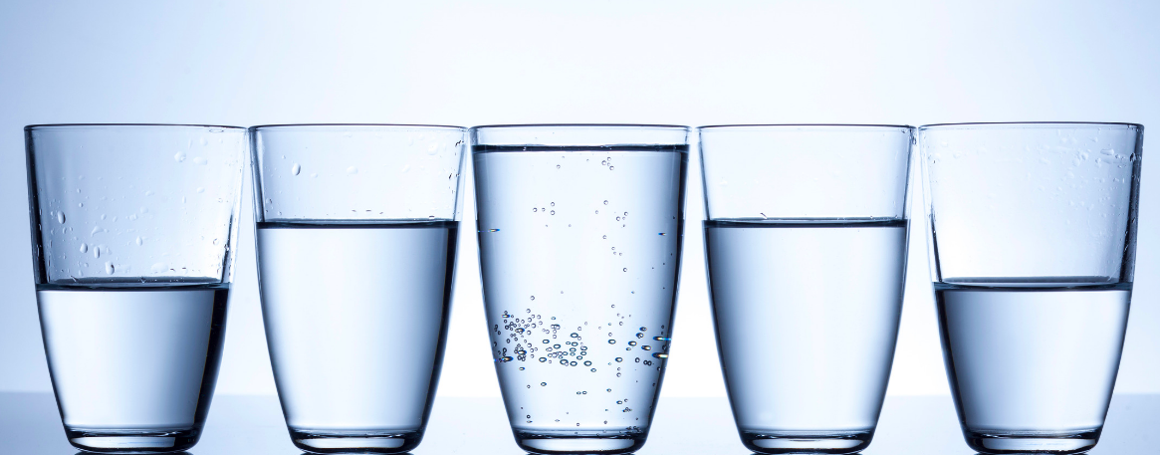
What do you notice? What do you wonder?
What math sentences can you create to match the photo?
2.G.A3
Notes:
Week of April 11, 2022

Slide 7
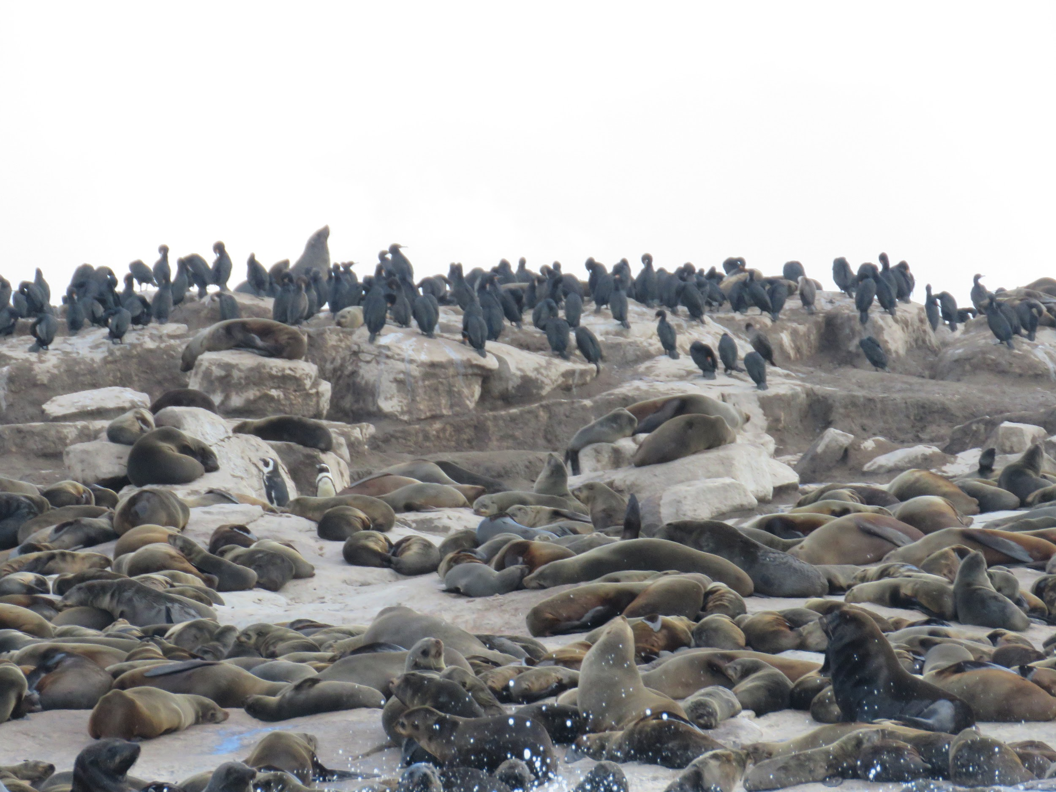
How many seals do you think are here on Robben Island in South Africa?
Estimate!
Why would you want to know?
2.OA.A

Slide 8
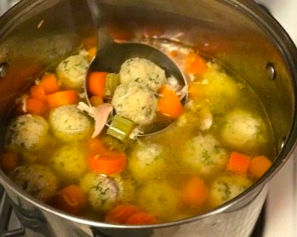
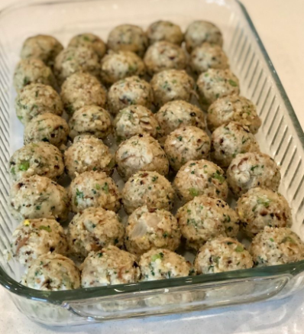
How many matzo balls are in the soup?
What is too low estimate?
What is too high estimate?
What is your just right estimate?
2.OA.C4

Slide 9
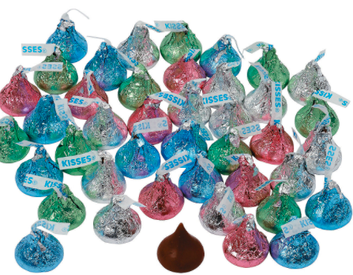
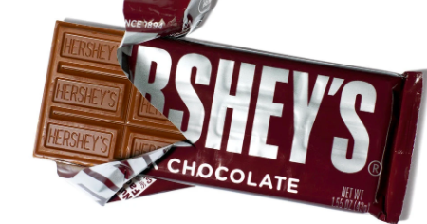
Would you rather ...
2 huge handfuls of Hershey Kisses or 1 Hershey bar?
2.MD

Slide 10
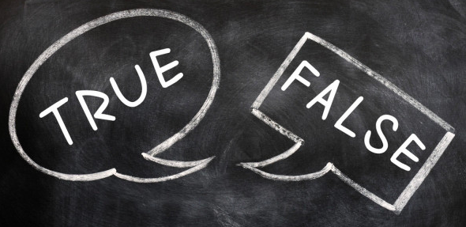
Prove it!
2 hundreds + 12 tens + 5 ones > 3 hundreds + 1 ten + 15 ones
8 hundreds + 1 ten + 32 ones = 7 hundreds + 40 tens + 12 ones
5 hundreds + 24 tens + 3 ones > 6 hundreds + 9 tens + 13 ones
2.NBT.A1
Notes:
Week of April 25, 2022

Slide 11
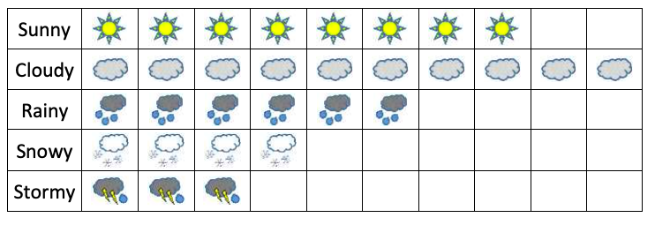
What do you notice?
What do you wonder?
What month might this be?
What is a creative name for this graph?
2.MD.D10

Slide 12
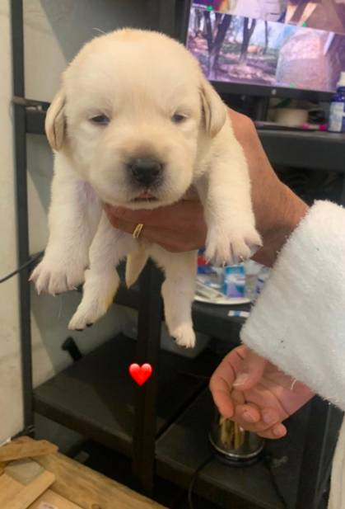
Meet Daphnee!
She is only 2 weeks old!
She now weighs 1350 grams.
Her weight will double in ten days!
How much will she weigh?
2.OA.A1

Slide 13
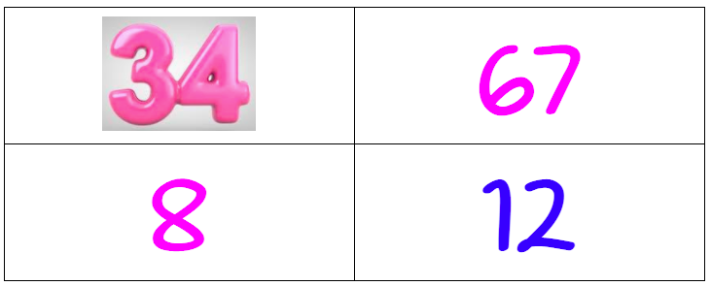
Which one doesn’t belong?
2.NBT.A4

Slide 14
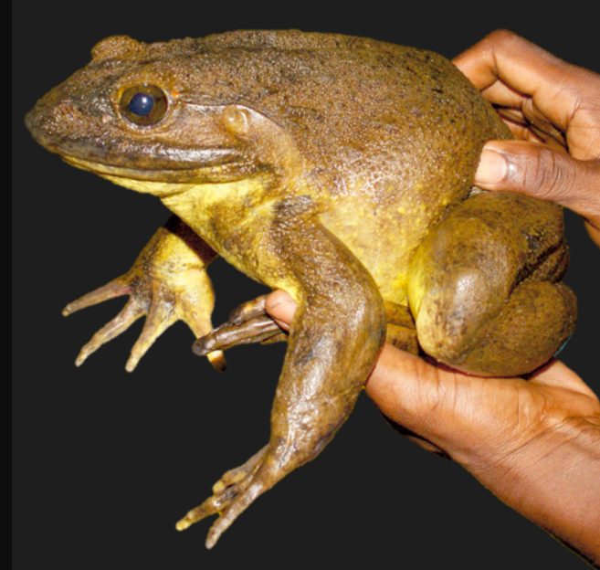
The West African Goliath Frog weighs more than 7 pounds!
Could you carry one of them?
Could you carry 2? 3? 10?
Why or why not?
2.MD.B

