Slide 1
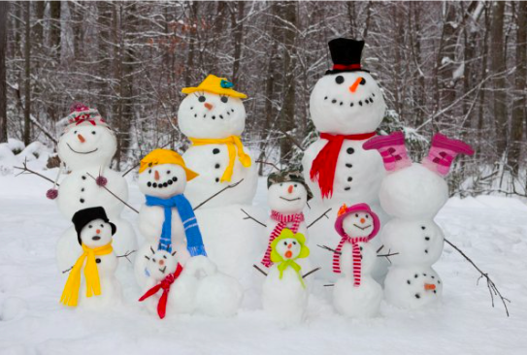
What can we say about this snow family?
Use words like next to, bigger, smaller…
What math do we see?
How many buttons? How many carrot noses?How many eyes?
K.MD.B3
Notes:
Week of February 28, 2022

Slide 2
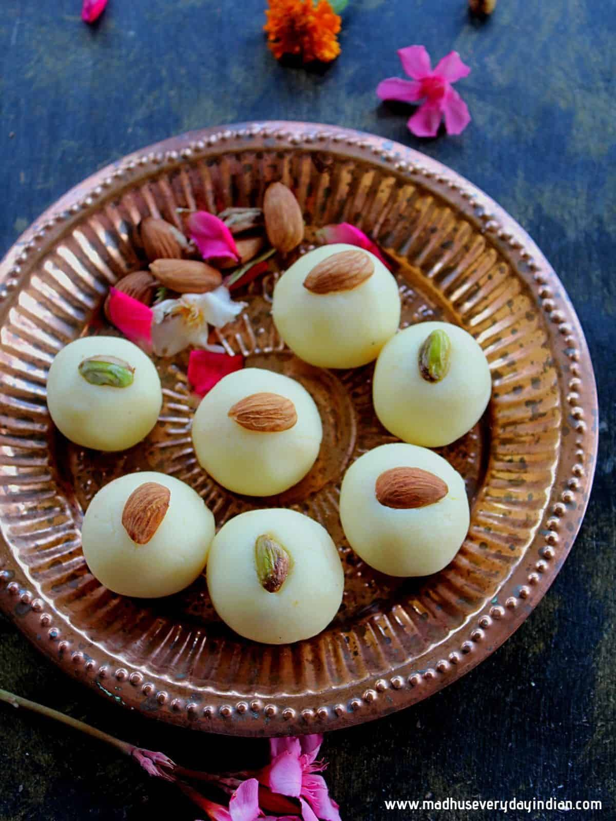
Maha Shivaratri Festival!
How many Malai Peda do we see?
How do we see them?
Create an equation to match your thinking!
K.CC.A5
Notes:
March 1, 2022
Maha Shivaratri Festival

Slide 3
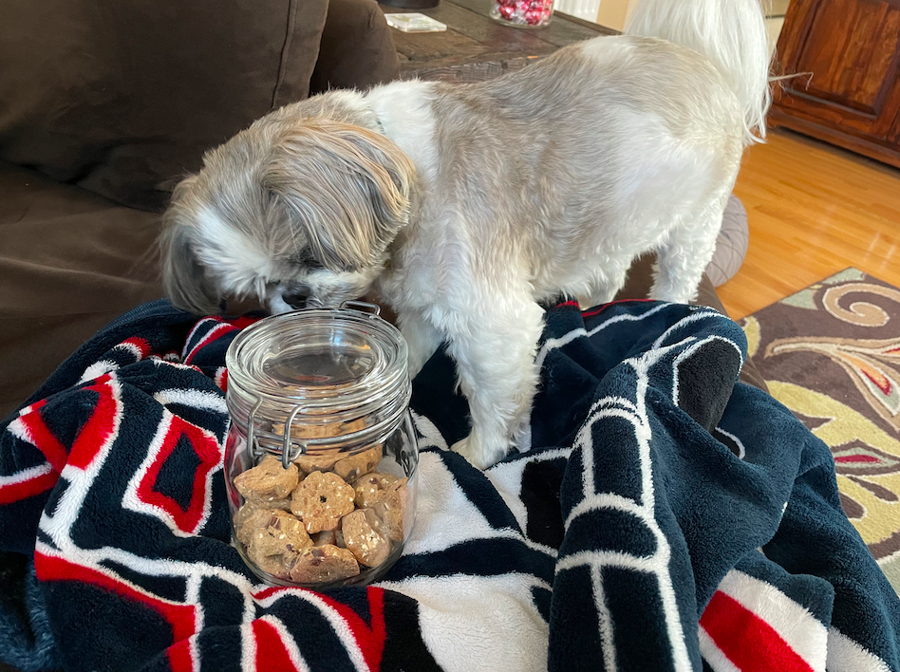
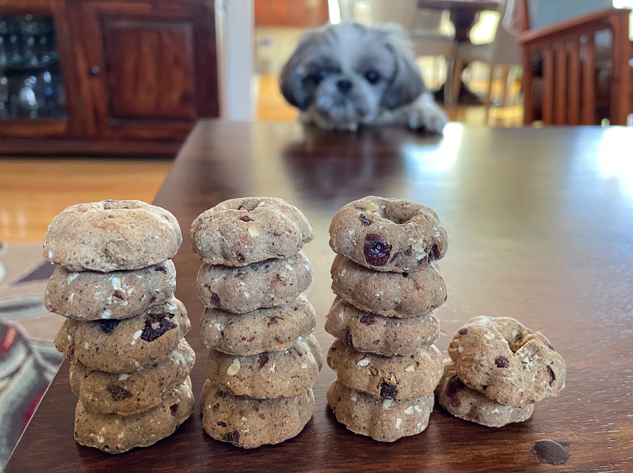
I wonder how many treats are in the jar?
Estimate!
How many different ways can you count them?
K.CC.B5

Slide 4
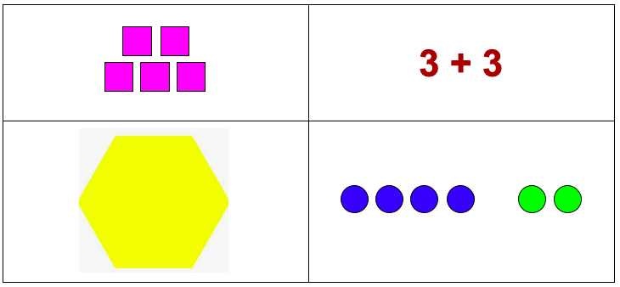
Which one doesn’t belong?
K.G.B4

Slide 5
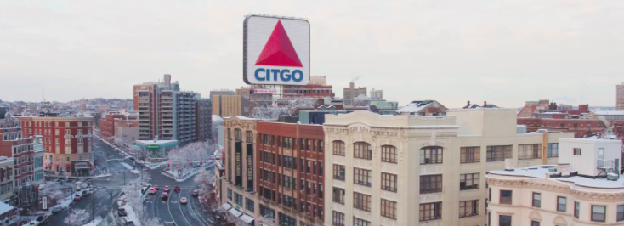
Talk about the shapes you see.
K.G.A2

Slide 6
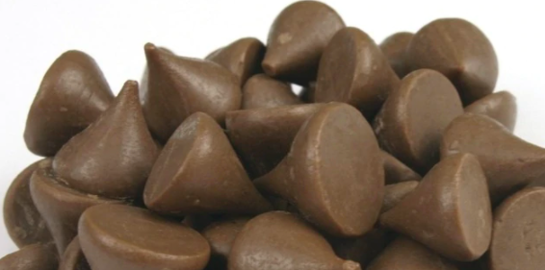
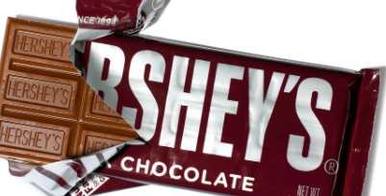
Would you rather . . .
A handful of kisses or a whole chocolate bar?
K.SMP.3
Notes:
Week of March 7, 2022

Slide 7
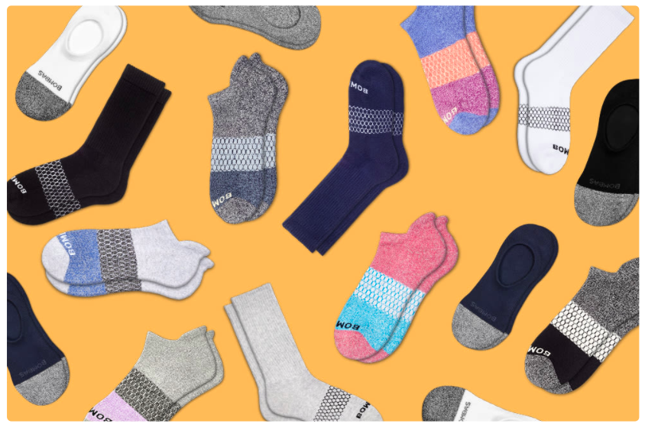
How would you sort these socks?
How many are there? How do you know?
K.MD.B3

Slide 8
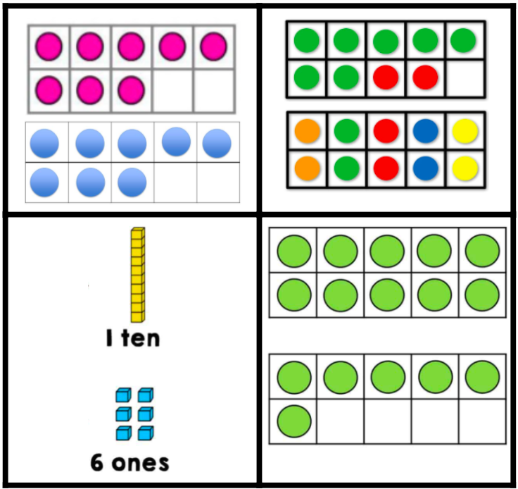
Which one does not belong?
K.NBT.A1

Slide 9
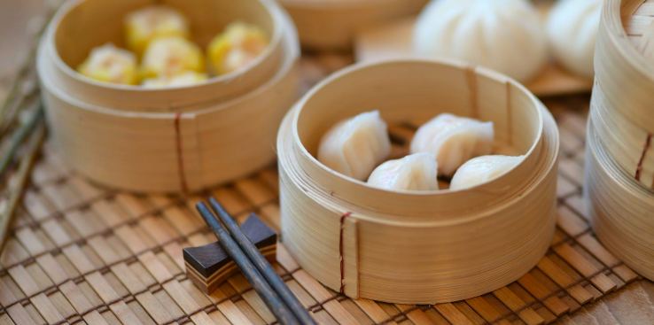
What shapes do you see?
K.G.A3

Slide 10
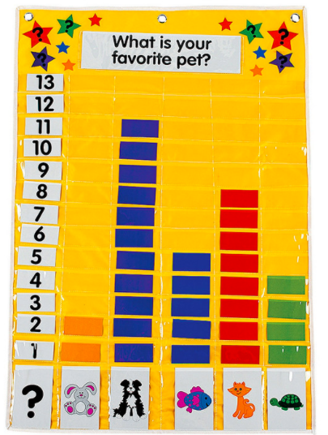
If this graph could talk, what would it say?
K.MD.B3

Slide 11
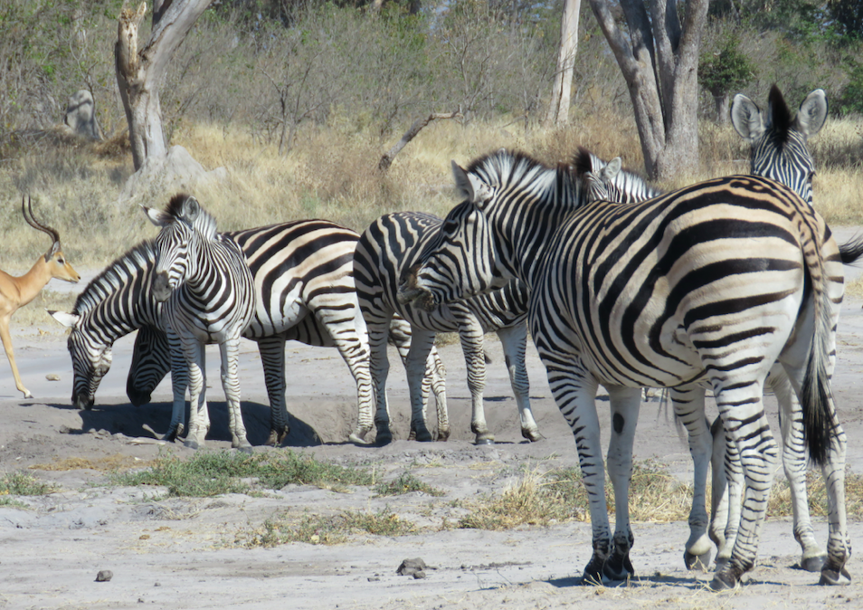
How many zebras do you see?
How many don’t you see?
Let’s create a math story to go with this photo.
K.OA.A1
Notes:
Week of March 14, 2022

Slide 12

How many?
K.CC.A1

Slide 13
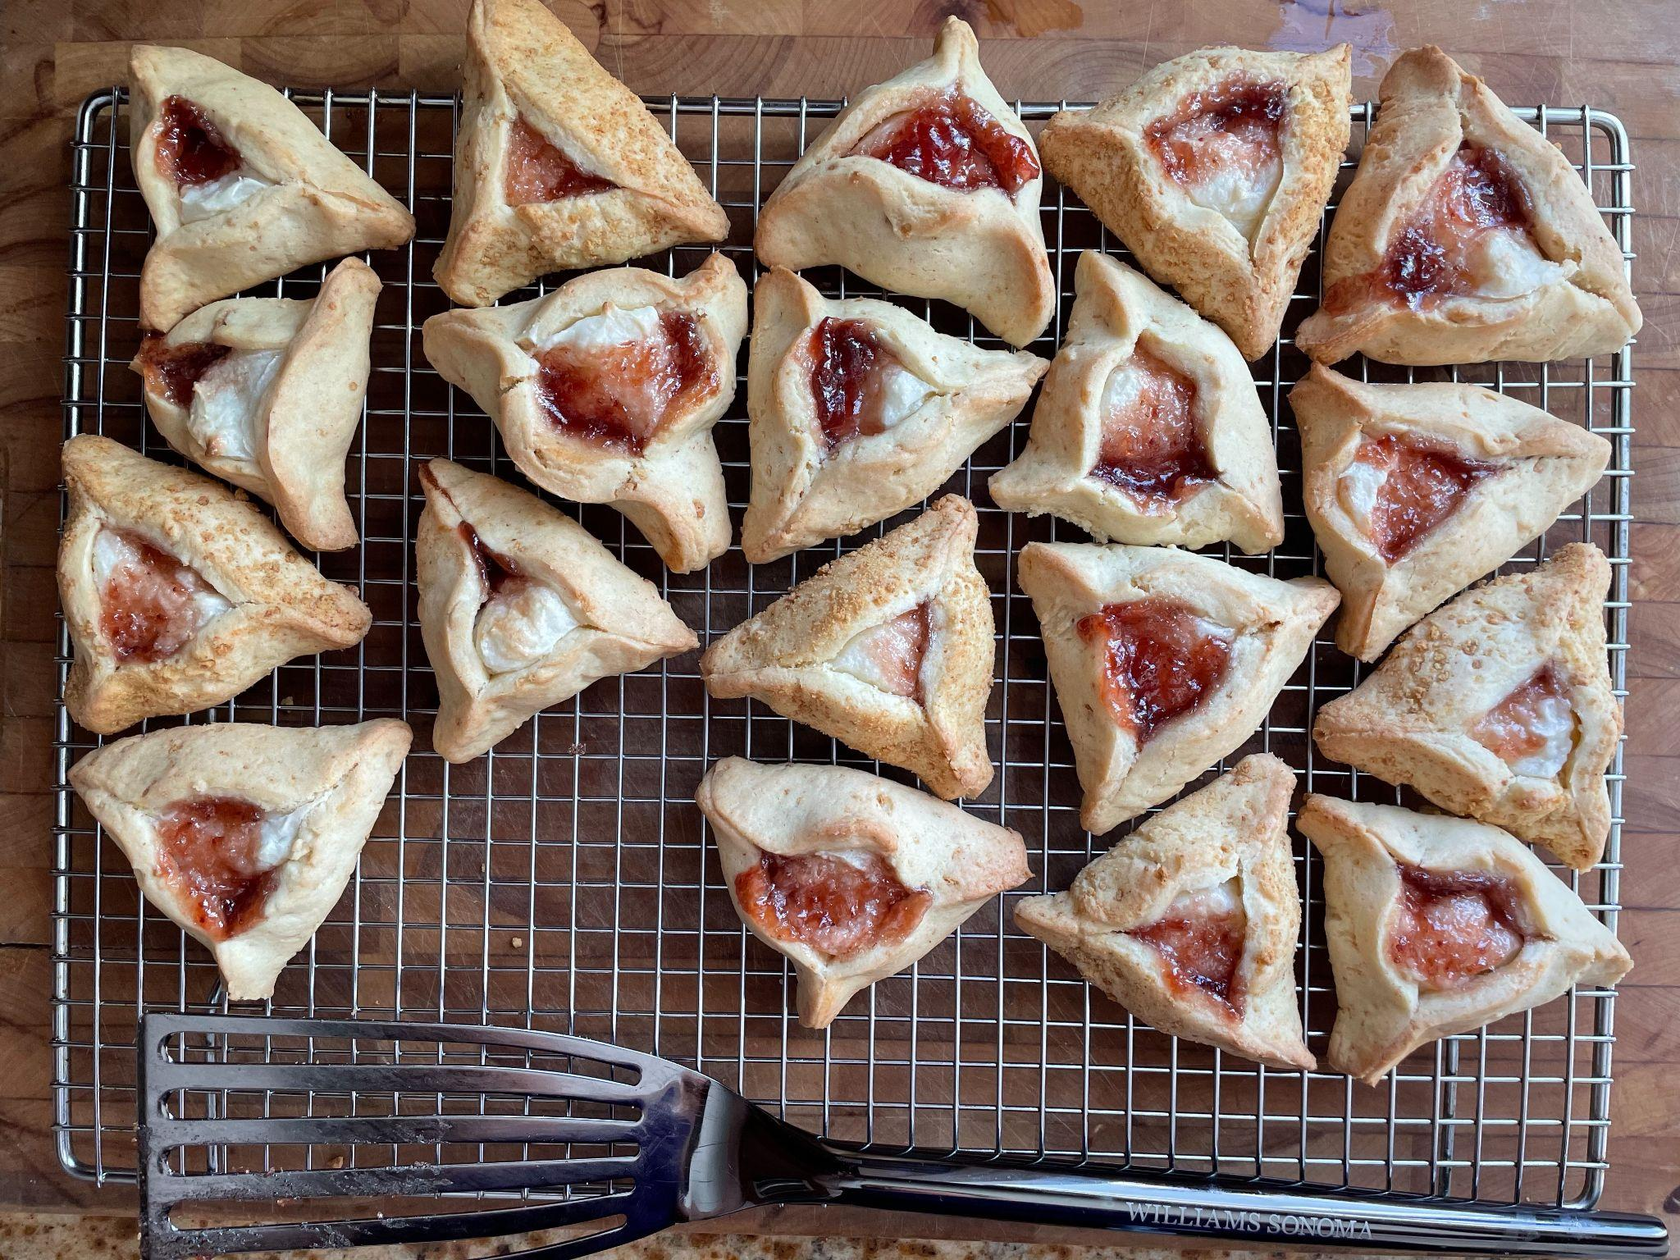
Happy Purim!
How many hamantaschen are here?
How many different ways can we count them?
K.CC.B4
Notes:
March 16, 2022
Purim!

Slide 14
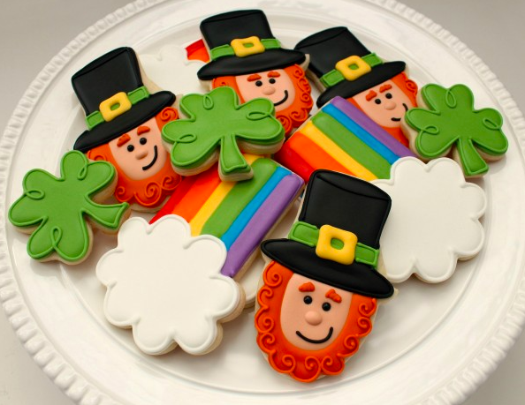
Create a number sentence to match this picture.
Can you create a different one?
K.OA.1
K.OA.A1
Notes:
March 17, 2022
St. Patrick’s Day

Slide 15
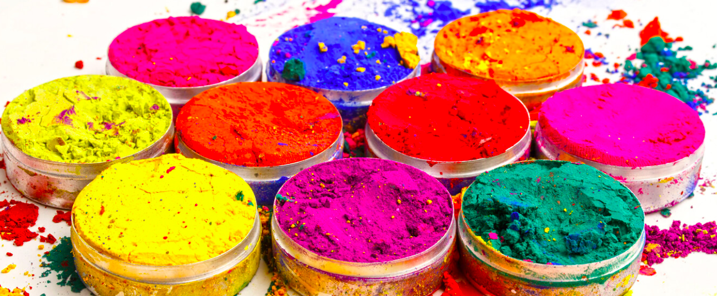
Happy Holi ~ A Festival of Colors
How many color pots are here? How do see them?
Can you write a number sentence to match this photo?
K.CC.5
K.OA.A3
Notes:
March 18, 2022
Holi (India)

Slide 16
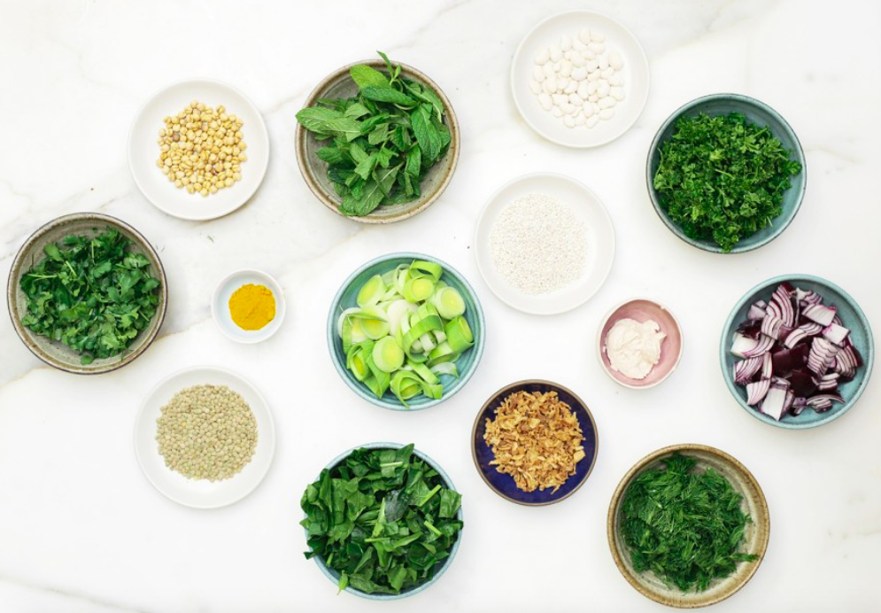
Happy Persian New Year Spring Equinox
We celebrate with yummy flavors of spring!
How can we sort these bowls?
How can we count them?
What number sentences can we write?
K.MD.B3
Notes:
Week of March 21, 2022

Slide 17
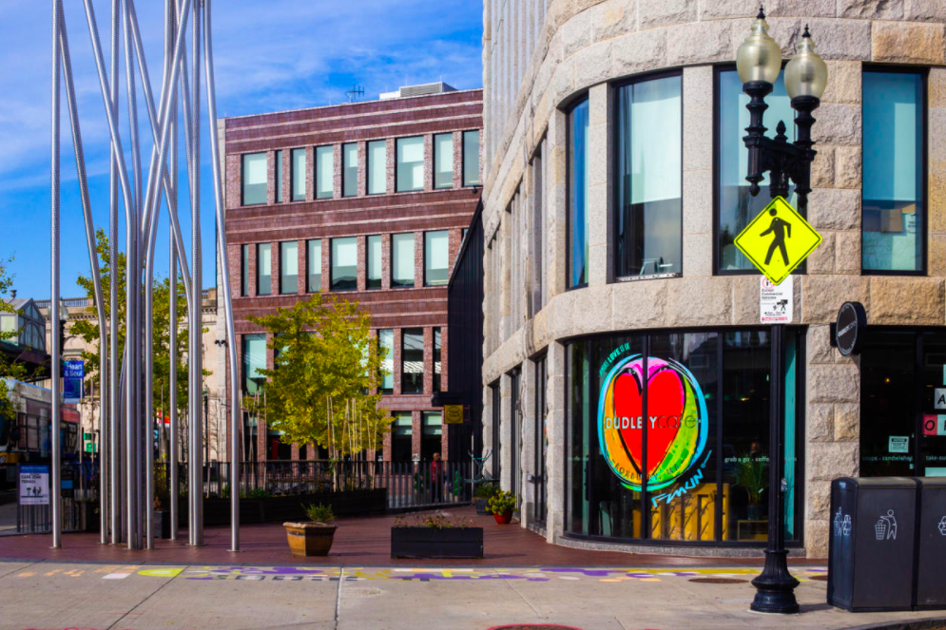
Wow! Look at of these cool shapes!
Describe what you see.
Use words like next to, under, on top of.
K.G.A1

Slide 18
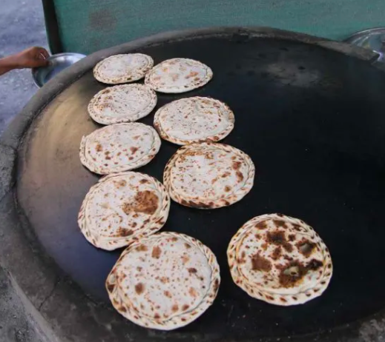
It’s Pakistan Day!
How many flatbreads are here?
Create an equation to match your thinking!
K.OA.A3
Notes:
March 23, 2022
Pakistan Day

Slide 19
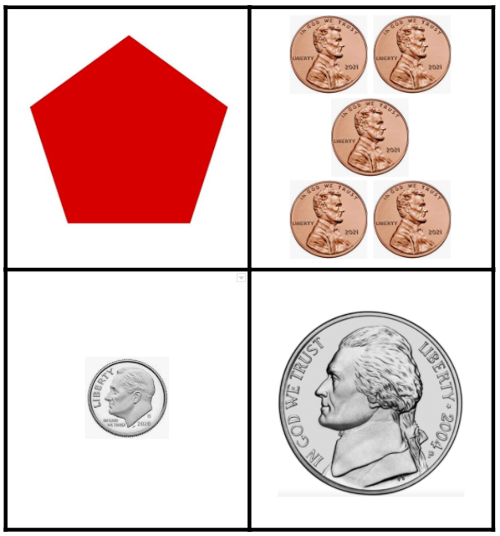
Which one doesn’t belong?
K.SMP.3

Slide 20
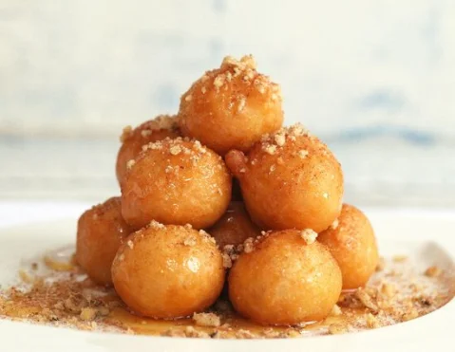
Happy Greek Independence Day!
How many Loukoumades do we see?
How many don’t we see?
How many might be here altogether?
K.CC.B5
Notes:
March 25
Greek Independence Day

Slide 21
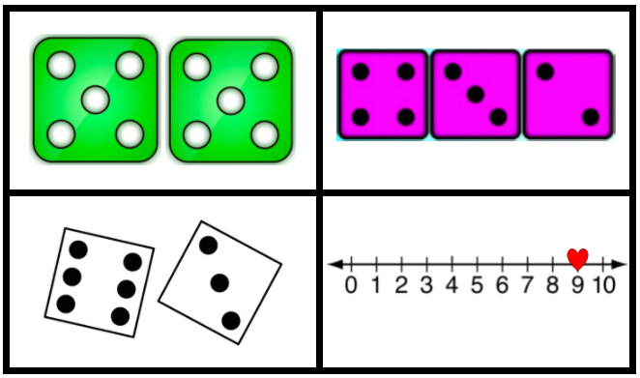
Which one doesn’t belong?
K.OA.A2
Notes:
Week of March 28, 2022

Slide 22
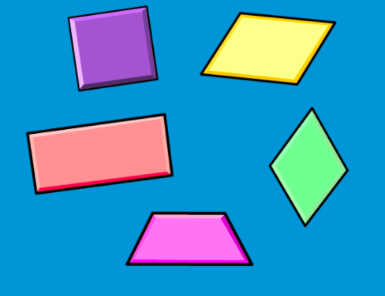
Let’s talk about these shapes!
How are they the same?
How are they different?
K.G.B4

Slide 23
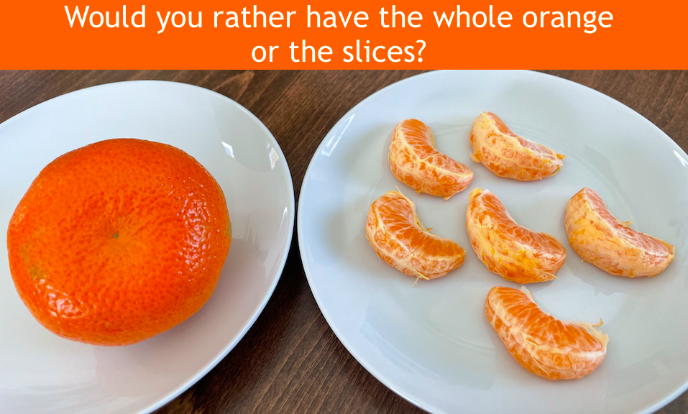
K.MD.A2

Slide 24
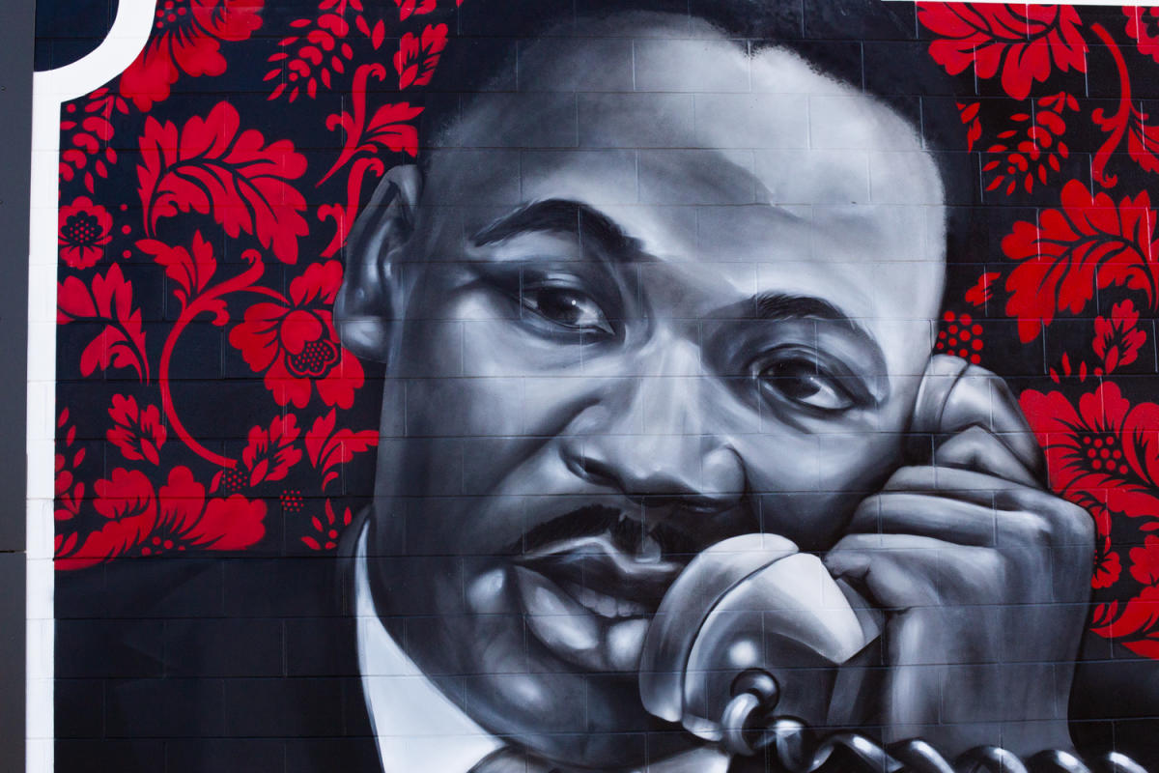
What do we notice?
What do we wonder?
What math question can we ask?
K.CC.A1

Slide 25
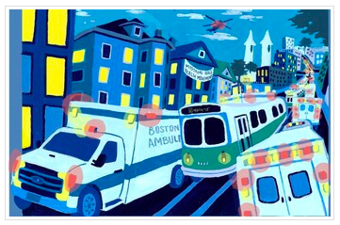
What are some interesting shapes you see here?
Can you draw them?
K.G.B4

