Slide 1
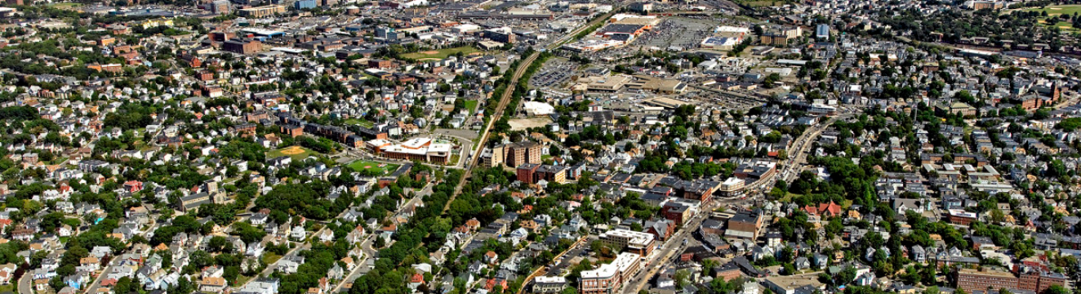
What estimation strategies can you use to determine how many homes
are in this photo of Dorchester?
5.NBT.A
Notes:
Week of February 28, 2022

Slide 2
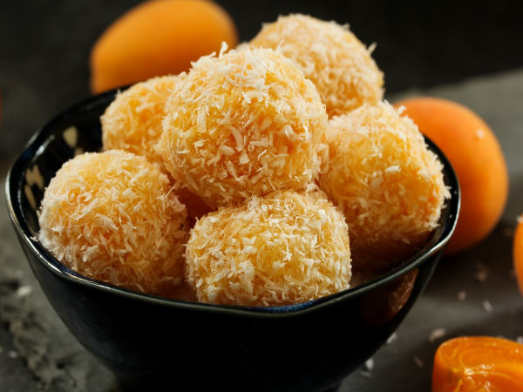
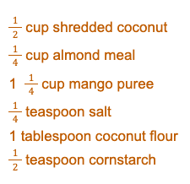
Happy Maha Shivaratri!
We are making Mango Ladoo.
We need to TRIPLE the recipe.
What if we needed “one-and-a-half” the recipe?
5.NF.B4
Notes:
March 1, 2022
Maha Shivaratri (India)

Slide 3
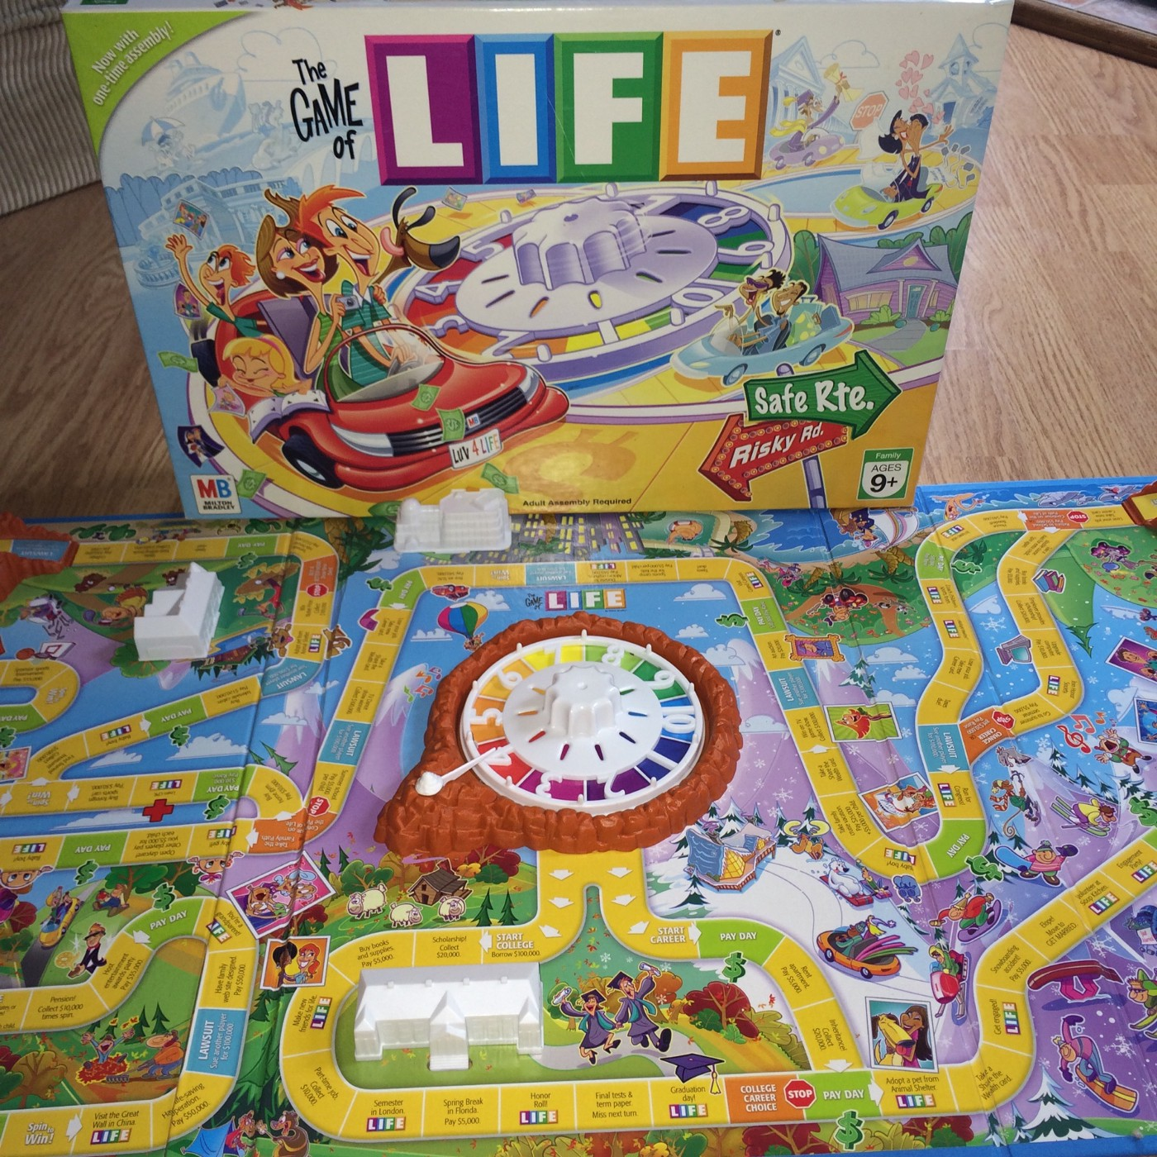
This LIFE game board is a rectangle with an area greater than 150 square inches, but less than 300 square inches.
What could be the length of each side of the game board?
5.MD

Slide 4

If this infographic could talk, what would it say?
5.MD.B
Notes:
How to strengthen your immune system this winter

Slide 5
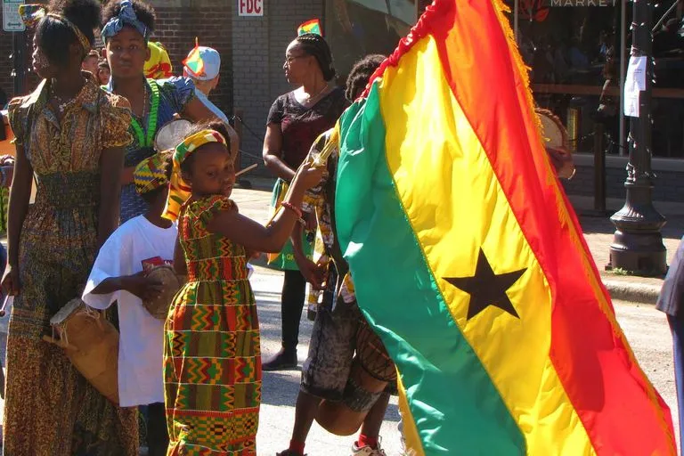
Happy Independence Day in Ghana!
Celebrate Ghana’s independence from the United Kingdom in 1957.
Can you 5 STEPS to 0 1957?
5.NBT.B
Notes:
March 6, 2022
Ghana Independence Day

Slide 6
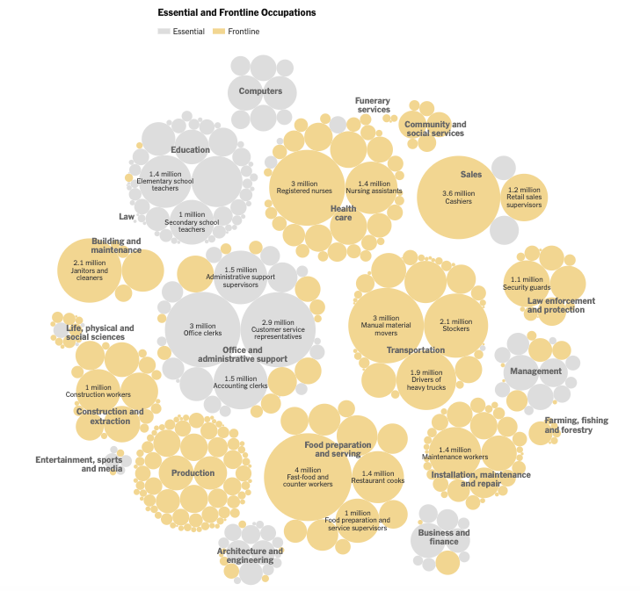
What do you notice?
What do you wonder?
What impact does this have on you and your community?
What’s going on in this graph? Write a catchy headline that captures the map’s main idea.
interactive
5.MD.B
Notes:
Week of March 7, 2022

Slide 7
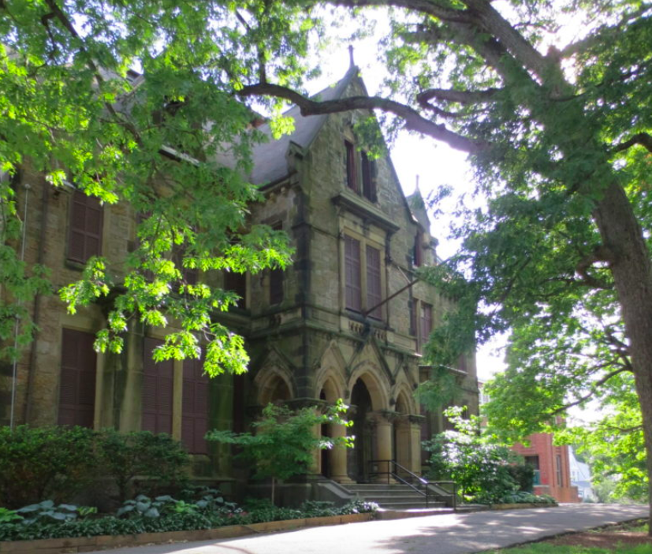
Abbotsford is now
Museum of the National Center for Afro-American Artists
It was built in 1872.
How many years has it been in Roxbury?
How many MONTHS?
(it was completed June 1872)
5.MD.A1

Slide 8
1 + 2 + 3 + 4 + 5 + 6 + 7 + 8 + 9 + 10 + 11 +12 +13 +14 +15 +16 +17 +18 + 19 + 20
How can you solve this?
Is that the only way?
5.OA.B3

Slide 9
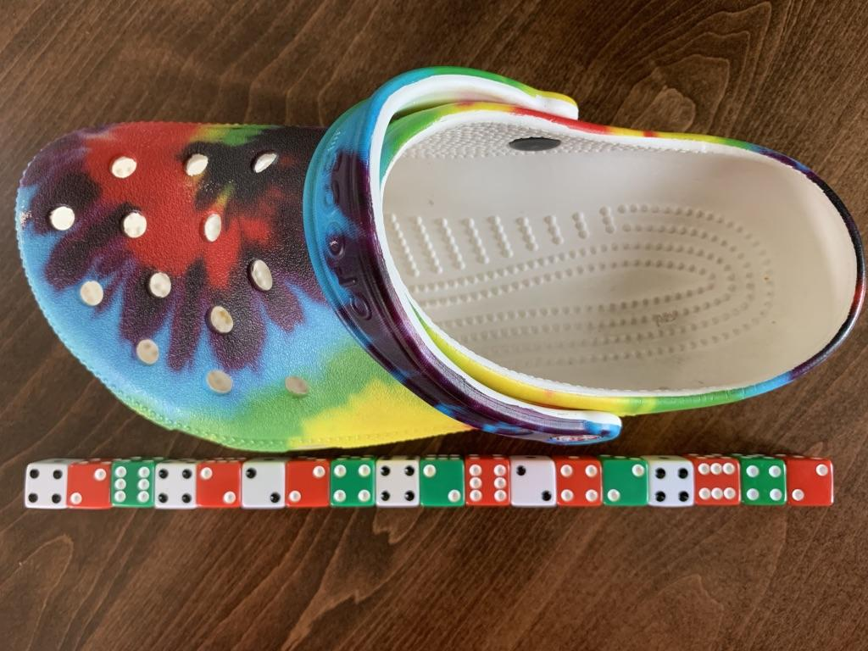
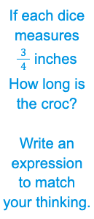
5.NF.B4

Slide 10
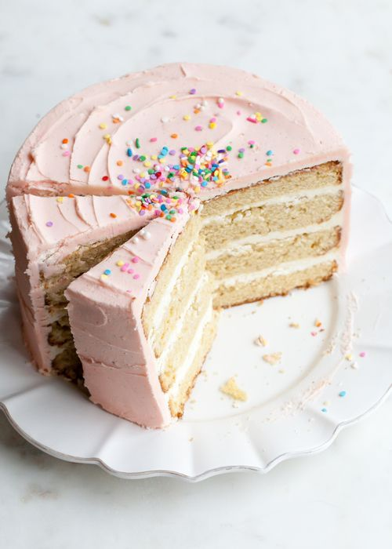
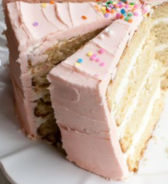
Estimate the fraction of cake that is missing.
What fraction do the two slices represent?
About what fraction of the cake is not cut yet?
5.NF.A

Slide 11
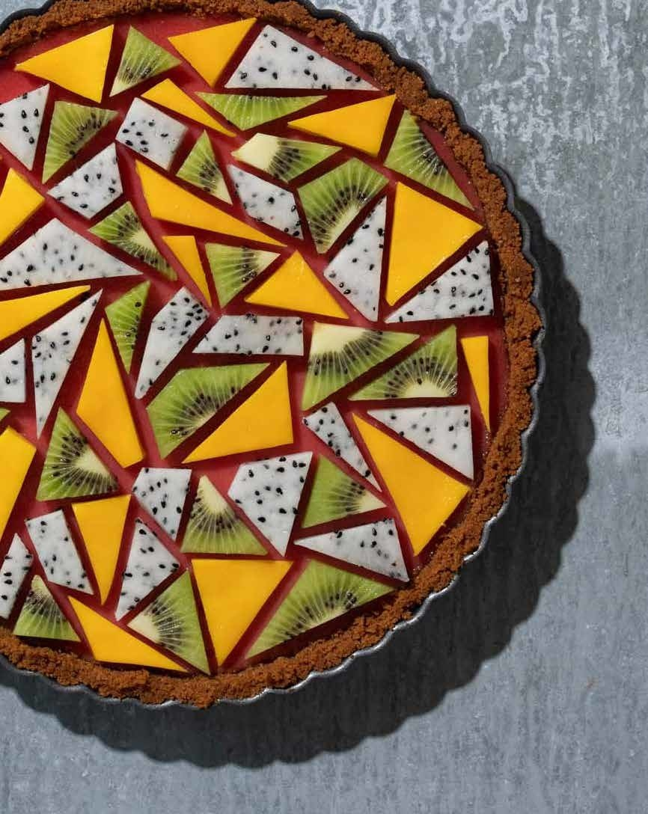
How would you classify the shapes in ths pie?
Name the shapes,
be as precise as possible!
Happy 𝝅 Day!
5.G.B3
Notes:
Week of March 14, 2022
Pi Day

Slide 12
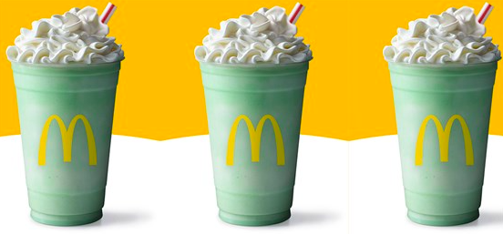
The McDonald’s Shamrock Shake!
Each of these shakes is 16 ounces, there are 46 calories per ounce.
How many calories in one shake? How many in 2 shakes? 3 shakes?
5.NBT.B5

Slide 13
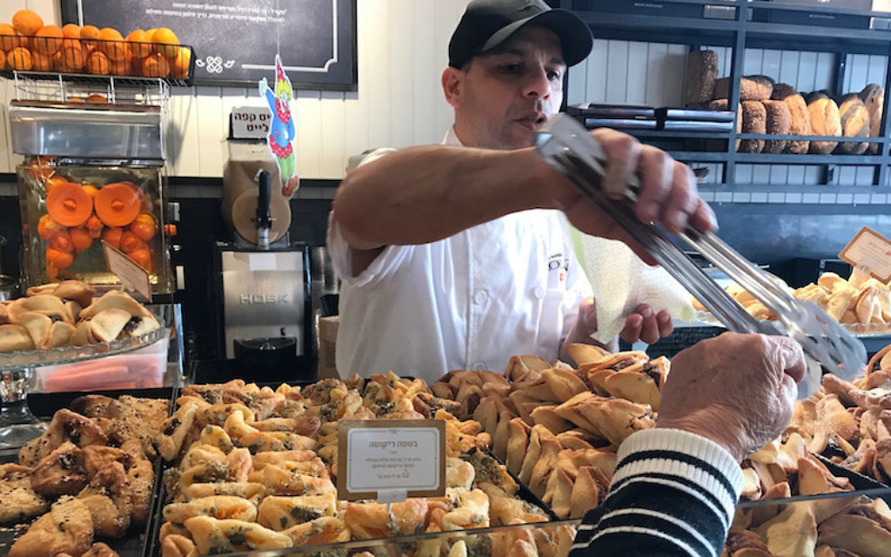
Happy Purim!
Roladin Bakery in Tel Aviv will bake 2,000,000 Hamantschen for the holiday.
How many factor pairs of 2,000,000 can we record?
5.OA.B
Notes:
March 16, 2022
Purim

Slide 14
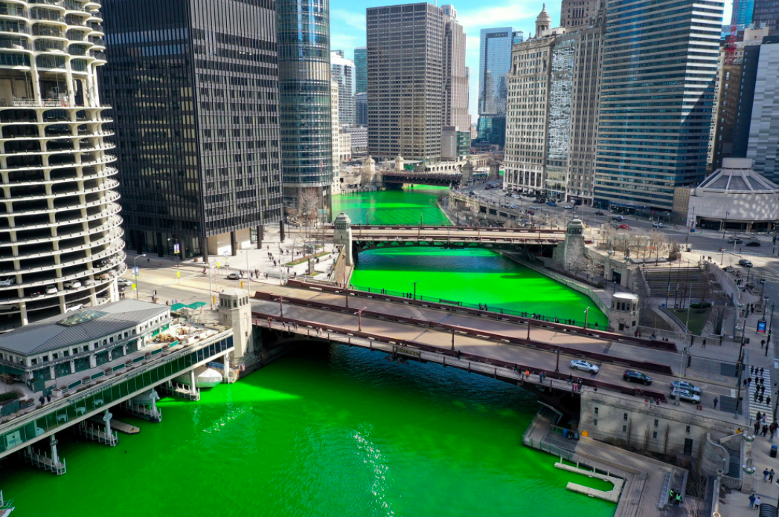
The Chicago River has been dyed green (by the Plumbers Union) for St. Patrick’s Day every year since 1962.
It takes 3 boats and 20 minutes to dye a full city block.
They use 40 pounds of dye.
How much dye does each boat use? How much dye do they drop per minute?
5.NBT.B6
Notes:
March 17, 2022
St. Patrick’s Day
Link to video

Slide 15
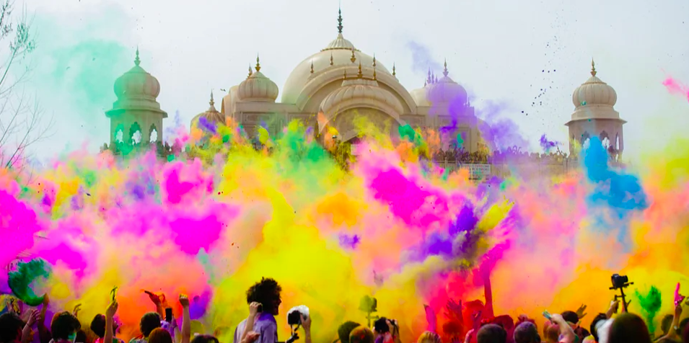
Happy Holi ~ The Festival of Colors
This photo was taken about a half a kilometer from the Taj Mahal.
How many meters is that? How many centimeters would that be?
5.MD.A1
Notes:
March 18, 2022
Holi (India)

Slide 16
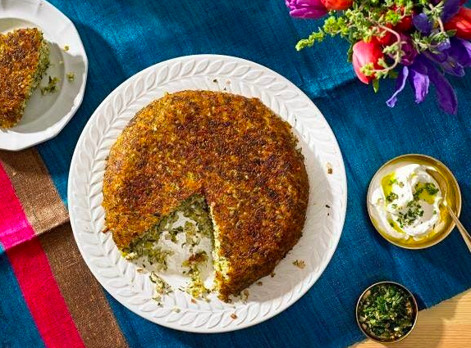
Happy Persian
New Year
Spring Equinox!
About what fraction of this Sabzi Polo, a traditional rice dish with lots of yummy herbs, is left on the plate?
Justify your estimate with math!
5.NF.A2
Notes:
Week of March 21, 2022
Persian New Year

Slide 17
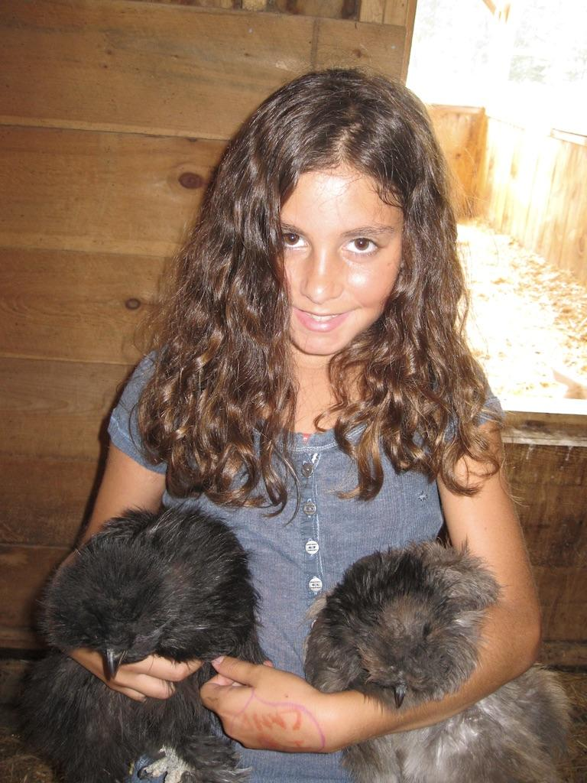
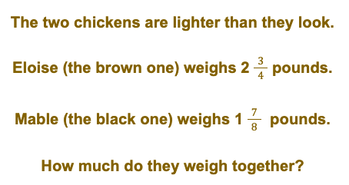
5.NF.A2

Slide 18
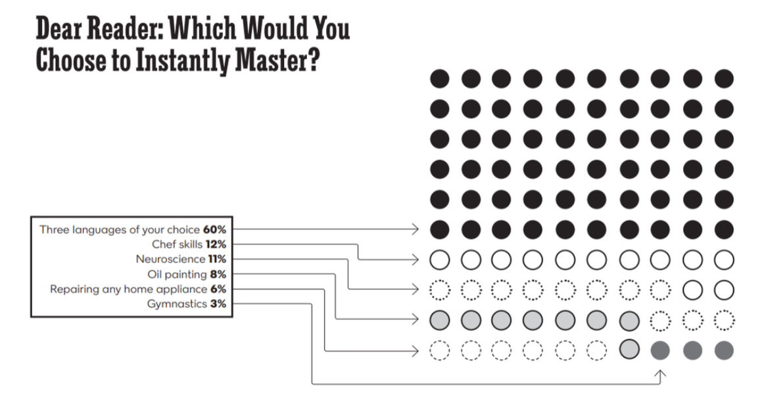
What do you notice?
What do you wonder?
What impact does this have on you and your community?
What’s going on in this graph? Write a catchy headline that captures the graph’s main idea.
5.MD.B

Slide 19
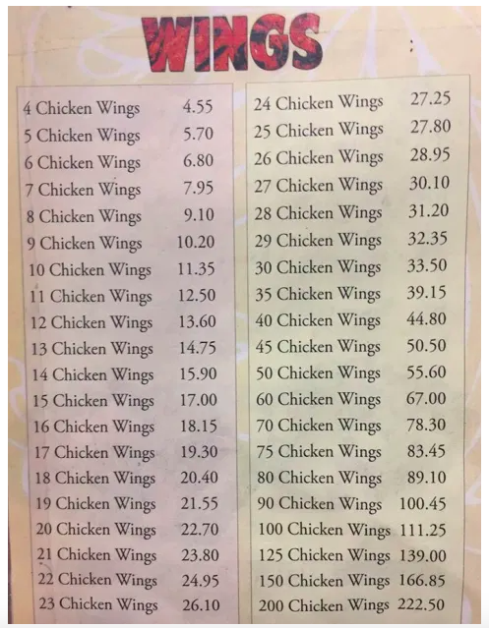
Very strange pricing scheme.
Can you see a pattern?
5.OA.B3

Slide 20
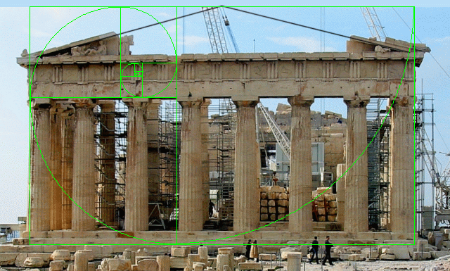
Happy Greek Independence Day!
The Parthenon was built to extremely precise dimensions according to the mathematical ratios of sacred geometry.
The rectangular building is 101 feet wide by 228 feet long. It was constructed of brilliant white marble, surrounded by 46 great columns, roofed with tiles, and housed a nearly 40 foot tall statue of the goddess Athena.
Where’s the MATH?
Think area, perimeter, height…
5.MD.C
Notes:
March 25, 2022
Greek Independence Day

Slide 21
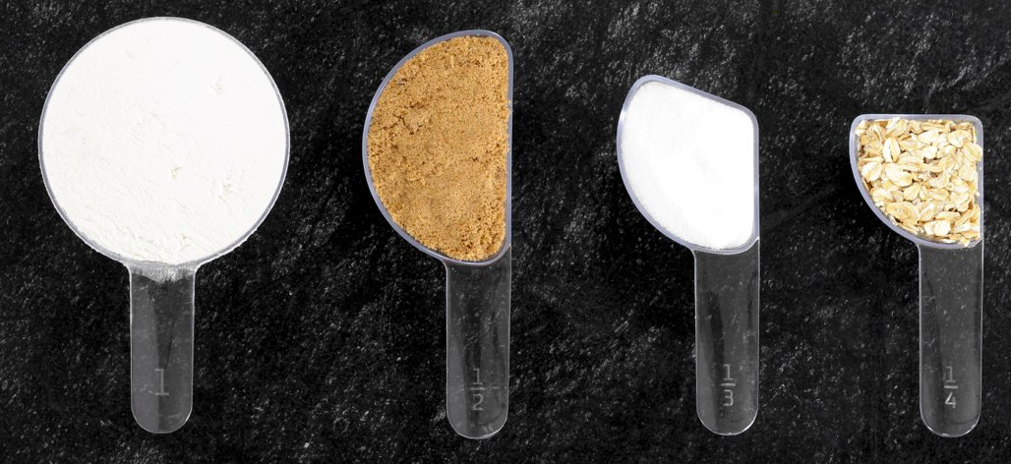
What can you say about these measuring cups?
What do you notice? What do you wonder?
Can you make EQUIVALENT fractions from what you see?
5.NF.A
Notes:
Week of March 28, 2022

Slide 22
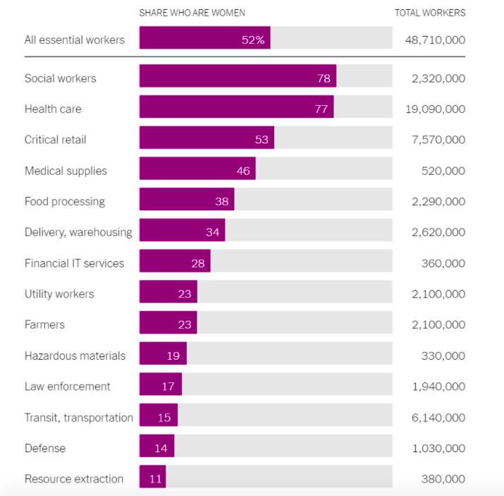
Who are our Essential Workers?
What do you notice?
What do you wonder?
What impact does this have on you and your community?
What’s going on in this graph? Write a catchy headline that captures the graph’s main idea.
5.MD.B

Slide 23
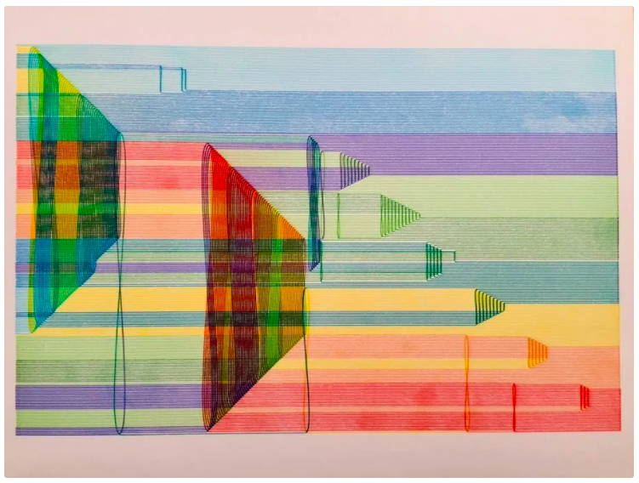
Talk about the math you see here.
5.G.B

Slide 24
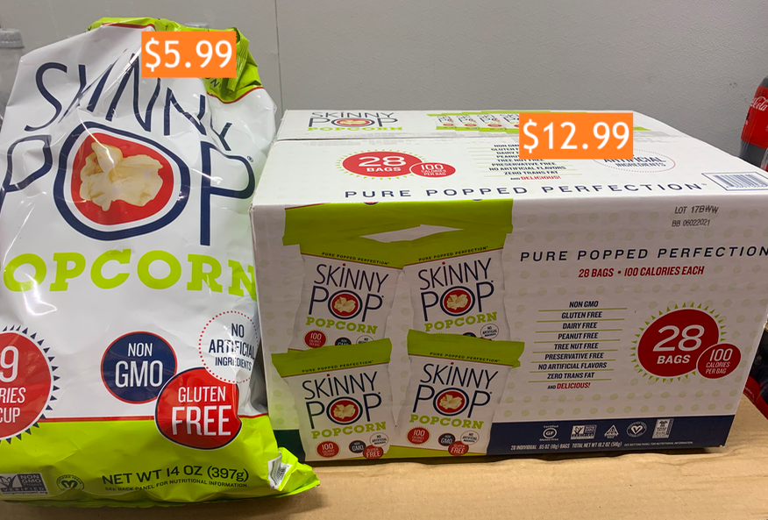
Would You Rather Buy ...
5.NBT.B7

Slide 25
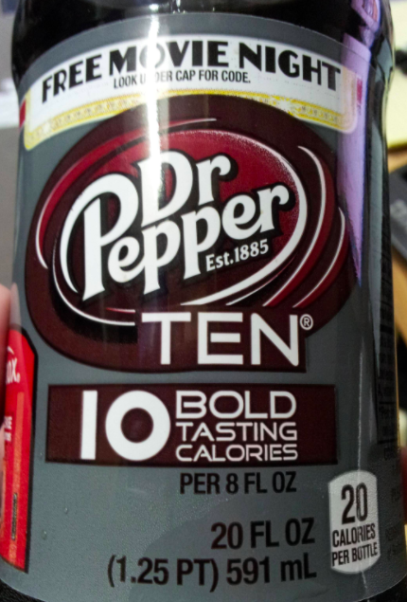
Look closely.
What do you notice?
What is the true calorie count?
5.NBT.B7

