Slide 1
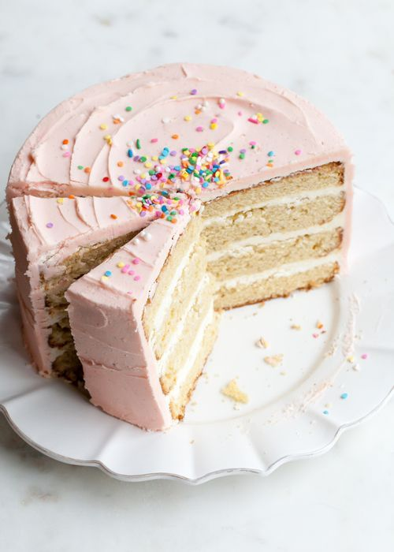
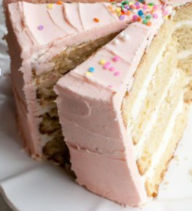
Estimate the fraction of cake that is missing.
What fraction do the two slices represent?
About what fraction of the cake is not cut yet?
4.NF.B3
Notes:
Week of February 28, 2022

Slide 2
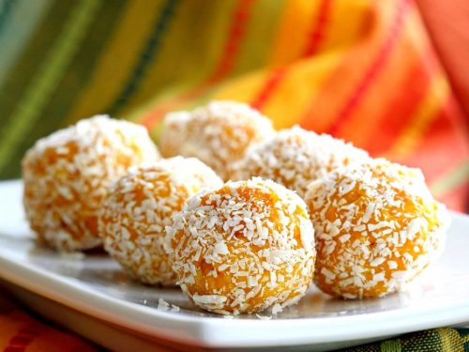
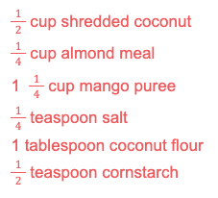
Happy Maha Shivaratri!
We are making Coconut Mango Ladoo.
We need to DOUBLE the recipe.
What if we TRIPLED the recipe?
4.NF.B4
Notes:
March 1, 2022
Maha Shivaratri (India)

Slide 3
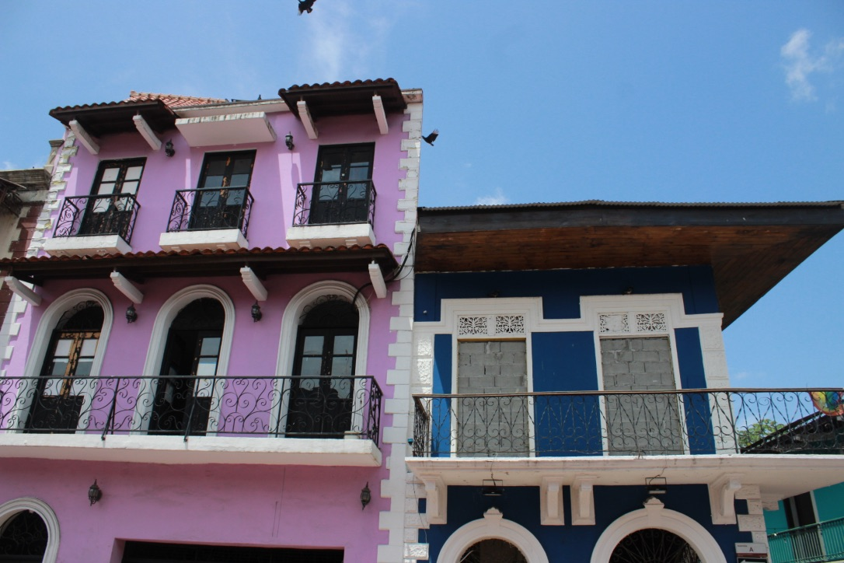
Where do you see parallel or perpendicular line segments in the picture?
Where do you see symmetry?
4.G.A3

Slide 4
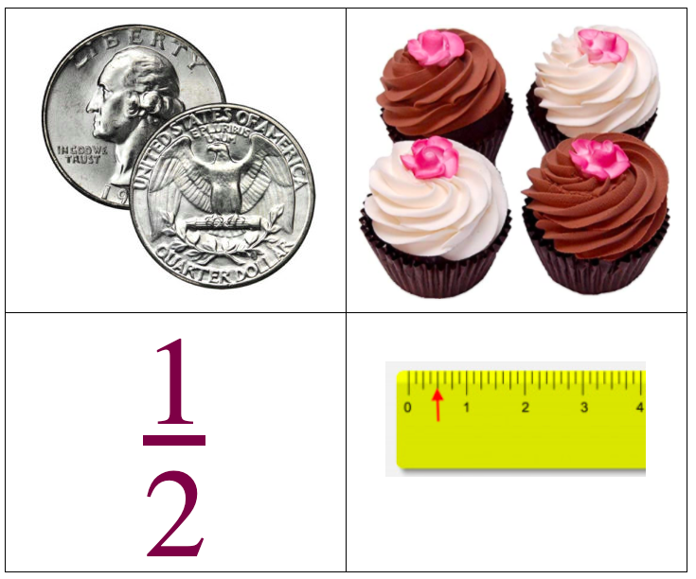
What’s the same?
What’s different?
4.NF.A1

Slide 5
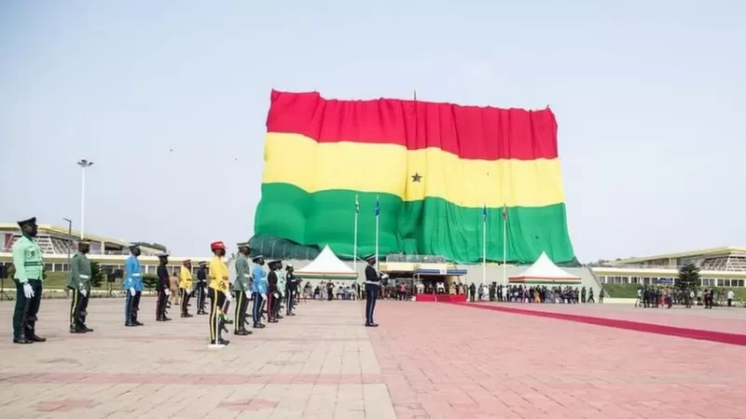
Happy Independence Day in Ghana!
This giant flag measures 85m x 50m
What can we say about the perimeter and the area?
3.MD.A3
Notes:
March 6, 2022
Ghana Independence Day

Slide 6
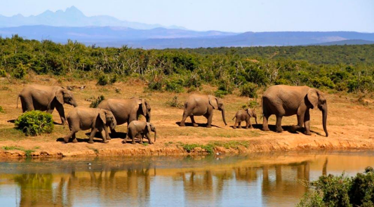
An African forest elephants’ tusks grow about 17 cm each year. If an elephant lives to be 65 years old,
about how long would their tusks be? How many meters is that?
4.MD.A2
Notes:
Week of March 7, 2022

Slide 7
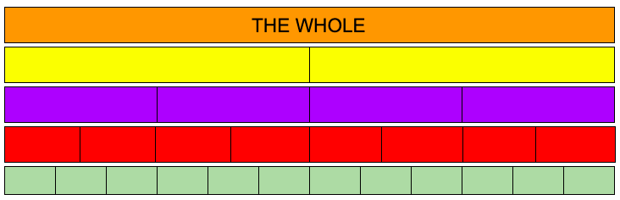
What do you notice here?
What fraction statements can you make?
Can you name the fractions you see?
Can you make some comparisons?
4.NF.A2

Slide 8
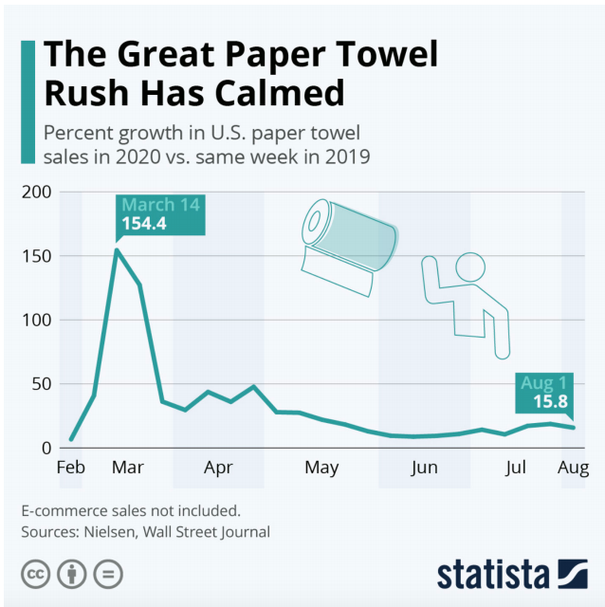
What do you notice?
What do you wonder?
What is going on in this data visualization?
4.MD.B

Slide 9
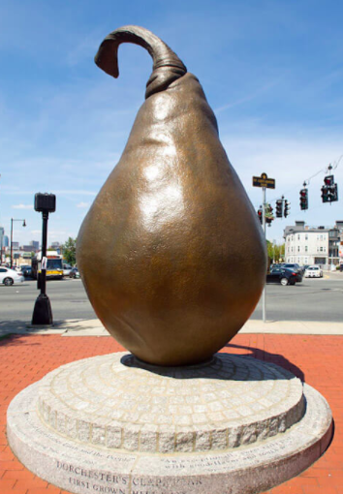

This Giant Pear bronze statue sits on what used to be an orchard in Dorchester. Did you know that Dorchester used to be mostly apple and pear farms?
The statue is 12 feet tall.
How much taller is it than you?
What fraction of the pear are you?
4.MD.A2

Slide 10


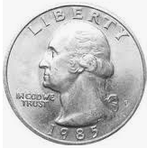
0
1
Which one doesn’t belong?
4.NF.A1

Slide 11
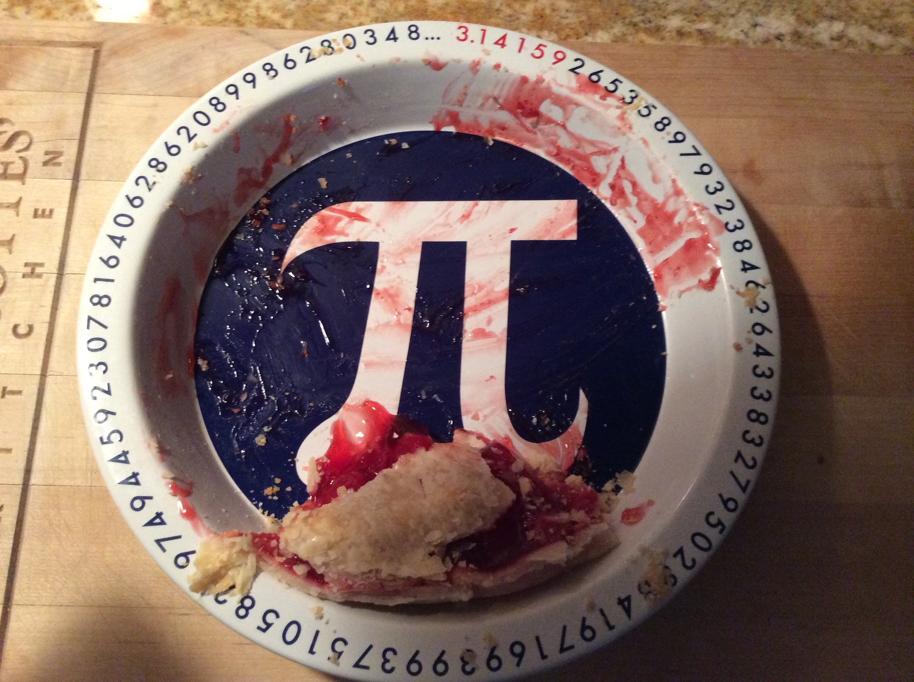
Happy Pi Day!
About what fraction of the pie is here?
4.NF.A2
Notes:
Week of March 14, 2022
Pi Day

Slide 12
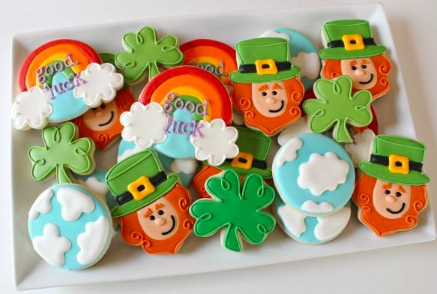
Happy St. Patrick’s Day!
What fraction of the whole tray of cookies are the clovers?
What fraction represents the leprechauns?
What about the cloudy cookies?
4.NF.B3

Slide 13
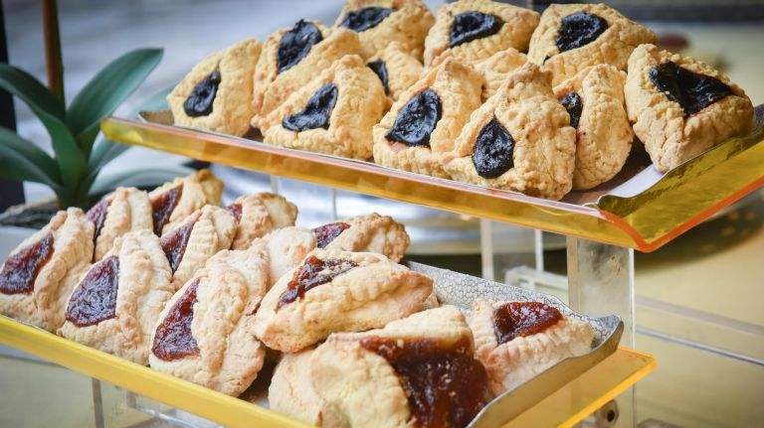
Happy Purim!
Moishe’s Bake Shop in New York City will bake 2,000 hamantaschen a day for the holiday.
What are some factor pairs of 2,000?
4.OA.B4
Notes:
March 16, 2022
Purim

Slide 14
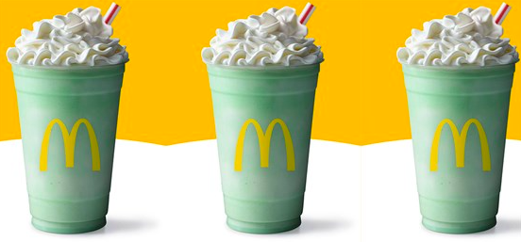
The McDonald’s Shamrock Shake!
Each of these shakes is 16 ounces, there are 46 calories per ounce.
How many calories in one shake? How many in 2 shakes? 3 shakes?
4.NBT.B5
Notes:
March 17, 2022
St. Patrick’s Day

Slide 15
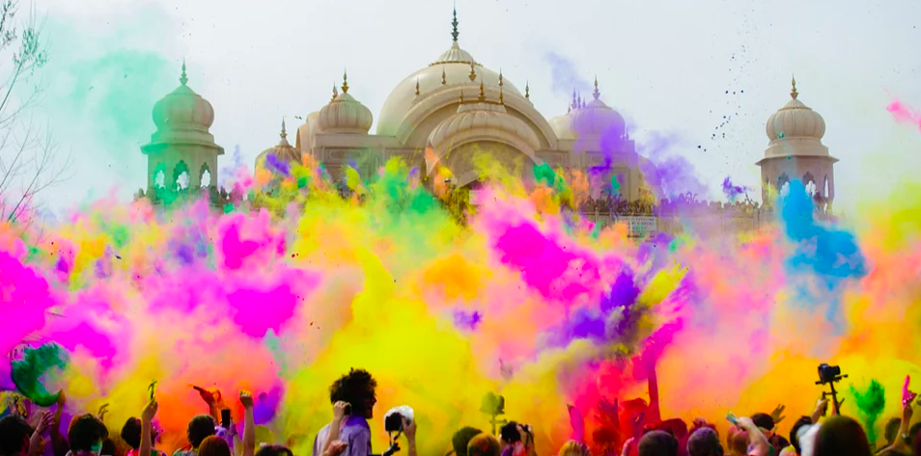
Happy Holi ~ The Festival of Colors
The Taj Mahal complex is believed to have been completed in its entirety in 1653 at a cost estimated at the time to be around 32 million rupees, which in 2021 would be approximately 70 billion rupees. What is the difference? How many times MORE? How can you figure it out?
4.NBT.A2
Notes:
March 18, 2022
Holi (India)

Slide 16
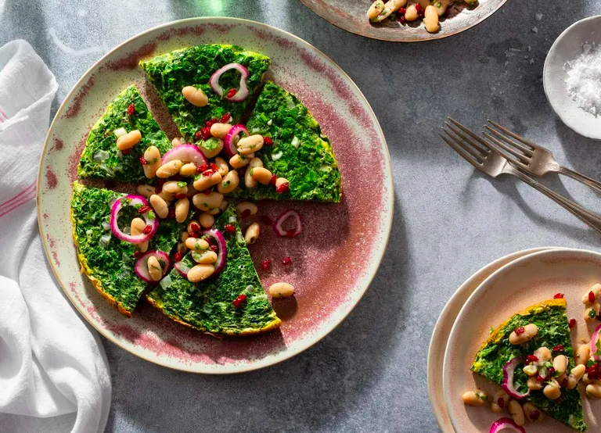
Happy Persian New Year Spring Equinox
What fraction of this delicious Kuku Sabzi is missing?
Write a number sentence with fractions to show your thinking.
4.NF.B3
Notes:
Week of March 21, 2022
Persian New Year

Slide 17
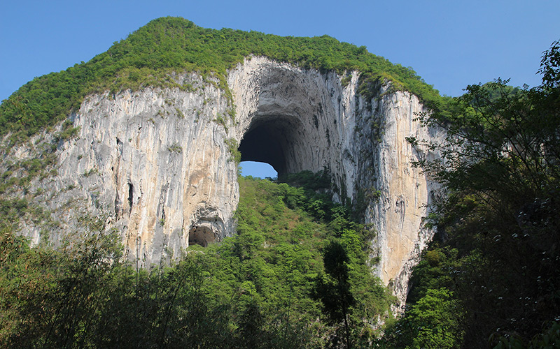
This is the Great Arch of Getu, Shuiyanba Dong, in China.
It is a very popular climbing destination!
The arch is 237 feet high!
If we were to climb one-half of the way up, how high would that be?
What if we only climbed one-third of the way?
4.MD.A2

Slide 18
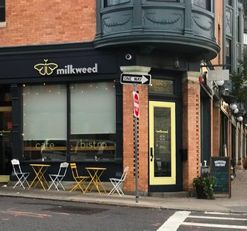
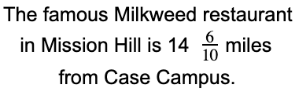
If went there for lunch, and then came right back to school, How many miles did we travel?
4.NF.B3

Slide 19
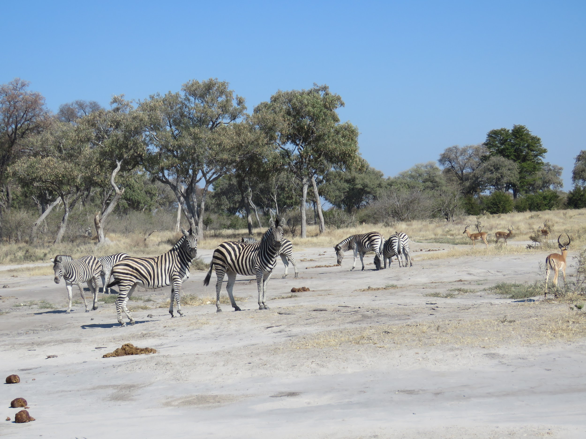
There are
8 zebras and
4 gazelles in this photo.
What fraction statements can you make?
4.NF.B3

Slide 20
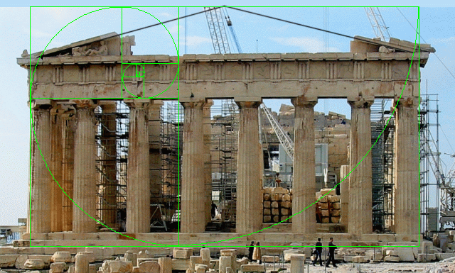
Happy Greek Independence Day!
The Parthenon was built to extremely precise dimensions according to the mathematical ratios of sacred geometry.
The rectangular building is 101 feet wide by 228 feet long. It was constructed of brilliant white marble, surrounded by 46 great columns, roofed with tiles, and housed a nearly 40 foot tall statue of the goddess Athena.
Where’s the MATH?
Think area, perimeter, height…
4.MD.A3
Notes:
March 25, 2022
Greek Independence Day

Slide 21
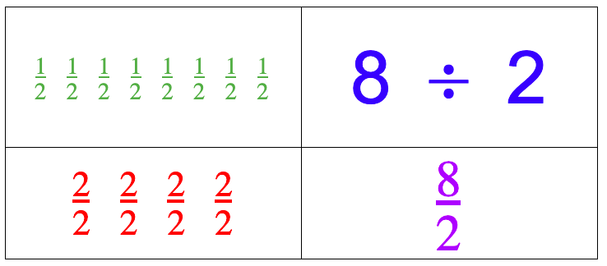
What do they all have in common? What is different about them?
4.NF.B4
Notes:
Week of March 28, 2022

Slide 22
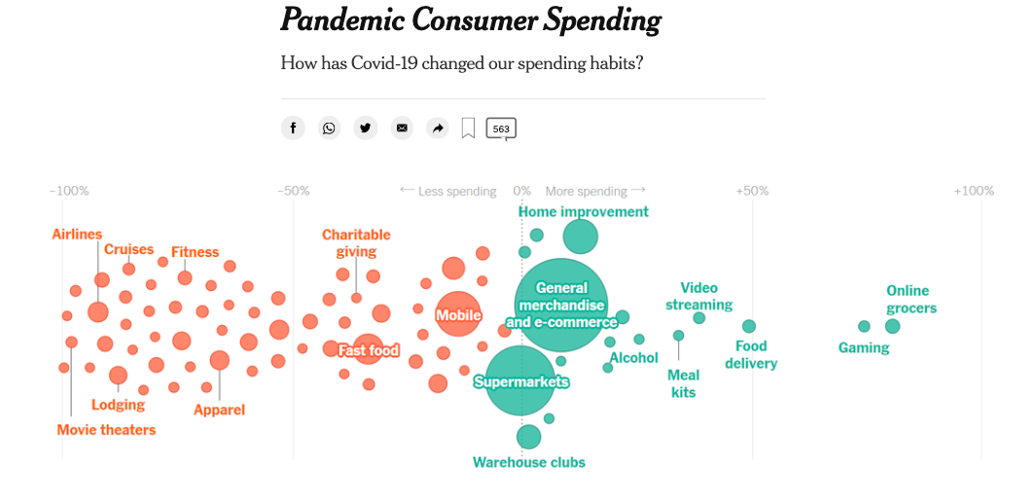
What do you notice? What do you wonder? What questions do you have? Why does it matter?
4.MD.B

Slide 23
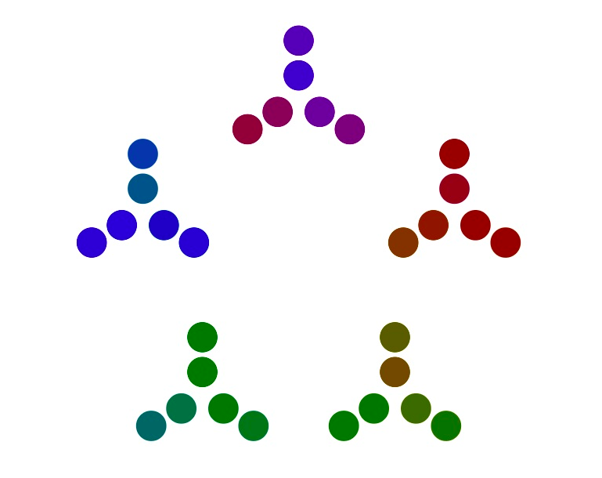
What can you
say about this number visualization?
Where do you see PRIME numbers?
4.OA.B4

Slide 24
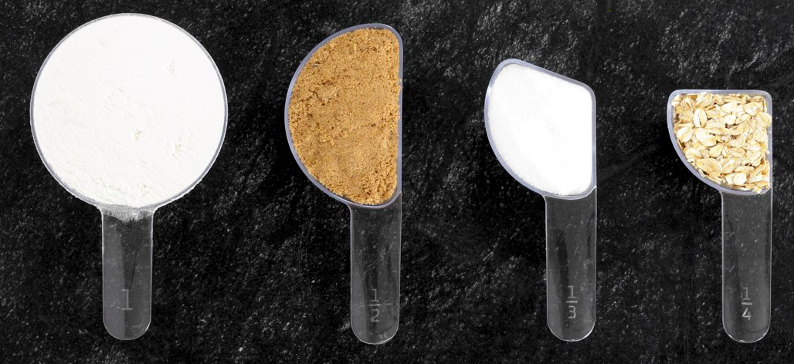
What can you say about these measuring cups?
What do you notice? What do you wonder?
Can you make EQUIVALENT fractions from what you see?
4.NF.A2

Slide 25
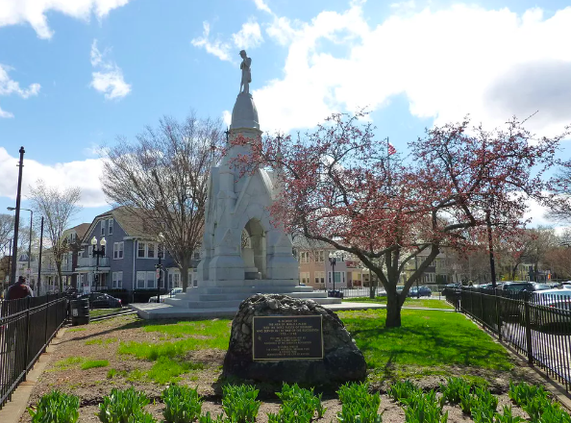
Soldier’s Monument in Jamaica Plain is a 28 foot monument to commemorate the Civil War contributions of the then-Town of West Roxbury.
The soldier on the top of the monument is 7 feet tall.
What FRACTION of the whole monument is he?
4.MD.A2

