Slide 1
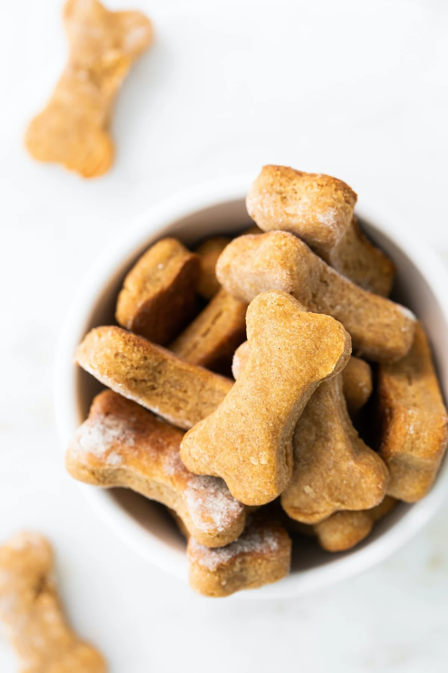
A dog owner gave his dog the same number of treats each day for 4 days.
Over the 4 days, he gave his dog a total of 12 treats.
Write an EXPRESSION to match the story.
Can you write another one?
Which expression can be used to find the number of treats he gave his dog each day?
12 - 4 12 + 4
12 ÷ 4 12 x 4

Slide 2
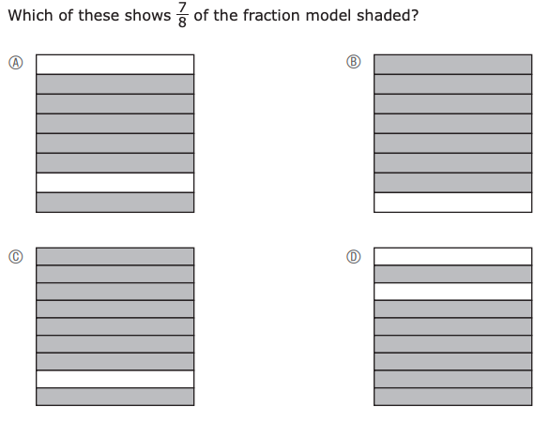

Slide 3
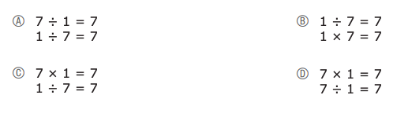
What do you notice? What do you wonder?
In which pair of equations are
BOTH equations true?

Slide 4
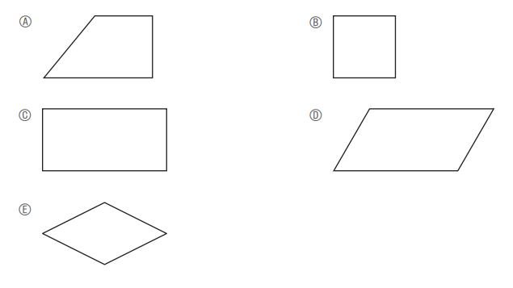
Do we see a rhombus here?
Can we find another one?

Slide 5
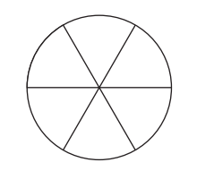
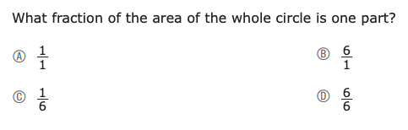
This circle is divided into equal parts.
What can we say about ONE of the parts?

Slide 6
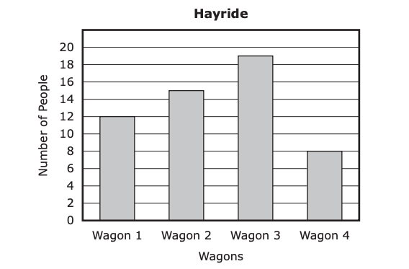
What do we notice?
What do we wonder?
The total number of people in wagons 1 and 4 was how much greater than the number in wagon 2?

Slide 7

Tazi has 32 pencils to share with her friends. She gave each friend the SAME number of pencils.
What is possible?
She is sharing with 4 friends.
What is the total number of pencils Tazi gave each friend?
36 28
8 7

Slide 8
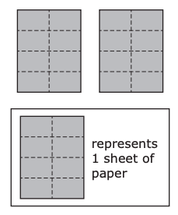

A student folded 2 sheets of paper along dotted lines, as shown.
What do we notice (think fractions!)
Which of these fractions also shows how many sheets of paper the student folded?

Slide 9
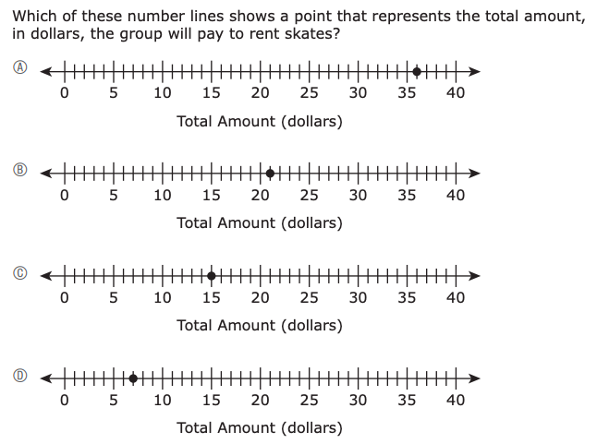

A group of 12 friends are going skating. Some of the friends will rent skates.
5 of the friends will NOT rent skates
The remaining friends will each rent skates for $3.00
How can we solve this problem?

Slide 10
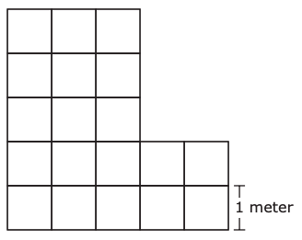
The floor of a room is covered with square tiles, with no gaps or overlaps. Each square tile has a side length of 1 meter, as shown in this diagram.
What can we say about this room?
What is the area, in square meters, of the floor of the room?

Slide 11
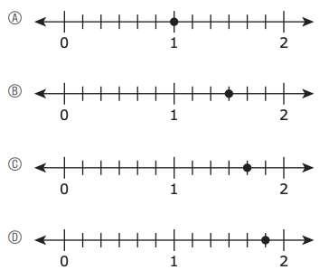
What do we notice?

Slide 12
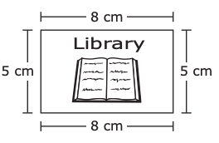
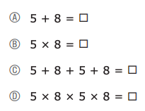
What can we say about the area of the card?
Which number sentence can be used to find the area, in square centimeters, of the library card?
A library card is in the shape of a rectangle.
The library card and its side lengths are shown.

Slide 13
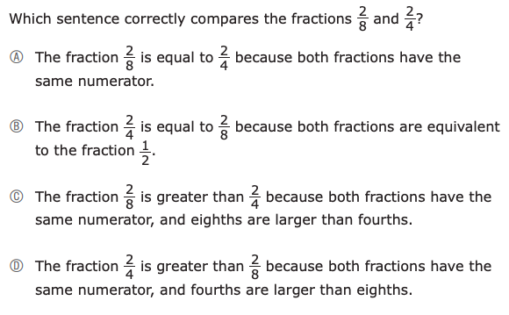
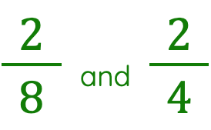
What can we say about these fractions?

Slide 14
27 ÷ 3 = m
m ÷ 27 = 3
3 ÷ 27 = m
m x 3 = 27
27 x 3 = m
What do you we notice?
What do we wonder?
Which of these can also be used to find the value of m?

Slide 15
The first four numbers in a pattern are shown.
39, 43, 47, 51, ?
Which of these sentences are true about the number pattern?
Select the two correct answers.
A The rule for the pattern is “add 3.”
B The rule for the pattern is “add 4.”
C The rule for the pattern is “subtract 6.”
D The next number in the pattern is 45.
E The next number in the pattern is 54.
F The next number in the pattern is 55.
What can we say about this pattern?

Slide 16

Which of these have the same value as the expression
5 x 90
Select the two correct answers.
A. 5 x 10
B. 9 x 10
C. 90 x 5
D. 5 x 9 x 10
E. 90 x 90 x 90 x 90 x 90
An expression is shown.
5 x 90
Create an expression that has the same value!

