Slide 1
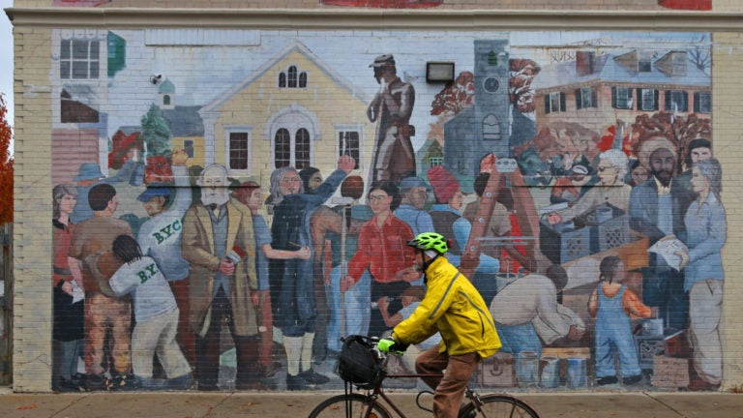
Look closely at this mural in Jamaica Plain
What quantities can we estimate?
Length?
Height?
Bricks?
Characters?
3.MD.A2
Notes:
Week of February 28, 2022

Slide 2
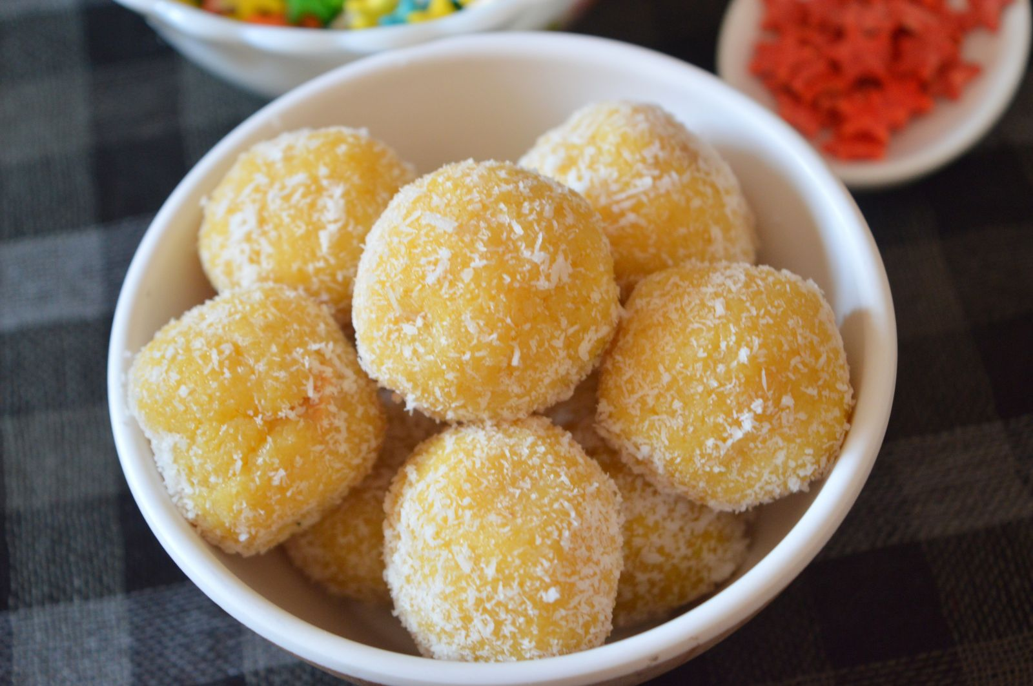
Happy Maha Shivaratri
Each of these Mango Ladoo weighs around 65 grams.
How much might they all weigh together?
3.MD.A2
Notes:
March 1, 2022
Maha Shivaratri (India)

Slide 3
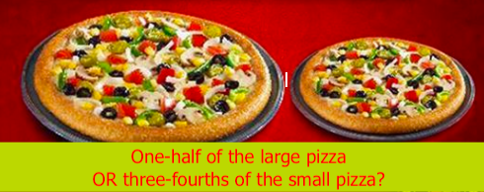
Would you rather . . .
3.NF.A3

Slide 4
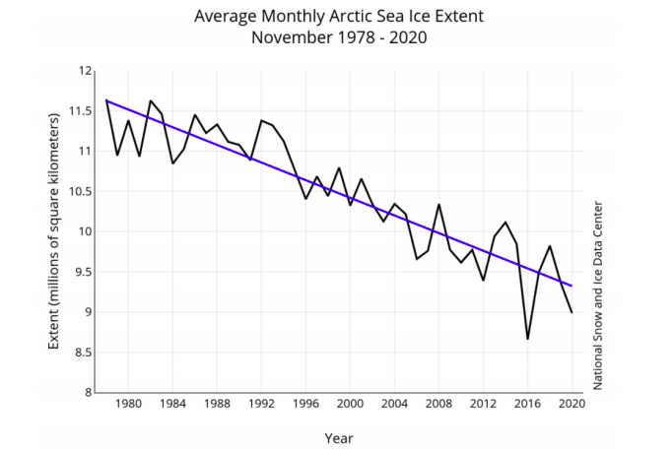
What do you notice?
What do you wonder?
What is going on in this data visualization?
YouCubed, Stanford University
3.MD.B
Notes:
This graph from the National Snow & Ice Data Center shows the extent of sea ice in the month of November between 1978 and 2020. What do you notice about this trend? Why do you think this trend is happening? The NY Times released an article saying that some populations of polar bears have declined by 40% between 2000 and 2010. Polar bears live on sea ice. Do you think this graph is related to the decreasing polar bear population?

Slide 5
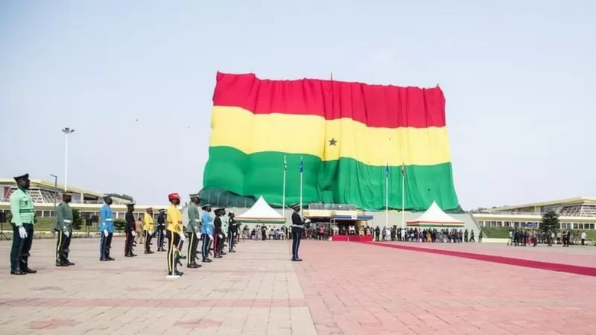
Happy Independence Day in Ghana!
This giant flag measures 85m x 50m
What can we say about the perimeter and the area?
3.MD.D8
Notes:
March 6, 2022
Ghana Independence Day

Slide 6
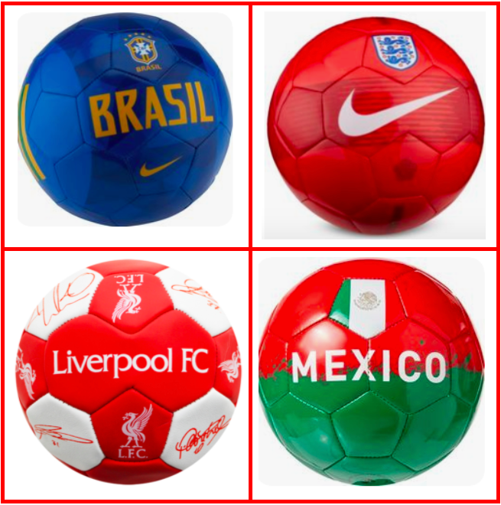
Which one doesn’t belong?
3.G.A1
Notes:
Week of March 7, 2022

Slide 7
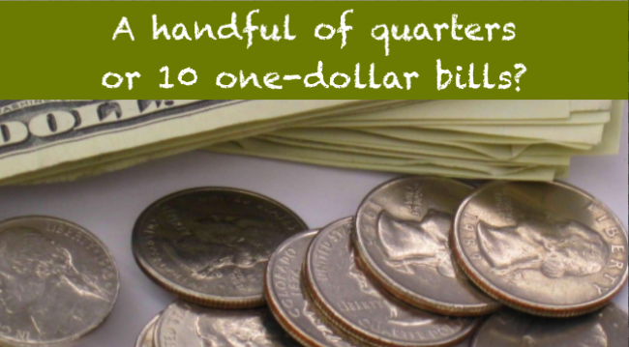
Would you rather have...
3.MD

Slide 8


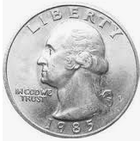
0
1
Which one doesn’t belong?
3.NF.A2

Slide 9
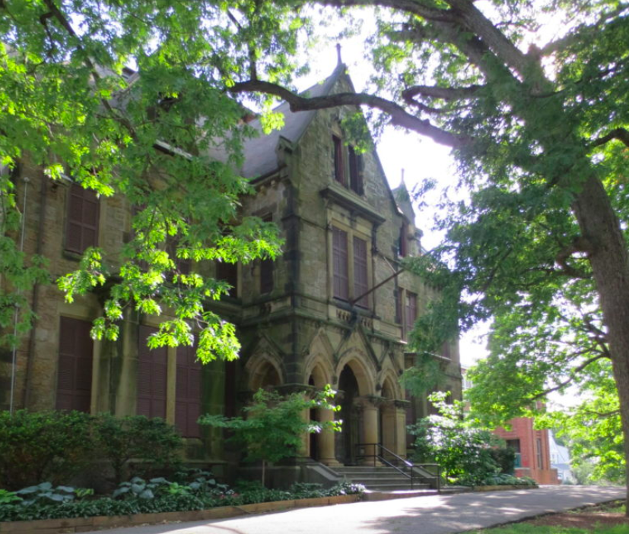
Abbotsford is now
Museum of the National Center for Afro-American Artists
It was built in 1872.
How many years has it been in Roxbury?
3.NBT.A2

Slide 10
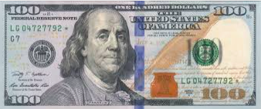
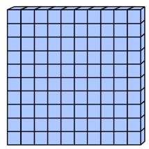

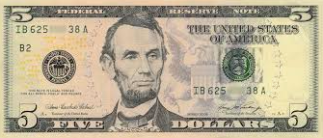
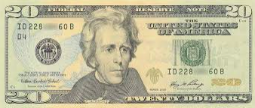
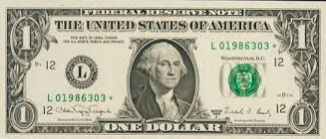
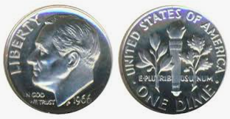
Which one doesn’t belong?
3.MD

Slide 11
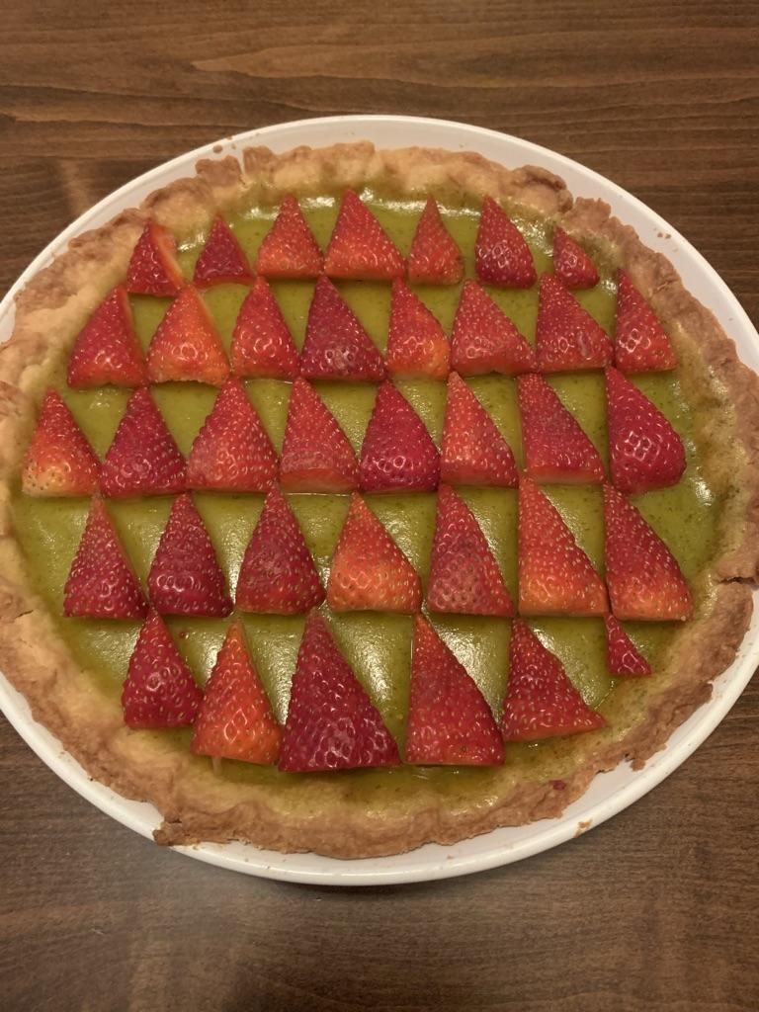
Piometry! Happy Pi Day!
What shapes do you see in this pie?
What other maths can we see?
3.G.A1
Notes:
Week of March 14, 2022

Slide 12
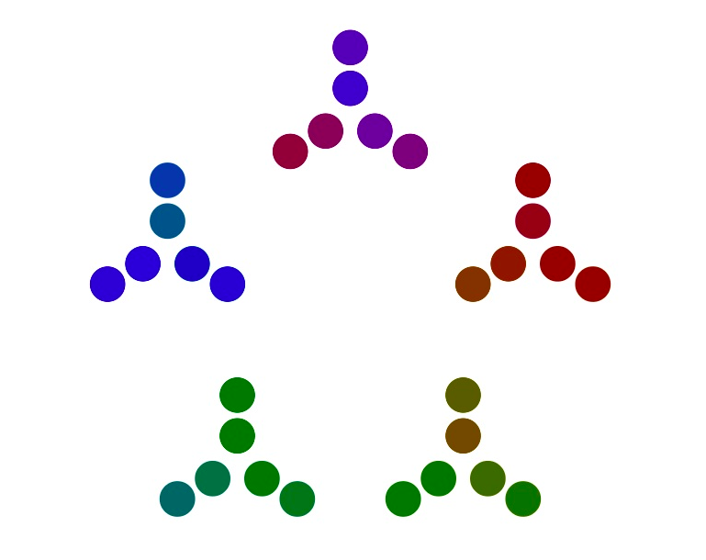
What can you
say about this number visualization?
Where do you see PRIME numbers?
3.OA. A1

Slide 13
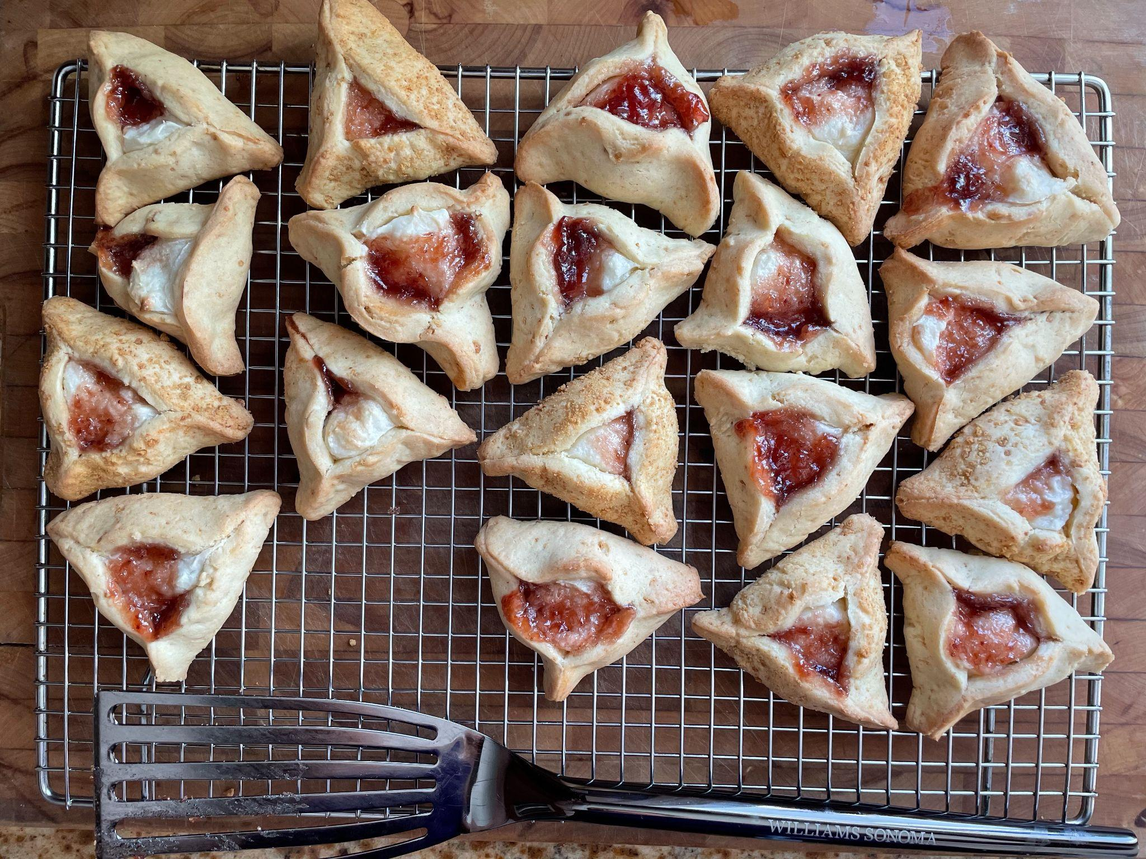
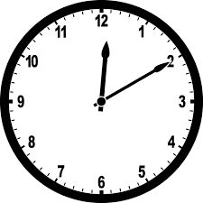
Happy Purim!
We just took these hamantaschen out of the oven.
They baked for 18 minutes.
When did we put them into the oven?
We are putting another tray in the oven, when will they be done?
3.MD.A1
Notes:
March 16, 2022
Purim

Slide 14
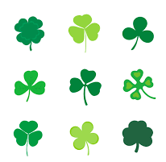
How many different number sentences can we create to match this picture?
3.OA.A3
Notes:
March 17, 2022
St. Patrick’s Day

Slide 15
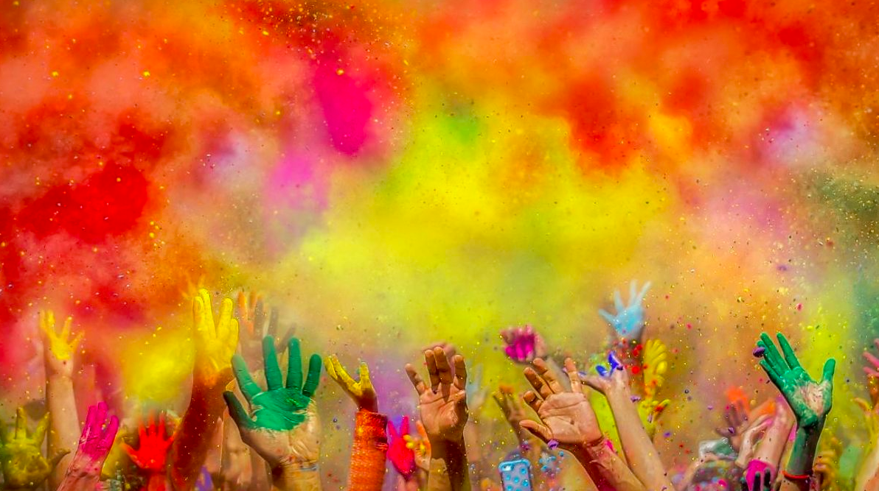
Happy Holi!
Estimate how many hands you see here!
How many is too many? How many is too few?
Suppose there are 59 hands in this photo.
How many fingers are there?
How many different ways could you figure it out?
3.NBT.A3
Notes:
March 18, 2022
Holi (India)

Slide 16
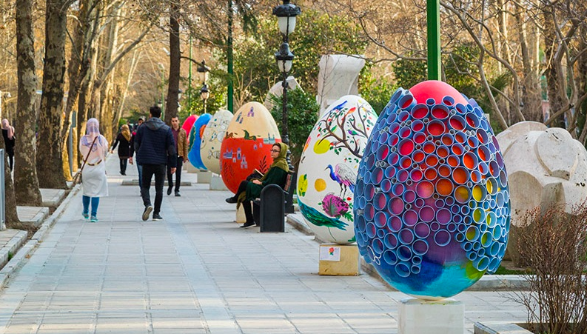
Happy Persian New Year Spring Equinox
What do you notice?
What do you wonder?
What math questions can we ask and investigate?
3.MD.A2
Notes:
Week of March 21, 2022
Persian New Year

Slide 17
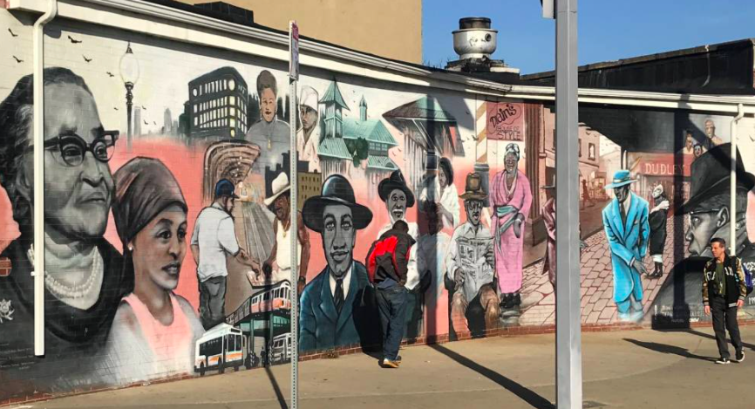
It takes 23 minutes to go from Case Campus to this mural in Nubian Square.
If we leave school at 12:30 to go see the mural and come right back,
what time will it be when we return?
3.MD.A1

Slide 18
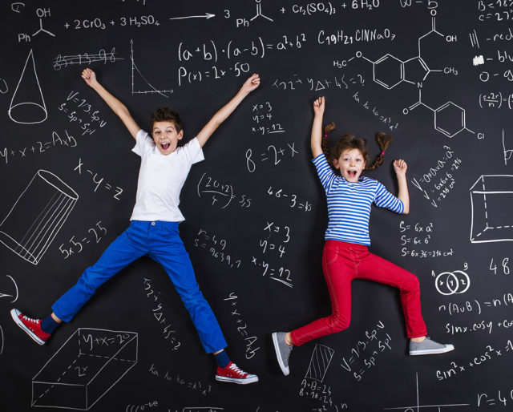
It’s World Maths Day!
The very 1st World Maths Day was celebrated in 2007.
How long ago was that?
Create an expression that equals 2007 using as many different operations as you can!
3.OA.D8

Slide 19
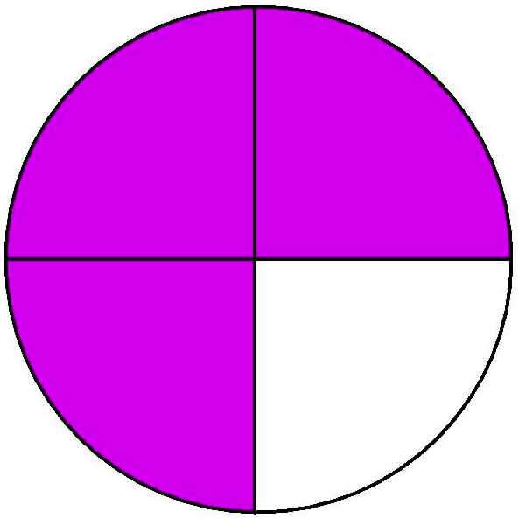
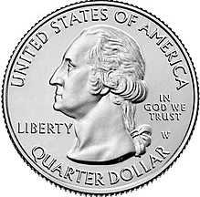

Which one doesn’t belong?
3.NF.A3

Slide 20
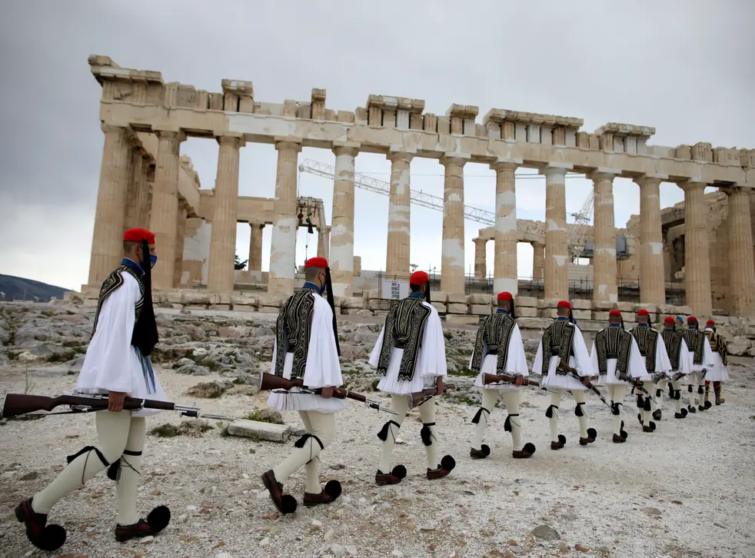
Happy Greek Independence Day!
The Parthenon was built to extremely precise dimensions according to the mathematical ratios of sacred geometry.
The rectangular building is 101 feet wide by 228 feet long. It was constructed of brilliant white marble, surrounded by 46 great columns, roofed with tiles, and housed a nearly 40 foot tall statue of the goddess Athena.
Where’s the MATH?
3.MD.D8
Notes:
March 25, 2022
Greek Independence Day

Slide 21
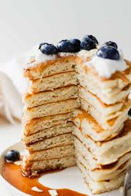
About what fraction of the pancake stack has been eaten?
What fraction is left in the stack?
3.NF.A1
Notes:
Week of March 28, 2022

Slide 22

2 x 5 x 3 = 6 x 5
9 x 8 > 6 x 6 x 2
50 ÷ 5 < 10 x 2
100 ÷ 4 = 5 x 4
Prove it!
3.OA.B5

Slide 23
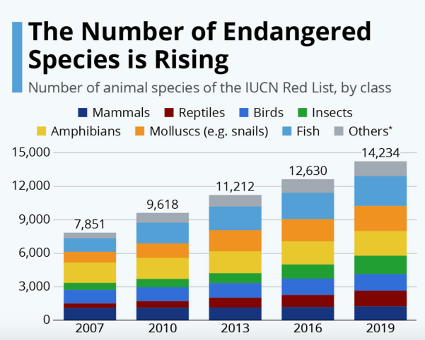
What do you notice?
What do you wonder?
What is going on in this data visualization?
YouCubed, Stanford University
3.MD.B

Slide 24
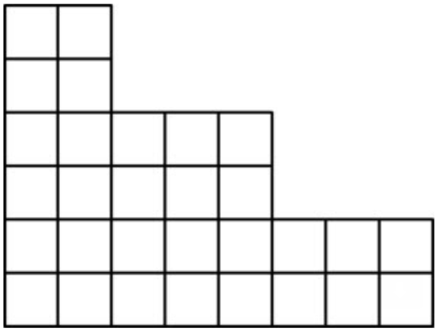
What’s the AREA?
Let’s make RECTANGLES!
How many different ways can we partition this figure into 3 rectangles?
3.MD.C6
Notes:
March 1, 2021

Slide 25
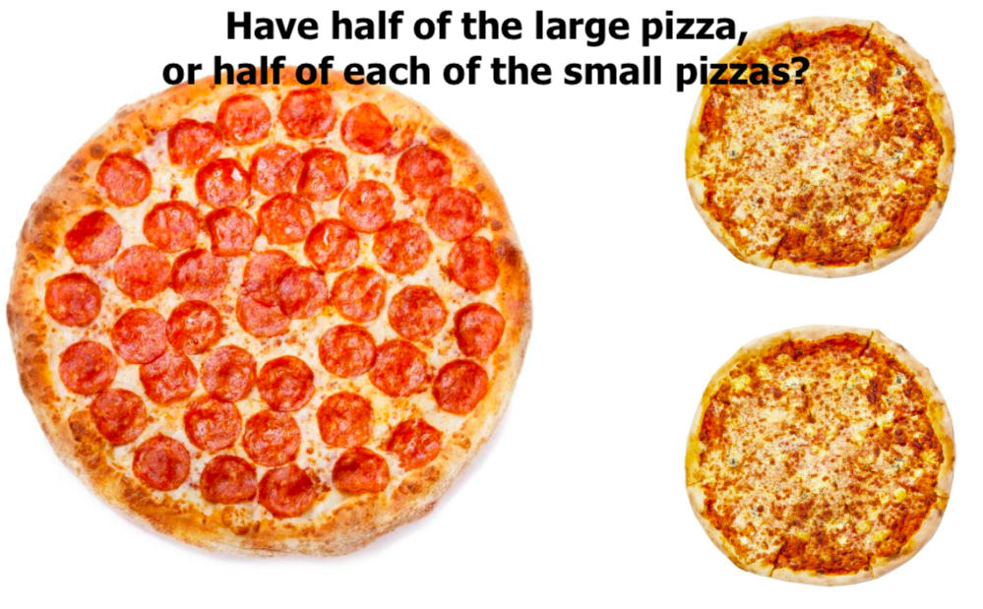
Would you rather . . .
3.NF.A3

