Slide 1
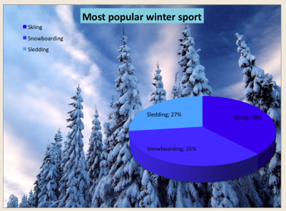
If this graph could talk what would it say?
What questions do you have about this data?
2.MD.D
Notes:
Week of February 28, 2022

Slide 2
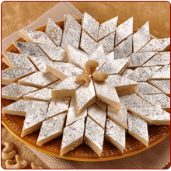
Happy Maha Shivaratri
How many kaju katli do we see on the plate?
How can we count them?
How can we use “groups of” to help us solve this?
Write an expression to match your thinking?
2.OA.C3
Notes:
March 1, 2022
Maha Shivaratri (India)

Slide 3
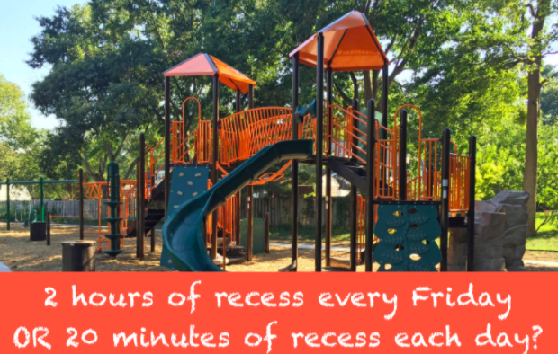
Would you rather have ...
2.MD.C7

Slide 4
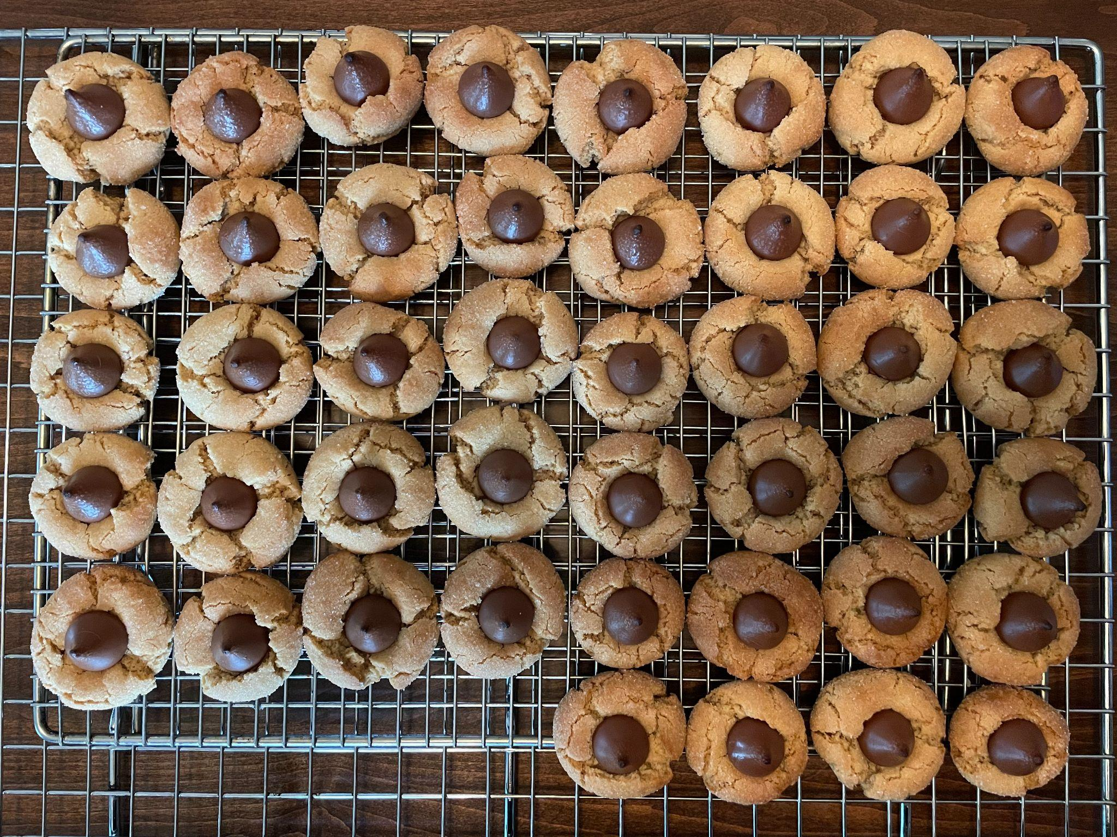
How many kiss cookies are here?
How can we use ARRAYS to figure it out?
2.OA.C4

Slide 5
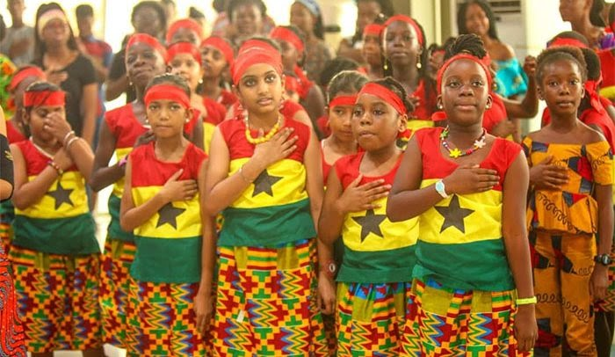
It’s Ghana National Day!
The celebration commemorate Ghana’s independence from the United Kingdom in 1957.
How long ago was that?
How can we use mental math to figure it out?
2.NBT.B7
Notes:
March 6, 2022
Ghana Independence Day

Slide 6
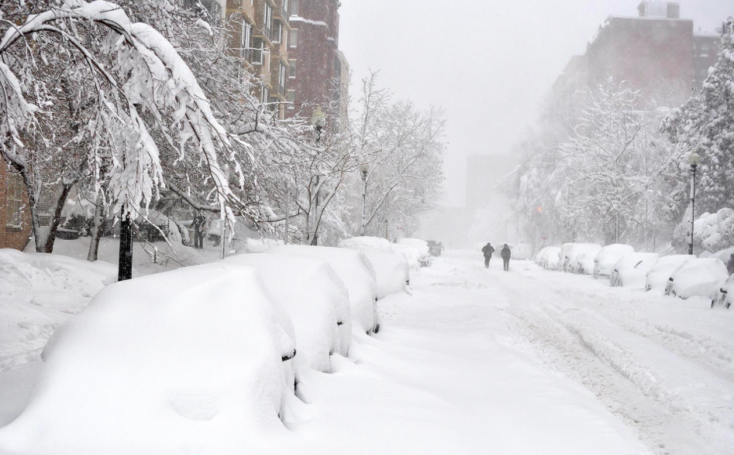
2.MD.C7
Would you rather have ONE HUGE snowstorm,
or one inch of snow EVERY DAY for a month?
Notes:
Week of March 7, 2022

Slide 7
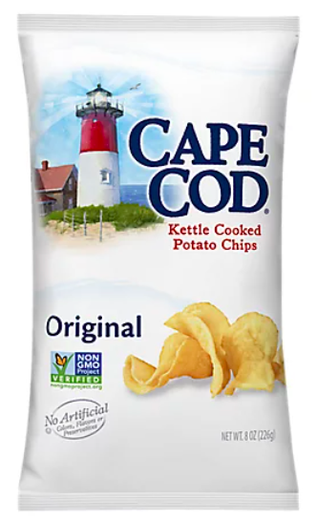
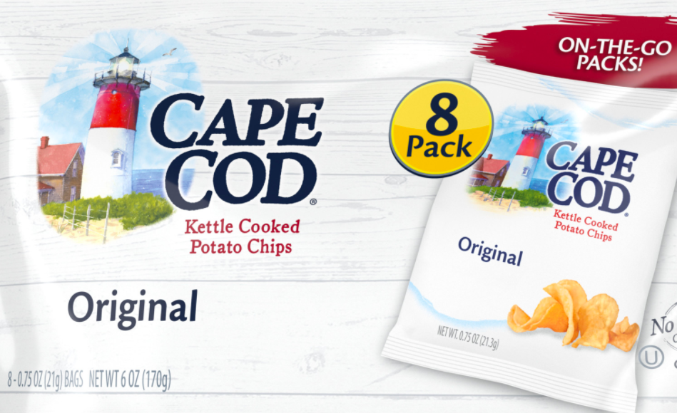
Would you rather have
8 small bags of chips or 1 large bag?
2.SMP.3

Slide 8
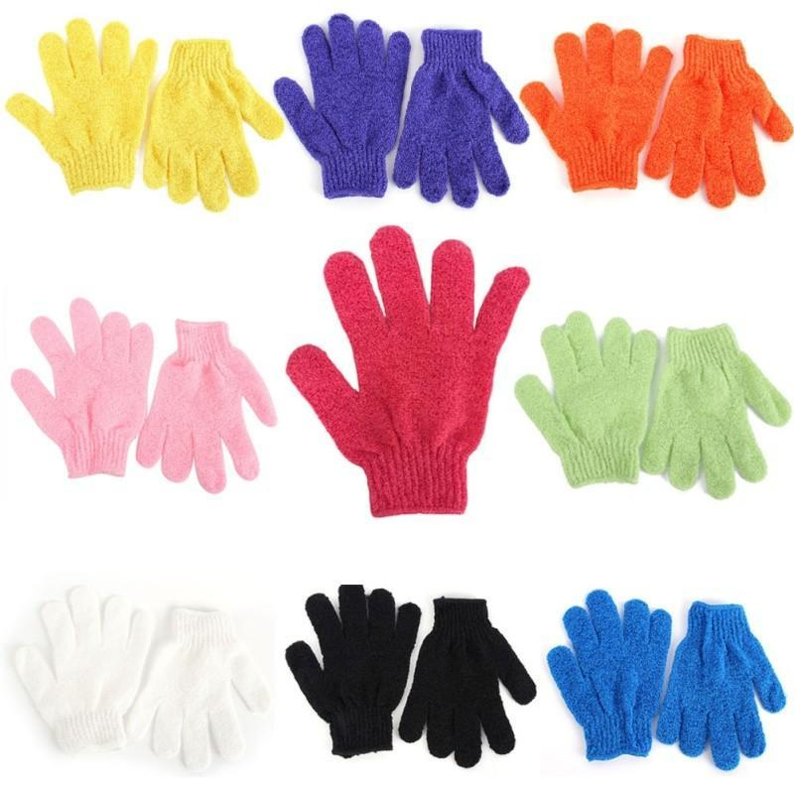
Is the number of gloves odd or even?
How do you know?
Is the number of FINGERS on the gloves odd or even?
How do you know?
How can you count them?
2.OA.C3

Slide 9
Which one doesn’t belong?
555 | 23
741 | 648
2.NBT.A1

Slide 10
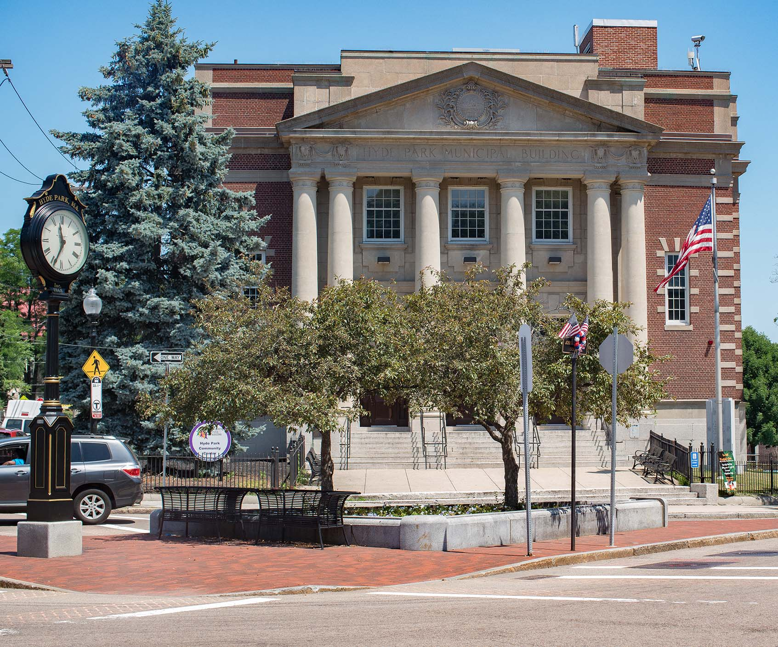
If the flagpole outside of the Municipal Building in Hyde Park is 20’ tall, estimate the height of the building.
What else can we estimate in this picture?
2.MD.A3

Slide 11
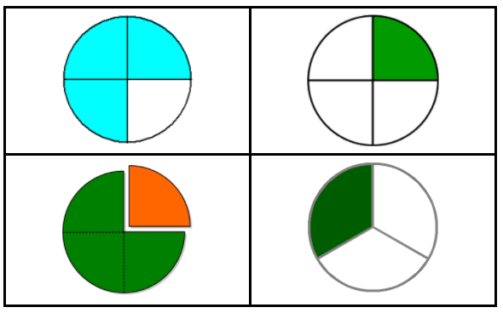
Happy Pi Day!
Which one doesn’t belong?
2.G.A3
Notes:
Week of March 14, 2022

Slide 12
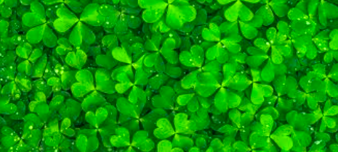
How many shamrocks do you see? Let’s estimate!
2.NBT.A2

Slide 13
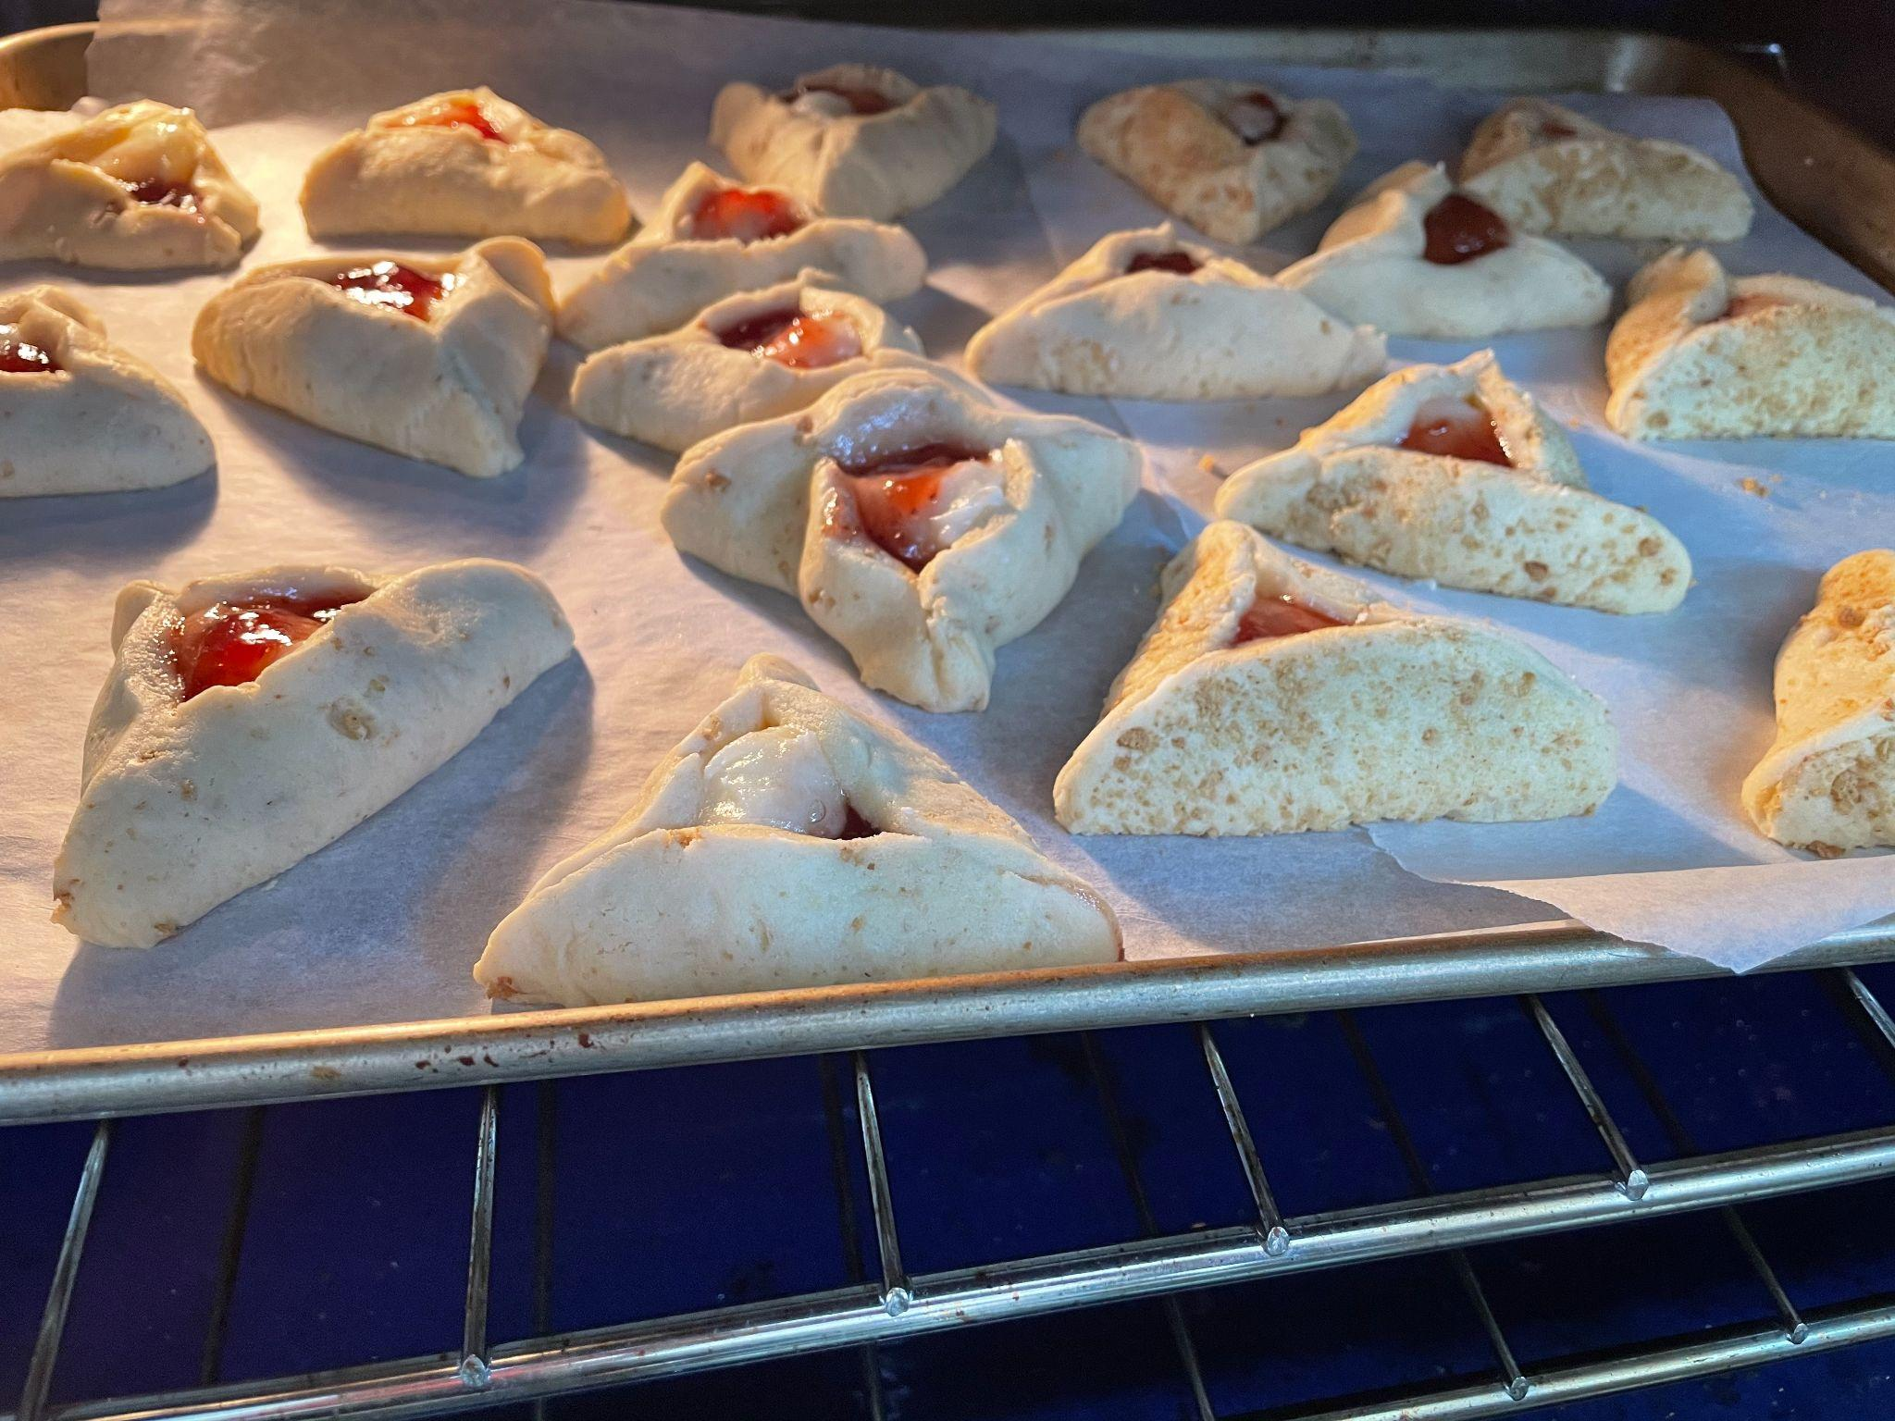
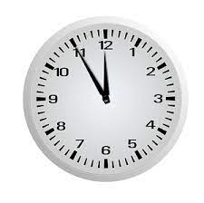
Happy Purim!
This is the time we put these hamantaschen in the oven.
They bake for 15 minutes.
Then we put another tray of them in the oven!
When will they be done?
2.MD.C7
Notes:
March 16, 2022
Purim

Slide 14
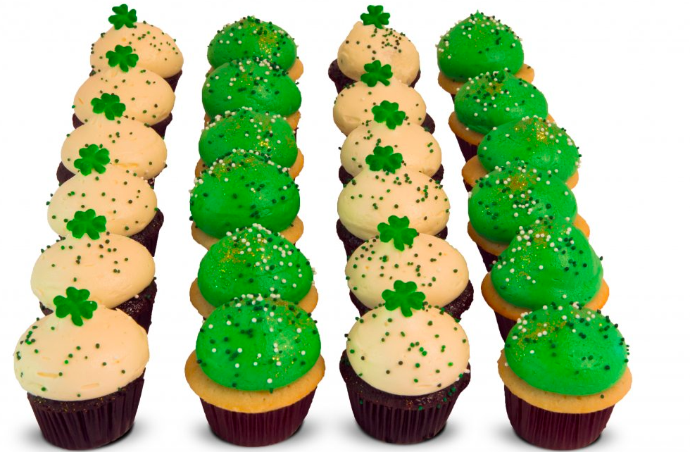
How can we count these cupcakes without actually COUNTING?
2.OA.C3
Notes:
March 17, 2022
St. Patrick’s Day

Slide 15
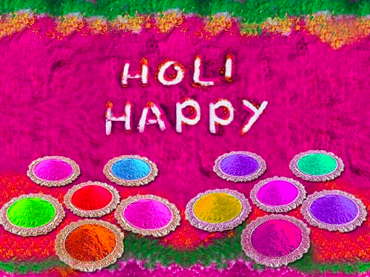
Happy Holi A Festival of Colors!
How many different number sentences can you create to represent the color pots?
2.OA.A2
Notes:
March 18, 2022
Holi (India)

Slide 16
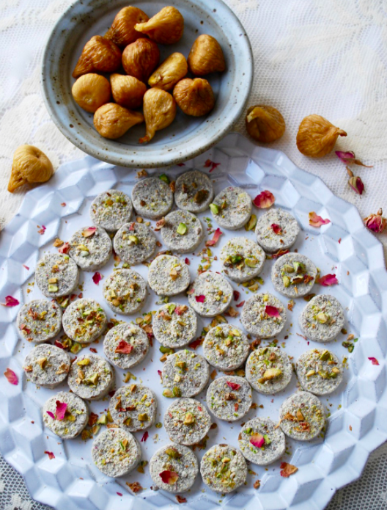
Happy Persian New Year Spring Equinox
How many yummy cookies do you think are here? Estimate!
How many different number sentences can you write to match this photo of Fresh Figs and Pistachio Fig Coins?
2.OA.A1
Notes:
Week of March 21, 2022
Persian New Year

Slide 17
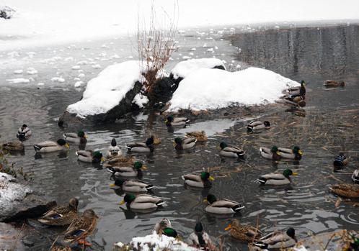
Winter Ducks!
How many are here?
Estimate
How many would be left if half of them flew away?
2.OA.A1

Slide 18
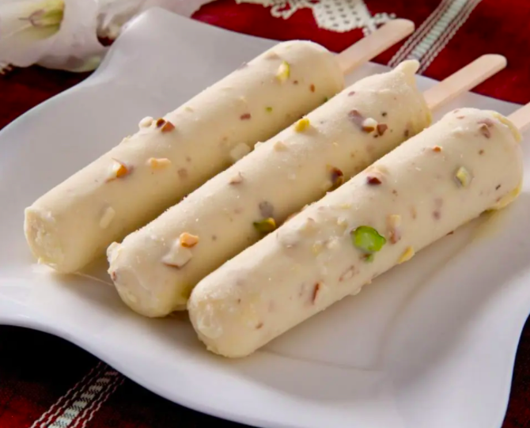
Happy Pakistan Day!
This an 8”square plate.
Estimate the lengths of these kulfi treats
2.MD.A3
Notes:
March 23, 2022
Pakistan Day

Slide 19
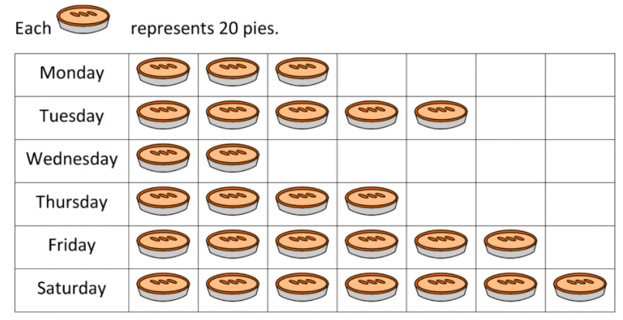
If this graph could talk, what would it say?
What’s a good name for this graph be?
2.MD.D10

Slide 20
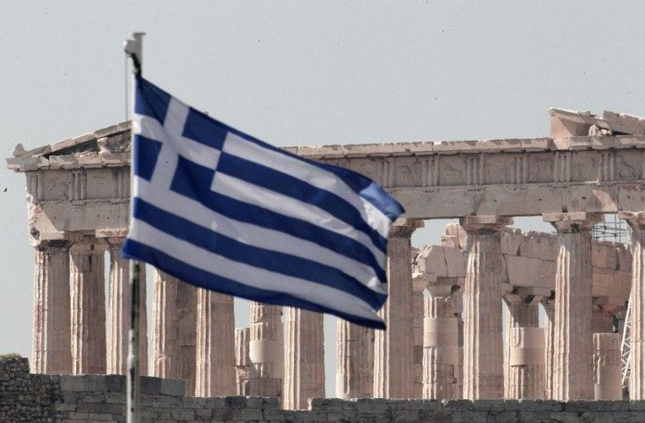
Happy Greek Independence Day!
Greece was declared an independent state in 1830. In 1832 the final borders of Greece were established.
How long ago was 1832?
2.NBT.B7
Notes:
March 25, 2022
Greek Independence Day

Slide 21
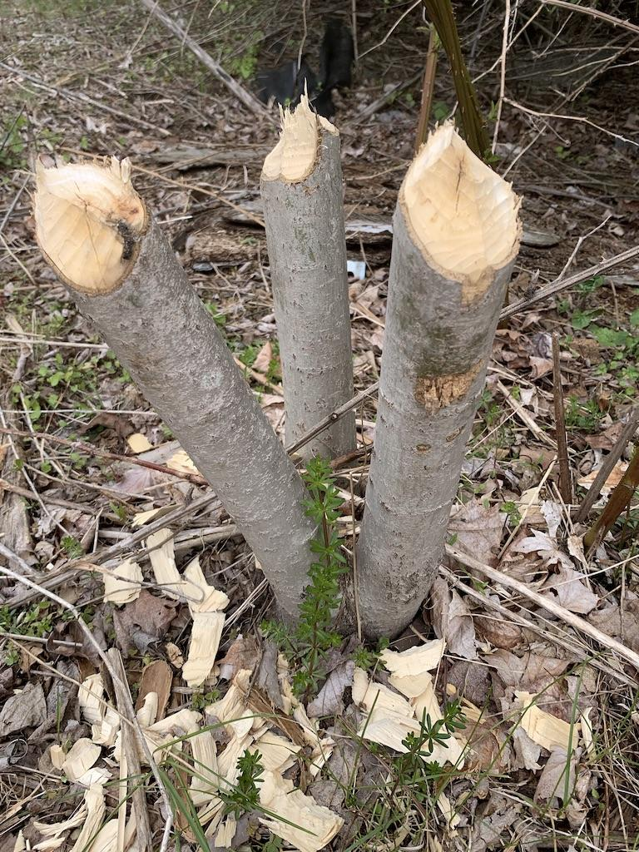
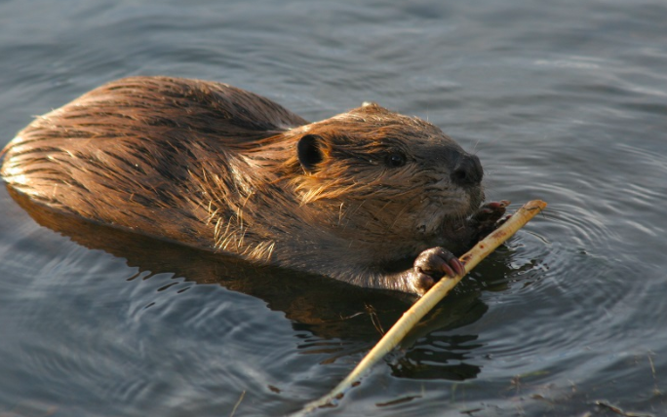
The beaver family that lives in our neighborhood took down these 3 small trees in one day.
How many trees will they be able to cut down in a week?
In a month?
2.NBT.B7
Notes:
Week of March 28, 2022

Slide 22
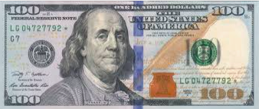
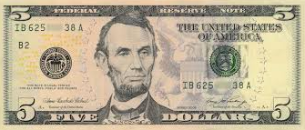
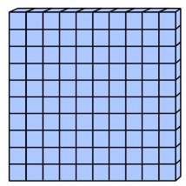

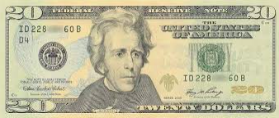
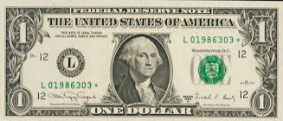
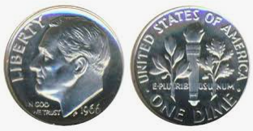
Which one doesn’t belong?
2.MD.C8

Slide 23
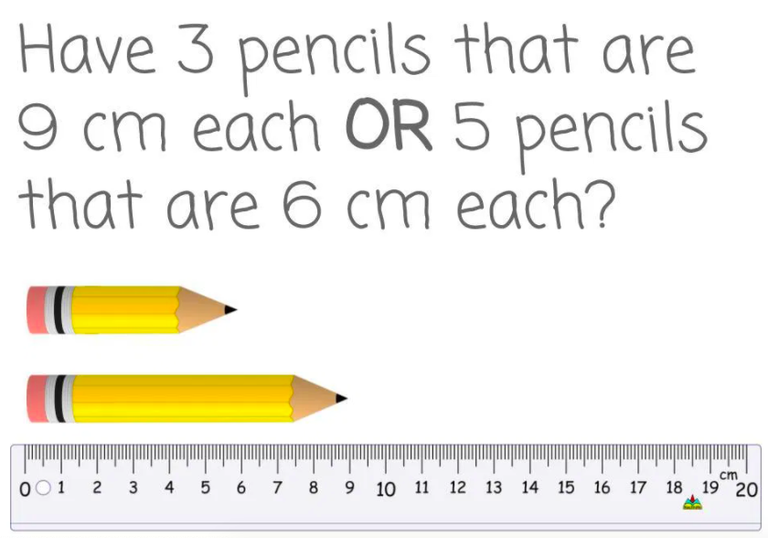
Would you rather...
2.MD.A3
wouldyourathermath.com

Slide 24

20 + 345 > 20 + 245
657 - 40 < 657 - 30
999 + 10 < 999 + 20
2.NBT.A4

Slide 25
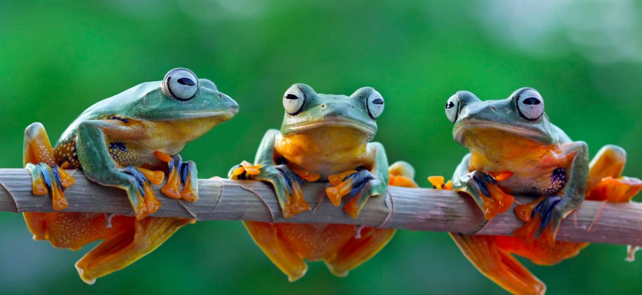
These Tree frogs weigh about 14 grams each.
How much do they weigh together?
2.MD.B5

