Slide 1
What is the Same?
What is Different?
K.OA.A3
Notes:
Week of January 31, 2022

Slide 2

Happy Chinese
New Year!
Are there more than 10 lanterns or less than 10?
How do you know?
K.CC.B4
Notes:
February 1, 2022
Chinese New Year

Slide 3

The date is 2 - 2 - 22
What can we do with all of these 2s?
K.OA.A1
Notes:
February 2, 2022
Groundhog Day

Slide 4
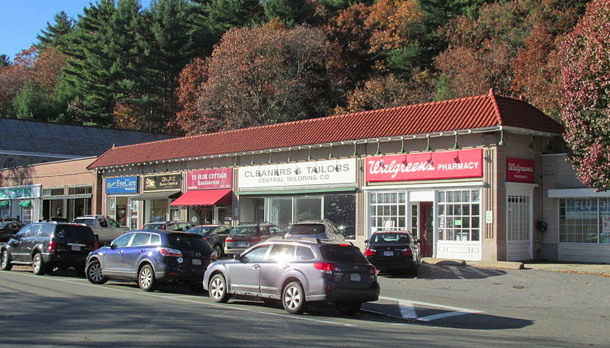
Talk about the different shapes you see here.
K.G.A2

Slide 5
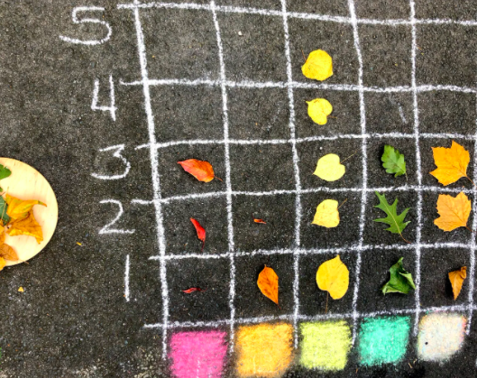
What can you say about this graph?
K.MD.B3

Slide 6
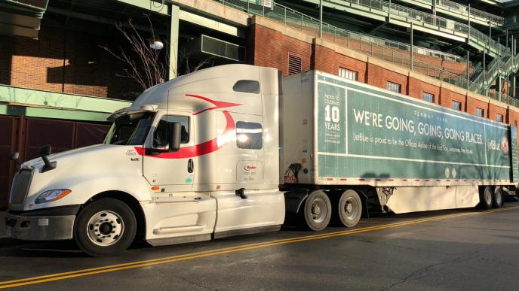
It’s Truck Day in Red Sox Nation!
Spring Training is in the air! What’s on the truck?
20,400 baseballs
1,100 bats
200 batting gloves
200 batting helmets
400 T-shirts
400 pairs of socks
20 cases of bubble gum
60 cases of sunflower seeds
How many wheels do you think are on that truck?
How many do you see?
How many don’t you see?
K.CC.B5
Notes:
Week of February 7, 2022
Truck Day

Slide 7
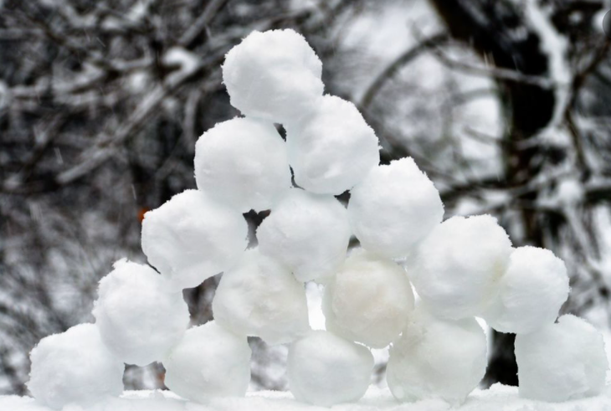
Are there more than 10 snowballs or less?
How can you count them?
K.CC.B5

Slide 8
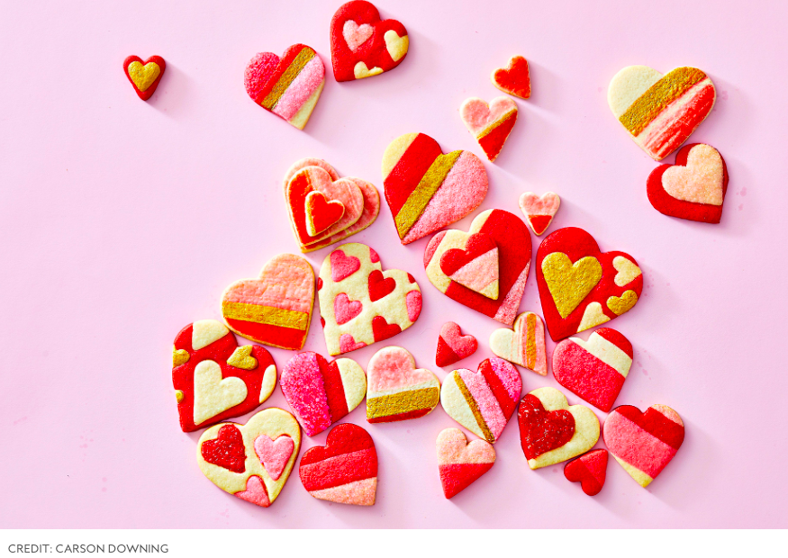
What do you notice?
What math do you see?
K.CC.B4

Slide 9
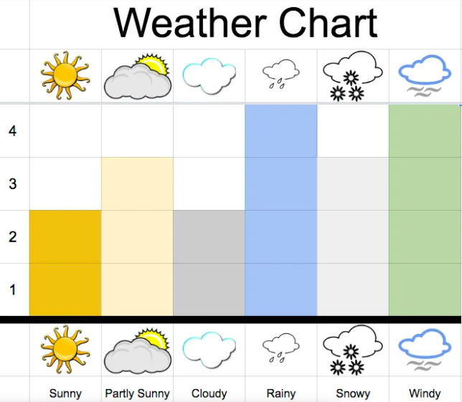
What you notice?
What do you wonder?
K.MD.B3

Slide 10
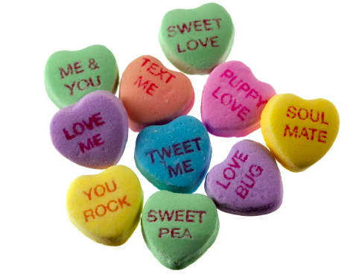
How many hearts are here?
How can we count them?
Let’s write an equation to match our thinking!
K.OA.A1

Slide 11
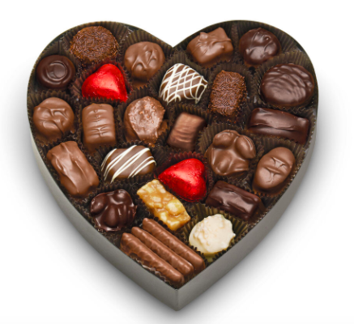
How would you sort these?
How would you count them?
K.MD.B3
Notes:
Week of February 14, 2022

Slide 12
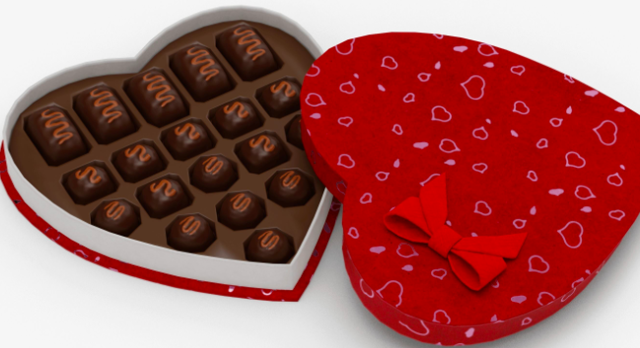
What shapes do you see?
What interesting number sentence can you create?
K.G.OA

Slide 13
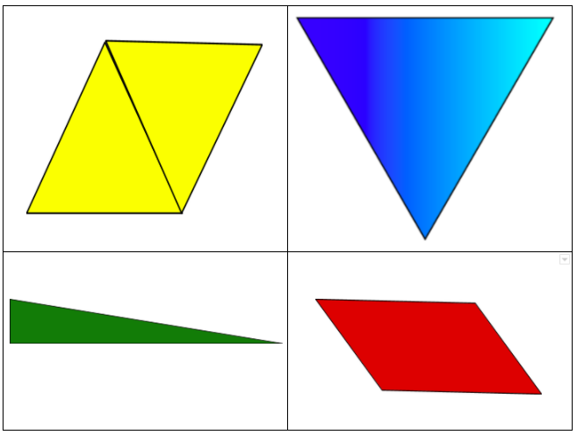
Which one does not belong?
K.G.B4

Slide 14
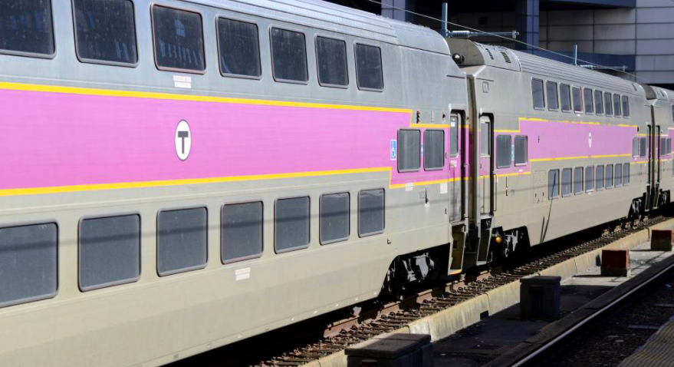
How many windows are on the train?
How many would be on 2 trains?
K.CC.B5

Slide 15
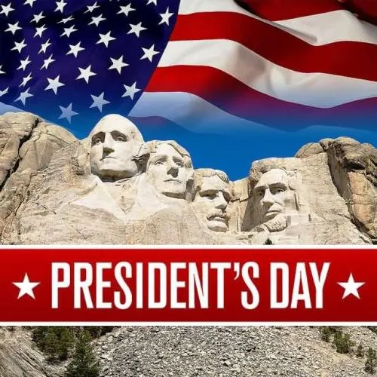
How many presidents are here?
Who are the presidents on Mount Rushmore?
How many different ways can we make 4?
K.OA.A3

