Slide 1
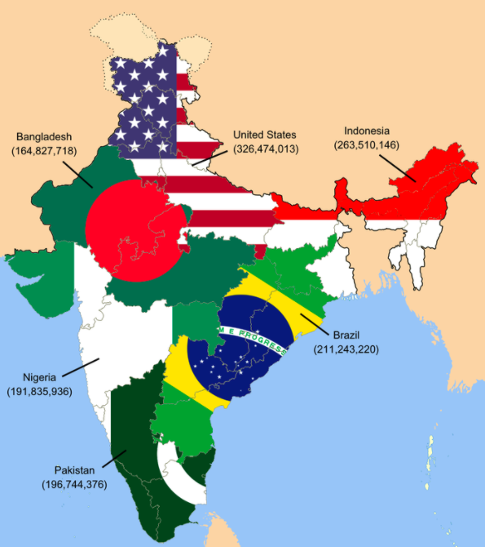
If this infographic could talk, what would it say?
This rough map illustrates that the population of India is as high as the next six most populated countries of the world... combined.
What is a good name for this graphic?
5.MD.B
Notes:
Week of January 31, 2022

Slide 2
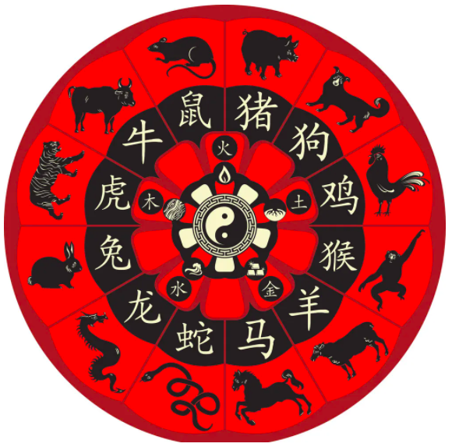
Happy Chinese New Year!
It’s the year of the Tiger!
What do you notice? What do you wonder?
The Chinese Zodiac is a 12 year cycle?
What year were you born? What animal was that?
Mac Jones is also a Tiger! What year was he born?
5.NBT.5
Notes:
February 1, 2022
Chinese New Year

Slide 3
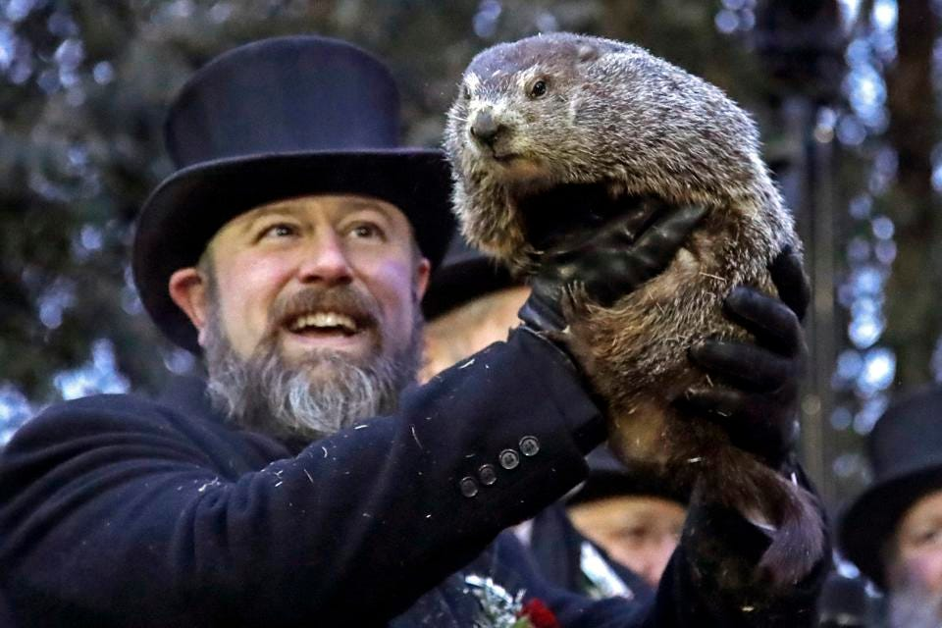
Did you know that an average Groundhog (which is exactly the same as a woodchuck!) weighs between 5 - 13 pounds.
If this little guy is EXACTLY in between 5 - 13 pounds, how many ounces is that? (There are 16 ounces in a pound)
Punxsutawney Phil checks for his shadow at Gobbler’s Knob in Punxsutawney, Pennsylvania each year. Will he see his shadow? Will we have an early Spring?
5.MD.A1
Notes:
February 2, 2022
Groundhog Day

Slide 4
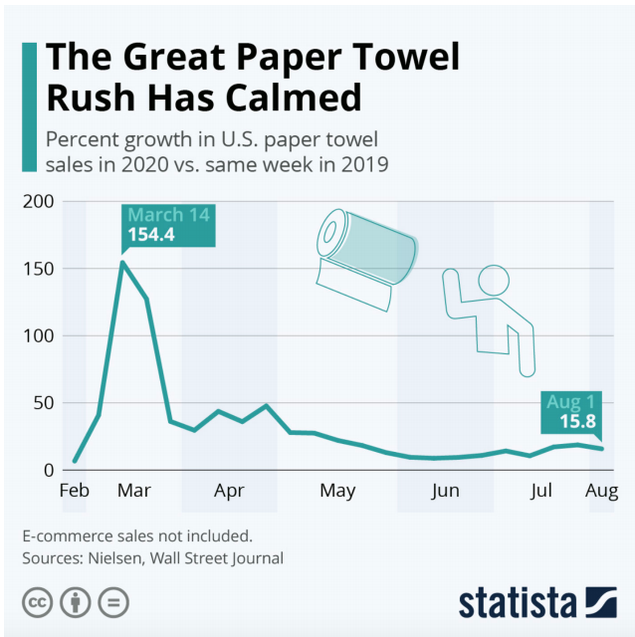
What do you notice?
What do you wonder?
What is going on in this data visualization?
5.MD.B

Slide 5
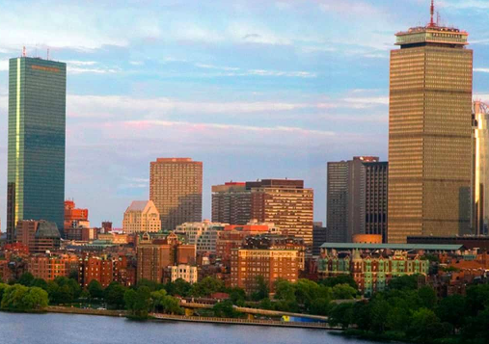
The distance between the Hancock Tower and the Prudential Center is .7 miles.
How far is that?
How many feet is that?
(There are 5280 feet in a mile)
Estimate!!
How can you solve this?
5.NBT.B7

Slide 6
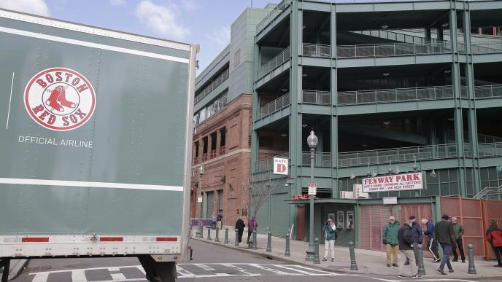
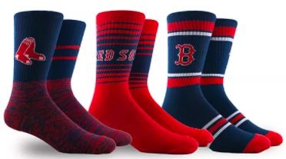
It’s Truck Day in Red Sox Nation!
Spring Training is in the air! What’s on the truck?
20,400 baseballs
1,100 bats
200 batting helmets
200 batting gloves
400 T-shirts
400 pairs of socks
20 cases of bubble gum
60 cases of sunflower seeds
5.NF.A
Let’s do some mental math!
How many pieces of equipment?
How many pieces clothing (gloves, shirts, socks)? What fraction of the all of the clothing are the
gloves? T-Shirts? Socks?
Notes:
Week of February 7, 2022

Slide 7
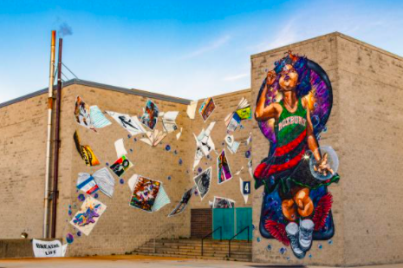
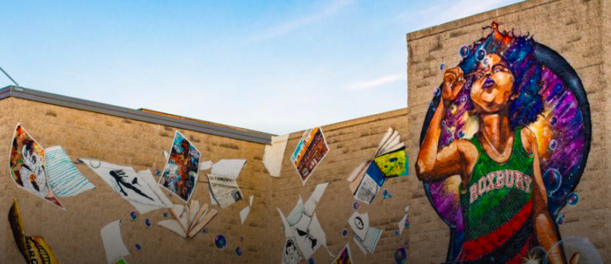
Use mathematics to estimate how high this mural is. Think in meters and centimeters!
5.MD.A1

Slide 8
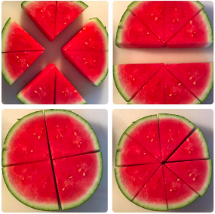
What fractions do you see?
5.NF.A

Slide 9
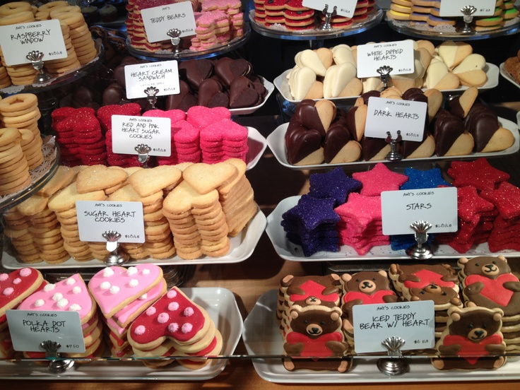
Where’s the Math?
5.NBT.5

Slide 10
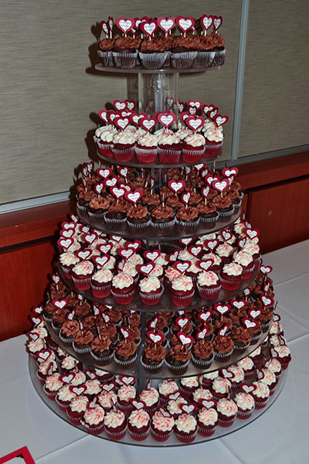
Estimate the number of cupcakes in this tower.
How can you use math to help you get close?
What fraction might be vanilla frosted? chocolate frosted?
5.NF.A

Slide 11
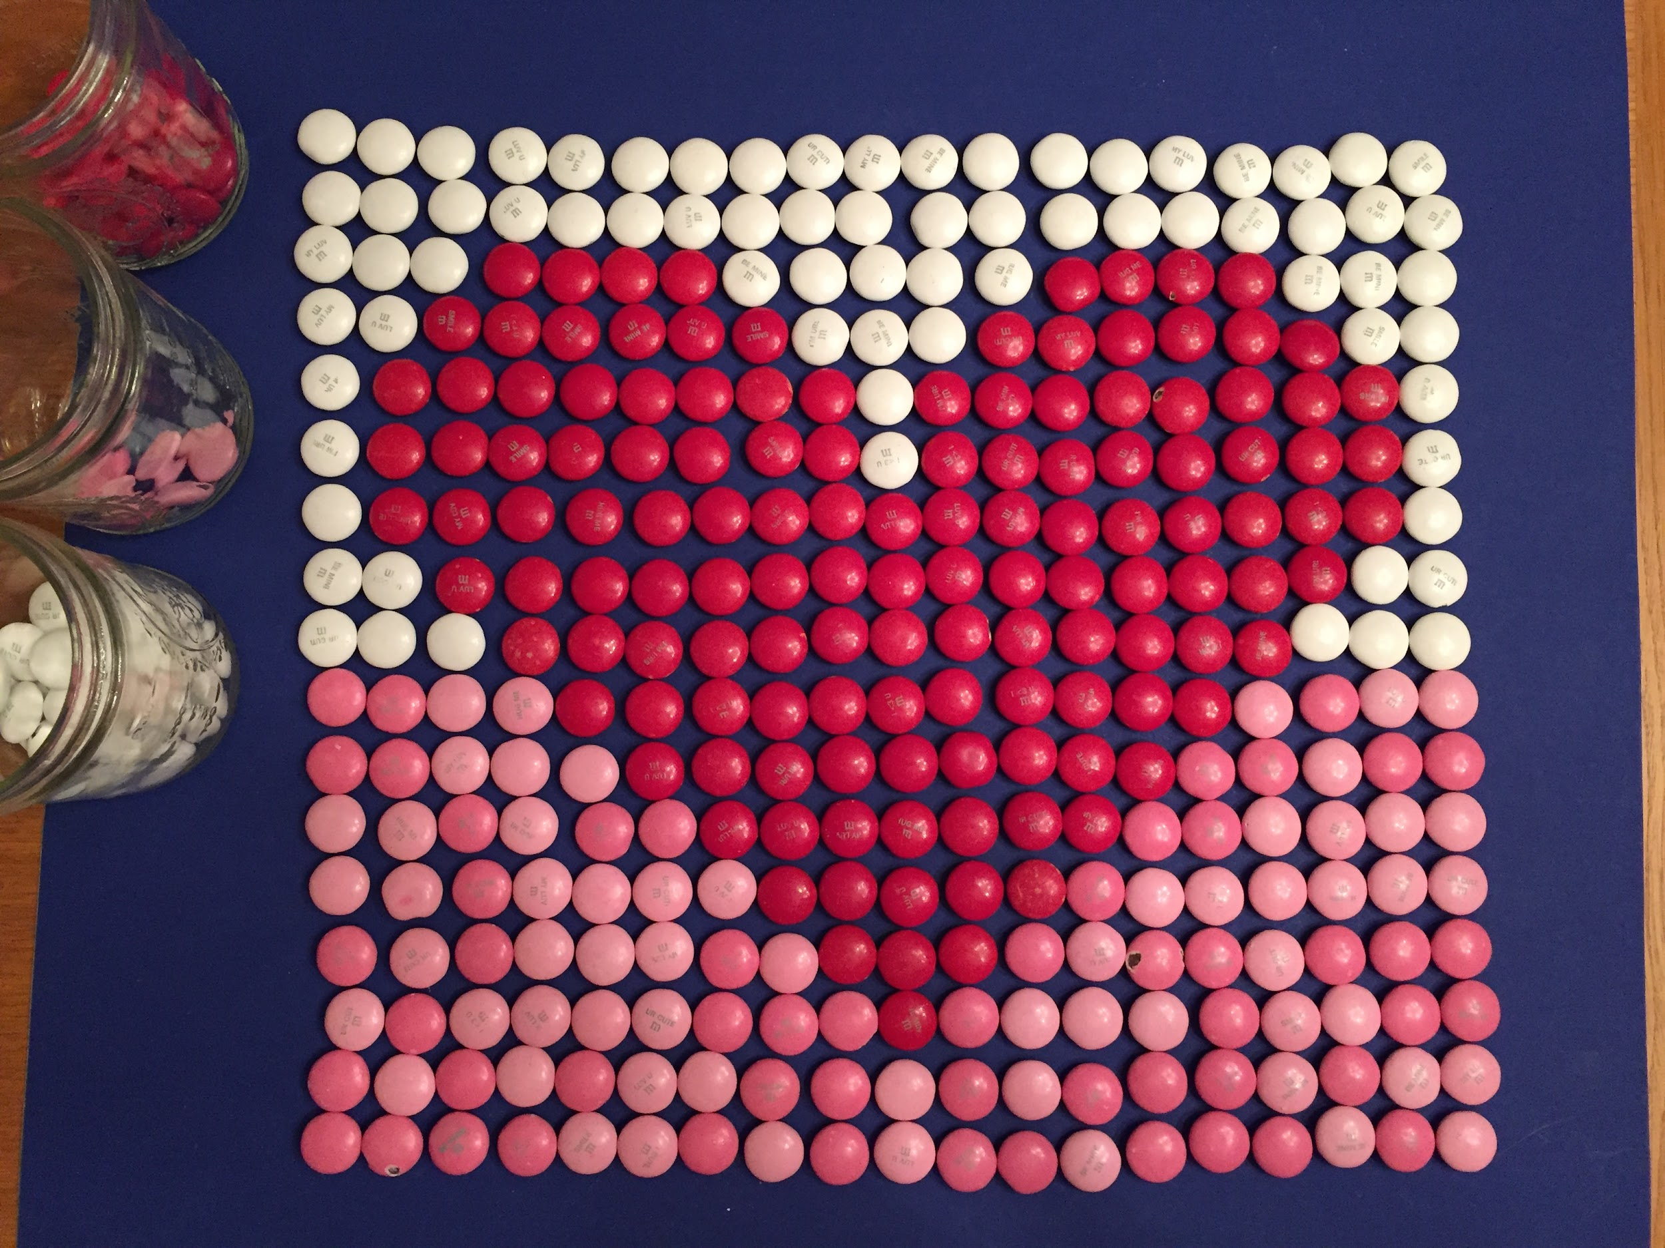
Estimate what fraction of the whole is made of white m&ms.
Red m&ms?
Pink m&ms?
How many m&ms are here altogether?
How can arrays help you solve this?
5.NF.NBT
Notes:
Monday, February 14, 2022

Slide 12
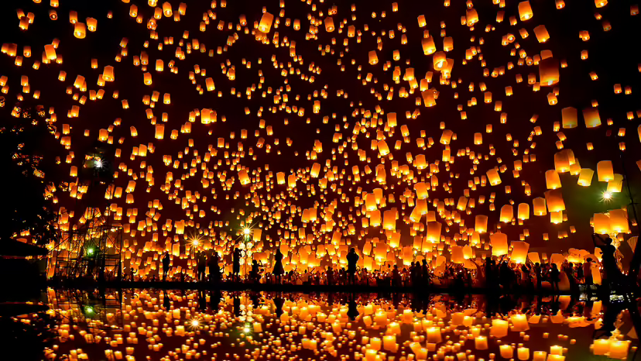
How long ago was the year 104 B.C.?
How can we figure it out?
In 104 B.C., Emperor Wu of the Han dynasty declares that the LANTERN FESTIVAL ceremony should be held through the night to inspire light in the darkness of winter.
5.MD
Notes:
February 15, 2022
Lantern Festival (China)

Slide 13
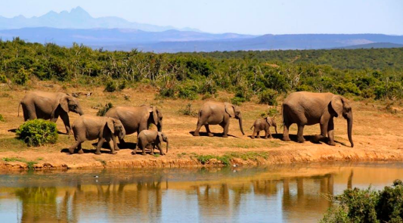
An African forest elephants’ tusks grow about 17 cm each year. If an elephant lives to be 65 years old,
about how long, in meters, would their tusks be?
5.MD.A1

Slide 14
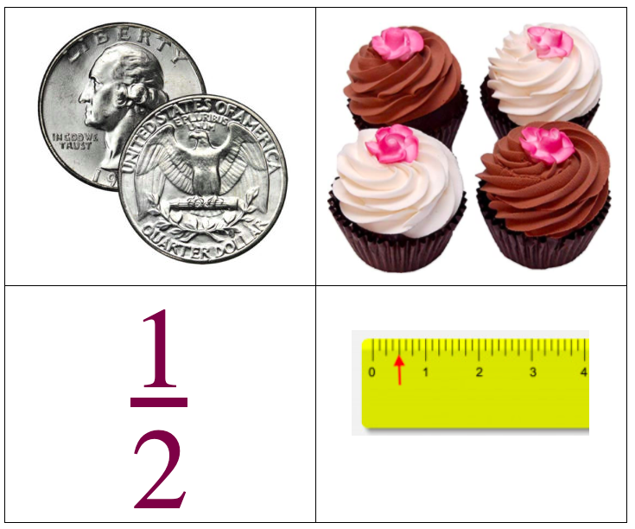
What’s the same?
What’s different?
5.NF.A

Slide 15
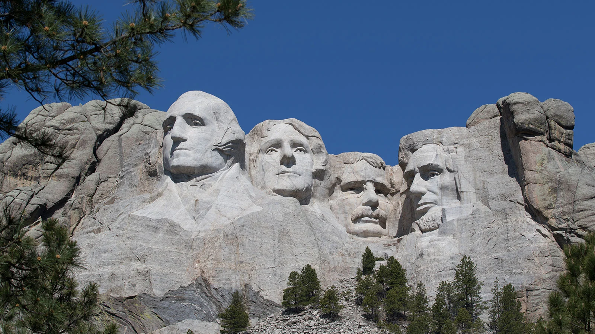
Construction began on Mount Rushmore in 1927. The monument was completed in 1941. How long did it take?
How many months was that?
How many days?
Before it became known as Mount Rushmore, the Lakota called this granite formation Tunkasila Sakpe Paha, or Six Grandfathers Mountain.
5.MD.A1
Notes:
PRESIDENTS ON MOUNT RUSHMORE: George Washington, the country’s first president, would represent its birth. Thomas Jefferson, who nearly doubled the country’s size with his purchase of the Louisiana Territory, stood for its westward expansion. Theodore Roosevelt, who had overseen the construction of the Panama Canal, was a symbol of economic growth. And Abraham Lincoln was selected for having fought to preserve the nation in the Civil War.

