Slide 1
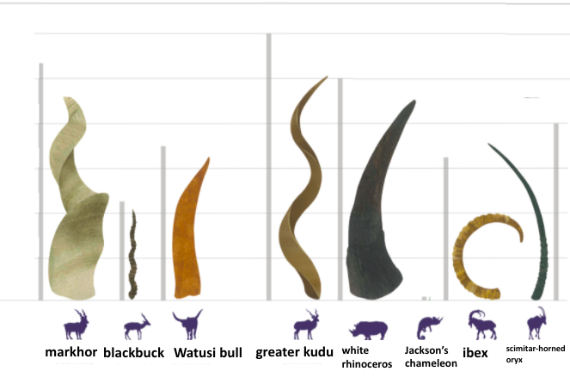
What do you notice?
What do you wonder?
What’s going on in this graph?
3.MD.B4
Notes:
Week of January 31, 2022

Slide 2
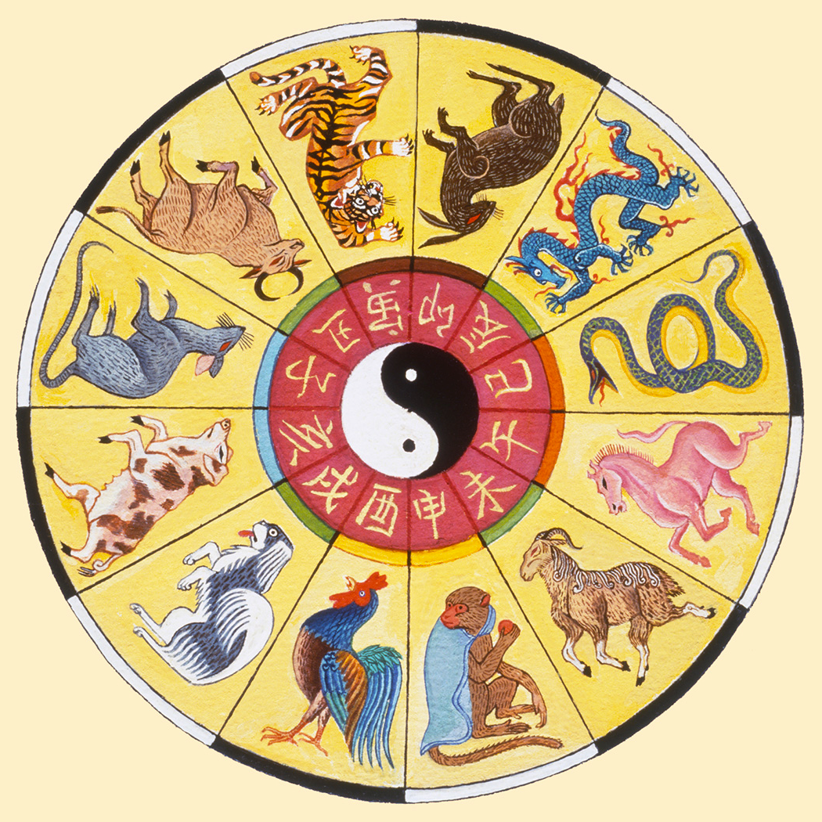

What do you notice about the Chinese Zodiac?
What do you wonder?
It’s the year of the Tiger!
When is the next year of the Tiger?
Can you figure out which animal sign you were born under?
3.OA.D9
Notes:
February 1, 2022
Chinese New Year

Slide 3
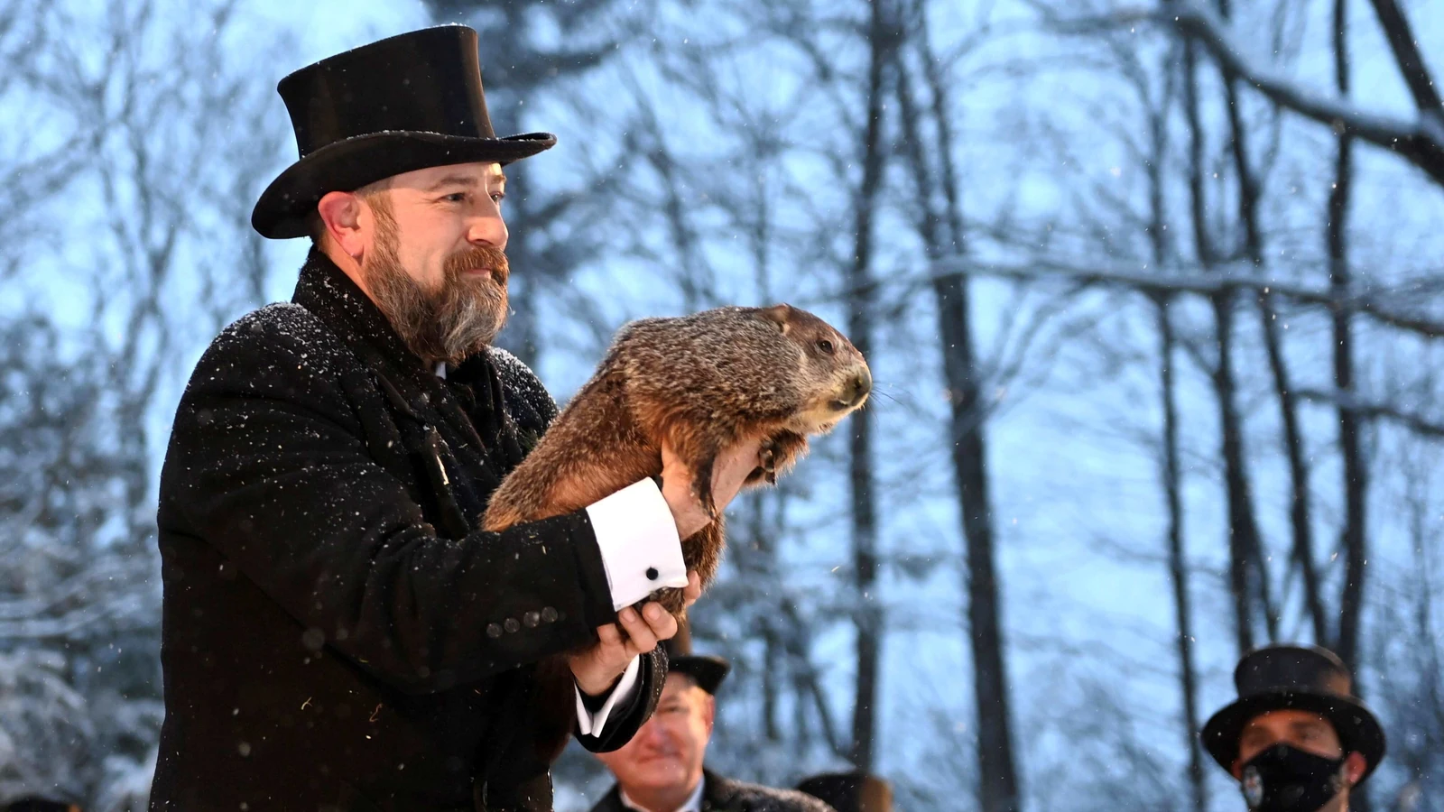
Happy Groundhog Day!
The first-ever Groundhog Day was in 1886 in Gobbler’s Knob, Pennsylvania.
How long ago was 1886?
What strategies can we use to figure it out?
3.NBT.A2
Notes:
February 2, 2022
Groundhog Day

Slide 4
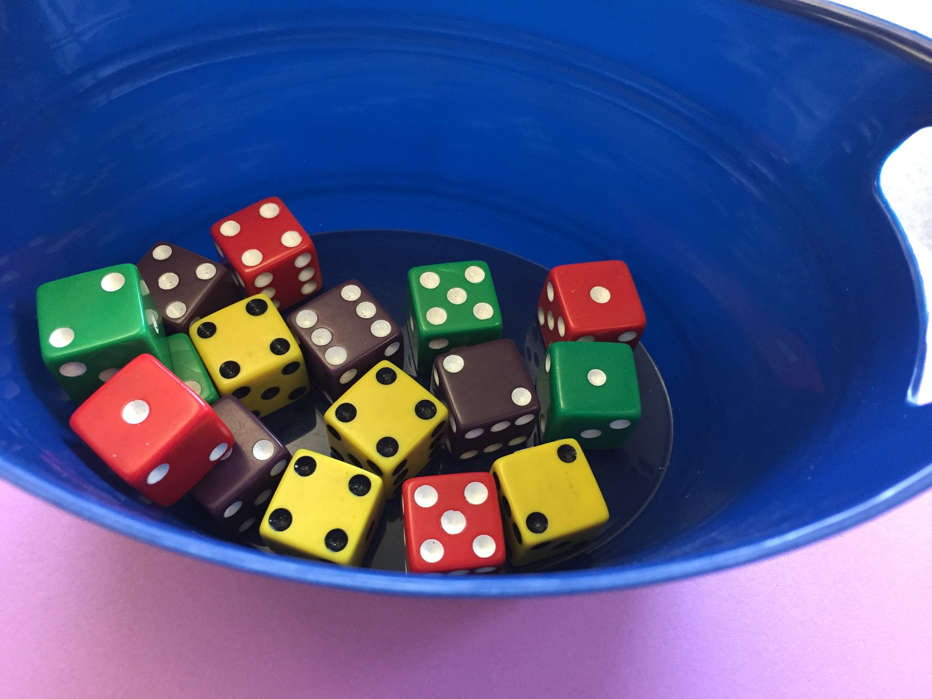
What MATH do you see in this picture?
How many different EQUATIONS can you record to represent your mathematical thinking?
3.OA.D8

Slide 5
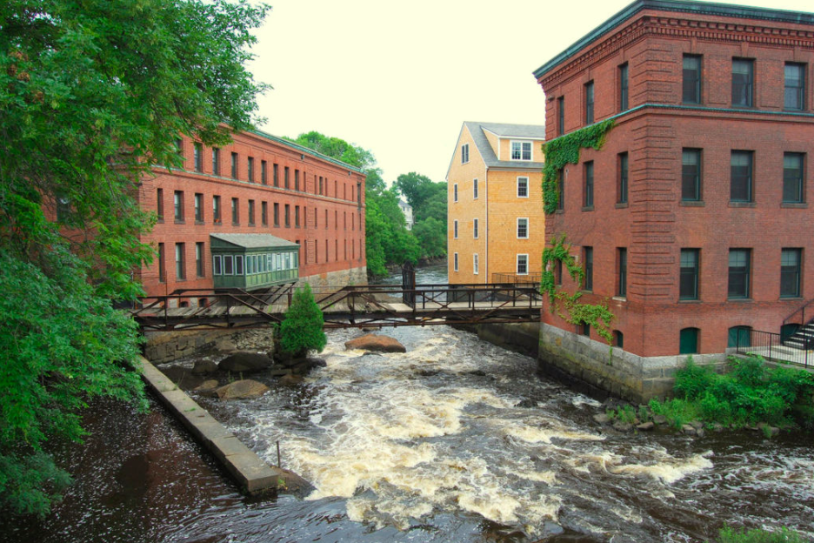
Where do you see arrays in this photo of the Neponset River?
How can they help you determine the actual number?
What are some multiplication equations that match this photo?
3.OA.A3

Slide 6
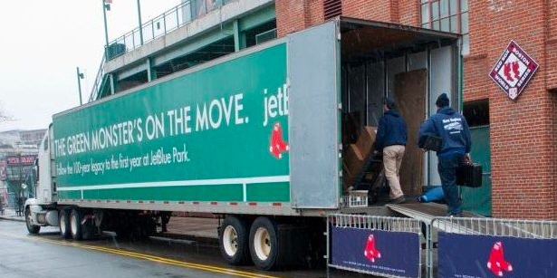
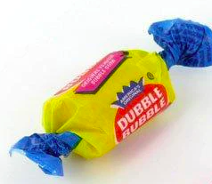
It’s Truck Day in Red Sox Nation!
Spring Training is in the air! What’s on the truck?
20,400 baseballs
1,100 bats
200 batting gloves
200 batting helmets
400 T-shirts
400 pairs of socks
20 cases of bubble gum
60 cases of sunflower seeds
Let’s do some mental math!
How many pieces of equipment?
How many pieces clothing?
How many pieces of bubble gum if each case has
1,700 pieces?
3.OA.C7
Notes:
Week of February 7, 2022
Truck Day

Slide 7
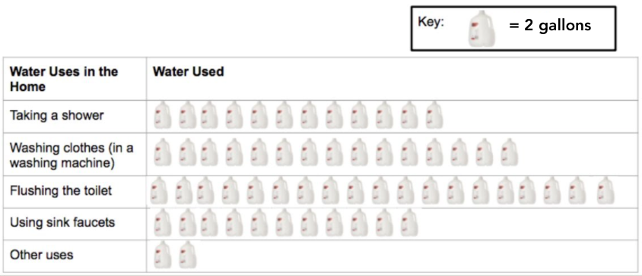
If this graph could talk, what would it say?
Create a name for this graph.
3.MD

Slide 8

5 x 6 = 5 x 2 x 3
5 x 6 = 5 x 3 x 3
10 x 3 = (5 x 3) + (5 x 3)
3.OA.B5

Slide 9
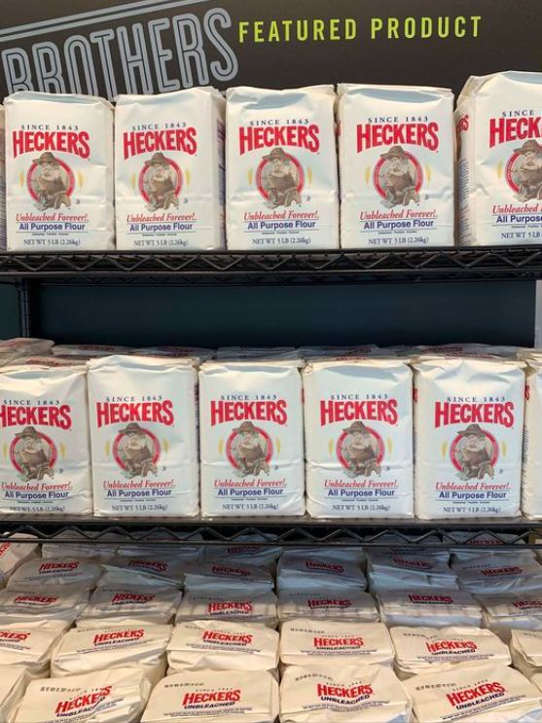
Estimate how many bags of flour are on display.
How can you use math to figure it out?
(think arrays!!!)
3.OA.D8

Slide 10
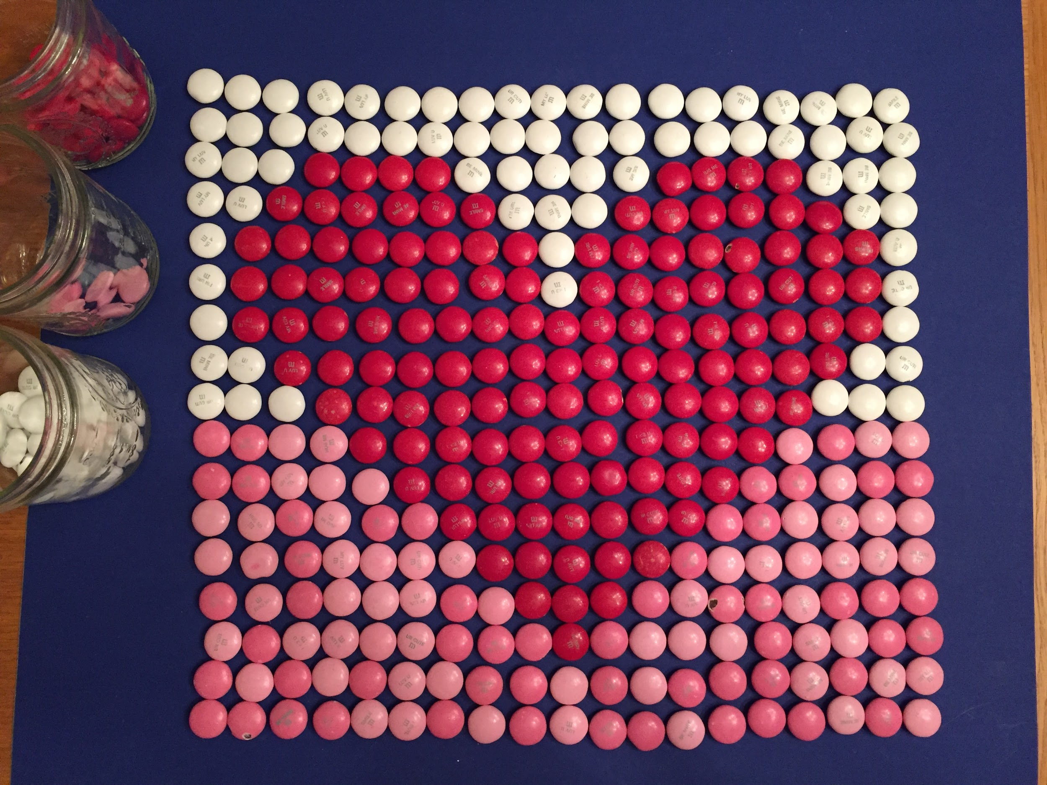
Estimate
How many White m&ms?
Red m&ms?
Pink m&ms?
Do we see any arrays here?
3.OA.A3

Slide 11
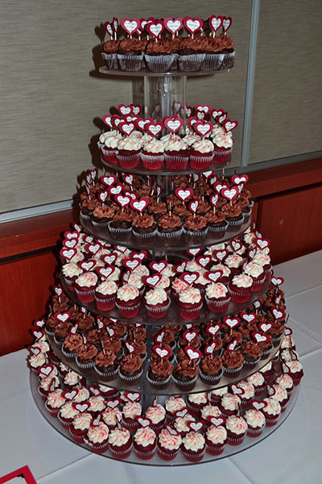
Estimate the number of cupcakes in this tower.
How can you use math to help you get close?
What fraction might be vanilla frosted? Chocolate frosted?
3.NF.A1
Notes:
Week of February 14th, 2022
Valentine’s Day

Slide 12

Today is the Lantern Festival in China.
The largest standing lantern measures 66 feet high and was achieved by Tang Paradise in Xi'an, Shaanxi, China, in 2020.
How high is 66 feet?
About how many times higher is 66 feet than your height?
3.OA.D8
Notes:
February 15, 2022
Lantern Festival (China)

Slide 13
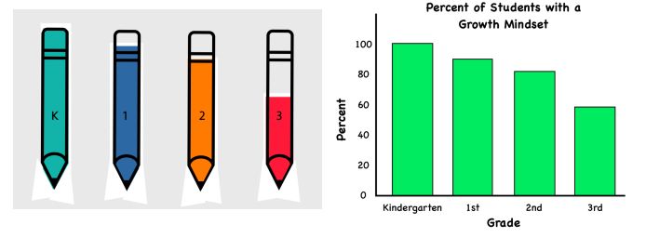
What do you notice? What do you wonder?
What is going on in this data visualization?
3.MD

Slide 14
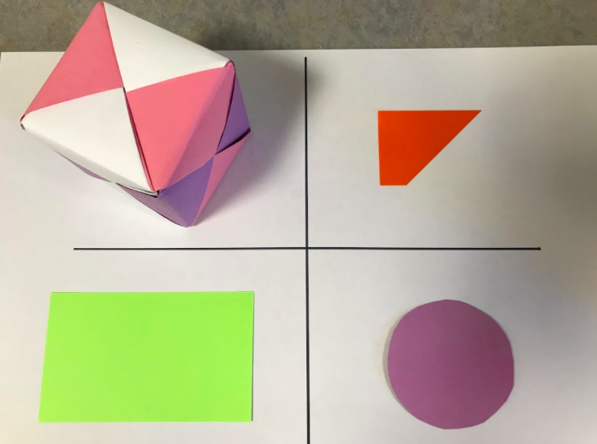
Which one does not belong?
3.G.A1

Slide 15
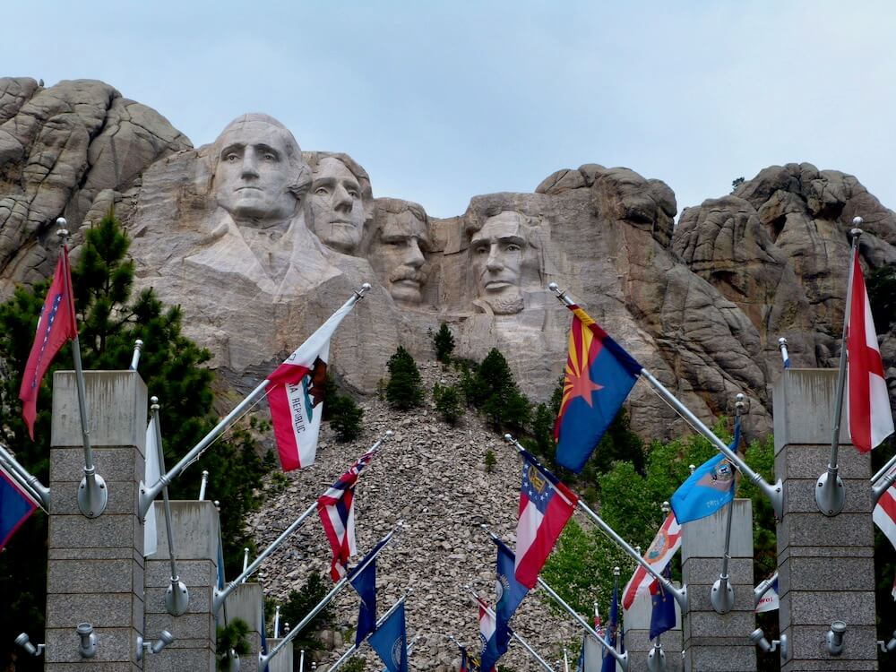
Construction began on Mount Rushmore in 1927. The monument was completed in 1941. How long did it take?
Mount Rushmore National Park was established in 1925. How long ago was that?
3.NBT.A2
Notes:
PRESIDENTS ON MOUNT RUSHMORE: George Washington, the country’s first president, would represent its birth. Thomas Jefferson, who nearly doubled the country’s size with his purchase of the Louisiana Territory, stood for its westward expansion. Theodore Roosevelt, who had overseen the construction of the Panama Canal, was a symbol of economic growth. And Abraham Lincoln was selected for having fought to preserve the nation in the Civil War.

