Slide 1

Use the digits on the tiles to create 2 numbers with a sum close to 100.
Can you create 3 numbers with a sum close to 100?
2.NBT.B5
Notes:
Week of January 31, 2022

Slide 2
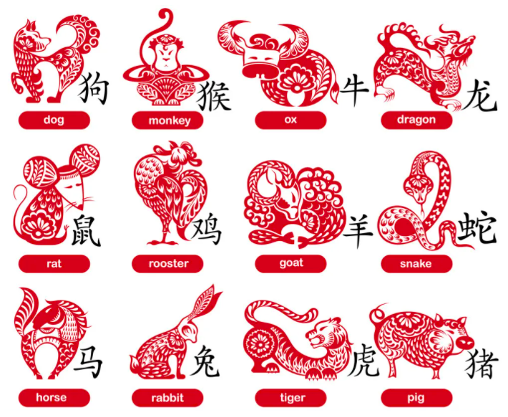
Happy Chinese New Year!
It’s the Year of the Tiger!
What do you notice about the Chinese Zodiac?
When is the next Year of the Tiger?
2.OA.A1
Notes:
February 1, 2022
Chinese New Year
Cycle of 12 years

Slide 3
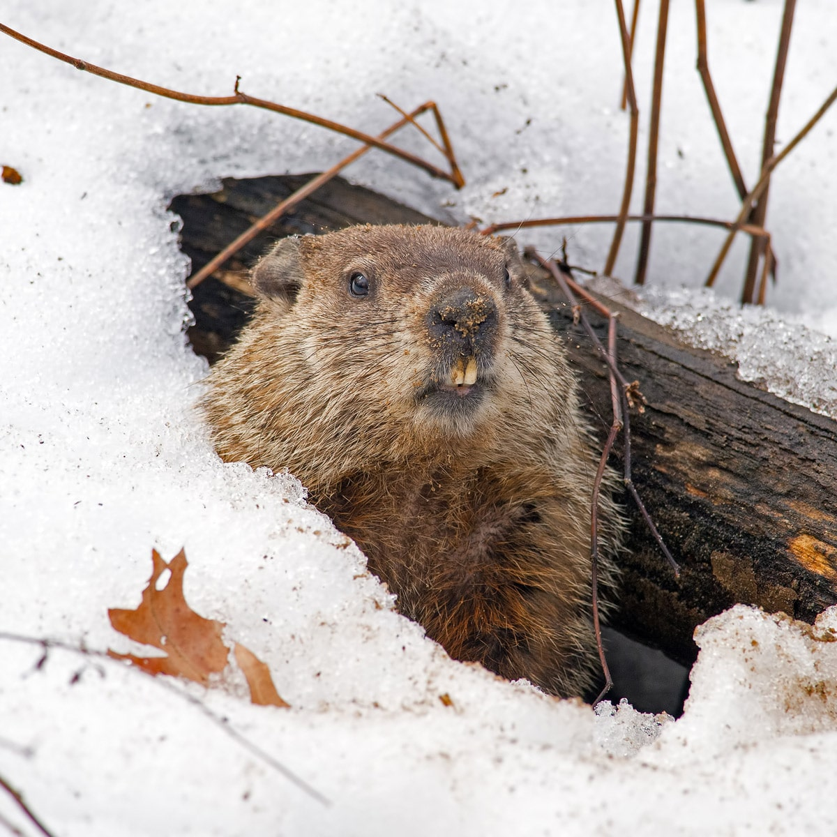
Happy Groundhog Day!
Punxsutawney Phil comes out today to see his shadow!
Will we have 6 more weeks of cold winter, or an early spring?
How many days are in 6 weeks?
How many months is that?
2.MD.C7

Slide 4
Which one does not belong?
55 | 173
84 | 41
2.OA.C3
Notes:
55 (same digits)
173 (3-digits)
84 (even)
41 (one even one odd digits)

Slide 5

What interesting shapes do you see?
Can you see any 3-D shapes?
2.G.A1

Slide 6
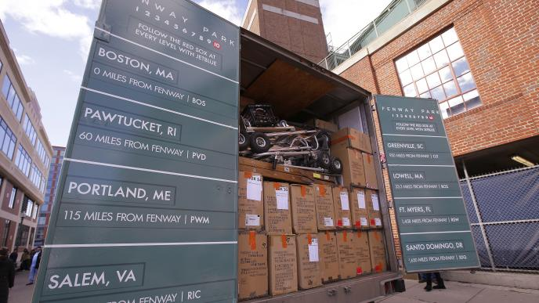
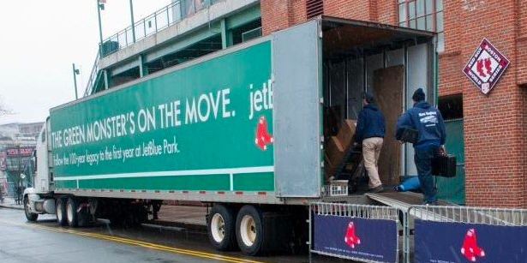
It’s Truck Day in Red Sox Nation!
Spring Training is in the air! What’s on the truck?
20,400 baseballs
1,100 bats
200 batting gloves
200 batting helmets
400 T-shirts
400 pairs of socks
20 cases of bubble gum
60 cases of sunflower seeds
Which item do you think is the HEAVIEST?
Which is the LIGHTEST?
2.MD
Notes:
Week of February 7, 2022
Truck Day!

Slide 7
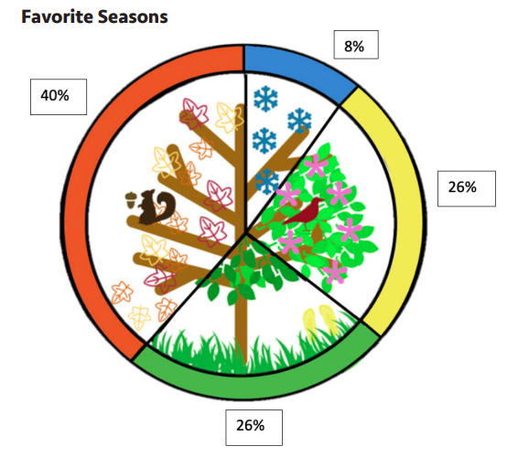
What do you notice?
What do you wonder?
What is going on in this data visualization?
2.MD.D
Notes:
This data is representing 1,005 adults in the United States in September 2015 who reported their favorite season. According to studyfinds.org many people pick Fall as their favorite season for a multitude of reasons, not just the weather. Over 50% of people in the U.S. like Fall due to the changing leaves while 41% enjoy the chill in the air. What other reasons might someone like Fall? What is your favorite season? What about this data surprises you?

Slide 8
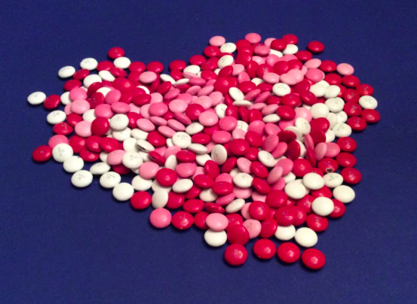
ESTIMATE
How many…
Red m&ms?
White m&ms?
Pink m&ms?
2.NBT

Slide 9
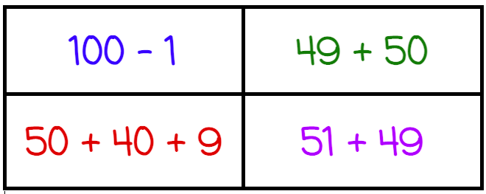
Which one doesn’t belong?
2.NBT.B5

Slide 10
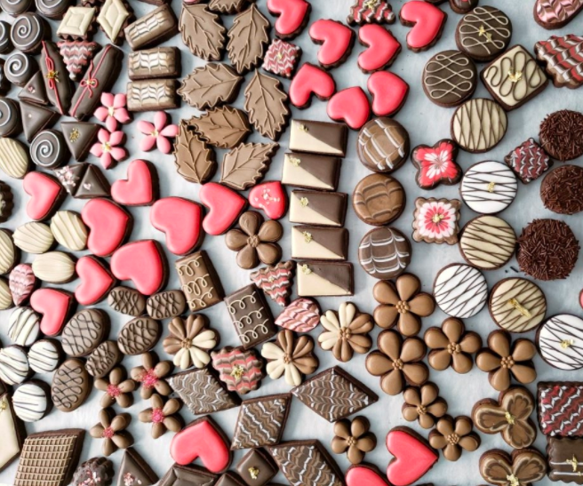
How can you count these cookies?
2.NBT.A2

Slide 11
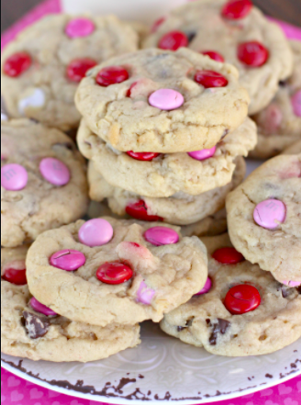
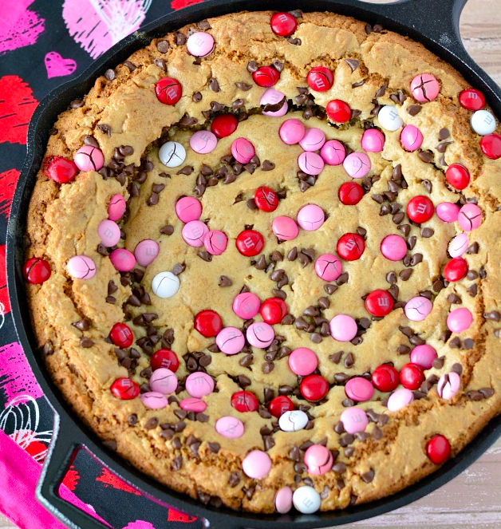
Would you rather have a whole plate of cookies or one giant cookie?
2.SMP.3
Notes:
Week of February 14, 2022
Valentine’s Day

Slide 12
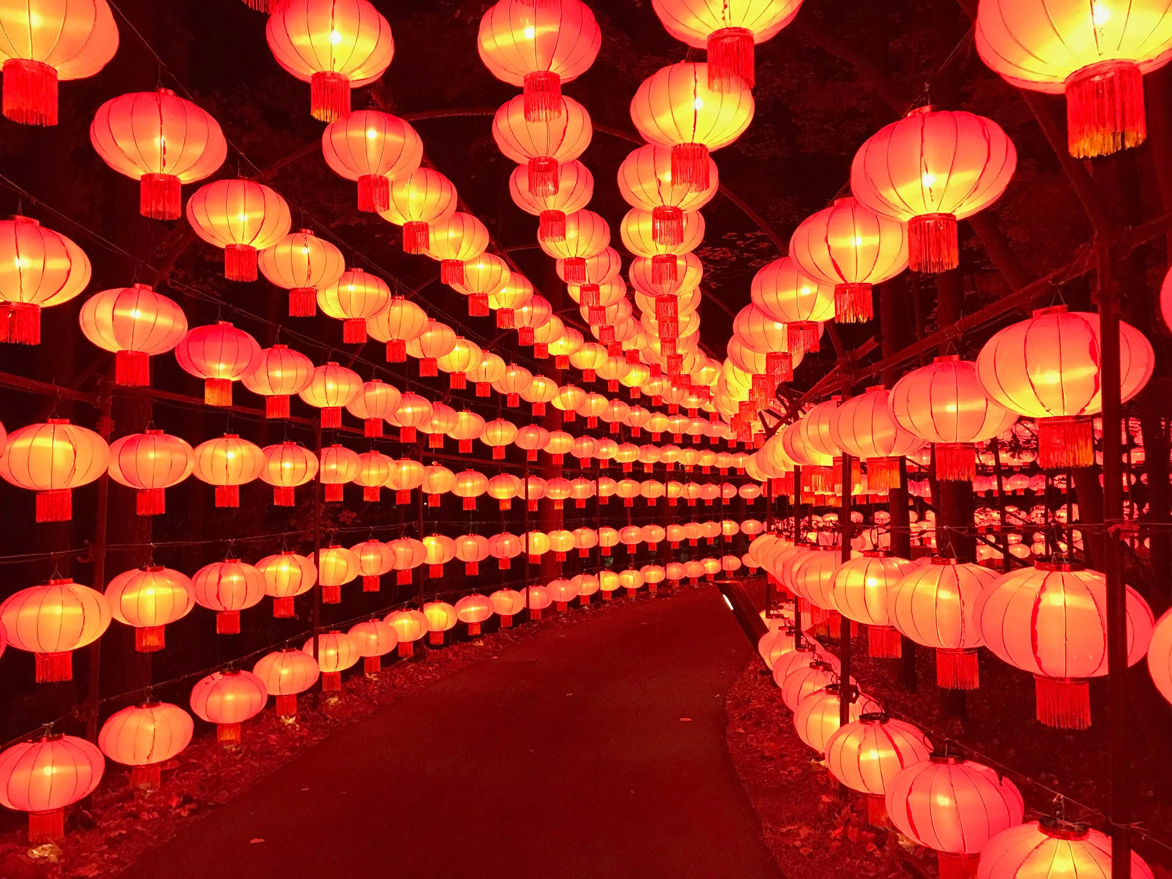
It’s the Lantern Festival in China!
How can we efficiently estimate the number of lanterns here?
Let’s talk about our strategies!
2.OA.C4
Notes:
February 15, 2022
Lantern Festival (China)

Slide 13
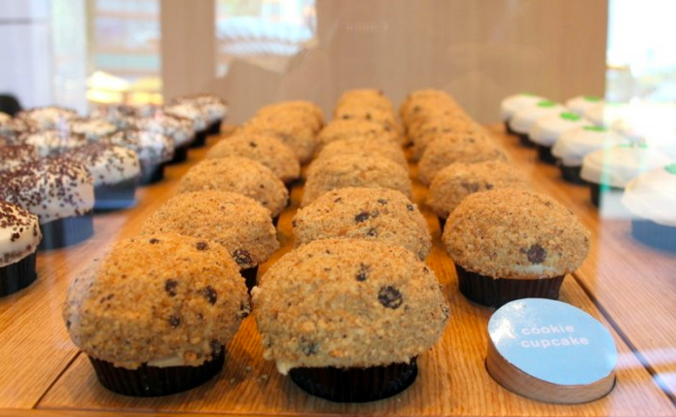
How might we count these muffins?
2.OA.C4

Slide 14
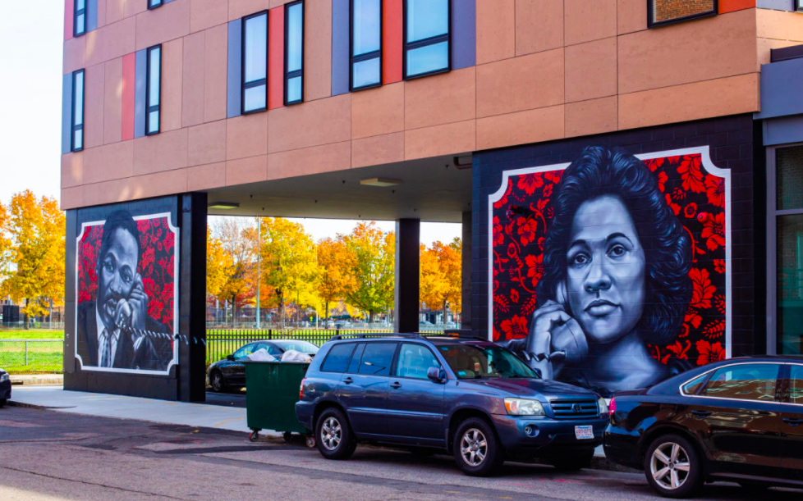
These two murals are each more than 12 feet long!
How long might they be together?
2.MD.A3

Slide 15
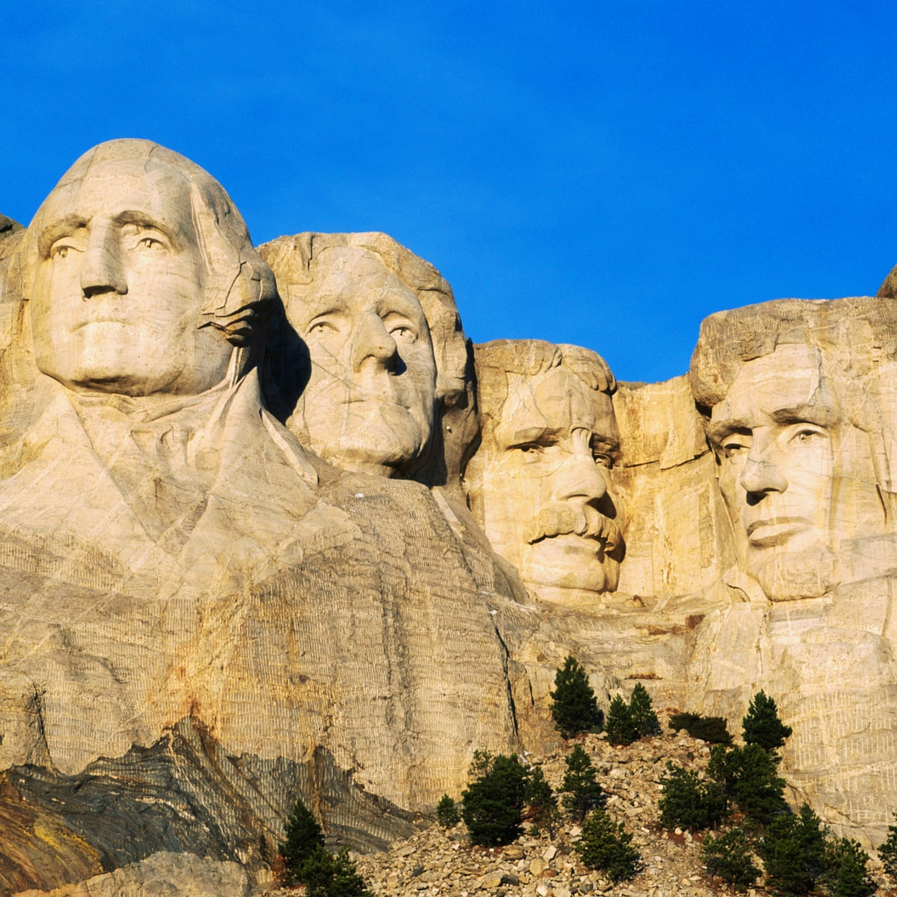
Happy President’s Day!
This is Mount Rushmore in South Dakota
George Washington’s face is 60 feet tall.
Abraham Lincoln’s face is 62 feet tall.
Teddy Roosevelt’s is 59 feet, and Thomas Jefferson’s is 61 feet.
How many feet is that altogether?
2.MD.B5

