Slide 1
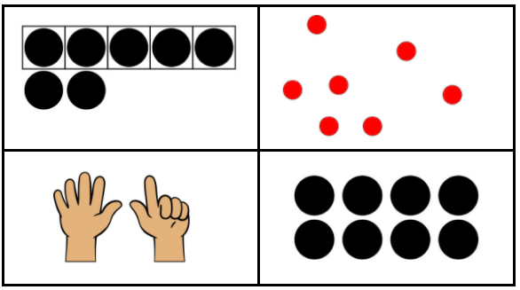
Which one doesn’t belong?
K.CC.C6
Notes:
Week of January 3, 2022

Slide 2
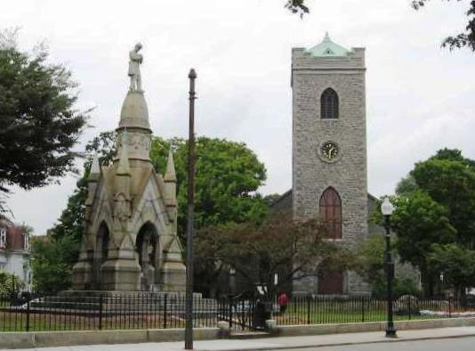
Let’s talk about the shapes we see here!
K.G.A2
Notes:
Encourage using words: above, below, next to

Slide 3
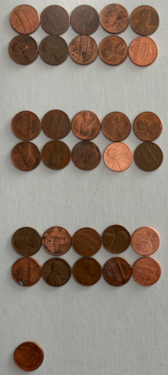
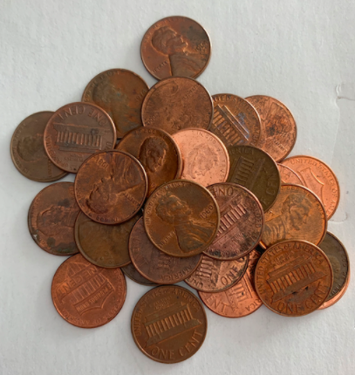
How many pennies are in the pile?
K.NBT.A1

Slide 4
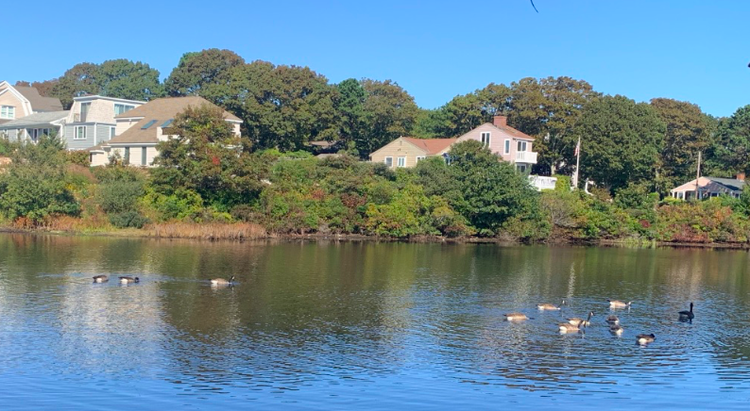
How can you count the ducks?
What number sentences can you create?
K.NBT.A1

Slide 5
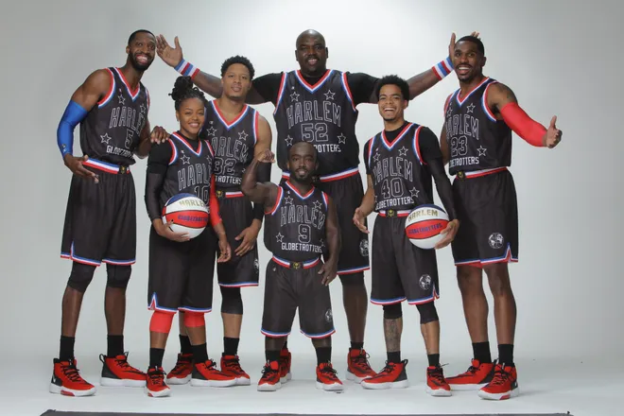
Happy Harlem Globetrotter’s Day!
How many players do we see here?
How can we be sure we have counted them all?
K.CC.B5
Notes:
January 7, 2022
Harlem Globetrotter’s Day

Slide 6
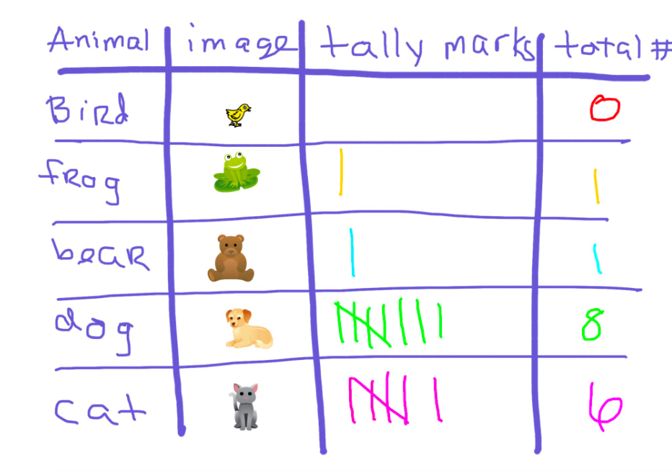
What do you notice? What do you wonder?
K.MD.B3
Notes:
Week of January 10, 2022

Slide 7
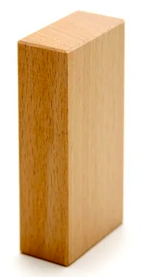
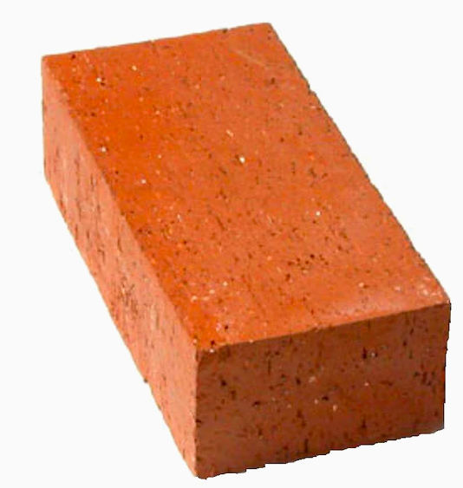
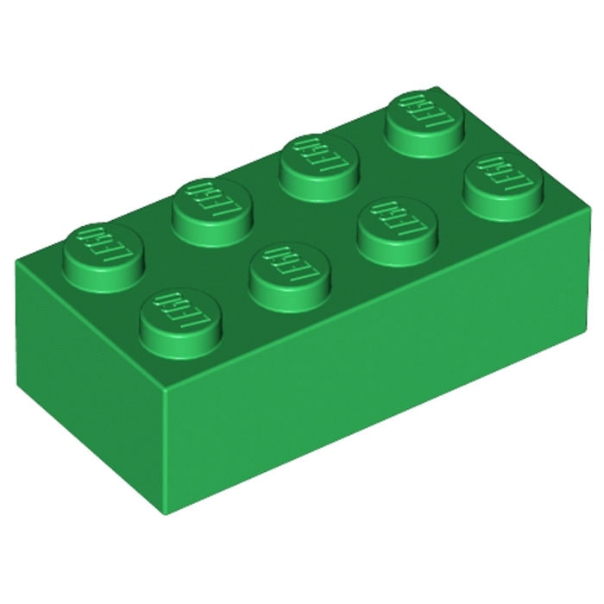
How can we compare these blocks?
K.MD.A2

Slide 8


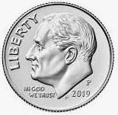
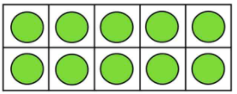

What do you notice?
What else comes in 10s?
K.OA.A3

Slide 9
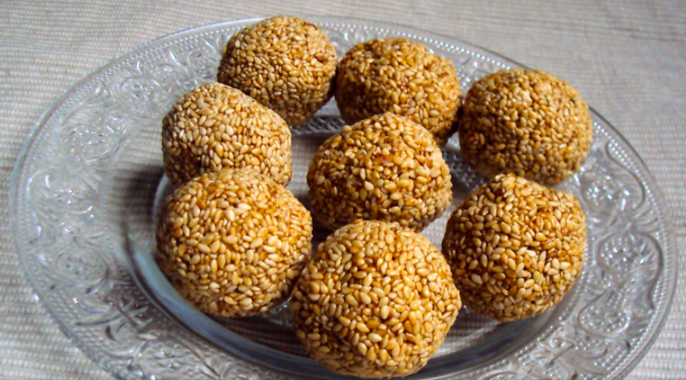
Happy Lohri! How many Ladoo are here? How do we see them?
K.CC.B5
Notes:
January 13, 2022
Lohri (India)

Slide 10
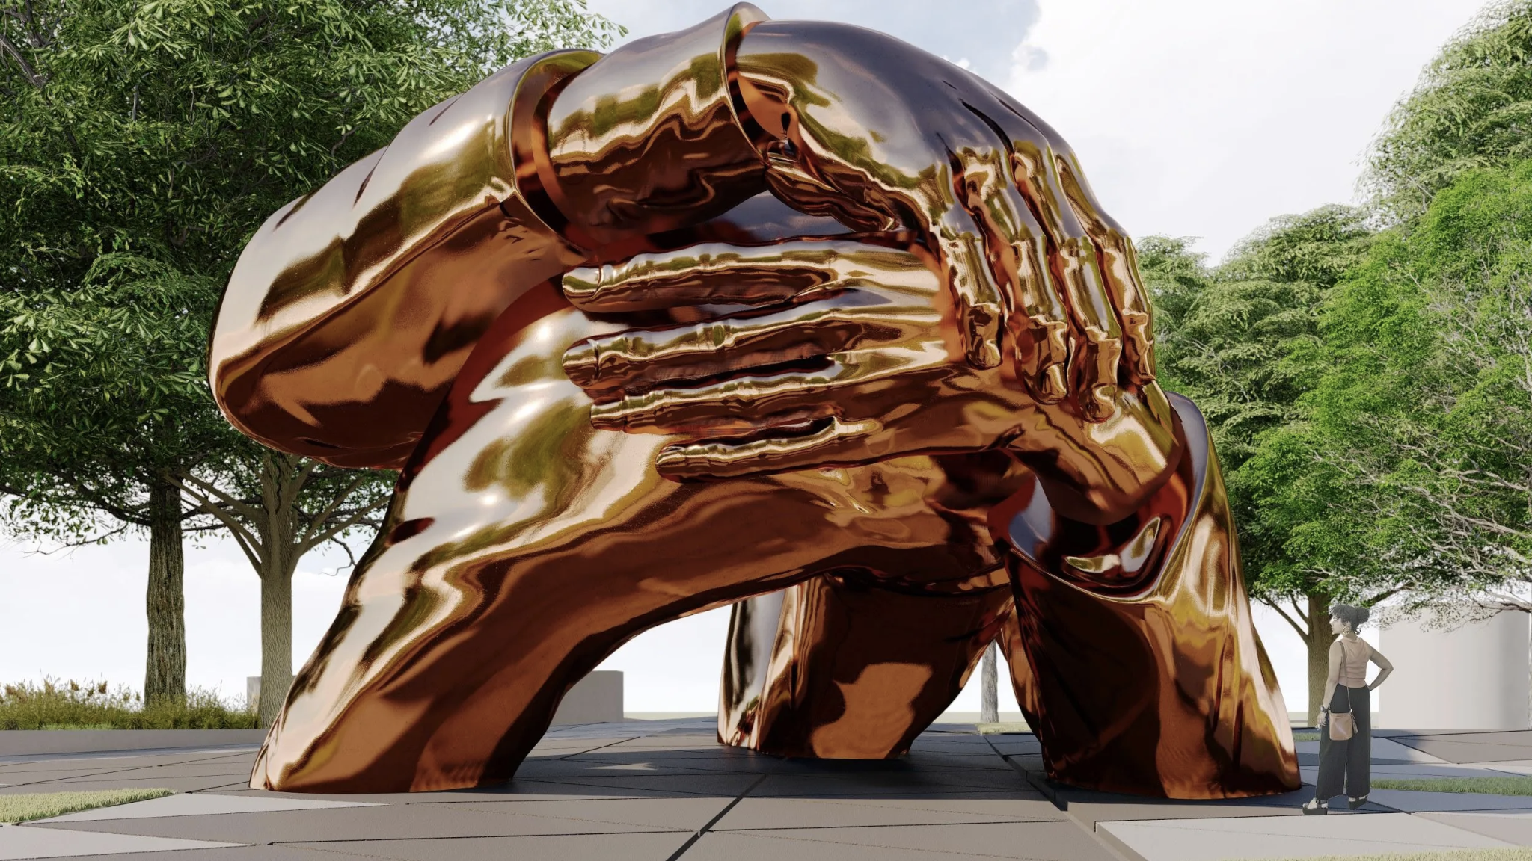
This sculpture honors Martin Luther King Jr. and Coretta Scott King.
What do you notice?
There are 3 arms.
How many ways can we show 3?
Where does 3 live on our number line?
What is 1 more? 1 less?
The Embrace, Boston Common (coming soon…) Hank Willis Thomas
K.CC.C6
Notes:
Week of January 18, 2022
Martin Luther King Jr. Day

Slide 11
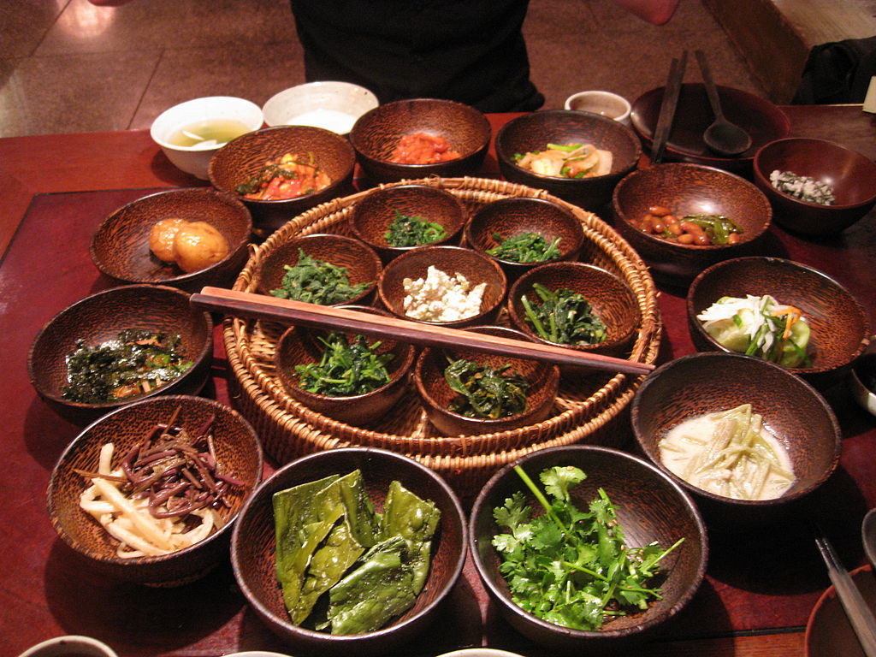
It’s Mahayana New Year in Northeast Asia!
How many bowls do we see here?
How do we see them?
How might we sort them?
K.MD.B3
Notes:
January 18, 2022
Mahayana New Year, Northern Asia

Slide 12


What is the same?
What is different?
K.G.B4

Slide 13
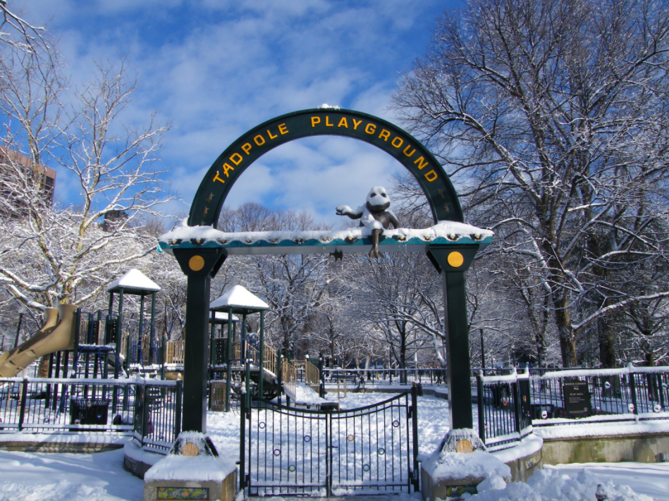
What shapes do you see hiding in this picture?
K.G.A2

Slide 14
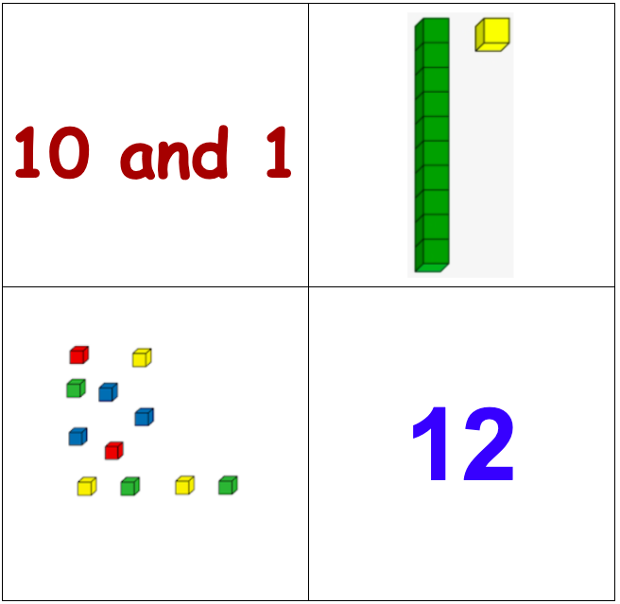
Which one does not belong?
K.NBT.A1
Notes:
Week of January 24

Slide 15
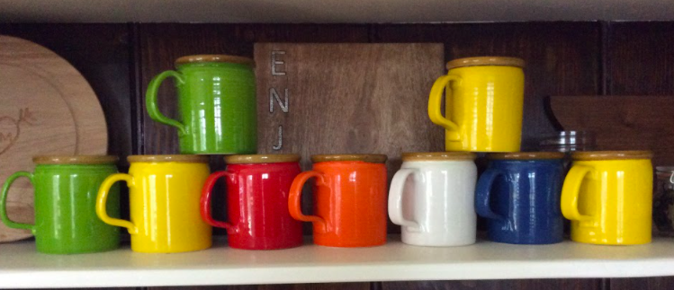
How many mugs do you see?
How many different ways can you count them?
K.OA.A1

Slide 16
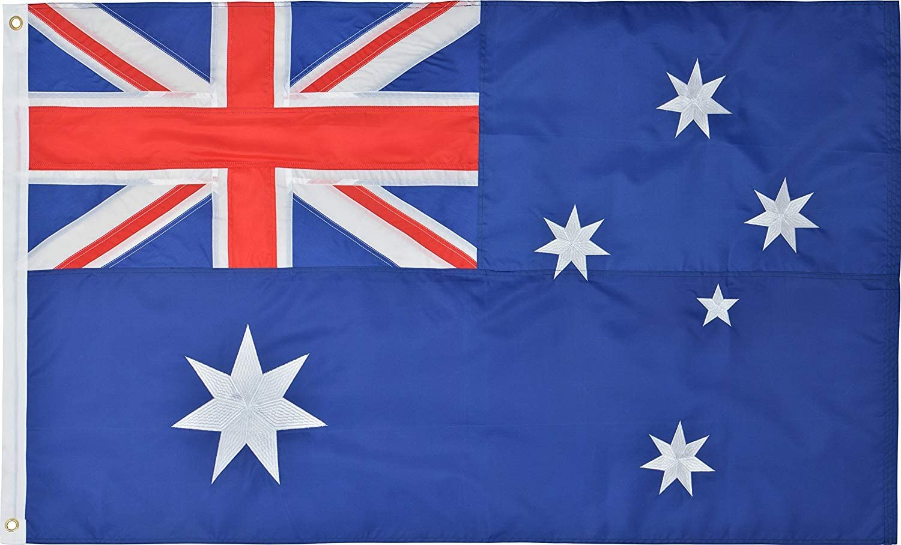
Happy Australia Day!
Let’s talk about the shapes we see in the flag.
K.G.A2
Notes:
January 26, 2022
Australia Day

Slide 17
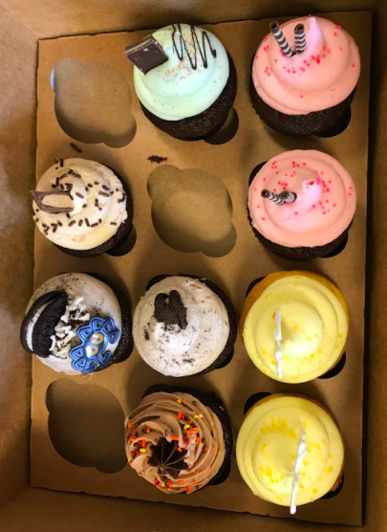
How many cupcakes do you see?
How many don’t you see?
Can you write a number sentence to match your thinking?
K.OA.A2

Slide 18
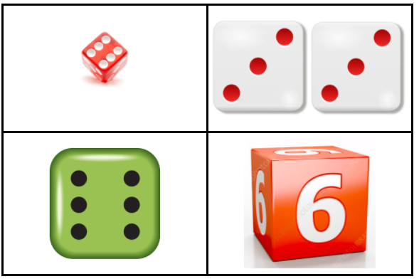
Which one does not belong?
K.CC.A3

