Slide 1
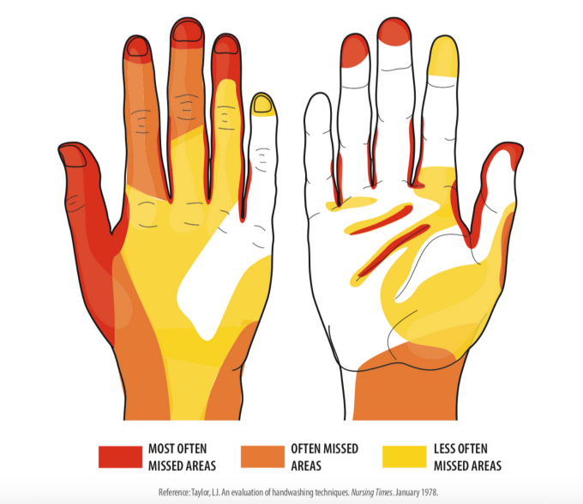
What do you notice?
What do you wonder?
What is going on in this data visualization?
5.MD.B
YouCubed @ Stanford University
Notes:
Week of January 3, 2022

Slide 2
Which one DOES NOT belong?
2300 ÷ 10 | 0.23 x 10³
23 x 100 | 230
5.NBT.A2

Slide 3
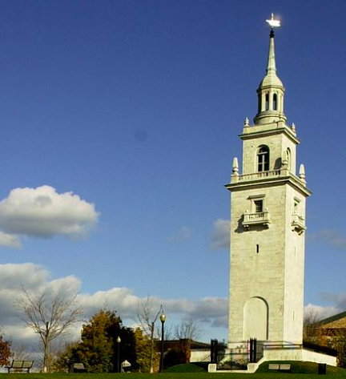
The Dorchester Heights Monument is 115 ft. tall
About how many times taller is it than you?
About how many times taller is it than Dr. Green? (He’s 6ft. tall)
5.NF.B5

Slide 4
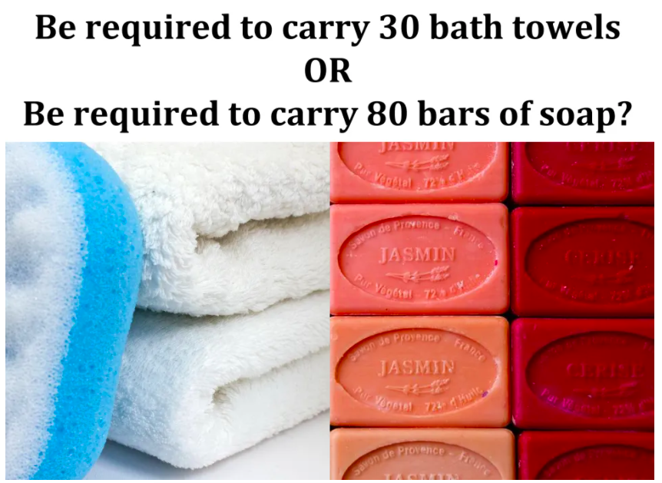
Would You Rather ...
5.SMP.3
wouldyourathermath.com

Slide 5
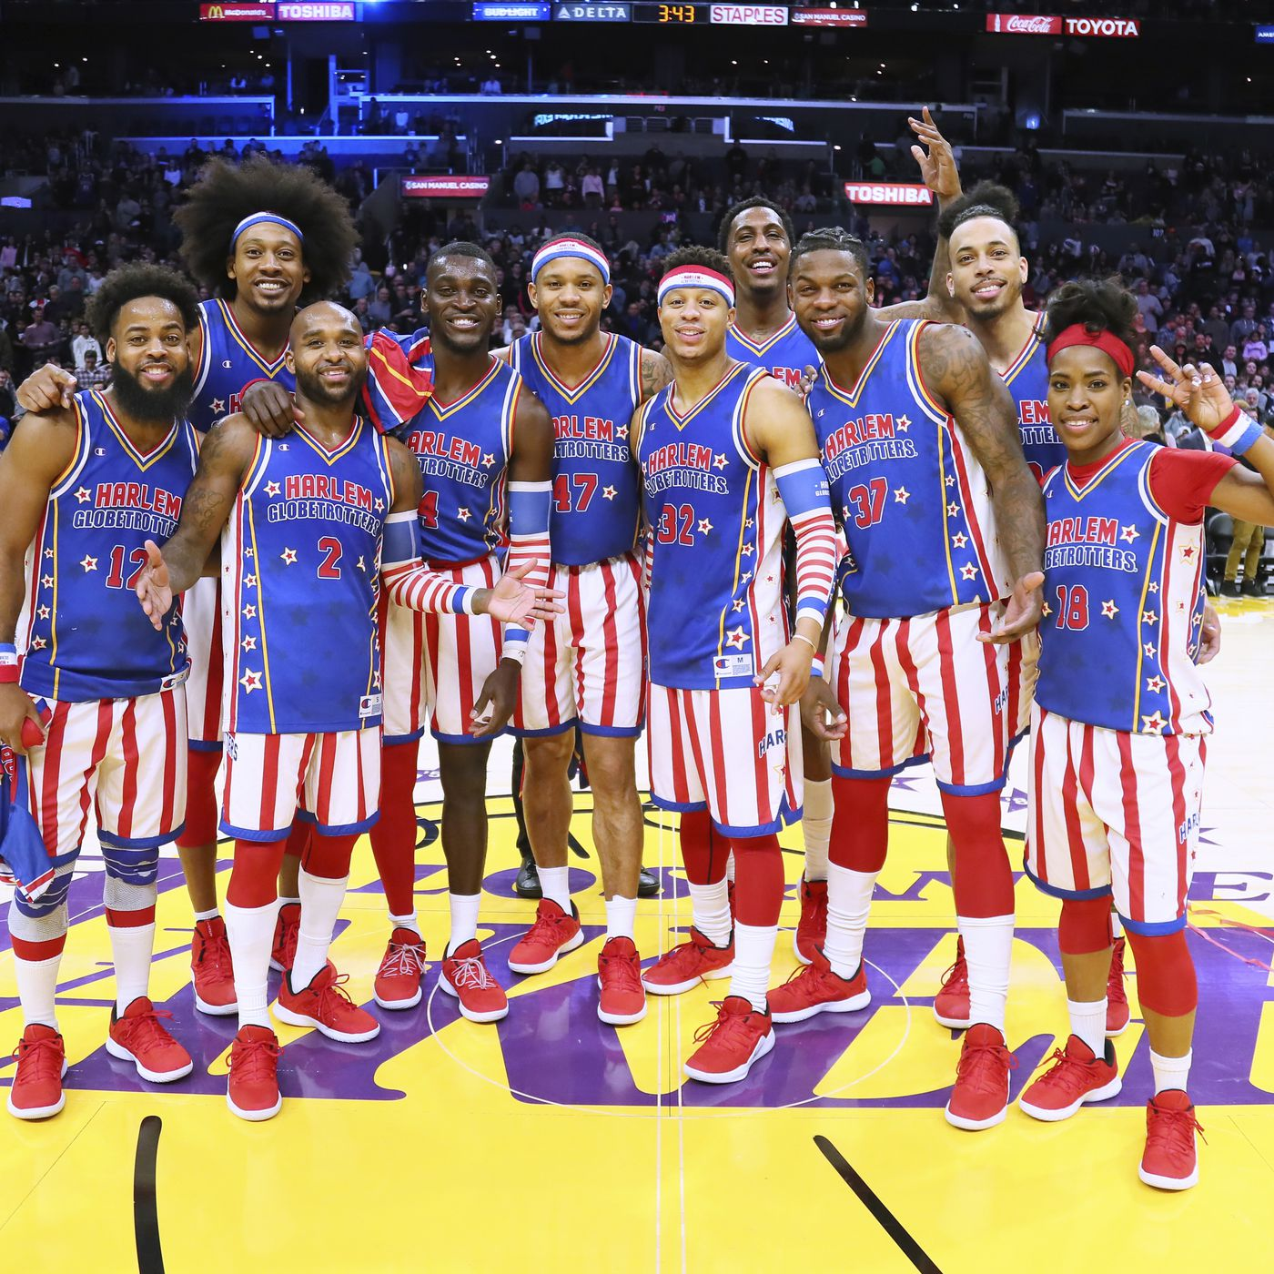
Happy Harlem Globetrotter’s Day!
Founded in Chicago (not Harlem!!) in 1926, they’ve won over 27,000 games over the decades! Harlem Globetrotters Day is a day to honor and remember the achievement of this great basketball team and all other teams worldwide.
Find as many factor pairs of 27,000 as you can! Hint… think factor pairs of 27
5.NBT.B

Slide 6
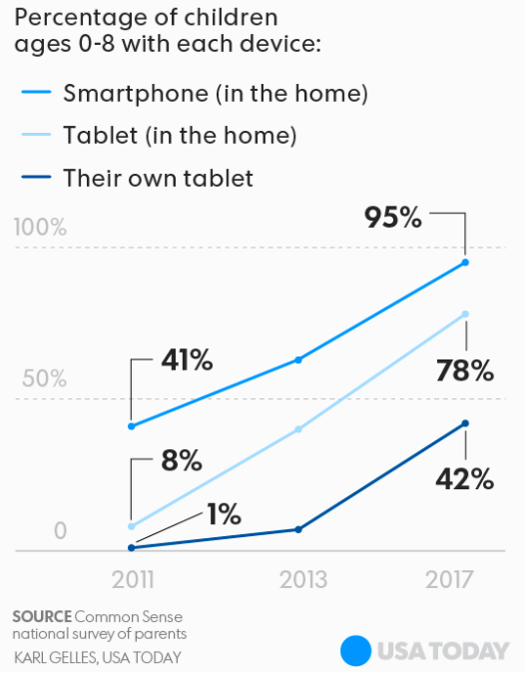
If this GRAPH could talk, what would it say?
What is a clever NAME for this graph?
Why does it matter?
5.MD.B
Notes:
Week of January 10, 2022

Slide 7

5.NBT.B5
wouldyourathermath.com

Slide 8
What can you say about these two models?
What is the SAME? What is DIFFERENT?
5.OA.A2

Slide 9

It was in 1903 that just over 100 Koreans first arrived in the United States. That number quickly grew and within two years a further 7,500 Korean immigrants had made the same journey. On Korean American day we honor and celebrate all of the wonderful contributions our Korean American friends have made.
How many times bigger is 7,500 than 100?
What are some factor pairs of 7,500?
5.NBT.B6
Notes:
January 13, 2022
Korean American Day

Slide 10
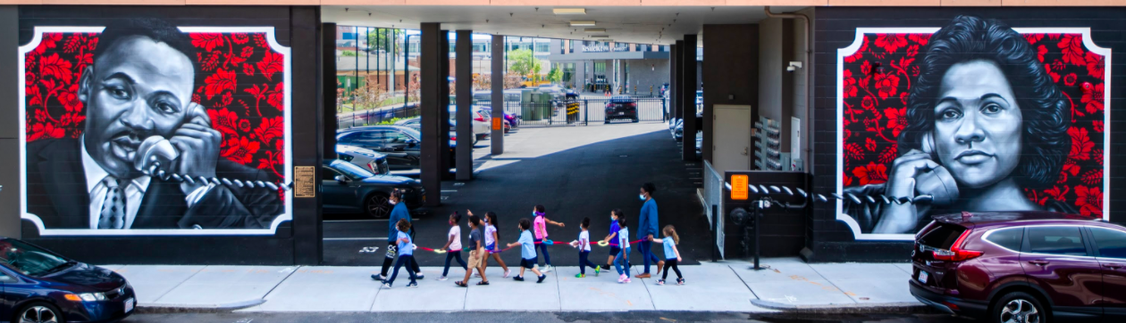
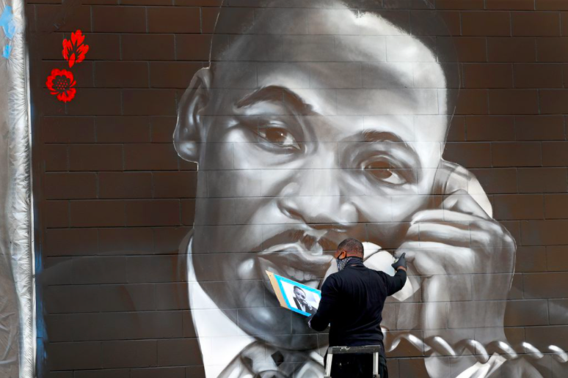
Here is a close-up of this mural under construction
(ProBlak and GoFive)
How can we use multiplication and estimation to determine how many bricks make up both murals?
5.NBT.B5
Notes:
Week of January 18, 2022
Martin Luther King Jr. Day

Slide 11
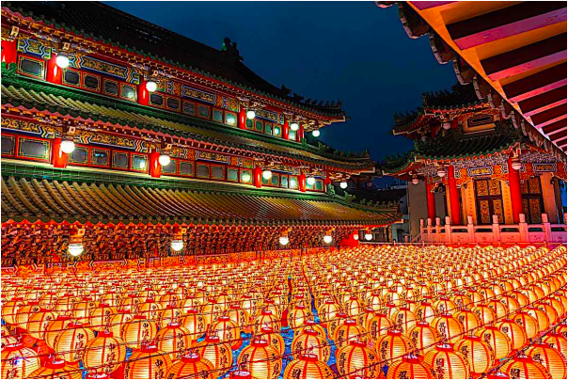
Happy Mahayana New Year!
How can we use multiplication and arrays to estimate how many lanterns are here?
What is a good estimate?
5.NBT.B5
Notes:
January 18, 2022
Mahayana New Year (Northeast Asia)

Slide 12
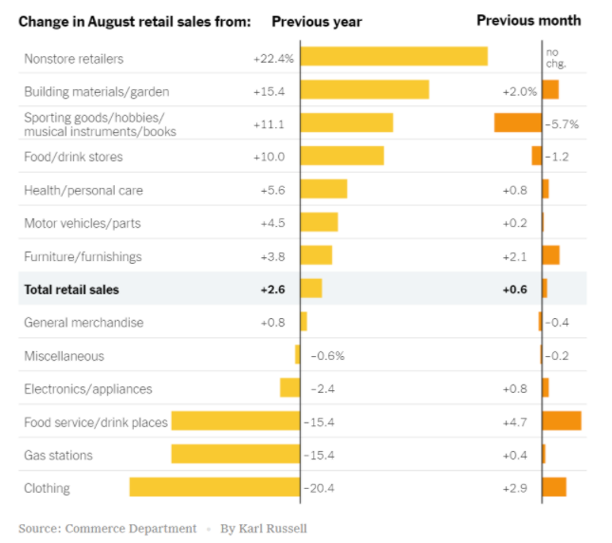
What do you notice?
What do you wonder?
What impact does this have on you and your community?
What’s going on in this graph?
Write a catchy headline!
5.MD.B

Slide 13

40 x 2 x 10 = 4 x 10
40 x 2 x 10 = 20 x 4 x 10
80 x 10 = 40 x 20
5.NBT.A2

Slide 14

5.SMP.3
wouldyourathermath.com
Notes:
Week of January 24, 2022

Slide 15
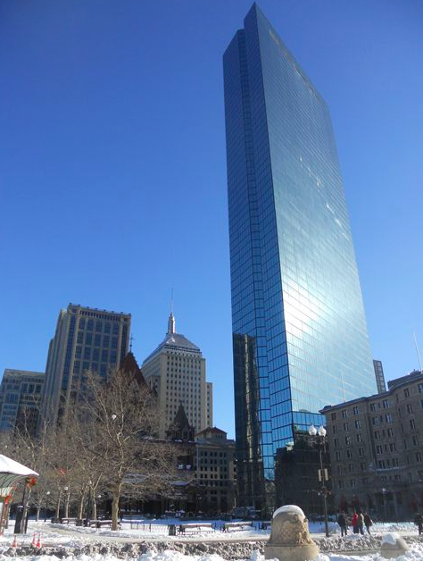
The John Hancock Tower is 790’ high.
There are 62 floors in the tower, ABOUT how high is each floor?
ANSWER: about 12’ + or -
5.NBT.B6

Slide 16
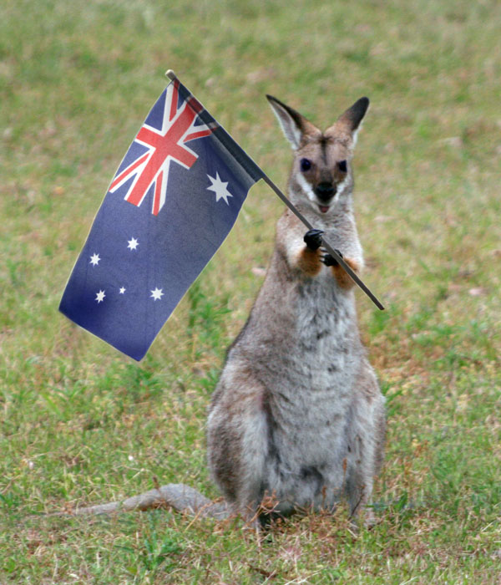
Happy Australia Day!
January 26 commemorates the arrival of British ships to establish the first settlement in 1788. These ships carried over 750 criminals who had been tried and convicted in Great Britain for mostly petty crimes and then transported to penal colonies established by the British throughout the world.
What are some factor pairs of 1,788?
5.NBT.B6
Notes:
January 26, 2022
Australia Day

Slide 17
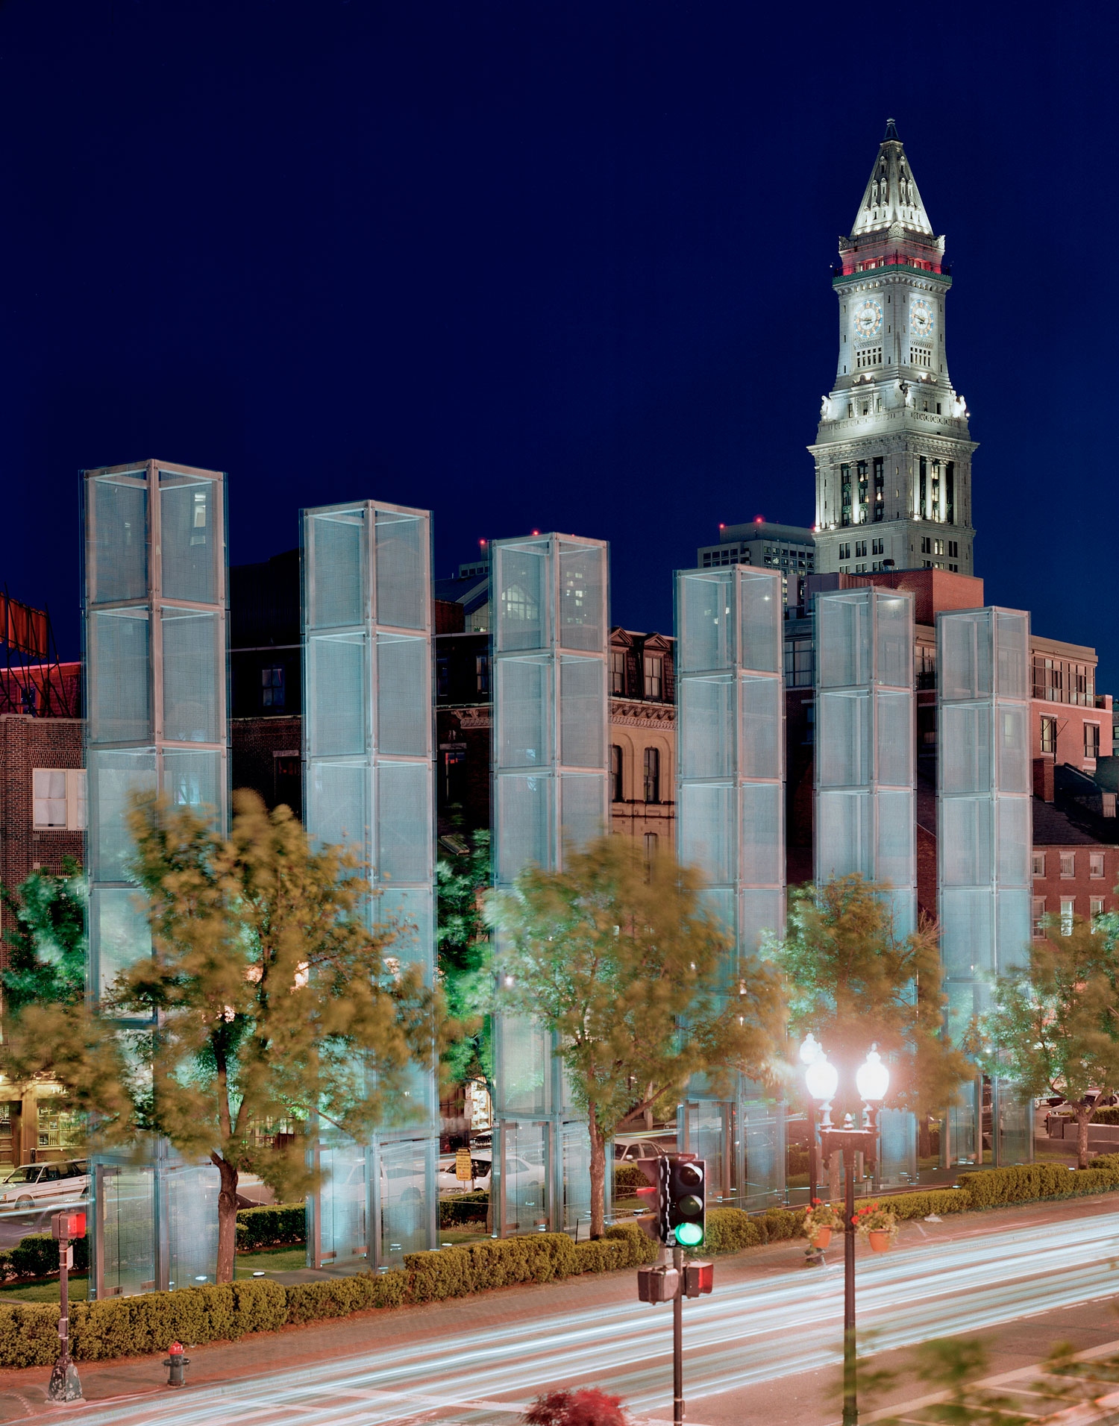
The New England Holocaust Memorial is along the Freedom Trail in Boston.
The memorial is made of 6 towers that are each 54’ high.
How many feet is that altogether?
Look closely at the towers, how many panels of glass make up the memorial?
5.NBT.B5
Notes:
January 27, 2002
Holocaust Remembrance Day

Slide 18

Would you rather . . .
$2.00 a day (every day) for a year or
$60.00 a month?
5.SMP.3

