Slide 1
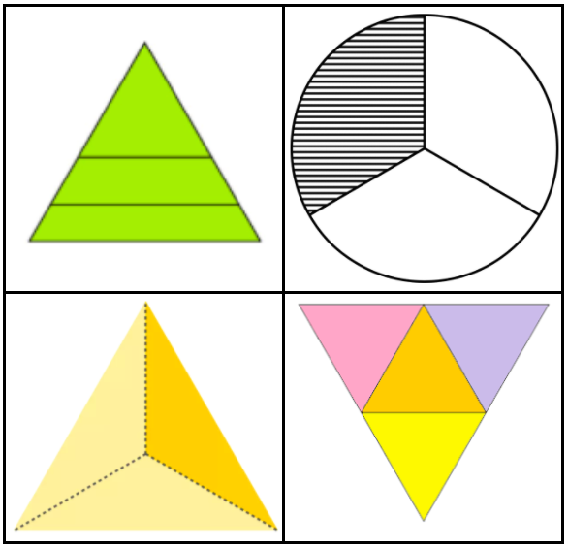
Which one doesn’t belong?
3.G.A2
Notes:
Week of January 3, 2022

Slide 2
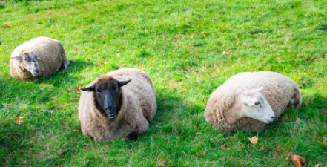
Meet the sheep at Land’s Sake Farm . . .
Eli weighs about 200 pounds.
Ted weighs about 10 pounds less and Bob weighs about 10 pounds more.
What’s possible?
Ted
Eli
Bob
3.NBT.A1

Slide 3
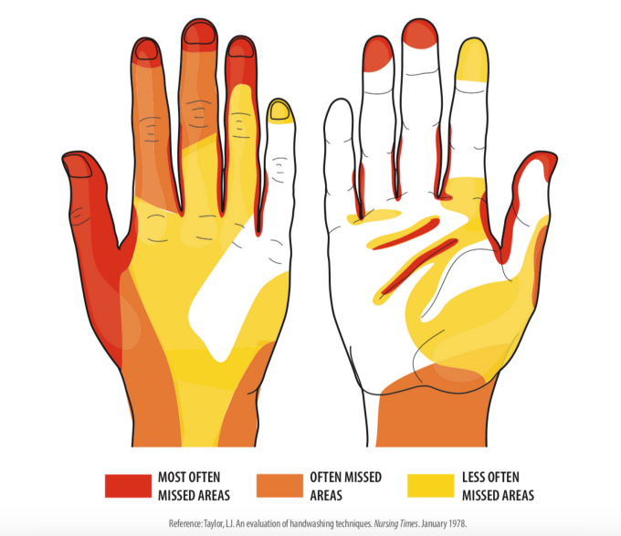
What do you notice?
What do you wonder?
What is going on in this data visualization?
3.MD.B

Slide 4
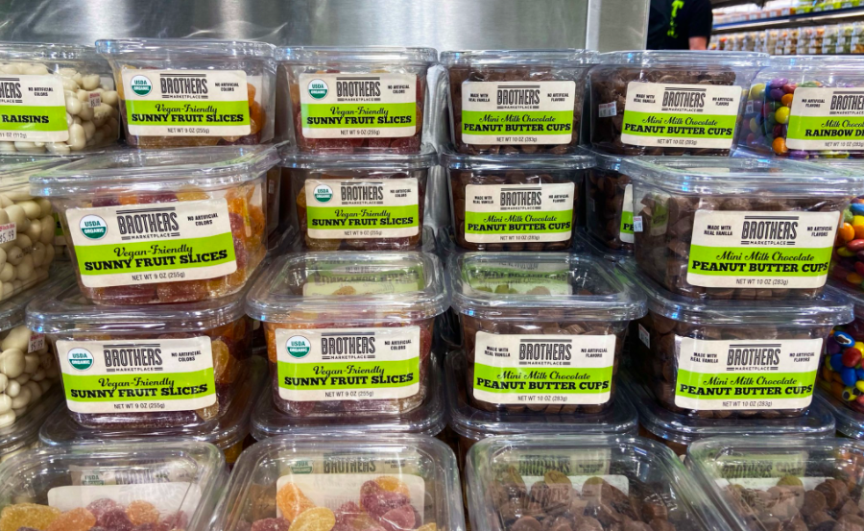
What do you notice? How can you figure out how many?
3.OA.A3

Slide 5
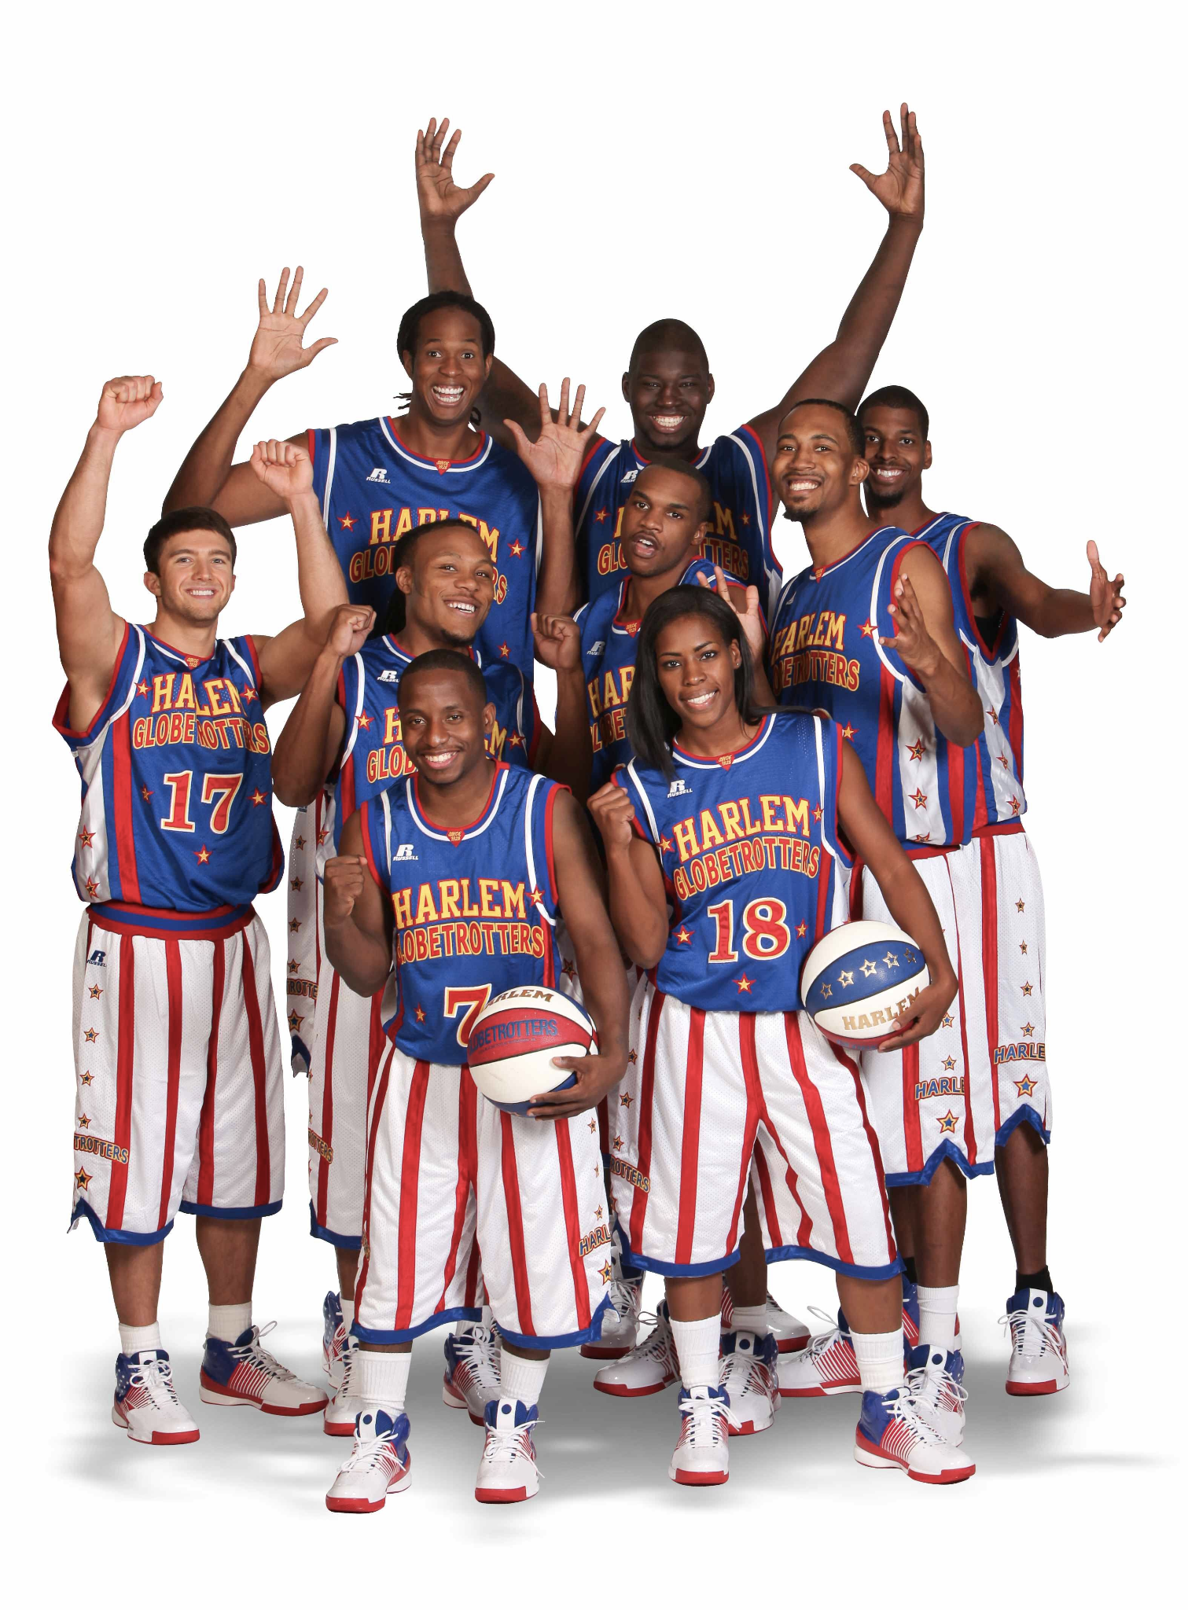
Happy Harlem Globetrotter’s Day!
The Harlem Globetrotters first played in Chicago in 1926.
How long ago was that?
How many ways can we figure it out?
3.NBT.A2
Notes:
January 7, 2022
Harlem Globetrotter’s Day

Slide 6

Would you rather . . .
3.SMP.3
Notes:
Week of January 10, 2022

Slide 7
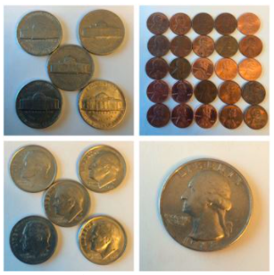
Which one doesn’t belong?
3.MD

Slide 8
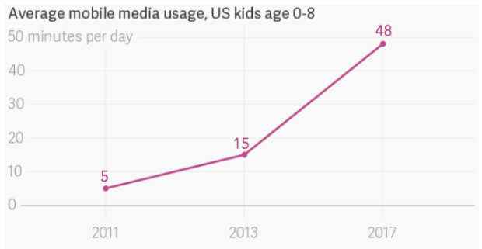
If this GRAPH could talk, what would it say?
What is a good NAME for this graph?
3.MD.B

Slide 9

Happy Korean American Day
We celebrate and honor our friends of Korean descent who have made immeasurable contributions to our country.
The first immigration wave happened way back in 1903.
How long ago was that?
3.NBT.A2
Notes:
January 13, 2022
Korean American Day

Slide 10
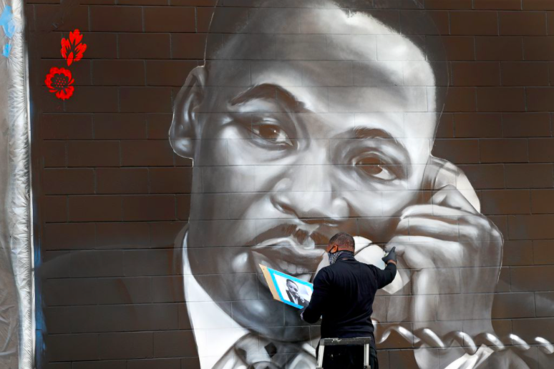
How can we use multiplication to estimate the number of bricks in this mural by Rob "Problak" Gibbs
3.OA.A3
Notes:
Week of January 18, 2022
Martin Luther King Jr. Day

Slide 11

Estimate how many lanterns are at this Mahayana celebration.
Why is estimation important?
3.OA.A3
Notes:
January 18, 2022
Mahayana New Year

Slide 12
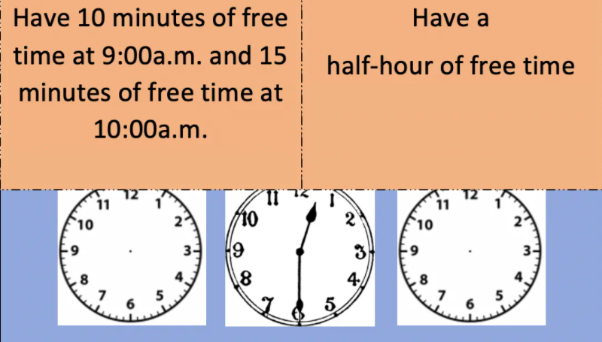
Would you rather . . .
wouldyourathermath.com
3.MD.A1

Slide 13
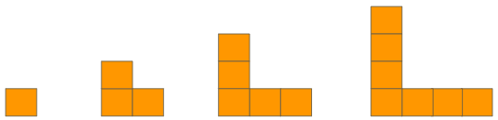
What can you say about this pattern?
What would the next figure look like?
3.OA.D9

Slide 14
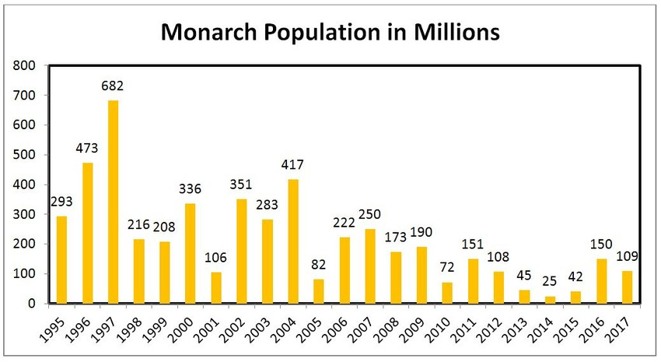
What’s going on in this graph?
3.MD.B
Notes:
Week of January 24, 2022

Slide 15
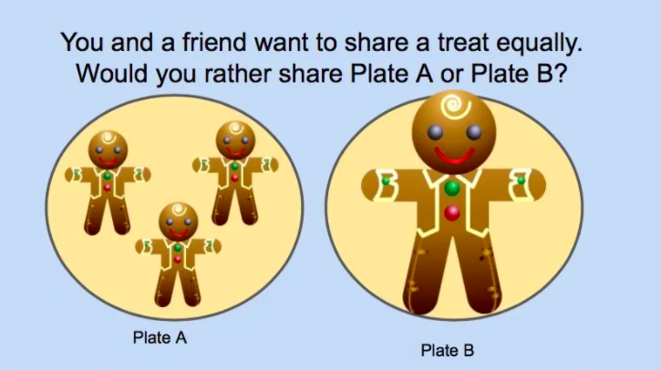
wouldyourathermath.com
3.SMP.3

Slide 16
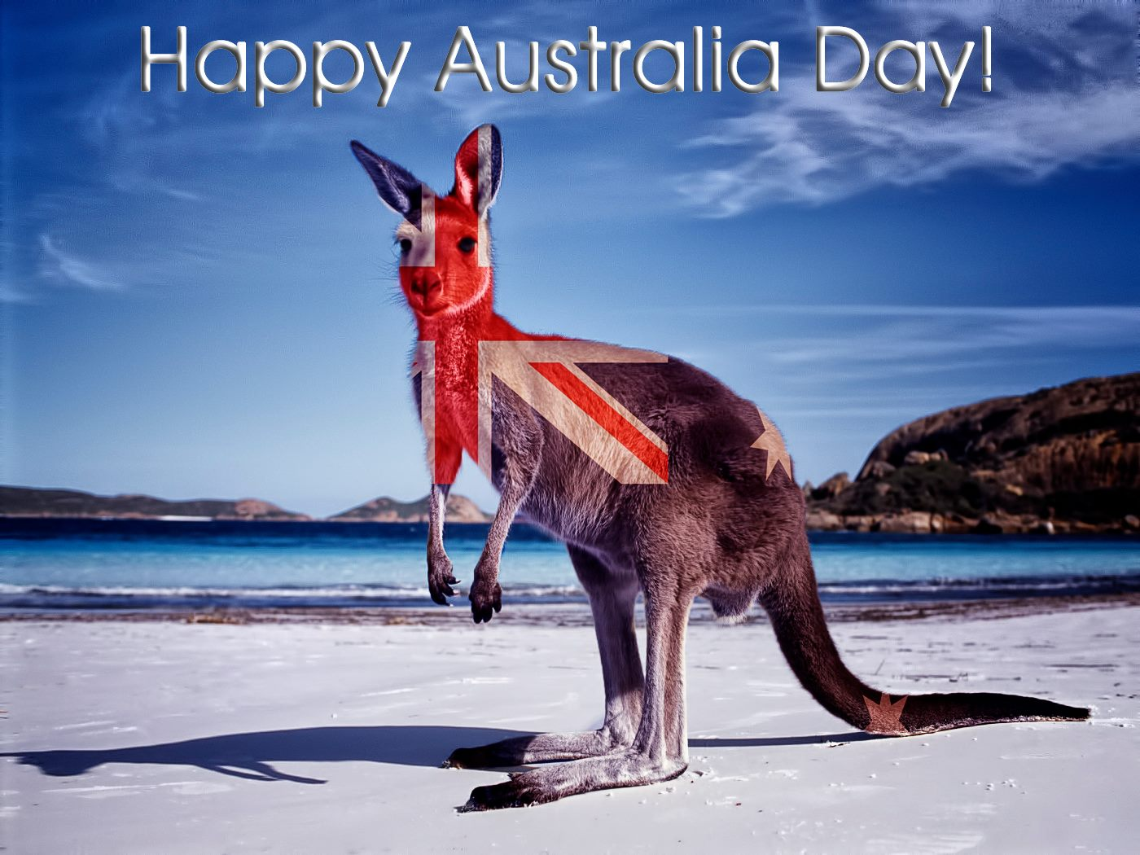
The first settlement in Australia was in 1788!
About how long ago was that?
How can we figure it out?
3.NBT.A2

Slide 17

These light-posts are about 15 feet tall.
How tall is that?
How tall are you?
How many of YOU would be as tall?
3.OA.A3

Slide 18
Which one does not belong?
55 | 173
84 | 41
3.OA.D9
Notes:
55 (same digits)
173 (3-digits)
84 (even)
41 (one even one odd digits)

